Slide 1
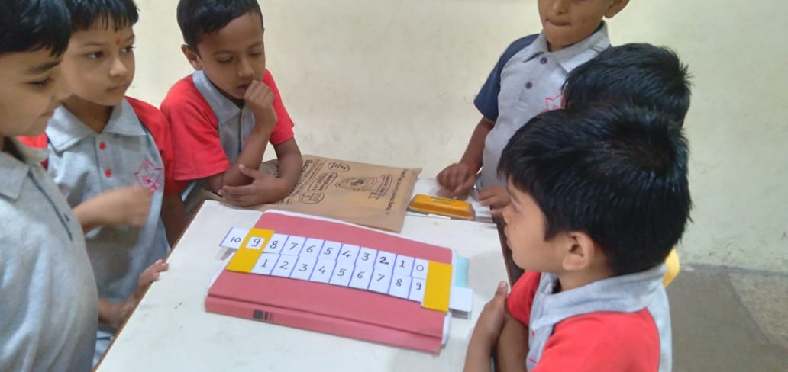
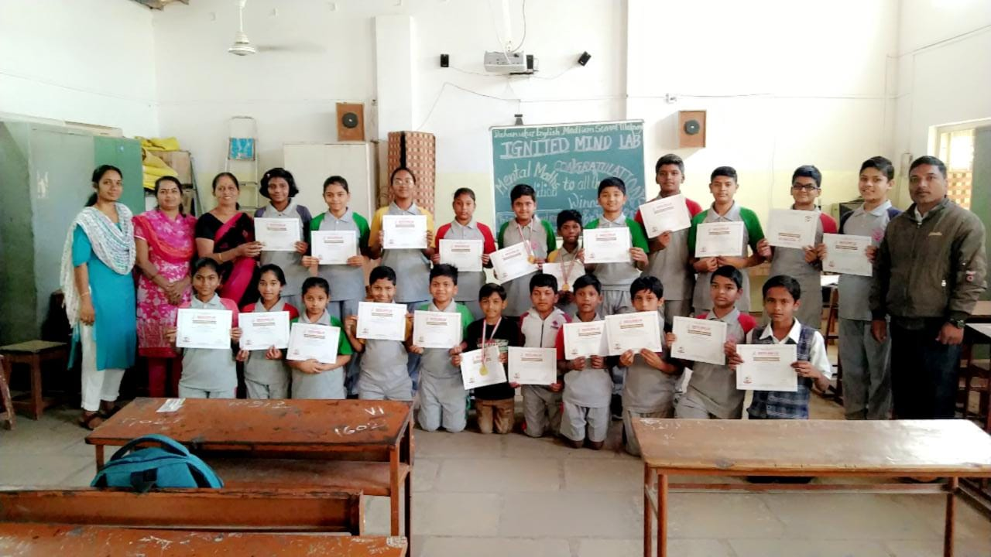
DAHANUKAR ENGLISH MEDIUM SCHOOL
Education Redefined
1. Daily Assembly with music, Shlokas and Subhashits, Students performances
2. Saturday quiz
3..Environment club
4. Awareness sessions
5. Robotics Lab set up
6. Sports , Music, Art ,Craft, Drama
7. Intervention of Indian Knowledge System Dharma Gurukulam Coimbatore syllabus for middle school
8. Teachers Trainings for Robotics, Story Telling, Bharatiya Ganita and Vigyan
9. Setting up educational toys and sports gadgets

