Slide 1
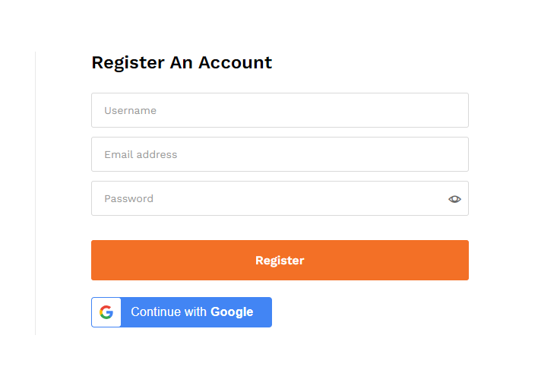
REGISTRATION
You can register Via Google

Slide 2
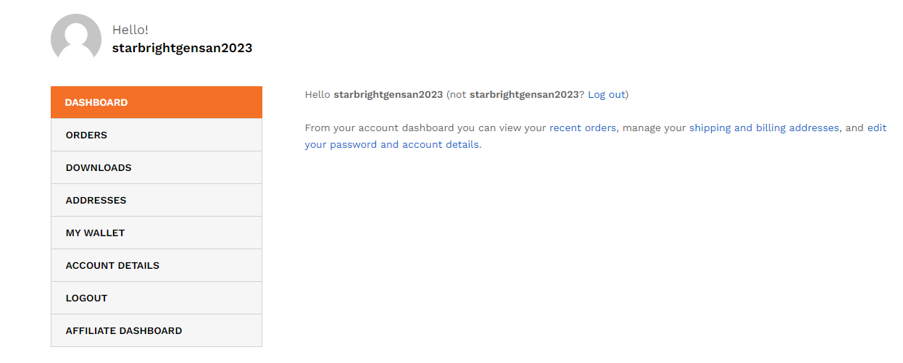
DASHBOARD PANEL

Slide 3
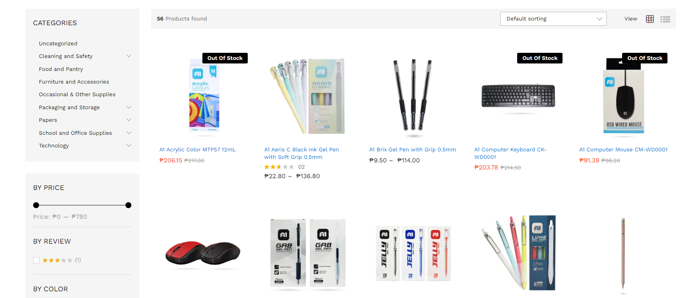
SHOP

Slide 4
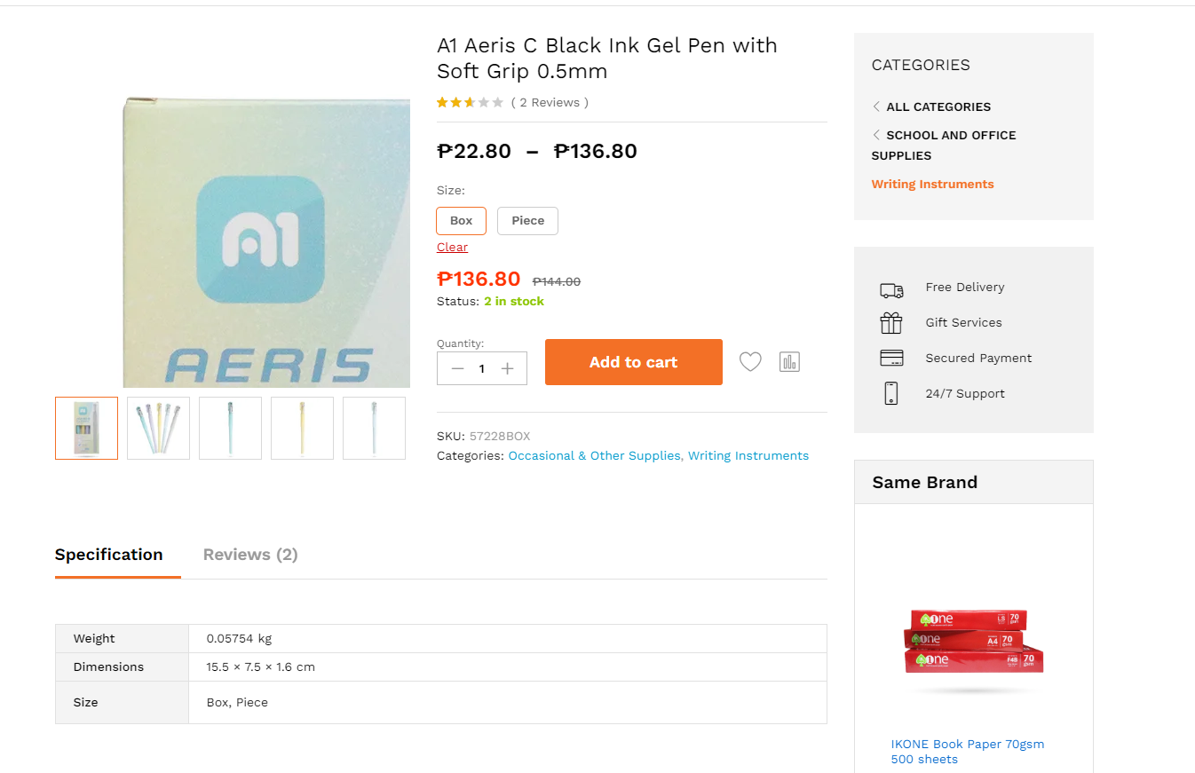
SINGLE SHOP PRODUCT

Slide 5
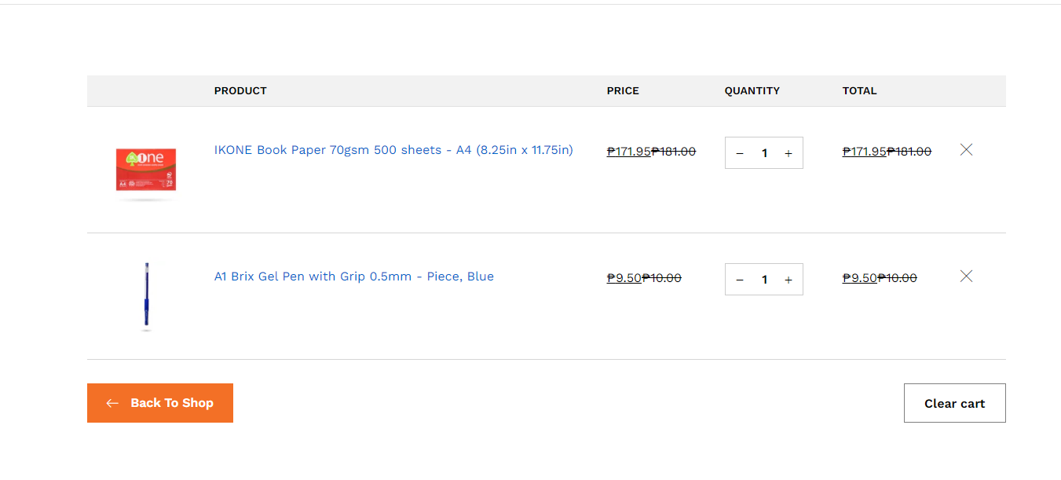
CART
Discount Applied
for selected user

Slide 6
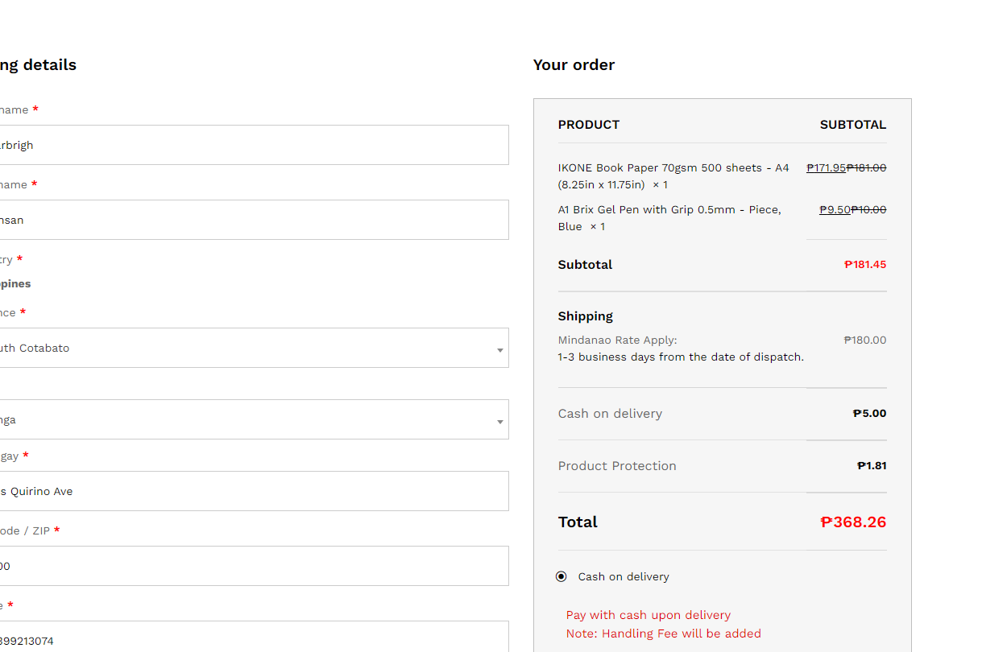
CHECKOUT BREAKDOWN
Original Price/Discount
Charge applicable
Total Amount
Shipping applied
Cash on delivery charge = 2.75%
Product Protection charge =1%
Cash on delivery option

Slide 7
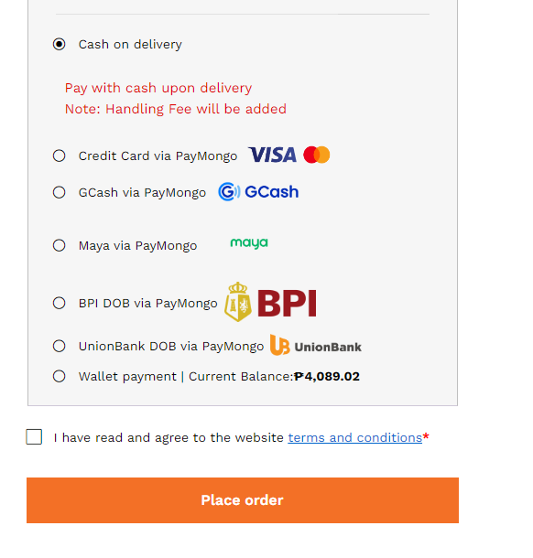
PAYMENT OPTION
PayMongo Api
Wallet Option
Confirmation for payment

Slide 8
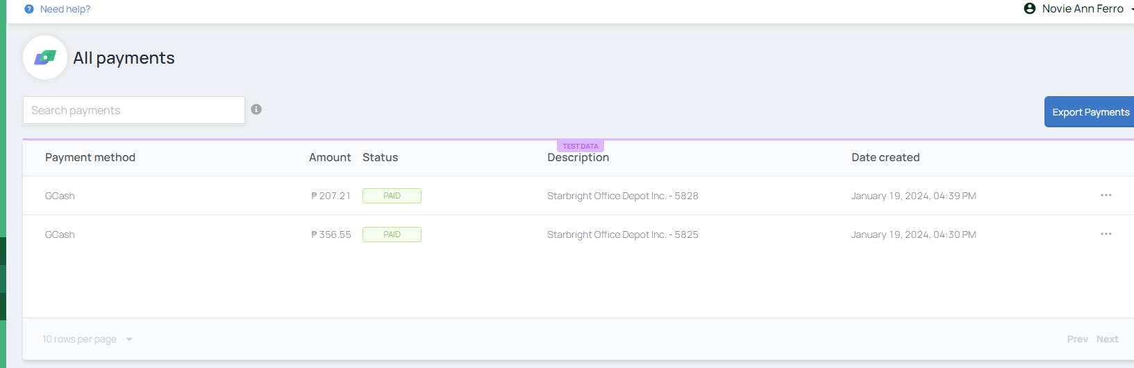
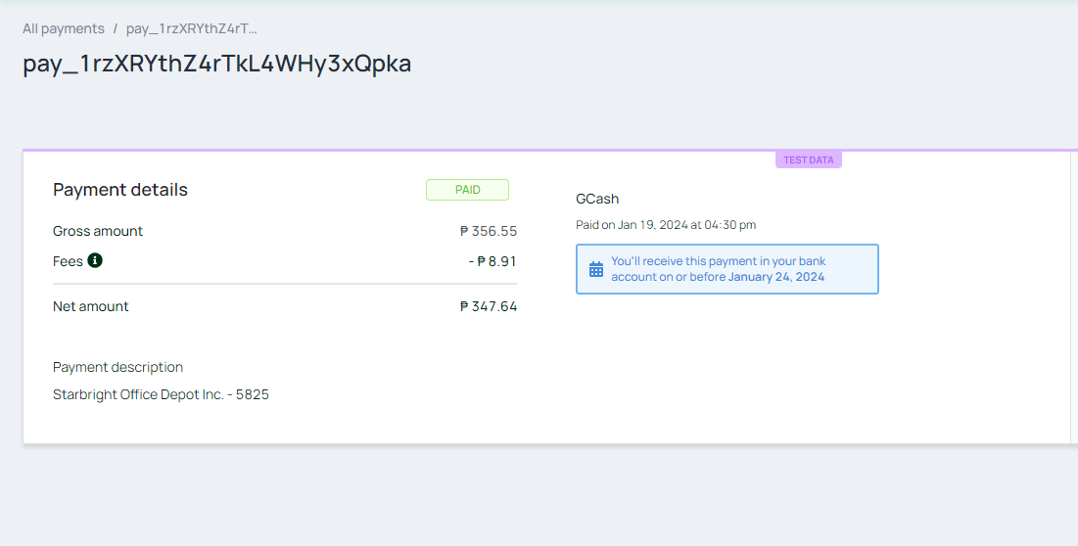
PAYMONGO API CHARGE
Payment charge by Paymongo

Slide 9
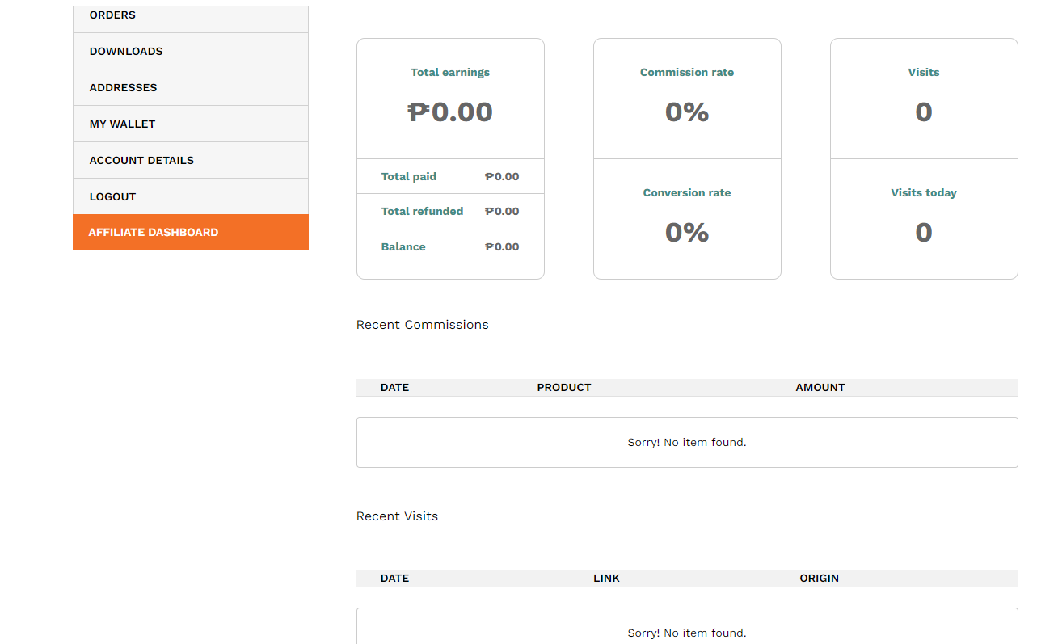
AFFILIATE DASHBOARD

Slide 10
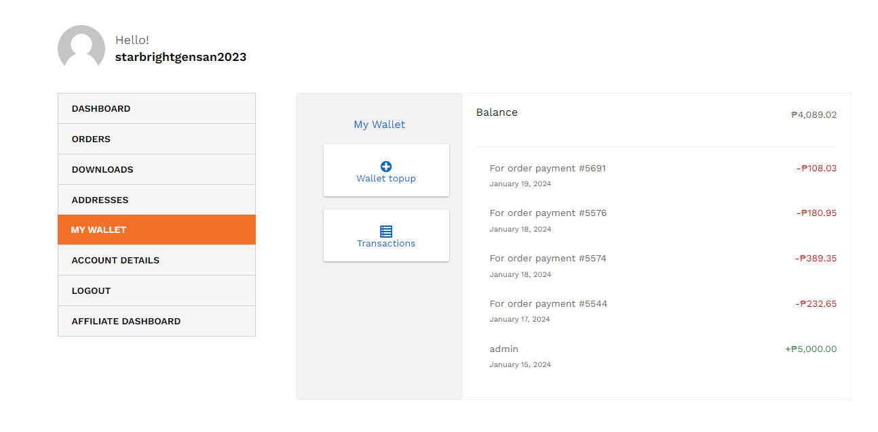
WALLET OPTION

Slide 11
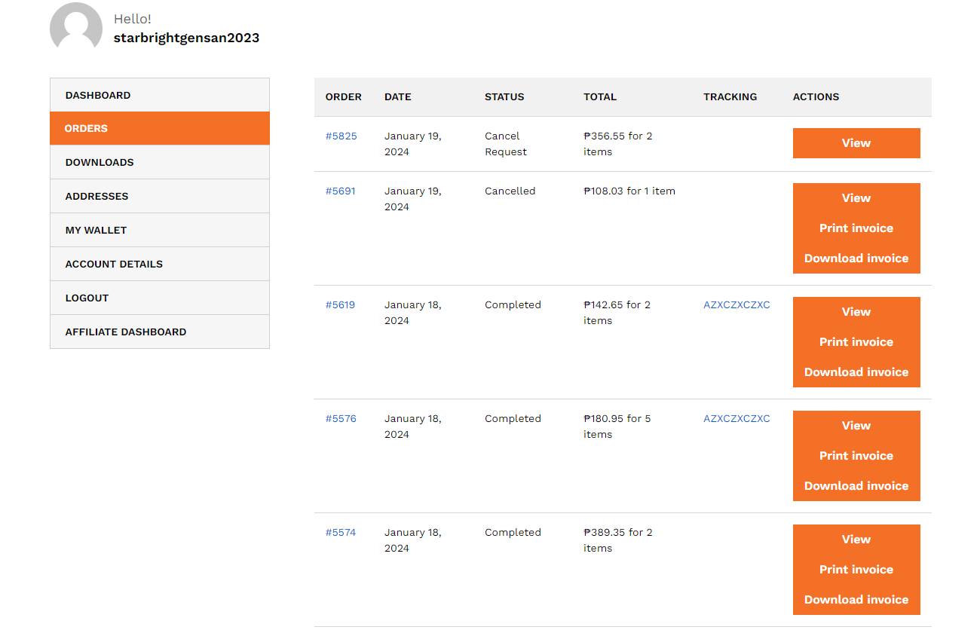
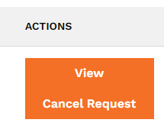
ORDER TABLE
TRACKING RECORD
This will Redirect to affiliate couriers
Cancel Request

Slide 12
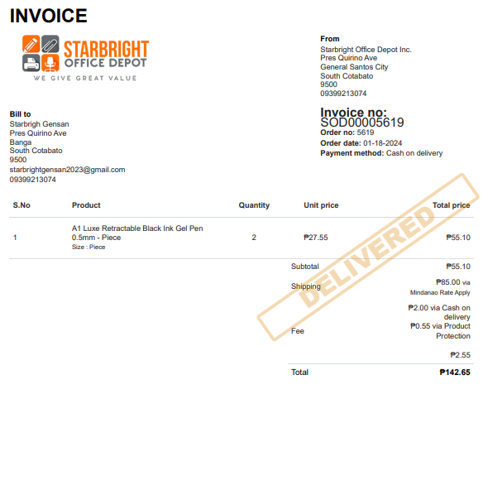
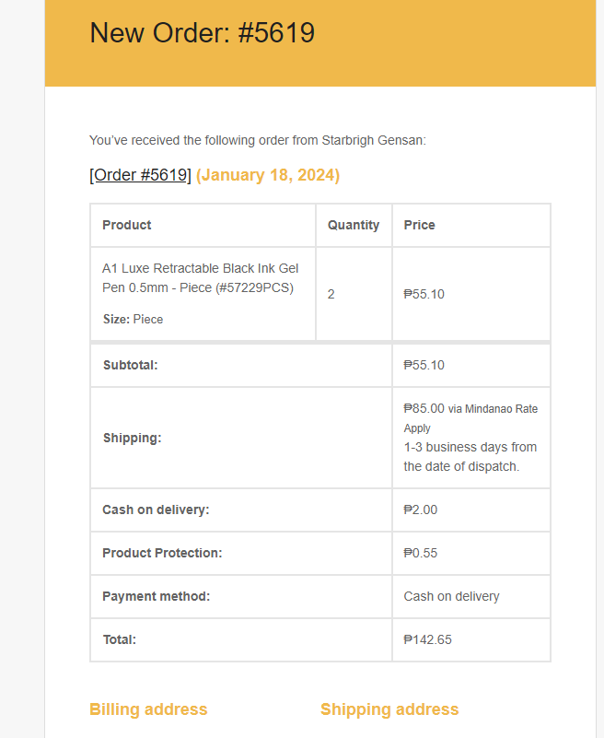
PRINT INVOICE
EMAIL RECEIVED BY THE CUSTOMER

Slide 13
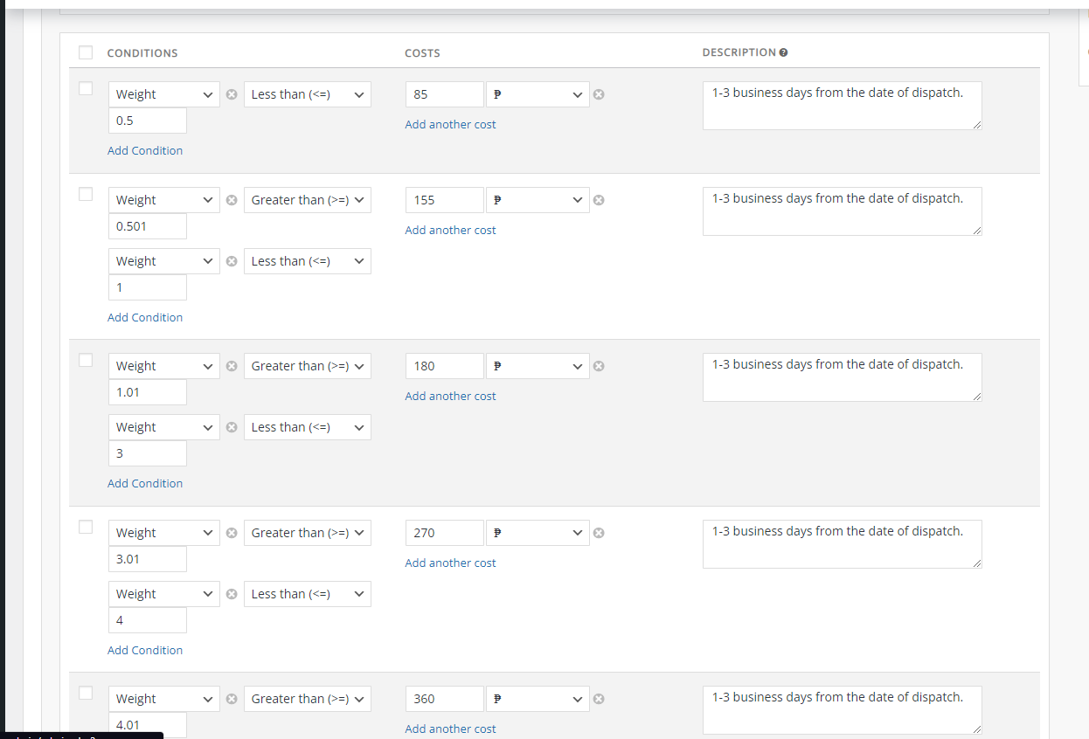
SHIPMENT TABLE

Slide 14
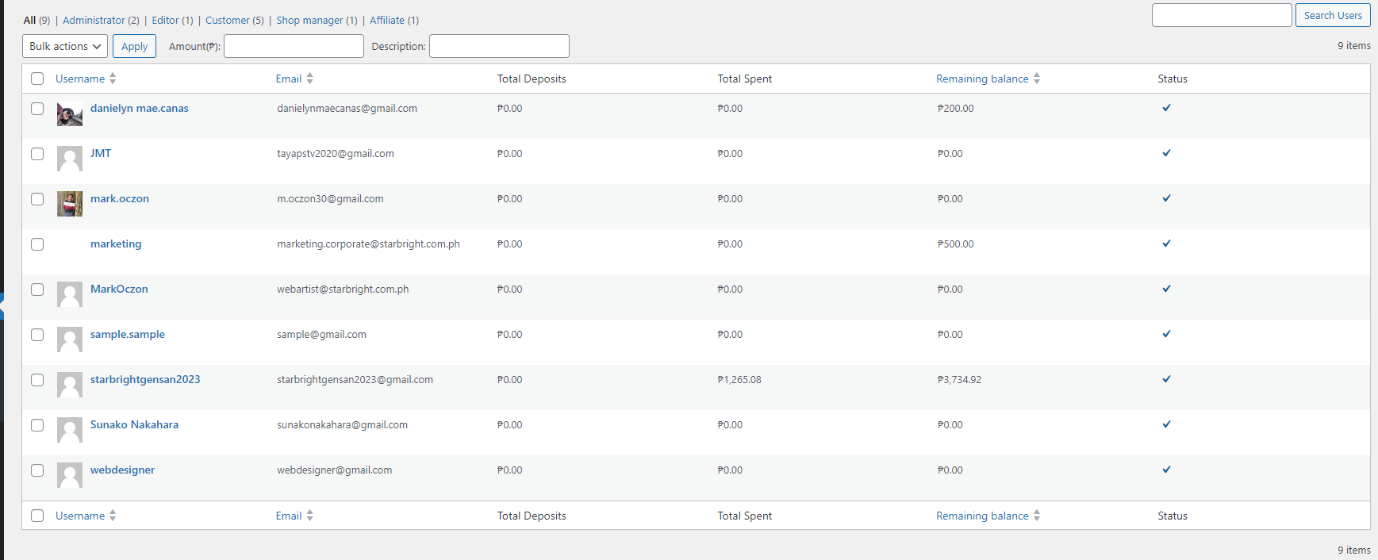
Wallet dashboard for admin

Slide 15
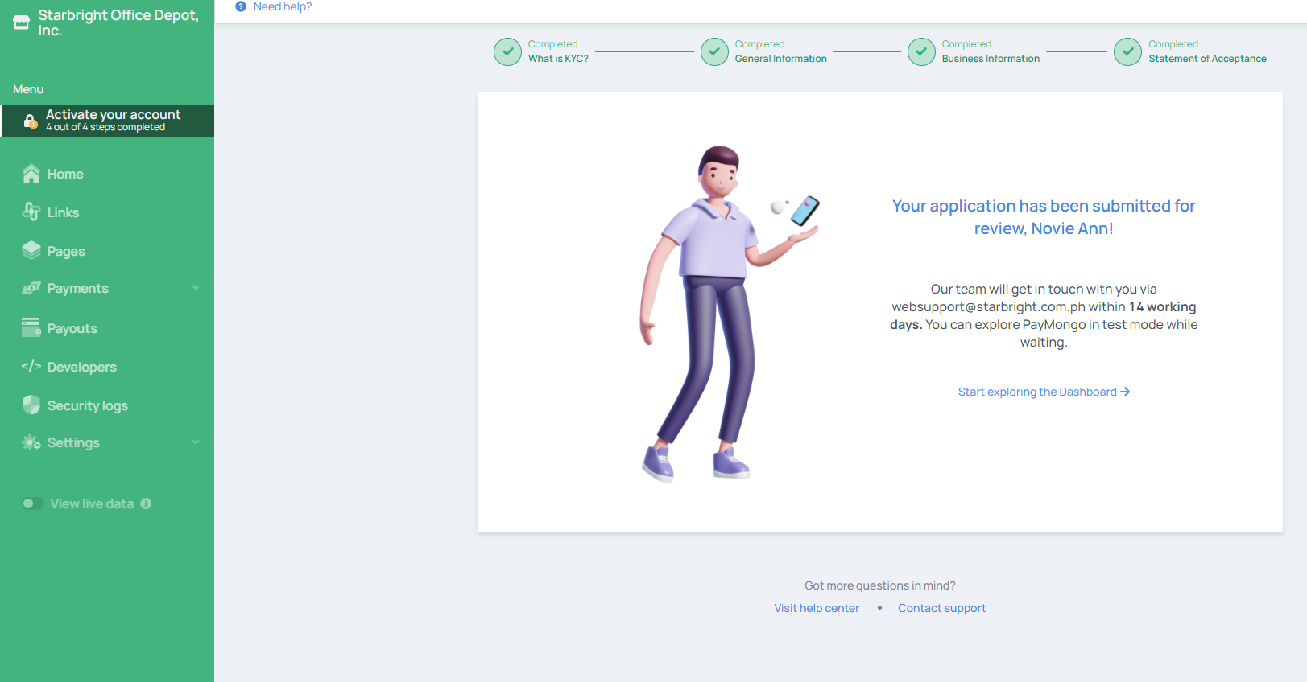
PAYMONGO UPDATE

Slide 16
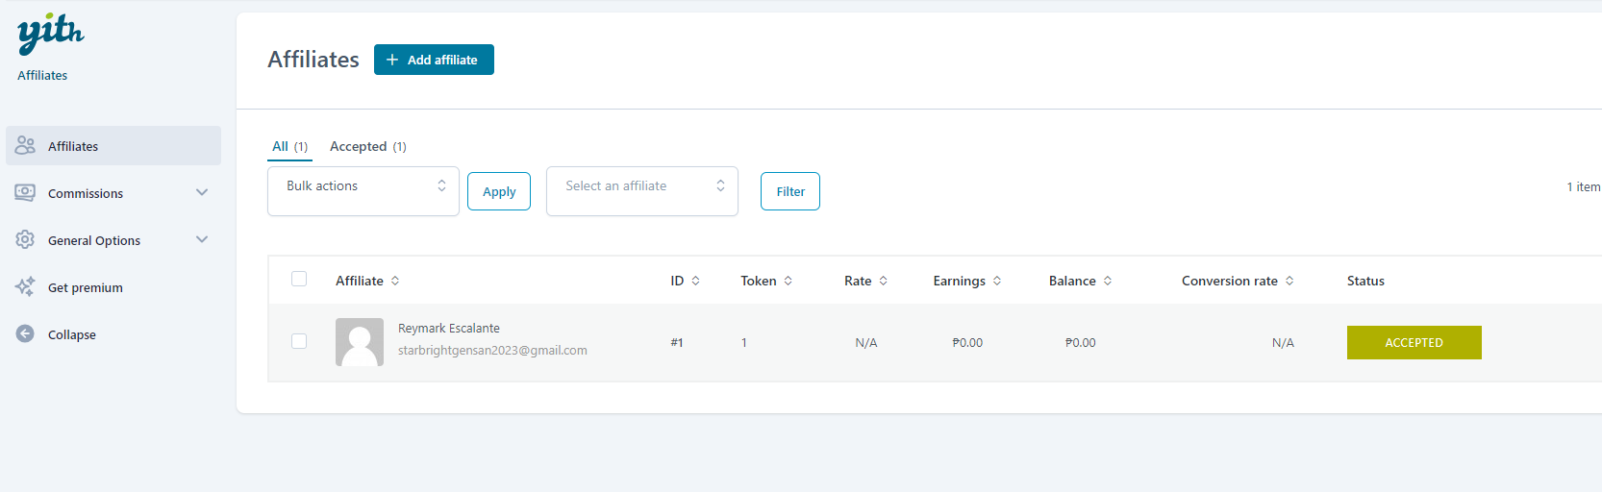
Affilate Admin dashboard

Slide 17
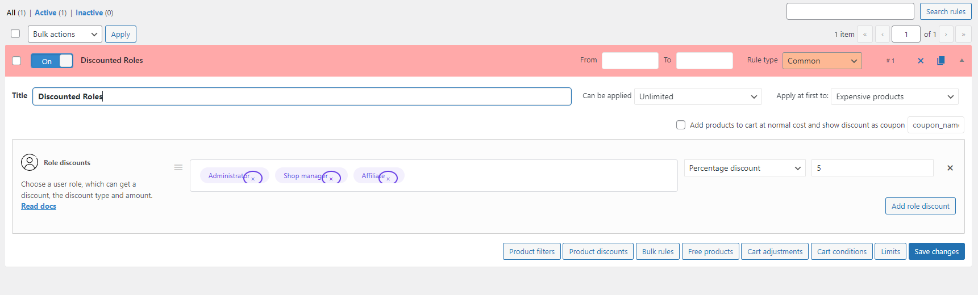
Discounted Admin Dashboard

