Slide 1
Features vector
From each detection, the following 13 features were extracted for use in clustering:
  Center Frequency (Hz)
  Bandwidth (Hz)
  C₄₂ (4th order power cumulant)
  C₆₃ (6th order power cumulant)
  Transmission length (seconds)
  P_{db} (2nd order power cumulant)
  Number of peaks in the frequency direction
  Number of peaks in the time direction
  Prominence of the major frequency peak
  Avg. spacing of the frequency peaks
  Avg. spacing of the time peaks
  Normalized power centroid in the time direction
  Width in the frequency direction (channels)

Slide 2
Autoencoder approach
Separately, two methods are being tried using a convolutional autoencoder:
  For the first, all signals are being shoved into the encoder, and the latent feature space is being used for clustering (no results yet)
  For the second, a collection of signals known to be noisy is used for training, and then the rest are considered anomalous. The following few slides show the process of separating those signals using a parallel coordinates plot (no results yet)

Slide 3
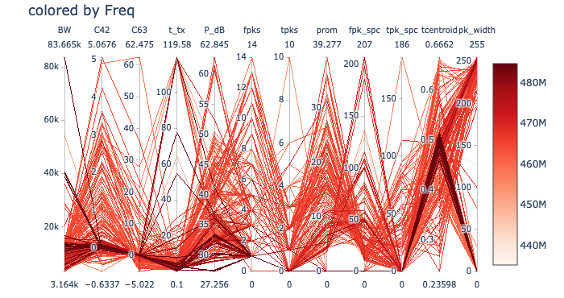
Full dataset

Slide 4
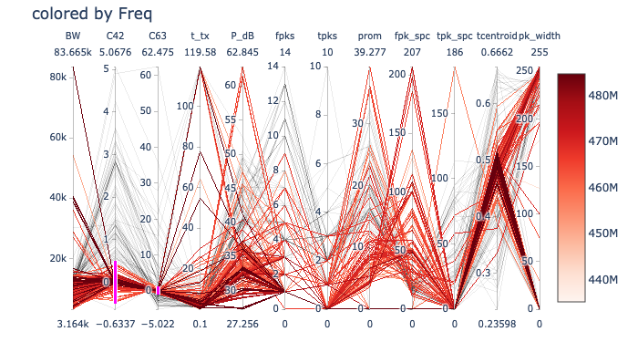
Dataset used for training (see pink)

Slide 5
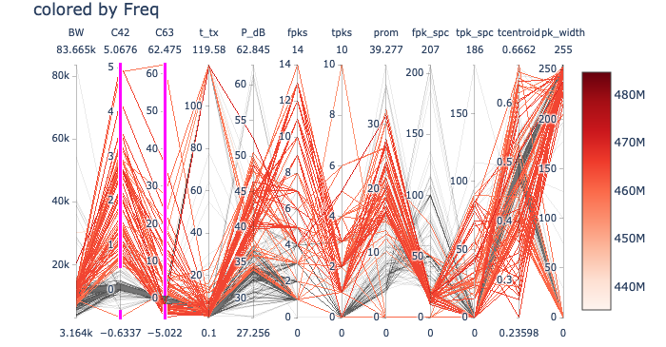
Data considered anomalous (see pink)

