Slide 1
Butterfly Detection with YOLOv5
FML Assignment
Mistir Nigusse Ketema
Date 24/JUN/2025

Slide 2
Dataset Overview
Roboflow Butterfly Detection
Total images: 180
Splits: 70% train / 20% val / 10% test
YOLO-format annotations (bounding boxes)

Slide 3
Model & Training Setup
YOLOv5-s fine-tuning
Pretrained on COCO, Colab Tesla T4 GPU
Image size: 640x640, batch size: 16
Experiments: 50 epochs (exp_ep50), 30 epochs (exp_ep30, patience 10)

Slide 4
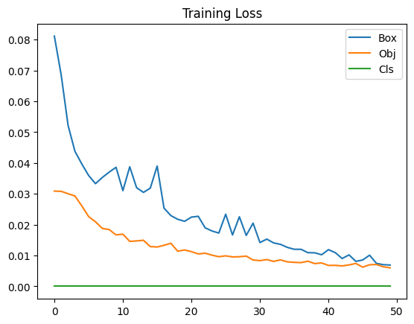
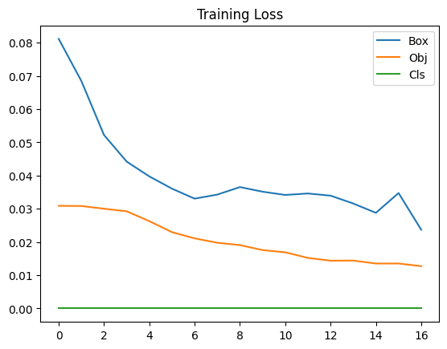
Training & Validation Curves
Loss curves (box, obj, class loss) over epochs
30 epoch
50 epoch

Slide 5
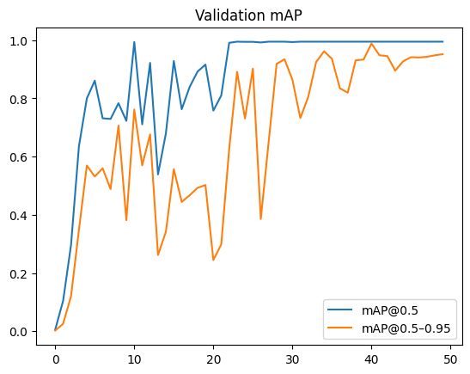
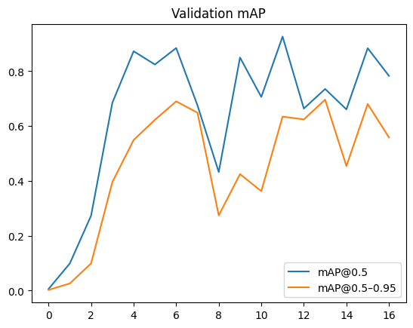
Training & Validation Curves
• Validation mAP@0.5 and mAP@0.5–0.95 trends
30 epoch
50 epoch

Slide 6
Test Metrics Comparison
Comparison of exp_ep30 vs exp_ep50 on test split
Precision: 0.886 vs 0.992
Recall: 0.944 vs 1.000
mAP@0.5: 0.964 vs 0.995
mAP@0.5–0.95: 0.751 vs 0.926

Slide 7
Error Analysis
Per-image detection outcomes
exp_ep30: 15 detected / 3 missed
exp_ep50: 18 detected / 0 missed
Missed cases often have tiny or occluded butterflies

Slide 8
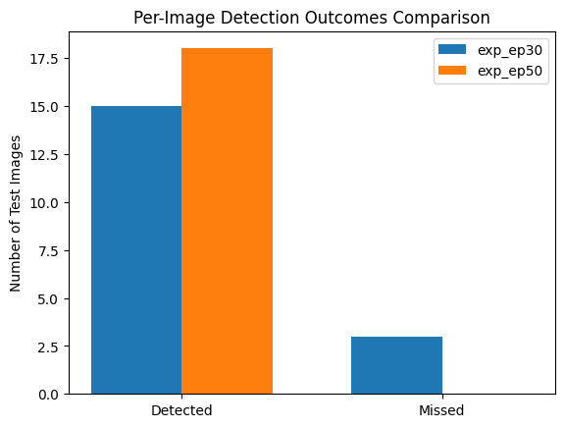

Slide 9
Conclusions & Future Work
Conclusions
exp_ep50 yields superior performance and zero misses
Model shows near-perfect mAP on the small test set (0.99+), which may indicate overfitting due to the limited number of training images.
Future: more data, stronger augmentation, higher resolution, larger models

