Slide 1

Term Project: Vaccination Clinic Discrete Event Simulation
MSDS 460: Decision Analytics
Michael Mistarz & Alex McCorriston

Slide 2
Goals & Problem Statement
Goals:
Incorporate walk-ins and scheduled appointments
Incorporate balking and reneging
Incorporate patient types (i.e. relaxed vs. rushed)
Problem Statement:
What is the optimal number of receptionists and nurses to have on staff that maximize the number of patients vaccinated while minimizing balking, reneging, and employee downtime?
Notes:
Vaccination clinics play a critical role in public health by ensuring widespread immunization against infectious diseases. Efficient operation of these clinics is essential to maximize the number of patients vaccinated and ensure smooth clinic workflows. We were interested in creating a realistic simulation and aimed to incorporate both walk-ins and patient with scheduled appointments. We also wanted to incorporate balking and reneging, and, on top of that, incorporate two types of patients–relaxed and rushed–for which the balking and reneging thresholds differ.
Our ultimate objective was to answer: problem statement

Slide 3
Key Simulation Components
Arrival Streams
Appointments (fixed interval)
Walk-ins (normally distributed)
High flow rate before work, after work, during lunch
Low flow rate otherwise
Resources
Receptionists (vary from 1-10)
Nurses (vary from 1-10)
Processes
Check-in with receptionist
Balk at check-in queue
Renege in check-in queue
Renege in vaccination queue
Get vaccine from nurse
Parameters
Simulation time is 12 hours
Mean check-in time is 1 minute
Mean vaccine time is 3 minutes
“Relaxed patient” and “rushed patient” types
Notes:
To provide a more in-depth overview of the simulation, we have two different arrival streams–patients with appointments, which are scheduled at a fixed interval and walk-ins, which are drawn from normal distributions that depend on time of day. We set our appointments to occur every 15 minutes. We have the clinic set to be in a high flow state before work, after work, and during lunch, so walk-ins are modeled as coming in on average every 30 seconds. The clinic is in a low flow state otherwise, so walk-ins are modeled as coming in on average every one minute.
Our simulation also has two primary resources–receptionists who check the patient in and nurses who administer the vaccine. This is what we systematically vary across runs of our simulation to determine what combination of resources is optima. The processes involved in the simulation are checking-in with the receptionist, balking at the check-in que, reneging in the check-in queue, reneging in the vaccination queue, and getting the vaccine from the nurse. Other parameters we have set are that the simulation time is 12 hours, the mean check-in time is 1 minute, and the mean vaccine time is 3 minutes. Again, we also have two types of patients–relaxed and rushed that are randomly assigned. Relaxed patients balk if the check-in queue is greater than 15 and renege after waiting for 15 times the mean vaccine time plus check-in time. Rushed patients balk if the check-in queue is greater than 5 and renege after waiting for 5 times the mean vaccine time plus check-in time.

Slide 4
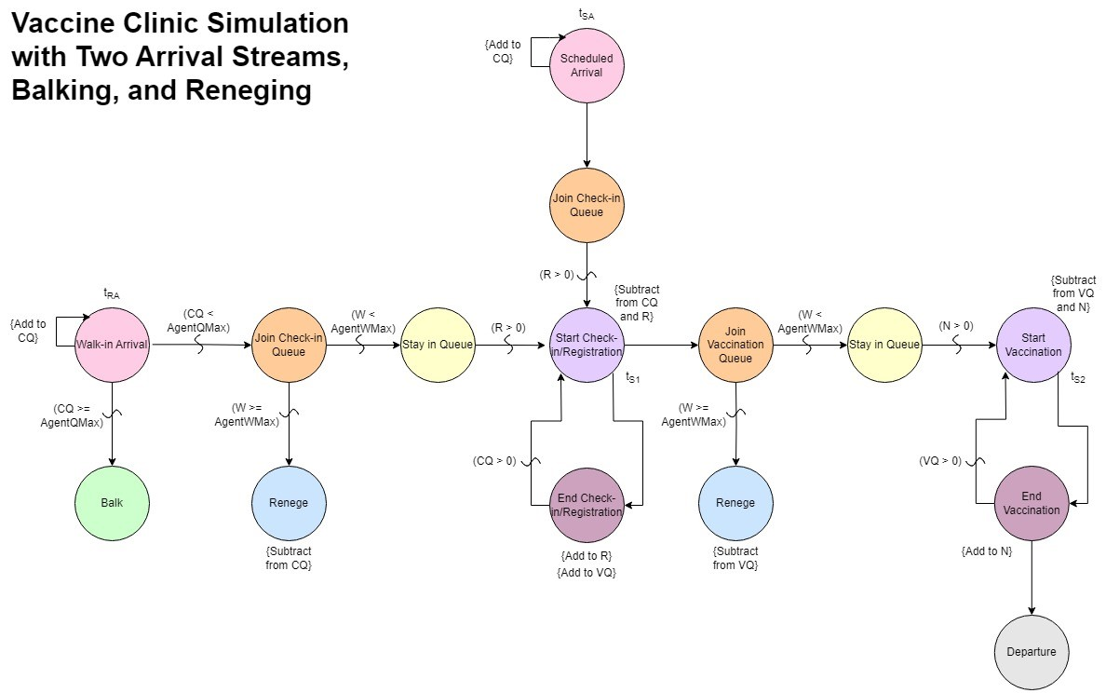
Event Graph
Notes:
The event graph helps visualize the process flow.

Slide 5
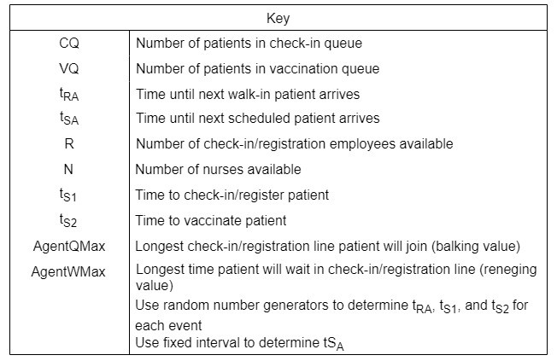
Event Graph
Notes:
Key for event graph.

Slide 6
Simulation Output
Excel file documenting movement of every patient that enters the clinic from arrival to departure
Event Log
Excel files documenting patient type, balking and reneging characteristics, check-in, departure, and service times, and actions (i.e. vaccinated, balked, reneged)
Patient Info Dataframes (All, Balked, and Reneged)
Excel files documenting queue lengths at different points in the simulation
Check-in Queue and Vaccination Queue Lengths
Excel files documenting how much down time receptionists and nurses had at different points in the simulation
Receptionist and Nurse Down Times
Notes:
The outputs of our simulation include…

Slide 7
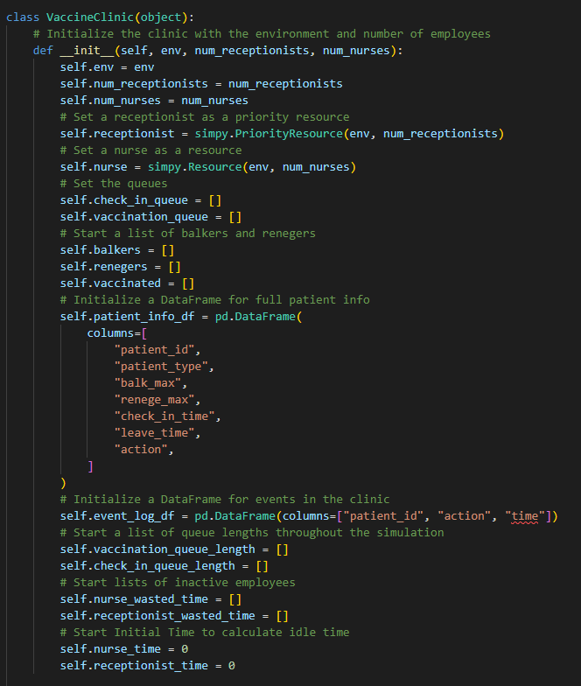
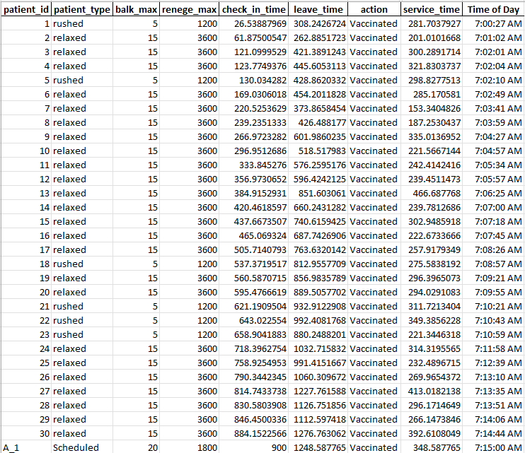
SimPy & Coding Considerations

Slide 8
Coding Functions
Arrive and Scheduled Arrival
Add to Check-In Queue
Randomized Patients (Rushed vs. Relaxed)
Check-In with Receptionist (simpy.PriorityResource)
Add to Vaccination Queue
Vaccinated by Nurse (simpy.Resource)

Slide 9
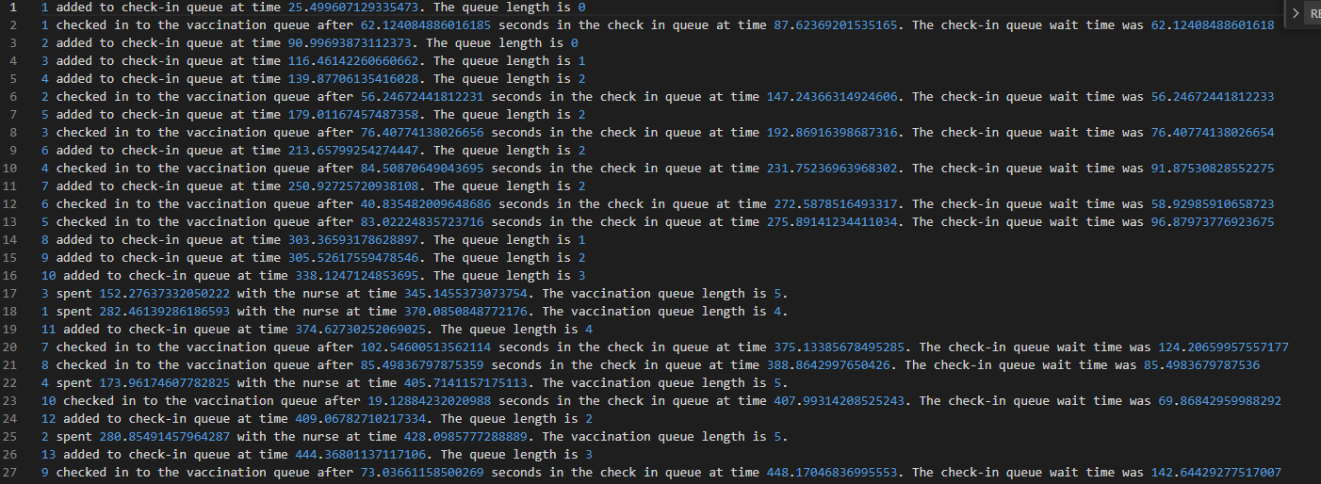
Event Log Example

Slide 10
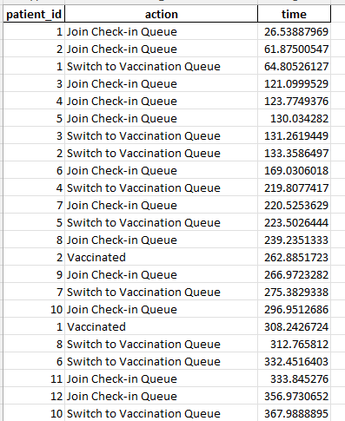
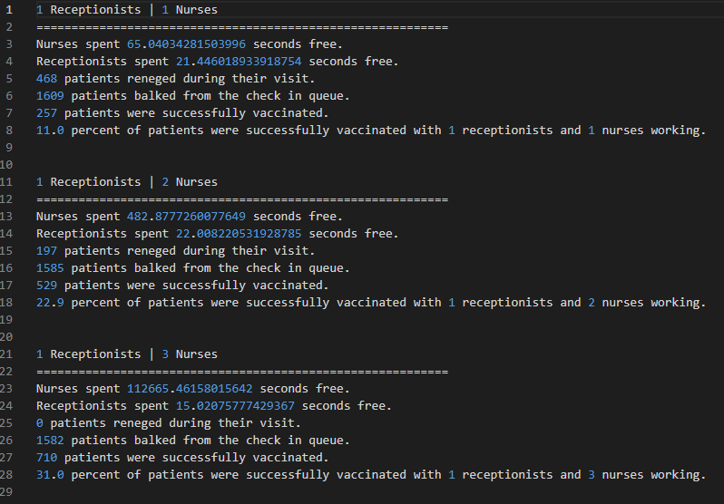
More Logging Examples

Slide 11
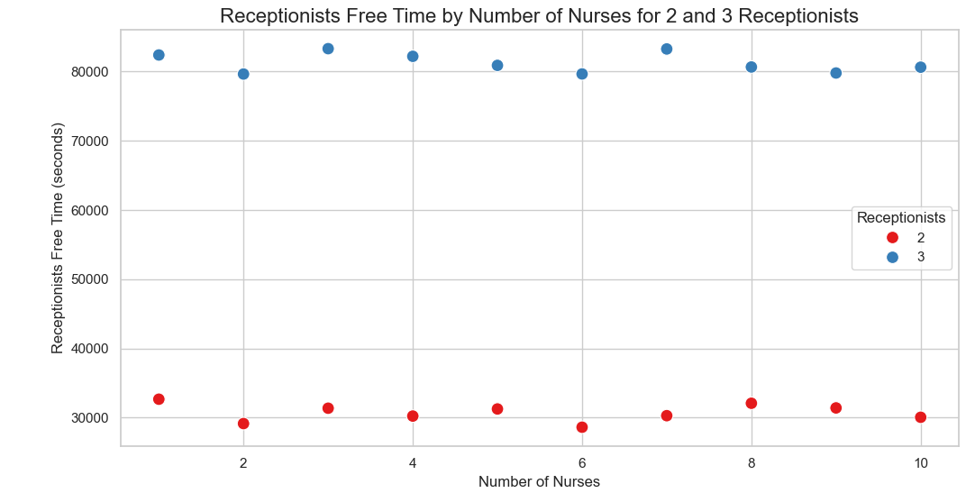
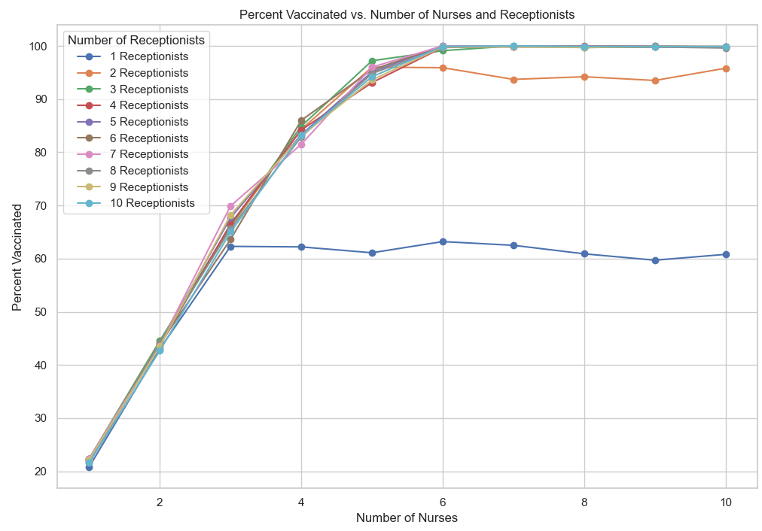
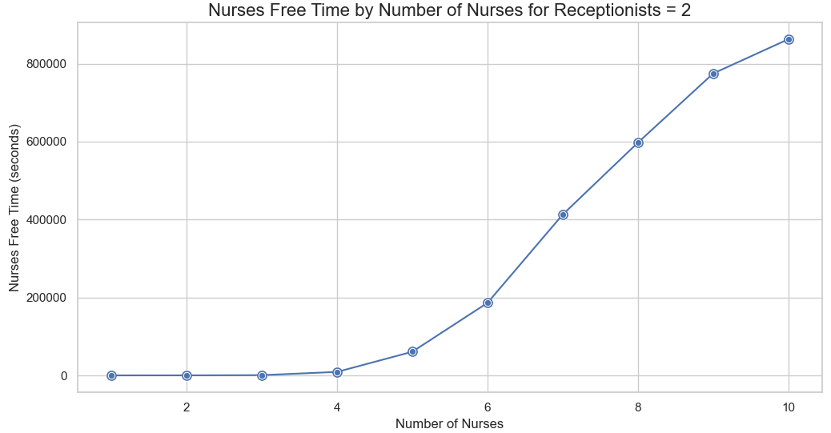
Initial Run Findings
Notes:
Initial reproducible run parameters:
Walk-ins:
High flow rate: 30 seconds
Low flow rate: 1 minute
Scheduled arrivals every 15 minutes
Testing 1-10 receptionists and 1-10 nurses available
Graphs give idea of what our optimal range to further test is
Left: At least 2 receptionists and 4-6 nurses results in 80-high 90 percent vaccinated
Top Right: Comparing 2 receptionists to 3 receptionists over range of nurse availability shows that downtime more than doubles, which hurts our objective of minimizing staff costs (also, not shown but the decrease in balking from having a third receptionist is minimal compared to the large increase in downtime)
Bottom Right: Focusing in on 2 receptionists, nurse free time starts to jump after 5 nurses are available (also, now shown but decrease in reneging after having 4 nurses is minimal compared to large increase in downtime) so given all this evidence and keeping in mind our objective, we think it’s best to run our simulation with the following scenarios:
1: 2 receptionists, 4 nurses
2: 2 receptionists, 5 nurses
3: 2 receptionists, 6 nurses
Note: I can add in those two “not shown” graphs if it’s helpful

Slide 12
Preliminary Results
2 Receptionists, 4-6 Nurses, Run 100x
Nurses | Vaccinations | Balks | Reneges | % Vaccinated | Receptionist Free Time (s) | Nurse Free Time (s)
4 | 988.91 | 57.04 | 132.59 | 83.92 | 31006 | 5136
5 | 1105.66 | 55.49 | 16.32 | 93.91 | 31336 | 32810
6 | 1119.45 | 56.98 | 0.00 | 95.16 | 30993 | 80203

Slide 13
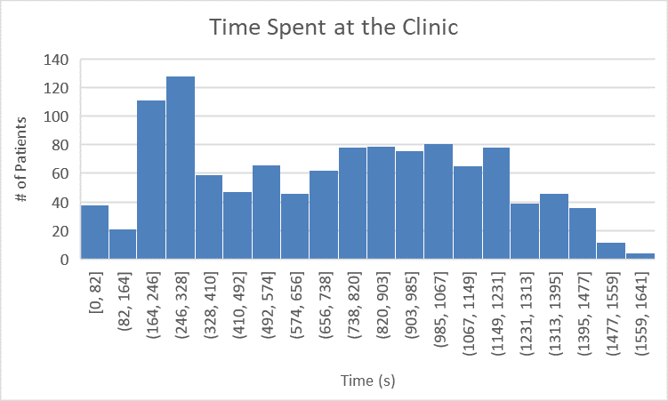
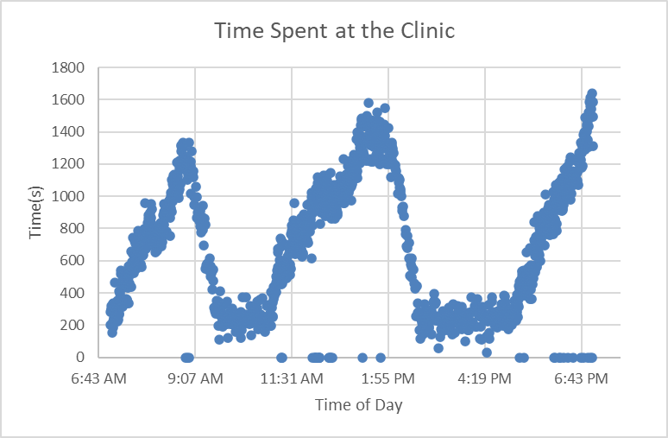
Optimal Solution
2 Receptionists, 5 Nurses

