Slide 1
Frontier AI. In your hands.
Configurable AI for all builders
July 2025
Notes:
Good [morning/afternoon], everyone. Thank you for joining us today. I'm [Your Name], and over the next 15 minutes, I'm going to share with how Mistral’s configurable AI platform can help you accelerate AI adoption and leverage AI to build a massive competitive advantage. Mistral AI is all about putting cutting-edge AI directly in your hands, enabling you to build secure, private, and customizable AI aligned with your goals.

Slide 2











The Mistral AI model landscape
Models
La Plateforme
Le Chat
Mistral Code
Mistral Compute
Our flagship model, for your most sophisticated needs
Our frontier-class reasoning model
Our most efficient / powerful edge models
Our moderation service to detect harmful text content
Mistral Medium 3
Magistral Medium
Ministral 3B/8B
Mistral Moderation
Premier models
Our low- latency code model for code generation (FIM)
Our agentic LLM for high-performance software engineering tasks
Our embedding model to make your data accessible
The world’s best OCR model to-date
Codestral
Devstral
Medium
Mistral Embed
Mistral OCR
Open- source models Apache 2.0
Our frontier speech understanding models
Our enterprise- grade small model, cost efficient and fast
Our small reasoning model
Our small agentic LLM for software engineering tasks
Voxstral Small/Mini
Mistral Small 3.2
Magistral Small
Devstral Small

Slide 3
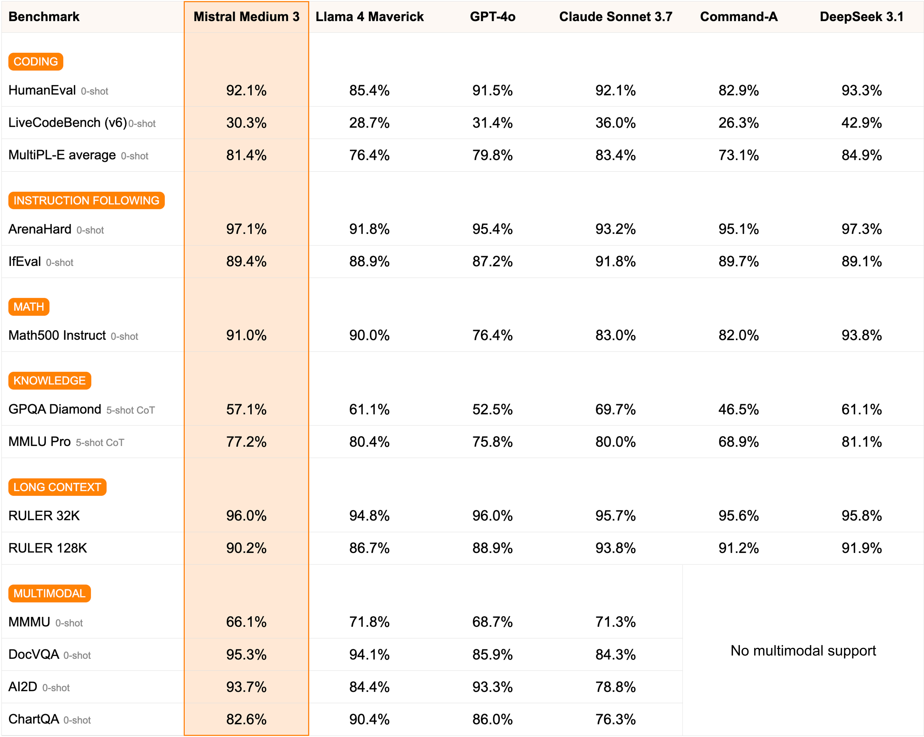
Mistral Medium Benchmark

Slide 4
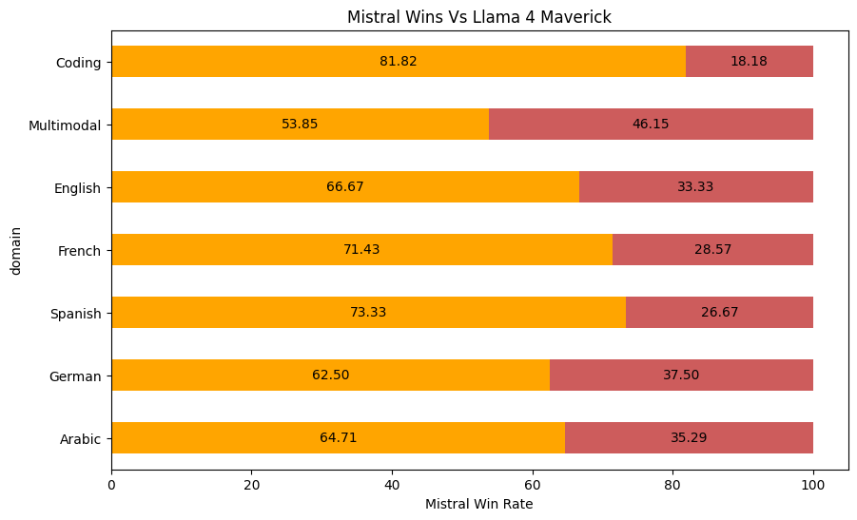
Mistral Medium 3.1

Slide 5






We’ve delivered for our customers
Use case: Comprehensive internal generative AI platform
Adoption: 30k+ users, 100+ use cases across banking, markets, retail
Metrics: ~50% cheaper than Llama and other alternatives
Business value: Est. >$30M / yr productivity unlocked
Use case: Vision-Language-Action models, enhancing defence platforms' ability to understand their environment, communicate with operators, and make rapid, reliable decisions in complex scenarios. This initiative fosters human-AI collaboration on the battlefield and revolutionizing defence operations.
Use case: Banking Advisor Agent for Customer Support
Adoption: >5000 tickets automated per month
Metrics: 88% accuracy, 80% decrease in cost per ticket
Business value: Est. ~$500k / yr. saved
Use case: Enterprise AI agents for customer service and internal RAG applications
Adoption: 30k+ active users
Metrics: 20%+ uplift in daily productivity with task automation
Business value: Est. >$50M / yr. saved
Use case: Automatic customer review response
Adoption: 3k+ stores, 1.3M monthly reviews
Metrics: 80%+ reduction in review response time, 80%+ satisfaction
Business value: Est. >$10M / yr. saved
Use case: SQL assistant Cortex Analyst
Adoption: Est. 100+ Snowflake customers in production
Metrics: ~90%+ accuracy, ~2X single-shot SQL generation
Business value: Est. >$3M productivity unlocked
Find more stories on:
https://mistral.ai/customers
Confidential ©2025 Mistral AI. All rights reserved.

