Slide 1

BIN 503 – BIOLOGICAL DATABASES AND DATA ANAYSIS TOOLS
Spring 2016
on Tuesdays, 9:40-12:30

Slide 2
Week II: Database Concepts and Relational Algebra

Slide 3
TODAY’S AGENDA
Course I (50 min): Introduction to database systems.
(10 min break)
Course II (50 min): Database concepts and Relational Algebra
(10 min break)
Course III (50 min): Relational Algebra (cont’d)

Slide 4
Course I (50 min): Introduction to database systems.
Introduction to database concepts;
What is a database?
Definition of some frequently used terms
Database properties.
Database management system (DBMS)
Overview of database architectures
Data models, schemas and instances.
Three-schema architecture and data independence.
The basic relational model

Slide 5
A database is a collection of related data
Data,
i.e. consider the names, telephone numbers, and addresses of the people you know.
Indexed address book
Stored on a hard drive using MS Access or Excel

Slide 6
Database Management System (DBMS)
The DBMS is a general-purpose software system that facilitates the processes of defining, constructing, manipulating and sharing databases among various users and applications.
DBMS = database (data) + set of programs (that access data)

Slide 7
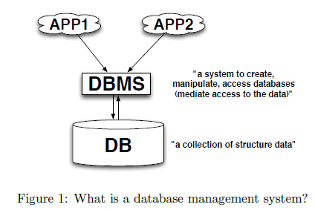

Slide 8
Where to use?
Database Applications:
Airlines: reservations, schedules; geographically distributed terminals accessing to the central database system
Universities: registration, grades
Telecommunication: call records
Science: Bioinformatics, Physics, Atmospheric Sciences, …
Interaction with databases:
Earlier: very few interacted directly (e.g., airline reservation agents); then ATMs appeared
Web-era: online interfaces to databases (online stores, … and, of course, bioinformatics databases)

Slide 9
Database concepts: data abstraction
Purpose of database system: provide users with an abstract view of data
Abstraction hides complexity and simplifies users’ interactions
Physical level: describes HOW the data is actually (physically) stored
Logical level: describes WHAT data stored in database, and the relationships among the data
View level: describes part of database (“hiding” information) (example: ATM allows you to access to only your account information)

Slide 10
Database concepts: database languages
Database systems provides:
Data Definition Language (DDL): specify database schema
Data Manipulation Language (DML): express queries (access to data defined by schema); manipulation – retrieval, insertion, deletion, modification
Query language often means DML
Usually, DDL and DML form one language (e.g., SQL)

Slide 11
Database concepts
Defining a database;
Specifying the data types, structures and constraints of the data to be stored in the database.
Constructing the database;
The process of storing the data on some storage medium that is controlled by the DBMS.
Manipulating the database;
Functions such as querying the database to retrieve specific data, updating the database to reflect changes in the miniworld and generating reports from the data.

Slide 12
Name | Student_number | Class | Major
Smith | 17 | 1 | CS
Brown | 8 | 2 | CS
STUDENT
Course_name | Course_number | Credit_hours | Department
Intro to Computer Science | CS1310 | 4 | CS
Data Structures | CS3320 | 4 | CS
Discrete Mathematics | MATH2410 | 3 | MATH
Database | CS3380 | 3 | CS
COURSE
SECTION
GRADE_REPORT
Section_identifier | Course_number | Semester | Year | Instructor
85 | MATH2410 | Fall | 07 | King
92 | CS1310 | Fall | 07 | Anderson
102 | CS3320 | Spring | 08 | Knuth
112 | MATH2410 | Fall | 08 | Chang
119 | CS1310 | Fall | 08 | Anderson
135 | CS3380 | Fall | 08 | Stone
Student_number | Section_identifier | Grade
17 | 112 | B
17 | 119 | C
8 | 85 | A
8 | 92 | A
8 | 102 | B
8 | 135 | A
PREREQUISITE
Course_number | Prerequisite_number
CS3380 | CS3320
CS3380 | MATH2410
CS3320 | CS1310
Define the database -> specify the data elements, specify data type
Construct the database -> relation between multiple elements.

Slide 13
Defining the database
STUDENT
Name | Student_number | Class | Major
Smith | 17 | 1 | CS
Brown | 8 | 2 | CS
GRADE_REPORT
Student_number | Section_identifier | Grade
17 | 112 | B
17 | 119 | C
8 | 85 | A
8 | 92 | A
8 | 102 | B
8 | 135 | A
Data elements;
Student’s name, class and major
Data type;
Student’s name is a string of alphabetic characters
Student number is an integer.
Grade is a single character from the set {‘A’,’B’,’C’,’D’,’F’,’I’}

Slide 14
Name | Student_number | Class | Major
Smith | 17 | 1 | CS
Brown | 8 | 2 | CS
Student_number | Section_identifier | Grade
17 | 112 | B
17 | 119 | C
8 | 85 | A
8 | 92 | A
8 | 102 | B
8 | 135 | A
Course_number | Prerequisite_number
CS3380 | CS3320
CS3380 | MATH2410
CS3320 | CS1310
Section_identifier | Course_number | Semester | Year | Instructor
85 | MATH2410 | Fall | 07 | King
92 | CS1310 | Fall | 07 | Anderson
102 | CS3320 | Spring | 08 | Knuth
112 | MATH2410 | Fall | 08 | Chang
119 | CS1310 | Fall | 08 | Anderson
135 | CS3380 | Fall | 08 | Stone
Store data to represent each student, course, section, grade report and prerequisite.
Many types of records and many relationships among the records.

Slide 15
Manipulating the database
Retrieve a list of all courses and grades of ‘Smith’
Name | Student_number | Class | Major
Smith | 17 | 1 | CS
Brown | 8 | 2 | CS
Section_identifier | Course_number | Semester | Year | Instructor
85 | MATH2410 | Fall | 07 | King
92 | CS1310 | Fall | 07 | Anderson
102 | CS3320 | Spring | 08 | Knuth
112 | MATH2410 | Fall | 08 | Chang
119 | CS1310 | Fall | 08 | Anderson
135 | CS3380 | Fall | 08 | Stone
Student_number | Section_identifier | Grade
17 | 112 | B
17 | 119 | C
8 | 85 | A
8 | 92 | A
8 | 102 | B
8 | 135 | A
Name | Grade | Course_number
Smith | B | MATH2410
Smith | C | CS1310

Slide 16
Database concepts
Sharing the database;
Allowing multiple users and programs to access the database simultaneously.
An application program accesses the database by sending queries or requests for the data to the DBMS.
A query causes some data to be retrieved.
A transaction causes some data to be read and some data to be written into the database.

Slide 17
Database Design
Design of a new database starts off with requirements specification and analysis phase.
Conceptual Design
Representation which can be easily maintained, modified and transformed into a database implementation.
Entity-Relationship models
Logical Design
That can be expressed in a data model implemented in a commercial DBMS. Relational Data Models.
Physical Design
During which further specifications are provided for storing and accessing the database.

Slide 18
Overview of database design
Requirements analysis (or what users want from a database):
What data to be stored
What applications to be built on top of db
What operations to be most frequent
Discussions with users, survey of current operating environment, etc.

Slide 19
Overview of database design
Conceptual database design:
Based on the requirements develop a high-level description of data to be stored in db
Supplement with known constraints over the data
Often carried out using the Entity-Relationship data model (or using some other high-level data model)

Slide 20
Overview of database design
Logical database design:
Choose a particular DBMS
Convert conceptual database design into a database schema in the data model of the chosen DBMS
“By default”, convert an ER schema into a relational database schema

Slide 21
Overview of database design
Schema refinement (in case of relational DBMS):
Analyze relational database schema to identify potential problems and refine schema
Not-subjective step (unlike requirements analysis and conceptual design steps)
Normalization process

Slide 22
Overview of database design
Physical database design (database tuning):
Consider typical expected workloads and further refine to meet desired performance
Building indexes, clustering/partitioning some tables
May involve a substantial redesign of schema from previous steps

Slide 23
Overview of database design
Security design:
Identify different user groups
Specify which parts of db can be accessed by particular user group and which parts cannot be accessed

Slide 24
Main characteristics of database approach versus file-processing approach
Self-describing nature of a database system
Insulation between programs and data and data abstraction
Support of multiple views of the data.
Sharing the data and multiuser transaction processing.

Slide 25
Self-describing nature of a database system
RELATIONS
Relation_name | No_of_columns
STUDENT | 4
COURSE | 4
SECTION | 5
GRADE_REPORT | 3
PREREQUISITE | 2
A database catalog
Not only the database itself but also a complete definition or description of the database structure and constraints.
COLUMNS
Column_name | Data_type | Belongs_to_relation
Name | Character (30) | STUDENT
Student_number | Character (4) | STUDENT
Class | Integer (1) | STUDENT
Major | Major_type | STUDENT
Course_name | Character (10) | COURSE
Course_number | XXXXNNNN | COURSE
… | … | …
… | … | …
Prerequisite_number | XXXXNNNN | PREREQUISITE

Slide 26
Insulation between programs and data and data abstraction
Program-data independence
Program-operation independence

Slide 27
Support of multiple views of the data.
USER I
Student_name | Student_transcript
 | Course_number | Grade | Semester | Year | Section_id
Smith | CS1310 | C | Fall | 08 | 119
 | MATH2410 | B | Fall | 08 | 112
Brown | MATH2410 | A | Fall | 07 | 85
 | CS1310 | A | Fall | 07 | 92
 | CS3320 | B | Spring | 08 | 102
 | CS3380 | A | Fall | 08 | 135
USER II
Course_number | Course_number | Prerequisite
Database | CS3380 | CS3320
 |  | MATH2410
Data Structures | CS3320 | CS1310
Two derived views from UNIVERSITY database

Slide 28
Sharing the data and multiuser transaction processing
The DBMS must include concurrency control software to ensure that several users trying to update the same data do so in a controlled manner.
A transaction is an executing program or process that includes one or more database access.
The isolation property ensures that each transaction appears to execute in isolation from other transactions.
Atomicity property ensures that either all the database operations in a transaction are executed or none are.

Slide 29
Database concepts: databases versus files
Drawbacks of using file systems for storage:
Data redundancy and inconsistency:
Multiple file formats, several languages used, duplication of information in different files
Difficulty in accessing data:
New task -> new program
Data isolation:
Multiple files and formats
Integrity problems:
Managing integrity constraints (e.g., account balance > 0, DNA sequence consists of certain letters)
Hard to add new constraints or change existing ones

Slide 30
Data normalization;
Store each logical data item in only one place in the database.
Controlled redundancy
i.e. Student_name and Course_number are redundantly stored in a GRADE_REPORT file.

Slide 31
Relational Model Concepts
The relational model represents the database as a collection of relations.
When a relation is thought of as a table of values, each row in the table represents a collection of related data values.
The table name and column names are used to help to interpret the meaning of the values in each row.

Slide 32
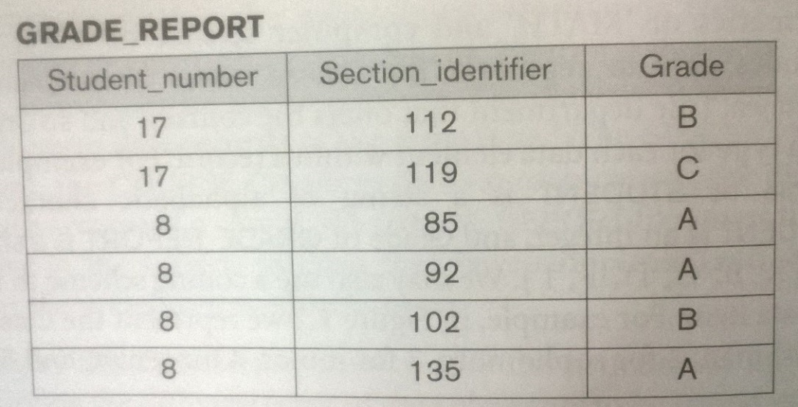
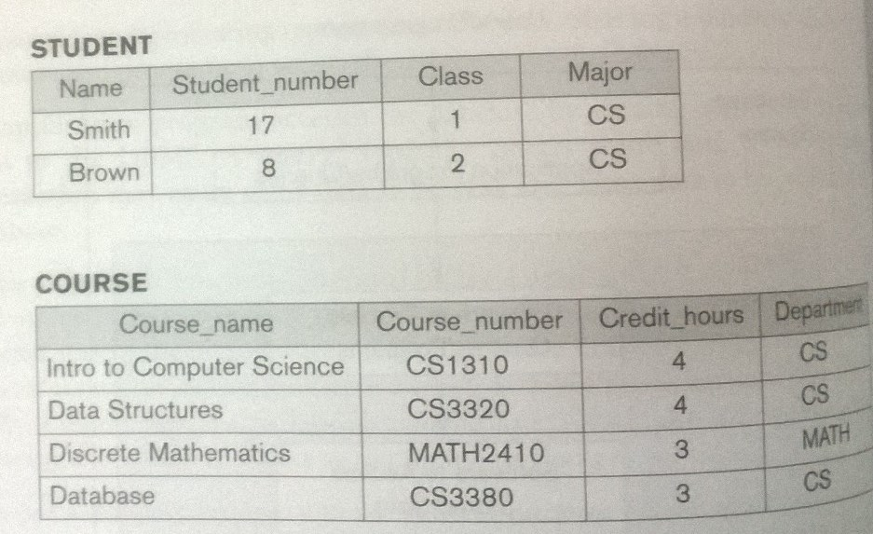
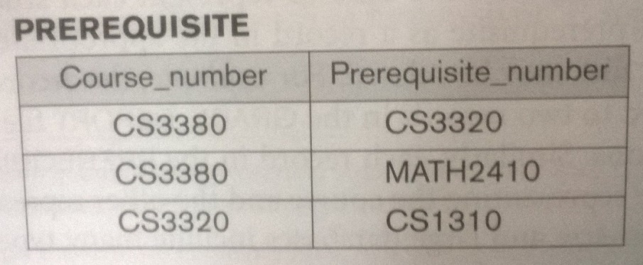
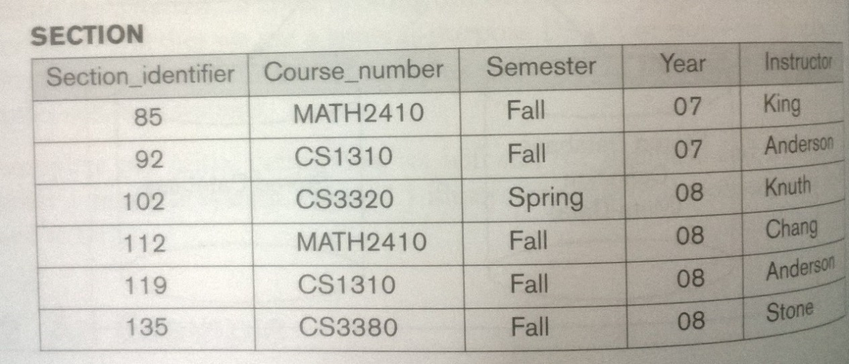
Name | Student_number | Class | Major
Smith | 17 | 1 | CS
Brown | 8 | 2 | CS
Table called STUDENT, because each row represents facts about a particular student entity.
The column names specify how to interpret the data values in each row.

Slide 33
Relational Model Concepts
In the formal relational model terminology;
A row is called a tuple,
A column header is called an attribute,
The table is called a relation.
The data type describing the types of values that can appear in each column is represented by a domain of possible values.

Slide 34
Relational Model Concepts
Domain: set of permitted values for each attribute
DNA sequence – {A,C,T,G,-}
Attribute types:
Simple and composite (if has sub-parts – name: first name, last name) attributes
Single-valued and multi-valued attributes (multivalued attribute: phone numbers of a person)
Derived attributes
Computed from other attributes
Example: age (from date_of_birth)

Slide 35
Example of domains;
Social_security_names. The set of valid nine-digit Social Security numbers.
Employee_ages. Integer value between 18-65
Data type;
For Employee_ages is an integer value between 18-65

Slide 36
Name | Student_number | Class | Major
Smith | 17 | 1 | CS
Brown | 8 | 2 | CS
Course_name | Course_number | Credit_hours | Department
Intro to Computer Science | CS1310 | 4 | CS
Data Structures | CS3320 | 4 | CS
Discrete Mathematics | MATH2410 | 3 | MATH
Database | CS3380 | 3 | CS
Section_identifier | Course_number | Semester | Year | Instructor
85 | MATH2410 | Fall | 07 | King
92 | CS1310 | Fall | 07 | Anderson
102 | CS3320 | Spring | 08 | Knuth
112 | MATH2410 | Fall | 08 | Chang
119 | CS1310 | Fall | 08 | Anderson
135 | CS3380 | Fall | 08 | Stone
Student_number | Section_identifier | Grade
17 | 112 | B
17 | 119 | C
8 | 85 | A
8 | 92 | A
8 | 102 | B
8 | 135 | A
Course_number | Prerequisite_number
CS3380 | CS3320
CS3380 | MATH2410
CS3320 | CS1310
Define the database -> specify the data elements, specify data type
Construct the database -> relation between multiple elements.

Slide 37
Relational Model Concepts
A relation schema R, denoted by R(A₁, A₂, …, A_{n}) is made up of a relation name R and a list of attributes A₁, A₂, … A_{n}.
Each attribute A_{i} is the name of a role played by some domain D, denoted by dom(A_{i}).
Relation Name
Attributes
STUDENT
Name | Ssn | Home_phone | Address | Office_phone | Age | Gpa
Benjamin Bayer | 305-61-2435 | (817)373-1616 | 2918 Bluebonnet Lane | NULL | 19 | 3.21
Chung-cha Kim | 381-62-1245 | (817)375-4409 | 125 Kirby Road | NULL | 18 | 2.89
Dick Davidson | 422-11-2320 | NULL | 3452 Elgin Road | (817)749-1253 | 25 | 3.53
Tuples

Slide 38
A relation of degree seven;
STUDENT(Name, Ssn, Home_phone, Address, Office_phone, Age, Gpa)
Using the data type of each attribute;
STUDENT(Name:string, Ssn:string, Home_phone:string, Address:string, Office_phone:string, Age:integer, Gpa:real)

Slide 39
Relational Model Notation
A relation schema R of degree n;
R(A₁, A₂, …, A_{n})
Upper letters Q,R,S denote relation names.
Lowercase letters q,r,s denote relation states.
Letters t,u,v denote tuples.
An attribute A can be qualified with the relation name R by the dot notation R.A
An n-tuple t in a relation r(R) is denoted by t=<v₁,v₂,…,v_{n}> where v_{i} is the value corresponding to attribute A_{i}.
t[A_{i}] = t.A_{i} = v_{i}

Slide 40
Relational Model Notation
As an example,
t=<‘Barbara Benson’, ‘533-69-1238’, ‘(817)839-8461’, ‘7384 Fontana Lane’, NULL, 19, 3.25>
t[Name]= <‘Barbara Benson’>
t[Ssn,Gpa,Age]= <‘533-69-1238’, 3.25, 19>

Slide 41
All tuples in a relation must be distinct.
No two tuples can have the same combinations of values for all their attributes.
There are other subsets of attributes of a relation schema R with that property.
Denote one such subset of attributes by SK
t1[SK] ≠ t2[SK]
Any such set of attributes SK is called a superkey of the relation schema R.
A superkey can have redundant attributes ;
A more useful concept is key, which has no redundancy.
{Ssn} is a key of STUDENT
{Ssn, Name, Age} is a superkey.

Slide 42
The primary key of a relational table uniquely identifies each record in the table.
It can either be a normal attribute that is guaranteed to be unique (such as Social Security Number in a table with no more than one record per person) or it can be generated by the DBMS (such as a globally unique identifier).
Primary keys may consist of a single attribute or multiple attributes in combination.
The attributes that form the primary key of a relation schema are underlined.

Slide 43
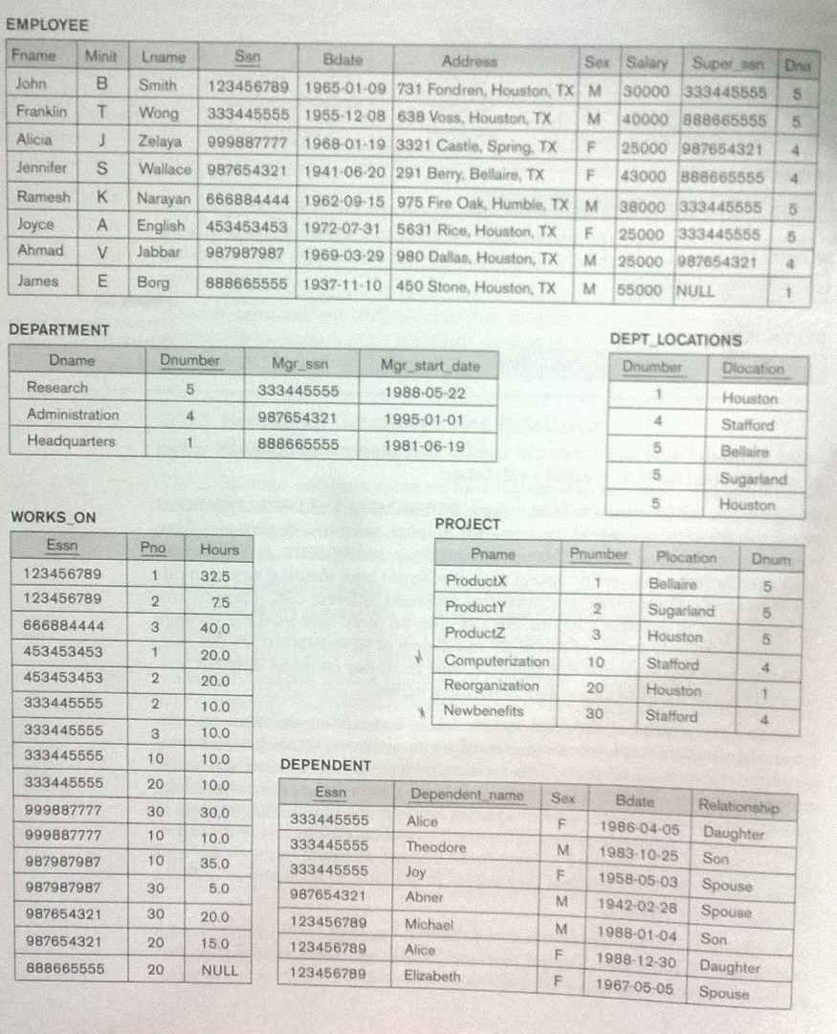

Slide 44
To define referential integrity, definition of the concept of foreign key is necessary.
A foreign key is an attribute or a group of attributes in a relational database table that provides a link between data in two tables.
For the given two relation schemas R₁ and R₂, a set of attributes in R₁ is a foreign key of R₁ that references relation R₂ if it satisfies two conditions;
The attributes in foreign key have the same domain as the primary key attributes of R₂.
A value of foreign key in a tuple t₁ of the current state r₁(R₁) either occurs as a value of primary key for some tuple t₂ in the current state r₂(R₂) or is NULL.

Slide 45
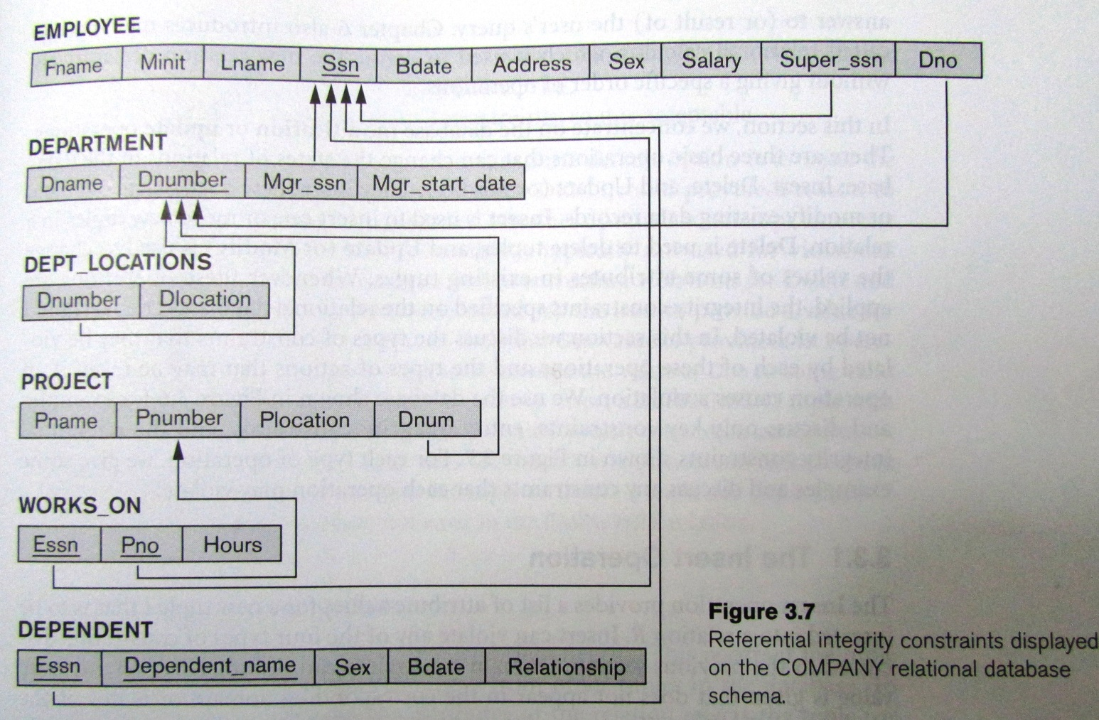
Relational Database Schema
Diagrammatically, a directed arc from foreign key to the relation it references.

Slide 46
Constraints
Domain constraint;
can be violated if an attribute value is given that does not in the corresponding domain or is not of the appropriate data type.
Entity integrity constraint;
Designate a primary key.
Primary key can not be NULL.
Key constraint;
If a key value in the new tuple is already exists in another tuple in the relation r(R).
Referential integrity constraint;
Violated if the value of any foreign key in t refers to a tuple that does not exist in the referenced relation.

Slide 47
Operations
INSERT
Can violate all four constraints.
DELETE
Can violate only referential integrity constraint.
UPDATE
If an attribute is not a primary key nor a foreign key usually causes no problems.
Just confirm the data type and domain.

Slide 48
INSERT <‘Cecilia’, ‘F’, ‘Kolonsky’, NULL, ‘1960-04-05’, ‘6357 Windy Lane, Katy TX’, F, 28000, NULL, 4> into EMPLOYEE
Result; violates the entity integrity constraint.
Primary key Ssn is NULL
Insert rejected.

Slide 49
INSERT <‘Alicia’, ‘J’, ‘Zelaya’, ‘999887777’, ‘1960-04-05’, ‘6357 Windy Lane, Katy TX’, F, 28000, ‘987654321’, 4> into EMPLOYEE
Result; violates the key constraint.
The same Ssn already exists
Insert rejected.

Slide 50
INSERT <‘Cecilia’, ‘F’, ‘Kolonsky’, ‘677678989’, ‘1960-04-05’, ‘6357 Windy Lane, Katy TX’, F, 28000, ‘987654321’, 7> into EMPLOYEE
Result; violates the referential integrity constraint.
Dno=7, no corresponding referenced tuple exists in DEPARTMENT with Dnumber = 7
Insert rejected.

Slide 51
INSERT <‘Cecilia’, ‘F’, ‘Kolonsky’, ‘677678989’, ‘1960-04-05’, ‘6357 Windy Lane, Katy TX’, F, 28000, NULL, 4> into EMPLOYEE
Result; accepted

Slide 52
DELETE the WORKS_ON tuple with Essn=‘999887777’ and Pno=10
Result; accepted

Slide 53
DELETE the EMPLOYEE tuple with Ssn=‘999887777’
Result; rejected
There are tuples in WORKS_ON that refer to this tuple.
Referential integrity violation.

Slide 54
DELETE the EMPLOYEE tuple with Ssn=‘333445555’
Result; rejected
There are tuples in WORKS_ON, DEPARTMENT and DEPENDENT that refer to this tuple.
Referential integrity violation.

Slide 55
UPDATE the salary of the EMPLOYEE tuple with Ssn=‘999887777’ to 28000
Result; accepted

Slide 56
UPDATE the Dno of the EMPLOYEE tuple with Ssn=‘999887777’ to 1
Result; accepted

Slide 57
UPDATE the Dno of the EMPLOYEE tuple with Ssn=‘999887777’ to 7
Result; rejected
Violates referential integrity.
There is no department with Dnumber 7 in DEPARTMENT and DEPT_LOCATIONS relations.

Slide 58
Relational Algebra.
Introduction to relational algebra;
Operations of Relational Algebra
SELECT
PROJECT
JOIN
Set Theory Operations
CARTESIAN PRODUCT
Query Tree
Examples of Queries in Relational Algebra

Slide 59
Relational Algebra
The basic set of operations for the relational model is the relational algebra.
These operations enable a user to specify basic retrieval requests as relational algebra expressions.
The result of a retrieval is a new relation which may have been formed from one or more relations.

Slide 60
Why is Relational Algebra important?
provides a formal foundation for relational model operations.
is used as a basis for implementing and optimizing queries in the query processing and optimization modules.
Some of its concepts are incorporated into the SQL.

Slide 61
Operations of Relational Algebra
The SELECT Operation;
Horizontal partition,
Restrict the tuples in a relation to only those tuples that satisfy the condition.
σ_{<selection condition>}(R)
i.e. Select the EMPLOYEE tuples whose department is 4.
σ_{Dno=4}(EMPLOYEE)
i.e. Select the EMPLOYEE tuples whose salary is greater than $30000.
σ_{Salary>30000}(EMPLOYEE)

Slide 62
Operations of Relational Algebra
The SELECT Operation;
<selection condition>
<attribute name> <comparison operation> <constant value>
or
<attribute name> <comparison operation> < attribute name >
<comparison operation>
one of the operators {=, <, >, ≤, ≥, ≠} or Boolean operators {AND, OR, NOT}
<constant value> is a constant value from the attribute domain.

Slide 64
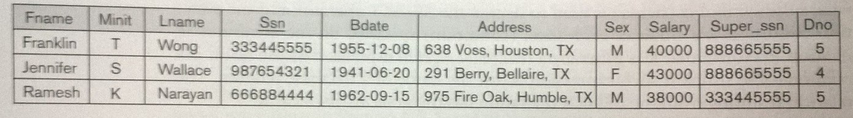
Operations of Relational Algebra
The SELECT Operation;
i.e. Select the EMPLOYEE tuples who either work for department 4 and make over $25000 per year, or work in department 5 and make over $30000.
σ(Dno=4 AND Salary>25000) OR (Dno=5 AND Salary>30000)(EMPLOYEE)

Slide 65
Operations of Relational Algebra
The SELECT Operation;
Boolean conditions;
(cond1 AND cond2) is TRUE is both (cond1) and (cond2) are TRUE; otherwise, it is FALSE.
(cond1 OR cond2) is TRUE is either (cond1) or (cond2) or both are TRUE; otherwise, it is FALSE.
(NOT cond) is TRUE if cond is FALSE; otherwise, it is FALSE
SELECT operation is commutative
σ_{<cond1>}(σ_{<cond2>}(R)) = σ_{<cond2>}(σ_{<cond1>}(R))
SELECT operation is conjunctive
σ_{<cond1>}(σ_{<cond2>}(…(σ_{<cond2>}(R)))) = σ<cond1>AND<cond2>AND…..AND<condn>(R)

Slide 66
Operations of Relational Algebra
The PROJECT Operation;
Vertical partition,
Selects certain columns from the table and discards the other columns .
π_{<attribute list>}(R)
i.e. List each employee’s first and last name and salary.
π_{Lname,} _{Fname, Salary}(EMPLOYEE)
π_{<list1>}(π_{<list2>}( R)) = π_{<list1>}(R)
as long as <list2> contains the attributes in <list1>; otherwise the left-hand side is an incorrect expression.

Slide 67
Operations of Relational Algebra
Sequences of Operations
i.e. Retrieve the first name, last name, and salary of all employees who work in department number 4.
π_{Lname,} _{Fname, Salary}(σ_{Dno=4}(EMPLOYEE))
or
DEP4_EMPS←σ_{Dno=4}(EMPLOYEE)
RESULT ←π_{Lname,} _{Fname, Salary}(DEP4_EMPS)

Slide 68
Operations of Relational Algebra
The RENAME Operation;
ρ_{S(B1, B2, …, Bn)}(R) – rename both relation and its attributes
ρ_{S}(R) – rename the relation only.
ρ_{(B1, B2, …, Bn)}(R) – rename the attributes only.
Example;
TEMP←σ_{Dno=4}(EMPLOYEE)
RESULT← ρ(Last_name, First_name, Salary)( π_{Lname,} _{Fname, Salary}(TEMP))

Slide 69
Operations of Relational Algebra
UNION, INTERSECTION and MINUS Operations
Any of these three operations are applied must have the same type of tuples.
R(A₁, A₂, …, A_{n}) and S(B₁, B₂, …,B_{n}) are union compatible if they have the same degree n and if dom(A_{i}) = dom(B_{i}) for 1≤i≤n.

Slide 70
Operations of Relational Algebra
UNION, INTERSECTION and MINUS Operations
UNION: R U S includes all tuples that are either in R or in S or in both.
INTERSECT: R ∩ S includes all tuples that are in both R and S.
MINUS: R – S all tuples that are in R but not in S.
UNION and INTERSECT are commutative operations
R U S = S U R and R ∩ S = S ∩ R
UNION and INTERSECT are associative operations
R U (S U T) = (R U S) U T and R ∩ (S ∩ T) = (R ∩ S) ∩ T
MINUS is not commutative operation.
R – S ≠ S − R

Slide 71
Operations of Relational Algebra
The CARTESIAN PRODUCT
R(A₁, A₂, …, A_{n}) X S(B₁, B₂, …,B_{m}) is a relation Q with degree n+m attributes Q(A₁, A₂, …, A_{n}, B₁, B₂, …,B_{m})

Slide 72
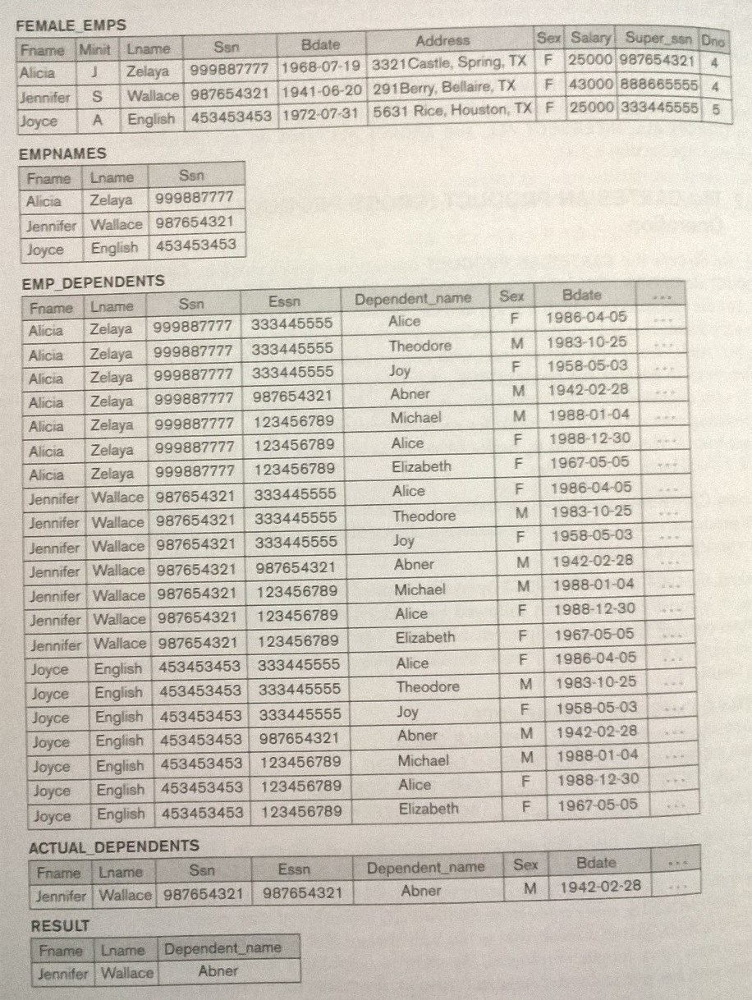
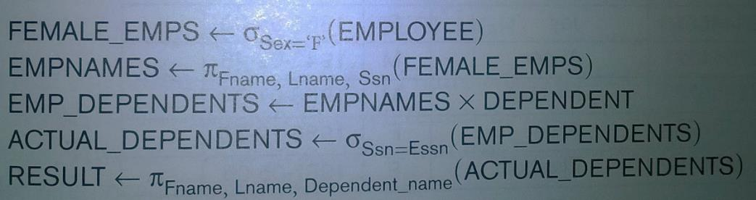
Operations of Relational Algebra
The CARTESIAN PRODUCT
Retrieve a list of names of each female employee’s dependents.

Slide 73
Operations of Relational Algebra
The JOIN Operation
Used to combine related tuples from two relations into single longer tuples.
A general form of a JOIN operation on two relations R(A₁, A₂, …, A_{n}) and S(B₁, B₂, …,B_{m}) is
R ⋈_{<join condition>}S
DEPT_MGR←DEPARTMENT⋈_{Mgr_ssn=Ssn}EMPLOYEE
RESULT ←π_{Dname, Lname,} _{Fname}(DEPT_MGR)

Slide 74
Operations of Relational Algebra
Difference Between CARTESIAN PRODUCT and JOIN
In JOIN, only combination of tuples satisfying the join condition appear in the result.
In CARTESIAN PRODUCT, all combination of tuples are included in the result.
EMP_DEPENDENTS ← EMPNAMES X DEPENDENT
ACTUAL_DEPENDENTS ← σ_{Ssn=Essn}(EMP_DEPENDENTS)
ACTUAL_DEPENDENTS ← EMPNAMES ⋈ _{Ssn=Essn}(EMP_DEPENDENTS)

Slide 75
Operations of Relational Algebra
THETA JOIN:
Produces all combinations of tuples from R1 and R2 that satisfy the join condition.
EQUIJOIN:
Produces all the combinations of tuples from R1 and R2 that satisfy a join condition with only equality comparisons.
NATURAL JOIN:
If the join attributes have the same names, they do not have to be specified at all.

Slide 76
A complete set of relational algebra operations
The set of relational algebra operations {σ, π, U, ρ, −, x} is a complete set;
means that any of the relational algebra operations can be expressed as a sequence of operations from this set.
R ∩ S ≡ (R U S) − ((R − S) U (S − R))
R ⋈_{<condition>}S ≡ σ _{<condition>}(R x S)

Slide 77
Query Tree
For every project located in ‘Stafford’, list the project number, the controlling department number, and department manager’s last name, address and birth date.
S₁ ← σ_{Plocation=‘Stafford’}PROJECT
S₂ ← S₁ ⋈_{Dnum=Dnumber}DEPARTMENT
S₃ ← S₂ ⋈_{Mgr_ssn=Ssn}EMPLOYEE
RESULT ← πPnumber,Dnum, Lname, Address, Bdate(S₃)
πP.Pnumber,P.Dnum, E.Lname, E.Address, E.Bdate
⋈_{D.Mgr_ssn=E.Ssn}
⋈_{P.Dnum=D.Dnumber}
E
EMPLOYEE
D
DEPARTMENT
σ_{P.Plocation=‘Stafford’}
P
PROJECT

Slide 79
Examples of Queries in Relational Algebra
Query 1: Retrieve the name and address of all employees who work for the ‘Research’ department.
RESEARCH_DEPT ← σ_{Dname=‘Research’} (EMPLOYEE)
RESEARCH_EMPS← RESEARCH_DEPT ⋈_{Dnumber=Dno}(EMPLOYEE)
RESULT ← π_{Fname,Lname, Address}(RESEARCH_EMPS)

Slide 80
2
⋈_{DEPARTMENT.Dnumber=EMPLOYE.Dno}
1
σ_{DEPARTMENT.Dname=‘Research’}
Query 1: Retrieve the name and address of all employees who work for the ‘Research’ department.

Slide 81
Examples of Queries in Relational Algebra
Query 2: For every project located in ‘Stafford’, list the project number, the controlling department number and the department manager’s last name, address and birth date.
STAFFORD_PROJS← σ_{Plocation=‘Stafford’} (PROJECT)
CONTR_DEPTS← STAFFORD_PROJS ⋈_{Dnum=Dnumber}(DEPARTMENT)
PROJ_DEPT_MGRS← CONTR_DEPTS ⋈_{Mgs_ssn=Ssn}(EMPLOYEE)
RESULT ← πPnumber, Dnum, Lname, Address, Bdate(PROJ_DEPT_MGRS)

Slide 82
3
2
Query 2: For every project located in ‘Stafford’, list the project number, the controlling department number and the department manager’s last name, address and birth date.
1
σ_{Plocation=‘Stafford’} (PROJECT)

Slide 83
Examples of Queries in Relational Algebra
Query 3: List the names of managers who have at least one dependent.
MGRS(Ssn)← π_{Mgr_ssn}(DEPARTMENT)
EMPS_WITH_DEPS(Ssn)← π_{Essn}(DEPENDENT)
MGRS_WITH_DEPS←MGRS ∩ EMPS_WITH_DEPS
RESULT← π_{Lname,Fname}(MGRS_WITH_DEPS)

Slide 84
4
3
Intersection
1
Query 3: List the names of managers who have at least one dependent.
2

Slide 85
Next week…
Entity-Relationship Diagrams.
SQL tutorial
SQL Applications

