Slide 1

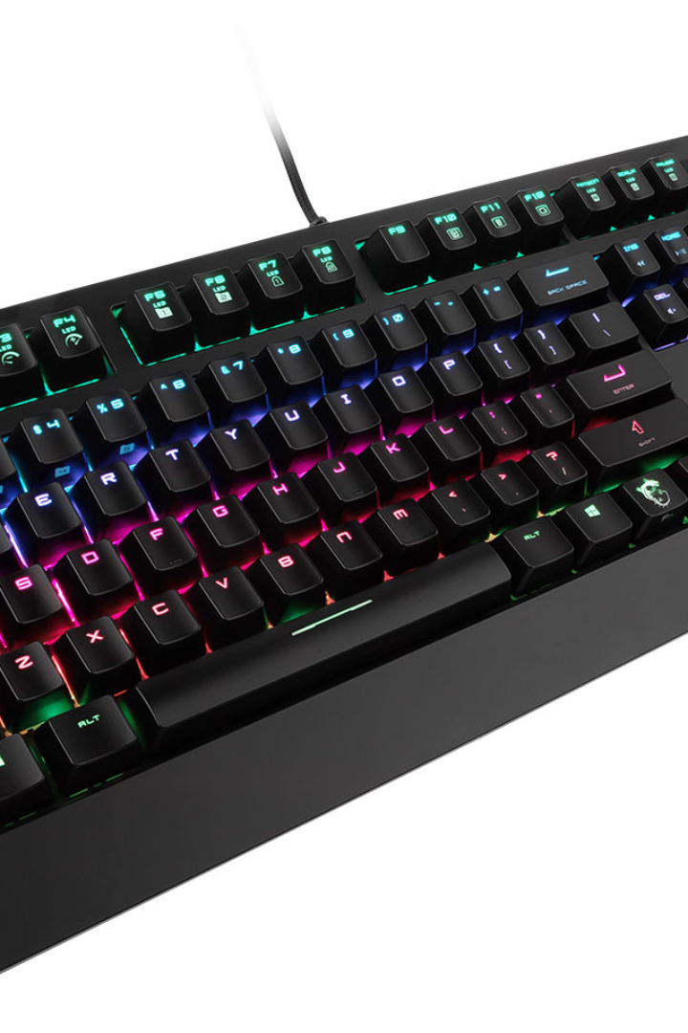
Typing Speed Test Using Python
The typing speed test project aims to enhance individual's keyboard proficiency by providing a platform to measure and improve typing speed and accuracy. It fosters efficient communication and productivity in the digital age, emphasizing the importance of fast and precise typing skills for various professional and personal endeavors.

Slide 2

Introduction
Welcome to the Typing Speed Test Project! In this digital era, efficient typing is vital for productivity. Our project offers a user-friendly platform to assess and enhance typing speed and accuracy. Whether for work or personal use, sharpen your keyboard skills here for improved communication and heightened efficiency.

Slide 3

Typing Speed Test
1
Overview
The Typing Speed Test Project is a user-friendly platform designed to evaluate and improve typing proficiency. Assess your speed and accuracy to enhance productivity in both professional and personal digital communication settings.
2
Components
It includes user interface, typing algorithms, performance analytics, and diverse exercises, fostering continual improvement in typing speed and accuracy.
3
Methodology
Utilizing algorithmic typing assessments, the methodology measures speed and accuracy, tailors exercises, and provides real-time feedback, optimizing user proficiency.

Slide 4
Software and Hardware Requirements
Software
Hardware
To develop a typing speed test using Python, we will need Windows 7 or more, Python 3.x, Visual Studio.
To develop a typing speed test using python, we will need minimum RAM- 4GB, minimum ROM-256GB, Keyboard for input and display for output result.

Slide 5


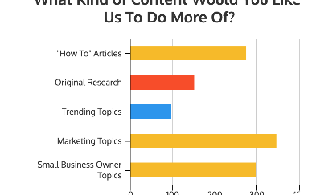
Features of the Python Program
User Interface Design
Timing and Accuracy Calculation
Display of Results
Utilize Pygame's graphics and event handling to create an engaging interface, enhancing the user experience and visual appeal for presentations.
Present comprehensive typing results post-test completion. Showcase metrics like words per minute (WPM), accuracy percentage, and completion time, offering users valuable insights into their typing proficiency and progress.
Record the time it takes to complete a test and evaluate accuracy by comparing user input to the expected result, providing insightful performance metrics.

Slide 6

Benefits of Typing Speed Test
1
Enhancing Typing Skills
2
Improving Productivity
3
Assessing Progress and Setting Goals
Elevate typing proficiency through systematic typing speed tests. Track progress, identify weaknesses, and improve speed and accuracy with targeted exercises and feedback.
Enhance keyboard efficiency, reduce task completion times, and boost overall work output through consistent practice and improvement.
Evaluate progress, set achievable goals, and enhance typing skills with the typing speed test. Track advancements for continuous improvement and increased efficiency.

Slide 7

Future Scope of the Typing Test
1
Artificial Intelligence Integration
Explore the future of typing speed tests with AI integration, enabling personalized feedback and adaptive learning.
2
Multi-language Support
Discover how typing speed tests can expand their offerings by incorporating support for multiple languages.
3
Interactive Training Modules
Learn about the potential to develop interactive training modules to enhance typing skills through gamification.

Slide 8
Conclusion
Incorporate the Typing Speed Test project to foster efficient communication and productivity. Utilize Pygame for an interactive UI, assess progress through timing and accuracy calculations, and present detailed results. Elevate typing skills systematically, promoting productivity by setting and achieving goals. This comprehensive approach ensures continual improvement, making the project an invaluable tool for enhancing digital communication proficiency.

