Slide 1
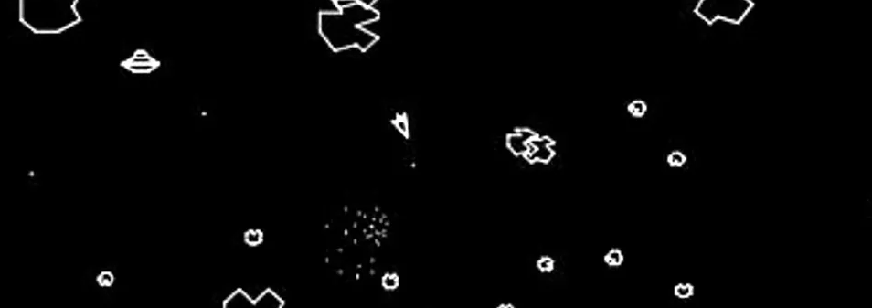
RETRO-STYLED PLANETARY EXPLORER GAME CONCEPT
By Khaan

Slide 2
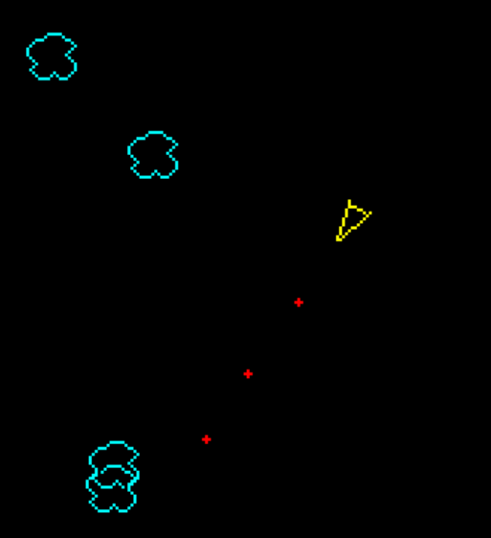
MY IDEA
I want to make an interactive game built with p5.js that’s themed around Space and Space Exploration.
The gameplay will be inspired by the old game Asteroids; 2D Top-down space-vehicle shooter.
It will feature a crude replica of our solar system as the playable space.
You will shoot through enemies, navigating across each planet, until you reach the end.

Slide 3
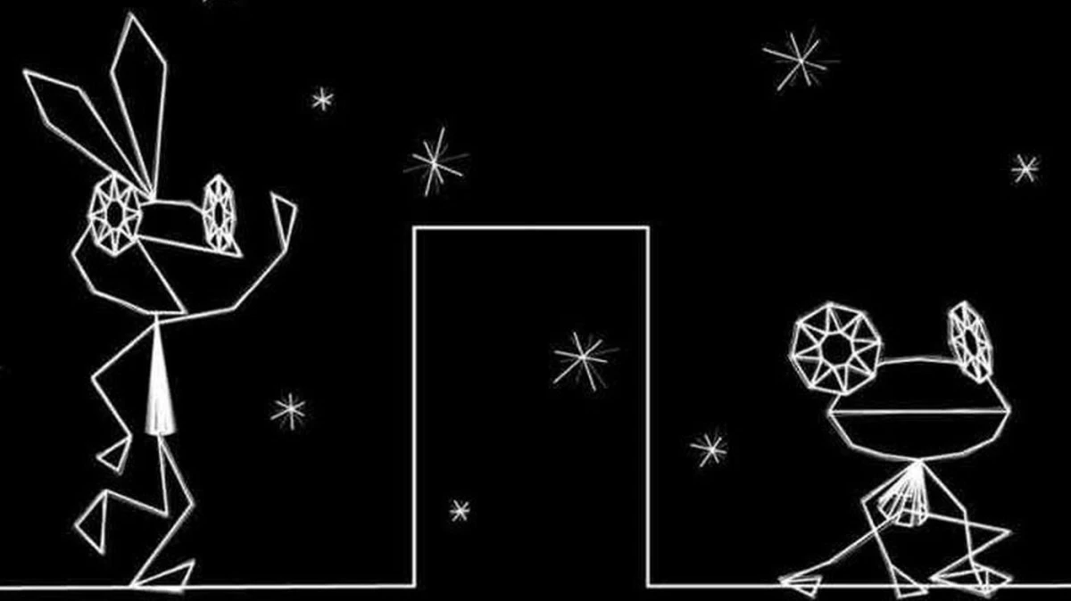
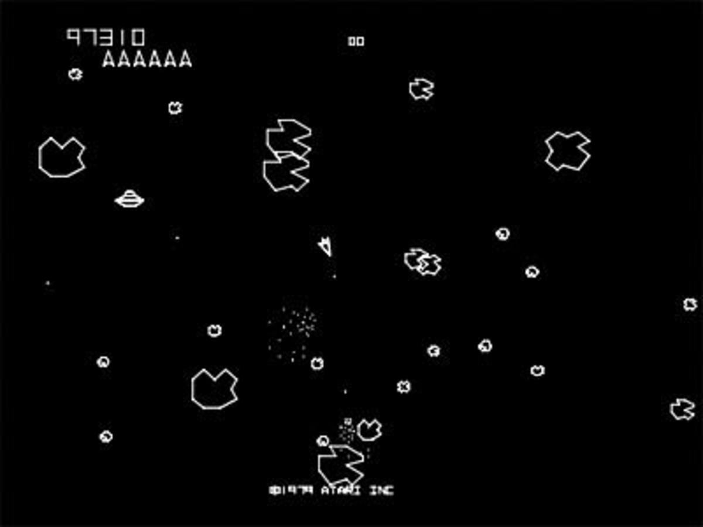
AESTHETIC INSPIRATION
Primarily, Vector Graphics.
Vib-ribbon (PS1)
Asteroids (Atari)

Slide 4
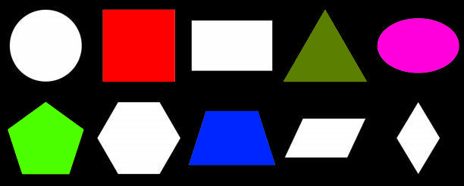
AESTHETIC INSPIRATION
For the planets, crude shapes. These will be filled-in with colour; mostly circles.
(yes, these are planets)

Slide 5
VERY CRUDE EXAMPLE (p5js)

