Slide 1
Machine Learning-Based Prediction of Method Renaming Refactorings in Python Projects
PROJECT TOPIC
Group 4
Raj Panchal · Johnson Amoah
Thompson Rivers University

Slide 2
What We Will Do
1. Collect
2. Learn
Use the 183 validated Python renames, plus ordinary methods that were not renamed.
Pick clues from the code and the change, then train a model.
3. Compare
4. Test
Check the model against a simple baseline.
Test it on PyRef Rename Method examples, kept apart from training.
Scope: Python only, Rename Method only. We predict that a rename happens, not the new name.

Slide 3
Datasets
Training: Validated Python Renames
Testing: PyRef
From the ICSE 2022 study of Python ML projects. 190 detected cases were checked by hand, and 183 were confirmed as real Rename Method refactorings.
139
Found with a Python version of RefactoringMiner, not PyRef.
Rename Method examples. Open source on GitHub, and the first dataset of refactorings in Python.

Slide 4
How We Use the Data
Training: validated renames
Testing: PyRef
183 confirmed Python renames from the ICSE 2022 dataset.
The 139 Rename Method examples are used only to test.
Not-renamed methods
Watch out
The training set has none. We will pick ordinary methods from the same projects and check them.
Only 183 examples, all from Python ML projects. Check for overlap with PyRef data.
Extra data option: ActRef, 1,914 validated Python refactorings, once overlap with PyRef is removed.

Slide 5
Project Progress
Done
In progress
Next
Scope fixed: Python, Rename Method only
Two key papers reviewed
Training data found and loaded: 190 detected renames
Python loading script working
Check which 183 of the 190 were confirmed by hand
Download the PyRef test file
Get the method code before and after each rename
Build the not-renamed methods
Remove overlap with PyRef
Train baseline, Random Forest and LightGBM
Test on PyRef: precision, recall, F1
The study reports 183 of the 190 detected cases as confirmed. We are finding which 7 were rejected.

Slide 6
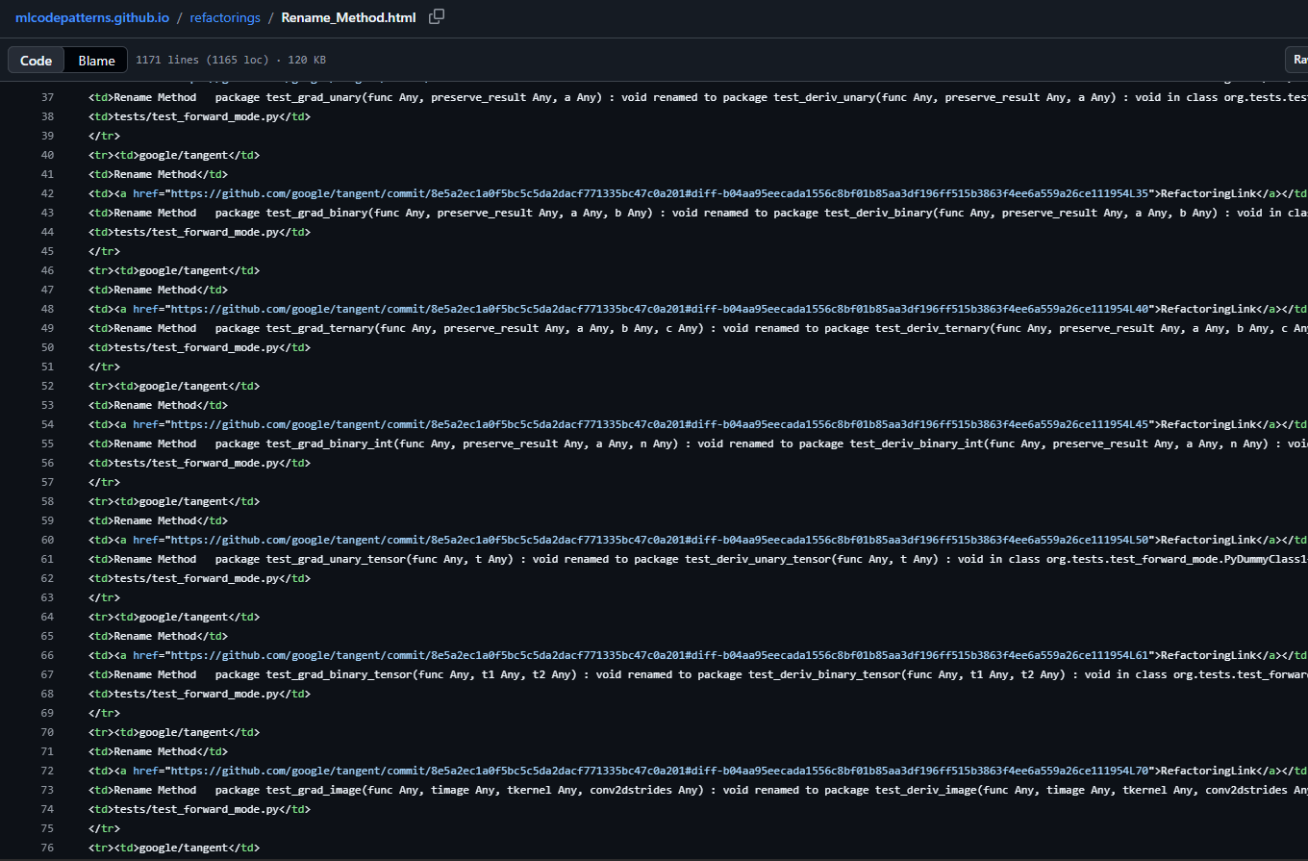
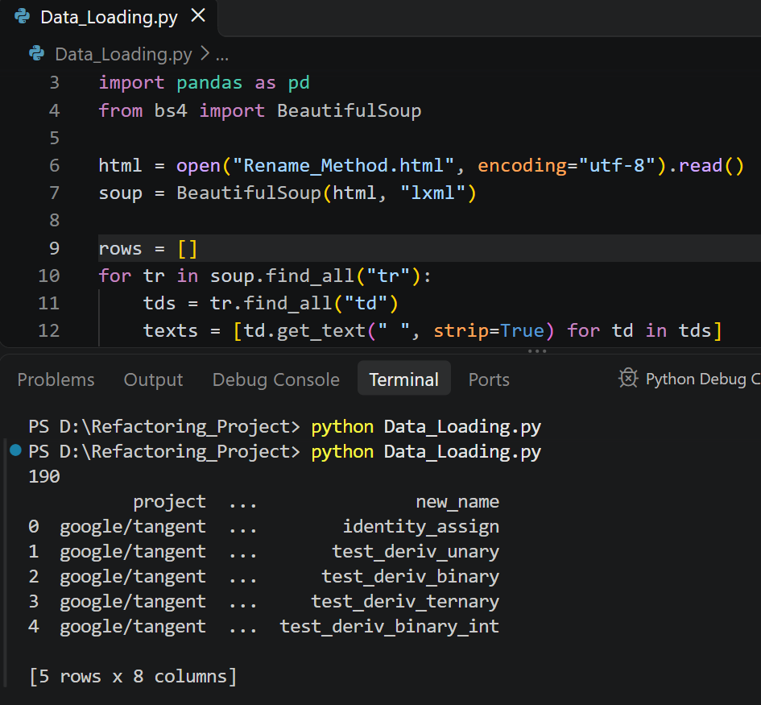
Training Data Loaded
Source: Rename_Method.html, ICSE 2022 GitHub repository
Loaded in Python with pandas: 190 rows

Slide 7
Models and Tools
1. Baseline
2. Random Forest
3. LightGBM
Majority-class guess, then Logistic Regression. The yardstick to beat.
Main model. Learns from clues in the code and the change.
Extra comparison. Best classifier in the related MLRefScanner paper.
Tools
How we judge
Python, Git, pandas, scikit-learn, LightGBM, matplotlib
Precision, recall and F1 on the PyRef test examples.

Slide 8
PyRef: Refactoring Detection in Python Projects
PAPER 1
Atwi, Lin, Tsantalis, Kashiwa, Kamei, Ubayashi, Bavota, Lanza · IEEE SCAM 2021
What it does
Results
Why it matters
A tool that finds mainly method-level refactorings in Python commit history.
89.6% precision and 76.1% recall, checked on three real Python projects.
We use its dataset to test our model.

Slide 9
Detecting Refactoring Commits in Machine Learning Python Projects: A Machine Learning-Based Approach
PAPER 2 (RELATED WORK)
Authors: Shayan Noei, Heng Li, Ying Zou
Published: ACM Transactions on Software Engineering and Methodology, 2024 (DOI 10.1145/3705309). Preprint on arXiv: 2404.06572
What it does
Results
Link to us
MLRefScanner is an ML tool that spots commits containing refactorings. Its best classifier is LightGBM.
94% precision, 82% recall and 89% AUC, tested on 199 open-source ML projects.
Shows ML can work on Python refactoring. Ours is narrower: method renames only.

Slide 10
Benefits and Implementation
Benefits
Possible use
Shows if ML can spot method renames
Shows how it performs on real PyRef examples
A starting point for later Python refactoring studies
Warn reviewers about methods likely to change
Help maintainers plan clean-up work
Extend to other refactoring types later

Slide 11
Thank You
Questions?
Group 4 · Raj Panchal · Johnson Amoah

