Slide 1
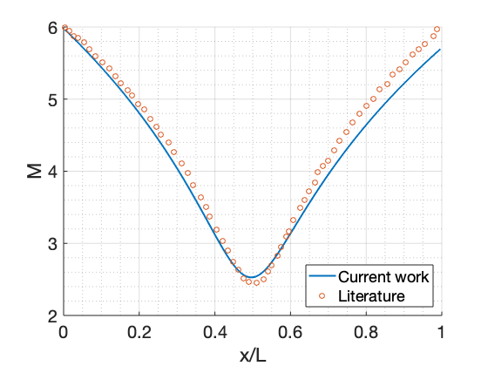
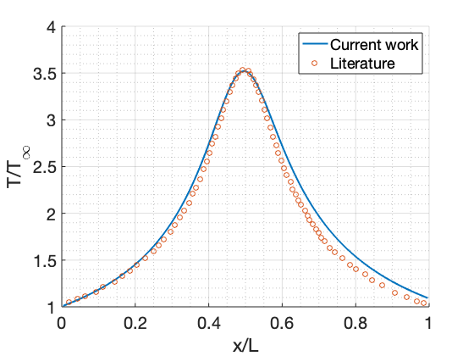




Compressible Chemically Reacting Flows S. Mukherjee, S. Sarode, Z. Mistry
Proposed Project Objectives/Goals:
Solve steady state behavior of compressible chemically reacting flows by integrating mass, momentum, energy and species conservation equations.
Project’s Key Idea/Takeaway:
Investigate acceleration techniques (time scaling) on steady state characteristics of the above system of stiff equations.
Stiffness is introduced primarily by source term of species conservation equation.
Research Methodology/ Key Graphics:
$$\frac{∂U}{∂t}=−\frac{∂F}{∂x}−H$$
$$U= \left[\begin{matrix}ρA \\ ρuA \\ \begin{matrix}ρEA \\ ρY_{k}A\end{matrix}\end{matrix}\right]$$
$F= \left[\begin{matrix}ρuA \\ ρu^{2}A+pA \\ \begin{matrix}ρHuA \\ ρY_{k}uA\end{matrix}\end{matrix}\right]$
$H= \left[\begin{matrix}0 \\ −p\frac{dA}{dx} \\ \begin{matrix}0 \\ {Aw}_{k}\end{matrix}\end{matrix}\right]$
U: Temporal discretization, F: Spatial discretization, H: Source
Each line corresponds to each of the governing equations
First we try to implement a inviscid flow model without reaction,
then try to add reacting effects and viscous effects.
Preliminary Results/ Progress:
Results for non-reacting inviscid flow model:
Reacting flow inviscid model implementation blowing up.
Remaining tasks:
1D Reacting Inviscid Flow implementation debugging
1D Reacting Viscous Flow solver
Extend model to 2-D if possible

