Slide 1
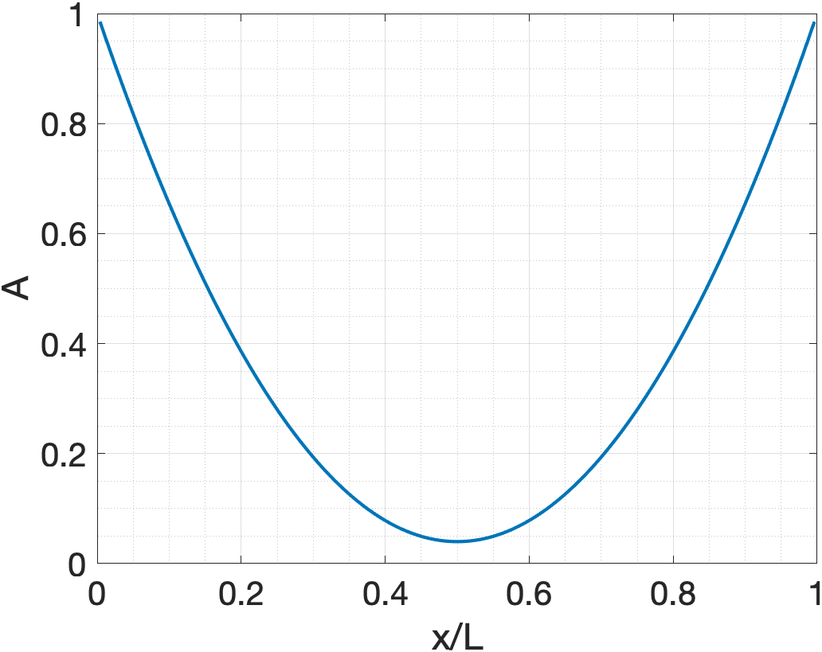
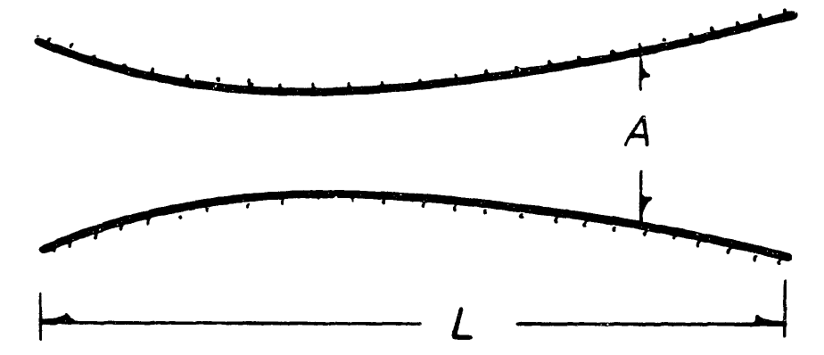
Chemically Reacting Compressible Flows
Eg. Oxygen dissociation, Hydrogen combustion
Representative Geometry (1D)
Geometry

Slide 2
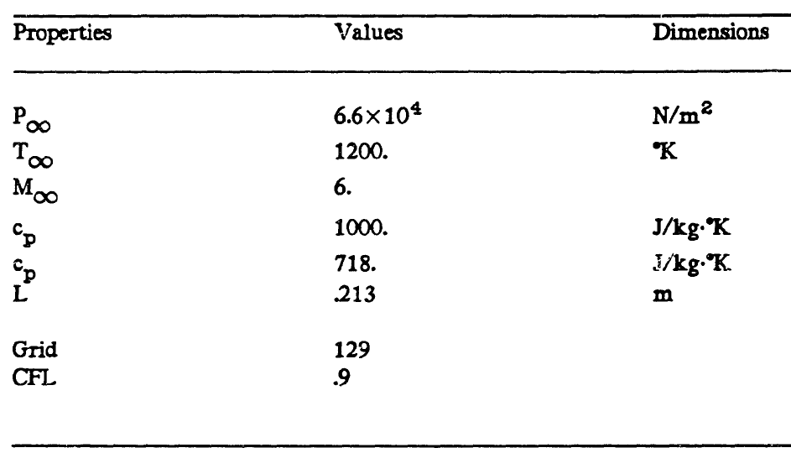
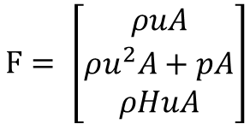

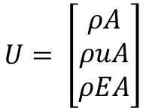





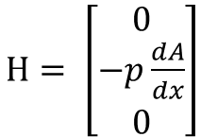
Problem 1: 1D Euler Flow
1. Mass conservation
$$\frac{∂ρ}{∂t}+∇∙\left(ρu\right)=0$$
$$\frac{∂U}{∂t}=−\frac{∂F}{∂x}−H$$
$$U= \left[\begin{matrix}ρA \\ ρuA \\ ρEA\end{matrix}\right]$$
$F= \left[\begin{matrix}ρuA \\ ρu^{2}A+pA \\ ρHuA\end{matrix}\right]$
$H= \left[\begin{matrix}0 \\ −p\frac{dA}{dx} \\ 0\end{matrix}\right]$
2. Momentum conservation
$$\frac{∂\left(ρV\right)}{∂t}+∇∙\left(ρuu\right)+∇∙p=0$$
3. Energy equation
$$\frac{∂\left(ρE\right)}{∂t}+∇∙\left(ρuE\right)+p∇∙u=0$$
4. Total energy
$$E=∫c_{v}dT+\frac{1}{2}u^{2}$$
5. Equation of state
$$p=ρ\frac{R_{u}}{w}T$$

Slide 3
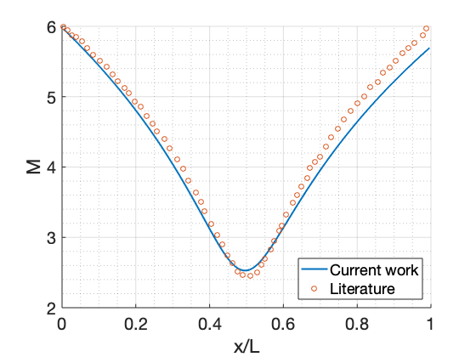
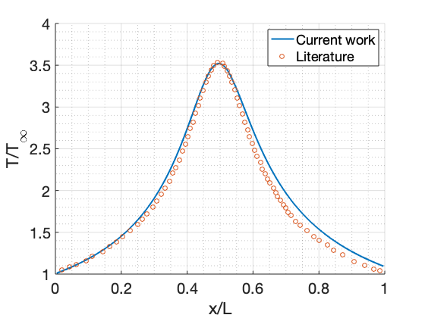
Problem 1: 1D Euler Flow
Mach number
Non-dimensional temperature

Slide 4
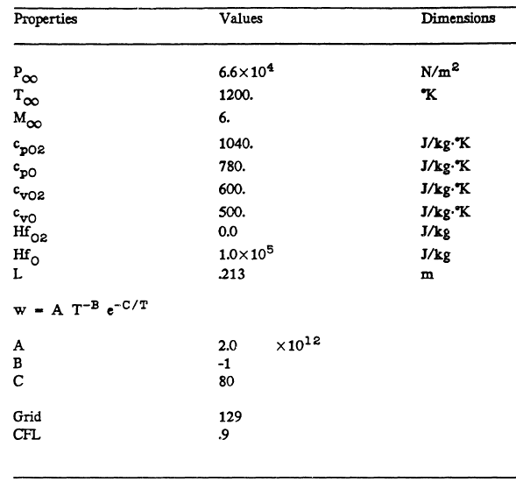



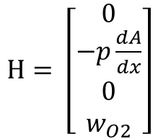

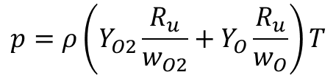
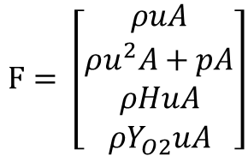


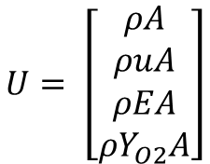


Problem 1: 1D Euler Flow - Reacting
1. Mass conservation
$$0$$
$$\frac{∂ρ}{∂t}+∇∙\left(ρu\right)=0$$
$$k_{f}=AT^{−B}e^{−\frac{C}{T}}$$
$$U= \left[\begin{matrix}ρA \\ ρuA \\ \begin{matrix}ρEA \\ ρY_{O2}A\end{matrix}\end{matrix}\right]$$
$F= \left[\begin{matrix}ρuA \\ ρu^{2}A+pA \\ \begin{matrix}ρHuA \\ ρY_{O2}uA\end{matrix}\end{matrix}\right]$
$H= \left[\begin{matrix}0 \\ −p\frac{dA}{dx} \\ \begin{matrix}0 \\ w_{O2}\end{matrix}\end{matrix}\right]$
2. Momentum conservation
$$\frac{∂\left(ρV\right)}{∂t}+∇∙\left(ρuu\right)+∇∙p=0$$
3. Energy equation
Mass Generation Rate
$$\frac{∂\left(ρE\right)}{∂t}+∇∙\left(ρuE\right)+p∇∙u=0$$
$w_{O2}=k_{f}Y_{O2}$A
4. Species conservation
$$\frac{∂\left(ρY_{O2}\right)}{∂t}+∇∙\left(ρY_{O2}u\right)=w_{O2}$$
5. Total energy
$$E=∫c_{v}dT+\frac{1}{2}u^{2}$$
6. Equation of state
$$p=ρ\left(Y_{O2}\frac{R_{u}}{w_{O2}}+Y_{O}\frac{R_{u}}{w_{O}}\right)T$$

Slide 5
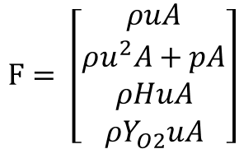
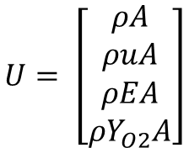
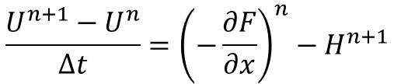
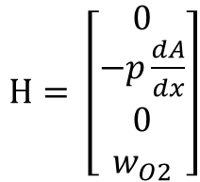
Problem 1: 1D Euler Flow - Reacting
Solution method
$$U= \left[\begin{matrix}ρA \\ ρuA \\ \begin{matrix}ρEA \\ ρY_{O2}A\end{matrix}\end{matrix}\right]$$
$F= \left[\begin{matrix}ρuA \\ ρu^{2}A+pA \\ \begin{matrix}ρHuA \\ ρY_{O2}uA\end{matrix}\end{matrix}\right]$
$H= \left[\begin{matrix}0 \\ −p\frac{dA}{dx} \\ \begin{matrix}0 \\ w_{O2}\end{matrix}\end{matrix}\right]$
Only mass generation source taken implicitly
$$\frac{U^{n+1}−U^{n}}{Δt}={\left(−\frac{∂F}{∂x}\right)}^{n}−H^{n+1}$$

Slide 6
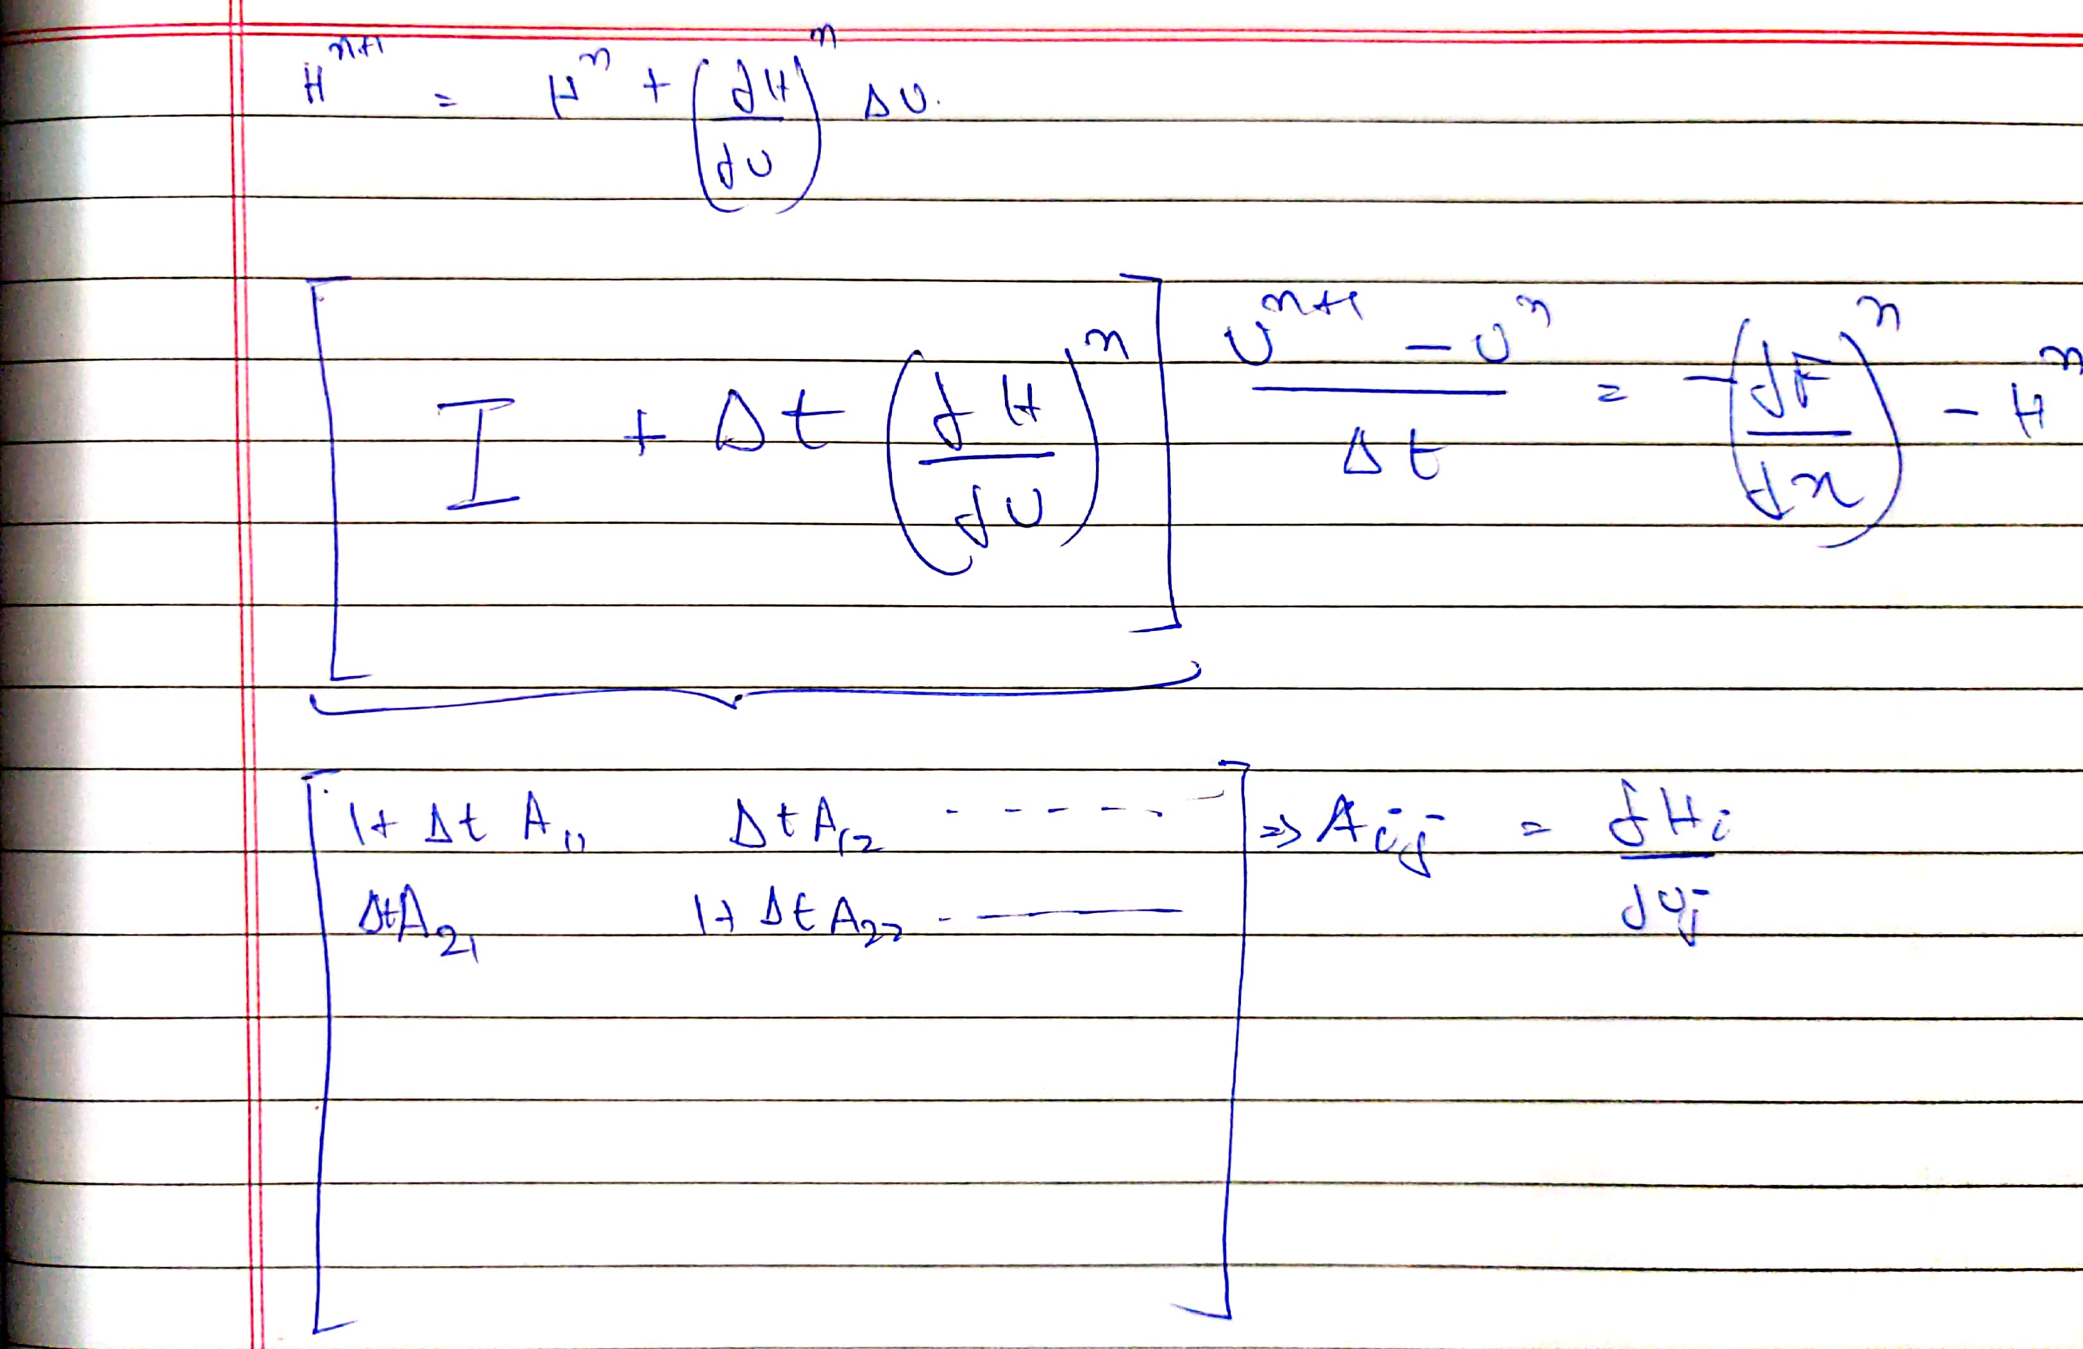
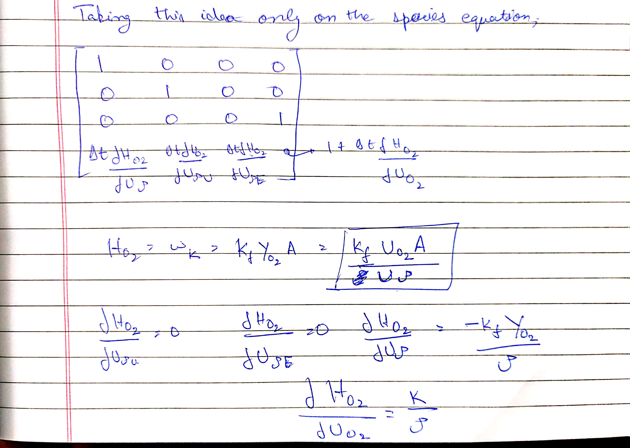
Problem 1: 1D Euler Flow - Reacting
Solution method
There might be certain problems with this methodology that make the entire time integration crash

