Slide 1
An Explainable AI Approach to ADHD and Gender Classification
Samia Rahman Misty
Registration No: 2400570
Course No: CE- 888
Presentation Demo : Zoom Link

Slide 2
Introduction
What is ADHD?
A neurodevelopmental disorder affecting attention, impulse control and activity levels.
How Dangerous is ADHD?
If untreated, can lead to academic, relationship issues, low self-esteem, and mental health risks.
How Deep Learning Helps
Analyzes complex data (e.g., fMRI, behavior) for accurate ADHD diagnosis.
Example: Deep learning achieved 70% accuracy in ADHD diagnosis using fMRI data¹.
1.Mao, Z., Su, Y., Xu, G., Wang, X., Huang, Y., Yue, W., ... & Xiong, N. (2019). Spatio-temporal deep learning method for adhd fmri classification. Information Sciences, 499, 1-11.

Slide 3
Dataset
GENDER
401
ADHD
157
Non-ADHD
174
ADHD
65.72%
Male
117
Non-ADHD
34.28%
Female

Slide 4
Objective
Is it possible to build a model to predict both an individual’s sex and their ADHD diagnosis?
Is the model biased in its predictions or training data?
Can the model misdiagnose females due to bias?

Slide 5
Data Integrity and Optimization
Missing Data
Some data entries were missing during collection, which were carefully handled through appropriate data imputation techniques.
Data Format Standardization
Variations in data formats and types were observed during collection. for example, the Edinburgh Handedness Questionnaire was aligned with the standard format¹.
Feature Redundancy
fMRI Data Handling
In the Strength and Difficulties Questionnaire, the Total Difficulties Score, Externalizing Score, and Hyperactivity Scale were highly correlated. To avoid redundancy, only one of these was retained.
The fMRI brain imaging data was large and complex. It was processed using appropriate techniques to ensure efficiency and maintain data integrity.
1. https://www.brainmapping.org/shared/Edinburgh.php

Slide 6
Selected Models
01
02
03
Logistic Regression
CNN + MLP Hybrid Architecture
CNN + ANN Hybrid Architecture
Its simplicity reduces the risk of errors when working with limited data.
1.CNN is effective at finding patterns in numbers, especially when those numbers are arranged in a meaningful order, like images or signals.
2.MLP part is good at understanding group-based information, such as age, gender, or other categories.
1.CNNs are effective at recognizing patterns in data that have a natural order or structure, helping to make sense of complex numerical information.
2.ANNs offer a more flexible way to understand grouped or labeled information, like age or gender, compared to simpler models.

Slide 7
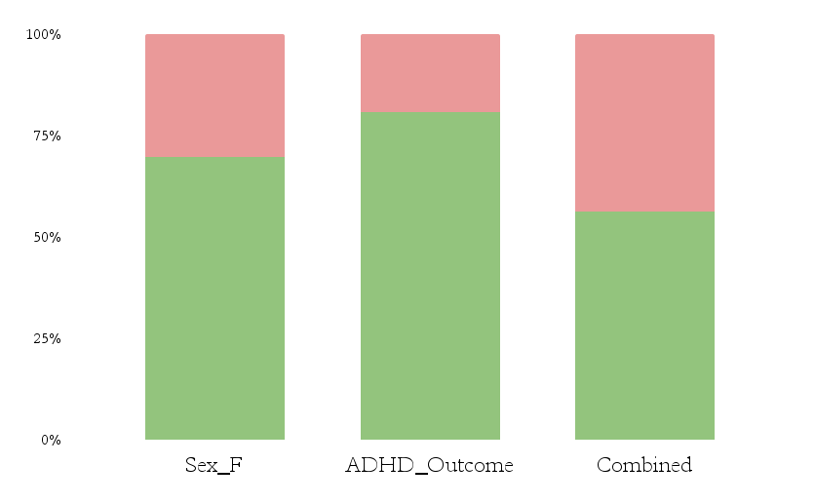
Logistic Regression Prediction
Male ADHD
Female ADHD
70
110
159
11.8%
88.3%
11.7%
88.2%
294
254
Male NonADHD
Female NonADHD
205
22.4%
44.1%
Correct vs Incorrect Predictions Per Label
77.6%
55.9%
Correct vs Incorrect Predictions Per Category
Correct Incorrect

Slide 8
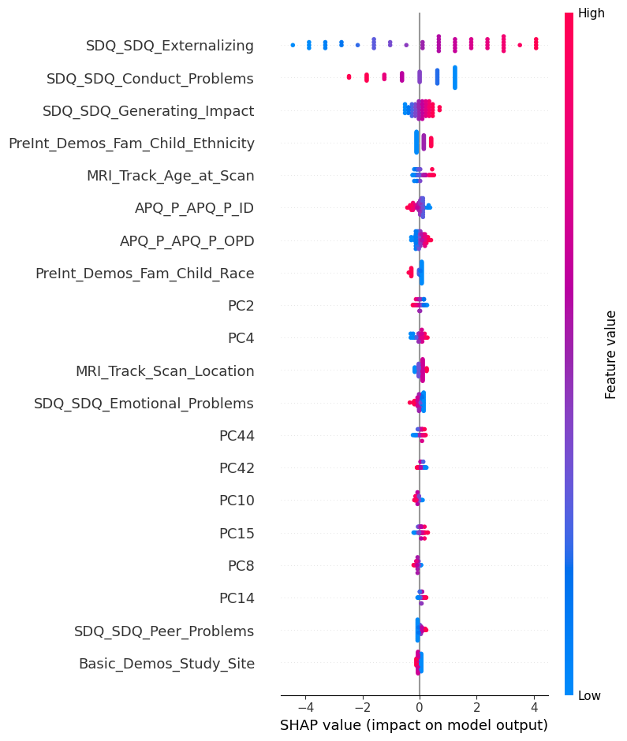
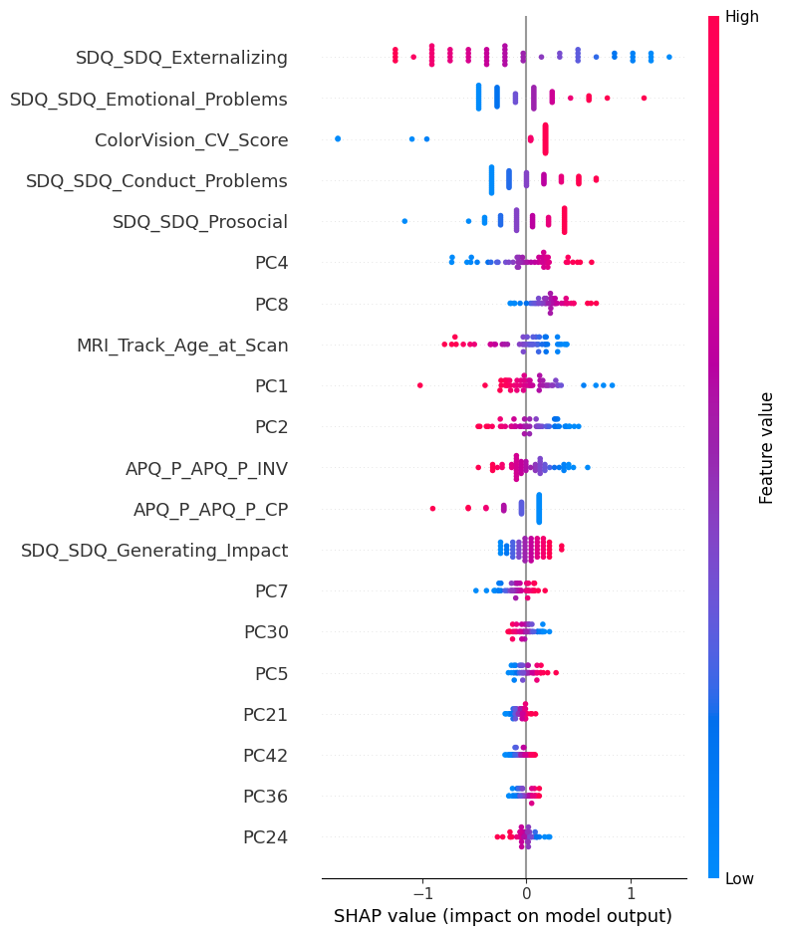
Logistic Regression SHAP Analysis
SHAP Analysis for Sex F
SHAP Analysis for ADHD Outcome

Slide 9
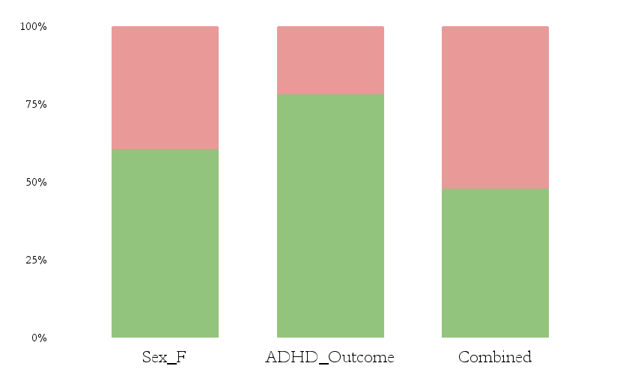
CNN + MLP Hybrid Architecture Prediction
Male ADHD
Female ADHD
79
143
43.4%
190
60.6%
39.4%
56.6%
285
Male NonADHD
Female NonADHD
221
174
44.9%
16.9%
Correct vs Incorrect Predictions Per Label
55.1%
83.1%
Correct vs Incorrect Predictions Per Category
Correct Incorrect

Slide 10
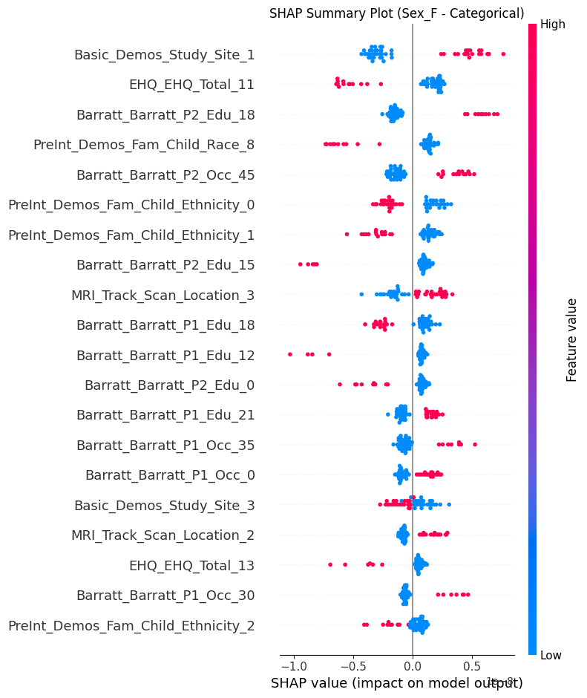
CNN + MLP Hybrid Architecture
SHAP Analysis
Study site, parental education & occupation, ethnicity, and scan location impact predictions the most.
Higher values in certain ethnicity and education features positively shift predictions, while others lower it, indicating varied demographic influence.
SHAP Analysis for Sex on Categorical Data

Slide 11
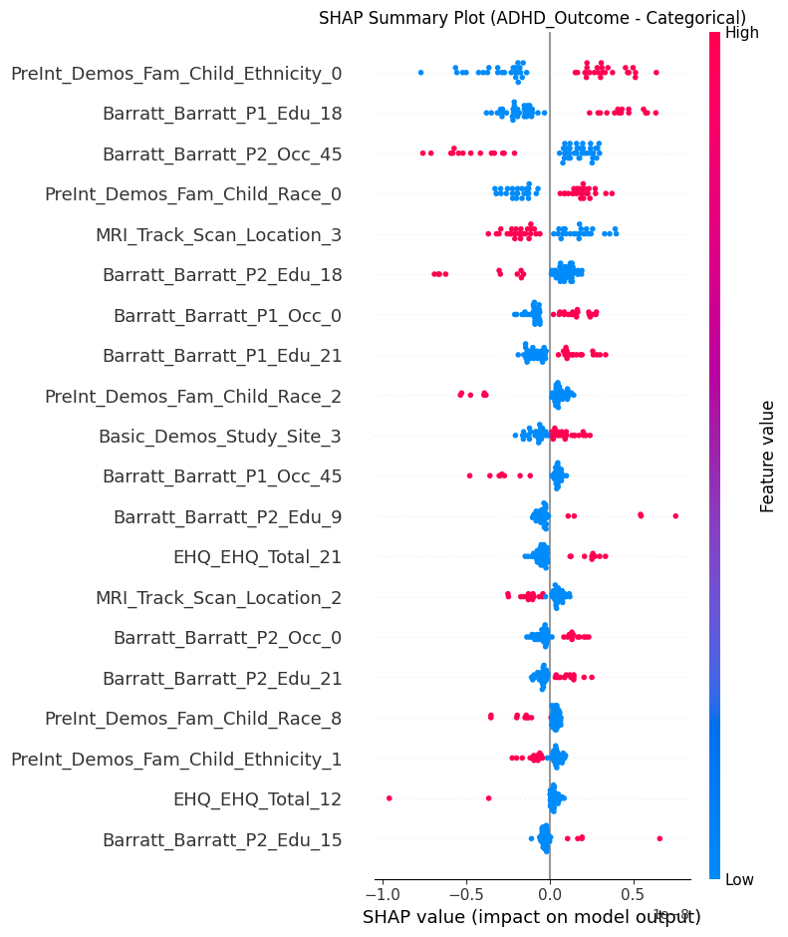
CNN + MLP Hybrid Architecture
SHAP Analysis
Top influential features include ethnicity (PreInt_Demos_Fam_Child_Ethnicity_0), parental education (Barratt_Barratt_P1_Edu_18) and occupation (Barratt_Barratt_P2_Occ_45).
MRI scan location contributes notably, suggesting site-specific effects in prediction.
Demographic variables show strong influence, indicating the model is sensitive to socio-demographic context.
SHAP Analysis for ADHD Outcome on Categorical Data

Slide 12
CNN + ANN Hybrid Architecture Prediction
Male ADHD
Female ADHD
79
127
34.2%
180
71.7%
28.3%
65.8%
285
Male NonADHD
Female NonADHD
237
184
30.6%
23.7%
69.4%
Correct vs Incorrect Predictions Per Label
76.3%
Correct vs Incorrect Predictions Per Category
Correct Incorrect

Slide 13
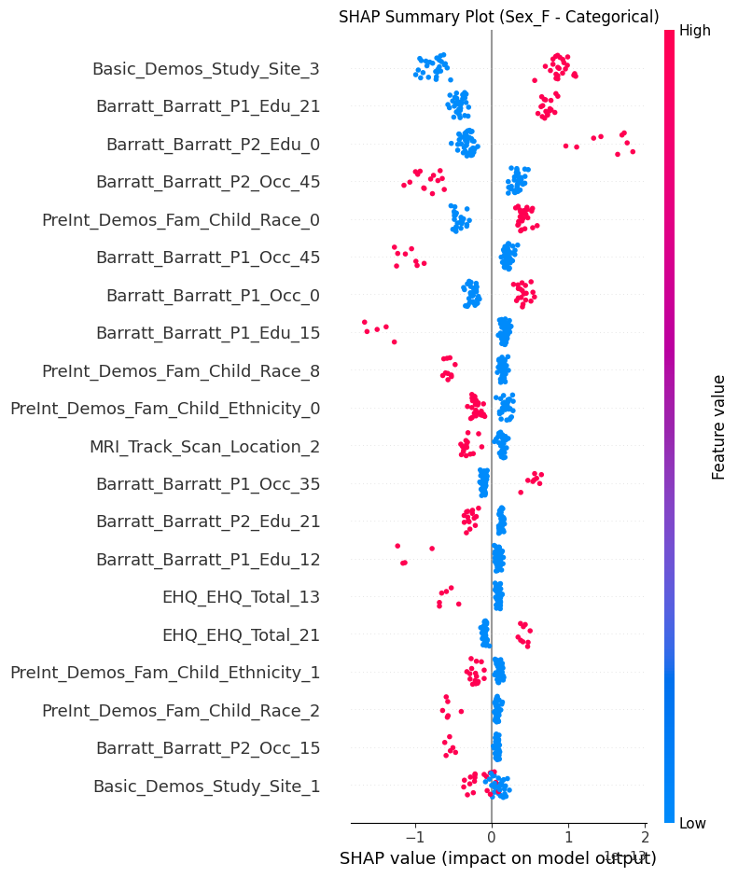
CNN + ANN Hybrid Architecture
SHAP Analysis
Study site and parental education are the most impactful categorical features for predicting female sex.
Ethnicity and race variables also play a notable role.
SHAP values closer to ±2 indicate stronger influence (either positive or negative) on the output.
SHAP Analysis for Sex on Categorical Data

Slide 14
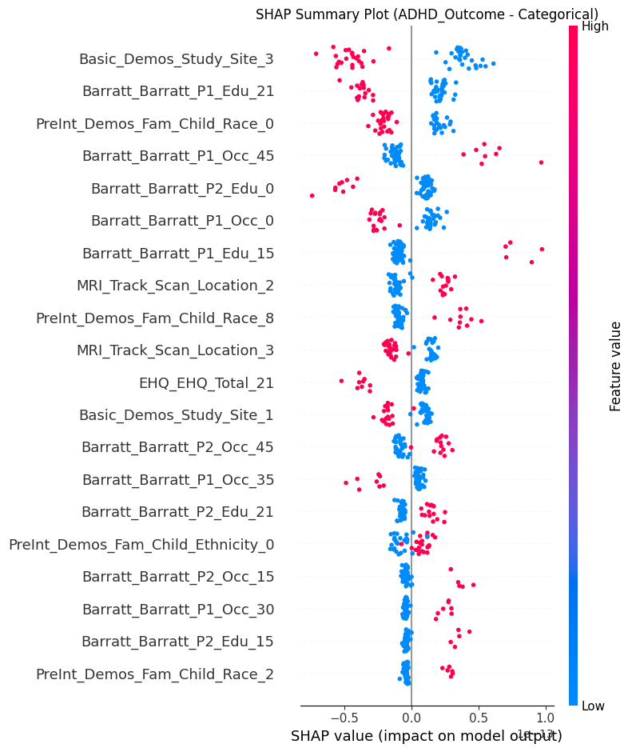
CNN + ANN Hybrid Architecture
SHAP Analysis
Study Site 3 is the most influential factor in predicting ADHD.
Parental education, especially having a graduate degree, strongly influences the model’s predictions.
The model heavily leans on socioeconomic, demographic, and site-related features to make ADHD predictions.
SHAP Analysis for ADHD Outcome on Categorical Data

Slide 15
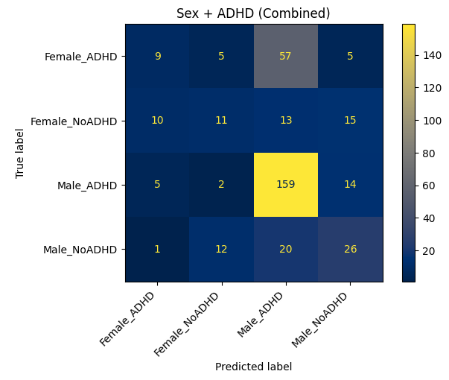
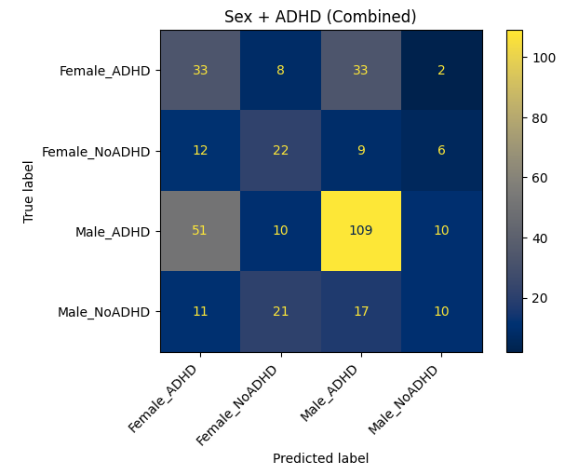
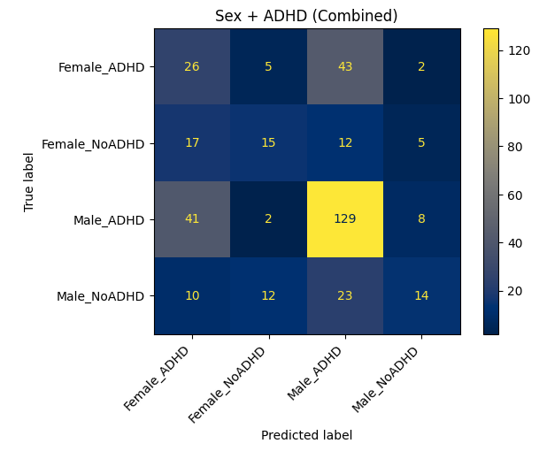
True vs. Predicted Labels: Model-Wise Breakdown
Confusion Matrix of Logistic Regression
Confusion Matrix of CNN + MLP Hybrid Architecture
Confusion Matrix of CNN + ANN Hybrid Architecture

Slide 16
Conclusions
01
02
03
Is the model suitable for the company’s needs and ready for deployment?
No, the model is not ready for deployment, as it fails to perform reliably across all classes.
Is the model showing any signs of bias, particularly gender-related?
Yes, the model shows gender related bias, frequently misclassifying female subjects.
Can insights from the data support future NHS projects beyond ADHD diagnosis?
Yes, the data insights can support future NHS projects, especially those involving behavioral patterns and gender disparities in diagnosis.

Slide 17
Future Work
Bias Mitigation through Demographic-Specific Modeling:
Large variation observed in parental education, occupation, and child’s race.
These factors may contribute to model bias or misclassification.
Train separate models for specific demographic groups (e.g., based on education and occupation levels).
Compare performance and bias metrics across groups.
Investigate if demographic-specific training improves fairness and accuracy.

Slide 18
Thank You!

