Slide 1
CSE4204 LAB-1 : Intro to WebGL
Mohammad Imrul Jubair

Slide 2
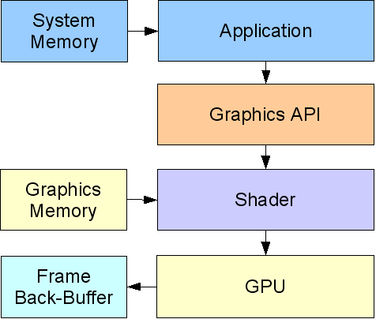
Graphics API
Example: OpenGL, WebGL, Direct3D, etc.
Source: https://ict.senecacollege.ca/~chris.szalwinski/archives/gam670.071/content/shadr_p.html

Slide 3
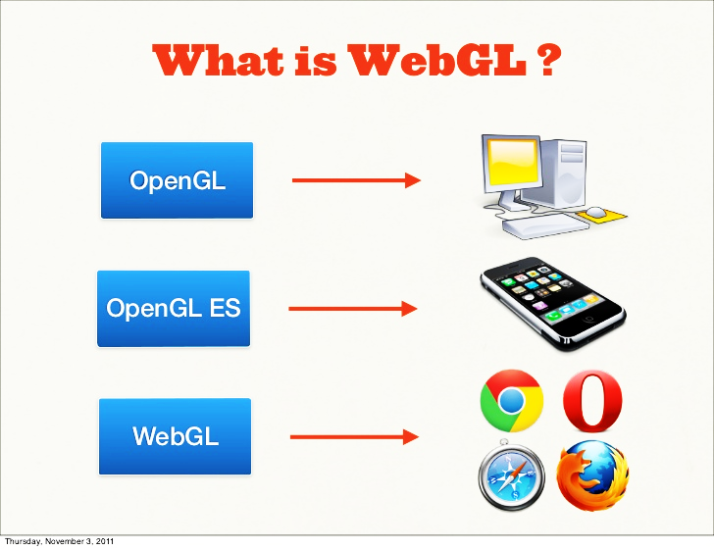
OpenGL
OpenGL and OpenGL ES
C/ C++
Source: https://ict.senecacollege.ca/~chris.szalwinski/archives/gam670.071/content/shadr_p.html

Slide 4
WebGL
a JavaScript interface for OpenGL-ES-2.x API, promoted by Khronos.
JavaScript
Source: https://ict.senecacollege.ca/~chris.szalwinski/archives/gam670.071/content/shadr_p.html

Slide 5
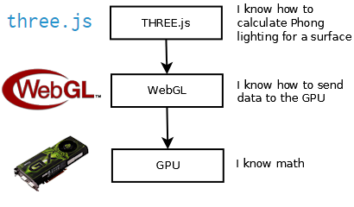
WebGL
Source: https://cglearn.codelight.eu/pub/computer-graphics/computer-graphics

Slide 6
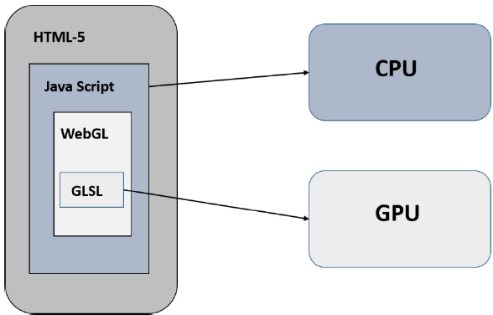
A WebGL Program
There are two sides to any WebGL program:
Part – 1: written in JavaScript
Part – 2: written in GLSL, a language for writing "shader" programs that run on the GPU.
Source: http://math.hws.edu/graphicsbook
Source: https://www.tutorialspoint.com/webgl/webgl_quick_guide.htm

Slide 7
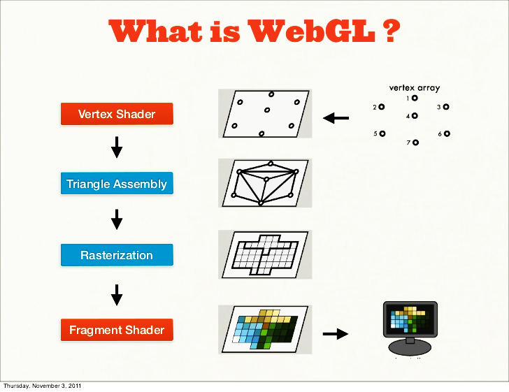
A Graphics Pipeline
Frame Buffer
Source: https://pt.slideshare.net/senchainc/webgl-fundamentals-10013633/12

Slide 8
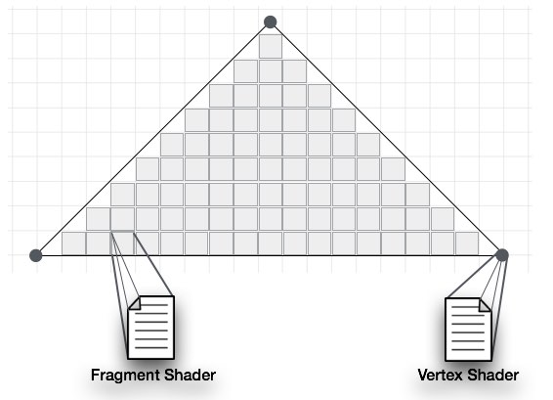
Shaders
Vertex Shader: Per-vertex
Fragment Shader: Per-fragment/ per-pixel
Source: https://www.tutorialspoint.com/webgl/webgl_quick_guide.htm

Slide 9
A Shader Program
References:
https://www.tutorialspoint.com/webgl/webgl_drawing_points.htm
http://math.hws.edu/graphicsbook/index.html

Slide 10
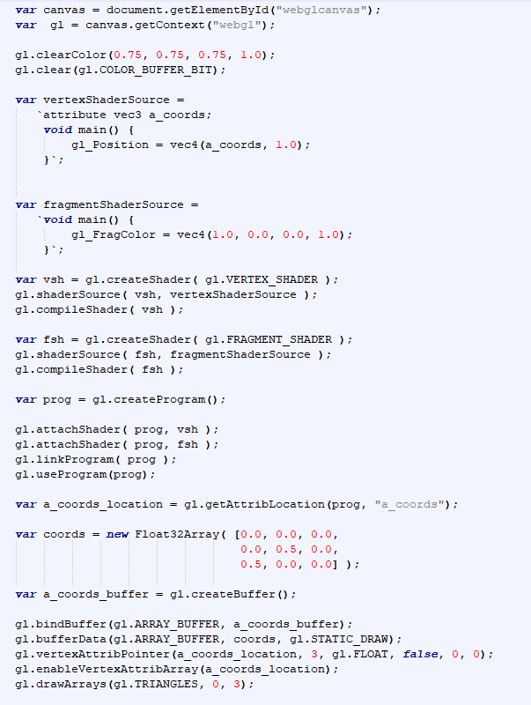
Steps*
Get the code: https://rb.gy/cpf3uo
Step 1 − Prepare the canvas and get WebGL rendering context
Step 2 − Create and compile Shader programs
Step 3 − Associate the shader programs with buffer objects
Step 4 − Define the geometry and store it in buffer objects
Step 5 − Drawing the required object
Modified from the source: https://www.tutorialspoint.com/webgl/webgl_drawing_points.htm
*Can be altered

Slide 11
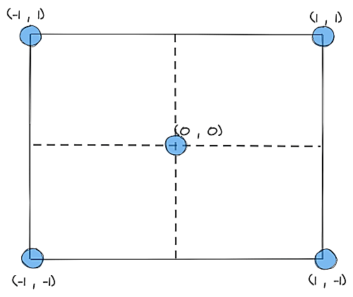
Step – 1: Canvas and WebGL rendering context
<canvas
id="webglcanvas" width="500" height="500">
</canvas>
var canvas = document.getElementById("webglcanvas");
var gl = canvas.getContext("webgl");
HTML-5 canvas
get the id of the current canvas

Slide 12

Step – 1: Background and reset buffer
gl.clearColor(0.75, 0.75, 0.75, 1.0);
gl.clear(gl.COLOR_BUFFER_BIT);

Slide 13
Step – 2: Vertex Shader
var vertexShaderSource =
`attribute vec3 a_coords;
void main() {
gl_Position = vec4(a_coords, 1.0);
}`;
vertices
Clipping

Slide 14
Step – 2: Vertex Shader
var vertexShaderSource =
`attribute vec3 a_coords;
void main() {
gl_Position = vec4(a_coords, 1.0);
}`;
Per-vertex

Slide 15
Step – 2: Fragment Shader
var fragmentShaderSource =
`void main() {
gl_FragColor = vec4(1.0, 0.0, 0.0, 1.0);
}`;
Colored pixels

Slide 16
Step – 2: Create and Compile Shaders
var vsh = gl.createShader( gl.VERTEX_SHADER );
gl.shaderSource( vsh, vertexShaderSource );
gl.compileShader( vsh );

Slide 17
Step – 2: Create and Compile Shaders
var fsh = gl.createShader( gl.FRAGMENT_SHADER );
gl.shaderSource( fsh, fragmentShaderSource );
gl.compileShader( fsh );

Slide 18
Step – 2: Link shaders and use program
var prog = gl.createProgram();
gl.attachShader( prog, vsh );
gl.attachShader( prog, fsh );
gl.linkProgram( prog );
gl.useProgram(prog);

Slide 19
Step – 3: Associate Shaders
var a_coords_location =
gl.getAttribLocation(prog, "a_coords");
attribute vec3 a_coords;
void main() { gl_Position = vec4(a_coords, 1.0);
}

Slide 20
Step – 4: Define Geometry
var coords = new Float32Array( [0.0, 0.0, 0.0, \\V0
0.0, 0.5, 0.0, \\V1
0.5, 0.0, 0.0] \\V2
);
V1
V0
V2

Slide 21
Step – 4: Vertex Buffer Objects (VBOs)
var a_coords_buffer = gl.createBuffer();
[0.0, 0.0, 0.0,
0.0, 0.5, 0.0,
0.5, 0.0, 0.0]
Attribute data
CPU
Vertex Buffer Object (VBO)
Memory accessible by GPU
attribute vec3 a_coords;
void main() { gl_Position = vec4(a_coords, 1.0);
}
GPU

Slide 22
Step – 4: Vertex Buffer Objects (VBOs)
gl.bindBuffer(gl.ARRAY_BUFFER, a_coords_buffer);
gl.bufferData(gl.ARRAY_BUFFER, coords, gl.STATIC_DRAW);
gl.vertexAttribPointer(a_coords_location, 3,
gl.FLOAT, false, 0, 0);
gl.enableVertexAttribArray(a_coords_location);
will be used for attribute
It specifies how the VBO will be used.
same data will be used
For 3D data (x,y,z)

Slide 23
Step – 5: Draw Required Objects
gl.drawArrays(gl.TRIANGLES, 0, 3);
primitives
Start vertex
Number of vertices
[0.0, 0.0, 0.0, → 0
0.0, 0.5, 0.0, → 1
0.5, 0.0, 0.0] → 3

Slide 24
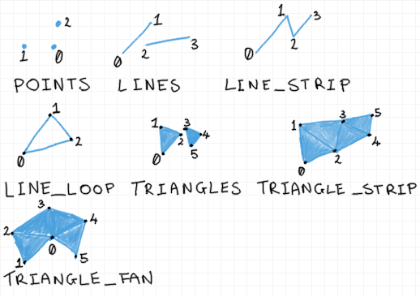
Primitives
gl.drawArrays(gl.TRIANGLES, 0, 3);
Source: https://antongerdelan.net/opengl/vertexbuffers.html

Slide 25
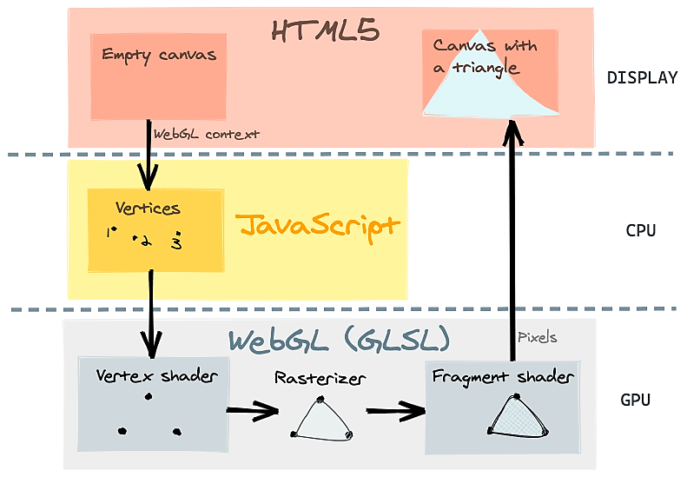
Full Code
Source: https://www.h5w3.com/44328.html

