Slide 1
CSE4204 LAB-4 : Perspective projection, camera transformation and multiple shader
Mohammad Imrul Jubair

Slide 2
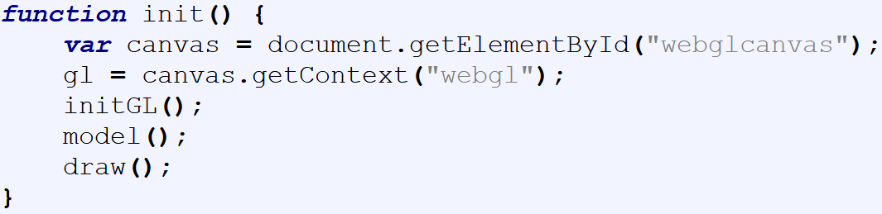
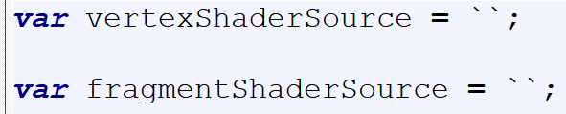
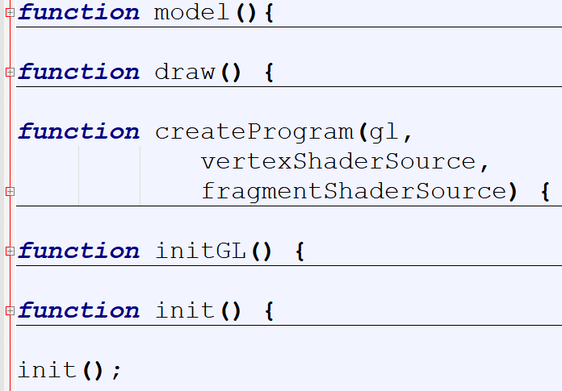
Modularize your code
Canvas and WebGL context
Create and Compile Shaders
Associate the shader variable
Define model + color
and store it in buffer
Draw object

Slide 3
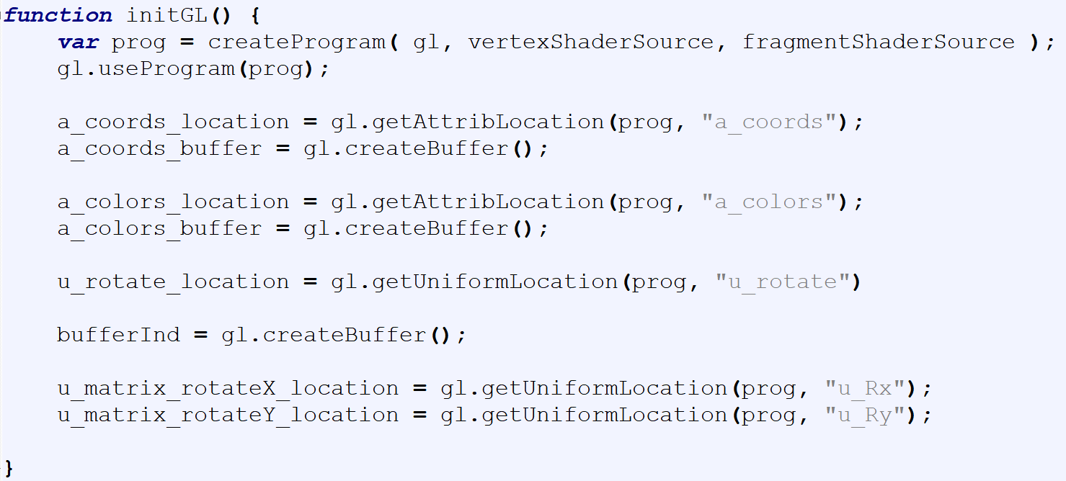
Modularize your code
Canvas and WebGL context
Create and Compile Shaders
Associate the shader variable
Define model + color
and store it in buffer
Draw object

Slide 4
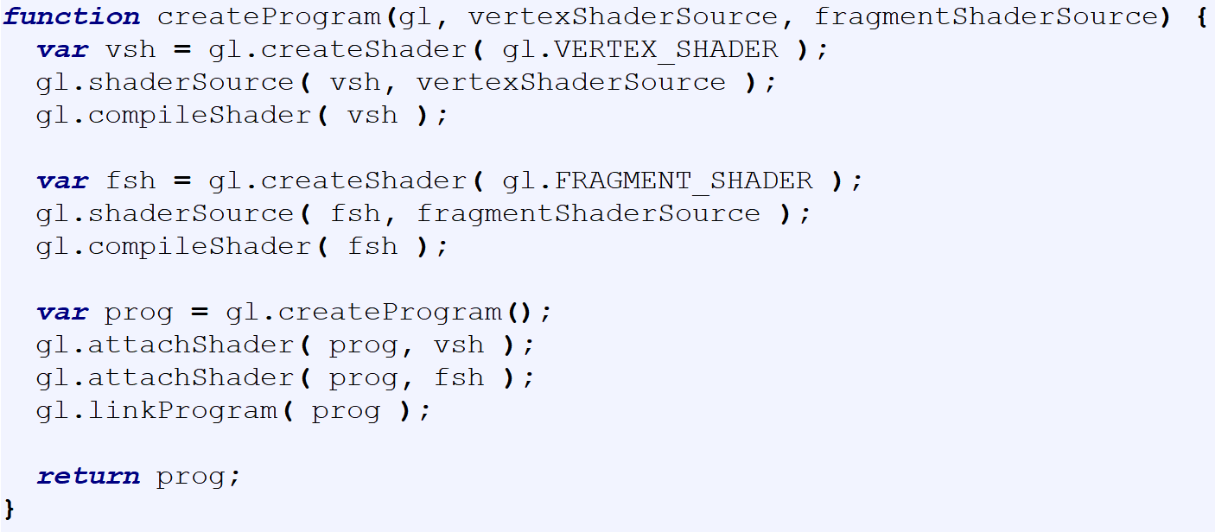
Modularize your code
Canvas and WebGL context
Create and Compile Shaders
Associate the shader variable
Define model + color
and store it in buffer
Draw object

Slide 5
Modularize your code
Canvas and WebGL context
Create and Compile Shaders
Associate the shader variable
Define model + color
and store it in buffer
Draw object

Slide 6
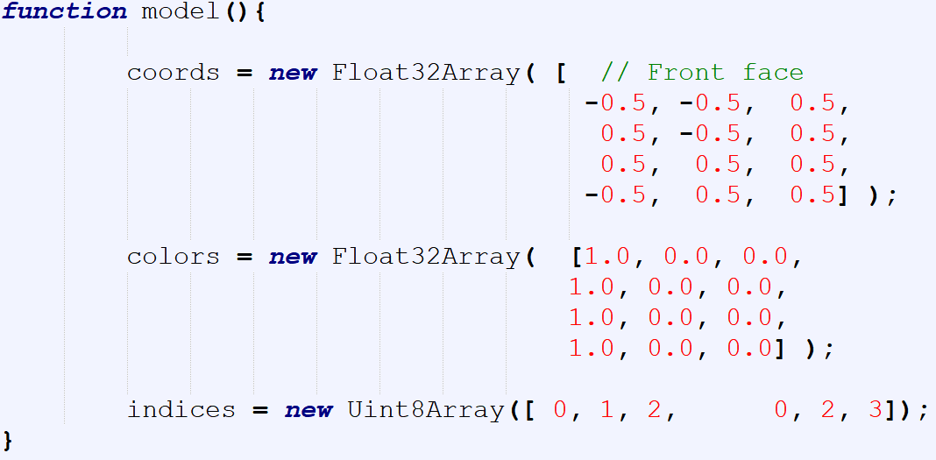
Modularize your code
Canvas and WebGL context
Create and Compile Shaders
Associate the shader variable
Define model + color
and store it in buffer
Draw object

Slide 7
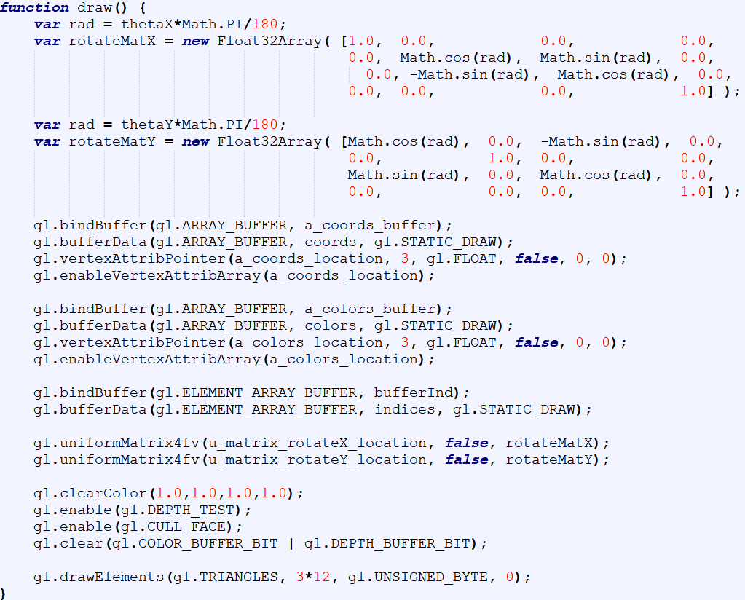
Modularize your code
Canvas and WebGL context
Create and Compile Shaders
Associate the shader variable
Define model + color
and store it in buffer
Draw object

Slide 8
https://rb.gy/7e2em9
Get the code

Slide 9
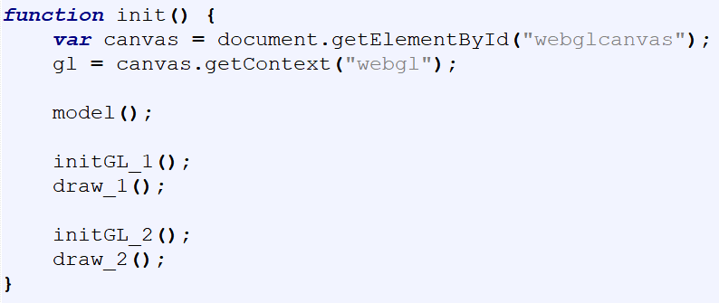

Multiple shaders

Slide 10
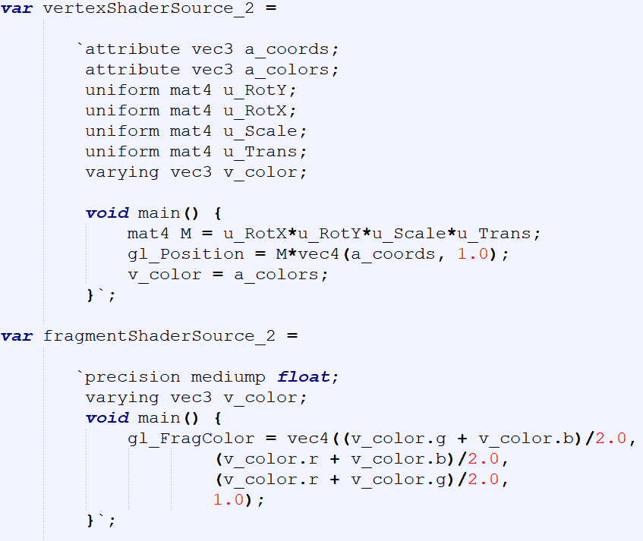
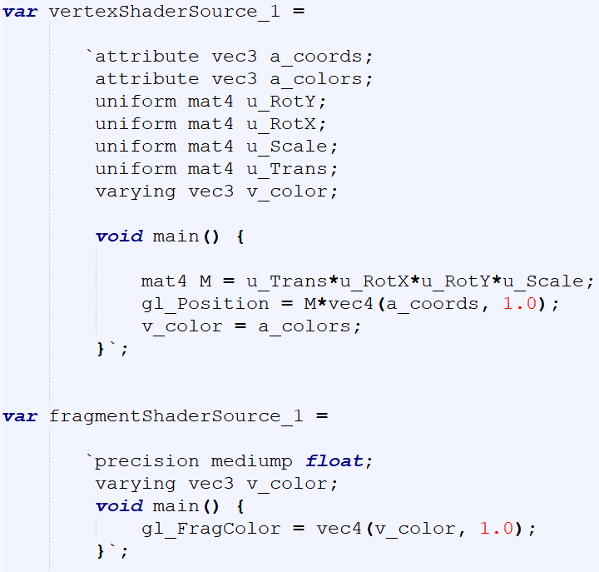
Multiple shaders

Slide 11
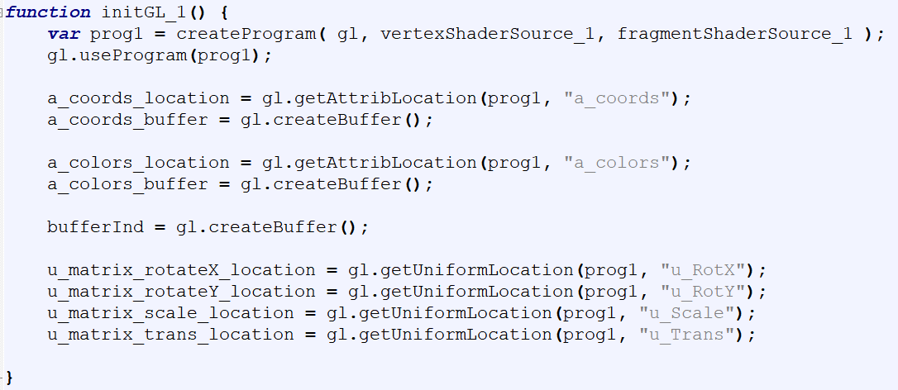
Multiple shaders

Slide 12
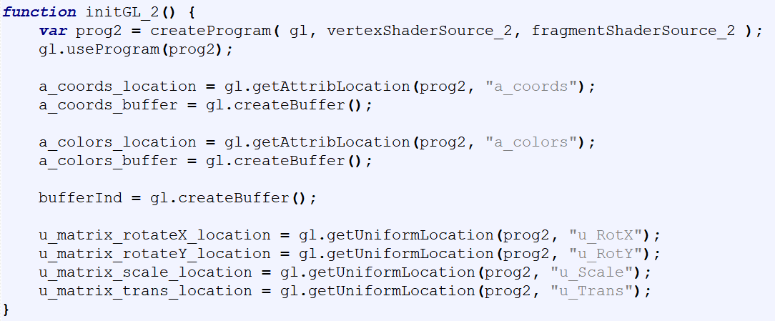
Multiple shaders

Slide 13

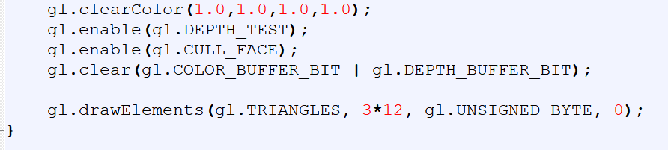

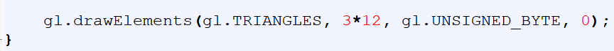
Multiple shaders

Slide 14
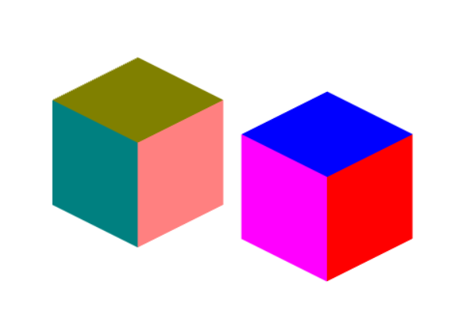
Multiple shaders

Slide 15
https://rb.gy/pkhnfo
Get the code

Slide 16
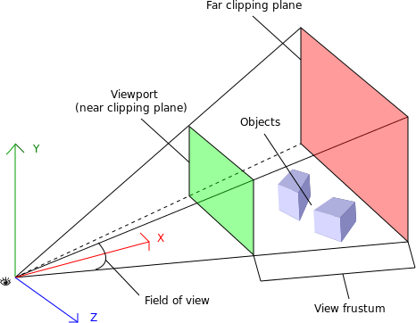
Perspective Projection
https://www.oreilly.com/library/view/webgl-up-and/9781449326487/ch01.html

Slide 17
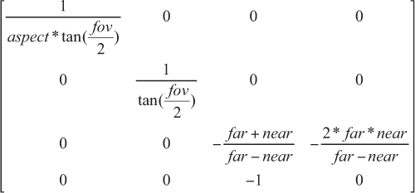
Perspective Projection
persMat =
https://www.oreilly.com/library/view/webgl-up-and/9781449326487/ch01.html

Slide 18
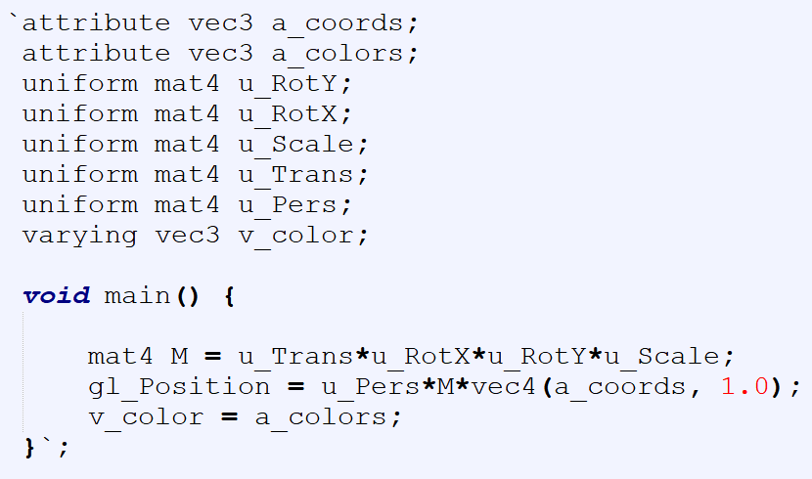
Perspective Projection

Slide 19
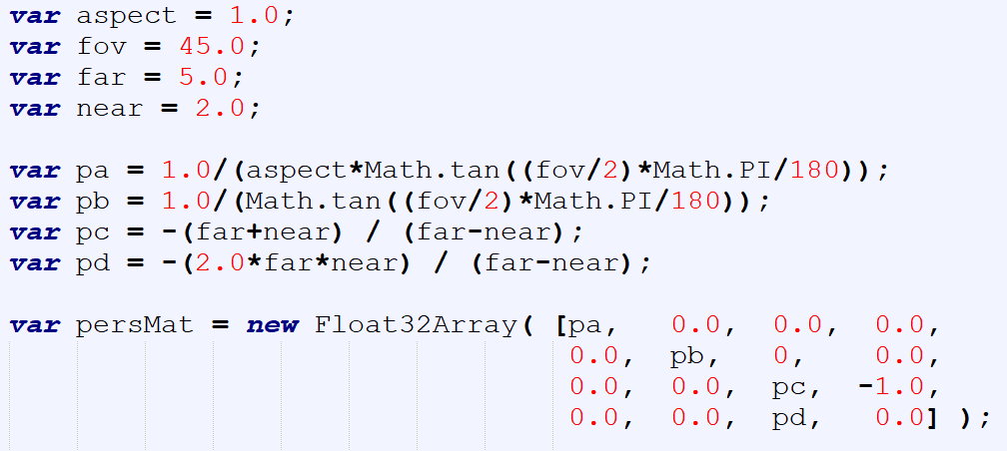
Perspective Projection

Slide 20
https://rb.gy/wmjdic
Get the code

Slide 21
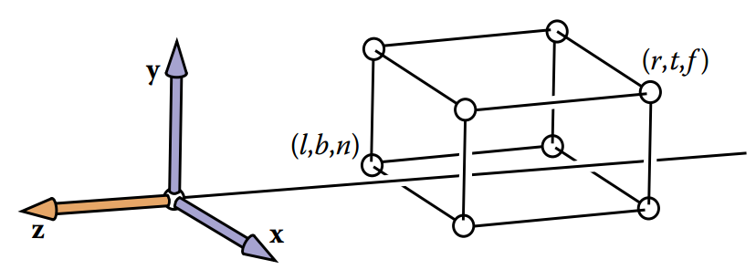
Camera
We’d like to be able to change the viewpoint in 3D and look in any direction.
Credit: Fundamentals of Computer Graphics 3rd Edition by Peter Shirley, Steve Marschner | http://www.cs.cornell.edu/courses/cs4620/2019fa/

Slide 22
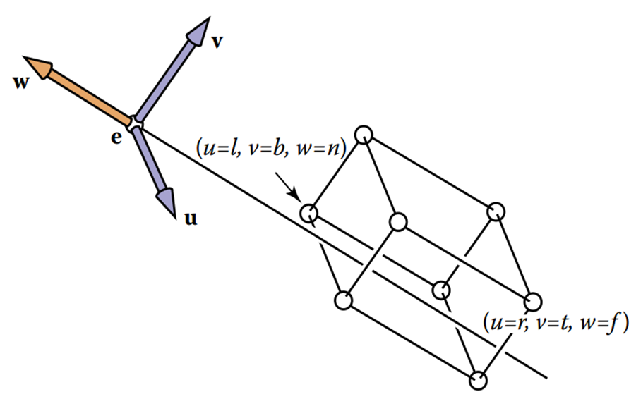
Camera
e: camera/eye position
- w: viewing direction
v: top
u: right
Credit: Fundamentals of Computer Graphics 3rd Edition by Peter Shirley, Steve Marschner | http://www.cs.cornell.edu/courses/cs4620/2019fa/

Slide 23
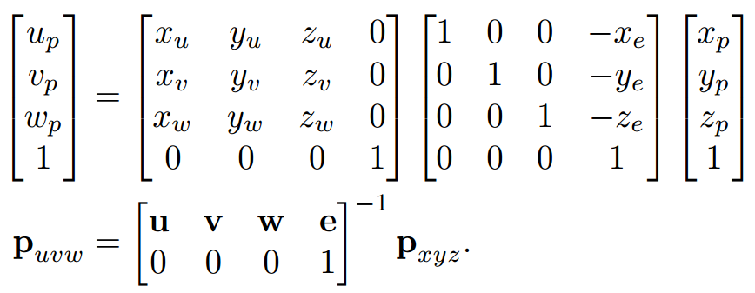
Camera
e: camera/eye position
- w: viewing direction
v: top
u: right

Slide 24
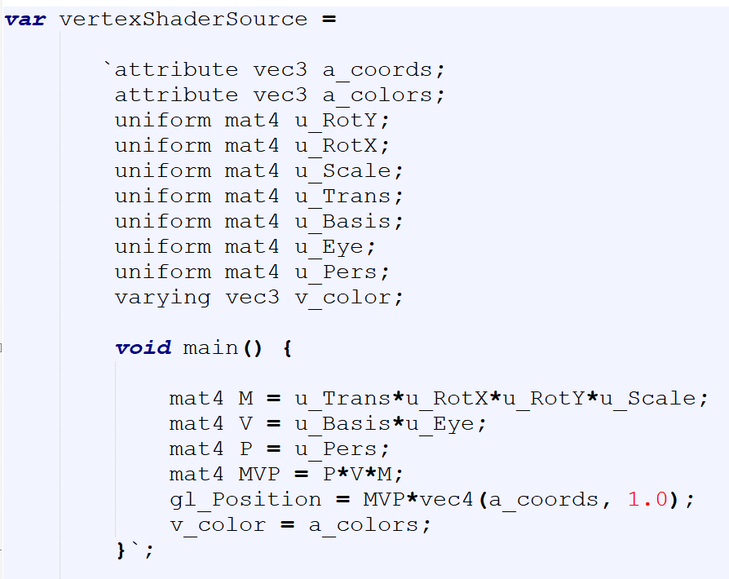
Camera

Slide 25
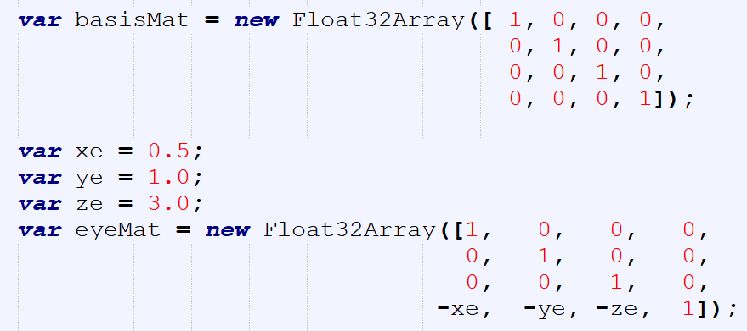
Camera

Slide 26
https://rb.gy/4vmkdg
Get the code

