Slide 1
CSE4204 LAB-3 : Index buffer and Transformation Matrices
Mohammad Imrul Jubair

Slide 2
Recap: Uniform vs Attribute vs Varying
uniform are per-primitive parameters
constant during an entire draw call
attribute are per-vertex parameters
typically : positions, normals, colors, UVs, ...
varying are per-fragment (or per-pixel) parameters
they vary from pixels to pixels
Source: https://stackoverflow.com/questions/17537879/in-webgl-what-are-the-differences-between-an-attribute-a-uniform-and-a-varying

Slide 3
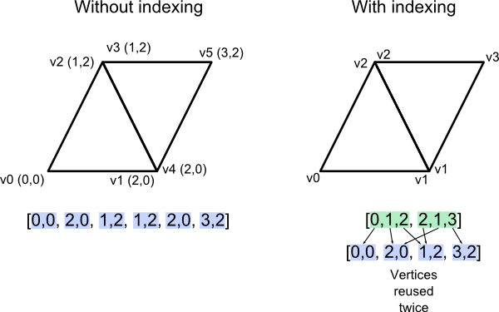
Index Buffer

Slide 4
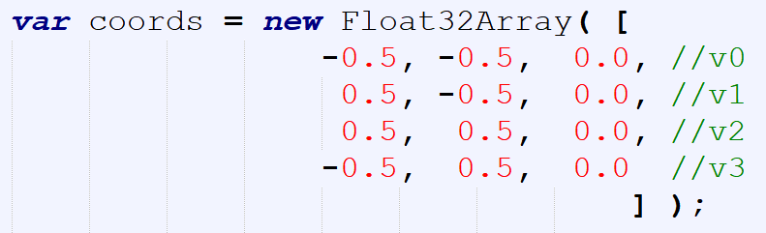
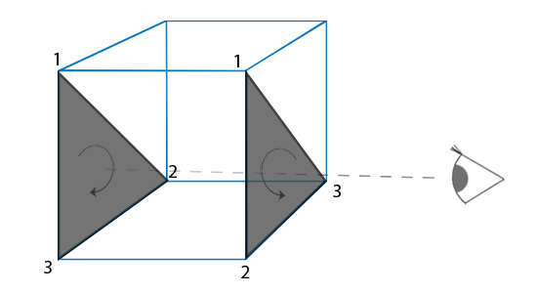
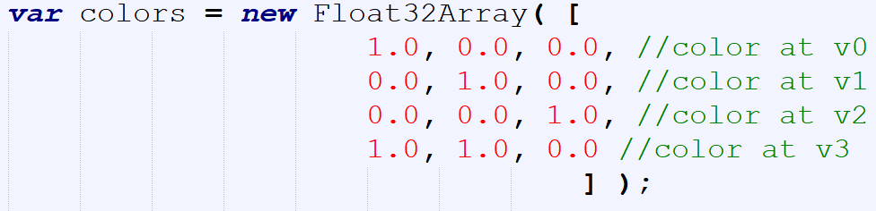

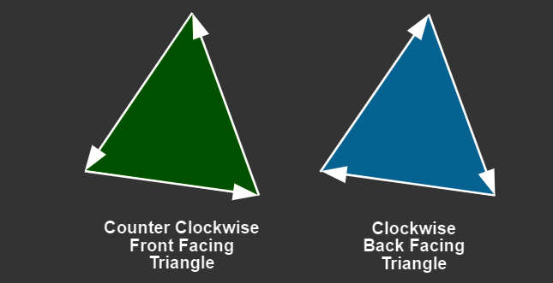
Index Buffer
v3
v2
v0
v1
https://webglfundamentals.org/webgl/lessons/webgl-3d-orthographic.html

Slide 5
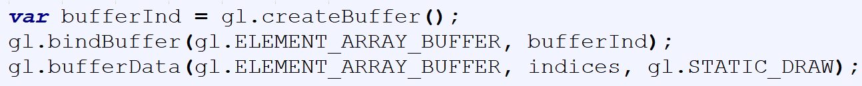
Index Buffer
v3
v2
v0
v1

Slide 6
https://rb.gy/pnoyvj
Get the code

Slide 7
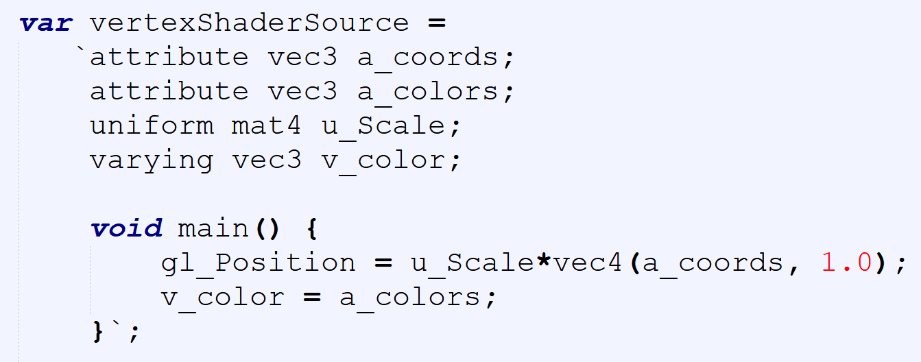
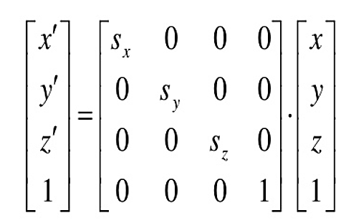

Transformation Matrix
$$V^{′}=S×V$$

Slide 8
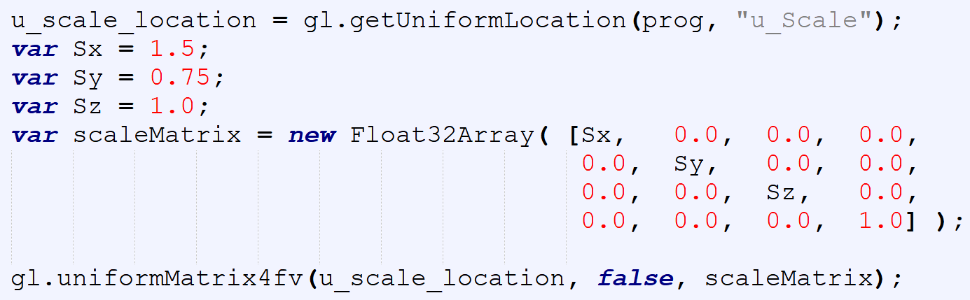
Scale Matrix

Slide 9
Column Major

Slide 10
https://rb.gy/1zrhvj
Get the code

Slide 11
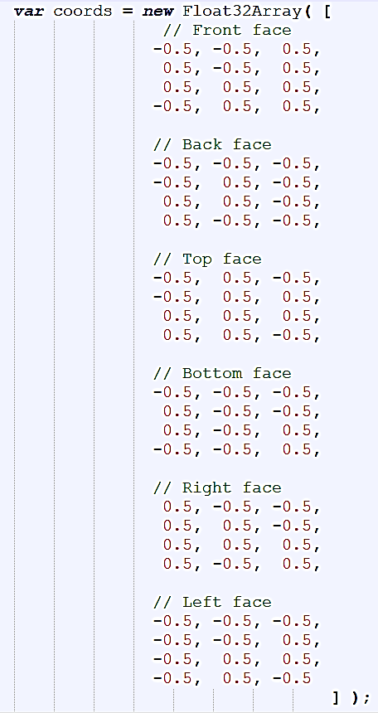
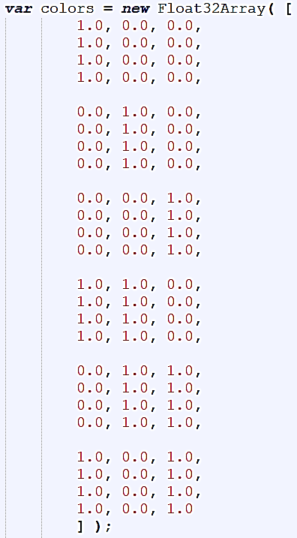

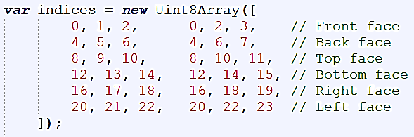
3D Cube

Slide 12
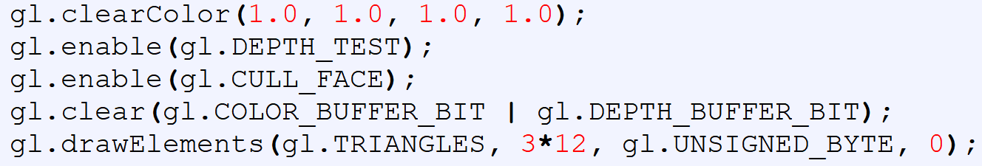
Depth Test + Face Culling

Slide 13
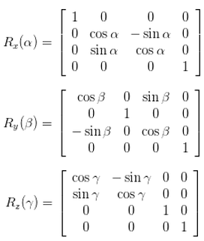
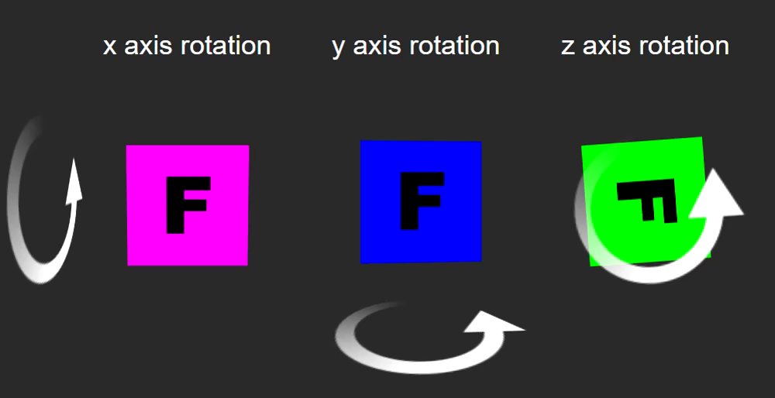

Rotation in 3D
CCW → +ve rotation
$$V^{′}=R×V$$

Slide 14
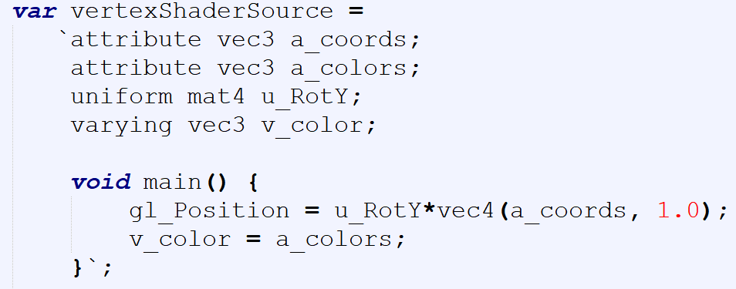

Rotation in 3D
$$V^{′}=R_{y}×V$$

Slide 15
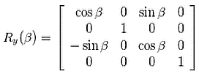
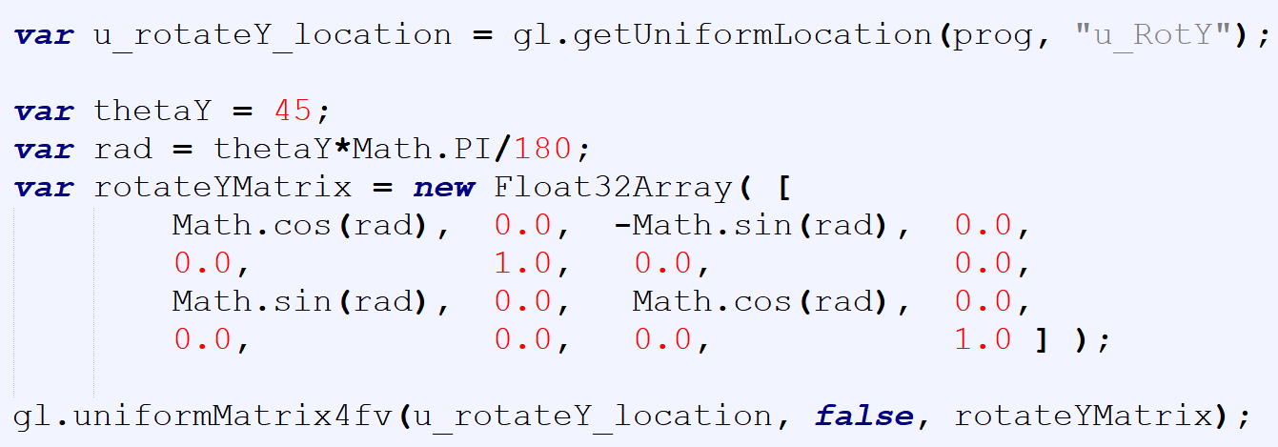
Rotation in 3D

Slide 16

Rotation in 3D

Slide 17
https://rb.gy/ah1cft
Get the code

Slide 18
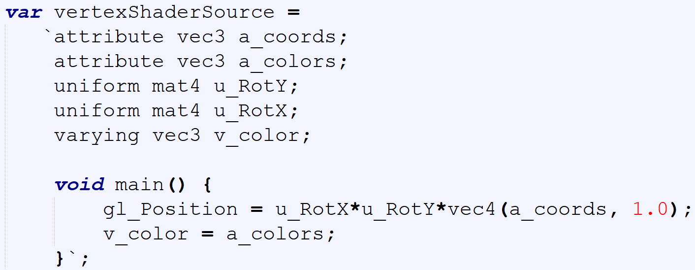

Composite Transformation
$$V^{′}=R_{x}×R_{y}×V$$

Slide 19
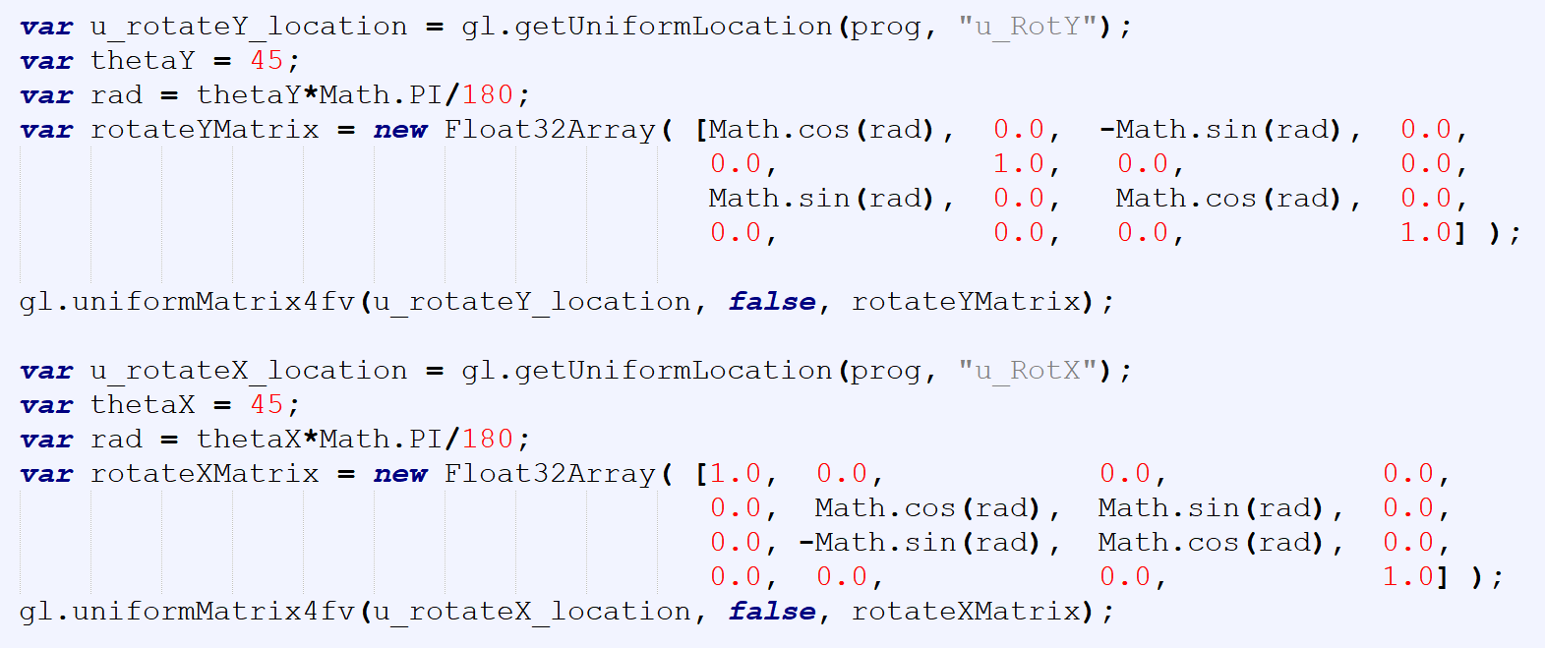
Composite Transformation

Slide 20
https://rb.gy/1zmo7c
Get the code

Slide 21

Composite Transformation
Example
$$V^{′}=R_{x}×R_{y}×S×V$$

