Slide 1
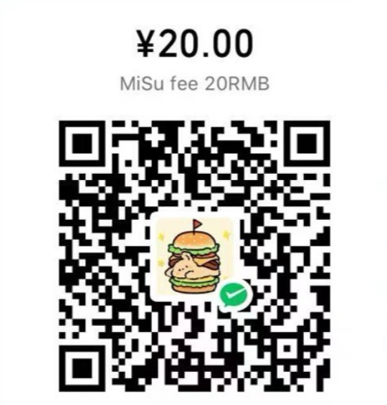
SUZHOU TOASTMASTERS CLUB
访客登记表 Visitor FORM
付费二维码 PAYMENT BARCODE

Slide 2
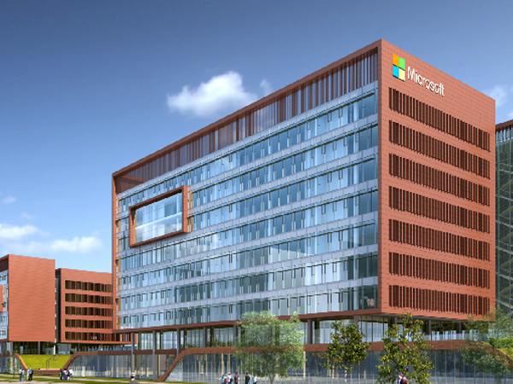
MICROSOFT SUZHOU TOASTMASTERS CLUB

Slide 3



Ground Rules
Don’t walk around during the meeting without purpose
Keep phone in silent mode
Shake hands when you come into /out of the stage

Slide 4


The Taboos
Politics
Religion
Race
Sex

Slide 5
TBD
TBD

Slide 6
TBD
TBD
Microsoft Suzhou Toastmasters Club
TBD

Slide 7
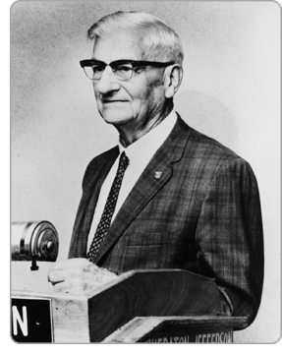
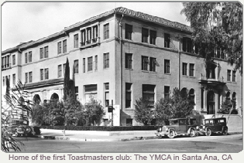

Origination
Since 1924
Dr. Ralph Smedley
Start from a basement in Santa Ana, California U.S.A.

Slide 8
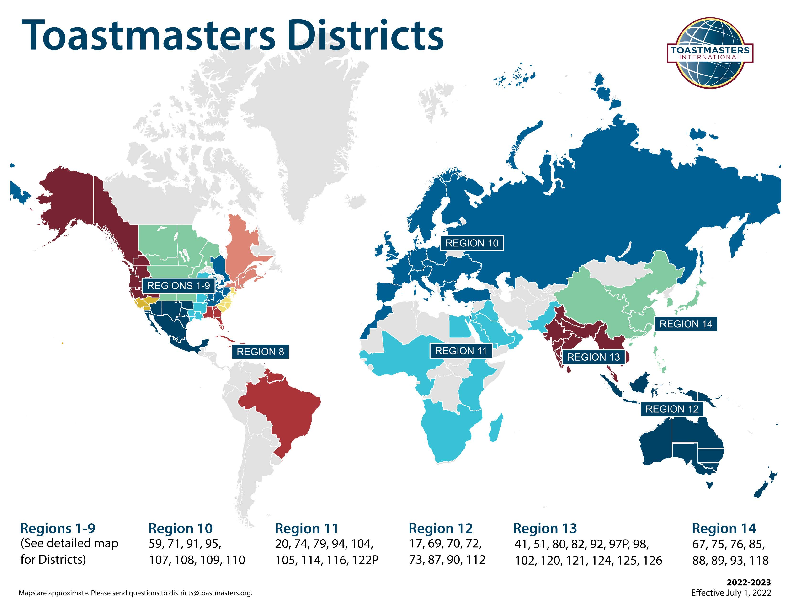

What’s TM
A worldwide nonprofit educational organization that empowers people to become more effective communicators and leaders
270K+ Members
150 Countries
14.2K Clubs
SINCE 1924

Slide 9
Toastmasters International Mission 国际演讲会使命
We empower individuals to become more effective communicators and leaders.
我们赋能个体成为更有效的沟通者和领导者。
Notes:
1mins阐述完毕：说明empower和teach，train的不同

Slide 10
Brand Promise 品牌承诺
Empowering individuals through personal and professional development.
促进个人和职业发展
Notes:
1分钟提问加互动

Slide 11

Toastmasters Values
Integrity - living up to the Toastmasters
Respect - understanding each other among membership.
Service - stepping up when required to help the club function
Excellence - performing assigned duties to the best of our ability every time.

Slide 12
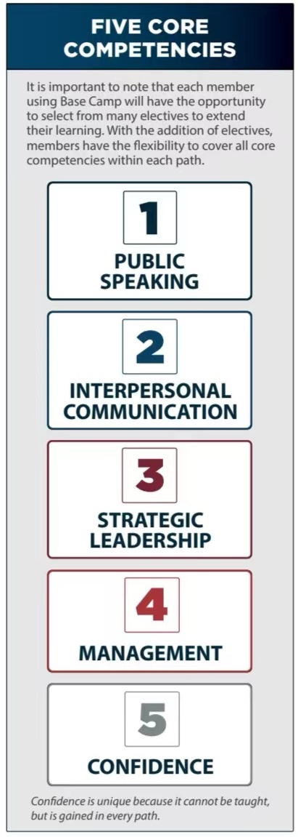
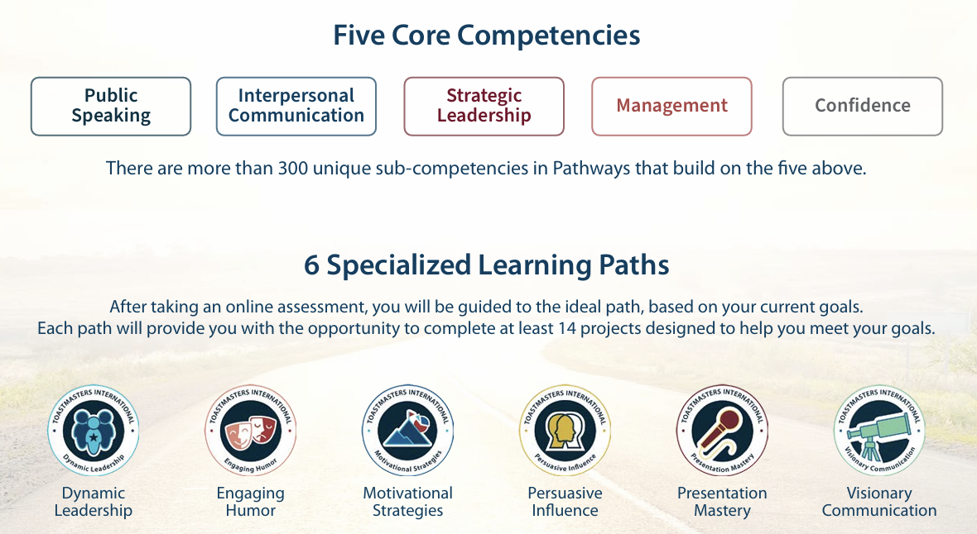
Pathways
Pathways is designed to help you build the skills you need to communicate and lead. It is comprised of 11 paths that teach more than 300 unique competencies.
领导力发展
激励策略
有说服力的影响
精通演讲

Slide 13
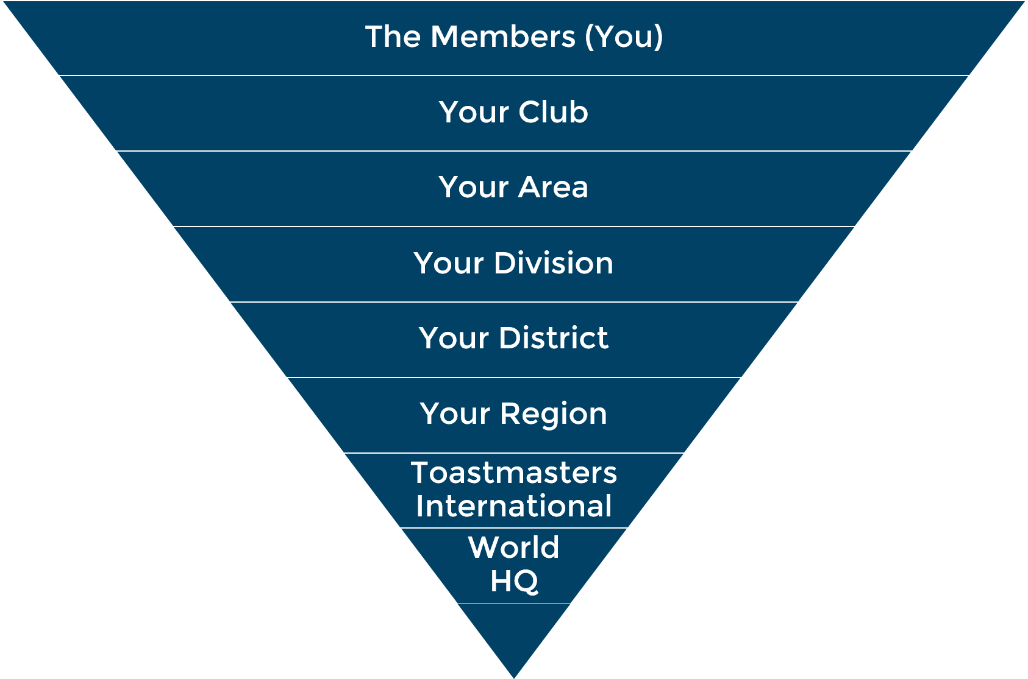
Leadership Structure
(MISU,No.07964606)
(R3)
(R)
(128)
(14)

Slide 14
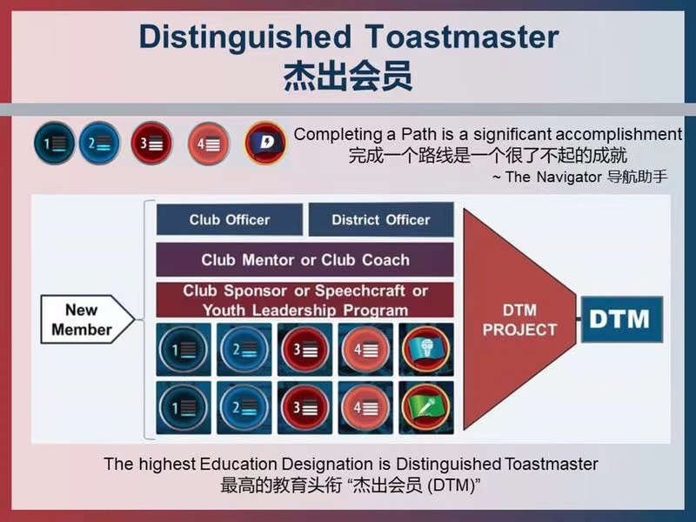
Pathways Chart to DTM

Slide 15
Microsoft Suzhou Toastmasters Club (MiSu)
MiSu - Moving Into Success With You
Microsoft Mission: To empower every individual on the planet to achieve more.
MiSu Mission: To empower every individual to grow into an inspiring communicator and authentic leader.

Slide 16
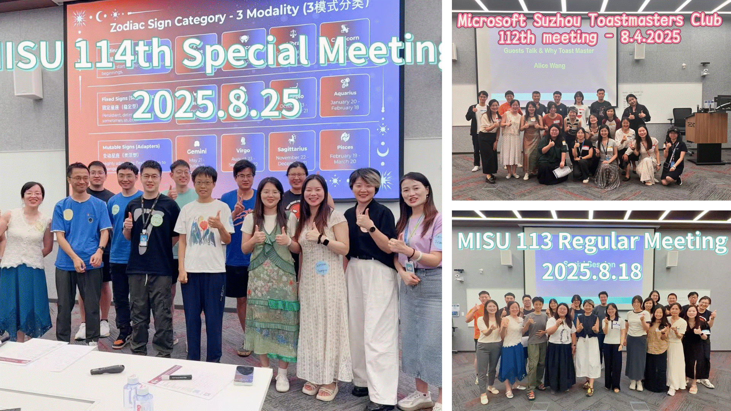
Microsoft Suzhou Toastmasters Club (MiSu)
1st/112th
2025.8.4
28th/139th
2026.6.22
Success

Slide 17
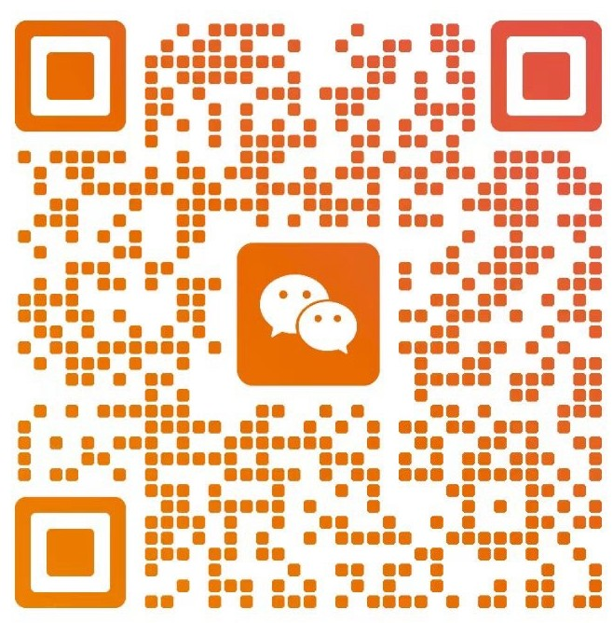
How to join us?
Corporate Club (Open for All)
Language: English
Meeting Time:
  Biweekly Monday Evening (7- 9 PM)
  Special meetings Occasionally
Regular meeting/Activity x 3
With Table Topics x 2
200 (new member) + 100/month
VPM
Serena Zhan

Slide 18
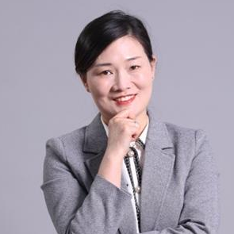
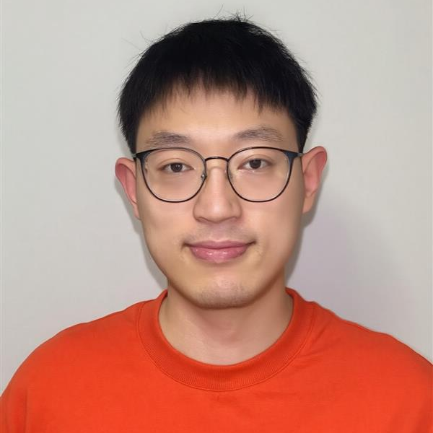
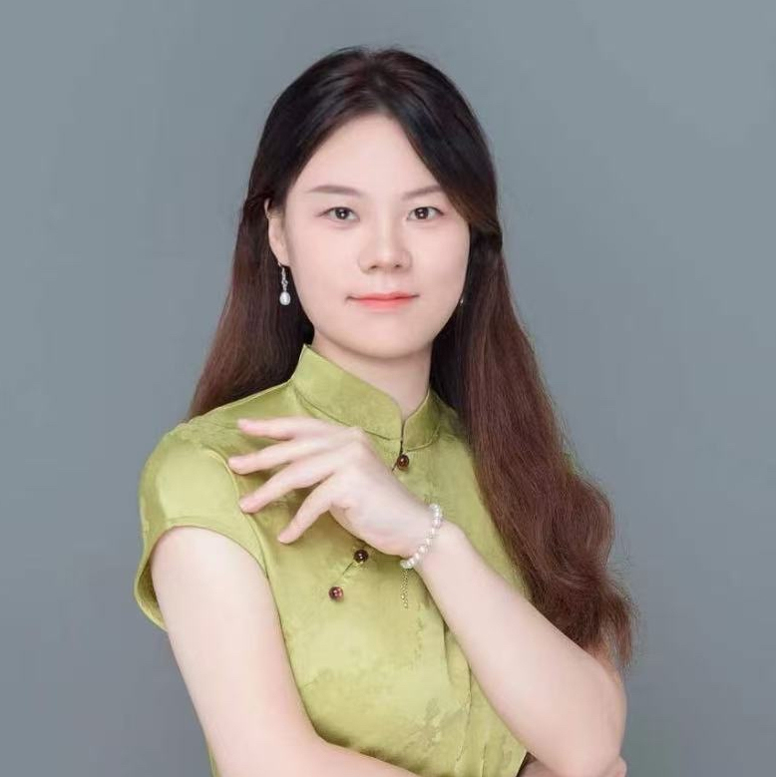
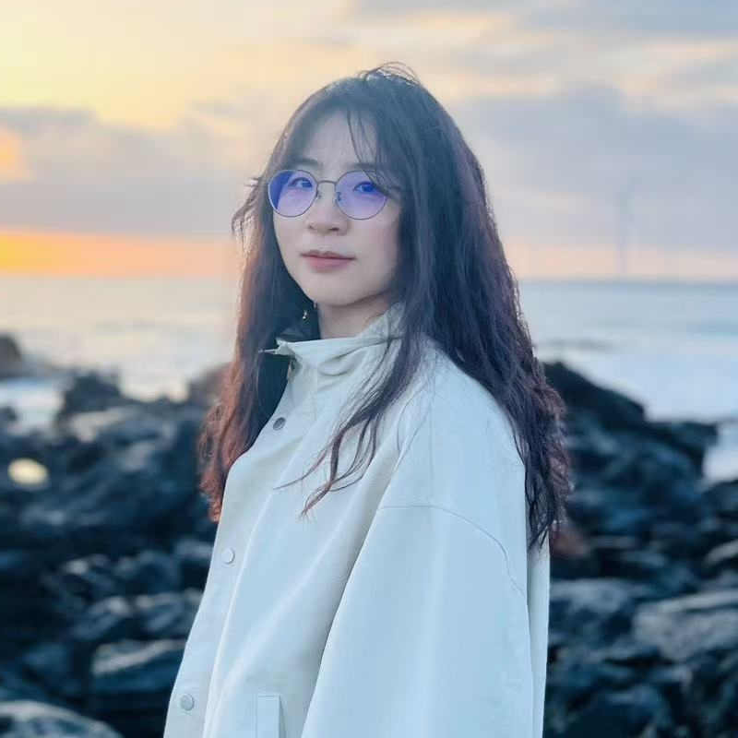
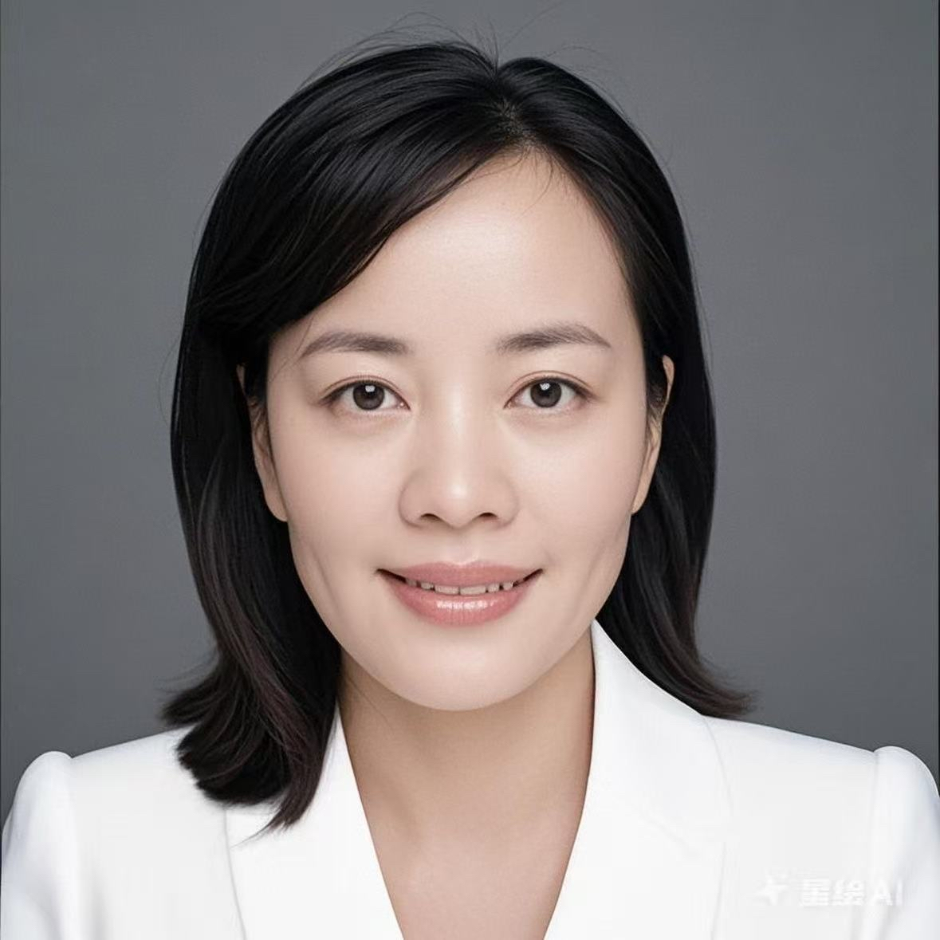
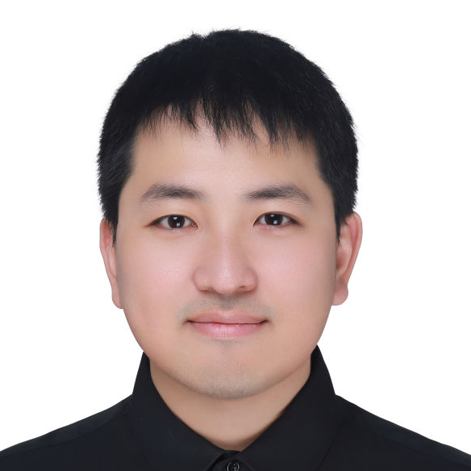
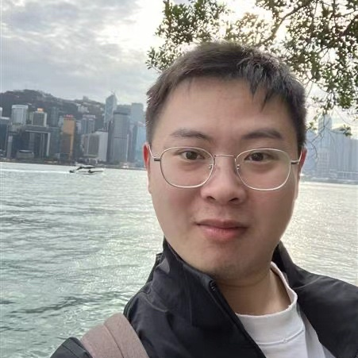
MiSu 1st Officer Team (2025.9 – 2026.6)
President
Cecily Wang
VPE
Chao Chen
VPM
Serena Zhan
VPPR
Sophia Chen
Secretary
Jiajia Bao
Treasurer
Johnny Yao
SAA
Tao Lu

Slide 19

WHERE LEADERS ARE MADE

Slide 20
TBD
TBD

Slide 21
TBD
TBD
WHERE LEADERS ARE MADE

Slide 22
TBD
TBD

Slide 23
TBD
TBD

Slide 24
TBD
WHERE LEADERS ARE MADE

Slide 25
TBD
TBD

Slide 26
TBD
TBD

Slide 27
TBD

Slide 28
TBD
WHERE LEADERS ARE MADE

Slide 29
TBD
TBD

Slide 30
TBD

Slide 31
TBD
TBD

Slide 32
TBD
TBD

Slide 33
TBD
TBD

Slide 34
TBD
TBD

Slide 35
TBD

Slide 36
TBD

Slide 37
TBD

Slide 38
Appreciation to Team
Meeting Manager
TBD
Photographer
TBD

Slide 39
MISU Officer Team(2026.07-2027.06)
President
Cecily Wang
VPE
Chao Chen
VPM
Serena Zhan
VPPR
Sophia Chen
Secretary
Jiajia Bao
Treasure
Johnny Yao
SAA
Tao Lu

