Slide 1
StreamIt: A Language for Streaming Applications
William Thies, Michal Karczmarek, Michael Gordon, David Maze, Jasper Lin, Ali Meli, Andrew Lamb, Chris Leger and Saman Amarasinghe
MIT Laboratory for Computer Science
New England Programming Languages and Systems Symposium
August 7, 2002

Slide 2
Streaming Application Domain
Based on streams of data
Increasingly prevalent and important
  Embedded systems
    Cell phones, handheld computers, DSP’s
  Desktop applications
    Streaming media – Real-time encryption
    Software radio - Graphics packages
  High-performance servers
    Software routers
    Cell phone base stations
    HDTV editing consoles

Slide 3
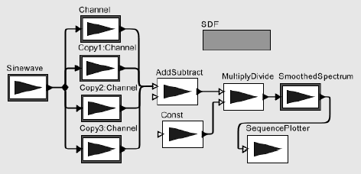
Synchronous Dataflow (SDF)
Application is a graph of nodes
Nodes send/receive items over channels
Nodes have static I/O rates
Can construct a static schedule

Slide 4
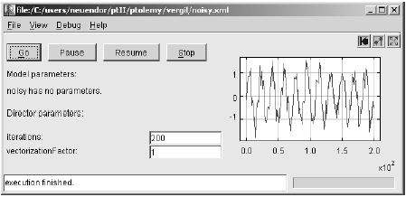
Prototyping Streaming Apps.
Modeling Environments:
  Ptolemy (UC Berkeley)
  COSSAP (Synopsys)
  SPW (Cadence)
  ADS (Hewlett Packard)
  DSP Station (Mentor Graphics)

Slide 5
Programming Streaming Apps.
C / C++ / Assembly
Compiler-
Conscious
Language
Design
Performance
Synchronous Dataflow
- LUSTRE - SIGNAL
- Silage - Lucid
Programmability

Slide 6
The StreamIt Language
Also a synchronous dataflow language
  With a few extra features
Goals:
  High performance
  Improved programmer productivity
Language Contributions:
  Structured model of streams
  Messaging system for control
  Automatic program morphing
ENABLES
Compiler
Analysis &
Optimization

Slide 7
Outline
Design of StreamIt
  Structured Streams
  Messaging
  Morphing
Results
Conclusions

Slide 8
Outline
Design of StreamIt
  Structured Streams
  Messaging
  Morphing
Results
Conclusions

Slide 9
Representing Streams
Conventional wisdom: streams are graphs
  Graphs have no simple textual representation
  Graphs are difficult to analyze and optimize

Slide 10
Representing Streams
Conventional wisdom: streams are graphs
  Graphs have no simple textual representation
  Graphs are difficult to analyze and optimize
Insight: stream programs have structure
unstructured
structured

Slide 11
Structured Streams
Hierarchical structures:
  Pipeline
  SplitJoin
  Feedback Loop
Basic programmable unit: Filter

Slide 12
Structured Streams
Hierarchical structures:
  Pipeline
  SplitJoin
  Feedback Loop
Basic programmable unit: Filter
Splits / Joins are compiler-defined

Slide 13
Representing Filters
Autonomous unit of computation
  No access to global resources
  Communicates through FIFO channels
    - pop() - peek(index) - push(value)
  Peek / pop / push rates must be constant
Looks like a Java class, with
  An initialization function
  A steady-state “work” function
  Message handler functions

Slide 14
Filter Example: LowPassFilter
float->float filter LowPassFilter (float N) {
float[N] weights;
init {
weights = calcWeights(N);
}
work push 1 pop 1 peek N {
float result = 0;
for (int i=0; i<weights.length; i++) {
result += weights[i] * peek(i);
}
push(result);
pop();
}
}

Slide 15
Filter Example: LowPassFilter
float->float filter LowPassFilter (float N) {
float[N] weights;
init {
weights = calcWeights(N);
}
work push 1 pop 1 peek N {
float result = 0;
for (int i=0; i<weights.length; i++) {
result += weights[i] * peek(i);
}
push(result);
pop();
}
}
N

Slide 16
Filter Example: LowPassFilter
float->float filter LowPassFilter (float N) {
float[N] weights;
init {
weights = calcWeights(N);
}
work push 1 pop 1 peek N {
float result = 0;
for (int i=0; i<weights.length; i++) {
result += weights[i] * peek(i);
}
push(result);
pop();
}
}
N

Slide 17
Filter Example: LowPassFilter
float->float filter LowPassFilter (float N) {
float[N] weights;
init {
weights = calcWeights(N);
}
work push 1 pop 1 peek N {
float result = 0;
for (int i=0; i<weights.length; i++) {
result += weights[i] * peek(i);
}
push(result);
pop();
}
}
N

Slide 18
Filter Example: LowPassFilter
float->float filter LowPassFilter (float N) {
float[N] weights;
init {
weights = calcWeights(N);
}
work push 1 pop 1 peek N {
float result = 0;
for (int i=0; i<weights.length; i++) {
result += weights[i] * peek(i);
}
push(result);
pop();
}
}
N

Slide 19
Pipeline Example: FM Radio
pipeline FMRadio {
add DataSource();
add LowPassFilter();
add FMDemodulator();
add Equalizer(8);
add Speaker();
}
DataSource
LowPassFilter
FMDemodulator
Equalizer
Speaker

Slide 20
Pipeline Example: FM Radio
pipeline FMRadio {
add DataSource();
add LowPassFilter();
add FMDemodulator();
add Equalizer(8);
add Speaker();
}
DataSource
LowPassFilter
FMDemodulator
Equalizer
Speaker

Slide 21
SplitJoin Example: Equalizer
pipeline Equalizer (int N) {
add splitjoin {
split duplicate;
float freq = 10000;
for (int i = 0; i < N; i ++, freq*=2) {
add BandPassFilter(freq, 2*freq);
}
join roundrobin;
}
add Adder(N);
}
}
duplicate
BPF
BPF
BPF
roundrobin (1)
Adder

Slide 22
Why Structured Streams?
Compare to structured control flow
Tradeoff:
  PRO: - more robust - more analyzable
  CON: - “restricted” style of programming
GOTO statements
If / else / for statements

Slide 23
Structure Helps Programmers
Modules are hierarchical and composable
  Each structure is single-input, single-output
Encapsulates common idioms
Good textual representation
  Enables parameterizable graphs

Slide 24
N-Element Merge Sort (3-level)
N
N/2
N/2
N/4
N/4
N/4
N/4
N/8
N/8
N/8
N/8
N/8
N/8
N/8
N/8
Sort
Sort
Sort
Sort
Sort
Sort
Sort
Sort
Merge
Merge
Merge
Merge
Merge
Merge
Merge

Slide 25
N-Element Merge Sort (K-level)
pipeline MergeSort (int N, int K) {
if (K==1) {
add Sort(N);
} else {
add splitjoin {
split roundrobin;
add MergeSort(N/2, K-1);
add MergeSort(N/2, K-1);
joiner roundrobin;
}
}
add Merge(N);
}
}

Slide 26
Structure Helps Compilers
Enables local, hierarchical analyses
  Scheduling
  Optimization
  Parallelization
  Load balancing

Slide 27
Structure Helps Compilers
Enables local, hierarchical analyses
  Scheduling
  Optimization
  Parallelization
  Load balancing
Examples:
Pipeline
Fusion
SplitJoin
Fusion
…
…
Pipeline
Fission
SplitJoin
Fission

Slide 28
Structure Helps Compilers
Enables local, hierarchical analyses
  Scheduling
  Optimization
  Parallelization
  Load balancing
Examples:
Filter
Hoisting
…
…

Slide 29
Structure Helps Compilers
Enables local, hierarchical analyses
  Scheduling
  Optimization
  Parallelization
  Load balancing
Disallows non-sensical graphs
Simplifies separate compilation
  All blocks single-input, single-output

Slide 30
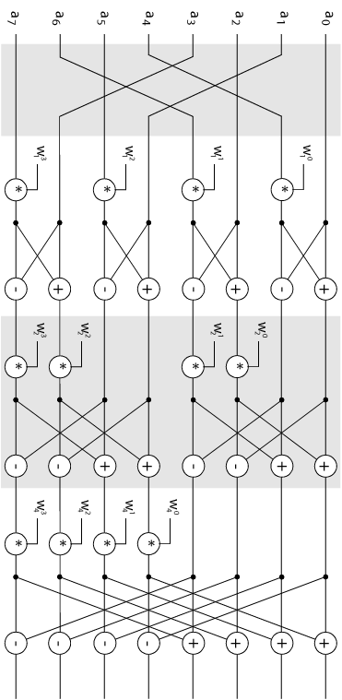
CON: Restricts Coding Style
Some graphs need
to be re-arranged
Example: FFT
roundrobin (2)
push(pop())
push(pop() * w[…])
Bit-reverse order
roundrobin (1)
Butterfly
(2 way)
duplicate
Butterfly
(4 way)
push(pop() + pop())
push(pop() – pop())
Butterfly
(8 way)
roundrobin (2)

Slide 31
Outline
Design of StreamIt
  Structured Streams
  Messaging
  Morphing
Results
Conclusions

Slide 32
Control Messages
Structures for regular, high-bandwidth data
But also need a control mechanism for irregular, low-bandwidth events
  Change volume on a cell phone
  Initiate handoff of stream
  Adjust network protocol

Slide 33
Supporting Control Messages
Option 1: Embed message in stream
  PRO: - message arrives with data
  CON: - complicates filter code
  - complicates structure
  - runtime overhead
Option 1: Embed message in stream
  PRO: - method arrives with data
  CON: - complicates filter code
  - complicates structure
Option 2: Synchronous method call
  PRO: - delivery transparent to user
  CON: - timing is unclear
  - limits parallelism

Slide 34
StreamIt Messaging System
Looks like method call, but semantics differ
  No return value
  Asynchronous delivery
  Can broadcast to multiple targets
void raiseVolume(int v) {
myVolume += v;
}

Slide 35
StreamIt Messaging System
Looks like method call, but semantics differ
Timed relative to data
  User gains precision; compiler gains flexibility
Looks like method call, but semantics differ
  No return value
  Asynchronous delivery
  Can broadcast to multiple targets
TargetFilter x;
work {
…
if (lowVolume())
x.raiseVolume(10) at 100;
}

Slide 36
Message Timing
A sends message to B with zero latency
A
B

Slide 37
Message Timing
A sends message to B with zero latency
A
B

Slide 38
Message Timing
A sends message to B with zero latency
A
B

Slide 39
Message Timing
A sends message to B with zero latency
A
B

Slide 40
Message Timing
A sends message to B with zero latency
A
B

Slide 41
Message Timing
A sends message to B with zero latency
A
B

Slide 42
Message Timing
A sends message to B with zero latency
A
B

Slide 43
Message Timing
A sends message to B with zero latency
A
B

Slide 44
Message Timing
A sends message to B with zero latency
A
B

Slide 45
Message Timing
A sends message to B with zero latency
A
B

Slide 46
Message Timing
A sends message to B with zero latency
A
B

Slide 47
Message Timing
A sends message to B with zero latency
A
B

Slide 48
Message Timing
A sends message to B with zero latency
A
Distance
between
wavefronts
might have
changed
B

Slide 49
Message Timing
A sends message to B with zero latency
A
B

Slide 50
General Message Timing
Latency of N means:
  Message attached
  to wavefront that
  sender sees in N
  executions
A
B

Slide 51
General Message Timing
Latency of N means:
  Message attached
  to wavefront that
  sender sees in N
  executions
Examples:
  A → B, latency 1
A
B

Slide 52
General Message Timing
Latency of N means:
  Message attached
  to wavefront that
  sender sees in N
  executions
Examples:
  A → B, latency 1
A
B

Slide 53
General Message Timing
Latency of N means:
  Message attached
  to wavefront that
  sender sees in N
  executions
Examples:
  A → B, latency 1
  B → A, latency 25
A
B

Slide 54
General Message Timing
Latency of N means:
  Message attached
  to wavefront that
  sender sees in N
  executions
Examples:
  A → B, latency 1
  B → A, latency 25
A
B

Slide 55
Rationale
Better for the programmer
  Simplicity of method call
  Precision of embedding in stream
Better for the compiler
  Program is easier to analyze
    No code for timing / embedding
    No control channels in stream graph
  Can reorder filter firings, respecting constraints
  Implement in most efficient way

Slide 56
Outline
Design of StreamIt
  Structured Streams
  Messaging
  Morphing
Results
Conclusions

Slide 57
Dynamic Changes to Stream
Stream structure needs to change
Examples
  Switch radio from AM to FM
  Change from Bluetooth to 802.11
Program
“Morphing”

Slide 58
Dynamic Changes to Stream
Stream structure needs to change
Challenges for programmer:
  Synchronizing the beginning, end of morphing
  Preserving live data in the system
  Efficiency

Slide 59
Morphing in StreamIt
Send message to “init” to morph a structure
pipeline Equalizer (int N) {
…
}

Slide 60
Morphing in StreamIt
Send message to “init” to morph a structure
pipeline Equalizer (int N) {
…
}
myEqualizer.init (6);

Slide 61
Morphing in StreamIt
Send message to “init” to morph a structure
  When message arrives, structure is replaced
  Live data is automatically drained
pipeline Equalizer (int N) {
…
}
myEqualizer.init (6);

Slide 62
Rationale
Programmer writes “init” only once
  No need for complicated transitions
Compiler optimizes each phase separately
  Benefits from anticipation of phase changes

Slide 63
Outline
Design of StreamIt
  Structured Streams
  Messaging
  Morphing
Results
Conclusions

Slide 64
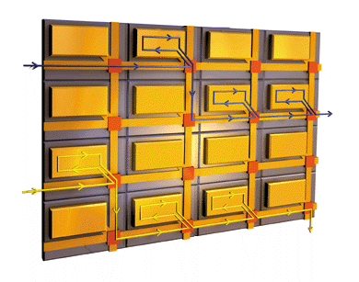
Implementation
Basic StreamIt implementation complete
Backends:
  Uniprocessor
  Raw: A tiled architecture
  with fine-grained,
  programmable
  communication
Extended KOPI, open-source Java compiler

Slide 65
Results
Developed applications in StreamIt
  GSM Decoder - FFT
  FM Radio - 3GPP Channel Decoder
  Radar - Bitonic Sort
Load-balancing transformations improve performance on RAW
Vertical
Fusion
Horizontal
Fusion
…
…
Vertical
Fission
Horizontal
Fission

Slide 66
Example: Radar App. (Original)
Splitter
FIRFilter
FIRFilter
FIRFilter
FIRFilter
FIRFilter
FIRFilter
FIRFilter
FIRFilter
FIRFilter
FIRFilter
FIRFilter
FIRFilter
FIRFilter
FIRFilter
FIRFilter
FIRFilter
FIRFilter
FIRFilter
FIRFilter
FIRFilter
FIRFilter
FIRFilter
FIRFilter
FIRFilter
Joiner
Splitter
Vector Mult
Vector Mult
Vector Mult
Vector Mult
FirFilter
FirFilter
FirFilter
FirFilter
Magnitude
Magnitude
Magnitude
Magnitude
Detector
Detector
Detector
Detector
Joiner

Slide 67

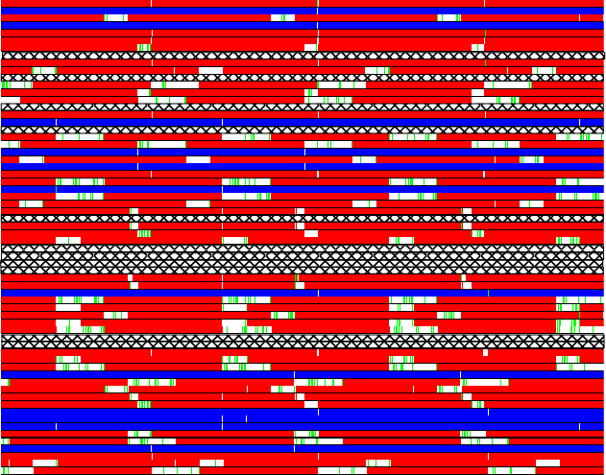
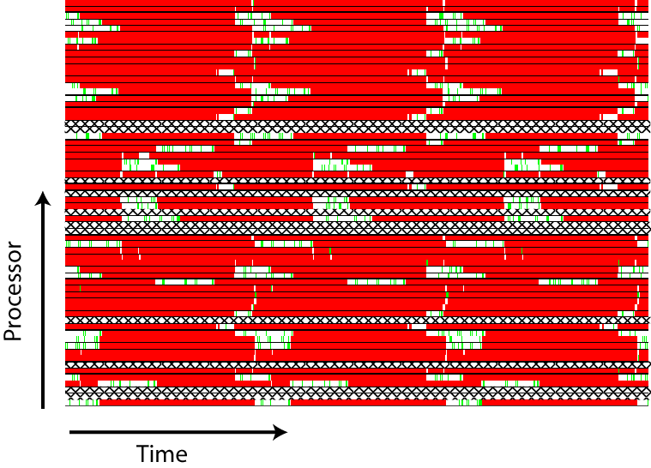
Example: Radar App. (Original)

Slide 68
Example: Radar App. (Original)
Splitter
FIRFilter
FIRFilter
FIRFilter
FIRFilter
FIRFilter
FIRFilter
FIRFilter
FIRFilter
FIRFilter
FIRFilter
FIRFilter
FIRFilter
FIRFilter
FIRFilter
FIRFilter
FIRFilter
FIRFilter
FIRFilter
FIRFilter
FIRFilter
FIRFilter
FIRFilter
FIRFilter
FIRFilter
Joiner
Splitter
Vector Mult
Vector Mult
Vector Mult
Vector Mult
FirFilter
FirFilter
FirFilter
FirFilter
Magnitude
Magnitude
Magnitude
Magnitude
Detector
Detector
Detector
Detector
Joiner

Slide 69
Example: Radar App. (Original)
Splitter
FIRFilter
FIRFilter
FIRFilter
FIRFilter
FIRFilter
FIRFilter
FIRFilter
FIRFilter
FIRFilter
FIRFilter
FIRFilter
FIRFilter
FIRFilter
FIRFilter
FIRFilter
FIRFilter
FIRFilter
FIRFilter
FIRFilter
FIRFilter
FIRFilter
FIRFilter
FIRFilter
FIRFilter
Joiner
Splitter
Vector Mult
Vector Mult
Vector Mult
Vector Mult
FirFilter
FirFilter
FirFilter
FirFilter
Magnitude
Magnitude
Magnitude
Magnitude
Detector
Detector
Detector
Detector
Joiner

Slide 70
Example: Radar App.
Splitter
FIRFilter
FIRFilter
FIRFilter
FIRFilter
FIRFilter
FIRFilter
FIRFilter
FIRFilter
FIRFilter
FIRFilter
FIRFilter
FIRFilter
FIRFilter
FIRFilter
FIRFilter
FIRFilter
FIRFilter
FIRFilter
FIRFilter
FIRFilter
FIRFilter
FIRFilter
FIRFilter
FIRFilter
Joiner
Splitter
Vector Mult
Vector Mult
Vector Mult
Vector Mult
FirFilter
FirFilter
FirFilter
FirFilter
Magnitude
Magnitude
Magnitude
Magnitude
Detector
Detector
Detector
Detector
Joiner

Slide 71
Example: Radar App.
Splitter
FIRFilter
FIRFilter
FIRFilter
FIRFilter
FIRFilter
FIRFilter
FIRFilter
FIRFilter
FIRFilter
FIRFilter
FIRFilter
FIRFilter
FIRFilter
FIRFilter
FIRFilter
FIRFilter
FIRFilter
FIRFilter
FIRFilter
FIRFilter
FIRFilter
FIRFilter
FIRFilter
FIRFilter
Joiner
Splitter
Vector Mult
Vector Mult
Vector Mult
Vector Mult
FirFilter
FirFilter
FirFilter
FirFilter
Magnitude
Magnitude
Magnitude
Magnitude
Detector
Detector
Detector
Detector
Joiner

Slide 72
Example: Radar App.
Splitter
FIRFilter
FIRFilter
FIRFilter
FIRFilter
FIRFilter
FIRFilter
FIRFilter
FIRFilter
FIRFilter
FIRFilter
FIRFilter
FIRFilter
FIRFilter
FIRFilter
FIRFilter
FIRFilter
FIRFilter
FIRFilter
FIRFilter
FIRFilter
FIRFilter
FIRFilter
FIRFilter
FIRFilter
Joiner
Splitter
Vector Mult
Vector Mult
Vector Mult
Vector Mult
FirFilter
FirFilter
FirFilter
FirFilter
Magnitude
Magnitude
Magnitude
Magnitude
Detector
Detector
Detector
Detector
Joiner

Slide 73
Example: Radar App.
Splitter
FIRFilter
FIRFilter
FIRFilter
FIRFilter
FIRFilter
FIRFilter
FIRFilter
FIRFilter
FIRFilter
FIRFilter
FIRFilter
FIRFilter
FIRFilter
FIRFilter
FIRFilter
FIRFilter
FIRFilter
FIRFilter
FIRFilter
FIRFilter
FIRFilter
FIRFilter
FIRFilter
FIRFilter
Joiner
Splitter
Vector Mult
FIRFilter
Magnitude
Detector
Vector Mult
FIRFilter
Magnitude
Detector
Vector Mult
FIRFilter
Magnitude
Detector
Vector Mult
FIRFilter
Magnitude
Detector
Joiner

Slide 74
Example: Radar App.
Splitter
FIRFilter
FIRFilter
FIRFilter
FIRFilter
FIRFilter
FIRFilter
FIRFilter
FIRFilter
FIRFilter
FIRFilter
FIRFilter
FIRFilter
FIRFilter
FIRFilter
FIRFilter
FIRFilter
FIRFilter
FIRFilter
FIRFilter
FIRFilter
FIRFilter
FIRFilter
FIRFilter
FIRFilter
Joiner
Splitter
Vector Mult
FIRFilter
Magnitude
Detector
Vector Mult
FIRFilter
Magnitude
Detector
Vector Mult
FIRFilter
Magnitude
Detector
Vector Mult
FIRFilter
Magnitude
Detector
Joiner

Slide 75
Example: Radar App.
Splitter
FIRFilter
FIRFilter
FIRFilter
FIRFilter
FIRFilter
FIRFilter
FIRFilter
FIRFilter
FIRFilter
FIRFilter
FIRFilter
FIRFilter
FIRFilter
FIRFilter
FIRFilter
FIRFilter
FIRFilter
FIRFilter
FIRFilter
FIRFilter
FIRFilter
FIRFilter
FIRFilter
FIRFilter
Joiner
Splitter
Vector Mult
FIRFilter
Magnitude
Detector
Vector Mult
FIRFilter
Magnitude
Detector
Vector Mult
FIRFilter
Magnitude
Detector
Vector Mult
FIRFilter
Magnitude
Detector
Joiner

Slide 76
Example: Radar App.
Splitter
FIRFilter
FIRFilter
FIRFilter
FIRFilter
FIRFilter
FIRFilter
FIRFilter
FIRFilter
FIRFilter
FIRFilter
FIRFilter
FIRFilter
FIRFilter
FIRFilter
FIRFilter
FIRFilter
FIRFilter
FIRFilter
FIRFilter
FIRFilter
FIRFilter
FIRFilter
FIRFilter
FIRFilter
Joiner
Splitter
Vector Mult
FIRFilter
Magnitude
Detector
Vector Mult
FIRFilter
Magnitude
Detector
Vector Mult
FIRFilter
Magnitude
Detector
Vector Mult
FIRFilter
Magnitude
Detector
Joiner

Slide 77
Example: Radar App.
Splitter
FIRFilter
FIRFilter
FIRFilter
FIRFilter
FIRFilter
FIRFilter
FIRFilter
FIRFilter
FIRFilter
FIRFilter
FIRFilter
FIRFilter
FIRFilter
FIRFilter
FIRFilter
FIRFilter
FIRFilter
FIRFilter
FIRFilter
FIRFilter
FIRFilter
FIRFilter
FIRFilter
FIRFilter
Joiner
Splitter
Vector Mult
FIRFilter
Magnitude
Detector
Vector Mult
FIRFilter
Magnitude
Detector
Vector Mult
FIRFilter
Magnitude
Detector
Vector Mult
FIRFilter
Magnitude
Detector
Joiner

Slide 78
Example: Radar App.
Splitter
FIRFilter
FIRFilter
FIRFilter
FIRFilter
FIRFilter
FIRFilter
FIRFilter
FIRFilter
FIRFilter
FIRFilter
FIRFilter
FIRFilter
FIRFilter
FIRFilter
FIRFilter
FIRFilter
FIRFilter
FIRFilter
FIRFilter
FIRFilter
FIRFilter
FIRFilter
FIRFilter
FIRFilter
Joiner
Splitter
Vector Mult
FIRFilter
Magnitude
Detector
Vector Mult
FIRFilter
Magnitude
Detector
Vector Mult
FIRFilter
Magnitude
Detector
Vector Mult
FIRFilter
Magnitude
Detector
Joiner

Slide 79
Example: Radar App.
Splitter
FIRFilter
FIRFilter
FIRFilter
FIRFilter
FIRFilter
FIRFilter
FIRFilter
FIRFilter
FIRFilter
FIRFilter
FIRFilter
FIRFilter
FIRFilter
FIRFilter
FIRFilter
FIRFilter
FIRFilter
FIRFilter
FIRFilter
FIRFilter
FIRFilter
FIRFilter
FIRFilter
FIRFilter
Joiner
Splitter
Vector Mult
FIRFilter
Magnitude
Detector
Vector Mult
FIRFilter
Magnitude
Detector
Vector Mult
FIRFilter
Magnitude
Detector
Vector Mult
FIRFilter
Magnitude
Detector
Joiner

Slide 80
Example: Radar App. (Balanced)
Splitter
FIRFilter
FIRFilter
FIRFilter
FIRFilter
FIRFilter
FIRFilter
FIRFilter
FIRFilter
FIRFilter
FIRFilter
FIRFilter
FIRFilter
FIRFilter
FIRFilter
FIRFilter
FIRFilter
FIRFilter
FIRFilter
FIRFilter
FIRFilter
FIRFilter
FIRFilter
FIRFilter
FIRFilter
Joiner
Splitter
Vector Mult
FIRFilter
Magnitude
Detector
Vector Mult
FIRFilter
Magnitude
Detector
Vector Mult
FIRFilter
Magnitude
Detector
Vector Mult
FIRFilter
Magnitude
Detector
Joiner

Slide 81
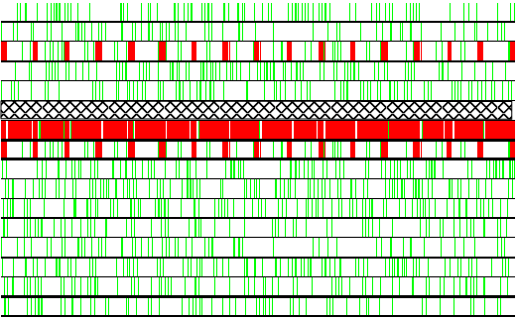
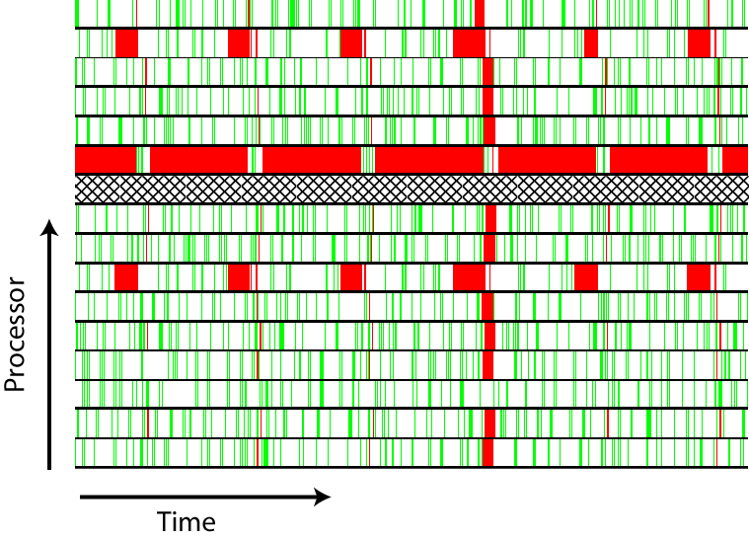
Example: Radar App. (Balanced)

Slide 82
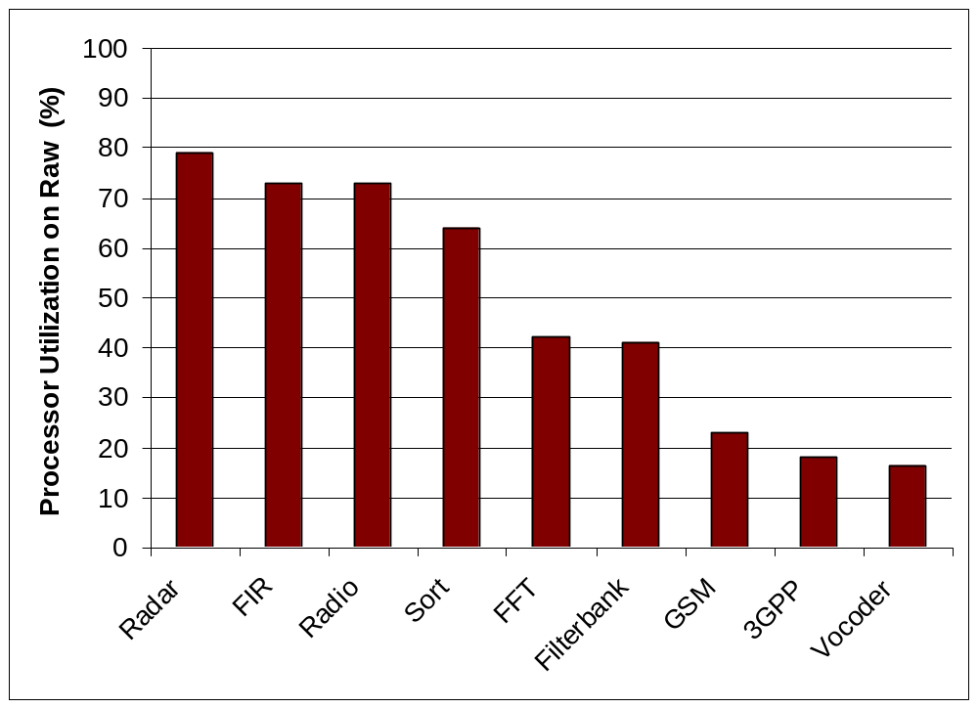

Slide 83
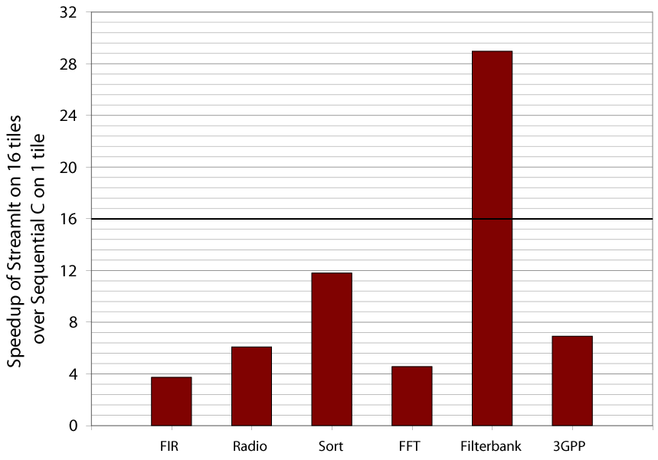

Slide 84
Outline
Design of StreamIt
  Structured Streams
  Messaging
  Morphing
Results
Conclusions

Slide 85
Conclusions
Compiler-conscious language design can improve both programmability and performance
  Structure enables local, hierachical analyses
  Messaging simplifies code, exposes parallelism
  Morphing allows optimization across phases
Goal: Stream programming at high level of abstraction without sacrificing performance

Slide 86
For More Information
StreamIt Homepage
http://compiler.lcs.mit.edu/streamit

Slide 87
