Slide 1



Searching the World Wide Web
in Low Connectivity Communities
Libby Levison
Massachusetts Institute of Technology

Slide 2
Web search
Alternative information sources exist
Web search replaces other info sources
Existing telecomms infrastructure
Optimized for fast delivery

Slide 3
Search: low-connectivity communities
Few sources of information
Web could provide information access
But - little infrastructure:
  Telephone
  Electric
Notes:
No Computer tech

Slide 4
Costs
High-bandwidth search in low-connectivity settings
Cost of infrastructure
ISP access fees
Telephone fees
Is the goal still fast delivery?
Notes:
When we think about what it would cost to have high-speed access in a low connectivity community…
And the question became, given the cost, should the goal still be fast delivery?
What are the costs to do the same thing there as here…

Slide 5
Proposal: email-based search
ISP
Search
Server
World
Wide
Web
Email
user
User reads results off-line
Results downloaded from ISP
Server performs search, returns results
If information not found,
email query to Server on Internet.
User searches on local machine
Notes:
So what is TEK doing? Instead of the infrastructure costs required for high-connectivity search, we’re ‘paying’ for information with time – and running with the existing infrastructures.

Slide 6
The TEK Search Engine
Notes:
Inter library loan: rather than buy a book, you are willing to ‘pay’ for the information in that book with a few days of your time… TEK is the same idea.

Slide 7
Talk Outline
Introduction
TEK Implementation
Rationale
TEK for the Global Community
Discussion

Slide 8
TEK Design Goals
Reduce dependence on telecomms
  Low & intermittent connectivity
  Low-bandwidth
Reduce number of Internet searches
Similar to existing search engines
User friendly

Slide 9
TEK: Time Equals Knowledge
ISP
TEK
Server
World
Wide
Web
Email
TEK Client
Decouple search from Internet access:
TEK Client: user interface
Email protocol: transfers info via email
TEK Server: finds, returns results
Notes:
Client: fewer searches, user friendly, Similar
Protocol: low-connectivity
Server: low-bandwidth

Slide 10
Demo
Notes:
DEMO: Let me show you…

Slide 11
TEK Protocol
ISP
TEK
Server
World
Wide
Web
Email
TEK Client
Email not reliable: messages get lost
TEK Protocol tracks all messages

Slide 12
TEK Protocol
Runs on both TEK Client and TEK Server
Request-reply model
If no reply, automatic retransmission
Other functions:
  Client Registration
  Administration messages

Slide 13
TEK Server
ISP
TEK
Server
World
Wide
Web
Email
TEK Client
Receives information request
  General search, page fetch
Finds & returns information
Provides front page navigation tool

Slide 14
TEK Server
Goals: 1. Reduce bandwidth
2. Send best content
Remove duplicate pages
Remove extraneous code
Select authority pages over hubs
Notes:
We exclude graphics unless user specifically requests them.

Slide 15
TEK Server: Track Client state
Record all client search requests
Record all URLs sent to client
Checks all candidate URLs,
does not send previously sent URLs
Notes:
Protocols that record client state unexplored in US.
For many global communities, cheaper to download once and save.

Slide 16
TEK: Summary
Low-connectivity
Low-bandwidth
User friendly
Similar to existing search engines
Manageable amount of information

Slide 17
Talk Outline
Introduction
TEK Implementation
Rationale
TEK for the Global Community
Discussion

Slide 18
Rationale I: Decreased Cost
Connection time is shorter
Email-only accounts less expensive
Call ISP at will:
Calls cheaper, lines less-noisy, off peak
Local web cache prevents some searches

Slide 19
Email and Internet rates
 | Email only (month) | Internet (month)
Armenia Arminico | $8.50 | $42 | Night discount: 50%
Malawi E & O | $15 | $30
Sri Lanka LankaNet | $11 | $15 | Extra hours: $1.32 peak $0.88 off peak

Slide 20
Rationale II: Improved Reliability
ISP
TEK
SERVER
World
Wide
Web
Email
user
Email as communication medium:
Never need continuous path from client to server
Reduce dependence on global network
Store and forward
Asynchronous
Notes:
Asynchronous – use extra time to post process at Server

Slide 21
Rationale II: Improved Reliability
ISP
TEK
SERVER
World
Wide
Web
Email
user
Email as communication medium:
Never need continuous path from client to server
Reduce dependence on global network
Store and forward
Asynchronous

Slide 22
Rationale II: Improved Reliability
ISP
TEK
SERVER
World
Wide
Web
Email
user
Email as communication medium:
Never need continuous path from client to server
Reduce dependence on global network
Store and forward
Asynchronous

Slide 23
Rationale II: Improved Reliability
ISP
TEK
SERVER
World
Wide
Web
Email
user
Email as communication medium:
Never need continuous path from client to server
Reduce dependence on global network
Store and forward
Asynchronous

Slide 24
Rationale III: Improved Convenience
View results offline : quick, reliable
  Build local URL library
  More people can use computer
Send email during off peak hours
Filtered results returned by TEK Server
Manageable amount of information
Notes:
Avoids peak traffic in connecting to ISP

Slide 25
Talk Outline
Introduction
TEK Implementation
Rationale
TEK for the Global Community
Discussion

Slide 26
TEK for the Global Community
Extends Web search to email-only users
Extend still farther:
collect outgoing emails on diskette,
take diskette to Internet

Slide 27
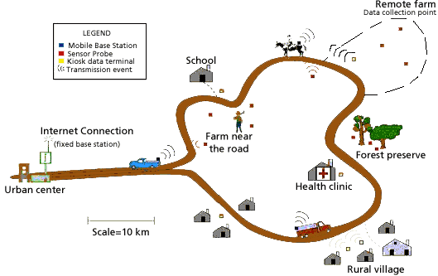
Applications: DakNet
Fletcher & Hasson, 2002
Notes:
DakNet will push Internet/email access frontier further out than the telephone periphery

Slide 28
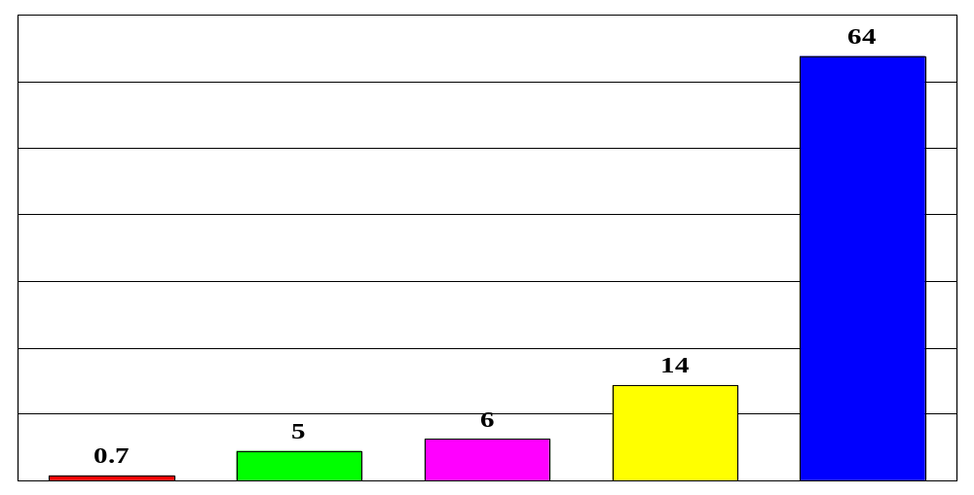
Percentage population online
Africa
Asia
Latin
America
Europe
US & Canada
2001 data

Slide 29
Appropriate Information Technology
“Technology that fits”
Need to understand:
  What technology is possible
  What technology, infrastructure exist
  Cultural context
Numerous technical challenges,
if we can find them

Slide 30
Talk Outline
Introduction
TEK Implementation
Rationale
TEK for the Global Community
Discussion

Slide 31
Open Issues
TEK: Web search only
Access must be bi-directional
Different cultural information needs
Summarization
Send graphics on request

Slide 32
Summary
TEK: email-based Search engine
  More affordable
  More reliable
  More convenient
Extends access to Web search
TEK: Appropriate Info Technology
Alpha deployment this summer

Slide 33









TEK Participants
William Thies
Janelle Prevost
Tazeen Mahtab
Genevieve Cuevas
Saad Shakhshir
Bihn Vo
Alexandro Artola
Yuliya Litvak
Sheldon Chan
Sid Henderson
Mark Halsey
Damon Berry
Libby Levison
Saman Amarasinghe

Slide 34
The end

