Slide 1
Linear Analysis and Optimization of Stream Programs
Andrew A. Lamb
William Thies
Saman Amarasinghe
The New Laboratory for Computer Science and Artificial Intelligence
Massachusetts Institute of Technology

Slide 2
Streaming Application Domain
Based on audio, video, or data stream
Increasingly prevalent and important
  Embedded systems
    Cell phones, handheld computers
  Desktop applications
    Streaming media • Real-time encryption
    Software radio • Graphics packages
  High-performance servers
    Software routers (Example: Click)
    Cell phone base stations
    HDTV editing consoles

Slide 3
Properties of Stream Programs
A large (possibly infinite) amount of data
  Limited lifetime of each data item
  Little processing of each data item
Computation: apply multiple filters to data
  Each filter takes an input stream, does some processing, and produces an output stream
  Filters are independent and self-contained
A regular, static computation pattern
  Filter graph is relatively constant
  A lot of opportunities for compiler optimizations

Slide 4
The StreamIt Language
Goals:
  Provide a High-Level Programming Paradigm
  Improve Programmer Productivity
  Match Performance of Hand-Hacked Assembly
Contributions
  Language Design, Structured Streams, Buffer Management (CC 2002)
  Exploiting Wire-Exposed Architectures (ASPLOS 2002)
  Scheduling of Static Dataflow Graphs (LCTES 2003)
  Domain Specific Optimizations (PLDI 2003)

Slide 5
Example: Freq band detection
Used in…
  metal detector
  garage door opener
  spectrum analyzer
Source:
Application Report SPRA414
Texas Instruments, 1999
A/D
Band pass
Duplicate
Detect
Detect
Detect
Detect
LED
LED
LED
LED

Slide 6
Freq band detection in StreamIt
void->void pipeline FrequencyBand {
float sFreq = 4000;
float cFreq = 500/(sFreq*2*pi);
float wFreq = 100/(sFreq*2*pi);
add D2ASource(sFreq);
add BandPassFilter(1, cFreq-wFreq,
cFreq+wFreq, 100);
add splitjoin {
split duplicate;
for (int i=0; i<4; i++) {
add Detector(i/4);
add LEDOutput(i);
}
join roundrobin(0);
}
}
A/D
Band pass
Duplicate
Detect
Detect
Detect
Detect
LED
LED
LED
LED

Slide 7
Freq band detection in StreamIt
void->void pipeline FrequencyBand {
float sFreq = 4000;
float cFreq = 500/(sFreq*2*pi);
float wFreq = 100/(sFreq*2*pi);
add D2ASource(sFreq);
add BandPassFilter(1, cFreq-wFreq,
cFreq+wFreq, 100);
add splitjoin {
split duplicate;
for (int i=0; i<4; i++) {
add Detector(i/4);
add LEDOutput(i);
}
join roundrobin(0);
}
}
A/D
float->float pipeline BandPassFilter(float gain, float ws,
float wp, int num) {
add LowPassFilter(1, wp, num);
add HighPassFilter(gain, ws, num);
}
Band pass
Low pass
High pass
Duplicate
Detect
Detect
Detect
Detect
LED
LED
LED
LED

Slide 8
Freq band detection in StreamIt
void->void pipeline FrequencyBand {
float sFreq = 4000;
float cFreq = 500/(sFreq*2*pi);
float wFreq = 100/(sFreq*2*pi);
add D2ASource(sFreq);
add BandPassFilter(1, cFreq-wFreq,
cFreq+wFreq, 100);
add splitjoin {
split duplicate;
for (int i=0; i<4; i++) {
add Detector(i/4);
add LEDOutput(i);
}
join roundrobin(0);
}
}
float->float filter LowPassFilter(float g,
float cFreq, int N)
{
float[N] h;
init {
int OFF = N/2;
for (int i=0; i<N; i++) {
h[i] = g*sin(…);
}
}
work peek N pop 1 push 1 {
float sum = 0;
for (int i=0; i<N; i++) {
sum += h[i]*peek(i);
}
push(sum);
pop();
}
A/D
float->float pipeline BandPassFilter(float gain, float ws,
float wp, int num) {
add LowPassFilter(1, wp, num);
add HighPassFilter(gain, ws, num);
}
float->float pipeline BandPassFilter(float gain, float ws,
float wp, int num) {
add LowPassFilter(1, wp, num);
add HighPassFilter(gain, ws, num);
}
Band pass
Low pass
High pass
Duplicate
Detect
Detect
Detect
Detect
LED
LED
LED
LED

Slide 9
Freq band detection in StreamIt
void->void pipeline FrequencyBand {
float sFreq = 4000;
float cFreq = 500/(sFreq*2*pi);
float wFreq = 100/(sFreq*2*pi);
add D2ASource(sFreq);
add BandPassFilter(1, cFreq-wFreq,
cFreq+wFreq, 100);
add splitjoin {
split duplicate;
for (int i=0; i<4; i++) {
add Detector(i/4);
add LEDOutput(i);
}
join roundrobin(0);
}
}
float->float filter LowPassFilter(float g,
float cFreq, int N)
{
float[N] h;
init {
int OFF = N/2;
for (int i=0; i<N; i++) {
h[i] = g*sin(…);
}
}
work peek N pop 1 push 1 {
float sum = 0;
for (int i=0; i<N; i++) {
sum += h[i]*peek(i);
}
push(sum);
pop();
}
A/D
float->float pipeline BandPassFilter(float gain, float ws,
float wp, int num) {
add LowPassFilter(1, wp, num);
add HighPassFilter(gain, ws, num);
}
float->float pipeline BandPassFilter(float gain, float ws,
float wp, int num) {
add LowPassFilter(1, wp, num);
add HighPassFilter(gain, ws, num);
}
Band pass
Low pass
High pass
Duplicate
Detect
Detect
Detect
Detect
LED
LED
LED
LED

Slide 10
Freq band detection on a TI DSP
A/D
Band pass
Low pass
High pass
Duplicate
Detect
Detect
Detect
Detect
LED
LED
LED
LED

Slide 11
DSP Implementation
;*******************************************************************
; File Name: FIR0.ASM
; Originator: Digital control systems Apps group - Houston
; Target Sys: 'C24x Evaluation Board
;
; Description: FIR bandpass filter which detects the presence of a
; 500Hz signal. If the tone is detected an LED is
; lit by using the output port. Sampling Frequency
; forced to be 4kHz.
;
; Last Update: 9 June 1997
;
;*******************************************************************
.include f240regs.h
;-------------------------------------------------------------------
; I/O Mapped EVM Registers
;-------------------------------------------------------------------
DAC0 .set 0000h ;Input data register for DAC0
DAC1 .set 0001h ;Input data register for DAC1
DAC2 .set 0002h ;Input data register for DAC2
DAC3 .set 0003h ;Input data register for DAC3
DACUPDATE .set 0004h ;DAC Update Register
;-------------------------------------------------------------------
; Variable Declarations for B2
;-------------------------------------------------------------------
.bss GPR0,1 ;General Purpose Register
.bss DAC0VAL,1 ;DAC0 Channel Value
.bss DAC1VAL,1 ;DAC1 Channel Value
.bss DAC2VAL,1 ;DAC2 Channel Value
.bss DAC3VAL,1 ;DAC3 Channel Value
;-------------------------------------------------------------------
; Vector address declarations
;-------------------------------------------------------------------
.sect ".vectors"
RSVECT B START ; Reset Vector
INT1 B PHANTOM ; Interrupt Level 1
INT2 B FIR_ISR ; Interrupt Level 2
INT3 B PHANTOM ; Interrupt Level 3
INT4 B PHANTOM ; Interrupt Level 4
INT5 B PHANTOM ; Interrupt Level 5
INT6 B PHANTOM ; Interrupt Level 6
RESERVED B PHANTOM ; Reserved
SW_INT8 B PHANTOM ; User S/W Interrupt
SW_INT9 B PHANTOM ; User S/W Interrupt
SW_INT10 B PHANTOM ; User S/W Interrupt
SW_INT11 B PHANTOM ; User S/W Interrupt
SW_INT12 B PHANTOM ; User S/W Interrupt
SW_INT13 B PHANTOM ; User S/W Interrupt
SW_INT14 B PHANTOM ; User S/W Interrupt
SW_INT15 B PHANTOM ; User S/W Interrupt
SW_INT16 B PHANTOM ; User S/W Interrupt
TRAP B PHANTOM ; Trap vector
NMINT B PHANTOM ; Non-maskable Interrupt
EMU_TRAP B PHANTOM ; Emulator Trap
SW_INT20 B PHANTOM ; User S/W Interrupt
SW_INT21 B PHANTOM ; User S/W Interrupt
SW_INT22 B PHANTOM ; User S/W Interrupt
SW_INT23 B PHANTOM ; User S/W Interrupt
;===================================================================
; M A I N C O D E - starts here
;===================================================================
.text
NOP
START: SETC INTM ;Disable interrupts
SPLK #0002h,IMR ;Mask all core interrupts
; except INT2
LACC IFR ;Read Interrupt flags
SACL IFR ;Clear all interrupt flags
CLRC SXM ;Clear Sign Extension Mode
CLRC OVM ;Reset Overflow Mode
CLRC CNF ;Config Block B0 to Data mem
;-----------------------------------
; Set up PLL Module
;-----------------------------------
LDP #00E0h ;DP = 224; Address for
;7000h - 707Fh
;The following line is necessary if a previous program set the PLL
;to a different setting than the settings which the application
;uses. By disabling the PLL, the CKCR1 register can be modified
;so that the PLL can run at the new settings when it is re-enabled.
SPLK #0000000001000001b,CKCR0 ;CLKMD=PLL Disable
;SYSCLK=CPUCLK/2
; 5432109876543210
SPLK #0000000010111011b,CKCR1
;CLKIN(OSC)=10MHz,CPUCLK=20MHz
;CKCR1 - Clock Control Register 1
;Bits 7-4 (1011)CKINF(3)-CKINF(0) - Crystal or Clock-In Frequency
; Frequency = 10MHz
;Bit 3 (1) PLLDIV(2) - PLL divide by 2 bit
; Divide PLL input by 2
;Bits 2-0 (011) PLLFB(2)-PLLFB(0) - PLL multiplication ratio
; PLL Multiplication Ration = 4
; 5432109876543210
SPLK #0000000011000011b,CKCR0
;CLKMD=PLL Enable, SYSCLK=CPUCLK/2
;CKCR0 - Clock Control Register 0
;Bits 7-6 (11) CLKMD(1),CLKMD(0) - Operational mode of Clock
; Module
; PLL Enabled; Run on CLKIN on exiting low power mode
;Bits 5-4 (00) PLLOCK(1),PLLOCK(0) - PLL Status. READ ONLY
;Bits 3-2 (00) PLLPM(1),PLLPM(0) - Low Power Mode
; LPM0
;Bit 1 (0) ACLKENA - 1MHz ACLK Enable
; ACLK Enabled
;Bit 0 (1) PLLPS - System Clock Prescale Value
; f(sysclk)=f(cpuclk)/2
; 5432109876543210
SPLK #0100000011000000b,SYSCR ;CLKOUT=CPUCLK
;SYSCR - System Control Register
;Bit 15-14 (01) RESET1,RESET0 - Software Reset Bits
; No Action
;Bits 13-8 (000000) Reserved
;Bit 7-6 (11) CLKSRC1,CLKSRC0 - CLKOUT-Pin Source Select
; CPUCLK: CPU clock output mode
;Bit 5-0 (000000) Reserved
SPLK #006Fh, WDCR ;Disable WD if VCCP=5V (JP5 in pos. 2-3)
KICK_DOG ;Reset Watchdog
;*-*-*-*-*-*-*-*-*-*-*-*-*-*-*-*-*-*-*-*-*-*-*-*-*-*-*-*-*-*-*-*-*-*
;- Event Manager Module Reset
;*
;-This section resets all of the Event Manager Module Registers.
;*This is necessary for silicon revsion 1.1; however, for
;-silicon revisions 2.0 and later, this is not necessary
;*
;-
;*-*-*-*-*-*-*-*-*-*-*-*-*-*-*-*-*-*-*-*-*-*-*-*-*-*-*-*-*-*-*-*-*-*
LDP #232 ;DP=232 Data Page for the Event
;Manager
SPLK #0000h,GPTCON ;Clear General Purpose Timer Control
SPLK #0000h,T1CON ;Clear GP Timer 1 Control
SPLK #0000h,T2CON ;Clear GP Timer 2 Control
SPLK #0000h,T3CON ;Clear GP Timer 3 Control
SPLK #0000h,COMCON ;Clear Compare Control
SPLK #0000h,ACTR ;Clear Full Compare Action Control
;Register
SPLK #0000h,SACTR ;Clear Simple Compare Action Control
;Register
SPLK #0000h,DBTCON ;Clear Dead-Band Timer Control
;Register
SPLK #0FFFFh,EVIFRA;Clear Interrupt Flag Register A
SPLK #0FFFFh,EVIFRB;Clear Interrupt Flag Register B
SPLK #0FFFFh,EVIFRC;Clear Interrupt Flag Register C
SPLK #0000h,CAPCON ;Clear Capture Control
SPLK #0000h,EVIMRA ;Clear Event Manager Mask Register A
SPLK #0000h,EVIMRB ;Clear Event Manager Mask Register B
SPLK #0000h,EVIMRC ;Clear Event Manager Mask Register C
;*-*-*-*-*-*-*-*-*-*-*-*-*-*-*-*-*-*-*-*-*-*-*-*-*-*-*-*-*-*-*-*-*-*
; End of RESET section for silicon revision 1.1 *
;*-*-*-*-*-*-*-*-*-*-*-*-*-*-*-*-*-*-*-*-*-*-*-*-*-*-*-*-*-*-*-*-*-*
;-----------------------------------
; Set up Event Manager Module
;-----------------------------------
T1COMPARE .set 2500
T1PERIOD .set 5000 ;Sets up period for 4kHz frequency
LDP #232 ;DP=232, Data Page for Event Manager
Addresses
SPLK #T1COMPARE,T1CMPR;Compare value for 50% duty cycle
; 2109876543210
SPLK #0000001010101b,GPTCON
;GPTCON - GP Timer Control Register
;Bit 15 (0) T3STAT - GP Timer 3 Status. READ ONLY
;Bit 14 (0) T2STAT - GP Timer 2 Status. READ ONLY
;Bit 13 (0) T1STAT - GP Timer 1 Status. READ ONLY
;Bits 12-11 (00) T3TOADC - ADC start by event of GP Timer 3
; No event starts ADC
;Bits 10-9 (00) T2TOADC - ADC start by event of GP Timer 2
; No event starts ADC
;Bits 8-7 (00) T1TOADC - ADC start by event of GP Timer 1
; No event starts ADC
;Bit 6 (1) TCOMPOE - Compare output enable
; Enable all three GP timer compare outputs
;Bits 5-4 (01) T3PIN - Polarity of GP Timer 3 compare output
; Active Low
;Bits 3-2 (01) T2PIN - Polarity of GP Timer 2 compare output
; Active Low
;Bits 1-0 (01) T1PIN - Polarity of GP Timer 1 compare output
; Active Low
SPLK #T1PERIOD,T1PR ;Period value for 2kHz signal
SPLK #0000h,T1CNT ;Clear GP Timer 1 Counter
SPLK #0000h,T2CNT ;Clear GP Timer 2 Counter
SPLK #0000h,T3CNT ;Clear GP Timer 3 Counter
; 5432109876543210
SPLK #0001000000000010b,T1CON
Source: Application Report SPRA414, Texas Instruments, 1999

Slide 12
Cont.
;T1CON - GP Timer 1 Control Register
;Bits 15-14(00) FREE,SOFT - Emulation Control Bits
; Stop immediately on emulation suspend
;Bits 13-11(010) TMODE2-TMODE0 - Count Mode Selection
; Continuous-Up Count Mode
;Bits 10-8 (000) TPS2-TPS0 - Input Clock Prescaler
; Divide by 1
;Bit 7 (0) Reserved
;Bit 6 (0) TENABLE - Timer Enable
; Disable timer operations
;Bits 5-4 (00) TCLKS1,TCLKS0 - Clock Source Select
; Internal Clock Source
;Bits 3-2 (00) TCLD1,TCLD0 - Timer Compare Register Reload
; Condition
; When counter is 0
;Bit 1 (1) TECMPR - Timer compare enable
; Enable timer compare operation
;Bit 0 (0) Reserved
; 5432109876543210
SPLK #0000000000000000b,T2CON
;GP Timer 2 - Not Used
;T2CON - GP Timer 2 Control Register
;Bits 15-14(00) FREE,SOFT - Emulation Control Bits
; Stop immediately on emulation suspend
;Bits 13-11(000) TMODE2-TMODE0 - Count Mode Selection
; Stop/Hold
;Bits 10-8 (000) TPS2-TPS0 - Input Clock Prescaler
; Divide by 1
;Bit 7 (0) TSWT1 - GP Timer 1 timer enable bit
; Use own TENABLE bit
;Bit 6 (0) TENABLE - Timer Enable
; Disable timer operations
;Bits 5-4 (00) TCLKS1,TCLKS0 - Clock Source Select
; Internal Clock Source
;Bits 3-2 (00) TCLD1,TCLD0 - Timer Compare Register Reload
; Condition
; When counter is 0
;Bit 1 (0) TECMPR - Timer compare enable
; Disable timer compare operation
;Bit 0 (0) SELT1PR - Period Register select
; Use own period register
; 5432109876543210
SPLK #0000000000000000b,T3CON
;GP Timer 3 - Not Used
;T3CON - GP Timer 3 Control Register
;Bits 15-14(00) FREE,SOFT - Emulation Control Bits
; Stop immediately on emulation suspend
;Bits 13-11(000) TMODE2-TMODE0 - Count Mode Selection
; Stop/Hold
;Bits 10-8 (000) TPS2-TPS0 - Input Clock Prescaler
; Divide by 1
;Bit 7 (0) TSWT1 - GP Timer 1 timer enable bit
; Use own TENABLE bit
;Bit 6 (0) TENABLE - Timer Enable
; Disable timer operations
;Bits 5-4 (00) TCLKS1,TCLKS0 - Clock Source Select
; Internal Clock Source
;Bits 3-2 (00) TCLD1,TCLD0 - Timer Compare Register Reload
; Condition
; When counter is 0
;Bit 1 (0) TECMPR - Timer compare enable
; Disable timer compare operation
;Bit 0 (0) SELT1PR - Period Register select
; Use own period register
;-----------------------------------
; Set up Digital I/O Port
;-----------------------------------
LDP #225 ;DP=225, Data Page to Configure OCRA
; 5432109876543210
SPLK #0011100000001111b,OCRA
;OCRA - Output Control Register A
;Bit 15 (0) CRA.15 - IOPB7
;Bit 14 (0) CRA.14 - IOPB6
;Bit 13 (1) CRA.13 - T3PWM/T3CMP
;Bit 12 (1) CRA.12 - T2PWM/T2CMP
;Bit 11 (1) CRA.11 - T1PWM/T1CMP
;Bit 10 (0) CRA.10 - IOPB2
;Bit 9 (0) CRA.9 - IOPB1
;Bit 8 (0) CRA.8 - IOPB0
;Bits 7-4 (0000)Reserved
;Bit 3 (1) CRA.3 - ADCIN8
;Bit 2 (1) CRA.2 - ADCIN9
;Bit 1 (1) CRA.1 - ADCIN1
;Bit 0 (1) CRA.0 - ADCIN0
;-----------------------------------
; Set up ADC Module
;-----------------------------------
LDP #224
; 5432109876543210
SPLK #1000100100000000b,ADCTRL1
;ADCTRL1 - ADC Control Register 1
;Bit 15 (1) Suspend-SOFT -
; Complete Conversion before halting emulator
;Bit 14 (0) Suspend-FREE -
; Operations is determined by Suspend-SOFT
;Bit 13 (0) ADCIMSTART - ADC start converting immediately
; No Action
;Bit 12 (0) ADC2EN - Enable/Disable ADC2
; Disable ADC2
;Bit 11 (1) ADC1EN - Enable/Disable ADC1
; Enable ADC1
;Bit 10 (0) ADCCONRUN - ADC Continuous Conversion Mode
; Disable Continuous Conversion
;Bit 9 (0) ADCINTEN - Enable ADC Interrupt
; Mask ADC Interrupt
;Bit 8 (1) ADCINTFLAG - ADC Interrupt Flag
; Clear Interrupt Flag Bit
;Bit 7 (0) ADCEOC - End of Conversion Bit READ ONLY
;Bits 6-4 (000) ADC2CHSEL - ADC2 Channel Select
; Channel 8
;Bits 3-1 (000) ADC1CHSEL - ADC1 Channel Select
; Channel 0
;Bit 0 (0) ADCSOC - ADC Start of conversion bit
; No Action
; 5432109876543210
SPLK #0000000000000101b,ADCTRL2
;ADCTRL2 - ADC Control Register 2
;Bits 15-11 (00000)Reserved
;Bit 10 (0) ADCEVSOC - Event Manager SOC mask bit
; Mask ADCEVSOC
;Bit 9 (0) ADCEXTSOC - External SOC mask bit
; Mask ADCEXTSOC
;Bit 8 (0) Reserved
;Bits 7-6 (00) ADCFIFO1 - Data Register FIFO1 Status READ
ONLY
;Bit 5 (0) Reserved
;Bits 4-3 (00) ADCFIFO2 - Data Register FIFO2 Status READ
ONLY
;Bits 2-0 (101) ADCPSCALE - ADC Input Clock Prescaler
; Prescale Value 16
; SYSCLK Period = 0.1usec
; 0.1usec x 16 x 6 = 9.6 usec >= 6usec
;-----------------------------------
; Set up DAC Module
;-----------------------------------
;The DAC module requires that wait states be generated for proper
;operation.
LDP #0000h ;Set Data Page Pointer to 0000h, Block B2
SPLK #4h,GPR0 ;Set Wait State Generator for
OUT GPR0,WSGR ;Program Space, 0WS
;Date Space, 0WS
;I/O Space, 1WS
;-------------------------------------------------------------------
; MAIN LINE
;-------------------------------------------------------------------
.sect ".blk0"
XVALUE .word 0,0,0,0,0,0,0,0,0,0,0,0,0,0,0,0,0,0,0,0
.word 0,0,0,0,0,0,0,0,0,0,0,0,0,0,0,0,0,0,0,0
.word 0,0,0,0,0,0,0,0,0,0,0,0,0,0,0,0,0,0,0,0
.word 0,0,0,0,0,0,0,0,0,0,0,0,0,0,0,0,0,0,0,0
.word 0,0,0,0,0,0,0,0,0,0,0,0,0,0,0,0,0,0,0,0,0
.sect ".blk1"
VALUEIN .word 0,0,0,0,0,0,0,0,0,0,0,0,0,0,0,0,0,0,0,0,0,0,0,0,0,0,0,0,0,0,0,0
.word 0,0,0,0,0,0,0,0,0,0,0,0,0,0,0,0,0,0,0,0,0,0,0,0,0,0,0,0,0,0,0,0
.word 0,0,0,0,0,0,0,0,0,0,0,0,0,0,0,0,0,0,0,0,0,0,0,0,0,0,0,0,0,0,0,0
.word 0,0,0,0,0,0,0,0,0,0,0,0,0,0,0,0,0,0,0,0,0,0,0,0,0,0,0,0,0,0,0,0
VALUEOUT .word 0,0,0,0,0,0,0,0,0,0,0,0,0,0,0,0,0,0,0,0,0,0,0,0,0,0,0,0,0,0,0,0
.word 0,0,0,0,0,0,0,0,0,0,0,0,0,0,0,0,0,0,0,0,0,0,0,0,0,0,0,0,0,0,0,0
.word 0,0,0,0,0,0,0,0,0,0,0,0,0,0,0,0,0,0,0,0,0,0,0,0,0,0,0,0,0,0,0,0
.word 0,0,0,0,0,0,0,0,0,0,0,0,0,0,0,0,0,0,0,0,0,0,0,0,0,0,0,0,0,0,0,0
.data
;Coefficients for 500Hz Bandpass filter for 4kHz Sampling Frequency
BCOEFF .word 0000h,0002h,0002h,0001h
.word 0000h,0000h,0000h,0FFFFh
.word 0FFFFh,0000h,0000h,0002h
.word 0002h,0FFFFh,0FFF9h,0FFF7h
.word 0000h,0013h,0025h,0021h
.word 0FFFBh,0FFBCh,0FF90h,0FFA7h
.word 0011h,00A4h,00FDh,00BFh
.word 0FFDEh,0FEC3h,0FE2Ah,0FEA7h
.word 0033h,0206h,02F1h,0220h
.word 0FFC2h,0FD19h,0FBD6h,0FD05h
.word 003Ch,03B8h,054Ah,03C5h
.word 0FFD4h,0FBB4h,0F9EAh,0FBADh
.word 0010h,0484h,0660h,0484h
.word 0010h,0FBADh,0F9EAh,0FBB4h
.word 0FFD4h,03C5h,054Ah,03B8h
.word 003Ch,0FD05h,0FBD6h,0FD19h
.word 0FFC2h,0220h,02F1h,0206h
.word 0033h,0FEA7h,0FE2Ah,0FEC3h
.word 0FFDEh,00BFh,00FDh,00A4h
.word 0011h,0FFA7h,0FF90h,0FFBCh
.word 0FFFBh,0021h,0025h,0013h
.word 0000h,0FFF7h,0FFF9h,0FFFFh
.word 0002h,0002h,0000h,0000h
.word 0FFFFh,0FFFFh,0000h,0000h
.word 0000h,0001h,0002h,0002h
.word 0000h
LEDS .set 000Ch ;I/O Address for LEDS register
WINDOW .set 500 ;Number of smpls to check before
;reset’g MAX values
.bss LEDSOUT,1 ;Variable for which LEDS to light
.bss MAXIN,1 ;Maximum value input value
.bss MAXOUT,1 ;Maxumum FIR result value
.bss DIFFIN,1 ;Maximum Input Value - DC Offset
;(7ffh)
.bss DIFFOUT,1 ;Maximum Output value - DC Offset
;(7ffh)
.bss THRESHOLD1,1 ;Threshold value for 1st LED
.bss THRESHOLD2,1 ;Threshold value for 2nd LED
.bss THRESHOLD3,1 ;Threshold value for 3rd LED
.bss THRESHOLD4,1 ;Threshold value for 4th LED
.bss THRESHOLD5,1 ;Threshold value for 5th LED
.bss THRESHOLD6,1 ;Threshold value for 6th LED
.bss THRESHOLD7,1 ;Threshold value for 7th LED
.bss THRESHOLD8,1 ;Threshold value for 8th LED
.bss RESET_MAX,1 ;Counter to determine when to
Source: Application Report SPRA414, Texas Instruments, 1999

Slide 13
Cont. Cont.
;reset MAX values
.bss TEMP,1 ;Variable for temporary storage
;of values
.text
MAIN LAR AR1,#ADCFIFO1 ; AR1 = ADCFIFO1 address
LAR AR2,#ADCTRL1 ; AR2 = ADCTRL1 address
LAR AR3,#BCOEFF ; AR3 = BCOEFF address
LAR AR5,#LEDS ; AR5 = LEDS Output
LDP #232
LACC EVIFRA ;ACC = Event Module Type A Interrupt
;Flags
SACL EVIFRA ;EVIFRA = ACC; Clears the current
;set flags
SPLK #0080h,EVIMRA ; Enable Timer 1 Period
; Interrupt
MAR *,AR2 ;ARP = AR2
LACC * ;ACC = ADCTRL1
ADD #1 ;SET BIT FOR SINGLE CONVERSION
SACL *,0,AR1 ;STARTS ADC CONVERSION
SBIT1 T1CON,B6_MSK ;Sets Bit 6 of T1CON; Starts
;the timer
LDP #0 ;DP = 0; Addresses 0000h - 007Fh
SPLK #0000h,LEDSOUT ;Clear the LEDS
OUT LEDSOUT,LEDS
SPLK #0E38h,THRESHOLD1;Q15 value for 1/9
SPLK #1C71h,THRESHOLD2;Q15 value for 2/9
SPLK #2AAAh,THRESHOLD3;Q15 value for 3/9
SPLK #38E3h,THRESHOLD4;Q15 value for 4/9
SPLK #471Ch,THRESHOLD5;Q15 value for 5/9
SPLK #5555h,THRESHOLD6;Q15 value for 6/9
SPLK #638Eh,THRESHOLD7;Q15 value for 7/9
SPLK #71C7h,THRESHOLD8;Q15 value for 8/9
SPLK #0000h,MAXIN ;Initialize Maxmimum input
;value
SPLK #0000h,MAXOUT ;Initialize Maximum FIR output
;value
SPLK #WINDOW,RESET_MAX ;Initialize the maximum
;reset counter
CLRC INTM ;Enable Interrupts
WAIT B WAIT ;Wait for interrupt
;-------------------------------------------------------------------
; INTERRUPT SERVICE ROUTINES FOR FIR FILTER
;-------------------------------------------------------------------
FIR_ISR LAR AR4,#XVALUE+100 ;AR4 = DATA ADDRESS
MAR *,AR1 ;ARP = AR1 = ADCFIFO1
LACC *,0,AR4 ;ACC = ADCFIFO1; ARP =
AR4
LDP #0 ;DP = 0
;Addresses 0000h - 007Fh
SACL DAC1VAL ;DAC1VAL = ADCFIFO1
RPT #7 ;Shift ADC value 8 places
; - Reduce to 8 bit value
SFR ;Larger bit values produced
;large results
SUB #7Fh ;Subtract the equivalent 8 bit
;DC offset
LDP #04h ;DP = 4; Address 0200h - 027Fh
SACL XVALUE ;XVALUE = ADCFIFO1 / 256;
LACC #0h ;Initialize the ACCUMULATOR
MPY #0h ;Initialize the PROD REG
RPT #100 ;Calculate Y
MACD BCOEFF,*- ;Multiply X with B, and add
APAC ;final accumulation
LDP #0
RPT #7 ;Shift the result 8 places to left
SFL
SACH DAC0VAL,1 ;DAC0VAL = Y * 2; shift to
;remove extra sign bit
;FIR result to output
;Multiply the values by 5/4 because the maximum gain is 4/5
LT DAC0VAL ;TREG = DAC0VAL
MPY #5 ;PREG = DAC0VAL * 5
PAC ;ACC = PREG = DAC0VAL * 5
SFR ;ACC = DAC0VAL * 5 / 2
SFR ;ACC = DAC0VAL * 5 / 4
SACL DAC0VAL ;DAC0VAL = DAC0VAL * 5/4
LACC DAC0VAL ;ACC = DAC0VAL
RPT #3 ;Shift right 4 times
; = 16 bit value to
SFR ;12 bit value because
;DAC is 12bits
ADD #7FFh ;Add DC offset
AND #0FFFh ;Ensure 12 bits
SACL DAC0VAL ;Store value for output on the DAC
LDP #7 ;DP=7; Address for 0380h to 03FFh
SACL VALUEOUT ;Store value to find maximum
;value of the output values
LAR AR6,#(VALUEOUT+127-1) ;AR6 = End of VALUE OUT
;buffer
LAR AR7,#126 ;AR7 = 127 - 1; Number of
;values to move
MAR *,AR6 ;ARP = AR6
SHIFT1 DMOV *-,AR7 ;Move all of the values in
;the VALUEOUT
BANZ SHIFT1,*-,AR6 ;Data Buffer to the next
;higher address
LDP #0 ;DP = 0; Addresses 0000h - 007Fh
LACC DAC1VAL ;ACC = DAC1VAL = Input Value
RPT #3 ;Shift the value to the
;right 4 times
SFR ;Convert the value from 16
;bits to 12 bits
SACL DAC1VAL ;DAC1VAL = 12 bit value for DAC
LDP #6 ;DP = 6; Addresses 0300h - 037Fh
SACL VALUEIN ;VALUEIN = DAC1VAL
LAR AR6,#(VALUEIN+127-1);AR6 = End of VALUE IN
;buffer
LAR AR7,#126 ;AR7 = 127 - 1; Number of
;values to move
MAR *,AR6 ;ARP = AR6
SHIFT2 DMOV *-,AR7 ;Move all of the values in
;the VALUEIN
BANZ SHIFT2,*-,AR6 ;Data Buffer to the next
;higher address
;Outputs the FIR results and the original value
;DAC0 has the FIR results and DAC1 has the original value
LDP #0
OUT DAC0VAL,DAC0 ;DAC0 = DAC0VAL; FIR result on
;DAC channel 0
OUT DAC1VAL,DAC1 ;DAC1 = DAC1VAL; Input value
;on DAC channel 1
OUT DAC0VAL,DACUPDATE
;Update the values on the DAC
;Find the maximum value among VALUEIN and VALUEOUT for the LEDs
LACC RESET_MAX ;ACC = RESET_MAX
; Max Reset Counter
SUB #1 ;Decrement by 1
SACL RESET_MAX ;Store new value for RESET_MAX
BCND NO_RESET,GT ;If not WINDOWth value, don’t
;reset counter
SPLK #WINDOW,RESET_MAX
;Else reset the max reset counter
SPLK #0000h,MAXIN ;Reset the MAXIN value
SPLK #0000h,MAXOUT ;Reset the MAXOUT value
NO_RESET LAR AR6,#VALUEIN ;AR6 = VALUEIN; Beginning of
;Data In Buffer
LAR AR7,#127 ;AR7 = 128 - 1; Counter to find
;max value in
MAR *,AR6 ;ARP = AR6
FIND_MAXIN LACC *+,0,AR7 ;ACC = Value pointed by AR6
SUB MAXIN ;Subtract MAXIN
BCND RESUME1,LEQ ;If the value results in a
;value less than 0,
;then the value is smaller
;than MAXIN, else the
;value is larger than MAXIN
ADD MAXIN ;ACC = Value pointed by AR6
SACL MAXIN ;Store new MAXIN value
RESUME1 BANZ FIND_MAXIN,*-,AR6 ;If smaller than MAXIN,
;decrement loop counter
;(AR7), move to next value in
;buffer
LAR AR7,#127 ;Since VALUEIN buffer is
;adjacent to
;VALUEOUT buffer, only AR7
;needs to be reset
;ARP is already AR6
FIND_MAXOUT LACC *+,0,AR7 ;ACC = Value pointed by AR6
SUB MAXOUT ;Subtract MAXOUT
BCND RESUME2,LEQ ;If the value results in a
;value less than 0,
;then the value is smaller than
;MAXOUT, els
;the value is larger than
;MAXOUT
ADD MAXOUT ;ACC = Value pointed by AR6
SACL MAXOUT ;Store new MAXOUT value
RESUME2 BANZ FIND_MAXOUT,*-,AR6 ;If smaller than MAXOUT,
;dec loop counter (AR7),
;move to next value in buffer
;The following section determines if the value meets the threshold
;requirement
LDP #0 ;DP = 0; Addresses 0000h to 007Fh
;All variables used are in B2
;Need to remove the DC offset because if the FIR result is 0 it will
;equal 7ffh which is already 50% of the maximum input value
LACC MAXIN ;ACC = MAXIN
SUB #7FFh ;Subtract the DC offset
SACL DIFFIN ;DIFFIN = MAXIN - 7ffh
LACC MAXOUT ;ACC = MACOUT
SUB #7FFh ;Subtract the DC offset
SACL DIFFOUT ;DIFFOUT = MAXOUT - 7ffh
;Check if the output exceeds the middle threshold value, THRESHOLD4
LT DIFFIN ;TREG = DIFFIN
TH4 MPY THRESHOLD4 ;PREG = DIFFIN * THRESHOLD4
PAC ;ACC = PREG
SACH TEMP,1 ;TEMP = ACC*2; Shift to remove
;extra sign bit
LACC TEMP ;ACC = TEMP
SUB DIFFOUT ;Subtract DIFFOUT
BCND ABOVE4,LT ;If DIFFOUT is greater than
;TEMP, then the FIR result is
;greater than VALUEIN * THRESHOLD4,
;else, it is below THRESHOLD4 value
;Output is below THRESHOLD4. Check if above THRESHOLD2
BELOW4 LT DIFFIN
TH2 MPY THRESHOLD2
PAC
SACH TEMP,1
LACC TEMP
SUB DIFFOUT
BCND ABOVE2,LT
;Output is below THRESHOLD4 & THRESHOLD2. Check if above THRESHOLD1
BELOW2 LT DIFFIN
TH1 MPY THRESHOLD1
PAC
SACH TEMP,1
LACC TEMP
SUB DIFFOUT
BCND ABOVE1,LT
Source: Application Report SPRA414, Texas Instruments, 1999

Slide 14
Cont. Cont. Cont.
;Output is below THRESHOLD4, THRESHOLD2, & THRESHOLD1. Turn off LEDS
BELOW1 SPLK #0000h,LEDSOUT
B OUTLEDS
;Output is below THRESHOLD4, THRESHOLD2, but above THRESHOLD1. Turn
;on DS1
ABOVE1 SPLK #0001h,LEDSOUT
B OUTLEDS
;Output is below THRESHOLD4, but above THRESHOLD2. Check if above
;THRESHOLD3
ABOVE2 LT DIFFIN
TH3 MPY THRESHOLD3
PAC
SACH TEMP,1
LACC TEMP
SUB DIFFOUT
BCND ABOVE3,LT
;Output is below THRESHOLD4 and THRESHOLD3, but above THRESHOLD2.
;Turn on DS1-DS2
BELOW3 SPLK #0003h,LEDSOUT
B OUTLEDS
;Output is below THRESHOLD4, but above THRESHOLD3 and THRESHOLD2.
;Turn on DS1-DS3
ABOVE3 SPLK #0007h,LEDSOUT
B OUTLEDS
;Output is above THRESHOLD4. Check if above THRESHOLD6
ABOVE4 LT DIFFIN
TH6 MPY THRESHOLD6
PAC
SACH TEMP,1
LACC TEMP
SUB DIFFOUT
BCND ABOVE6,LT
;Output is above THRESHOLD4, but below THRESHOLD6. Check if above
;THRESHOLD5.
BELOW6 LT DIFFIN
TH5 MPY THRESHOLD5
PAC
SACH TEMP,1
LACC TEMP
SUB DIFFOUT
BCND ABOVE5,LT
;Output is above THRESHOLD4, but below THRESHOLD6 & THRESHOLD5. Turn
;on DS1-DS4
BELOW5 SPLK #000Fh,LEDSOUT
B OUTLEDS
;Output is above THRESHOLD4 & THRESHOLD5, but below THRESHOLD6.
;Turn on DS1-DS5
ABOVE5 SPLK #001Fh,LEDSOUT
B OUTLEDS
;Output is above THRESHOLD4 & THRESHOLD6. Check if above THRESHOLD8.
ABOVE6 LT DIFFIN
TH8 MPY THRESHOLD8
PAC
SACH TEMP,1
LACC TEMP
SUB DIFFOUT
BCND ABOVE8,LT
;Output is above THRESHOLD4 & THRESHOLD6, but below THRESHOLD8.
;Check if above THRESHOLD7.
BELOW8 LT DIFFIN
TH7 MPY THRESHOLD7
PAC
SACH TEMP,1
LACC TEMP
SUB DIFFOUT
BCND ABOVE7,LT
;Output is above THRESHOLD4 & THRESHOLD6, but below THRESHOLD8 &
;THRESHOLD7. Turn on DS1-DS6
BELOW7 SPLK #003Fh,LEDSOUT
B OUTLEDS
;Output is above THRESHOLD4, THRESHOLD6, & THRESHOLD7, but below
;THRESHOLD8. Turn on ;DS1-DS7
ABOVE7 SPLK #007Fh,LEDSOUT
B OUTLEDS
;Output is above THRESHOLD4, THRESHOLD6, & THRESHOLD8. Turn on
;DS1-DS8
ABOVE8 SPLK #00FFh,LEDSOUT
OUTLEDS OUT LEDSOUT,LEDS ;Turn on the LEDS
RESTART_ADC MAR *,AR2 ;ARP = AR2
LACC * ;ACC = ADCTRL1
ADD #1h ;Set bit to restart the ADC
SACL * ;Start converting next value
LDP #232
LACC EVIFRA ;Clear the flag register of
;Event Manager
SACL EVIFRA
CLRC INTM ;ENABLE INTERRUPTS
RET ;Return to main line
;===================================================================
; I S R - PHANTOM
;
; Description: Dummy ISR, used to trap spurious interrupts.
;
; Modifies:
;
; Last Update: 16-06-95
;===================================================================
PHANTOM B PHANTOM
Source: Application Report SPRA414, Texas Instruments, 1999

Slide 15




Conventional DSP Design Flow
Spec. (data-flow diagram)
Design the Datapaths
(no control flow)
Signal Processing Expert
in Matlab
DSP Optimizations
Coefficient Tables
Rewrite the
program
Software Engineer
in C and Assembly
Architecture-specific
Optimizations
(performance,
power, code size)
C/Assembly Code

Slide 16
Any Design Modifications?
Center frequency from 500 Hz to 1200 Hz?
  According to TI,
  in the conventional design-flow:
    Redesign filter in MATLAB
    Cut-and-paste values to EXCEL
    Recalculate the coefficients
    Update assembly
  If using StreamIt
    Change one constant
    Recompile
A/D
Band pass
Duplicate
Detect
Detect
Detect
Detect
LED
LED
LED
LED

Slide 17


Design Flow with StreamIt
Application-Level Design
StreamIt Program
(dataflow + control)
Application Programmer
DSP Optimizations
StreamIt compiler
Architecture-Specific
Optimizations
C/Assembly Code

Slide 18
Design Flow with StreamIt
Application-Level Design
Benefits of programming in a single, high-level abstraction
  Modular
  Composable
  Portable
  Malleable
The Challenge: Maintaining Performance
  Replacing Expert DSP Engineer
  Replacing Expert Assembly Hacker
StreamIt Program
(dataflow + control)
DSP Optimizations
Architecture-Specific
Optimizations
C/Assembly Code

Slide 19
Our Focus: Linear Filters
Most common target of DSP optimizations
  FIR filters
  Compressors
  Expanders
  DFT/DCT
Example optimizations:
  Combining Adjacent Nodes
  Translating to Frequency Domain
Output is weighted sum of inputs

Slide 20
Representing Linear Filters

A linear filter is a tuple ↑A, b, o
  A: matrix of coefficients
  b: vector of constants
  o: number of items popped
Example



x
y
= x A + b
↑A, b, o


Slide 21
Representing Linear Filters

A linear filter is a tuple ↑A, b, o
  A: matrix of coefficients
  b: vector of constants
  o: number of items popped
Example

2 1
1 2
A =

b =
1 1
o = 1

Slide 22
Extracting Linear Representation
Linear
Dataflow
Analysis
work peek N pop 1 push 1 {
float sum = 0;
for (int i=0; i<N; i++) {
sum += h[i]*peek(i);
}
push(sum);
pop();
}
↑A, b, o

Resembles constant propagation
Maintains linear form ↑v, b for each variable
  Peek expression: generate fresh v
  Push expression: copy v into A
  Pop expression: increment o





Slide 23
Optimizations using Linear Analysis
Combining adjacent linear structures
Shifting from time to the frequency domain
Selection of ‘optimal’ set of transformations

Slide 24
1) Combining Linear Filters
Pipelines and splitjoins can be collapsed
Example: pipeline
x
Filter 1
y = x A
z = x A B
Combined
Filter
z = x C
y
C
Filter 2
z = y B
z

Slide 25

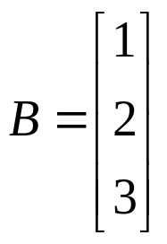
Combination Example
6 mults
1 mults
output
output
Filter 1
Combined
Filter
C = [ 32 ]
Filter 2

Slide 26
AB for any A and B??
Linear Expansion
Original
Expanded
U
[A]
U
E
[A]
σ
[A]
E
[A]
pop = σ
[A]

Slide 27
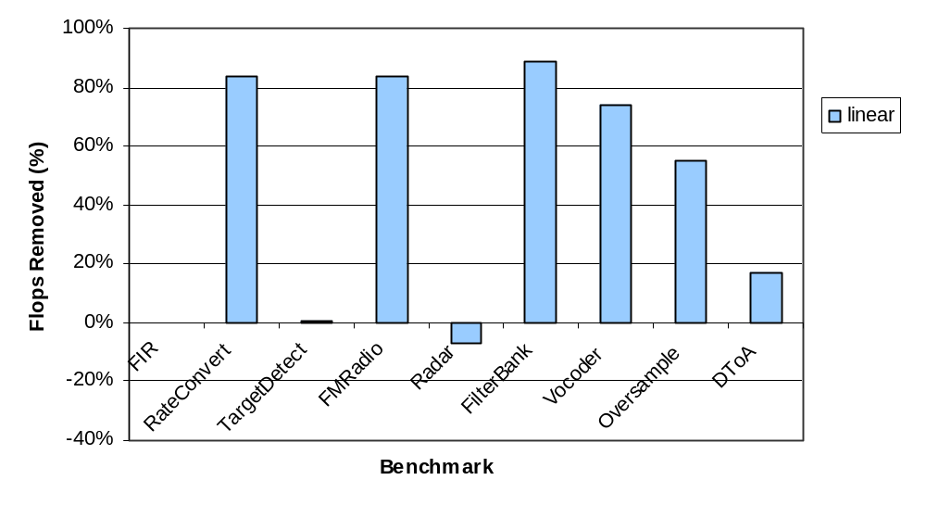
Floating-Point Operations Reduction
0.3%

Slide 28
2) From Time to Frequency Domain
Convolutions can be done cheaply in the Frequency Domain
Painful to do by hand
  Blocking
  Coefficient calculations
  Startup etc.
X ← F(x)
FFT
Σ
X_{i}*W_{n-i}
Y ← X .* H
VVM
y ← F ⁻¹(Y)
IFFT

Slide 29
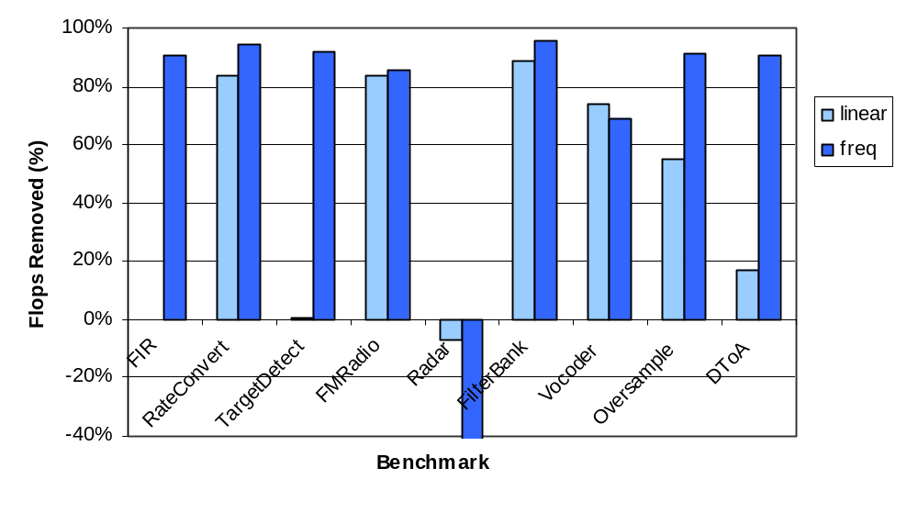
Floating-Point Operations Reduction
0.3%
-140%

Slide 30
3) Transformation Selection
When to apply what transformations?
  Linear filter combination can increase the computation cost
  Shifting to the Frequency domain is expensive for filters with pop > 1
    Compute all outputs, then decimate by pop rate
  Some expensive transformations may later enable other transformations, reducing the overall cost

Slide 31
Selection Algorithm
Estimate minimal cost for each structure:
  Linear combination
  Frequency translation
  No transformation
    If hierarchical, consider all possible
    groupings of children
Overlapping sub-problems allows efficient dynamic programming search
Cost function based
on profiler feedback

Slide 32
Radar (Transformation Selection)
Splitter
Splitter(null)
Input
Input
Input
Input
Input
Input
Input
Input
Input
Input
Input
Input
Dec
Dec
Dec
Dec
Dec
Dec
Dec
Dec
Dec
Dec
Dec
Dec
Cfilt
Cfilt
Cfilt
Cfilt
Cfilt
Cfilt
Cfilt
Cfilt
Cfilt
Cfilt
Cfilt
Cfilt
Dec
Dec
Dec
Dec
Dec
Dec
Dec
Dec
Dec
Dec
Dec
Dec
CFilt2
CFilt2
CFilt2
CFilt2
CFilt2
CFilt2
CFilt2
CFilt2
CFilt2
CFilt2
CFilt2
CFilt2
RR
Duplicate
BeamFrm
BeamFrm
BeamFrm
BeamFrm
Filter
Filter
Filter
Filter
Mag
Mag
Mag
Mag
Detect
Detect
Detect
Detect
RR
Sink

Slide 33
Radar (Transformation Selection)
First compute cost of individual filters:

Slide 34
Radar (Transformation Selection)
First compute cost of individual filters:
low
high
Linear Combination
Frequency
No Transform

Slide 35
Radar (Transformation Selection)
First compute cost of individual filters:
low
high
Linear Combination
Frequency
No Transform
1x1

Slide 36
Radar (Transformation Selection)
Then, compute cost of 1x2 nodes:
low
high
Linear Combination
Frequency
No Transform
1x1

Slide 37
Radar (Transformation Selection)
Then, compute cost of 1x2 nodes:
low
high
Linear Combination
Frequency
No Transform
?
min=
min=
+
1x1

Slide 38
Radar (Transformation Selection)
Then, compute cost of 1x2 nodes:
low
high
Linear Combination
Frequency
No Transform
1x2
1x1

Slide 39
Radar (Transformation Selection)
Continue with
2x1
2x2
2x3
2x4
3x1
3x2
3x3
3x4
4x1
4x2
4x3
4x4
1x3
1x4
Overall solution

Slide 40
Radar (Transformation Selection)
Splitter
Splitter(null)
Input
Input
Input
Input
Input
Input
Input
Input
Input
Input
Input
Input
Dec
Dec
Dec
Dec
Dec
Dec
Dec
Dec
Dec
Dec
Dec
Dec
Cfilt
Cfilt
Cfilt
Cfilt
Cfilt
Cfilt
Cfilt
Cfilt
Cfilt
Cfilt
Cfilt
Cfilt
Dec
Dec
Dec
Dec
Dec
Dec
Dec
Dec
Dec
Dec
Dec
Dec
CFilt2
CFilt2
CFilt2
CFilt2
CFilt2
CFilt2
CFilt2
CFilt2
CFilt2
CFilt2
CFilt2
CFilt2
RR
Duplicate
BeamFrm
BeamFrm
BeamFrm
BeamFrm
Filter
Filter
Filter
Filter
Mag
Mag
Mag
Mag
Detect
Detect
Detect
Detect
RR
Sink

Slide 41
Radar (Transformation Selection)
Splitter
Splitter(null)
Input
Input
Input
Input
Input
Input
Input
Input
Input
Input
Input
Input
RR
Duplicate
RR
BeamFrm
BeamFrm
RR
BeamFrm
BeamFrm
Filter
Filter
Filter
Filter
Mag
Mag
Mag
Mag
Detect
Detect
Detect
Detect
RR
Sink

Slide 42
Radar (Transformation Selection)
Splitter
Splitter(null)
Input
Input
Input
Input
Input
Input
Input
Input
Input
Input
Input
Input
RR
Duplicate
BeamFrm
BeamFrm
BeamFrm
BeamFrm
RR
RR
Filter
Filter
Filter
Filter
Mag
Mag
Mag
Mag
Detect
Detect
Detect
Detect
RR
Sink

Slide 43
Radar (Transformation Selection)
Splitter
Splitter(null)
Splitter(null)
Splitter
Input
Input
Input
Input
Input
Input
Input
Input
Input
Input
Input
Input
Input
Input
Input
Input
Input
Input
Input
Input
Input
Input
Input
Input
RR
Duplicate
RR
Mag
Mag
Mag
Mag
RR
Sink
Maximal Combination and
Shifting to Frequency Domain
Using Transformation
Selection
RR
2.4 times as many FLOPS
half as many FLOPS
Filter
Filter
Filter
Filter
Mag
Mag
Mag
Mag
Detect
Detect
Detect
Detect
RR
Sink

Slide 44
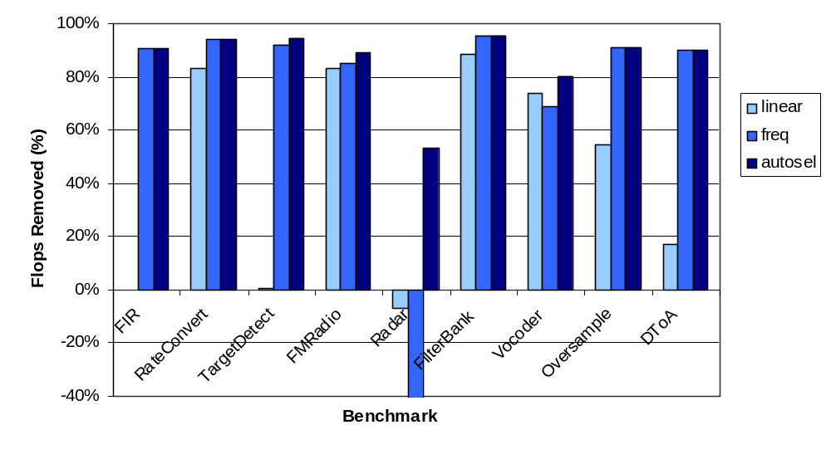
Floating-Point Operations Reduction
0.3%
-140%

Slide 45
Experimental Results
Fully automatic implementation
  StreamIt compiler
StreamIt to C compilation
  FFTW for shifting to the frequency domain
Benchmarks all written in StreamIt
Measurements
  Dynamic floating-point instruction counting
  Speedups on a general purpose processor

Slide 46
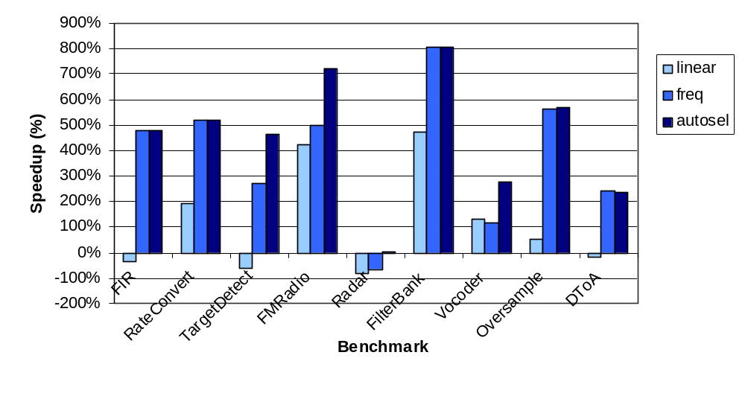
Execution Speedup
5%
On a Pentium IV

Slide 47
Related Work
SPIRAL/SPL (Püschel et. al)
  Automatic derivation of DSP transforms
FFTW (Friego et. al)
  Wicked fast FFT
ADE (Covell, MIT PhD Thesis, 1989)
Affine Analysis (Karr, Acta Informatica, 1976)
  Affine relationships among variables of a program
Linear Analysis (Cousot, Halbwatchs, POPL, 1978)
  Automatic discovery of linear restraints among variables of a program

Slide 48
Conclusions
A DSP Program Representation: Linear Filters
  A dataflow analysis that recognizes linear filters
Three Optimizations using Linear Information
  Adjacent Linear Structure Combination
  Time Domain to Frequency Domain Transformation
  Automatic Transformation Selection
Effective in Replacing the DSP Engineer from the Design Flow
  On the average 90% of the FLOPs eliminated
  Average performance speedup of 450%
StreamIt: A Unified High-level Abstraction for DSP Programming
  Increased abstraction does not have to sacrifice performance
http://cag.lcs.mit.edu/linear/

