Slide 1
A Practical Approach to
Exploiting Coarse-Grained
Pipeline Parallelism in C Programs
William Thies, Vikram Chandrasekhar, Saman Amarasinghe
Computer Science and Artificial Intelligence Laboratory
Massachusetts Institute of Technology
MICRO 40 – December 4, 2007

Slide 2
Legacy Code
310 billion lines of legacy code in industry today
  60-80% of typical IT budget spent re-engineering legacy code
  (Source: Gartner Group)
Now code must be migrated to multicore machines
  Current best practice: manual translation

Slide 3


Parallelization: Man vs. Compiler
 | Man | Compiler

Slide 4
Parallelization: Man vs. Compiler
 | Man | Compiler
Speed | 1 op / sec | 1,000,000,000 op / sec

Slide 5
Parallelization: Man vs. Compiler
 | Man | Compiler
Speed | 1 op / sec | 1,000,000,000 op / sec
Working Set | 100 lines | 1,000,000 lines

Slide 6
Parallelization: Man vs. Compiler
 | Man | Compiler
Speed | 1 op / sec | 1,000,000,000 op / sec
Working Set | 100 lines | 1,000,000 lines
Accuracy | Makes mistakes | Fail-safe

Slide 7
Parallelization: Man vs. Compiler
 | Man | Compiler
Speed | 1 op / sec | 1,000,000,000 op / sec
Working Set | 100 lines | 1,000,000 lines
Accuracy | Makes mistakes | Fail-safe
Effectiveness | GOOD | BAD

Slide 8
Parallelization: Man vs. Compiler
 | Man | Compiler
Speed | 1 op / sec | 1,000,000,000 op / sec
Working Set | 100 lines | 1,000,000 lines
Accuracy | Makes mistakes | Fail-safe
Effectiveness | GOOD | BAD
Preserve the | Functionality | Implementation

Slide 9
Parallelization: Man vs. Compiler
 | Man | Compiler
Speed | 1 op / sec | 1,000,000,000 op / sec
Working Set | 100 lines | 1,000,000 lines
Accuracy | Makes mistakes | Fail-safe
Effectiveness | GOOD | BAD
Preserve the | Functionality | Implementation
Approach | do { attempt parallelism } until pass regtest | Be conservative!

Slide 10
Parallelization: Man vs. Compiler
 | Man | Compiler
Speed | 1 op / sec | 1,000,000,000 op / sec
Working Set | 100 lines | 1,000,000 lines
Accuracy | Makes mistakes | Fail-safe
Effectiveness | GOOD | BAD
Preserve the | Functionality | Implementation
Approach | do { attempt parallelism } until pass regtest | Be conservative!
Can we improve compilers by making them more human?
Notes:
QA

Slide 11
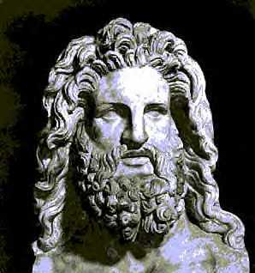
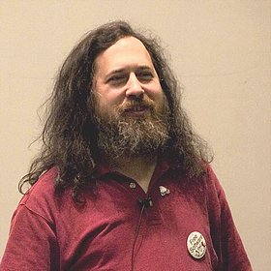
Humanizing Compilers
First step: change our expectations of correctness
Current: An Omnipotent Being
New: An Expert Programmer
?
=
Zeus
Richard Stallman

Slide 12
Humanizing Compilers
First step: change our expectations of correctness
Second step: use compilers differently
  Option A: Treat them like a programmer
    Transformations distrusted, subject to test
    Compiler must examine failures and fix them
  Option B: Treat them like a tool
    Make suggestions to programmer
    Assist programmers in understanding high-level structure
How does this change the problem?
  Can utilize unsound but useful information
  In this talk: utilize dynamic analysis

Slide 13
Dynamic Analysis for Extracting
Coarse-Grained Parallelism from C

Slide 14
Dynamic Analysis for Extracting
Coarse-Grained Parallelism from C
Focus on stream programs
  Audio, video, DSP, networking, and
  cryptographic processing kernels
  Regular communication patterns
Static analysis complex or intractable
  Potential aliasing (pointer arithmetic,
  function pointers, etc.)
  Heap manipulation (e.g., Huffman tree)
  Circular buffers (modulo ops)
  Correlated input parameters
Dynamic analysis promising
  Observe flow of data
  Very few variations at runtime
AtoD
FMDemod
Scatter
LPF₁
LPF₂
LPF₃
HPF₁
HPF₂
HPF₃
Gather
Adder
Speaker

Slide 15
Dynamic Analysis for Extracting
Coarse-Grained Parallelism from C
Focus on stream programs
  Audio, video, DSP, networking, and
  cryptographic processing kernels
  Regular communication patterns
Static analysis complex or intractable
  Potential aliasing (pointer arithmetic,
  function pointers, etc.)
  Heap manipulation (e.g., Huffman tree)
  Circular buffers (modulo ops)
  Correlated input parameters
Opportunity for dynamic analysis
  If flow of data is very stable,
  can infer it with a small sample
AtoD
FMDemod
Scatter
LPF₁
LPF₂
LPF₃
HPF₁
HPF₂
HPF₃
Gather
Adder
Speaker

Slide 16




Overview of Our Approach
Original
Program
Annotated
Program
Stream graph
Statement-level
communication
trace
main.c:9 → fft.c:5
fft.c:8 → fft.c:16
Mark
Potential
Actor Boundaries
Run
Dynamic
Analysis
Satisfied
with
Parallelism?
No
Hand Parallelized Program
Yes
Auto Parallelized Program
test and refine
using multiple
inputs
Communicate
data by hand
Communicate
based on trace

Slide 17
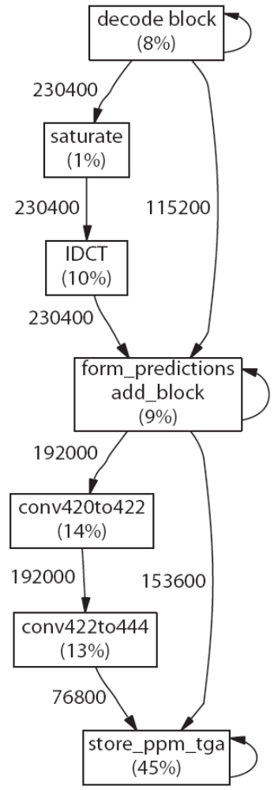
Stability of MPEG-2
MPEG-2 Decoder

Slide 18
Stability of MPEG-2
MPEG-2 Decoder

Slide 19
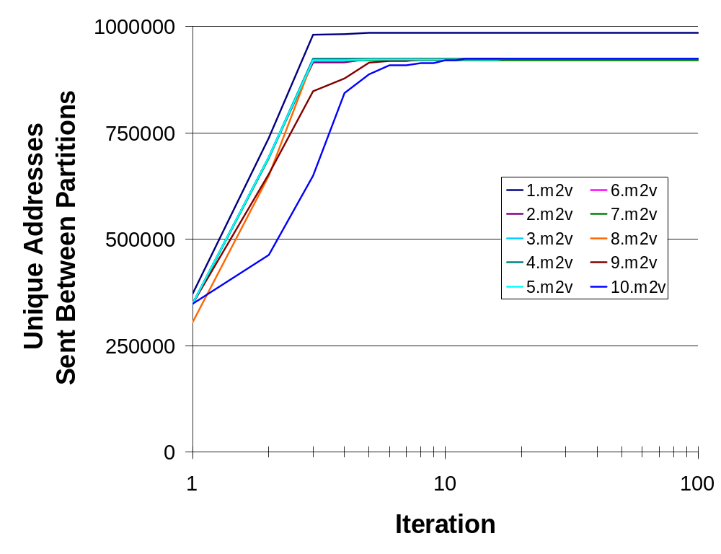
Stability of MPEG-2
(Within an Execution)
Top 10
YouTube Videos
Frame
Notes:
All traces constant after 50 frames
Video 1 has larger steady-state due to large frame size

Slide 20
Stability of MPEG-2
(Across Executions)
Minimum number of training iterations
(frames) needed on each video in order
to correctly decode the other videos.

Slide 21
Stability of MPEG-2
(Across Executions)
5 frames of training on one video is sufficient to correctly parallelize any other video
Minimum number of training iterations
(frames) needed on each video in order
to correctly decode the other videos.

Slide 22
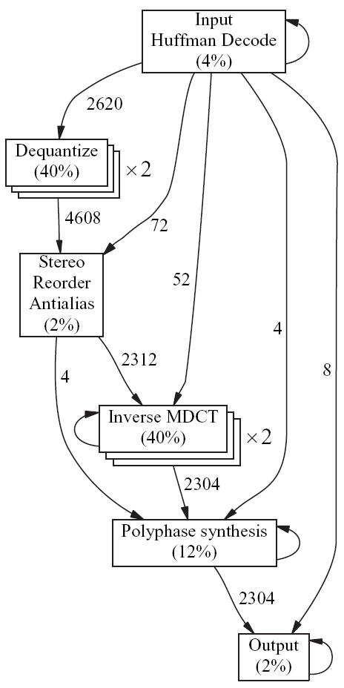
Stability of MP3
(Across Executions)
Minimum number of training iterations
(frames) needed on each track in order
to correctly decode the other tracks.

Slide 23
Stability of MP3
(Across Executions)
Minimum number of training iterations
(frames) needed on each track in order
to correctly decode the other tracks.

Slide 24
Stability of MP3
(Across Executions)
Layer 1 frames
Minimum number of training iterations
(frames) needed on each track in order
to correctly decode the other tracks.
Notes:
Previously unseen code

Slide 25
Stability of MP3
(Across Executions)
CRC Error
Minimum number of training iterations
(frames) needed on each track in order
to correctly decode the other tracks.

Slide 26
Stability of MP3
(Across Executions)
Minimum number of training iterations
(frames) needed on each track in order
to correctly decode the other tracks.

Slide 27
Outline
Analysis Tool
Case Studies

Slide 28
Outline
Analysis Tool
Case Studies

Slide 29
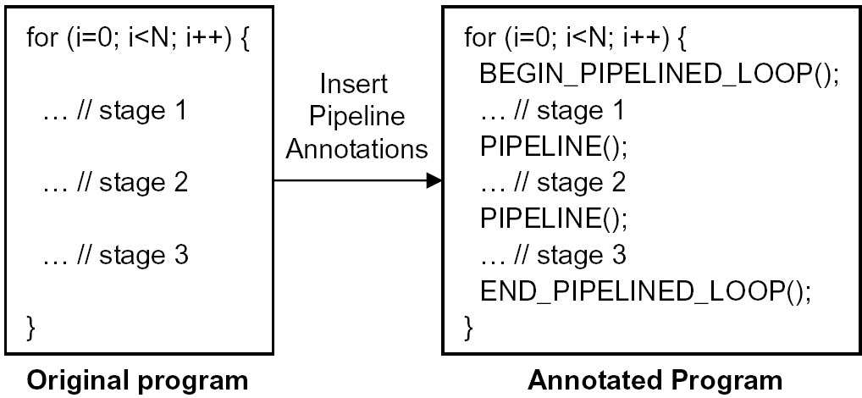
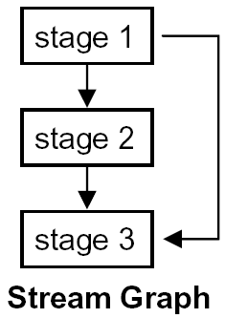
Annotating Pipeline Parallelism
Programmer indicates potential actor
boundaries in a long-running loop

Slide 30
Annotating Pipeline Parallelism
Programmer indicates potential actor
boundaries in a long-running loop

Slide 31
Annotating Pipeline Parallelism
Programmer indicates potential actor
boundaries in a long-running loop

Slide 32
Annotating Pipeline Parallelism
Programmer indicates potential actor
boundaries in a long-running loop
Serves as a fundamental API for pipeline parallelism
  Comparable to OpenMP for data parallelism
  Comparable to Threads for task parallelism

Slide 33

Dynamic Analysis
Legacy C Code
while (!end_bs(&bs)) {
for (ch=0; ch<stereo; ch++) {
III_hufman_decode(is[ch], &III_side_info, ch, gr,
part2_start, &fr_ps);
III_dequantize_sample(is[ch], ro[ch], III_scalefac,
&(III_side_info.ch[ch].gr[gr]), ch, &fr_ps);
}
…
for (ch=0; ch<stereo; ch++) {
…
III_antialias(re, hybridIn, /* Antialias butterflies */
&(III_side_info.ch[ch].gr[gr]), &fr_ps);
for (sb=0; sb<SBLIMIT; sb++) { /* Hybrid synthesis */
III_hybrid(hybridIn[sb], hybridOut[sb], sb, ch,
&(III_side_info.ch[ch].gr[gr]), &fr_ps);
}
/* Frequency inversion for polyphase */
for (ss=0;ss<18;ss++)
for (sb=0; sb<SBLIMIT; sb++)
if ((ss%2) && (sb%2))
hybridOut[sb][ss] = -hybridOut[sb][ss];
for (ss=0;ss<18;ss++) { /* Polyphase synthesis */
for (sb=0; sb<SBLIMIT; sb++)
polyPhaseIn[sb] = hybridOut[sb][ss];
clip += SubBandSynthesis (polyPhaseIn, ch,
&((*pcm_sample)[ch][ss][0]));
} }
/* Output PCM sample points for one granule */
out_fifo(*pcm_sample, 18, &fr_ps, done, musicout,
&sample_frames);
}
...
}
MP3 Decoding

Slide 34
Dynamic Analysis
Legacy C Code
Record Who Produces /
Consumes each Location
Build Block Diagram
while (!end_bs(&bs)) {
BEGIN_PIPELINED_LOOP();
for (ch=0; ch<stereo; ch++) {
III_hufman_decode(is[ch], &III_side_info, ch, gr,
part2_start, &fr_ps);
PIPELINE();
III_dequantize_sample(is[ch], ro[ch], III_scalefac,
&(III_side_info.ch[ch].gr[gr]), ch, &fr_ps);
}
…
PIPELINE();
for (ch=0; ch<stereo; ch++) {
…
III_antialias(re, hybridIn, /* Antialias butterflies */
&(III_side_info.ch[ch].gr[gr]), &fr_ps);
for (sb=0; sb<SBLIMIT; sb++) { /* Hybrid synthesis */
PIPELINE();
III_hybrid(hybridIn[sb], hybridOut[sb], sb, ch,
&(III_side_info.ch[ch].gr[gr]), &fr_ps);
PIPELINE();
}
/* Frequency inversion for polyphase */
for (ss=0;ss<18;ss++)
for (sb=0; sb<SBLIMIT; sb++)
if ((ss%2) && (sb%2))
hybridOut[sb][ss] = -hybridOut[sb][ss];
for (ss=0;ss<18;ss++) { /* Polyphase synthesis */
for (sb=0; sb<SBLIMIT; sb++)
polyPhaseIn[sb] = hybridOut[sb][ss];
clip += SubBandSynthesis (polyPhaseIn, ch,
&((*pcm_sample)[ch][ss][0]));
} }
PIPELINE();
/* Output PCM sample points for one granule */
out_fifo(*pcm_sample, 18, &fr_ps, done, musicout,
&sample_frames);
END_PIPELINED_LOOP();
}
...
}
Huffman () {
…
}
Mem
Huffman()
Dequantize() {
…
}
Dequantize()
Antialias() {
…
}
Antialias()
Hybrid() {
…
}
Hybrid()
Polyphase() {
…
}
Polyphase()
out_fifo() {
…
}
out_fifo()
MP3 Decoding
Implemented Using Valgrind

Slide 35
Exploiting the Parallelism
Huffman()
Stateless stage
(data parallel)
Dequantize()
Dequantize()
Antialias()
Antialias()
Hybrid()
Polyphase()
Stateful stage
(sequential)
Polyphase()
out_fifo()

Slide 36
Exploiting the Parallelism
for (i=0; i<N; i++) {
…
PIPELINE();
Dequantize();
PIPELINE();
….
}
Huffman()
Stateless stage
(data parallel)
Reorder()
Dequantize()
Antialias()
Antialias()
Hybrid()
Polyphase()
Stateful stage
(sequential)
Polyphase()
out_fifo()

Slide 37
Exploiting the Parallelism
for (i=0; i<N; i++) {
…
PIPELINE(N);
Dequantize();
PIPELINE();
….
}
Huffman()
Stateless stage
(data parallel)
Reorder()
Dequantize()
Antialias()
Antialias()
Hybrid()
Polyphase()
Stateful stage
(sequential)
Polyphase()
out_fifo()

Slide 38
Exploiting the Parallelism
for (i=0; i<N; i++) {
…
PIPELINE(N);
Dequantize();
PIPELINE();
….
}
Huffman()
Stateless stage
(data parallel)
Dequantize_{N}()
Dequantize₁()
Dequantize()
Antialias()
Antialias()
Hybrid()
Polyphase()
Stateful stage
(sequential)
Polyphase()
out_fifo()

Slide 39

Parallel Runtime Environment
Pipeline parallelism requires buffering between stages
Two ways to implement buffering:
  1. Modify original program to add buffers
  2. Wrap original code in virtual execution environment
We fork each actor into an independent process,
and communicate the recorded variables via pipes
  Robust in the presence of aliasing
  Suitable to shared or distributed memory
  Efficient (7% communication overhead on MP3)
Mem
Programmer
assistance
needed for:
- malloc’d data
- nested loops
- reduction vars
Dequantize()
Mem
Mem
pipe
Antialias()

Slide 40
Outline
Analysis Tool
Case Studies

Slide 41
Extracted Stream Graphs
Benchmark | Description | Source | Lines of Code
GMTI | Ground Moving Target Indicator | MIT Lincoln Laboratory | 37,000
MP3 | MP3 audio decoder | Fraunhofer IIS | 5,000
MPEG-2 | MPEG-2 video decoder | MediaBench | 10,000
197.parser | Grammatical parser of English language | SPECINT 2000 | 11,000
256.bzip2 | bzip2 compression and decompression | SPECINT 2000 | 5,000
456.hmmer | Calibrating HMMs for biosequence analysis | SPECCPU 2006 | 36,000

Slide 42
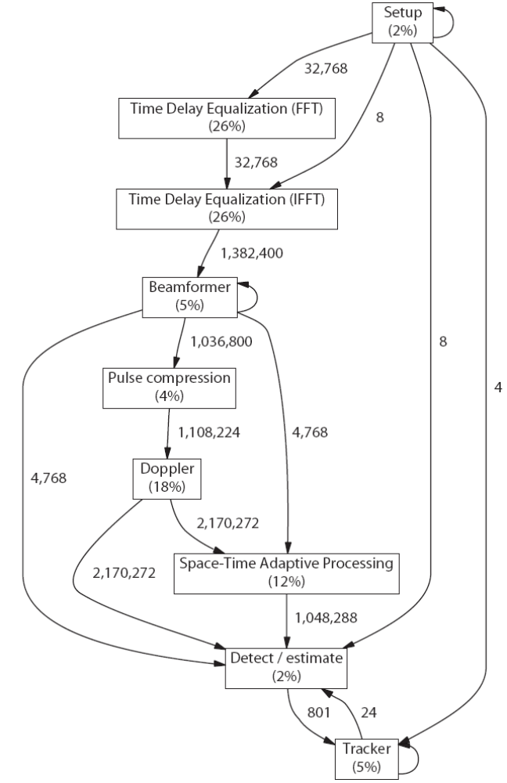
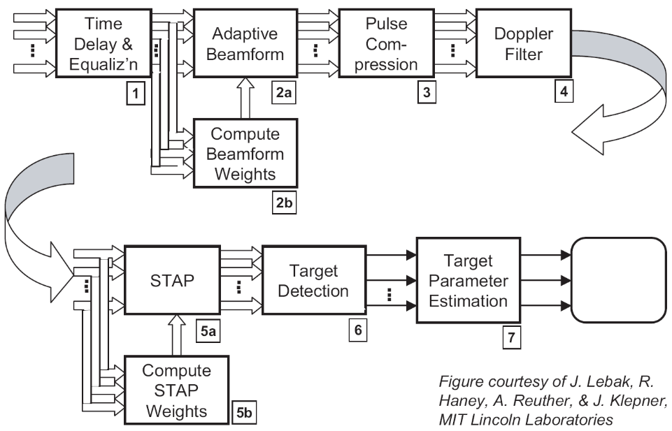
Ground Moving Target Indicator (GMTI)
Extracted with tool:
From GMTI specification:

Slide 43
Audio and Video Codecs
MP3 Decoder
MPEG-2 Decoder

Slide 44
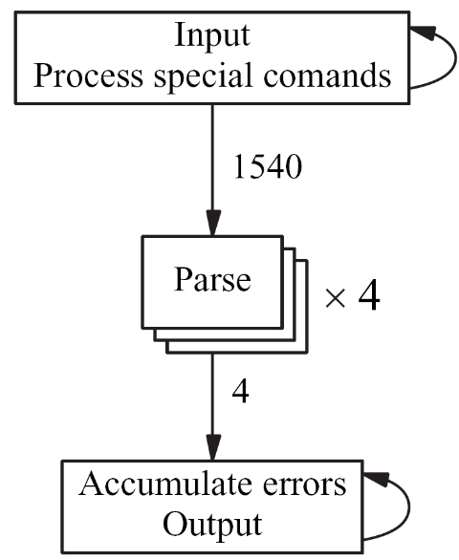
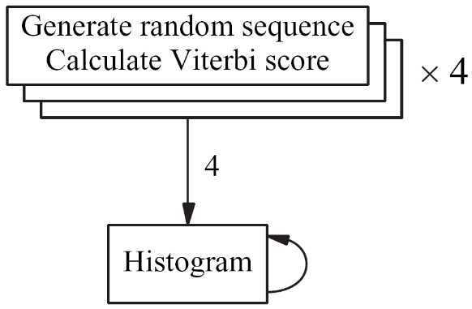
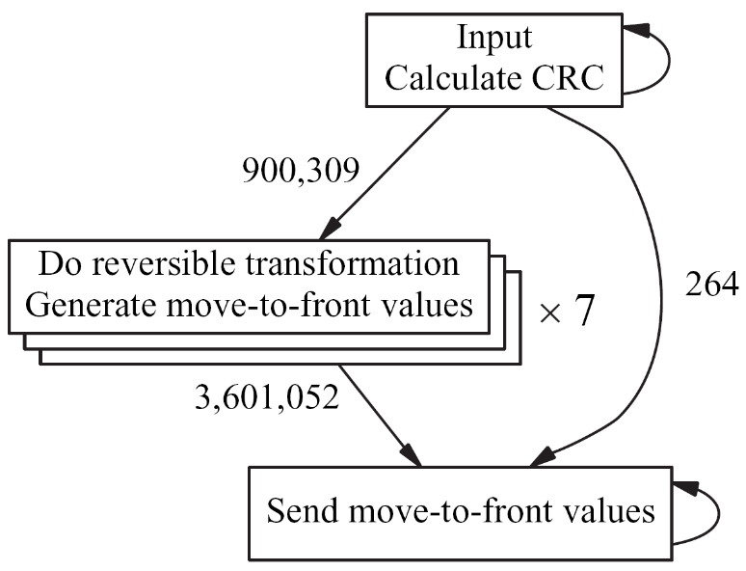
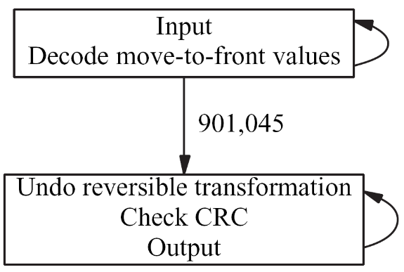
SPEC Benchmarks
456.hmmer
197.parser
256.bzip2 (decompression)
256.bzip2 (compression)

Slide 45
Interactive Parallelization Process
Analysis tool exposed serializing dependences
  As annotated back-edges in stream graph (main.c:9 → fft.c:5)
How to deal with serializing dependences?
  1. Rewrite code to eliminate dependence, or
  2. Instruct the tool to ignore the dependence
Lesson learned:
Many memory dependences can be safely ignored!
  Allow malloc (or free) to be called in any order (GMTI, hmmer)
  Allow rand() to be called in any order (hmmer)
  Ignore dependences on uninitialized memory (parser)
  Ignore ordering of demand-driven buffer expansion (hmmer)

Slide 46
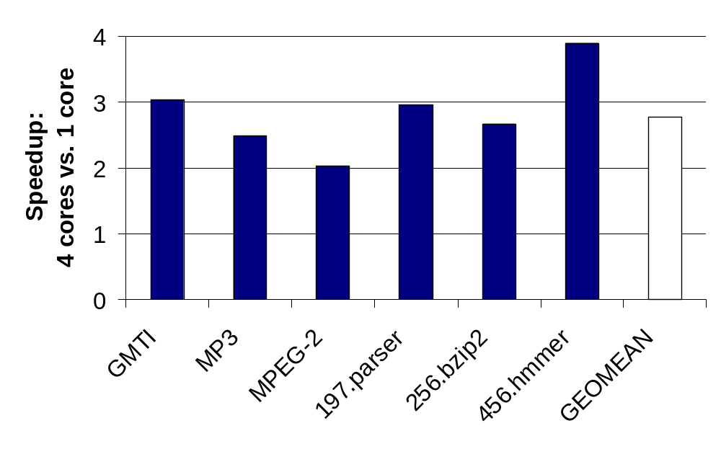
Results
On two AMD 270 dual-core processors

Slide 47
Results
Profiled for 10 iterations of training data
Ran for complete length of testing data
Only observed unsoundness: MP3

Slide 48
How to Improve Soundness?
Revert to sequential version upon seeing new code
(fixes MP3)
Hardware support
  Mondriaan memory protection (Witchel et. al)
  Versioned memory (used by Bridges et al.)
    Would provide safe communication, but unsafe parallelism
Rigorous testing with maximal code coverage
Programmer review

Slide 49
Related Work
Revisiting the Sequential Programming Model for Multi-Core (Bridges et al., yesterday)
  Same pipeline-parallel decompositions of parser, bzip2
  Like commutative annotation, we tell tool to ignore dependences
    But since we target distributed memory, annotation
    represents privatization rather than reordering
Dynamic analysis for understanding, parallelization
  Rul et. al (2006) – programmer manages communication
  Redux (2003) – fine-grained dependence visualization
  Karkowski and Corporaal (1997) – focus on data parallelism
Inspector/executor for DOACROSS parallelism
  Rauchwerger (1998) – survey

Slide 50
Conclusions
Dynamic analysis can be useful for parallelization
  Our tool is simple, transparent, and one of the first to
  extract coarse-grained pipeline parallelism from C programs
  Primary application: program understanding
  Secondary application: automatic parallelization
Future work in improving soundness, automation

