Slide 1


Gloss: Seamless Live Reconfiguration and Reoptimization of Stream Programs
Sumanaruban Rajadurai*, Jeffrey Bosboom^{ʄ}, Weng-Fai Wong*, Saman Amarasinghe^{ʄ}
*National University of Singapore ^{ʄ}MIT CSAIL
26-March-2018
@ASPLOS’18

Slide 2
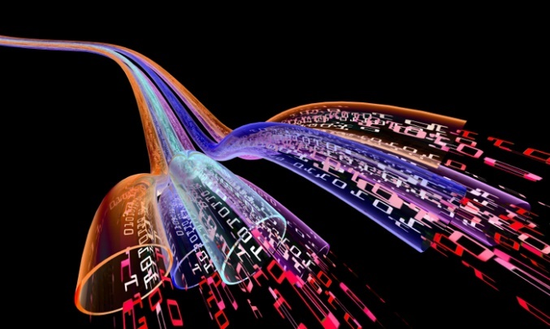
Characteristics of Stream Programs
Long running programs
Require high performance
Require high quality-of-service
Notes:
Third characteristics is “Similar computation pattern”. I removed it.

Slide 3
Programs on Modern Hardware Environments (Datacenters/Clouds)
1. Highly Dynamic Environments
a. Hardware Maintenance
b. Resource fluctuations
c. Failtures
Reconfiguration
Migration
Notes:
Modern Distributed Hardware Environments are Highly dynamic.
Long running programs are highly vulnerable to become suboptimal.
They also face unacceptable interruptions.
We need to continuously optimize a long running stream program to tackle various kinds of dynamism.
We also need to ensure programs’ quality-of-service during its lifecycle.

Slide 4
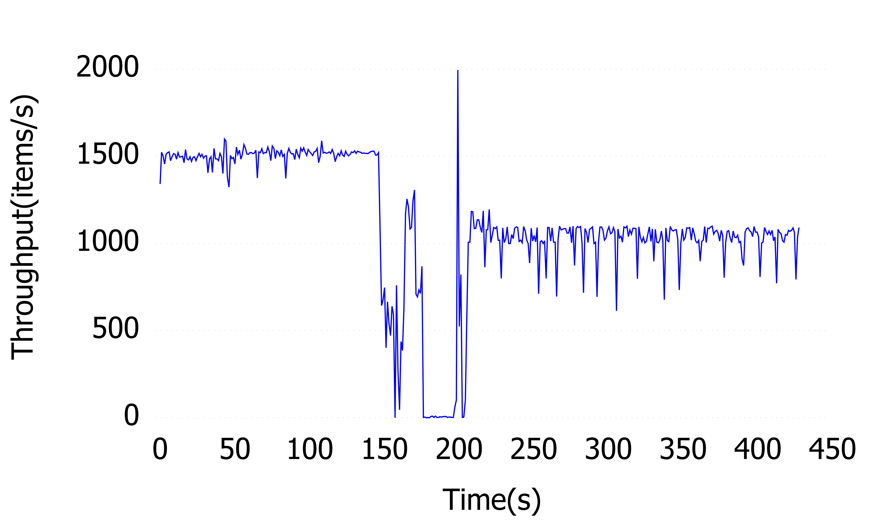
Programs on Modern Hardware Environments (Datacenters/Clouds)
Unacceptable downtime/service interruption
Sub-optimal program
Notes:
Modern Distributed Hardware Environments are Highly dynamic.
Long running programs are highly vulnerable to become suboptimal.
They also face unacceptable interruptions.
We need to continuously optimize a long running stream program to tackle various kinds of dynamism.
We also need to ensure programs’ quality-of-service during its lifecycle.

Slide 5
Programs on Modern Hardware Environments (Datacenters/Clouds)
Synchronous Data Flow (SDF) based stream programs do not take advantage of elastic cloud
They are still confined into specialized hardware
Longer development time
Close to any modification or changes
Expensive
Gloss solves these issues

Slide 6
Our Approach
Seamless Live Reconfiguration
Cluster-wide Dynamic recompilation
Implemented on StreamJIT
Distributed compiler and runtime system for high-performance stream processing

Slide 7
Stream Graph
Actors
Channels

Slide 8
Stream Graph
Static pop, push rates
Pop-3, Push-1

Slide 9
Stream Graph
Static pop, push rates

Slide 10
Stream Graph
Peeking
Notes:
Peeking creates states

Slide 11
Stream Graph
Stateful actors
Var a, b, c;

Slide 12
StreamJIT’s Execution Model
Controller
Node-1
Node-2
Notes:
StreamNode
Blob

Slide 13
Program Life Cycle
Initialization
Steady State
Draining

Slide 14
Reconfiguration
n+3
n
n+2
n-1
n+1
n-2
Notes:
That means it has to switch over at the exact point. You can't miss or duplicate any output.

Slide 15
Reconfiguration
Internal buffers and
Worker states
n+3
n
n+2
n-1
n+1
n-2

Slide 16
State Dependency
Deterministically persisting and transferring the program state
State is continuously changing
State is distributed
Notes:
Capturing the state as the program is running is diﬃcult because the program’s state is continously changing, with some edges of the stream graph split between nodes.
which must be minimized and made hidden as in modern garbage collectors.

Slide 17
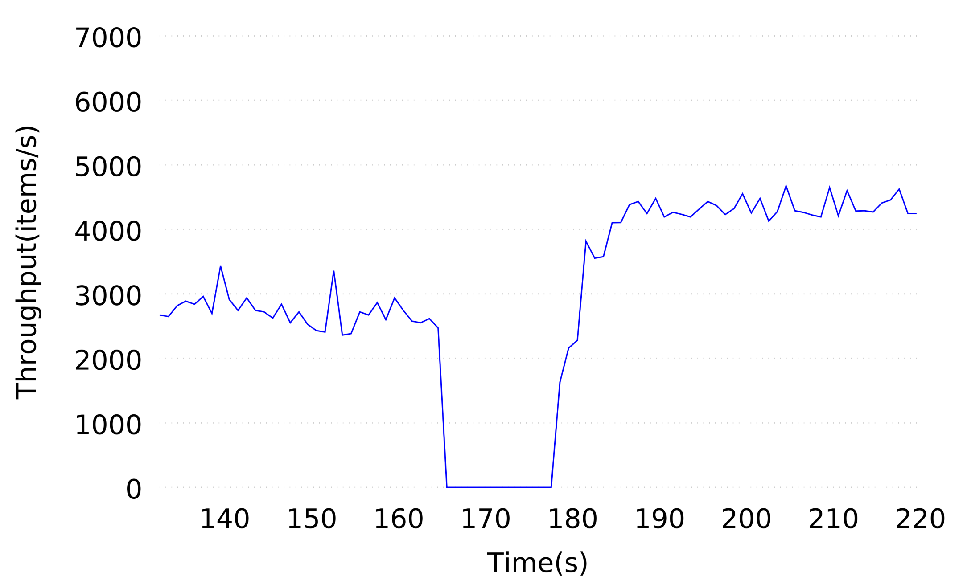
Stop-and-Copy Reconfiguration
Graph Instance 1
Graph Instance 2
Initialization
Compilation
Draining

Slide 18
Compilation time
Graph Instance 1
Graph Instance 2
Initialization
Compilation
Draining
Downtime
Challenge 1 : Hide the recompilation time as much as possible

Slide 19
Challenges
Compiled output must be able to continue the execution from the current state
Recompilation needs the current program instance’s program state.
Internal buffers

Slide 20
Two-phase recompilation
Phase-1
Compile all the time-consuming compiler operations, generating an intermediate output where state is not incorporated
Phase-2
Installs the program state and generates state-incorporated output

Slide 21
Two-phase recompilation
Graph Instance 1
Graph Instance 2
Phase-1
Initialization
Draining
Phase-2
Downtime
Visible recompilation time
Notes:
Hiding the compilation time is essential to achieve cluster-wide dynamic recompilation that is practical.

Slide 22
Goal
Graph Instance 1
Graph Instance 2
Phase-1
Initialization
Draining
Phase-2
Downtime

Slide 23
Challenges
Hiding draining and initialization time
Deterministically persisting and transferring the program state
State is continuously changing
State is distributed
Notes:
Capturing the state as the program is running is diﬃcult because the program’s state is continously changing, with some edges of the stream graph split between nodes.
which must be minimized and made hidden as in modern garbage collectors.

Slide 24
Techniques
Input duplication and concurrent execution
Asynchronous state transfer (AST)
Notes:
Capturing the state as the program is running is diﬃcult because the program’s state is continously changing, with some edges of the stream graph split between nodes.
which must be minimized and made hidden as in modern garbage collectors.

Slide 25
Controller

Slide 26
n+1
n
Current Input
Controller

Slide 27
n+1
n+1
Controller

Slide 28
n+1
Controller

Slide 29
Controller

Slide 30
Controller

Slide 31
Controller

Slide 32
Controller

Slide 33
Controller

Slide 34
Final Time Breakdown
AST
Phase-2
Phase-1
Initialization
Graph Instance 2
Graph Instance 1
Draining
Concurrent Execution
Notes:
Hiding the compilation time is essential to achieve cluster-wide dynamic recompilation that is practical.

Slide 35
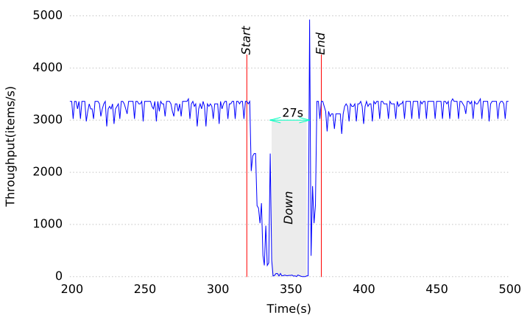
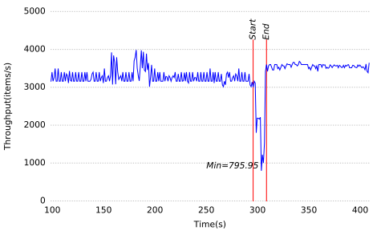
vMotion vs. Gloss
Beamformer

Slide 36
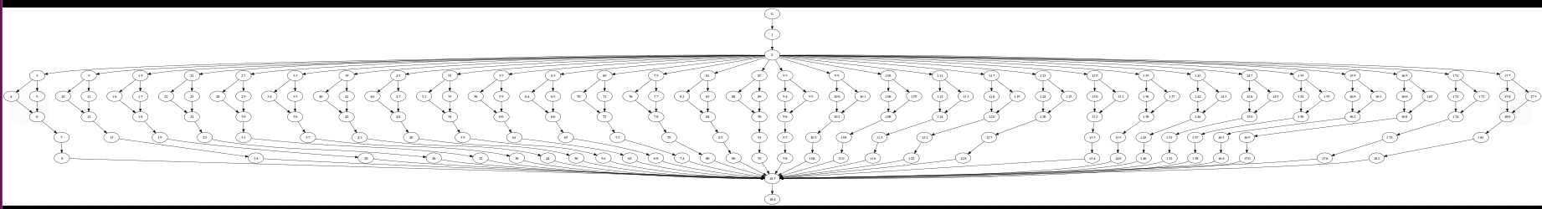
Elastic Computing
FM Radio on Amazon EC2

Slide 37
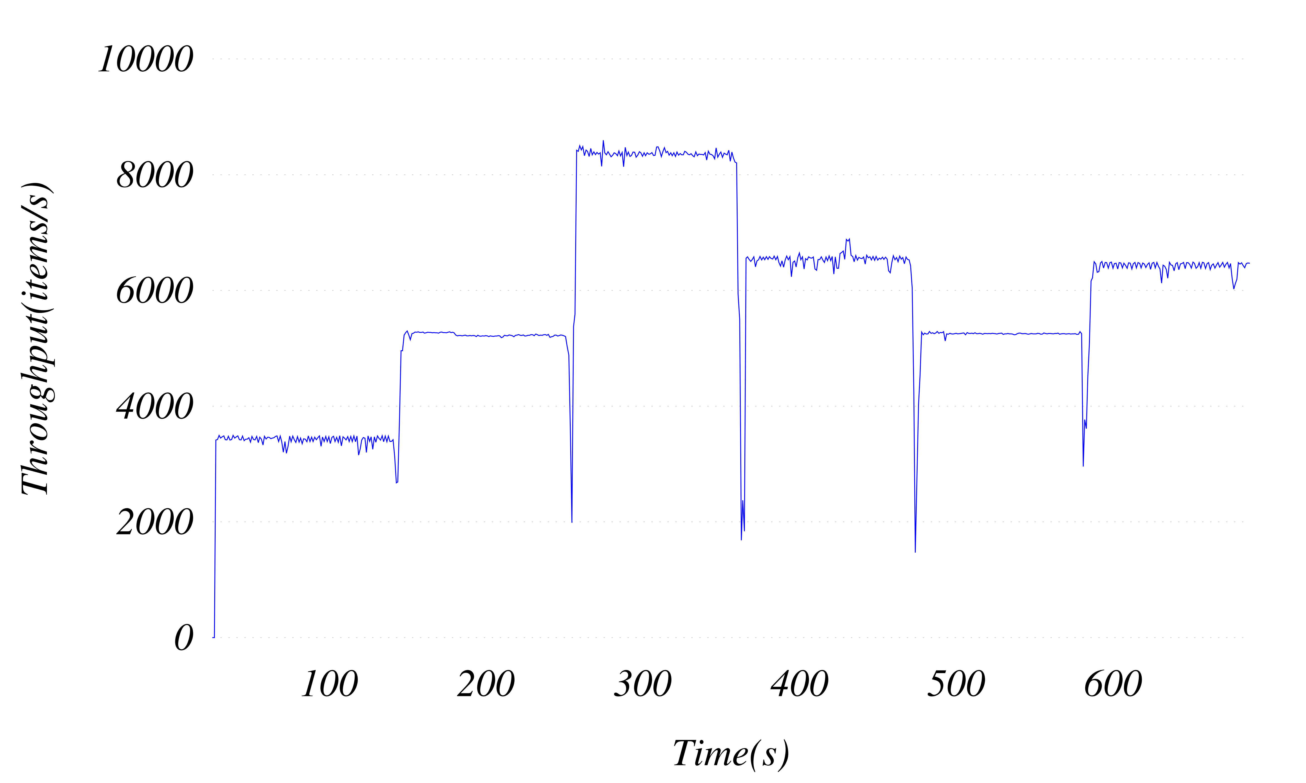
Elastic Computing
n
No of Nodes
6
5
5
No down time
4
4
2
FM Radio on Amazon EC2

Slide 38
Conclusion
Live reconfiguration is a practical necessity for long-running programs
Gloss for the first time
Downtime Free Reconfiguration
Cluster-wide Dynamic Recompilation
SDF programs can now take advantage of the elastic cloud
Cloud Radio Access Network (C-RAN) – 5G
Gloss enables commoditization and virtualization of large and complex SDF-based stream programs

Slide 39
Thank You!

Slide 40
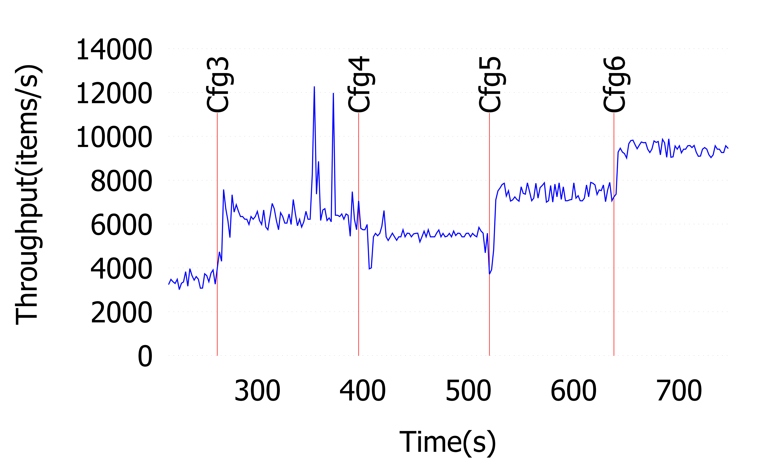
Online Autotuning
Beamformer

