Slide 1



Autoscheduling for Sparse Tensor Algebra with an Asymptotic Cost Model
Peter Ahrens, Fredrik Kjolstad, Saman Amarasinghe
pahrens@csail.mit.edu, kjolstad@cs.stanford.edu, saman@csail.mit.edu

Slide 2



















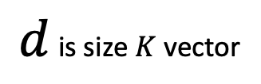


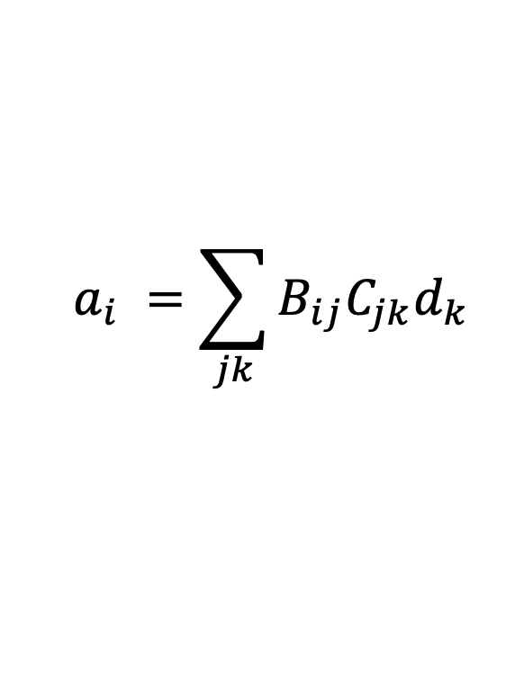










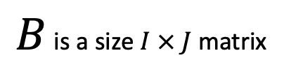










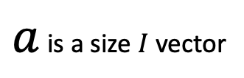










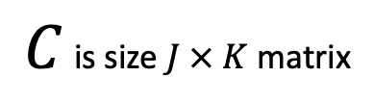



Same expression, different cost
$$a_{i} =\sum_{jk}{B_{ij}C_{jk}d_{k}}$$
$$j$$
$$k$$
$$a_{1}$$
$$B_{11}$$
$$B_{12}$$
$$B_{13}$$
$$B_{14}$$
$$C_{11}$$
$$C_{12}$$
$$C_{13}$$
$$C_{14}$$
$$d_{1}$$
$$a_{2}$$
$$B_{21}$$
$$B_{22}$$
$$B_{23}$$
$$B_{24}$$
$$C_{21}$$
$$C_{22}$$
$$C_{23}$$
$$C_{24}$$
$$d_{2}$$
$$⋅$$
$$⋅$$
$$i$$
$$=$$
$$i$$
$$j$$
$$k$$
$$a_{3}$$
$$B_{31}$$
$$B_{32}$$
$$B_{33}$$
$$B_{34}$$
$$C_{31}$$
$$C_{32}$$
$$C_{33}$$
$$C_{34}$$
$$d_{3}$$
$$a_{4}$$
$$B_{41}$$
$$B_{42}$$
$$B_{43}$$
$$B_{44}$$
$$C_{41}$$
$$C_{42}$$
$$C_{43}$$
$$C_{44}$$
$$d_{4}$$
$$C_{51}$$
$$C_{52}$$
$$C_{53}$$
$$C_{54}$$
$$d_{5}$$
$a$ is a size $I$ vector
$B$ is a size $I × J$ matrix
$C$ is size $J × K$ matrix
$d$ is size $K$ vector

Slide 3



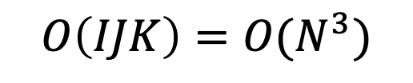


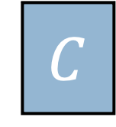


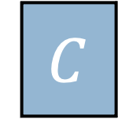


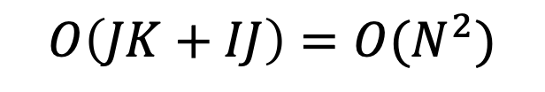


Same expression, different cost
A. A. Auer et al., “Automatic code generation for many-body electronic structure methods: the tensor contraction engine,” 2006
$$a_{i} =\sum_{jk}{B_{ij}C_{jk}d_{k}}$$
$$a$$
$$=$$
$$B$$
$$⋅$$
$$C$$
$$⋅$$
$$d$$
$$a$$
$$=$$
$$B$$
$$⋅$$
$$C$$
$$⋅$$
$$d$$
For i = 1:I
For j = 1:J
For k = 1:K
a[i]+=B[i,j]*C[j, k]*d[k]
For j = 1:J
For k = 1:K
w[j]+=C[j, k]*d[k]
For i = 1:I
For j = 1:J
a[i]+=B[i,j]*w[j]
$$O\left(IJK\right)=O(N^{3})$$
$$O\left(JK+IJ\right)=O(N^{2})$$
Notes:
This is factor of N speedup
Many optimizations equally applicable
Parallelize, Cache block, Unroll, etc…
Asymptotic does not preclude this stuff
Cannot beat factor of N asymptotic speedup
N can always grow larger
Usually easy to spot by hand, also automated by e.g. TCE for more complex kernels
Asymptotic speedups usually overshadow all other concerns

Slide 4
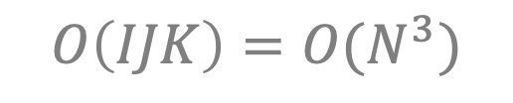
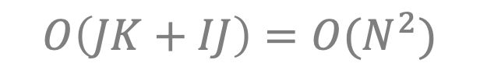
Same expression, different cost
A. A. Auer et al., “Automatic code generation for many-body electronic structure methods: the tensor contraction engine,” 2006
$$a_{i} =\sum_{jk}{B_{ij}C_{jk}d_{k}}$$
$$a$$
$$=$$
$$B$$
$$⋅$$
$$C$$
$$⋅$$
$$d$$
$$a$$
$$=$$
$$B$$
$$⋅$$
$$C$$
$$⋅$$
$$d$$
For i = 1:I
For j = 1:J
For k = 1:K
a[i]+=B[i,j]*C[j, k]*d[k]
For j = 1:J
For k = 1:K
w[j]+=C[j, k]*d[k]
For i = 1:I
For j = 1:J
a[i]+=B[i,j]*w[j]
$$O\left(IJK\right)=O(N^{3})$$
$$O\left(JK+IJ\right)=O(N^{2})$$
Notes:
This is factor of N speedup
Many optimizations equally applicable
Parallelize, Cache block, Unroll, etc…
Asymptotic does not preclude this stuff
Cannot beat factor of N asymptotic speedup
N can always grow larger
Under-discussed optimization
Asymptotic speedups usually overshadow all other concerns

Slide 5
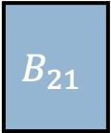
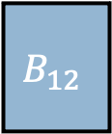
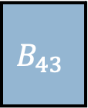
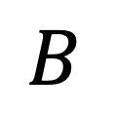
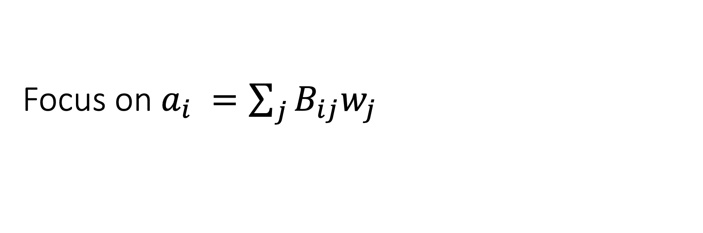
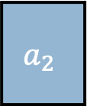
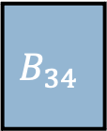
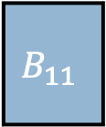
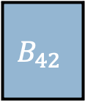

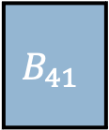
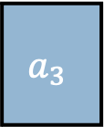
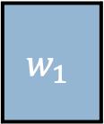
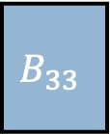
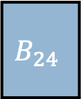

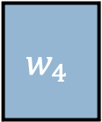
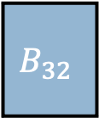
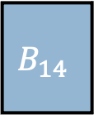
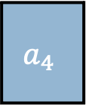
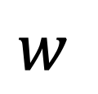
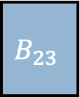
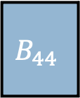
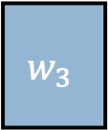
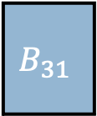
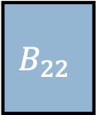
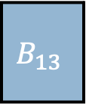
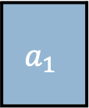

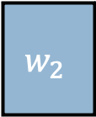
Focus on $a_{i} =\sum_{j}{B_{ij}w_{j}}$
$$w$$
$$w_{1}$$
$$w_{2}$$
$$w_{3}$$
$$w_{4}$$
$$⋅$$
Row major vs. Column major
$$a_{1}$$
$$B_{11}$$
$$B_{12}$$
$$B_{13}$$
$$B_{14}$$
$$a_{2}$$
$$B_{21}$$
$$B_{22}$$
$$B_{23}$$
$$B_{24}$$
$$=$$
$$a_{3}$$
$$a_{3}$$
$$B_{31}$$
$$B_{32}$$
$$B_{33}$$
$$B_{34}$$
$$a_{4}$$
$$a_{4}$$
$$B_{41}$$
$$B_{42}$$
$$B_{43}$$
$$B_{44}$$
$$a$$
$$B$$

Slide 6

Focus on $a_{i} =\sum_{j}{B_{ij}w_{j}}$
$$w$$
$$w_{1}$$
$$w_{2}$$
$$w_{3}$$
$$w_{4}$$
$$⋅$$
Row major vs. Column major
Same result
Both $O(IJ)$
$$a_{1}$$
$$B_{11}$$
$$B_{12}$$
$$B_{13}$$
$$B_{14}$$
$$a_{2}$$
$$B_{21}$$
$$B_{22}$$
$$B_{23}$$
$$B_{24}$$
$$=$$
$$a_{3}$$
$$a_{3}$$
$$B_{31}$$
$$B_{32}$$
$$B_{33}$$
$$B_{34}$$
$$a_{4}$$
$$a_{4}$$
$$B_{41}$$
$$B_{42}$$
$$B_{43}$$
$$B_{44}$$
$$a$$
$$B$$

Slide 7
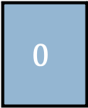
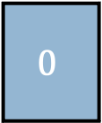
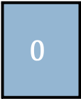
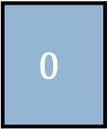
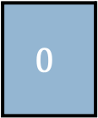



Focus on $a_{i} =\sum_{j}{B_{ij}w_{j}}$
$$w_{1}$$
$$w_{2}$$
$$w_{3}$$
$$0$$
$$w$$
$$0$$
$$w_{4}$$
$$⋅$$
What if inputs are sparse?
Sparsity is connectivity
Asymptotic opportunity
Skip multiply by zero
New challenges
😁
🤪
😍
🤨
$$a_{1}$$
$$B_{11}$$
$$B_{12}$$
$$0$$
$$B_{13}$$
$$B_{14}$$
😁
$$a_{2}$$
$$B_{21}$$
$$B_{22}$$
$$0$$
$$B_{23}$$
$$0$$
$$B_{24}$$
🤪
$$=$$
$$a_{3}$$
$$B_{31}$$
$$0$$
$$B_{32}$$
$$B_{33}$$
$$0$$
$$B_{34}$$
😍
$$a_{4}$$
$$0$$
$$B_{41}$$
$$B_{42}$$
$$0$$
$$B_{43}$$
$$B_{44}$$
🤨
$$a$$
$$B$$
Notes:
Sparse means mostly zero
Quite common
Graph Algorithms, Scientific applications, Neural Nets
Not surprise: Sparsity is connectivity
Dunbar says number of friends bounded by a constant
Opportunity
Skip Multiply by zero
Number of nonzeros growing slower than full matrix size
Might have constant number of nonzeros
Sometimes full matrix not representable
New challenges
Sparse programs behave differently than dense

Slide 8
Row vs. Column Major
Unnecessary work
$$w$$
$$w_{1}$$
$$w_{3}$$
$$⋅$$
In dense case, doesn’t matter
Sparse is different
Row major visits everything
$$a_{1}$$
$$B_{11}$$
$$B_{12}$$
$$B_{14}$$
$$a_{2}$$
$$B_{21}$$
$$B_{22}$$
$$=$$
$$a_{3}$$
$$B_{31}$$
$$B_{33}$$
$$a_{4}$$
$$B_{42}$$
$$B_{44}$$
$$a$$
$$B$$

Slide 9

















Column Major
Unnecessary work
$$w$$
$$w_{1}$$
$$w_{3}$$
$$⋅$$
In dense case, doesn’t matter
Sparse is different
Row major visits everything
Column major is efficient
$$a_{1}$$
$$B_{11}$$
$$B_{12}$$
$$B_{14}$$
$$a_{2}$$
$$B_{21}$$
$$B_{22}$$
$$=$$
$$w_{1}$$
$$w_{3}$$
$$a_{3}$$
$$B_{31}$$
$$B_{33}$$
$$⋅$$
$$a_{1}$$
$$B_{11}$$
$$B_{12}$$
$$B_{14}$$
$$a_{4}$$
$$B_{42}$$
$$B_{44}$$
$$a_{2}$$
$$B_{21}$$
$$B_{22}$$
$$=$$
$$a_{3}$$
$$B_{31}$$
$$B_{33}$$
$$a_{4}$$
$$B_{42}$$
$$B_{44}$$
$$a$$
$$B$$

Slide 10
Sparse Asymptotic Tradeoffs
$$w$$
$$w_{1}$$
$$w_{3}$$
$$⋅$$
Beyond Loop Ordering
Loop Fusion
Sparse Formats
Hash Table
Sorted List
Transposition
Format Capability
Iteration vs. random access
Pattern-dependent
$$a_{1}$$
$$B_{11}$$
$$B_{12}$$
$$B_{14}$$
$$a_{2}$$
$$B_{21}$$
$$B_{22}$$
$$=$$
$$a_{3}$$
$$B_{31}$$
$$B_{33}$$
$$a_{4}$$
$$B_{42}$$
$$B_{44}$$
$$a$$
$$B$$

Slide 11


Compilers to the rescue! Almost…
Domain Expert
👩‍🔬
So many options!
Compile program
TACO, MLIR, COMET
$$y_{i}=∑A_{ij}x_{j}$$
Tensor Expressions
Runtime
🌮
Tensor Framework
Input
Data
3.14…
Results
F. Kjolstad, S. Kamil, S. Chou, D. Lugato, and S. Amarasinghe, “The Tensor Algebra Compiler,” 2017
Notes:
Too many options to implement by hand
Scientist can use compiler to write for them
We use TACO

Slide 12
Compilers to the rescue! Almost…
Domain Expert
👩‍🔬
So many options!
Compile program
TACO, MLIR, COMET
Summarize choices with schedule
$$y_{i}=∑A_{ij}x_{j}$$
Tensor Expressions
Runtime
👷‍♀️
Performance Engineer
unroll(i).
reorder(j,k)…
Schedule
🌮
Tensor Framework
Input
Data
3.14…
Results
Notes:
Too many options to implement by hand
Scientist can use compiler to write for them
Options are specified by schedule, but it’s too complicated to use

Slide 13
Compilers to the rescue! Almost…
Domain Expert
👩‍🔬
So many options!
Compile program
TACO, MLIR, COMET
Summarize choices with schedule
$$y_{i}=∑A_{ij}x_{j}$$
Tensor Expressions
Runtime
🤖
Auto-scheduler
unroll(i).
reorder(j,k)…
Schedule
🌮
Tensor Framework
Input
Data
3.14…
Results
Notes:
Too many options to implement by hand
Scientist can use compiler to write for them
Options are specified by schedule, but it’s too complicated to use
Autoscheduler solves this problem

Slide 14

Compilers to the rescue! Almost…
sum(A.*x)
Scientific
Software
Domain Expert
👩‍🔬
⚙️
High-level
Compiler
So many options!
Compile program
TACO, MLIR, COMET
Summarize choices with schedule
Runtime may be input pattern dependent
We can still identify asymptotically unwise sparse programs without looking at data
$$y_{i}=∑A_{ij}x_{j}$$
Tensor Expressions
Runtime
🤖
Auto-scheduler
Input
Pattern
unroll(i).
reorder(j,k)…
Schedule
Runtime
🌮
Tensor Framework
Input
Data
3.14…
Results
Notes:
Too many options to implement by hand
Scientist can use compiler to write for them
Options are specified by schedule, but it’s too complicated to use
Autoscheduler solves this problem

Slide 15





Model program runtime symbolically
Sparse loops are filters
Skip multiply by zero
Runtime proportional to size of set of tasks
Name each task after index values in scope
for i ∈ I
print “foo”
if c
print “bar”
for j ∈ J
print “qux”
$O\left(\left|\left\{i∈I\right\}\right|\right)$ occurrences of “foo”
$O(\left|\left\{i∈I|c\right\}\right|)$ occurrences of “bar”
$O(\left|\left\{\left(i, j\right)∈I×J|c\right\}\right|)$ occurrences of “qux”
Runtime:
$$O(IJ)$$
$$O(\left|\left\{\left(i, j\right)∈I×J|c\right\}\right|+\left|\left\{i∈I\right\}\right|)$$
$$→\left\{[i,j]|c\right\}∪\{\left[i\right]\}$$
Notes:
Typical analysis uses polynomials (sums of products of dimensions)
Not good enough because of filters in sparse loops
Model runtime as set of iterations
This notation is more precise

Slide 16









































Symbolic set containment implies asymptotic domination
Unnecessary work
Column Major
Row Major
$$w$$
$$w_{1}$$
$$w_{3}$$
$$w$$
$$w_{1}$$
$$w_{3}$$
$$⋅$$
$$⋅$$
$$a_{1}$$
$$B_{11}$$
$$B_{12}$$
$$B_{14}$$
$$a_{1}$$
$$B_{11}$$
$$B_{12}$$
$$B_{14}$$
$$a_{2}$$
$$B_{21}$$
$$B_{22}$$
$$a_{2}$$
$$B_{21}$$
$$B_{22}$$
$$=$$
$$=$$
$$a_{3}$$
$$B_{31}$$
$$B_{33}$$
$$a_{3}$$
$$B_{31}$$
$$B_{33}$$
$$a_{4}$$
$$B_{42}$$
$$B_{44}$$
$$a_{4}$$
$$B_{42}$$
$$B_{44}$$
$$a$$
$$B$$
$$a$$
$$B$$
$$\left\{\left[i, j\right]\right|w_{j}∧B_{ij}\}⊆\left\{\left[i, j\right]\right|w_{j}∨B_{ij}\}$$

Slide 17




Our Autoscheduler
Tensor Expression
$$y_{i}=∑A_{ij}B_{jk}x_{k}$$
Generate asymptotic cost model from schedules
Symbolic set expressions
Compare one cost to another
Union of conjunctive queries containment
Filter out unwise schedules
Order of magnitude reduction in frontier size
Up to 100x, even after loop depth filtering
Schedules
for k
for j…
for i
for k
for j…
for j
for k…
for i
for j…
Loop Depth
2
3
2
2
Iteration Set
$$\left\{\left[k,j\right] | B_{jk}∨x_{k}\right\}…$$
$$\left\{\left[k,j\right] | B_{jk}∧x_{k}\right\}…$$
$$\left\{\left[i,j\right] | A_{ij}∨∃_{k}B_{jk}∧x_{k}\right\}…$$
A. K. Chandra and P. M. Merlin, “Optimal implementation of conjunctive queries in relational data bases,” 1977
Notes:
Median of 6 tensors and 3 indices
Data independent analysis (run once per program, not per pattern)
Few time constraints, cache results on server
Starting point for online, data-dependent techniques

Slide 18












































































Sampled Dense-Dense Matrix Multiply (SDDMM)
$$w_{11}$$
$$w_{12}$$
$$w_{13}$$
$$w_{14}$$
$$C_{11}$$
$$C_{12}$$
$$C_{13}$$
$$C_{14}$$
$$D_{11}$$
$$D_{12}$$
$$D_{13}$$
$$D_{14}$$
$$A=B⊙(CD)$$
$$w_{21}$$
$$w_{22}$$
$$w_{23}$$
$$w_{24}$$
$$+=$$
$$C_{21}$$
$$C_{22}$$
$$C_{23}$$
$$C_{24}$$
$$⋅$$
$$D_{21}$$
$$D_{22}$$
$$D_{23}$$
$$D_{24}$$
$$w_{31}$$
$$w_{32}$$
$$w_{33}$$
$$w_{34}$$
$$C_{31}$$
$$C_{32}$$
$$C_{33}$$
$$C_{34}$$
$$D_{31}$$
$$D_{32}$$
$$D_{33}$$
$$D_{34}$$
$$D_{41}$$
$$D_{42}$$
$$D_{43}$$
$$D_{44}$$
$$A_{11}$$
$$A_{12}$$
$$A_{13}$$
$$A_{14}$$
$$B_{11}$$
0
$$B_{13}$$
0
$$w_{11}$$
$$w_{12}$$
$$w_{13}$$
$$w_{14}$$
Unfused:
$\left\{\left[i,j,k\right]\right\}$ or $O(IJK)$
$$⊙$$
$$A_{21}$$
$$A_{22}$$
$$A_{23}$$
$$A_{24}$$
$$+=$$
$$B_{21}$$
$$B_{22}$$
0
$$B_{24}$$
$$w_{21}$$
$$w_{22}$$
$$w_{23}$$
$$w_{24}$$
$$A_{31}$$
$$A_{32}$$
$$A_{33}$$
$$A_{34}$$
0
0
$$B_{33}$$
0
$$w_{31}$$
$$w_{32}$$
$$w_{33}$$
$$w_{34}$$
Notes:
Align equality, add arrow

Slide 19

























































Sampled Dense-Dense Matrix Multiply (SDDMM)
$$A_{11}$$
$$A_{12}$$
$$A_{13}$$
$$A_{14}$$
$$B_{11}$$
$$B_{13}$$
$$C_{11}$$
$$C_{12}$$
$$C_{13}$$
$$C_{14}$$
$$C_{15}$$
$$D_{11}$$
$$D_{12}$$
$$D_{13}$$
$$D_{14}$$
$$A_{21}$$
$$A_{22}$$
$$A_{23}$$
$$A_{24}$$
$$B_{21}$$
$$B_{22}$$
$$B_{24}$$
$$⊙$$
$$C_{21}$$
$$C_{22}$$
$$C_{23}$$
$$C_{24}$$
$$C_{25}$$
$$⋅$$
$$D_{21}$$
$$D_{22}$$
$$D_{23}$$
$$D_{24}$$
$$+=$$
$$A_{31}$$
$$A_{32}$$
$$A_{33}$$
$$A_{34}$$
$$B_{33}$$
$$C_{31}$$
$$C_{32}$$
$$C_{33}$$
$$C_{34}$$
$$C_{35}$$
$$D_{31}$$
$$D_{32}$$
$$D_{33}$$
$$D_{34}$$
$$D_{41}$$
$$D_{42}$$
$$D_{43}$$
$$D_{44}$$
Fused:
$$\left\{\left[i,j,k\right] | B_{ij}\right\}$$
$$D_{51}$$
$$D_{52}$$
$$D_{53}$$
$$D_{54}$$
Unfused:
$\left\{\left[i,j,k\right]\right\}$
Notes:
TODO Label unnecessary work

Slide 20




Sparse-Sparse Matrix Multiply
$$A_{ij} =\sum_{k}{B_{ik}C_{kj}}$$
Inner Products
i,j,k or j,i,k
$\{[i,j,k]|B_{ik}∨C_{kj}\}$
Gustavson
i,k,j or j,k,i
$\{[i,j,k]|B_{ik}∧C_{kj}\}$
Outer Products
k,i,j or k,j,i
$\{[i,j,k]|B_{ik}∧C_{kj}\}$

Slide 21

Sparse-Sparse Matrix Multiply
Inner Products
$$1350×$$
Gustavson
Notes:
Differ only in loop ordering
Practitioners prefer Gustavson’s

Slide 22
Empirical Performance Improvements
Notes:
Patterns are uniform
Trends vary depending on the kernel, but trends nonetheless

Slide 23
Conclusion
We introduce a powerful new notation for sparse asymptotic analysis
We automate this analysis and use it to compare schedules
This makes it easier to use sparse tensor compilers
https://dl.acm.org/doi/abs/10.1145/3519939.3523442
http://tensor-compiler.org
https://github.com/peterahrens/Pigeon.jl
Notes:
Previous notations were not precise enough for sparsity
Our model explains practitioner choices
It is possible to implement this analysis
There are many approaches (compilers and libraries) for sparse tensors
Researchers come up with new approaches every day
Autoscheduling is the last piece of technology we need to bring tensor compilers to mainstream

Slide 24
Frontier Size Reduction
Notes:
This is just a number

Slide 25
Sparse Tensor Kernels are Usually Small
Notes:
comes after slide 9

Slide 26
Sparse Tensors
j
0.7
0
3.1
0
A tree of sparse vectors
Each level has a format
0
0
0
0
i
DCSR
CSR
1
2
3
0
4.3
2.2
5.4
Rows (i):
Dense
(Uncompressed)
Rows (i):
Sorted List
(Compressed)
Elements (j):
Sorted List
(Compressed)
0.7
0
3.1
0
0
0
0
0
0
4.3
2.2
5.4
1
2
3
4
1
2
3
4
1
2
3
4

