Slide 1

MPEG-2 Decoding in a Stream Programming Language
Matthew Drake, Hank Hoffmann, Rodric Rabbah and
Saman Amarasinghe
Massachusetts Institute of Technology
IPDPS
Rhodes, April 2006
http://cag.csail.mit.edu/streamit

Slide 2
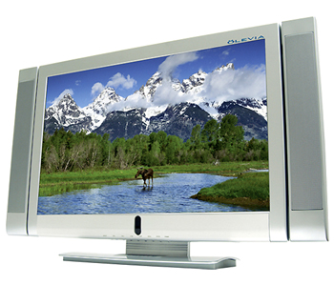
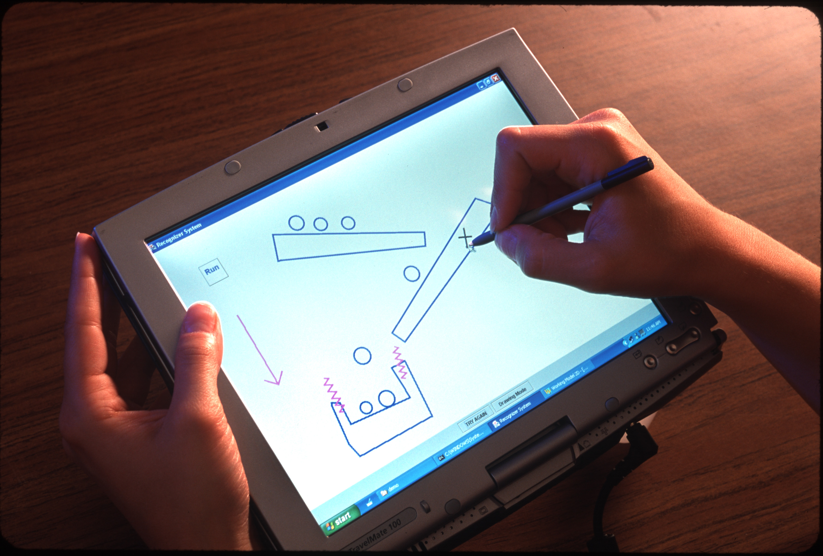

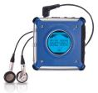

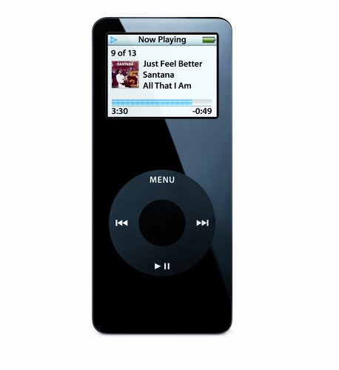
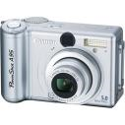


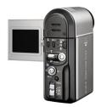
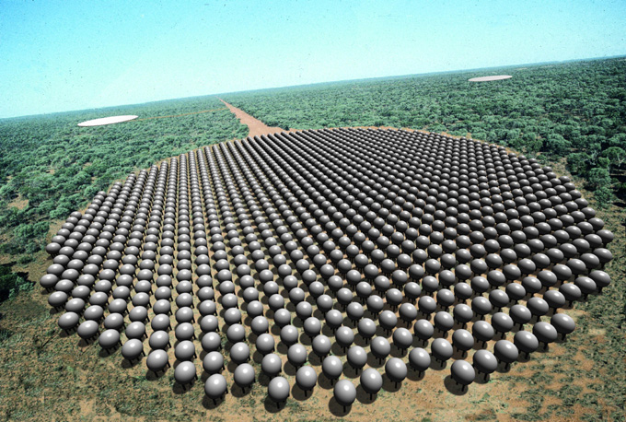

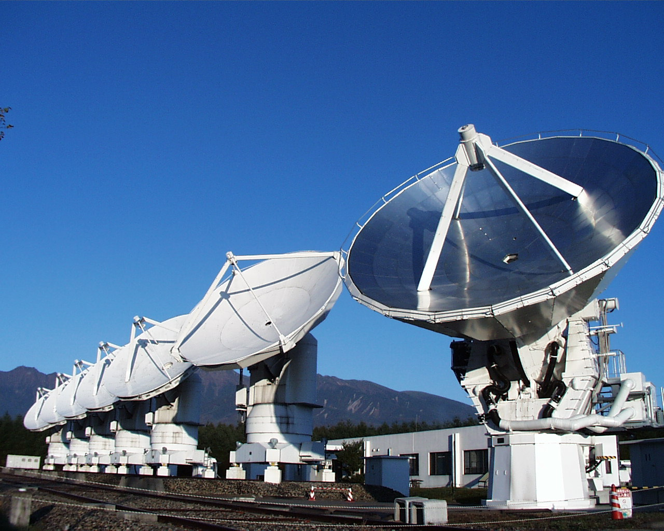
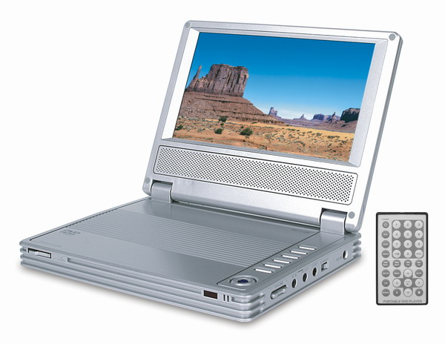
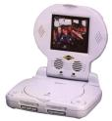
Stream Application Domain
Graphics
Cryptography
Databases
Object recognition
Network processing and security
Scientific codes
…

Slide 3
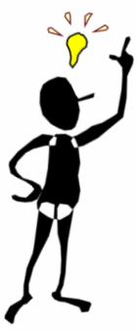
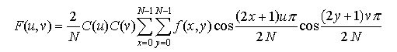
Parallel Programmer’s Dilemma
high
Rapid prototyping
- MATLAB
- Ptolemy
Natural parallelization
- StreamIt
Automatic parallelization
- FORTRAN compilers
- C/C++ compilers
Malleability
Manual parallelization
- C/C++ with MPI
Portability
Productivity
Optimal parallelization
- assembly code
low
Parallel Performance
high

Slide 4
Compiler-Aware Language Design
boost productivity, enable faster development and
rapid prototyping
programmability
domain specific
optimizations
enable parallel
execution
simple and effective optimizations for domain specific abstractions
target tiled architectures, clusters, DSPs, multicores, graphics processors, …

Slide 5
StreamIt Project
Language Semantics / Programmability
  StreamIt Language (CC 02)
  Programming Environment in Eclipse (P-PHEC 05)
Optimizations / Code Generation
  Phased Scheduling (LCTES 03)
  Cache Aware Optimization (LCTES 05)
Domain Specific Optimizations
  Linear Analysis and Optimization (PLDI 03)
  Optimizations for bit streaming (PLDI 05)
  Linear State Space Analysis (CASES 05)
Parallelism
  Teleport Messaging (PPOPP 05)
  Compiling for Communication-Exposed Architectures (ASPLOS 02)
  Load-Balanced Rendering
  (Graphics Hardware 05)
Applications
  SAR, DSP benchmarks, JPEG,
  MPEG [IPDPS 06], DES and
  Serpent [PLDI 05], …
StreamIt Program
Front-end
Annotated Java
Stream-Aware
Optimizations
Uniprocessor
backend
Cluster
backend
Raw
backend
IBM X10
backend
C
MPI-like
C
C per tile +
msg code
Streaming
X10 runtime

Slide 6
In This Talk
StreamIt Application Development : MPEG-2 Decoding
Natural expression of
  Program structure
  Parallelism
  Data distribution
Emphasis on programmability
  Comparison/Contrast with C

Slide 7
Stream Composition of
MPEG-2 Decoder
Variable length decoding
Spatial decoding
  block decoding in parallel with motion vector decoding
Temporal decoding
  all color channels motion compensated in parallel
Color space conversion and data ordering

Slide 8
Application Design
MPEG bit stream
picture type
Structured block level diagram describes computation and flow of data
Conceptually easy to understand
  Clean abstraction of functionality
VLD
add VLD(QC, PT1, PT2);
add splitjoin {
split roundrobin(N∗B, V);
add pipeline {
add ZigZag(B);
add IQuantization(B) to QC;
add IDCT(B);
add Saturation(B);
}
add pipeline {
add MotionVectorDecode();
add Repeat(V, N);
}
join roundrobin(B, V);
}
add splitjoin {
split roundrobin(4∗(B+V), B+V, B+V);
add MotionCompensation(4∗(B+V)) to PT1;
for (int i = 0; i < 2; i++) {
add pipeline {
add MotionCompensation(B+V) to PT1;
add ChannelUpsample(B);
}
}
join roundrobin(1, 1, 1);
}
add PictureReorder(3∗W∗H) to PT2;
add ColorSpaceConversion(3∗W∗H);
quantization coefficients
macroblocks, motion vectors
<QC>
splitter
<PT1, PT2>
frequency encoded
macroblocks
differentially coded
motion vectors
ZigZag
IQuantization
Motion Vector Decode
<QC>
IDCT
Repeat
Saturation
spatially encoded macroblocks
joiner
motion vectors
splitter
Y
Cb
Cr
Motion Compensation
Motion Compensation
Motion Compensation
<PT1>
reference
picture
<PT1>
reference
picture
<PT1>
reference
picture
Channel Upsample
Channel Upsample
joiner
recovered picture
Picture Reorder
<PT2>
Color Space Conversion

Slide 9
StreamIt Philosophy
MPEG bit stream
picture type
Preserve program structure
  Natural for application developers to express
Leverage program structure to discover parallelism and deliver high performance
Programs remain clean
  Portable and malleable
VLD
add VLD(QC, PT1, PT2);
add splitjoin {
split roundrobin(N∗B, V);
add pipeline {
add ZigZag(B);
add IQuantization(B) to QC;
add IDCT(B);
add Saturation(B);
}
add pipeline {
add MotionVectorDecode();
add Repeat(V, N);
}
join roundrobin(B, V);
}
add splitjoin {
split roundrobin(4∗(B+V), B+V, B+V);
add MotionCompensation(4∗(B+V)) to PT1;
for (int i = 0; i < 2; i++) {
add pipeline {
add MotionCompensation(B+V) to PT1;
add ChannelUpsample(B);
}
}
join roundrobin(1, 1, 1);
}
add PictureReorder(3∗W∗H) to PT2;
add ColorSpaceConversion(3∗W∗H);
quantization coefficients
macroblocks, motion vectors
<QC>
splitter
<PT1, PT2>
frequency encoded
macroblocks
differentially coded
motion vectors
ZigZag
IQuantization
Motion Vector Decode
<QC>
IDCT
Repeat
Saturation
spatially encoded macroblocks
joiner
motion vectors
splitter
Y
Cb
Cr
Motion Compensation
Motion Compensation
Motion Compensation
<PT1>
reference
picture
<PT1>
reference
picture
<PT1>
reference
picture
Channel Upsample
Channel Upsample
joiner
recovered picture
Picture Reorder
<PT2>
Color Space Conversion

Slide 10
StreamIt Philosophy
MPEG bit stream
picture type
VLD
add VLD(QC, PT1, PT2);
add splitjoin {
split roundrobin(N∗B, V);
add pipeline {
add ZigZag(B);
add IQuantization(B) to QC;
add IDCT(B);
add Saturation(B);
}
add pipeline {
add MotionVectorDecode();
add Repeat(V, N);
}
join roundrobin(B, V);
}
add splitjoin {
split roundrobin(4∗(B+V), B+V, B+V);
add MotionCompensation(4∗(B+V)) to PT1;
for (int i = 0; i < 2; i++) {
add pipeline {
add MotionCompensation(B+V) to PT1;
add ChannelUpsample(B);
}
}
join roundrobin(1, 1, 1);
}
add PictureReorder(3∗W∗H) to PT2;
add ColorSpaceConversion(3∗W∗H);
quantization coefficients
macroblocks, motion vectors
<QC>
splitter
<PT1, PT2>
frequency encoded
macroblocks
differentially coded
motion vectors
ZigZag
IQuantization
Motion Vector Decode
<QC>
IDCT
Repeat
Saturation
spatially encoded macroblocks
joiner
motion vectors
splitter
Y
Cb
Cr
Motion Compensation
Motion Compensation
Motion Compensation
<PT1>
reference
picture
<PT1>
reference
picture
<PT1>
reference
picture
Channel Upsample
Channel Upsample
joiner
recovered picture
Picture Reorder
<PT2>
Color Space Conversion
output to player

Slide 11
Stream Abstractions in StreamIt
MPEG bit stream
filters
VLD
add VLD(QC, PT1, PT2);
add splitjoin {
split roundrobin(N∗B, V);
add pipeline {
add ZigZag(B);
add IQuantization(B) to QC;
add IDCT(B);
add Saturation(B);
}
add pipeline {
add MotionVectorDecode();
add Repeat(V, N);
}
join roundrobin(B, V);
}
add splitjoin {
split roundrobin(4∗(B+V), B+V, B+V);
add MotionCompensation(4∗(B+V)) to PT1;
for (int i = 0; i < 2; i++) {
add pipeline {
add MotionCompensation(B+V) to PT1;
add ChannelUpsample(B);
}
}
join roundrobin(1, 1, 1);
}
add PictureReorder(3∗W∗H) to PT2;
add ColorSpaceConversion(3∗W∗H);
<QC>
splitter
<PT1, PT2>
pipelines
ZigZag
IQuantization
Motion Vector Decode
<QC>
IDCT
Repeat
Saturation
joiner
splitjoins
splitter
Motion Compensation
Motion Compensation
Motion Compensation
<PT1>
reference
picture
<PT1>
reference
picture
<PT1>
reference
picture
Channel Upsample
Channel Upsample
joiner
Picture Reorder
<PT2>
Color Space Conversion

Slide 12
StreamIt Language Highlights
Filters
Pipelines
Splitjoins
Teleport messaging

Slide 13
Example StreamIt Filter
0
1
2
3
4
5
6
7
8
9
10
11
input
FIR
0
1
output
float→float filter FIR (int N) {
work push 1 pop 1 peek N {
float result = 0;
for (int i = 0; i < N; i++) {
result += weights[i] ∗ peek(i);
}
push(result);
pop();
}
}

Slide 14
FIR Filter in C
FIR functionality obscured by buffer management details
Programmer must commit to a particular buffer implementation strategy
void FIR(
int* src,
int* dest,
int* srcIndex,
int* destIndex,
int srcBufferSize,
int destBufferSize,
int N) {
float result = 0.0;
for (int i = 0; i < N; i++) {
result += weights[i] * src[(*srcIndex + i) % srcBufferSize];
}
dest[*destIndex] = result;
*srcIndex = (*srcIndex + 1) % srcBufferSize;
*destIndex = (*destIndex + 1) % destBufferSize;
}

Slide 15
StreamIt Language Highlights
Filters
Pipelines
Splitjoins
Teleport messaging

Slide 16
Example StreamIt Pipeline
Pipeline
  Connect components in sequence
  Expose pipeline parallelism
Column_iDCTs
float→float pipeline 2D_iDCT (int N)
{
add Column_iDCTs(N);
add Row_iDCTs(N);
}
Row_iDCTs

Slide 17
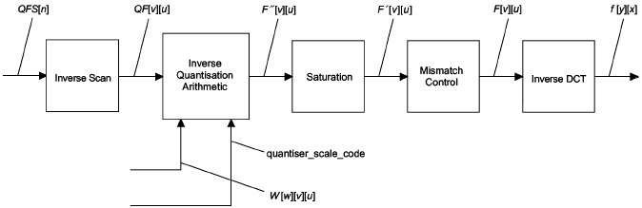
Preserving Program Structure
int->int pipeline BlockDecode(
portal<InverseQuantisation> quantiserData,
portal<MacroblockType> macroblockType) {
add ZigZagUnordering();
add InverseQuantization() to quantiserData, macroblockType;
add Saturation(-2048, 2047);
add MismatchControl();
add 2D_iDCT(8);
add Saturation(-256, 255);
}
quantiserData,
Can be reused for JPEG decoding
quantiserData,
64
64
1
1
64
From Figures 7-1 and 7-4 of the
MPEG-2 Specification
(ISO 13818-2, P. 61, 66)
exchange of control-relevant information

Slide 18
In Contrast: C Code Excerpt
EXTERN unsigned char *backward_reference_frame[3];
EXTERN unsigned char *forward_reference_frame[3];
EXTERN unsigned char *current_frame[3];
...etc...
decode_macroblock() {
parser();
motion_vectors();
for (comp=0;comp<block_count;comp++) {
parser();
Decode_MPEG2_Block();
}
}
motion_vectors() {
parser();
decode_motion_vector
parser();
}
Decode_Picture {
for (;;) {
parser()
for (;;) {
decode_macroblock();
motion_compensation();
if (condition)
then break;
}
}
frame_reorder();
}
motion_compensation() {
for (channel=0;channel<3;channel++)
form_component_prediction();
for (comp=0;comp<block_count;comp++) {
Saturate();
IDCT();
Add_Block();
}
}
Decode_MPEG2_Block() {
for (int i = 0;; i++) {
parsing();
ZigZagUnordering();
inverseQuantization();
if (condition) then
break;
}
}
Explicit for-loops iterate through picture frames
Frames passed through global arrays, handled with pointers
Mixing of parser, motion compensation, and spatial decoding

Slide 19
StreamIt Language Highlights
Filters
Pipelines
Splitjoins
Teleport messaging

Slide 20
Example StreamIt Splitjoin
Splitjoin
  Connect components in parallel
  Expose data parallelism and data distribution
float→float splitjoin Row_iDCT (int N)
{
split roundrobin(N);
for (int i = 0; i < N; i++) {
add 1D_iDCT(N);
}
join roundrobin(N);
}
splitter
joiner

Slide 21
Example StreamIt Splitjoin
float→float pipeline 2D_iDCT (int N)
{
add Column_iDCTs(N);
add Row_iDCTs(N);
}
splitter
float→float splitjoin Column_iDCT (int N)
{
split roundrobin(1);
for (int i = 0; i < N; i++) {
add 1D_iDCT(N);
}
join roundrobin(1);
}
iDCT
iDCT
iDCT
iDCT
joiner
splitter
splitter
splitter
float→float splitjoin Row_iDCT (int N)
{
split roundrobin(N);
for (int i = 0; i < N; i++) {
add 1D_iDCT(N);
}
join roundrobin(N);
}
iDCT
iDCT
iDCT
iDCT
joiner
joiner
joiner

Slide 22
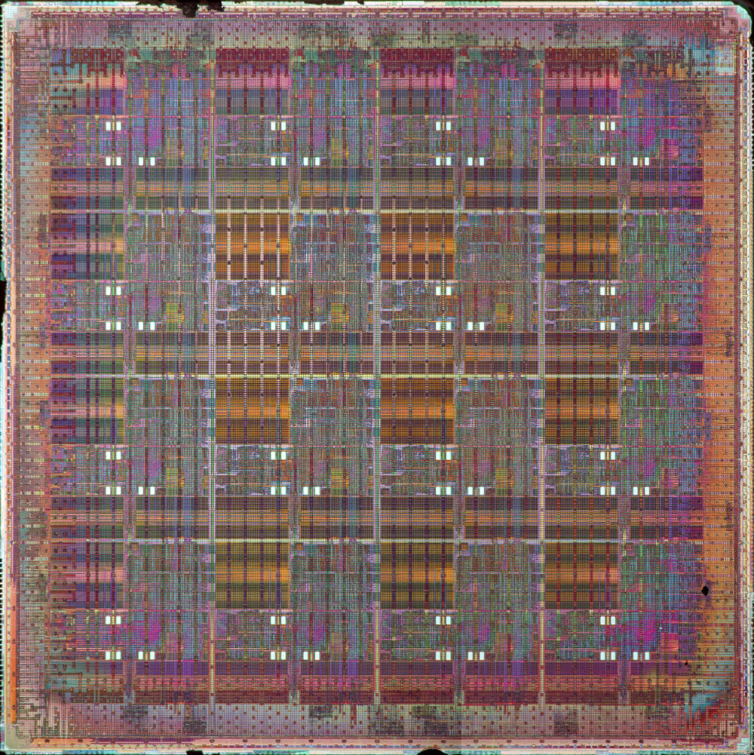
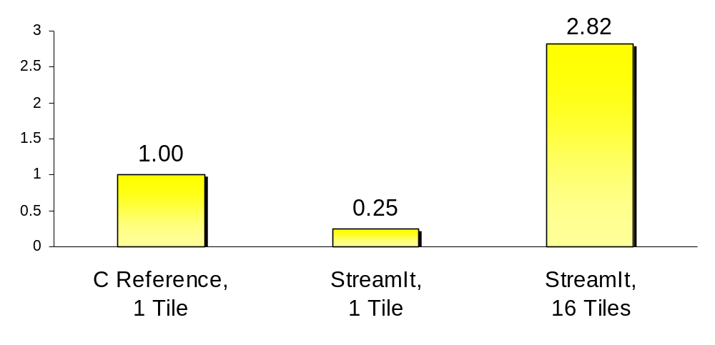
StreamIt Parallel Performance
2D Discrete Cosine Transform on MIT Raw Architecture
Speedup

Slide 23



Naturally Expose Data Distribution
1
2
3
4
5
6
Y
Cb
Cr
scatter macroblocks according to chroma format
add splitjoin {
split roundrobin(4*(B+V), B+V, B+V);
add MotionCompensation();
for (int i = 0; i < 2; i++) {
add pipeline {
add MotionCompensation();
add ChannelUpsample(B);
}
}
join roundrobin(1, 1, 1);
}
splitter 4:1:1
Y
Cb
Cr
Motion
Compensation
Motion
Compensation
Motion
Compensation
Channel
Upsample
Channel
Upsample
joiner 1:1:1
gather one pixel at a time
recovered picture

Slide 24


Stream Graph Malleability
1
2
splitter 4,1,1
MC
MC
MC
3
4
5
6
Upsample
Upsample
Y
Cb
Cr
joiner
4:2:0 chroma format
splitter 4,(2+2)
1
2
5
6
splitter 1,1
MC
MC
MC
3
4
7
8
Upsample
Upsample
Y
Cb
Cr
joiner
4:2:2 chroma format
joiner

Slide 25
StreamIt Code Sample
red = code added or modified to support 4:2:2 format
splitter 4,1,1
MC
MC
MC
// C = blocks per chroma channel per macroblock
// C = 1 for 4:2:0, C = 2 for 4:2:2
add splitjoin {
split roundrobin(4*(B+V), 2*C*(B+V));
add MotionCompensation();
add splitjoin {
split roundrobin(B+V, B+V);
for (int i = 0; i < 2; i++) {
add pipeline {
add MotionCompensation()
add ChannelUpsample(C,B);
}
}
join roundrobin(1, 1);
}
join roundrobin(1, 1, 1);
}
Upsample
Upsample
joiner
splitter 4,(2+2)
splitter 1,1
MC
MC
MC
Upsample
Upsample
joiner
joiner

Slide 26
In Contrast: C Code Excerpt
red = pointers used for address calculations
/* Y */
form_component_prediction(src[0]+(sfield?lx2>>1:0),dst[0]+(dfield?lx2>>1:0),
lx,lx2,w,h,x,y,dx,dy,average_flag);
if (chroma_format!=CHROMA444) {
lx>>=1; lx2>>=1; w>>=1; x>>=1; dx/=2;
}
if (chroma_format==CHROMA420) {
h>>=1; y>>=1; dy/=2;
}
/* Cb */
form_component_prediction(src[1]+(sfield?lx2>>1:0),dst[1]+(dfield?lx2>>1:0),
lx,lx2,w,h,x,y,dx,dy,average_flag);
/* Cr */
form_component_prediction(src[2]+(sfield?lx2>>1:0),dst[2]+(dfield?lx2>>1:0),
lx,lx2,w,h,x,y,dx,dy,average_flag);
Adjust values used for address calculations depending on the chroma format used.

Slide 27
StreamIt Language Highlights
Filters
Pipelines
Splitjoins
Teleport messaging

Slide 28
Teleport Messaging
Avoids muddling data
streams with control
relevant information
Localized interactions
in large applications
  A scalable alternative to
  global variables or
  excessive parameter
  passing
VLD
IQ
MC
MC
MC
Order

Slide 29
Motion Prediction and Messaging
picture type
portal<MotionCompensation> PT;
add splitjoin {
split roundrobin(4*(B+V), B+V, B+V);
add MotionCompensation() to PT;
for (int i = 0; i < 2; i++) {
add pipeline {
add MotionCompensation() to PT;
add ChannelUpsample(B);
}
}
join roundrobin(1, 1, 1);
}
splitter
Y
Cb
Cr
Motion
Compensation
Motion
Compensation
Motion
Compensation
Channel
Upsample
Channel
Upsample
joiner
recovered picture

Slide 30
Teleport Messaging Overview
Looks like method call, but timed
relative to data in the stream
Simple and precise for user
  Exposes dependences to compiler
  Adjustable latency
  Can send upstream or downstream
TargetFilter x;
if newPictureType(p) {
x.setPictureType(p) @ 0;
}
void setPicturetype(int p) {
reconfigure(p);
}

Slide 31
Messaging Equivalent in C
The MPEG Bitstream
Decode
Picture
File
Parsing
Global
Variable
Space
Decode
Macroblock
Decode
Block
ZigZagUnordering
Inverse
Quantization
Motion
Compensation
Decode
Motion
Vectors
Saturate
IDCT
Motion Compensation
For Single Channel
Frame Reordering
Output Video

Slide 32
Language Comparison:
Programmer’s Perspective
 | C | StreamIt
Correctness and Performance | Mixed together | Separation of concerns
Buffer management | Programmer managed | Compiler managed
Scheduling | Programmer managed | Compiler managed

Slide 33
Language Comparison:
Compiler’s Perspective
 | C | StreamIt
Memory Model | Global address space | Distributed (private) address spaces
Parallelism | Implicit | Explicit
Communication | Obscured | Exposed
Transformations | Limited | Global

Slide 34
Implementation
Functional MPEG-2 decoder
  Encoder recently completed
Developed by 1 programmer in 8 weeks
2257 lines of code
  Vs. 3477 lines of C code in MPEG-2 reference
48 static streams, 643 instantiated filters

Slide 35
Related Work
Synchronous Dataflow and Extensions
  Synchronous Piggybacked Dataflow
    C. Park, J. Chung, S. Ha 1999
    C. Park, J. Jung, S. Ha 2002
  Blocked Dataflow
    D.-I. Ko, S. S. Bhattacharyya 2005
  Hierarchical Dataflow
    S. Neuendorffer, E. Lee 2004
Implementations
  MPEG2 Decoding and Encoding
    E. Iwata, K. Olukotun 1998
  Parallel MPEG4 Encoding
    I. Assayad, P. Gerner, S. Yovine, V. Bertin 2005
Stream Oriented Languages
  Esterel, Lustre, Signal, Lucid, Cg, Brook, Spindle, StreamC, Occam, Parallel Haskell, Sisal
Notes:
Synchronous Piggybacked Dataflow
- global state table
- well timed reads and writes
Blocked Dataflow
- embed parameters in data streams
Assayed = MPEG4 Encoder

Slide 36
Ongoing and Future Work
MPEG-2 performance evaluation
Inter-language interfaces
  StreamIt to native C, and vice versa
More applications
we want to hear from you!

Slide 37
Conclusions
StreamIt language preserves program structure
  Natural for programmers
Parallelism and communication naturally exposed
  Compiler managed buffers, and portable parallelization technology
StreamIt increases programmer productivity, enables parallel performance

Slide 38
Thanks for Listening!
Any questions?
http://cag.csail.mit.edu/streamit

