Slide 1


Compilation of Dynamic Sparse Tensor Algebra
Stephen Chou
Saman Amarasinghe

Slide 2

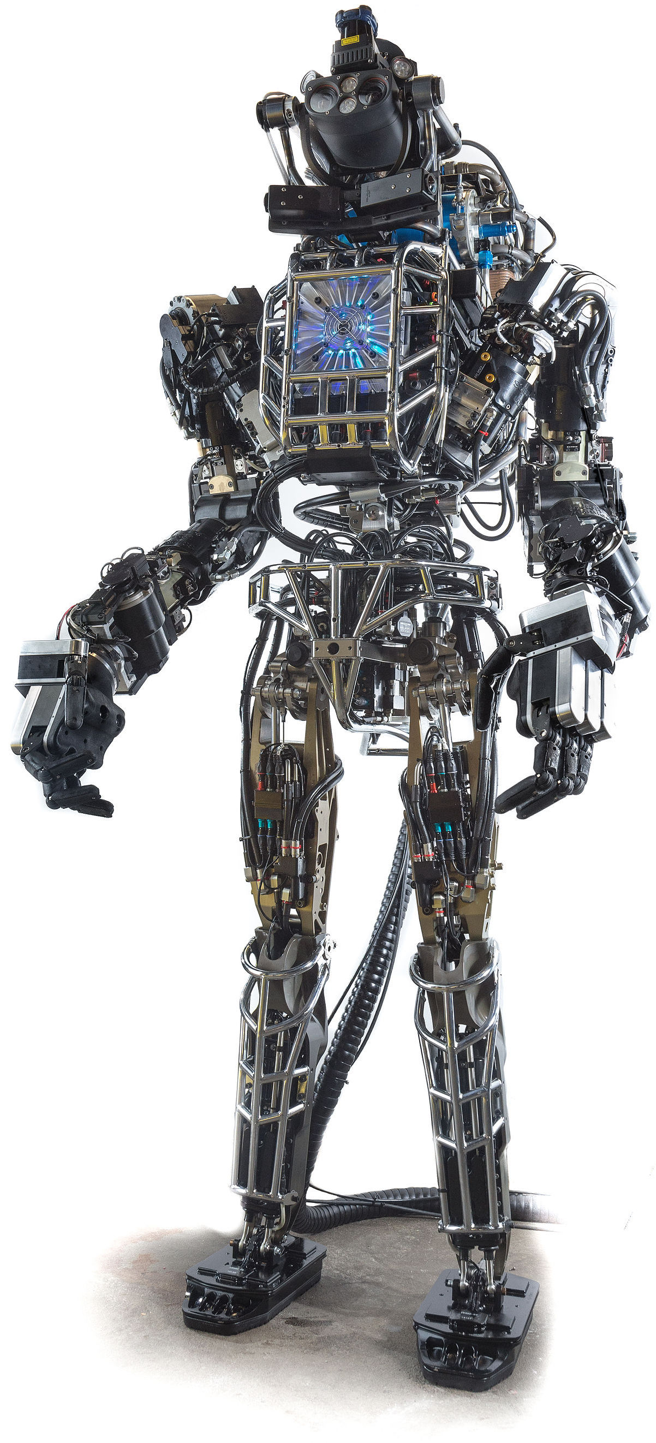
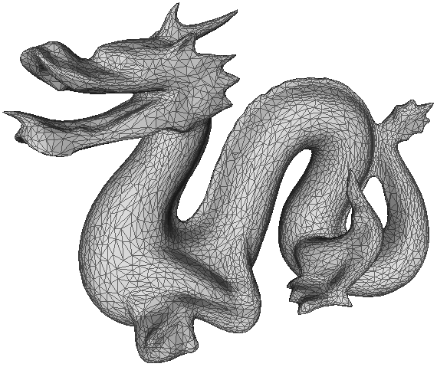

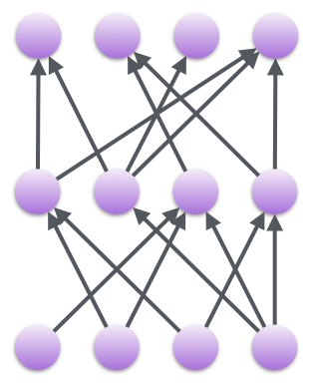

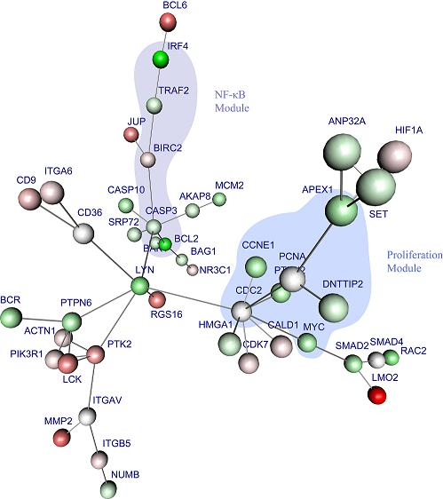


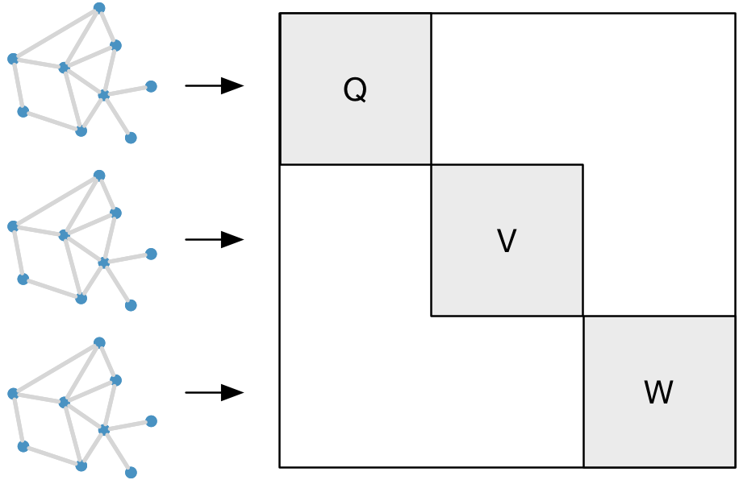

Sparse Data Values
Many real-world data sets are sparse
Large number of values are zero
Data Analytics
Machine Learning
Science and Engineering
Movies
Sparse Convolutional Networks
Robotics
Simulations
Sparse Networks
Product Reviews
Social Networks
Graph Convolutional Network
Computational Biology
Words
…
Poor
Amazing
Great
Extremely sparse
Dense storage: 107 Exabytes
Sparse storage: 13 Gigabytes
Peter
Lilly
Customers
Paul
Billy
Hilde
…
Bob
Sam
Mary
Products
…
2
Dubliners
Monitor
The Iliad
Sweater
Laptop
Candide
Jacket
Kindle

Slide 3
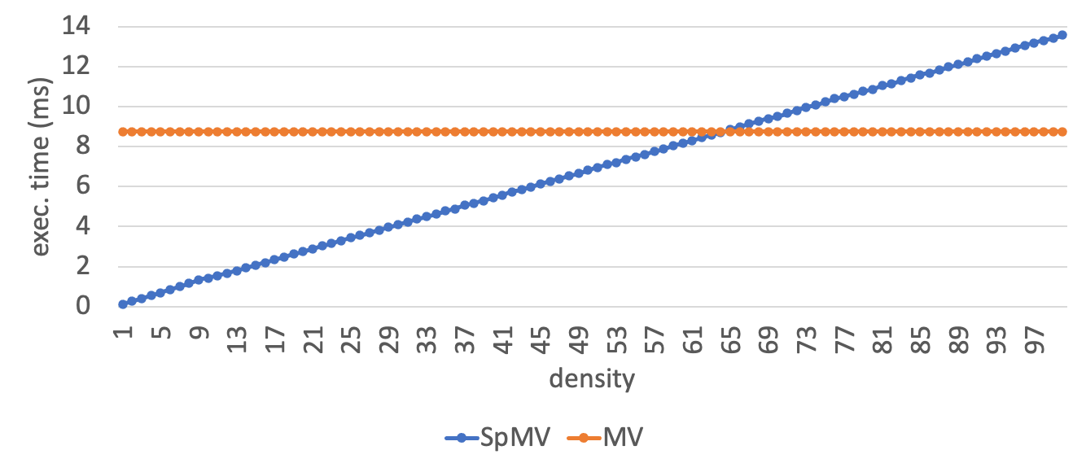
Ignoring Sparsity is Throwing away performance
8K x 8K
double precision
matrix in CSR
Sparse Matrix Vector Multiplication (SpMV)

Slide 4
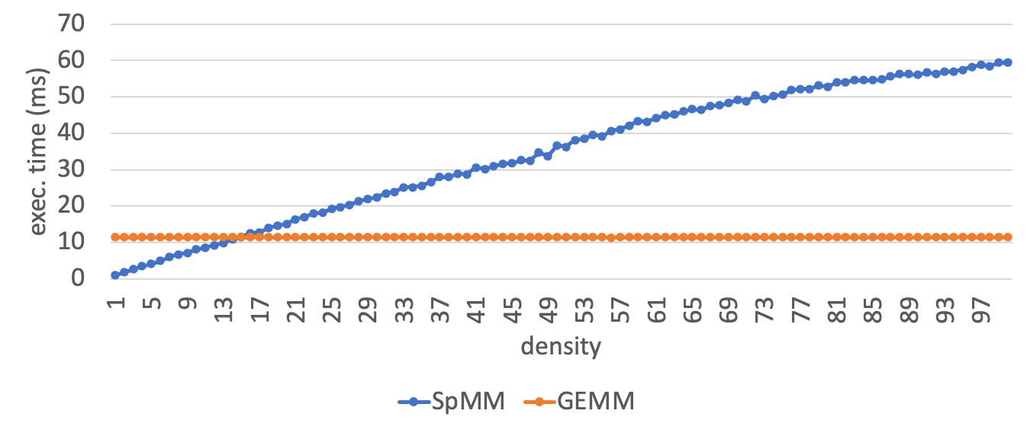
Ignoring Sparsity is Throwing away performance
4K x 4K
double precision
matrix in CSR
Sparse Matrix Matrix Multiplication (SpMM)

Slide 5

Sparse Problems are Everywhere
Dense
Array programs
0%
10%
Sparse Neural Networks
50%
100%
Density
SpMM
SpMV
10⁻⁶ %
10⁻⁵ %
10⁻⁴ %
10⁻³ %
0.01 %
0.1 %
1 %
Density
Log scale
Circuit Simulation
Fluid Dynamics
Internet & Social Media
Finite Element Methods
Problems in Statistics
Recommendation Systems
Computational Chemistry
Electromagnetics Proteins

Slide 6
Dense tensors are flexible but can waste memory
0
1
2
3
A
A
B
B
0
locate(1,2) = 1*4 + 2
C
C
D
D
E
E
1
= 6
F
F
2
0
1
2
3
4
5
6
7
8
9
10
11

Slide 7
Sparse tensors can be compressed by adding metadata
Compressed Sparse Row Format (CSR)
Coordinate Format (COO)
Duplicates
0
1
2
3
0
1
2
3
A
B
0
0
0
2
0
5
1
6
row(3) = ???
1
1
2
pos
rows
C
D
E
1
col(3) = ???
F
0
2
1
2
3
3
2
cols
A
B
C
D
E
F
0
1
2
3
4
5
6
7
8
9
10
11
0
1
2
3
4
5

Slide 8
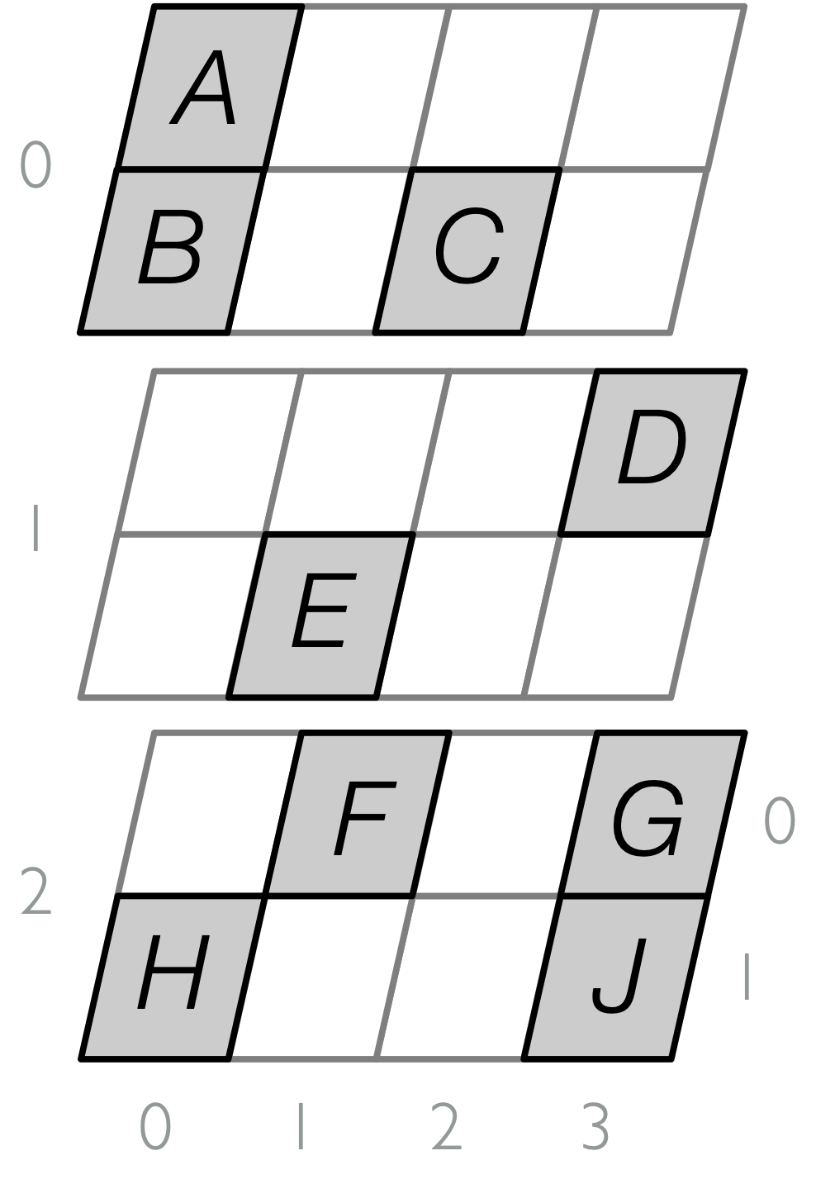
Tensor Formats Level-by-Level
Slice
Coordinates
3
Dense
0
3
5
9
Row Coordinates
Compressed
0
1
1
0
1
0
0
1
1
Column
Coordinates
0
0
2
3
1
1
3
0
3
Singleton
A
B
C
D
E
F
G
H
J
0
1
2
3
4
5
6
7
8

Slide 9
Level formats can be composed in many ways
Dense
Dense
Compressed
Compressed
Singleton
{
3
0
1
2
3
A
B
0
CSR
0
2
5
6
C
D
E
1
0
2
1
2
3
3
F
2
A
B
C
D
E
F

Slide 10
Level formats can be composed in many ways
Dense
Compressed
Compressed
Singleton
Singleton
{
0
6
0
1
2
3
0
0
1
1
1
2
A
B
0
Coordinates
C
D
E
1
0
2
1
2
3
3
F
2
A
B
C
D
E
F

Slide 11
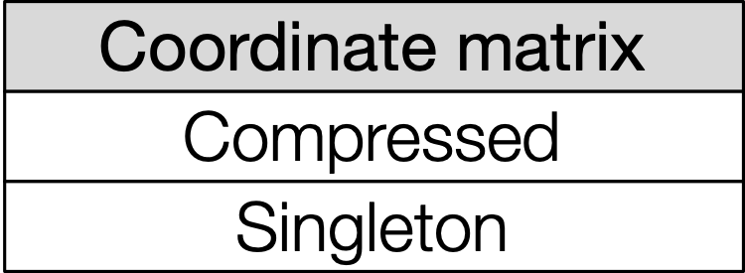
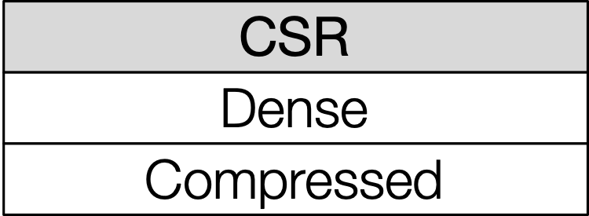
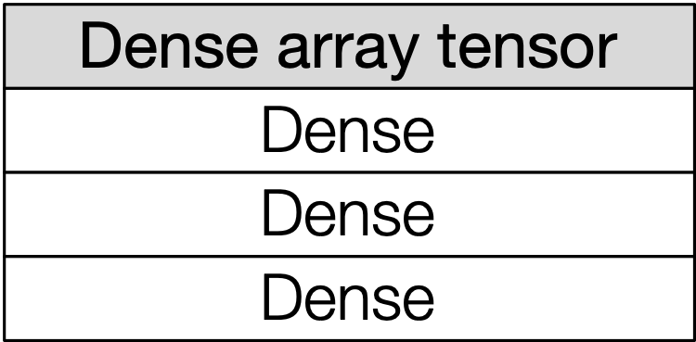
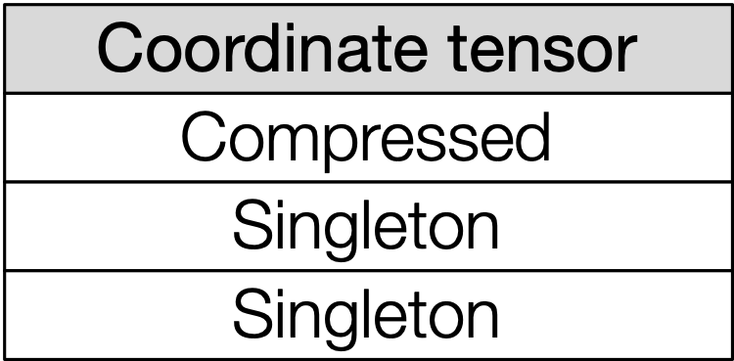
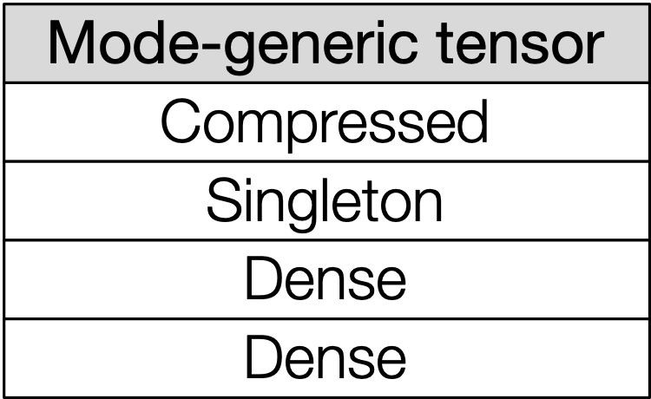
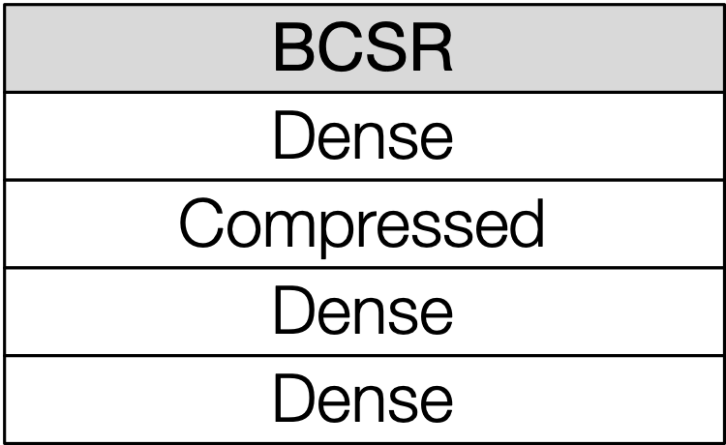
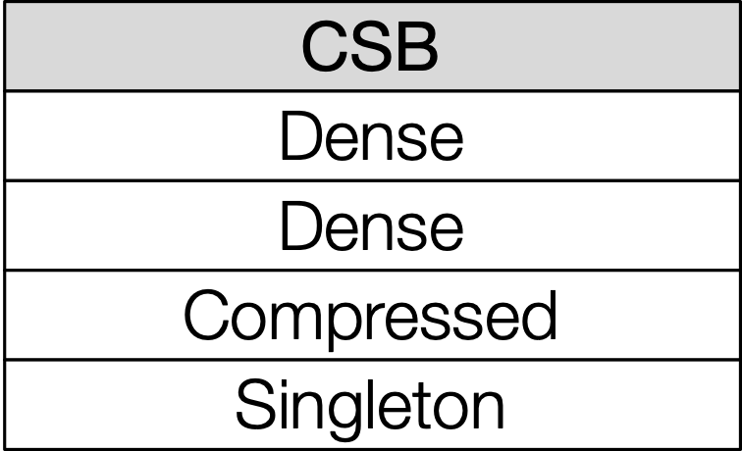
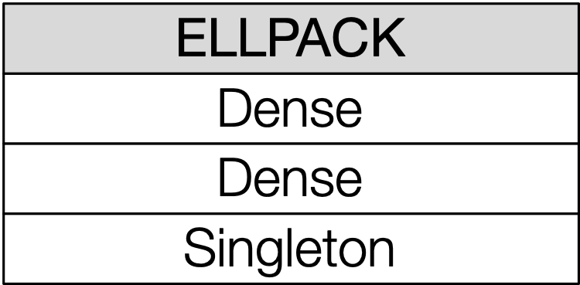
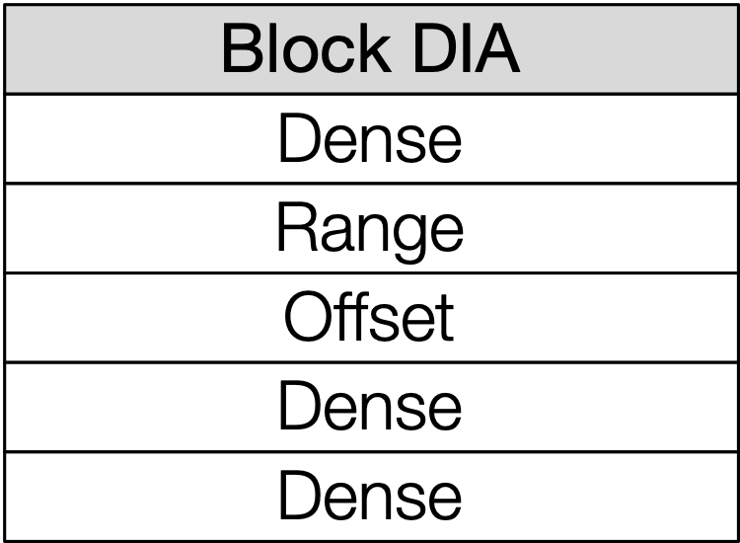
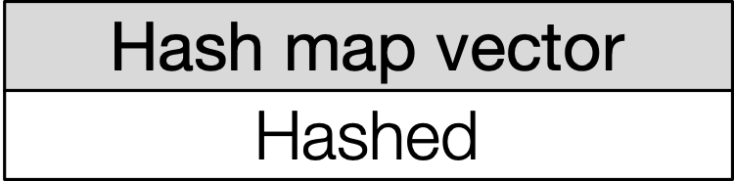
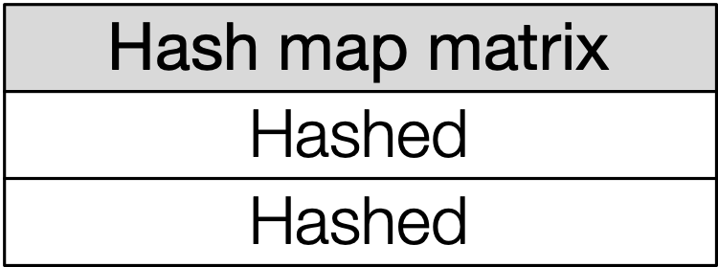
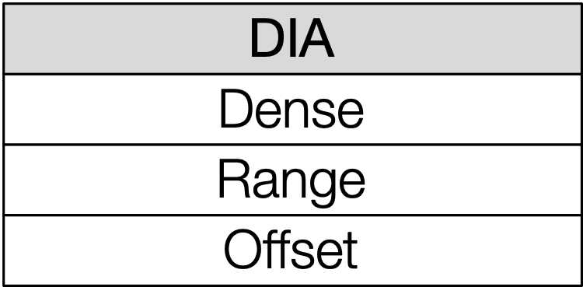
Level formats can represent most array-based sparse formats
Dense
Level formats
Compressed
Singleton
Hashed
Range
Offset
[Tinney and Walker, 1967]
Tensor formats
[Kincaid et al. 1989]
[Baskaran et al. 2012]
[Im and Yelick 1998]
[Buluç et al. 2009]
[Patwary et al. 2015]
[Saad 2003]

Slide 12
Many real-world applications work with dynamic sparse tensors
0
1
0
1
2
3
1
1
1
0
1
1
1
1
2
2
3
1
1
1
3

Slide 13
Many real-world applications work with dynamic sparse tensors
0
1
2
3
1
1
1
0
0
2
3
5
4
5
6
9
8
pos
1
1
1
1
2
3
3
2
3
3
0
1
2
crd
1
2
1
1
1
1
1
1
1
1
1
vals
1
1
1
3

Slide 14
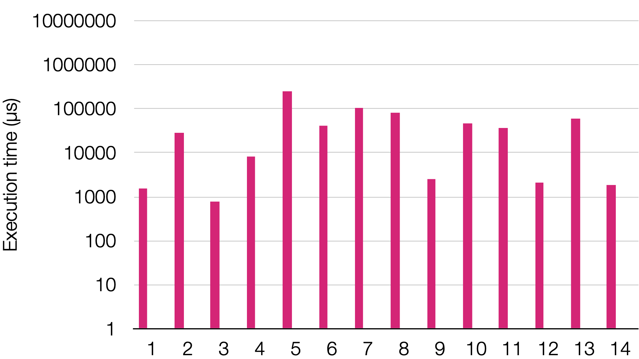
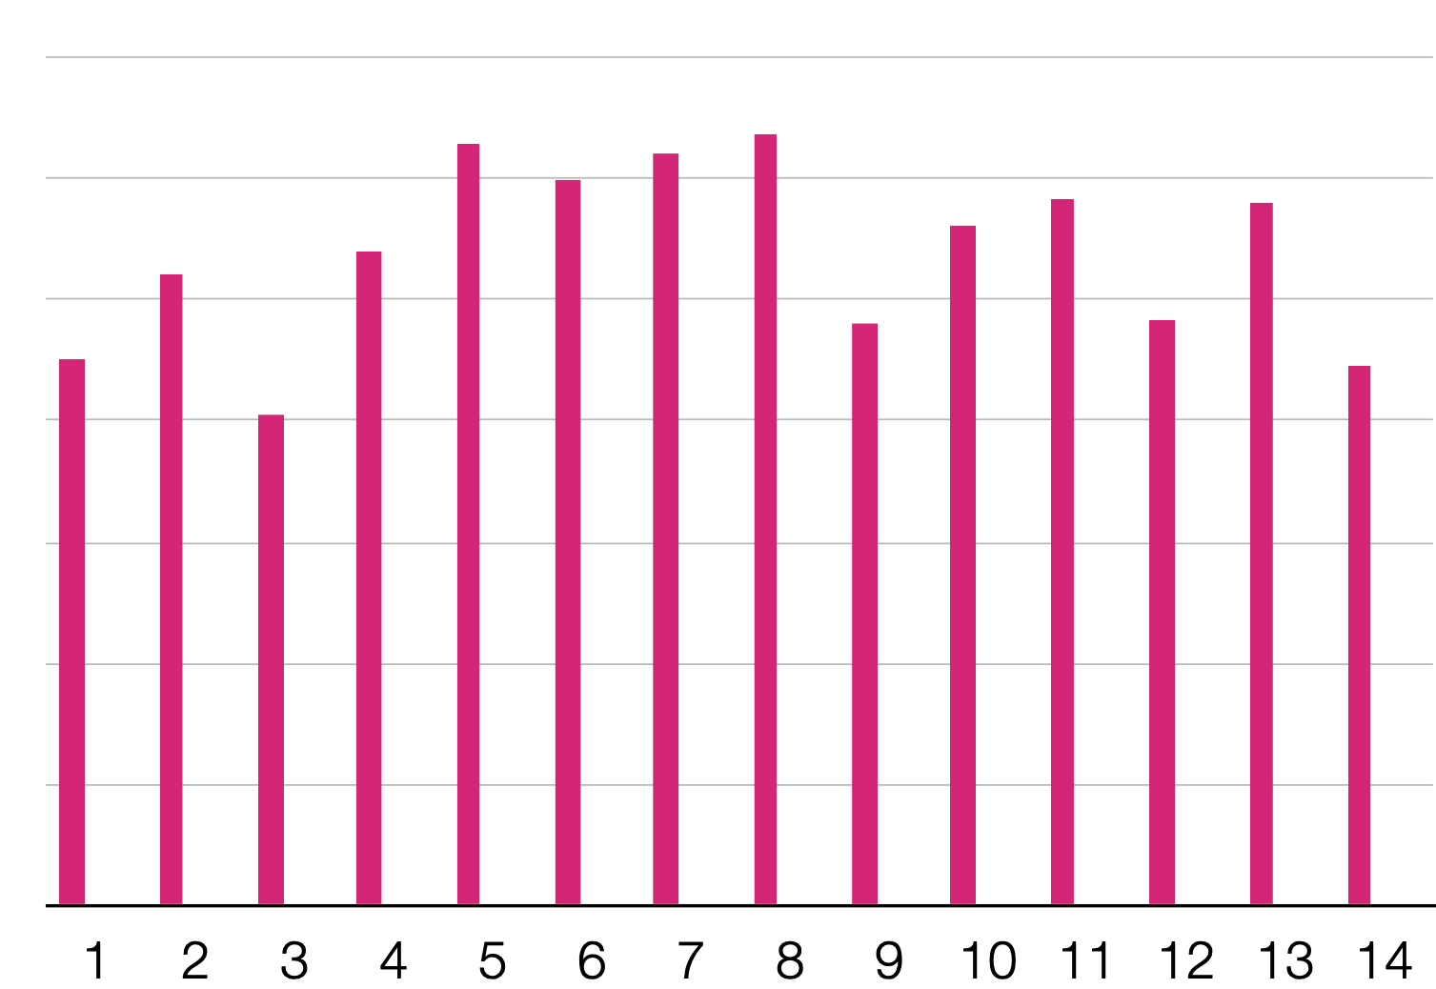
Inserting a new value to an array-based structure CSR
1.63M to 255M Number of Non-Zeros Stored in the CSR Format
PageRank Computation
Insert a Single Element

Slide 15
How to represent the sparse matrix with support for insertion?
0
1
2
3
1
1
0
1
1
1
1
2
1
1
1
3

Slide 16
Pointer-based formats allow for efficient in-place modification
0
1
2
3
2
1
1
1
1
3
0
3
1
1
1
0
2
1
1
2
2
3
0
2
1
1
1
3
3
0
3

Slide 17
There exists many different pointer-based dynamic sparse tensor formats
2
2
1
3
1
2
3
3
3
0
0
2
1
2
3
2
1
3
2
3
0
2
2
3
3
0
1
0
3
0
0
2
1
2
3
0
2
0
2
3
0
2
3
2
3
0
3
2
3
3
3
0
1
2
0
1
2

Slide 18
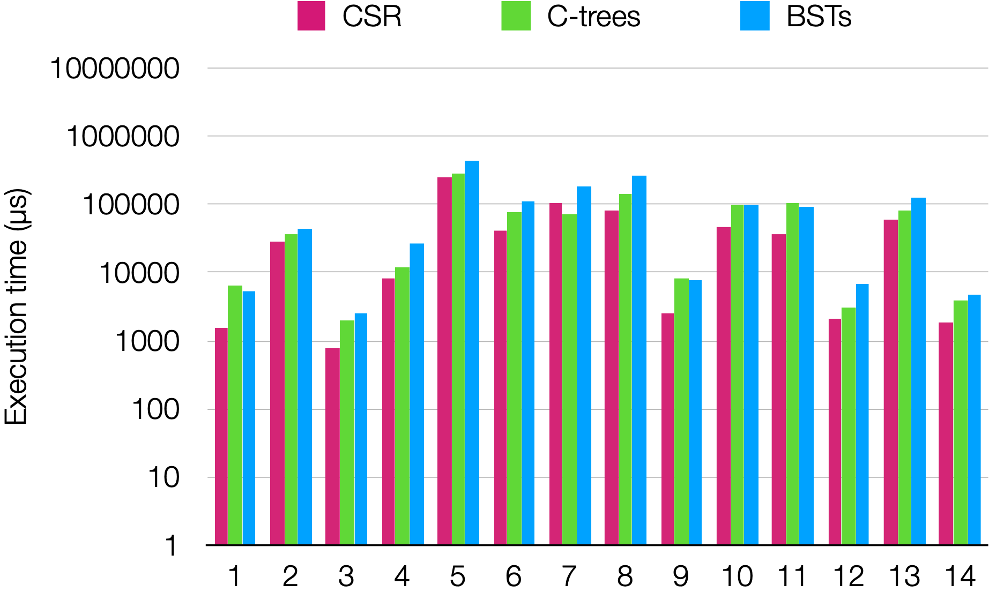
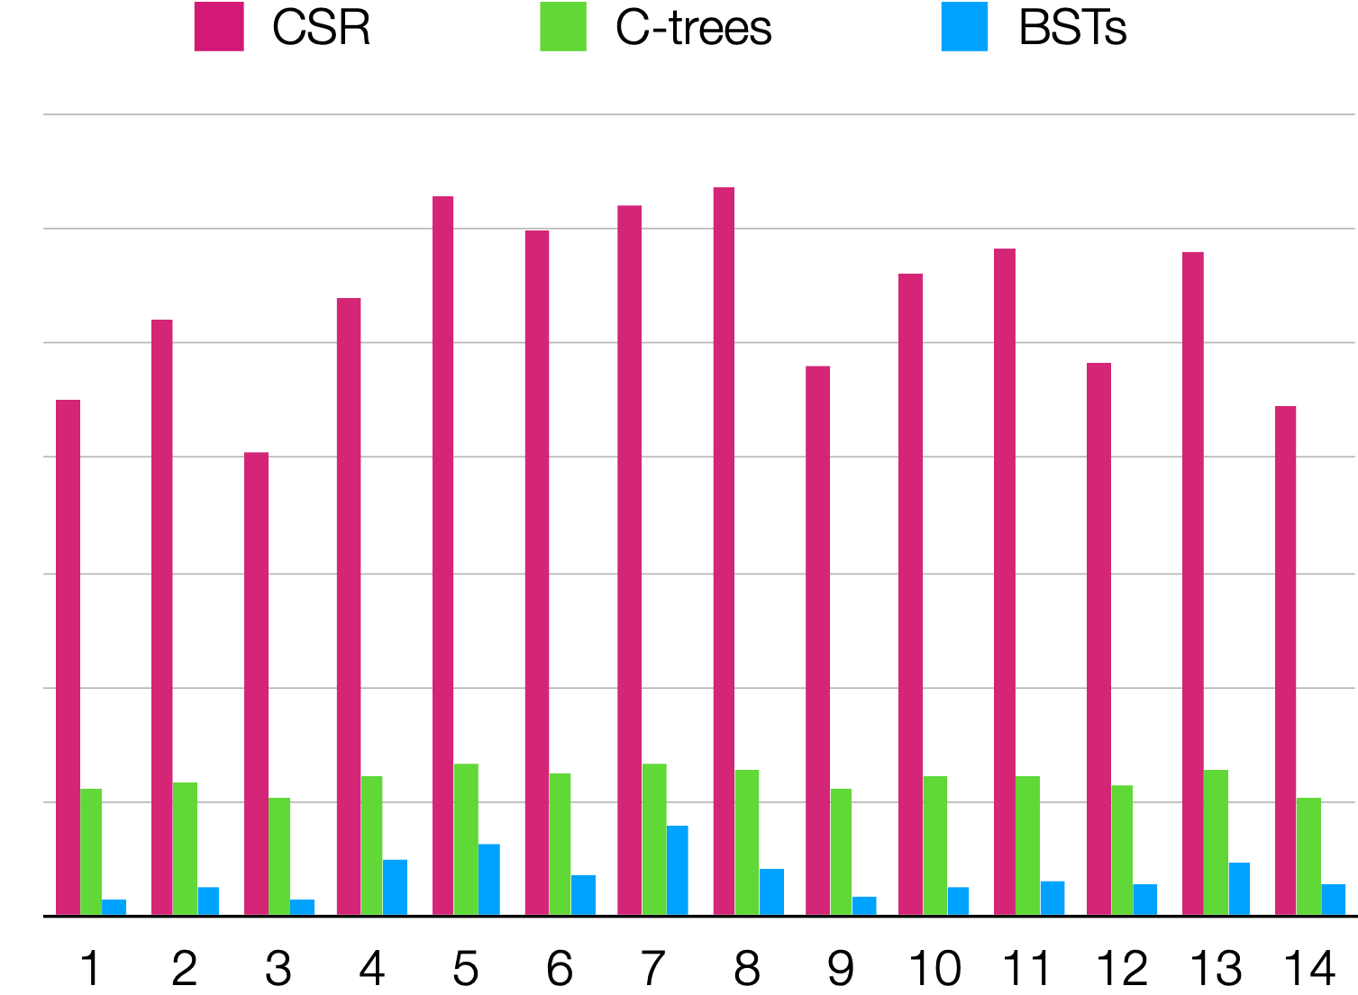
Performance of array-based vs. pointer-based formats
PageRank Computation
Insert a Single Element

Slide 19
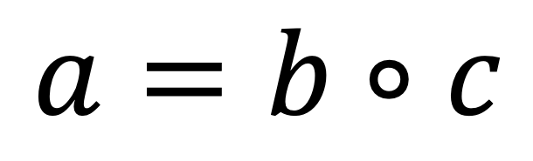
Computing with different formats can require very distinct code
$$a=b∘c$$
Dense Array ✕ Dense array
Block linked list ✕ Dense array
Binary search tree ✕ Dense array
void compute(...) {
for (int32_t k = 0; k < M; k++) {
a[k] = b[k] * c[k];
}
}
void compute(...) {
for (int32_t i = 0; i < M; i++) {
map_b2(b, c, a, i);
}
}
void map_b2(bll* b, ..., int32_t i) {
while (b) {
for (int32_t k = 0; k < b->B; k++) {
int32_t j = b->e[k].first;
int32_t p = i * N + j;
a[p] = b->e[k].second * c[p];
}
b = b->n;
}
}
void compute(...) {
map_b1(b, c, a);
}
void map_b1(bst_row* b, double* c, double* a) {
if (b) {
if (b->l)
map_b1(b->l, a, c);
map_b2(b->e.second, a, c, b->e.first);
if (b->r)
map_b1(b->r, a, c);
}
}
void map_b2(bst_col* b, ..., int32_t i) {
if (b) {
if (b->l)
map_b2(b->l, a, c, i);
int32_t p = i * N + b->e.first;
a[p] = b->e.second * c[p];
if (b->r)
map_b2(b->r, a, c, i);
}
}

Slide 20
Computing with different formats can require very distinct code
$$a=b∘c$$
Binary search tree ✕ Block linked list
void compute(...) {
map_b1(b, c, a);
}
void map_b1(bst_row* b, ...) {
if (b) {
int32_t i = b->e.first;
...
bst_col* bn = b->e.second;
bll* cn = c[i];
uint8_t bs =
iter_bst(0, bn, ..., jb, bv);
uint8_t cs =
iter_bll(0, cn, ..., jc, cv);
while (bs && cs) {
int32_t j = min(jb, jc);
if (j == jb && j == jc)
a[i * N + j] = bv * cv;
if (j == jb)
bs = iter_bst(bs, ..., bv);
if (j == jc)
cs = iter_bll(cs, ..., cv);
}
map_b1(b->l, c, a);
map_b1(b->r, c, a);
}
}
inline uint8_t iter_bst(...) {
if (state == 1)
goto iter_resume1;
cs.emplace(0, n);
while (!cs.empty()) {
n = get<1>(cs.top());
if (get<0>(cs.top()) == 1)
goto call_resume1;
while (n) {
if (n->l) {
get<0>(cs.top()) = 1;
get<1>(cs.top()) = n;
cs.emplace(0, n->l);
goto call_end;
call_resume1:;
}
c = n->e.first;
v = n->e.second;
return 1;
iter_resume1:
n = n->r;
}
cs.pop();
call_end:;
}
return 0;
}
inline uint8_t iter_bll(...) {
if (state == 1)
goto iter_resume1;
while (b) {
for (k = 0; k < b->B; k++) {
c = b->e[k].first;
v = b->e[k].second;
return 1;
iter_resume1:;
}
b = b->n;
}
return 0;
}

Slide 21
Dynamic tensor formats can be viewed as compositions of level formats
2
2
BST
1
3
1
3
BST
3
3
0
0
2
1
2
3
2
BST
C-tree
2
3
0
2
2
3
0
1
0
3
0
0
2
3
0
2
3
Dense
Dense
2
3
2
3
3
3
Linked list
BLL
0
1
2
0
1
2

Slide 22
Pointer-based data structures can be precisely defined
using node schema language
5
def bst {
e : elem nonempty
l : bst
r : bst
seq = l, e, r
}
3
8
0
4
6
9
1
7

Slide 23
Pointer-based data structures can be precisely defined
using node schema language

Slide 24
Pointer-based data structures can be precisely defined
using node schema language
2
1
3
3
0
2
3
0
2
3
0
2
3
2
2
3
2
3
2
3
0
1
3
3
0
0
1
2
0
1
2
def ctree {
h : elem nonempty
t : elem[B] nonempty
l : ctree
r : ctree
B : size
seq = l, h, {t}, r
}
def ll {
e : elem nonempty
n : ll
seq = e, n
}
def bll {
e : elem[B] nonempty
n : bll
B : size in [0, 2]
seq = {e}, n
}

Slide 25
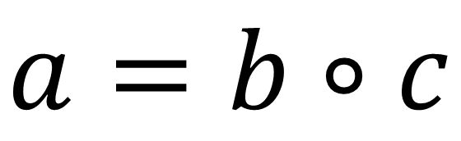
Compiler can generate code to compute on pointer-based data structures directly from node schemas
BST
$$a=b∘c$$
Dense array
Dense array
void compute(bst* b, double c[], double a[]) {
if (b) {
if (b->l)
# pragma omp task
compute(b->l, c, a);
int32_t i = b->e.first;
a[i] = b->e.second * c[i];
if (b->r)
# pragma omp task
compute(b->r, c, a);
}
}
void compute(bst* b, double c[], double a[]) {
if (b) {
if (b->l)
compute(b->l, c, a);
int32_t i = b->e.first;
a[i] = b->e.second * c[i];
if (b->r)
compute(b->r, c, a);
}
}
def bst {
e : elem nonempty
l : bst
r : bst
seq = l, e, r
}

Slide 26
Compiler can generate code to compute on pointer-based data structures directly from node schemas
BST
$$a=b∘c$$
Sparse vector
Sparse vector
pair<int32_t,double> iter(bst* b) {
if (b) {
if (b->l)
yield iter(b->l);
yield b->e;
if (b->r)
yield iter(b->r);
}
}
def bst {
e : elem nonempty
l : bst
r : bst
seq = l, e, r
}

Slide 27
Two-finger merge
void compute(bst* b,
int32_t c_pos[], int32_t c_crd[], double c[],
double a[]) {
auto biter = iter(b);
auto [ib, bv] = biter();
int32_t pc = c_pos[0];
while (ib != -1 && pc < c_pos[1]) {
int32_t ic = c_crd[pc];
int32_t i = min(ib, ic);
if (i == ib && i == ic)
a[i] = bv * c[pc];
if (i == ib)
tie(ib, bv) = biter();
pc += (i == ic);
}
}
int32_t b_pos[], int32_t b_crd[], double b[],
int32_t pb = c_pos[0];
while (pb < b_pos[1] && pc < c_pos[1]) {
int32_t ib = b_crd[pb];
pb += (i == ib);

Slide 28
Compiler can generate code to compute on pointer-based data structures directly from node schemas
pair<int32_t,double>
iter(bst* b) {
call_stack<bst*,uint8_t> cs;
cs.push({b, 0});
while (!cs.empty()) {
{b, s} = cs.top();
if (s == 1)
goto resume;
while (b) {
if (b->l) {
cs.top() = {b, 1};
cs.push({b->l, 0});
goto end;
resume:;
}
yield b->e;
b = b->r;
}
cs.pop();
end:;
}
}
pair<int32_t,double>
iter(bst* b) {
if (b) {
if (b->l)
yield iter(b->l);
yield b->e;
if (b->r)
yield iter(b->r);
}
}
pair<int32_t,double>
iter(bst* b) {
while (b) {
if (b->l)
yield iter(b->l);
yield b->e;
b = b->r;
}
}
Tail call elimination
Recursion elimination

Slide 29
Our technique generates efficient dynamic sparse tensor algebra code
PageRank Kernel
SpMM

Slide 30
Our technique supports a wide range of computations

Slide 31





Conclusion
Efficient code for computing on dynamic sparse tensors can be automatically generated from high-level specifications
Adding support for new dynamic sparse tensor formats is straightforward
Our technique makes it simple to exploit disparate formats for performance
tensor-compiler.org
This work was supported by:

