Slide 1
A Stream Compiler for
Communication-Exposed Architectures
Michael Gordon, William Thies, Michal Karczmarek, Jasper Lin, Ali Meli, Andrew Lamb, Chris Leger, Jeremy Wong, Henry Hoffmann, David Maze, Saman Amarasinghe
Laboratory for Computer Science
Massachusetts Institute of Technology

Slide 2
The Streaming Domain
Widely applicable and increasingly prevalent
  Embedded systems
    Cell phones, handheld computers, DSP’s
  Desktop applications
    Streaming media • Real-time encryption
    Software radio • Graphics packages
  High-performance servers
    Software routers (Example: Click)
    Cell phone base stations
    HDTV editing consoles
Based on audio, video, or data stream
  Predominant data types in the current data explosion

Slide 3
Properties of Stream Programs
A large (possibly infinite) amount of data
  Limited lifetime of each data item
  Little processing of each data item
Computation: apply multiple filters to data
  Each filter takes an input stream, does some processing, and produces an output stream
  Filters are independent and self-contained
A regular, static computation pattern
  Filter graph is relatively constant
  A lot of opportunities for compiler optimizations

Slide 4
StreamIt: A spatially-aware Language & Compiler
A language for streaming applications
  Provides high-level stream abstraction
Breaks the Von Neumann language barrier
  Each filter has its own control-flow
  Each filter has its own address space
  No global time
  Explicit data movement between filters
  Compiler is free to reorganize the computation
Spatially-aware Compiler
  Intermediate representation with stream constructs
  Provides a host of stream analyses and optimizations

Slide 5
Structured Streams
Hierarchical structures:
  Pipeline
  SplitJoin
  Feedback Loop
Basic programmable unit: Filter

Slide 6
Filter Example: LowPassFilter
float->float filter LowPassFilter(int N) {
float[N] weights;
init {
for (int i=0; i<N; i++)
weights[i] = calcWeights(i);
}
work push 1 pop 1 peek N {
float result = 0;
for (int i=0; i<N; i++)
result += weights[i] * peek(i);
push(result);
pop();
}
}

Slide 7
Filter Example: LowPassFilter
float->float filter LowPassFilter(int N) {
float[N] weights;
init {
for (int i=0; i<N; i++)
weights[i] = calcWeights(i);
}
work push 1 pop 1 peek N {
float result = 0;
for (int i=0; i<N; i++)
result += weights[i] * peek(i);
push(result);
pop();
}
}
N

Slide 8
Filter Example: LowPassFilter
float->float filter LowPassFilter(int N) {
float[N] weights;
init {
for (int i=0; i<N; i++)
weights[i] = calcWeights(i);
}
work push 1 pop 1 peek N {
float result = 0;
for (int i=0; i<N; i++)
result += weights[i] * peek(i);
push(result);
pop();
}
}
N

Slide 9
Filter Example: LowPassFilter
float->float filter LowPassFilter(int N) {
float[N] weights;
init {
for (int i=0; i<N; i++)
weights[i] = calcWeights(i);
}
work push 1 pop 1 peek N {
float result = 0;
for (int i=0; i<N; i++)
result += weights[i] * peek(i);
push(result);
pop();
}
}
N

Slide 10
Filter Example: LowPassFilter
float->float filter LowPassFilter(int N) {
float[N] weights;
init {
for (int i=0; i<N; i++)
weights[i] = calcWeights(i);
}
work push 1 pop 1 peek N {
float result = 0;
for (int i=0; i<N; i++)
result += weights[i] * peek(i);
push(result);
pop();
}
}
N

Slide 11
Example: Radar Array Front End
complex->void pipeline BeamFormer(int numChannels, int numBeams) {
add splitjoin {
split duplicate;
for (int i=0; i<numChannels; i++) {
add pipeline {
add FIR1(N1);
add FIR2(N2);
};
};
join roundrobin;
};
add splitjoin {
split duplicate;
for (int i=0; i<numBeams; i++) {
add pipeline {
add VectorMult();
add FIR3(N3);
add Magnitude();
add Detect();
};
};
join roundrobin(0);
};
}
Splitter
FIRFilter
FIRFilter
FIRFilter
FIRFilter
FIRFilter
FIRFilter
FIRFilter
FIRFilter
FIRFilter
FIRFilter
FIRFilter
FIRFilter
FIRFilter
FIRFilter
FIRFilter
FIRFilter
FIRFilter
FIRFilter
FIRFilter
FIRFilter
RoundRobin
Duplicate
Vector Mult
Vector Mult
Vector Mult
Vector Mult
FirFilter
FirFilter
FirFilter
FirFilter
Magnitude
Magnitude
Magnitude
Magnitude
Detector
Detector
Detector
Detector
Joiner

Slide 12
How to execute a Stream Graph?
Method 1: Time Multiplexing
Run one filter at a time
Pros:
  Scheduling is easy
  Synchronization from Memory
Cons:
  If a filter run is too short
    Filter load overhead is high
  If a filter run is too long
    Data spills down the cache hierarchy
    Long latency
  Lots of memory traffic
    Bad cache effects
  Does not scale with spatially-aware architectures
Processor
Memory

Slide 13
How to execute a Stream Graph?
Method 2: Space Multiplexing
Map filter per tile and run
forever
Pros:
  No filter swapping overhead
  Exploits spatially-aware
  architectures
    Scales well
  Reduced memory traffic
  Localized communication
  Tighter latencies
  Smaller live data set
Cons:
  Load balancing is critical
  Not good for dynamic behavior
  Requires # filters ≤ # processing elements

Slide 14
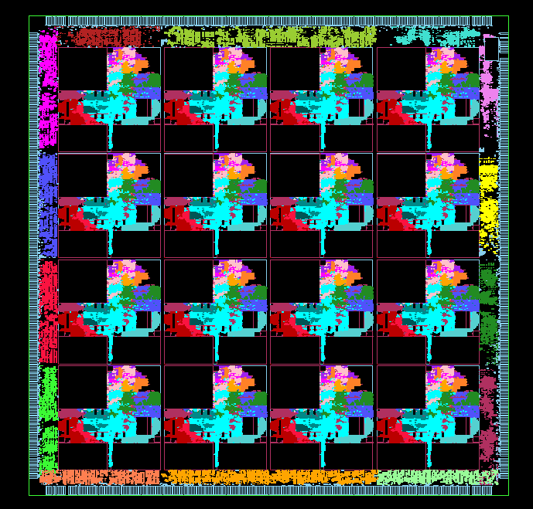
The MIT RAW Machine
Computation
Resources
A scalable computation fabric
  4 x 4 mesh of tiles, each tile is a simple microprocessor
Ultra fast interconnect network
  Exposes the wires to the compiler
  Compiler orchestrate the communication
Notes:
Now that I’ve show how we expose the gates to the ISA level, how do I expose the wires?
We do it through on-chip networks. It turns out that on-chip, we have massive, massive bandwidth.
On this chip, we have 462 Gb/s of bi-section bandwidth... and we’re not even full custom.
Let’s look at the actual network. It’s a point-to-point mesh network. If you noticed, the networks
are registered on input at each tile; this means that the longest wire in the system is the length of a tile.
Finally, one point to notice is that we’ve exposed wire delay in the form of network hops. If you want to get
from corner to corner of the chip, it’ll take you 6 hops, corresponding to approximately 6 cycles of wire delay.

Slide 15
Example: Radar Array Front End
complex->void pipeline BeamFormer(int numChannels, int numBeams) {
add splitjoin {
split duplicate;
for (int i=0; i<numChannels; i++) {
add pipeline {
add FIR1(N1);
add FIR2(N2);
};
};
join roundrobin;
};
add splitjoin {
split duplicate;
for (int i=0; i<numBeams; i++) {
add pipeline {
add VectorMult();
add FIR3(N3);
add Magnitude();
add Detect();
};
};
join roundrobin(0);
};
}
Splitter
FIRFilter
FIRFilter
FIRFilter
FIRFilter
FIRFilter
FIRFilter
FIRFilter
FIRFilter
FIRFilter
FIRFilter
FIRFilter
FIRFilter
FIRFilter
FIRFilter
FIRFilter
FIRFilter
FIRFilter
FIRFilter
FIRFilter
FIRFilter
RoundRobin
Duplicate
Vector Mult
Vector Mult
Vector Mult
Vector Mult
FirFilter
FirFilter
FirFilter
FirFilter
Magnitude
Magnitude
Magnitude
Magnitude
Detector
Detector
Detector
Detector
Joiner

Slide 16
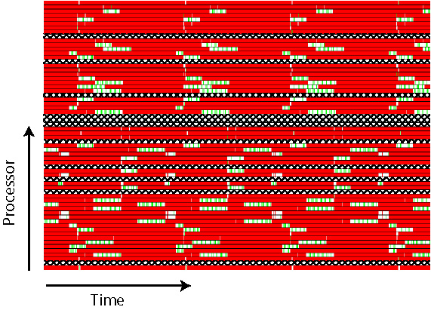
Radar Array Front End on Raw
Blocked on Static Network
Executing Instructions
Pipeline Stall

Slide 17
Bridging the Abstraction layers
StreamIt language exposes the data movement
  Graph structure is architecture independent
Each architecture is different in granularity and topology
  Communication is exposed to the compiler
The compiler needs to efficiently bridge the abstraction
  Map the computation and communication pattern of the program
  to the PE’s, memory and the communication substrate
The StreamIt Compiler
  Partitioning
  Placement
  Scheduling
  Code generation

Slide 18
Bridging the Abstraction layers
StreamIt language exposes the data movement
  Graph structure is architecture independent
Each architecture is different in granularity and topology
  Communication is exposed to the compiler
The compiler needs to efficiently bridge the abstraction
  Map the computation and communication pattern of the program
  to the PE’s, memory and the communication substrate
The StreamIt Compiler
  Partitioning
  Placement
  Scheduling
  Code generation

Slide 19
Partitioning: Choosing the Granularity
Mapping filters to tiles
  # filters should equal (or a few less than) # of tiles
  Each filter should have similar amount of work
    Throughput determined by the filter with most work
Compiler Algorithm
  Two primary transformations
    Filter fission
    Filter fusion
  Uses a greedy heuristic
Notes:
Could do better with that raw graphic on the right…

Slide 20
Partitioning - Fission
Fission - splitting streams
  Duplicate a filter, placing the duplicates in a SplitJoin to expose parallelism.
Splitter
…
Filter
Filter
Filter
Joiner
  Split a filter into a pipeline for load balancing
…
Filter
Filter0
Filter1
FilterN

Slide 21
Partitioning - Fusion
Fusion - merging streams
  Merge filters into one filter for load balancing and synchronization removal
Splitter
…
Filter0
FilterN
Filter
Joiner
…
Filter0
Filter1
FilterN
Filter

Slide 22
Example: Radar Array Front End (Original)
Splitter
FIRFilter
FIRFilter
FIRFilter
FIRFilter
FIRFilter
FIRFilter
FIRFilter
FIRFilter
FIRFilter
FIRFilter
FIRFilter
FIRFilter
FIRFilter
FIRFilter
FIRFilter
FIRFilter
FIRFilter
FIRFilter
FIRFilter
FIRFilter
FIRFilter
FIRFilter
FIRFilter
FIRFilter
Joiner
Splitter
Vector Mult
Vector Mult
Vector Mult
Vector Mult
FirFilter
FirFilter
FirFilter
FirFilter
Magnitude
Magnitude
Magnitude
Magnitude
Detector
Detector
Detector
Detector
Joiner

Slide 23
Example: Radar Array Front End
Splitter
FIRFilter
FIRFilter
FIRFilter
FIRFilter
FIRFilter
FIRFilter
FIRFilter
FIRFilter
FIRFilter
FIRFilter
FIRFilter
FIRFilter
FIRFilter
FIRFilter
FIRFilter
FIRFilter
FIRFilter
FIRFilter
FIRFilter
FIRFilter
FIRFilter
FIRFilter
FIRFilter
FIRFilter
Joiner
Splitter
Vector Mult
Vector Mult
Vector Mult
Vector Mult
FirFilter
FirFilter
FirFilter
FirFilter
Magnitude
Magnitude
Magnitude
Magnitude
Detector
Detector
Detector
Detector
Joiner

Slide 24
Example: Radar Array Front End
Splitter
FIRFilter
FIRFilter
FIRFilter
FIRFilter
FIRFilter
FIRFilter
FIRFilter
FIRFilter
FIRFilter
FIRFilter
FIRFilter
FIRFilter
FIRFilter
FIRFilter
FIRFilter
FIRFilter
FIRFilter
FIRFilter
FIRFilter
FIRFilter
FIRFilter
FIRFilter
FIRFilter
FIRFilter
Joiner
Splitter
Vector Mult
Vector Mult
Vector Mult
Vector Mult
FirFilter
FirFilter
FirFilter
FirFilter
Magnitude
Magnitude
Magnitude
Magnitude
Detector
Detector
Detector
Detector
Joiner

Slide 25
Example: Radar Array Front End
Splitter
FIRFilter
FIRFilter
FIRFilter
FIRFilter
FIRFilter
FIRFilter
FIRFilter
FIRFilter
FIRFilter
FIRFilter
FIRFilter
FIRFilter
FIRFilter
FIRFilter
FIRFilter
FIRFilter
FIRFilter
FIRFilter
FIRFilter
FIRFilter
FIRFilter
FIRFilter
FIRFilter
FIRFilter
Joiner
Splitter
Vector Mult
Vector Mult
Vector Mult
Vector Mult
FirFilter
FirFilter
FirFilter
FirFilter
Magnitude
Magnitude
Magnitude
Magnitude
Detector
Detector
Detector
Detector
Joiner

Slide 26
Example: Radar Array Front End
Splitter
FIRFilter
FIRFilter
FIRFilter
FIRFilter
FIRFilter
FIRFilter
FIRFilter
FIRFilter
FIRFilter
FIRFilter
FIRFilter
FIRFilter
FIRFilter
FIRFilter
FIRFilter
FIRFilter
FIRFilter
FIRFilter
FIRFilter
FIRFilter
FIRFilter
FIRFilter
FIRFilter
FIRFilter
Joiner
Splitter
Vector Mult
Vector Mult
Vector Mult
Vector Mult
FirFilter
FirFilter
FirFilter
FirFilter
Magnitude
Magnitude
Magnitude
Magnitude
Detector
Detector
Detector
Detector
Joiner

Slide 27
Example: Radar Array Front End
Splitter
FIRFilter
FIRFilter
FIRFilter
FIRFilter
FIRFilter
FIRFilter
FIRFilter
FIRFilter
FIRFilter
FIRFilter
FIRFilter
FIRFilter
FIRFilter
FIRFilter
FIRFilter
FIRFilter
FIRFilter
FIRFilter
FIRFilter
FIRFilter
FIRFilter
FIRFilter
FIRFilter
FIRFilter
Joiner
Splitter
Vector Mult
FIRFilter
Magnitude
Detector
Vector Mult
FIRFilter
Magnitude
Detector
Vector Mult
FIRFilter
Magnitude
Detector
Vector Mult
FIRFilter
Magnitude
Detector
Joiner

Slide 28
Example: Radar Array Front End
Splitter
FIRFilter
FIRFilter
FIRFilter
FIRFilter
FIRFilter
FIRFilter
FIRFilter
FIRFilter
FIRFilter
FIRFilter
FIRFilter
FIRFilter
FIRFilter
FIRFilter
FIRFilter
FIRFilter
FIRFilter
FIRFilter
FIRFilter
FIRFilter
FIRFilter
FIRFilter
FIRFilter
FIRFilter
Joiner
Splitter
Vector Mult
FIRFilter
Magnitude
Detector
Vector Mult
FIRFilter
Magnitude
Detector
Vector Mult
FIRFilter
Magnitude
Detector
Vector Mult
FIRFilter
Magnitude
Detector
Joiner

Slide 29
Example: Radar Array Front End
Splitter
FIRFilter
FIRFilter
FIRFilter
FIRFilter
FIRFilter
FIRFilter
FIRFilter
FIRFilter
FIRFilter
FIRFilter
FIRFilter
FIRFilter
FIRFilter
FIRFilter
FIRFilter
FIRFilter
FIRFilter
FIRFilter
FIRFilter
FIRFilter
FIRFilter
FIRFilter
FIRFilter
FIRFilter
Joiner
Splitter
Vector Mult
FIRFilter
Magnitude
Detector
Vector Mult
FIRFilter
Magnitude
Detector
Vector Mult
FIRFilter
Magnitude
Detector
Vector Mult
FIRFilter
Magnitude
Detector
Joiner

Slide 30
Example: Radar Array Front End
Splitter
FIRFilter
FIRFilter
FIRFilter
FIRFilter
FIRFilter
FIRFilter
FIRFilter
FIRFilter
FIRFilter
FIRFilter
FIRFilter
FIRFilter
FIRFilter
FIRFilter
FIRFilter
FIRFilter
FIRFilter
FIRFilter
FIRFilter
FIRFilter
FIRFilter
FIRFilter
FIRFilter
FIRFilter
Joiner
Splitter
Vector Mult
FIRFilter
Magnitude
Detector
Vector Mult
FIRFilter
Magnitude
Detector
Vector Mult
FIRFilter
Magnitude
Detector
Vector Mult
FIRFilter
Magnitude
Detector
Joiner

Slide 31
Example: Radar Array Front End (Balanced)
Splitter
FIRFilter
FIRFilter
FIRFilter
FIRFilter
FIRFilter
FIRFilter
FIRFilter
FIRFilter
FIRFilter
FIRFilter
FIRFilter
FIRFilter
FIRFilter
FIRFilter
FIRFilter
FIRFilter
FIRFilter
FIRFilter
FIRFilter
FIRFilter
FIRFilter
FIRFilter
FIRFilter
FIRFilter
Joiner
Splitter
Vector Mult
FIRFilter
Magnitude
Detector
Vector Mult
FIRFilter
Magnitude
Detector
Vector Mult
FIRFilter
Magnitude
Detector
Vector Mult
FIRFilter
Magnitude
Detector
Joiner

Slide 32
Placement: Minimizing Communication
Assign filters to tiles
  Communicating filters → try to make them adjacent
  Reduce overlapping communication paths
  Reduce/eliminate cyclic communication if possible
Compiler algorithm
  Uses Simulated Annealing

Slide 33
Placement for Partitioned Radar Array Front End
FIR
FIR
FIR
FIR
Vector Mult
FIR
Magnitude
Detector
FIR
FIR
FIR
FIR
Vector Mult
FIR
Magnitude
Detector
Joiner
FIR
FIR
FIR
FIR
FIR
FIR
FIR
FIR
FIR
FIR
FIR
FIR
FIR
FIR
FIR
FIR

Slide 34
Scheduling: Communication Orchestration
Create a communication schedule
Compiler Algorithm
  Calculate an initialization and steady-state schedule
  Simulate the execution of an entire cyclic schedule
  Place static route instructions at the appropriate time

Slide 35
Steady-State Schedule
All data pop/push rates are constant
Can find a Steady-State Schedule
  # of items in the buffers are the same before and the after executing the schedule
  There exist a unique minimum steady state schedule
Schedule = { }
A
B
C
…
push=2
pop=3
push=1
pop=2
…

Slide 36
Steady-State Schedule
All data pop/push rates are constant
Can find a Steady-State Schedule
  # of items in the buffers are the same before and the after executing the schedule
  There exist a unique minimum steady state schedule
Schedule = { A }
A
B
C
…
push=2
pop=3
push=1
…
push=2
pop=2
…

Slide 37
Steady-State Schedule
All data pop/push rates are constant
Can find a Steady-State Schedule
  # of items in the buffers are the same before and the after executing the schedule
  There exist a unique minimum steady state schedule
Schedule = { A, A }
A
B
C
…
push=2
pop=3
push=1
…
push=2
pop=2
…

Slide 38
Steady-State Schedule
All data pop/push rates are constant
Can find a Steady-State Schedule
  # of items in the buffers are the same before and the after executing the schedule
  There exist a unique minimum steady state schedule
Schedule = { A, A, B }
A
B
C
…
push=2
pop=3
push=1
pop=3
push=1
pop=2
…

Slide 39
Steady-State Schedule
All data pop/push rates are constant
Can find a Steady-State Schedule
  # of items in the buffers are the same before and the after executing the schedule
  There exist a unique minimum steady state schedule
Schedule = { A, A, B, A }
A
B
C
…
push=2
pop=3
push=1
…
push=2
pop=2
…

Slide 40
Steady-State Schedule
All data pop/push rates are constant
Can find a Steady-State Schedule
  # of items in the buffers are the same before and the after executing the schedule
  There exist a unique minimum steady state schedule
Schedule = { A, A, B, A, B }
A
B
C
…
push=2
pop=3
push=1
pop=3
push=1
pop=2
…

Slide 41
Steady-State Schedule
All data pop/push rates are constant
Can find a Steady-State Schedule
  # of items in the buffers are the same before and the after executing the schedule
  There exist a unique minimum steady state schedule
Schedule = { A, A, B, A, B, C }
A
B
C
…
push=2
pop=3
push=1
pop=2
…
pop=2
…

Slide 42
Initialization Schedule
When peek > pop, buffer cannot be empty after firing a filter
Buffers are not empty at the beginning/end of the steady state schedule
Need to fill the buffers before starting the steady state execution
peek=4
pop=3
push=1

Slide 43
Initialization Schedule
When peek > pop, buffer cannot be empty after firing a filter
Buffers are not empty at the beginning/end of the steady state schedule
Need to fill the buffers before starting the steady state execution
peek=4
pop=3
push=1
peek=4
pop=3
push=1

Slide 44
Code Generation: Optimizing tile performance
Creates code to run on each tile
  Optimized by the existing node compiler
Generates the switch code for the communication

Slide 45
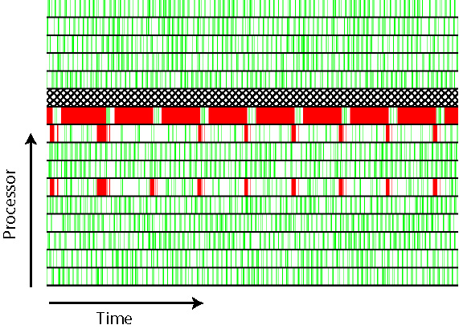
Performance Results for Radar Array Front End
Blocked on Static Network
Executing Instructions
Pipeline Stall

Slide 46
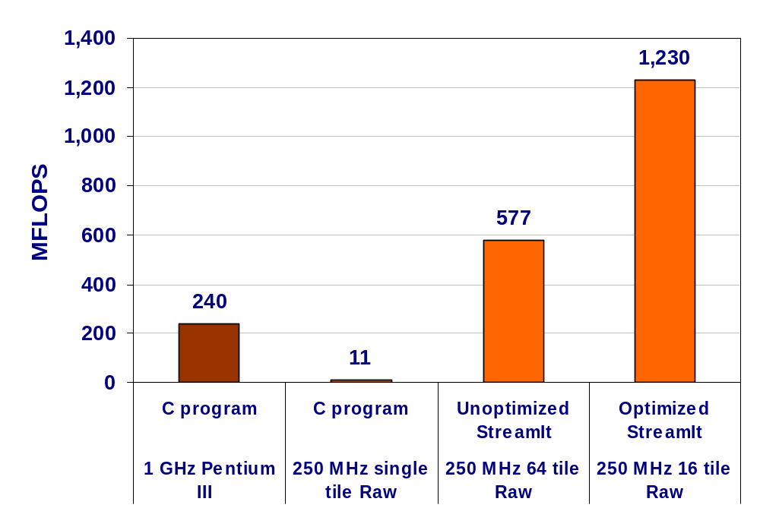
Performance of Radar Array Front End

Slide 47
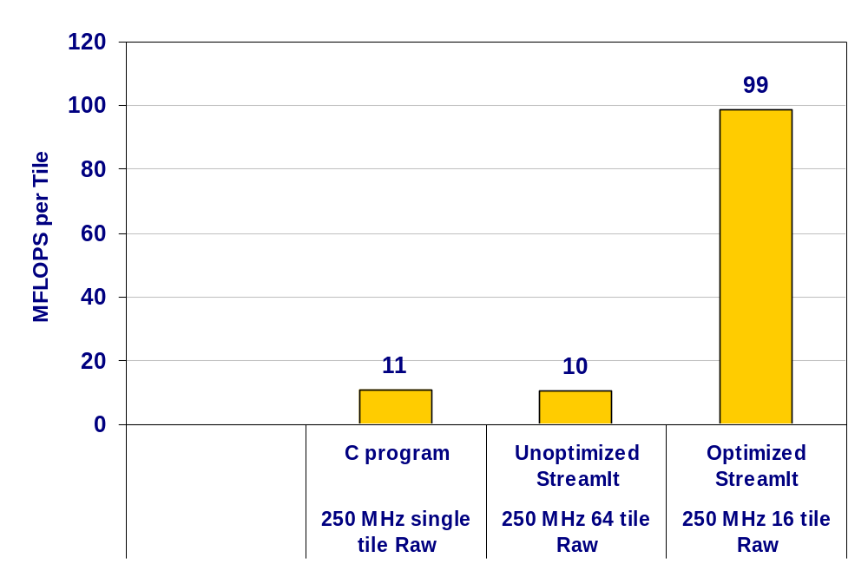
Utilization of Radar Array Front End

Slide 48
StreamIt Applications:
FM Radio with an Equalizer
Low Pass filter
FM Demodulator
Duplicate splitter
Low pass filter
Low pass filter
Low pass filter
Low pass filter
Low pass filter
Low pass filter
Low pass filter
Low pass filter
Low pass filter
Low pass filter
Float Diff filter
Float Diff filter
Float Diff filter
Float Diff filter
Float Diff filter
Float Diff filter
Float Diff filter
Float Diff filter
Float Diff filter
Float Diff filter
Round robin joiner
Float Diff filter
Float Adder filter

Slide 49
StreamIt Applications:
Vocoder
Duplicate splitter
DFT filter
DFT filter
DFT filter
DFT filter
DFT filter
DFT filter
DFT filter
DFT filter
DFT filter
DFT filter
Round robin joiner
Round robin splitter
Duplicate splitter
FIR Smoothing Filter
Identity
Phase unwrapper filter
Round robin joiner
Const Multiplier filter
Deconvolve filter
Round robin splitter
Linear Interpolator filter
Liner Interpolator Filter
Liner Interpolator Filter
Decimator filter
Decimator filter
Decimator filter
Round robin joiner
Multiplier filter
Round robin joiner

Slide 50
StreamIt Applications:
GSM decoder
Round robin splitter
Round robin splitter
Input
LTP Input Filter
Identity
Input
Round robin joiner
LTP Input Filter
LTP Filter
Round robin joiner
Additional Update filter
Duplicate splitter
Hold Filter
Round robin splitter
Input
Identity
LTP Input Filter
Round robin joiner
Reflection Coeff Filter
Short Term Synth Filter
Post Processing Filter

Slide 51
StreamIt Applications:
3GPP Radio Access Protocol – Physical Layer

Slide 52
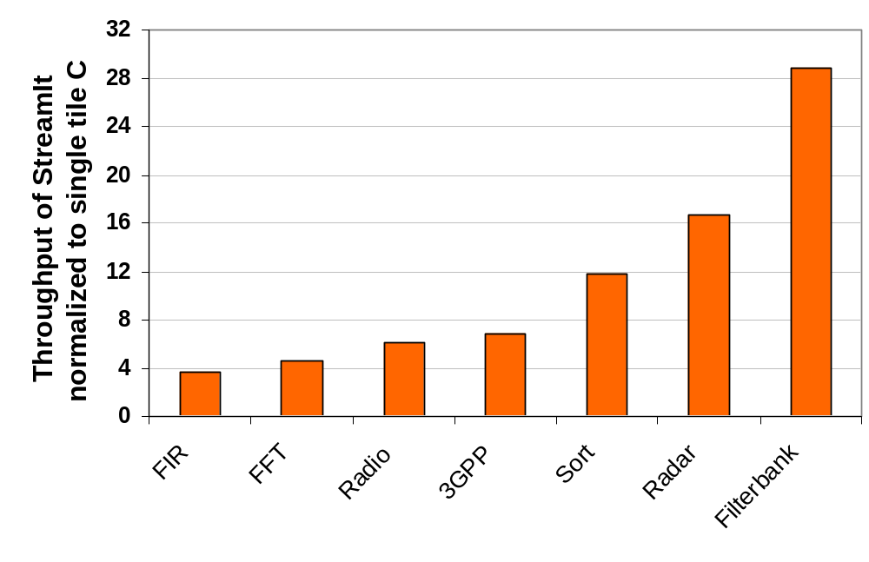
Application Performance

Slide 53
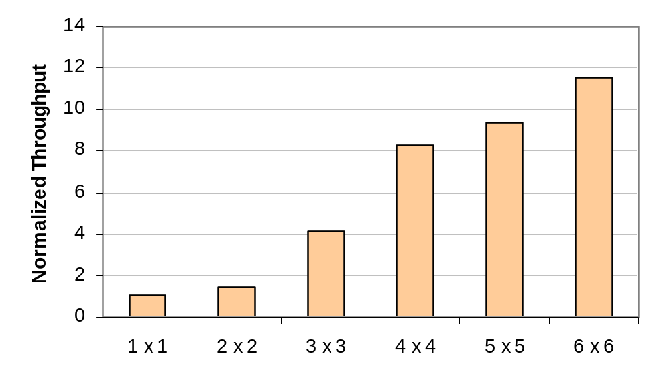
Scalability of StreamIt
Bitonic Sort

Slide 54
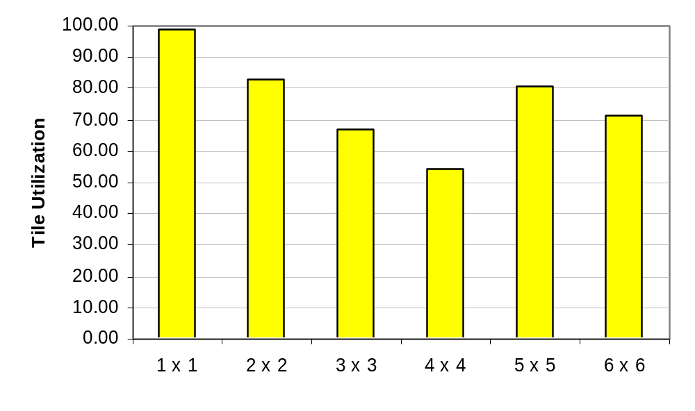
Scalability of StreamIt
Bitonic Sort

Slide 55
Related Work
Stream-C / Kernel-C (Dally et. al)
  Compiled to Imagine with time multiplexing
  Extensions to C to deal with finite streams
  Programmer explicitly calls stream “kernels”
  Need program analysis to overlap streams / vary target granularity
Brook (Buck et. al)
  Architecture-independent counterpart of Stream-C / Kernel-C
  Designed to be more parallelizable
Ptolemy (Lee et. al)
  Heterogeneous modeling environment for DSP
  Many scheduling results shared with StreamIt
  Don’t focus on language development / optimized code generation
Other languages
  Occam, SISAL – not statically schedulable
  LUSTRE, Lucid, Signal, Esterel – don’t focus on parallel performance

Slide 56
Conclusion
Streaming Programming Model
  An important class of applications
  Can break the von Neumann bottleneck
  A natural fit for a large class of applications
  Straightforward mapping to the architectural model
StreamIt: A Machine Language for Communication Exposed Architectures
  Expose the common properties
    Multiple instruction streams
    Software exposed communication
    Fast local memory co-located with execution units
  Hide the differences
    Granularity of execution units
    Type and topology of the communication network
    Memory hierarchy
A good compiler can eliminate the overhead of abstraction

