Slide 1
Genetic Programming Applied to Compiler Optimization
Mark Stephenson, Una-May O’Reilly,
Martin C. Martin, and Saman Amarasinghe
Massachusetts Institute of Technology

Slide 2

An Anatomy of a Compiler
High-level
program
Optimized
instructions
Constant
Propagation
Loop
Unrolling
Instruction
Scheduling
Code
Generation
…
Take a high-level specification, and produce “code” that can be run on a given architecture.
Compiler optimizations are almost never optimal.

Slide 3
System Complexities
Compiler complexity
  Open Research Compiler
    ~3.5 million lines of C/C++ code
  Trimaran’s compiler
    ~ 800,000 lines of C code
  Lots of stages with complicated interactions between them
Not to mention the target architectures
  Pentium® processor
    3.1 million transistors
  Pentium 4 processor
    55 million transistors
Notes:
Mention compiler passes and their interactions: give an example of instruction scheduling and register allocation. Say how they interact and that they are interdependent

Slide 4
Micro-Architectures Change
If the target architecture changes, the compiler needs to change
Performance of your software depends on the quality of your compiler

Slide 5
NP-Completeness
Many compiler optimizations are NP-complete
Compiler writers rely on heuristics
  In practice, heuristics perform well
  …but, require a lot of tweaking
Heuristics often have a focal point
  Rely on a single priority function

Slide 6
Priority Functions
A heuristic’s Achilles heel
  A single priority or cost function often dictates the efficacy of a heuristic
Priority functions rank the options available to a compiler heuristic
Notes:
Give an example of a priority function for instruction scheduling.

Slide 7
Qualities of Priority Functions
Can focus on a small portion of an optimization algorithm
Small change can yield big payoffs
Clear specification in terms of input/output
Prevalent in compiler heuristics
Perfectly matches GP’s representation
Notes:
Priority functions are a great place to apply GP. We make no changes to the compiler’s underlying algorithm, which among other things enforces the legality of the optimization.

Slide 8
Further Considerations
Who knows what target architecture the priority function was written for (or in what decade)?
If it was adequately optimized by the designer (for the applications we care about)?
If it ‘knows’ about the other optimizations the compiler performs?

Slide 9
An Example Optimization
Hyperblock Scheduling
Conditional execution is potentially very expensive on a modern architecture
Modern processors try to dynamically predict the outcome of the condition
  This works great for predictable branches…
  But some conditions can’t be predicted
If they don’t predict correctly you waste a lot of time

Slide 10
Example Optimization
Hyperblock Scheduling
Assume a[1] is 0
Machine code
if (a[1] == 0)
else
Modern architectures start executing instructions before they know whether or not they need to!
Oops, it mispredicted
Notes:
Fix the white on white arrows.

Slide 11
Example Optimization
Hyperblock Scheduling
Machine code
if (a[1] == 0)
else
Solution: simultaneously execute both conditions and simply discard the results of the instructions that weren’t supposed to be run.
Notes:
The combined sections of code are called a hyperblock.
All instructions in a hyperblock are executed

Slide 12
Example Optimization
Hyperblock Scheduling
There are unclear tradeoffs
  In some situations, hyperblocks are faster than traditional execution
  In others, hyperblocks impair performance
    If a condition is highly predictable, there’s probably no reason to form a hyperblock

Slide 13
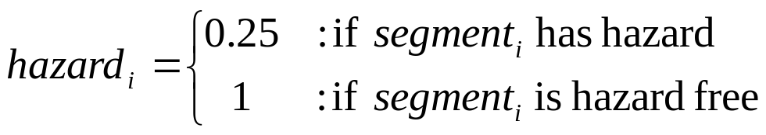
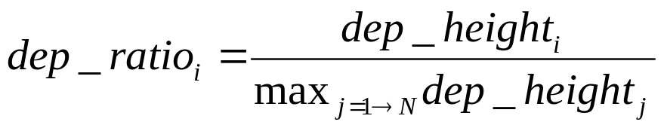
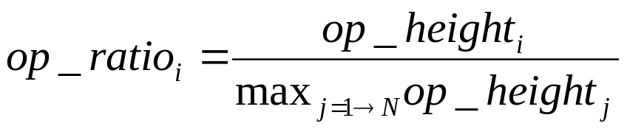
Trimaran’s Priority Function
Favor frequently
Executed code
Favor short code
segments
Penalize codes with hazards
Favor parallel code
Notes:
Trimaran is a research compiler that we used to collect experimental results. It’s a very mature system though that has been shown to be competitive with the best proprietary compilers. Here’s the priority function that Trimaran uses to select which code segments to merge. The code segments with the highest priorities are merged into a hyperblock.

Slide 14
Our Approach
What are the important characteristics of a hyperblock formation priority function?
Trimaran uses four characteristics
Our approach: Extract all the characteristics you can think of and have GP find the priority function

Slide 15
Hyperblock Formation
GP Terminals
Maximum ops over segments | Dependence height
Number of code segments | Number of operations
Does segment have subroutine calls? | Number of branches
Does segment have unsafe calls? | Execution ratio
Does code have pointer derefs? | Average ops executed in code segment
Issue width of processor | Average predictability of branches in segment
… | Predictability product of branches in segment
Notes:
These are some of the terminals that GP uses, and we use a standard set of arithmetic operators and constants. The result of each subexpression is either a boolean or a real value. Therefore these are reals or booleans.

Slide 16
General Flow
Create initial population
(initial solutions)
Vanilla GP system
Randomly generated initial population seeded with the compiler writer’s best guess
Evaluation
done?
Selection
Create Variants
Notes:
One of the individuals is Trimaran’s priority function, the other 399 are randomly generated.
Put the details in the slide

Slide 17
General Flow
Create initial population
(initial solutions)
Each expression is evaluated by compiling and running the benchmark(s)
Fitness is the relative speedup over Trimaran’s priority function on the benchmark(s)
We add parsimony pressure to favor more readable expressions
Use Dynamic Subset Selection [Gathercole]
Evaluation
done?
Selection
Create Variants
Notes:
Compiling a program and running it is time consuming, so we use dynamic subset selection and only focus on a subset of the benchmarks at a time.

Slide 18
GP Settings
Parameter | Setting
Generations | 50
Population Size | 400
Tournament Size | 7
Replacement Rate | 22%
Mutation Rate | 5%
DSS Set Size | 4, 5, 6
Training Set Size | 12

Slide 19
Goal of an Optimizing Compiler
A.c
B.c
C.c
D.c
Compiler
1
2
A
B
C
D

Slide 20
A Simpler Problem
Application-Specific Compilers
A.c
B.c
C.c
D.c
Compiler
1
2
A
B
C
D

Slide 21
Hyperblock Results
Application-Specific Compilers
3.5
Training input
Novel input
3
(add (sub (cmul (gt (cmul $b0 0.8982 $d17)…$d7)) (cmul $b0 0.6183 $d28)))
2.5
(add (div $d20 $d5) (tern $b2 $d0 $d9))
2
Speedup
1.5
1.54
1
1.23
0.5
0
toast
Average
g721encode
g721decode
huff_dec
huff_enc
rawcaudio
rawdaudio
mpeg2dec
129.compress
Notes:
The benchmarks listed on the x-axis are from a couple of different benchmark suites,namely,spec95 and mediabench. Fitness case is a benchmark plus its input. Train on individual, then present DSS results.

Slide 22
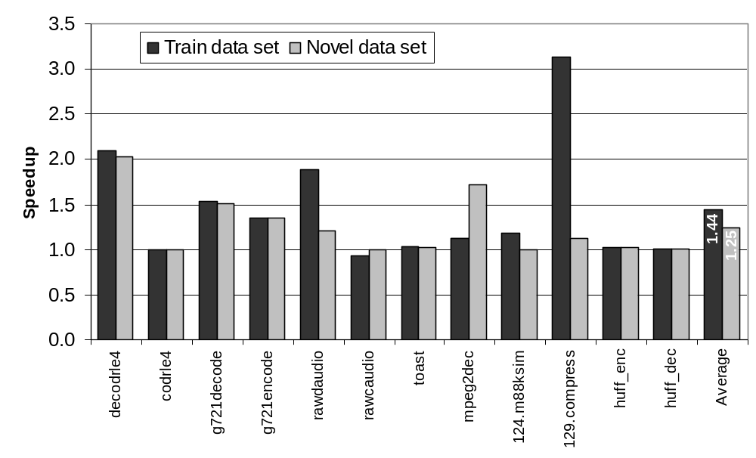
Hyperblock Results
General-Purpose Compiler

Slide 23
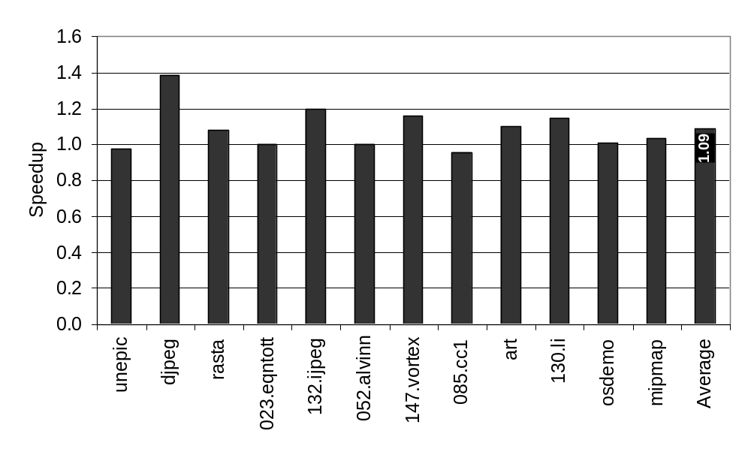
Cross Validation
Testing General-Purpose Applicability

Slide 24
Hyperblock Solutions
General Purpose
(add
(sub (mul exec_ratio_mean 0.8720) 0.9400)
(mul 0.4762
(cmul (not has_pointer_deref)
(mul 0.6727 num_paths)
(mul 1.1609
(add (sub
(mul (div num_ops dependence_height) 10.8240)
exec_ratio)
(sub (mul (cmul has_unsafe_jsr predict_product_mean 0.9838)
(sub 1.1039 num_ops_max))
(sub (mul dependence_height_mean num_branches_max) num_paths)))))))
Intron that doesn’t affect solution

Slide 25
GP Hyperblock Solutions
General Purpose
(add
(sub (mul exec_ratio_mean 0.8720) 0.9400)
(mul 0.4762
(cmul (not has_pointer_deref)
(mul 0.6727 num_paths)
(mul 1.1609
(add (sub
(mul (div num_ops dependence_height) 10.8240)
exec_ratio)
(sub (mul (cmul has_unsafe_jsr predict_product_mean 0.9838)
(sub 1.1039 num_ops_max))
(sub (mul dependence_height_mean num_branches_max) num_paths)))))))
Favor paths that don’t have pointer dereferences

Slide 26
GP Hyperblock Solutions
General Purpose
(add
(sub (mul exec_ratio_mean 0.8720) 0.9400)
(mul 0.4762
(cmul (not has_pointer_deref)
(mul 0.6727 num_paths)
(mul 1.1609
(add (sub
(mul (div num_ops dependence_height) 10.8240)
exec_ratio)
(sub (mul (cmul has_unsafe_jsr predict_product_mean 0.9838)
(sub 1.1039 num_ops_max))
(sub (mul dependence_height_mean num_branches_max) num_paths)))))))
Favor highly parallel (fat) paths

Slide 27
GP Hyperblock Solutions
General Purpose
(add
(sub (mul exec_ratio_mean 0.8720) 0.9400)
(mul 0.4762
(cmul (not has_pointer_deref)
(mul 0.6727 num_paths)
(mul 1.1609
(add (sub
(mul (div num_ops dependence_height) 10.8240)
exec_ratio)
(sub (mul (cmul has_unsafe_jsr predict_product_mean 0.9838)
(sub 1.1039 num_ops_max))
(sub (mul dependence_height_mean num_branches_max) num_paths)))))))
If a path calls a subroutine that may have side effects, penalize it

Slide 28
Future Work
Apply these techniques to a real machine
  Intel® Itanium®
  Using the Open Research Compiler
Investigate our solutions thoroughly
Notes:
Our results were collected on a simulator.

Slide 29
Conclusion
GP can identify effective priority functions
‘Proof of concept’ by evolving two well known priority functions
Take a huge compiler, optimize one priority function with GP and get nice speedups
The compiler community is interested (Programming Language Design and Implementation ’03)
Notes:
Present the speedup here.

