Slide 1
Phased Scheduling of Stream Programs
Michal Karczmarek, William Thies
and Saman Amarasinghe
MIT LCS

Slide 2
Streaming Application Domain
Based on audio, video and data streams
Increasingly prevalent
  Embedded systems
    Cell phones, handheld computers, etc.
  Desktop applications
    Streaming media
    Software radio
    Real-time encryption
  High-performance servers
    Software Routers (ex. Click)
    Cell phone base stations
    HDTV editing consoles

Slide 3
Properties of Stream Programs
A large (possibly infinite) amount of data
  Limited lifespan of each data item
  Little processing of each data item
A regular, static computation pattern
  Stream program structure is relatively constant
  A lot of opportunities for compiler optimizations

Slide 4
StreamIt Language
Source
Streaming Language from MIT LCS
Similar to Synchronous Data Flow (SDF)
Provides hierarchy & structure
Four Structures:
  Filter
  Pipeline
  SplitJoin
  FeedbackLoop
All Structures have Single-Input Channel Single-Output Channel
Filters allow ‘peeking’ – looking at items which are not consumed
LPF
Splitter
LPF
LPF
LPF
LPF
CClip
HPF
HPF
HPF
HPF
ACorr
Compress
Compress
Compress
Compress
Joiner
Sink
Notes:
Unique properties: hierarchy & structure
Peeking: we do buffer management, not the programmer
Explanation: schedule so always data available and so buffer space small and doesn’t grow

Slide 5
Our Contributions
New scheduling technique called Phased Scheduling
Small buffer sizes for hierarchical programs
Fine grained control over schedule size vs buffer size tradeoff
Allows for separate compilation by always avoiding deadlock
Performs initialization for peeking Filters

Slide 6
Overview
General Stream Concepts
StreamIt Details
Program Steady State and Initialization
Single Appearance and Pull Scheduling
Phased Scheduling
  Minimal Latency
Results
Related Work and Conclusion
Notes:
Go through faster
Background on streaming, background on scheduling and then our contributions, results, etc

Slide 7
Stream Programs
Consist of Filters and Channels
Filters perform computation
Channels act as FIFO queues for data between Filters
filter
filter
filter
filter

Slide 8
Filters
Execute a work function which:
  Consumes data from their input
  Produces data to their output
Filters consume and produce constant amount of data on every execution of the work function
  Rates are known at compilation time
Filter executions are atomic
filter

Slide 9
Stream Program Schedule
Describes the order in which filters are executed
Needs to manage grossly mismatched rates between filters
Manages data buffered up in channels between filters
Controls latency of data processing

Slide 10
Overview
General Stream Concepts
StreamIt Details
Program Steady State and Initialization
Single Appearance and Pull Scheduling
Phased Scheduling
  Minimal Latency
Results
Related Work and Conclusion

Slide 11
StreamIt - Filter
Performs the computation
Consumes pop data items
Produces push data items
Inspects peek data items
peek, pop
push

Slide 12
StreamIt - Filter
Example:
  FIR filter
peek = 3 pop = 1
FIR
push = 1

Slide 13
StreamIt - Filter
Example:
  FIR filter
  Inspects 3 data items
peek = 3 pop = 1
FIR
push = 1

Slide 14
StreamIt - Filter
Example:
  FIR filter
  Inspects 3 data items
  Consumes 1 data item
peek = 3 pop = 1
FIR
push = 1

Slide 15
StreamIt - Filter
Example:
  FIR filter
  Inspects 3 data items
  Consumes 1 data item
  Produces 1 data item
peek = 3 pop = 1
FIR
push = 1

Slide 16
StreamIt - Filter
Example:
  FIR filter
  Inspects 3 data items
  Consumes 1 data item
  Produces 1 data item
peek = 3 pop = 1
FIR
push = 1

Slide 17
StreamIt - Filter
Example:
  FIR filter
  Inspects 3 data items
  Consumes 1 data item
  Produces 1 data item
  And again…
peek = 3 pop = 1
FIR
push = 1

Slide 18
StreamIt - Filter
Example:
  FIR filter
  Inspects 3 data items
  Consumes 1 data item
  Produces 1 data item
  And again…
peek = 3 pop = 1
FIR
push = 1

Slide 19
StreamIt - Filter
Example:
  FIR filter
  Inspects 3 data items
  Consumes 1 data item
  Produces 1 data item
  And again…
peek = 3 pop = 1
FIR
push = 1

Slide 20
StreamIt - Filter
Example:
  FIR filter
  Inspects 3 data items
  Consumes 1 data item
  Produces 1 data item
  And again…
peek = 3 pop = 1
FIR
push = 1

Slide 21
StreamIt - Filter
Example:
  FIR filter
  Inspects 3 data items
  Consumes 1 data item
  Produces 1 data item
  And again…
peek = 3 pop = 1
FIR
push = 1

Slide 22
StreamIt Pipeline
Connects multiple components together
Sequential (data-wise) computation
Inserts implicit buffers between them
A
B
C

Slide 23
StreamIt SplitJoin
Also connects several components together
Parallel computation construct
Allows for computation of same data (DUPLICATE splitter) or different data (ROUND_ROBIN splitter)
splitter
A
B
joiner
Notes:
Don’t explain splitters/joiners

Slide 24
StreamIt FeedbackLoop
delay
ONLY structure to allow data cycles
Needs initialization on feedbackPath
Amount of data on feedbackPath is delay
joiner
B
L
splitter
Notes:
Mention names are B for Body and L for Loop!

Slide 25
Overview
General Stream Concepts
StreamIt Details
Program Steady State and Initialization
Single Appearance and Pull Scheduling
Phased Scheduling
  Minimal Latency
Results
Related Work and Conclusion

Slide 26
Scheduling – Steady State
Every valid stream graph has a Steady State
Steady State does not change amount of data buffered between components
Steady State can be executed repeatedly forever without growing buffers

Slide 27
Steady State Example
3:2 Rate Converter
First filter (A) upsamples by factor of 3
Second filter (B) downsamples by factor of 2
pop = 1
A
push = 3
pop = 2
B
push = 1

Slide 28
Steady State Example
A executes 2 times
  pushes 2 * 3 = 6 items
B executes 3 times
  pops 3 * 2 = 6 items
Number of data items stored between Filters does not change
pop = 1
A
push = 3
2 *
pop = 2
B
push = 1
3 *

Slide 29
Steady State Example
2
3:2 Rate Converter
First filter (A) upsamples by factor of 3
Second filter (B) downsamples by factor of two
Schedule:
pop = 1
A
push = 3
0
pop = 2
B
push = 1
0

Slide 30
Steady State Example
2
3:2 Rate Converter
First filter (A) upsamples by factor of 3
Second filter (B) downsamples by factor of two
Schedule:
  A
pop = 1
A
push = 3
0
pop = 2
B
push = 1
0

Slide 31
Steady State Example
1
3:2 Rate Converter
First filter (A) upsamples by factor of 3
Second filter (B) downsamples by factor of two
Schedule:
  A
pop = 1
A
push = 3
0
pop = 2
B
push = 1
0

Slide 32
Steady State Example
1
3:2 Rate Converter
First filter (A) upsamples by factor of 3
Second filter (B) downsamples by factor of two
Schedule:
  A
pop = 1
A
push = 3
3
pop = 2
B
push = 1
0

Slide 33
Steady State Example
1
3:2 Rate Converter
First filter (A) upsamples by factor of 3
Second filter (B) downsamples by factor of two
Schedule:
  AA
pop = 1
A
push = 3
3
pop = 2
B
push = 1
0

Slide 34
Steady State Example
0
3:2 Rate Converter
First filter (A) upsamples by factor of 3
Second filter (B) downsamples by factor of two
Schedule:
  AA
pop = 1
A
push = 3
3
pop = 2
B
push = 1
0

Slide 35
Steady State Example
0
3:2 Rate Converter
First filter (A) upsamples by factor of 3
Second filter (B) downsamples by factor of two
Schedule:
  AA
pop = 1
A
push = 3
6
pop = 2
B
push = 1
0

Slide 36
Steady State Example
0
3:2 Rate Converter
First filter (A) upsamples by factor of 3
Second filter (B) downsamples by factor of two
Schedule:
  AAB
pop = 1
A
push = 3
6
pop = 2
B
push = 1
0

Slide 37
Steady State Example
0
3:2 Rate Converter
First filter (A) upsamples by factor of 3
Second filter (B) downsamples by factor of two
Schedule:
  AAB
pop = 1
A
push = 3
4
pop = 2
B
push = 1
0

Slide 38
Steady State Example
0
3:2 Rate Converter
First filter (A) upsamples by factor of 3
Second filter (B) downsamples by factor of two
Schedule:
  AAB
pop = 1
A
push = 3
4
pop = 2
B
push = 1
1

Slide 39
Steady State Example
0
3:2 Rate Converter
First filter (A) upsamples by factor of 3
Second filter (B) downsamples by factor of two
Schedule:
  AABB
pop = 1
A
push = 3
4
pop = 2
B
push = 1
1

Slide 40
Steady State Example
0
3:2 Rate Converter
First filter (A) upsamples by factor of 3
Second filter (B) downsamples by factor of two
Schedule:
  AABB
pop = 1
A
push = 3
2
pop = 2
B
push = 1
1

Slide 41
Steady State Example
0
3:2 Rate Converter
First filter (A) upsamples by factor of 3
Second filter (B) downsamples by factor of two
Schedule:
  AABB
pop = 1
A
push = 3
2
pop = 2
B
push = 1
2

Slide 42
Steady State Example
0
3:2 Rate Converter
First filter (A) upsamples by factor of 3
Second filter (B) downsamples by factor of two
Schedule:
  AABBB
pop = 1
A
push = 3
2
pop = 2
B
push = 1
2

Slide 43
Steady State Example
0
3:2 Rate Converter
First filter (A) upsamples by factor of 3
Second filter (B) downsamples by factor of two
Schedule:
  AABBB
pop = 1
A
push = 3
0
pop = 2
B
push = 1
2

Slide 44
Steady State Example
0
3:2 Rate Converter
First filter (A) upsamples by factor of 3
Second filter (B) downsamples by factor of two
Schedule:
  AABBB
pop = 1
A
push = 3
0
pop = 2
B
push = 1
3

Slide 45
Steady State Example
0
3:2 Rate Converter
First filter (A) upsamples by factor of 3
Second filter (B) downsamples by factor of two
Schedule:
  AABBB
pop = 1
A
push = 3
0
pop = 2
B
push = 1
3

Slide 46
Steady State Example
2
3:2 Rate Converter
First filter (A) upsamples by factor of 3
Second filter (B) downsamples by factor of two
Schedule:
  AABBB
  A
pop = 1
A
push = 3
0
pop = 2
B
push = 1
0

Slide 47
Steady State Example
1
3:2 Rate Converter
First filter (A) upsamples by factor of 3
Second filter (B) downsamples by factor of two
Schedule:
  AABBB
  A
pop = 1
A
push = 3
0
pop = 2
B
push = 1
0

Slide 48
Steady State Example
1
3:2 Rate Converter
First filter (A) upsamples by factor of 3
Second filter (B) downsamples by factor of two
Schedule:
  AABBB
  A
pop = 1
A
push = 3
3
pop = 2
B
push = 1
0

Slide 49
Steady State Example
1
3:2 Rate Converter
First filter (A) upsamples by factor of 3
Second filter (B) downsamples by factor of two
Schedule:
  AABBB
  AB
pop = 1
A
push = 3
3
pop = 2
B
push = 1
0

Slide 50
Steady State Example
1
3:2 Rate Converter
First filter (A) upsamples by factor of 3
Second filter (B) downsamples by factor of two
Schedule:
  AABBB
  AB
pop = 1
A
push = 3
1
pop = 2
B
push = 1
0

Slide 51
Steady State Example
1
3:2 Rate Converter
First filter (A) upsamples by factor of 3
Second filter (B) downsamples by factor of two
Schedule:
  AABBB
  AB
pop = 1
A
push = 3
1
pop = 2
B
push = 1
1

Slide 52
Steady State Example
1
3:2 Rate Converter
First filter (A) upsamples by factor of 3
Second filter (B) downsamples by factor of two
Schedule:
  AABBB
  ABA
pop = 1
A
push = 3
1
pop = 2
B
push = 1
1

Slide 53
Steady State Example
0
3:2 Rate Converter
First filter (A) upsamples by factor of 3
Second filter (B) downsamples by factor of two
Schedule:
  AABBB
  ABA
pop = 1
A
push = 3
1
pop = 2
B
push = 1
1

Slide 54
Steady State Example
0
3:2 Rate Converter
First filter (A) upsamples by factor of 3
Second filter (B) downsamples by factor of two
Schedule:
  AABBB
  ABA
pop = 1
A
push = 3
4
pop = 2
B
push = 1
1

Slide 55
Steady State Example
0
3:2 Rate Converter
First filter (A) upsamples by factor of 3
Second filter (B) downsamples by factor of two
Schedule:
  AABBB
  ABAB
pop = 1
A
push = 3
4
pop = 2
B
push = 1
1

Slide 56
Steady State Example
0
3:2 Rate Converter
First filter (A) upsamples by factor of 3
Second filter (B) downsamples by factor of two
Schedule:
  AABBB
  ABAB
pop = 1
A
push = 3
2
pop = 2
B
push = 1
1

Slide 57
Steady State Example
0
3:2 Rate Converter
First filter (A) upsamples by factor of 3
Second filter (B) downsamples by factor of two
Schedule:
  AABBB
  ABAB
pop = 1
A
push = 3
2
pop = 2
B
push = 1
2

Slide 58
Steady State Example
0
3:2 Rate Converter
First filter (A) upsamples by factor of 3
Second filter (B) downsamples by factor of two
Schedule:
  AABBB
  ABABB
pop = 1
A
push = 3
2
pop = 2
B
push = 1
2

Slide 59
Steady State Example
0
3:2 Rate Converter
First filter (A) upsamples by factor of 3
Second filter (B) downsamples by factor of two
Schedule:
  AABBB
  ABABB
pop = 1
A
push = 3
0
pop = 2
B
push = 1
2

Slide 60
Steady State Example
0
3:2 Rate Converter
First filter (A) upsamples by factor of 3
Second filter (B) downsamples by factor of two
Schedule:
  AABBB
  ABABB
pop = 1
A
push = 3
0
pop = 2
B
push = 1
3

Slide 61
Steady State Example
0
3:2 Rate Converter
First filter (A) upsamples by factor of 3
Second filter (B) downsamples by factor of two
Schedule:
  AABBB
  ABABB
pop = 1
A
push = 3
0
pop = 2
B
push = 1
3

Slide 62
Steady State Example - Buffers
0
AABBB requires 6 data items of buffer space between filters A and B
ABABB requires 4 data items of buffer space between filters A and B
pop = 1
A
push = 3
0
pop = 2
B
push = 1
3

Slide 63
Steady State Example - Latency
0
AABBB – First data item output after third execution of an filter
  Also A already consumed 2 data items
ABABB – First data item output after second execution of an filter
  A consumed only 1 data item
pop = 1
A
push = 3
0
pop = 2
B
push = 1
3

Slide 64
Initialization
3
Filter Peeking provides a new challenge
Just Steady State doesn’t work:
pop = 1
A
push = 3
0
peek = 3, pop = 2
B
push = 1
0

Slide 65
Initialization
2
Filter Peeking provides a new challenge
Just Steady State doesn’t work:
  A
pop = 1
A
push = 3
3
peek = 3, pop = 2
B
push = 1
0

Slide 66
Initialization
1
Filter Peeking provides a new challenge
Just Steady State doesn’t work:
  AA
pop = 1
A
push = 3
6
peek = 3, pop = 2
B
push = 1
0

Slide 67
Initialization
1
Filter Peeking provides a new challenge
Just Steady State doesn’t work:
  AAB
pop = 1
A
push = 3
4
peek = 3, pop = 2
B
push = 1
1

Slide 68
Initialization
1
Filter Peeking provides a new challenge
Just Steady State doesn’t work:
  AABB
  Can’t execute B again!
pop = 1
A
push = 3
2
peek = 3, pop = 2
B
push = 1
2

Slide 69
Initialization
1
Filter Peeking provides a new challenge
Just Steady State doesn’t work:
  AABB
  Can’t execute B again!
Can’t execute A one extra time:
  AABB
pop = 1
A
push = 3
2
peek = 3, pop = 2
B
push = 1
2

Slide 70
Initialization
0
Filter Peeking provides a new challenge
Just Steady State doesn’t work:
  AABB
  Can’t execute B again!
Can’t execute A one extra time:
  AABBA
pop = 1
A
push = 3
5
peek = 3, pop = 2
B
push = 1
2

Slide 71
Initialization
0
Filter Peeking provides a new challenge
Just Steady State doesn’t work:
  AABB
  Can’t execute B again!
Can’t execute A one extra time:
  AABBAB
  Left 3 items between A and B!
pop = 1
A
push = 3
3
peek = 3, pop = 2
B
push = 1
3

Slide 72
Initialization
0
Must have data between A and B before starting execution of Steady State Schedule
Construct two schedules:
  One for Initialization
  One for Steady State
Initialization Schedule leaves data in buffers so Steady State can execute
pop = 1
A
push = 3
3
peek = 3, pop = 2
B
push = 1
3

Slide 73
Initialization
3
Initialization Schedule:
pop = 1
A
push = 3
0
peek = 3, pop = 2
B
push = 1
0

Slide 74
Initialization
2
Initialization Schedule:
  A
pop = 1
A
push = 3
3
peek = 3, pop = 2
B
push = 1
0

Slide 75
Initialization
2
Initialization Schedule:
  A
  Leave 3 items between A and B
Steady State Schedule:
pop = 1
A
push = 3
3
peek = 3, pop = 2
B
push = 1
0

Slide 76
Initialization
1
Initialization Schedule:
  A
  Leave 3 items between A and B
Steady State Schedule:
  A
pop = 1
A
push = 3
6
peek = 3, pop = 2
B
push = 1
0

Slide 77
Initialization
0
Initialization Schedule:
  A
  Leave 3 items between A and B
Steady State Schedule:
  AA
pop = 1
A
push = 3
9
peek = 3, pop = 2
B
push = 1
0

Slide 78
Initialization
0
Initialization Schedule:
  A
  Leave 3 items between A and B
Steady State Schedule:
  AAB
pop = 1
A
push = 3
7
peek = 3, pop = 2
B
push = 1
1

Slide 79
Initialization
0
Initialization Schedule:
  A
  Leave 3 items between A and B
Steady State Schedule:
  AABB
pop = 1
A
push = 3
5
peek = 3, pop = 2
B
push = 1
2

Slide 80
Initialization
0
Initialization Schedule:
  A
  Leave 3 items between A and B
Steady State Schedule:
  AABBB
pop = 1
A
push = 3
3
peek = 3, pop = 2
B
push = 1
3

Slide 81
Initialization
0
Initialization Schedule:
  A
  Leave 3 items between A and B
Steady State Schedule:
  AABBB
  Leave 3 items between A and B
pop = 1
A
push = 3
3
peek = 3, pop = 2
B
push = 1
3

Slide 82
Initialization
0
Initialization Schedule:
  A
  Leave 3 items between A and B
Steady State Schedule:
  AABBB
  Leave 3 items between A and B
See paper for more details
pop = 1
A
push = 3
3
peek = 3, pop = 2
B
push = 1
3
Notes:
Steady State Schedule executed correctly, and left same number of data items between A and B

Slide 83
Overview
General Stream Concepts
StreamIt Details
Program Steady State and Initialization
Single Appearance and Pull Scheduling
Phased Scheduling
  Minimal Latency
Results
Related Work and Conclusion

Slide 84
Scheduling
Steady State tells us how many times each component needs to execute
Need to decide on an order of execution
Order of execution affects
  Buffer size
  Schedule size
  Latency

Slide 85
Single Appearance Scheduling (SAS)
Every Filter is listed in the schedule only once
Use loop-nests to express the multiplicity of execution of Filters
Buffer size is not optimal
Schedule size is minimal

Slide 86
Schedule Size
Schedules can be stored in two ways
  Explicitly – in a schedule data structure
  Implicitly – as code which executes the schedule’s loop-nests
Schedule size = number of appearances of nodes (filters and splitters/joiners) in the schedule
  Single appearance schedule size is same as number of nodes in the program
  Other scheduling techniques can have larger size
  SAS schedule size is minimal: all nodes must appear in every schedule at least once

Slide 87
SAS Example – Buffer Size
Example: CD-DAT
CD to Digital Audio Tape rate converter
Mismatched rates cause large number of executions in Steady State
147 *
1
A
2
98 *
3
B
2
28 *
7
C
8
32 *
7
D
5

Slide 88
SAS Example – Buffer Size
Naïve SAS schedule:
  147A 98B 28C 32D
  Required Buffer Size: 714
  Unnecessarily large buffer requirements!
147 *
1
A
2
294
98 *
3
B
2
196
28 *
7
C
8
224
32 *
7
D
5

Slide 89
SAS Example – Buffer Size
Naïve SAS schedule:
  147A 98B 28C 32D
  Required Buffer Size: 714
  Unnecessarily large buffer requirements!
Optimal SAS CD-DAT schedule:
  49{3A 2B} 4{7C 8D}
  Required Buffer size: 258
1
A
2
3
B
2
7
C
8
7
D
5

Slide 90
SAS Example – Buffer Size
Naïve SAS schedule:
  147A 98B 28C 32D
  Required Buffer Size: 714
  Unnecessarily large buffer requirements!
Optimal SAS CD-DAT schedule:
  49{3A 2B} 4{7C 8D}
  Required Buffer size: 258
3 *
1
A
2
6
2 *
3
B
2
7
C
8
7
D
5

Slide 91
SAS Example – Buffer Size
Naïve SAS schedule:
  147A 98B 28C 32D
  Required Buffer Size: 714
  Unnecessarily large buffer requirements!
Optimal SAS CD-DAT schedule:
  49{3A 2B} 4{7C 8D}
  Required Buffer size: 258
3 *
1
A
2
6
2 *
3
B
2
7
C
8
7
D
5

Slide 92
SAS Example – Buffer Size
Naïve SAS schedule:
  147A 98B 28C 32D
  Required Buffer Size: 714
  Unnecessarily large buffer requirements!
Optimal SAS CD-DAT schedule:
  49{3A 2B} 4{7C 8D}
  Required Buffer size: 258
1
A
2
49 *
6
3
B
2
7
C
8
7
D
5

Slide 93
SAS Example – Buffer Size
Naïve SAS schedule:
  147A 98B 28C 32D
  Required Buffer Size: 714
  Unnecessarily large buffer requirements!
Optimal SAS CD-DAT schedule:
  49{3A 2B} 4{7C 8D}
  Required Buffer size: 258
1
A
2
49 *
6
3
B
2
7 *
7
C
8
56
8 *
7
D
5

Slide 94
SAS Example – Buffer Size
Naïve SAS schedule:
  147A 98B 28C 32D
  Required Buffer Size: 714
  Unnecessarily large buffer requirements!
Optimal SAS CD-DAT schedule:
  49{3A 2B} 4{7C 8D}
  Required Buffer size: 258
1
A
2
49 *
6
3
B
2
7 *
7
C
8
56
8 *
7
D
5

Slide 95
SAS Example – Buffer Size
Naïve SAS schedule:
  147A 98B 28C 32D
  Required Buffer Size: 714
  Unnecessarily large buffer requirements!
Optimal SAS CD-DAT schedule:
  49{3A 2B} 4{7C 8D}
  Required Buffer size: 258
1
A
2
49 *
6
3
B
2
7
C
8
4 *
56
7
D
5

Slide 96
SAS Example – Buffer Size
Naïve SAS schedule:
  147A 98B 28C 32D
  Required Buffer Size: 714
  Unnecessarily large buffer requirements!
Optimal SAS CD-DAT schedule:
  49{3A 2B} 4{7C 8D}
  Required Buffer size: 258
1
A
2
49 *
6
3
B
2
196
7
C
8
4 *
56
7
D
5

Slide 97
SAS Example – Buffer Size
Naïve SAS schedule:
  147A 98B 28C 32D
  Required Buffer Size: 714
  Unnecessarily large buffer requirements!
Optimal SAS CD-DAT schedule:
  49{3A 2B} 4{7C 8D}
  Required Buffer size: 258
1
A
2
6
3
B
2
196
7
C
8
56
7
D
5

Slide 98
Pull Schedule Example – Buffer Size
Pull Scheduling:
  Always execute the bottom-most element possible
CD-DAT schedule:
  2A B A B 2A B A B C D … A B C 2D
  Required Buffer Size: 26
  251 entries in the schedule
Hard to implement efficiently, as schedule is VERY large
1
A
2
4
3
B
2
8
7
C
8
14
7
D
5

Slide 99
SAS vs Pull Schedule
 | Buffer Size | Schedule Size
SAS | 258 | 4
Pull Schedule | 26 | 251
Need something in between SAS and Pull Scheduling

Slide 100
Overview
General Stream Concepts
StreamIt Details
Program Steady State and Initialization
Single Appearance and Pull Scheduling
Phased Scheduling
  Minimal Latency
Results
Related Work and Conclusion

Slide 101
Phased Scheduling
Idea:
  What if we take the naïve SAS schedule, and divide it into n roughly equal phases?
Buffer requirements would reduce roughly by factor of n
Schedule size would increase by factor of n
May be OK, because buffer requirements dominate schedule size anyway!

Slide 102
Phased Scheduling
Try n = 2:
Two phases are:
  74A 49B 14C 16D
  73A 49B 14C 16D
Total Buffer Size: 358
Small schedule increase
Greater n for bigger savings
1
A
2
148
3
B
2
98
7
C
8
112
7
D
5

Slide 103
Phased Scheduling
Try n = 3:
Three phases are:
  48A 32B 9C 10D
  53A 35B 10C 11D
  46A 31B 9C 11D
Total Buffer Size: 259
Basically matched best SAS result
  Best SAS was 258
1
A
2
106
3
B
2
71
7
C
8
82
7
D
5

Slide 104
Phased Scheduling
Try n = 28:
The phases are:
  6A 4B 1C 1D
  5A 3B 1C 1D
  …
  4A 3B 1C 2D
Total Buffer Size: 35
Drastically beat best SAS result
  Best SAS was 258
Close to minimal amount (pull schedule)
  Pull schedule was 26
1
A
2
13
3
B
2
8
7
C
8
14
7
D
5
Notes:
Say corresponds to Minimal Latency Schedule

Slide 105
CD-DAT Comparison:
SAS vs Pull vs Phased
 | Buffer Size | Schedule Size
SAS | 258 | 4
Pull Schedule | 26 | 251
Phased Schedule | 35 | 52

Slide 106
Phased Scheduling
Apply technique hierarchically
Children have several phases which all have to be executed
Automatically supports cyclo-static filters
Children pop/push less data, so can manage parent’s buffer sizes more efficiently
CD reader
Equalizer
CD-DAT
DAT
recorder
Notes:
Work on ME! ME ME ME! Memorize what you say to me!

Slide 107
Phased Scheduling
What if a Steady State of a component of a FeedbackLoop required more data than available?
Single Appearance couldn’t do separate compilation!
Phased Scheduling can provide a fine-grained schedule, which will always allow separate compilation (if possible at all)

Slide 108
Overview
General Stream Concepts
StreamIt Details
Program Steady State and Initialization
Single Appearance and Pull Scheduling
Phased Scheduling
  Minimal Latency
Results
Related Work and Conclusion

Slide 109
Minimal Latency Schedule
Every Phase consumes as few items as possible to produce at least one data item
Every Phase produces as many data items as possible
Guarantees any schedulable program will be scheduled without deadlock
Allows for separate compilation
For details, see our paper
Notes:
Explain Minimal Latency better. How? I don’t know…
Maybe give two definitions? Minimal amount of consumption for a particular amount of production

Slide 110
Minimal Latency Scheduling
delay = 10
Simple FeedbackLoop with a tight delay constraint
Not possible to schedule using SAS
Can schedule using Phased Scheduling
  Use Minimal Latency Scheduling
1 5
6
*4
3
B
5
4
L
4
*8
*5
2
1 1
*20

Slide 111
Minimal Latency Scheduling
delay = 10
Minimal Latency Phased Schedule:
1 5
6
10
0
3
B
5
4
L
4
0
2
1 1
0

Slide 112
Minimal Latency Scheduling
delay = 10
Minimal Latency Phased Schedule:
  join 2B 5split L
1 5
6
9
0
3
B
5
4
L
4
0
2
1 1
1

Slide 113
Minimal Latency Scheduling
delay = 10
Minimal Latency Phased Schedule:
  join 2B 5split L
  join 2B 5split L
1 5
6
8
0
3
B
5
4
L
4
0
2
1 1
2

Slide 114
Minimal Latency Scheduling
delay = 10
Minimal Latency Phased Schedule:
  join 2B 5split L
  join 2B 5split L
  join 2B 5split L
1 5
6
7
0
3
B
5
4
L
4
0
2
1 1
3

Slide 115
Minimal Latency Scheduling
delay = 10
Minimal Latency Phased Schedule:
  join 2B 5split L
  join 2B 5split L
  join 2B 5split L
  join 2B 5split 2L
1 5
6
10
0
3
B
5
4
L
4
0
2
1 1
0

Slide 116
Minimal Latency Schedule
delay = 10
Minimal Latency Phased Schedule:
  join 2B 5split L
  join 2B 5split L
  join 2B 5split L
  join 2B 5split 2L
Can also be expressed as:
  3 {join 2B 5split L}
  join 2B 5split 2L
Common to have repeated Phases
1 5
6
3
B
5
4
L
4
2
1 1

Slide 117
Why not SAS?
delay = 10
Naïve SAS schedule
  4join 8B 20split 5L:
  Not valid because 4join consumes 20 data items
Would like to form a loop-nest that includes join and L
But multiplicity of executions of L and join have no common divisors
1 5
6
*4
3
B
5
4
L
4
*8
*5
2
1 1
*20

Slide 118
Overview
General Stream Concepts
StreamIt Details
Program Steady State and Initialization
Single Appearance and Pull Scheduling
Phased Scheduling
  Minimal Latency
Results
Related Work and Conclusion

Slide 119
Results
SAS vs Minimal Latency
Used 17 applications
  9 from our ASPLOS paper
  2 artificial benchmarks
  2 from Murthy99
  Remaining 4 from our internal applications

Slide 120
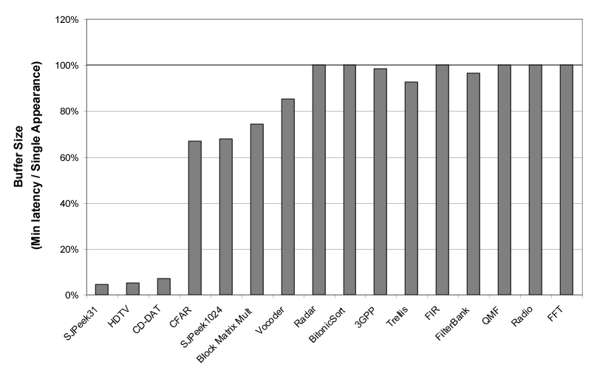
Results - Buffer Size
Notes:
Better explanation of the axis
Explain why better on benchmarks: rate mismatching

Slide 121
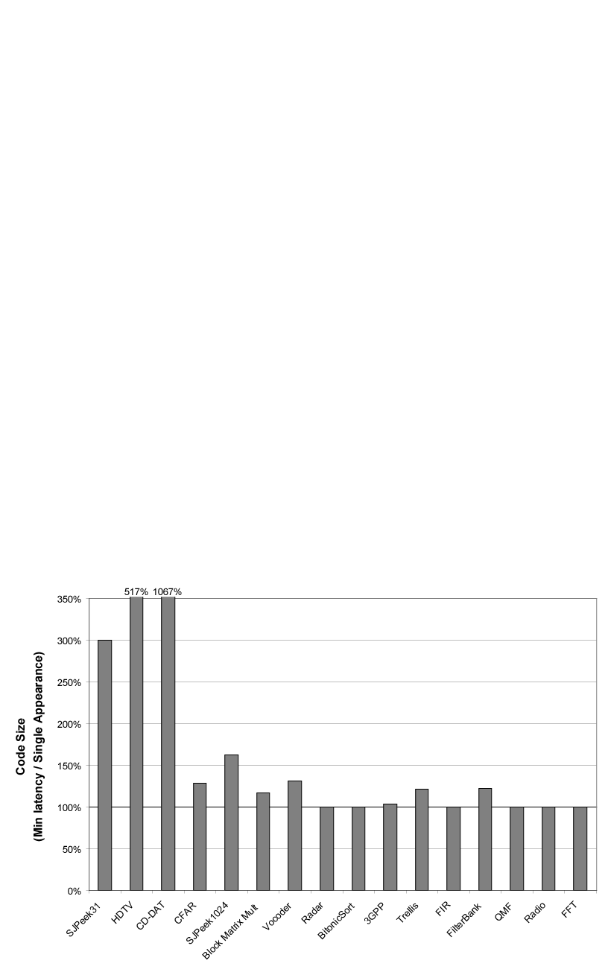
Results – Schedule Size

Slide 122
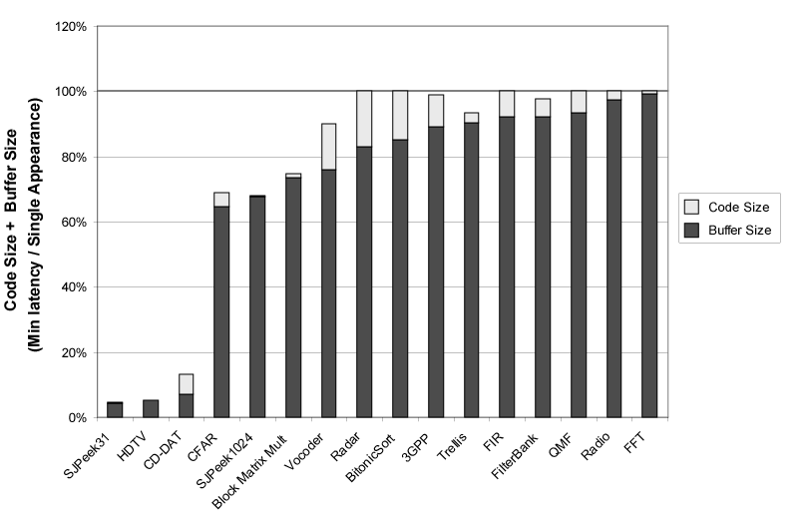
Results - Combined
Notes:
Explain my HUGE ASSUMPTION – data item size comparable to entry in schedule

Slide 123
Overview
General Stream Concepts
StreamIt Details
Program Steady State and Initialization
Single Appearance and Pull Scheduling
Phased Scheduling
  Minimal Latency
Results
Related Work and Conclusion

Slide 124
Related Work
Synchronous Data Flow (SDF)
Ptolemy [Lee et al.]
Many results for SAS on SDF
  Memory Efficient Scheduling [Bhattacharyya97]
  Buffer Merging [Murthy99]
Cyclo-Static [Bilsen96]
Peeking in US Navy Processing Graph Method [Goddard2000]
Languages: LUSTRE, Esterel, Signal

Slide 125
Conclusion
Presented Phased Scheduling Algorithm
  Provides efficient interface for hierarchical scheduling
  Enables separate compilation with safety from deadlock
  Provides flexible buffer / schedule size trade-off
  Reduces latency of data throughput
Step towards a large scale hierarchical stream programming model
Notes:
Work on ME. List contributions – flexible scheduling infrastructure and an instance of Minimal Latency
flexible tradeoff buff/sched size by varying granularity
Reduced buffer requirements for hierarchical schedules – separate compilation, no deadlock
Reduced latency for hierarchical components

Slide 126
Phased Scheduling of Stream Programs
StreamIt Homepage
http://cag.lcs.mit.edu/streamit

