Slide 1
Programmable Microfluidics
William Thies*, J.P. Urbanski†,
Mats Cooper†, David Wentzlaff*,
Todd Thorsen†, and Saman Amarasinghe*
* Computer Science and Artificial Intelligence Laboratory
† Hatsopoulos Microfluids Laboratory
Massachusetts Institute of Technology
October 12, 2004

Slide 2
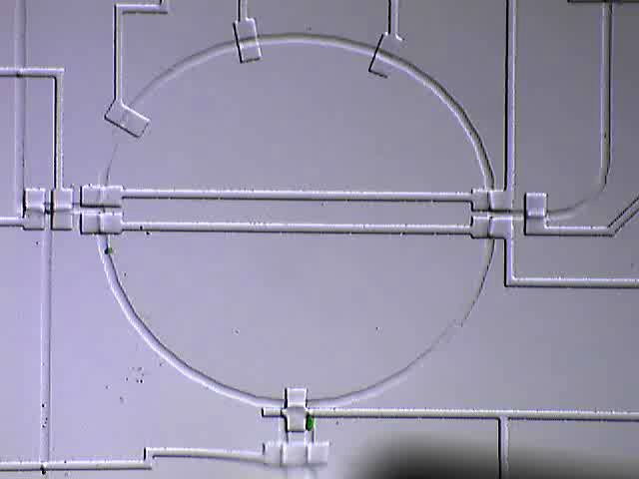
Microfluidic Chips
Idea: a whole biological lab on a single chip
  Input/output
  Actuators: temperature,
  light/dark, cell lysis, etc.
  Sensors: luminescence,
  pH, glucose, etc.
Benefits:
  Small sample volumes
  High throughput
  Geometrical manipulation
1 mm
Notes:
“Our work is motivated by recent technological advances in building microfluidic chips. These devices, also referred to as BioMems, “lab-on-a-chip” sytsems, or “micro total-analysis systems”, provide an integrated on-chip platform for biological analysis. They have mixing chambers for mixing fluids, actuators, for modifying…”

Slide 3
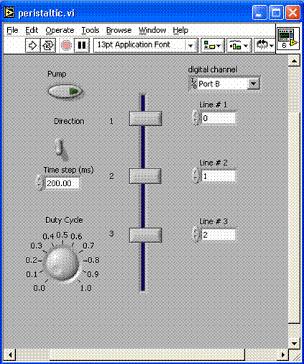
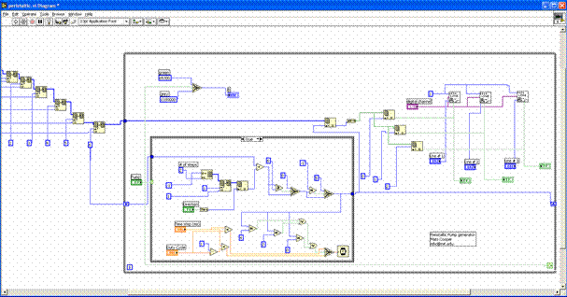
Our Goal:
Provide Abstraction Layers for this Domain
Current interface: gate-level control (Labview)
New abstraction layers will enable:
  Scalability - Portability
  Adaptivity - Optimization
NOT our goal: replace silicon computation

Slide 4
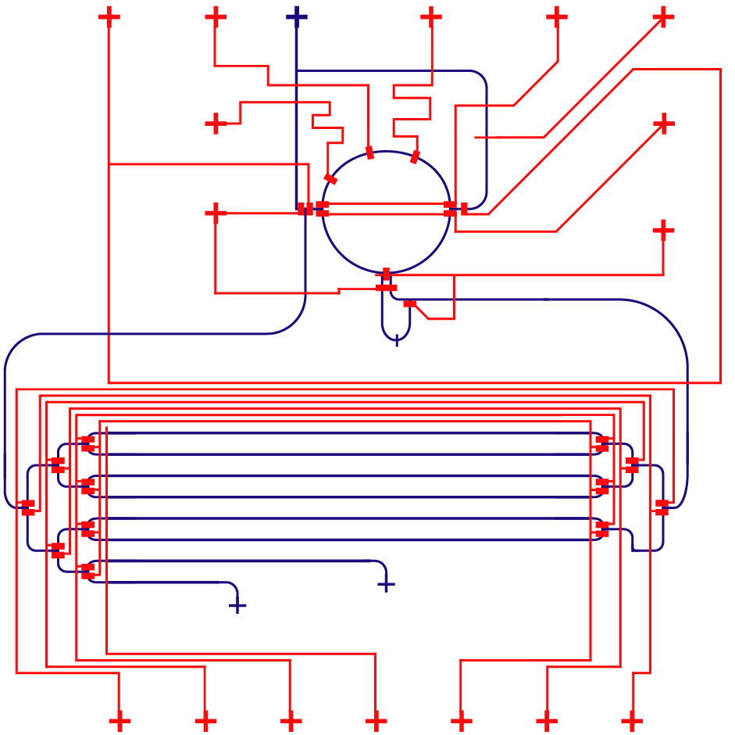
A General-Purpose Microfluidic Chip
Control layer
Flow layer
5 mm

Slide 5
A General-Purpose Microfluidic Chip
Wash
Out
Control layer
Control
ports
Flow layer
Mixer
Wash In
Storage Cells
Sample In
5 mm

Slide 6
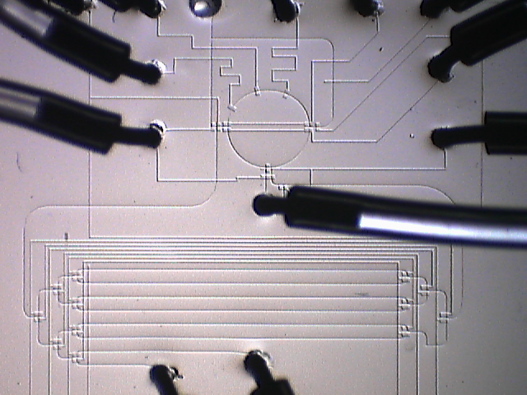
A General-Purpose Microfluidic Chip
Wash
Out
Control layer
Control
ports
Latch
Flow layer
Mixer
Wash In
Storage Cells
Sample In
Multiplexor
5 mm

Slide 7
Providing a Digital Abstraction
All fluid operations are lossy
How to control the error?

Slide 8
Providing a Digital Abstraction
All fluid operations are lossy
How to control the error?
Solution: discrete samples
  throw out half of
  sample on each mix

Slide 9
Providing a Digital Abstraction
All fluid operations are lossy
How to control the error?
Solution: discrete samples
  throw out half of
  sample on each mix

Slide 10
Providing a Digital Abstraction
All fluid operations are lossy
How to control the error?
Solution: discrete samples
  throw out half of
  sample on each mix

Slide 11
Providing a Digital Abstraction
All fluid operations are lossy
How to control the error?
Solution: discrete samples
  throw out half of
  sample on each mix

Slide 12
Providing a Digital Abstraction
All fluid operations are lossy
How to control the error?
Solution: discrete samples
  throw out half of
  sample on each mix

Slide 13
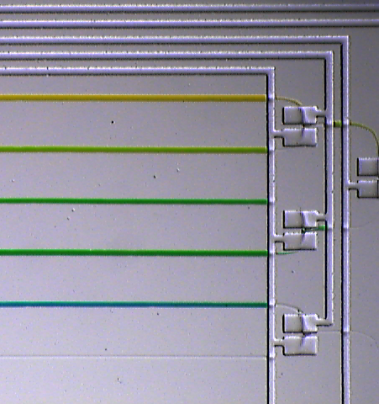
Programming Model
Fluid blue = input (0);
Fluid yellow = input(1);
for (int i=0; i<=4; i++) {
mix(blue, i/4, yellow, 1-i/4);
}
New abstractions:
- Regenerating fluids
- Efficient mixing algorithms
450 Valve Operations
Notes:
Things that are virtualized:
- # of chambers, pipes, mixing reservoirs, etc.
- Location of fluids on the chip
- Precision of mixing & routing hardware
- Timing of events

Slide 14
Example: Fixed pH Reaction
Fluid sample = input (0);
Fluid acid = input(1);
Fluid base = input(2);
do {
// test pH of sample
Fluid pH_test = mix(sample, 0.9, indicator, 0.1);
double pH = test_luminescence(pH_test);
// if pH is out of range, adjust sample
if (pH > 7.5) {
sample = mix (sample, 0.9, acid, 0.1);
} else if (pH < 6.5) {
sample = mix (sample, 0.9, base, 0.1);
}
wait(5);
} while (detect_activity(sample));

Slide 15
Example: Fixed pH Reaction
Fluid sample = input (0);
Fluid acid = input(1);
Fluid base = input(2);
do {
// test pH of sample
Fluid pH_test = mix(sample, 0.9, indicator, 0.1);
double pH = test_luminescence(pH_test);
// if pH is out of range, adjust sample
if (pH > 7.5) {
sample = mix (sample, 0.9, acid, 0.1);
} else if (pH < 6.5) {
sample = mix (sample, 0.9, base, 0.1);
}
wait(5);
} while (detect_activity(sample));
Feedback-Intensive Applications:
Cell isolation
and manipulation
Dose-response
curves
High-throughput
screening
Long, complex
protocols

Slide 16
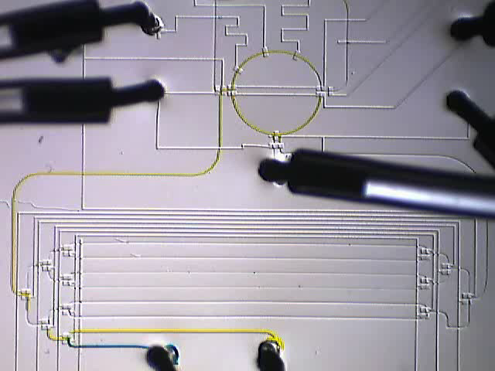
Opportunities for Computer Scientists
Experimental biology is becoming a digital science
  What are the right abstraction layers?
  We can have a large impact
Vision: A defacto language for experimental science
  Software:
  - scheduling
  - programming abstractions
  - verifying safety properties
  - optimizing throughput, cost
Hardware:
- parallelism
- error tolerance
- reducing design complexity
- minimizing control overhead

