Slide 1
Towards Programmable Microfluidics
William Thies*, Mats Cooper†, David Wentzlaff*, Todd Thorsen†, and Saman Amarasinghe*
* Computer Science and Artificial Intelligence Laboratory
† Hatsopoulos Microfluids Laboratory
Massachusetts Institute of Technology
April 15, 2004

Slide 2
Microfluidic Chips
Idea: a whole biological lab on a single chip
  Input channels for reagants
  Chambers for mixing fluids
  Actuators for modifying fluids
    Temperature - Ultraviolet radiation
    Light/dark - Electrophoresis
  Sensors for reading properties
    Luminescence - Immunosensors
    pH - Glucose
Starting to be manufactured and used today
Active area of research
Notes:
“Our work is motivated by recent technological advances in building microfluidic chips. These devices, also referred to as BioMems or “lab-on-a-chip” sytsems, provide an integrated on-chip platform for biological analysis. They have mixing chambers for mixing fluids, actuators, for modifying…”

Slide 3
Microfluidic Applications
Biochemistry
  Enzymatic assays
  The Polymerase Chain Reaction
  Nucleic acid arrays
  Biomolecular separations
  Immunohybridization reactions
  Piercing structures for DNA injection
Notes:
Say: benefits from parallelism and small sample volumes, e.g., drug discovery.

Slide 4
Microfluidic Applications
Biochemistry
Cell biology
  Flow cytometry / sorting
  Sperm/embryo tools: sperm motility, in vitro fertilization, embryo branding
  Force measurements with bending cantilevers
  Dialectrophoresis / electrorotation
  Impedance monitoring for cell motility and micromotion
  Chemical / physical substrate patterning
Notes:
Say: benefits from geometrical control of individual cells, e.g., for cell sorting

Slide 5
Microfluidic Applications
Biochemistry
Cell biology
General-Purpose Computing
  Compute with fluids
  Not our current interest

Slide 6
Microfluidic Applications
Biochemistry
Cell biology
General-Purpose Computing
Summary of Benefits:
  High throughput
  Small sample volumes
  Geometric manipulation
  Portable devices
  Automatic Control

Slide 7
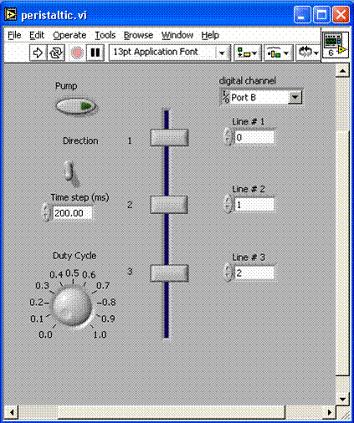
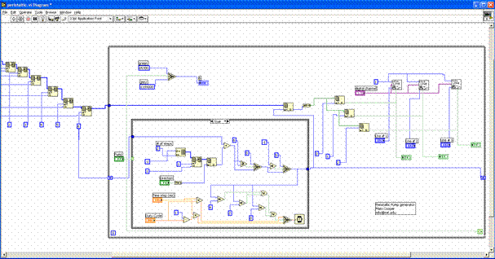
Our Goal:
Provide Abstraction Layers for this Domain
Current interface: gate-level control (e.g., Labview)
New abstraction layers will enable:
  Scalability
    Currently have 1,000 storage cells, can manage resources by hand
    Soon will have 1,000,000: how to manage complexity?
  Portability
    Hide architecture-specific details from programmer
    Same experiment works on successive generations of chips
  Modularity
    Create reusable components
    Enable large and complex procedures
  Adaptivity
    Use real-time sensor feedback to guide experiment
    Adjust procedure to suite field conditions

Slide 8
Our Goal:
Provide Abstraction Layers for this Domain
Current interface: gate-level control (e.g., Labview)
New abstraction layers will enable:
  Scalability
    Currently have 1,000 storage cells, can manage resources by hand
    Soon will have 1,000,000: how to manage complexity?
  Portability
    Hide architecture-specific details from programmer
    Same experiment works on successive generations of chips
  Modularity
    Create reusable components
    Enable large and complex procedures
  Adaptivity
    Use real-time sensor feedback to guide experiment
    Adjust procedure to suite field conditions

Slide 9
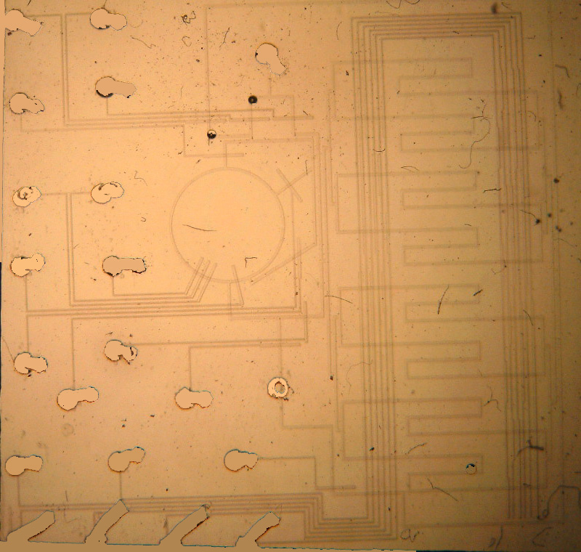
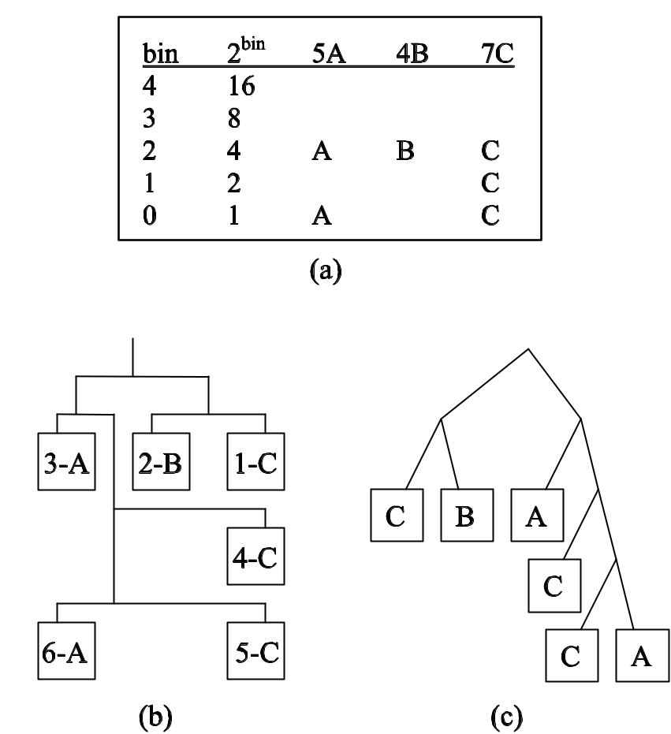
Our Contributions
1. End-to-end programmable system
  General-purpose microfluidic chip
  High-level software control
2. Novel mixing algorithms
  Mix k fluids in any concentration (± 1/n)
  Guarantees minimal number of mixes:
  O(k log n)

Slide 10
Outline
Introduction
Mixing algorithms
General-purpose microfluidic chip
Portable programming system
Implementation
Related Work
Conclusions

Slide 11
Outline
Introduction
Mixing algorithms
General-purpose microfluidic chip
Portable programming system
Implementation
Related Work
Conclusions

Slide 12
Mixing in Microfluidics
Mixing is fundamental operation of microfluidics
  Prepare samples for analysis
  Dilute concentrated substances
  Control reagant volumes
Important to mix on-chip
  Otherwise reagants leave system whenever mix needed
  Enables large, self-directing experiments
  Analogous to ALU operations on microprocessors

Slide 13
The Mixing Problem
Experiments demand mixing in arbitrary proportions
  For example, mix 15% reagant / 85% buffer
  Users should operate at this level of abstraction
However, microfluidic hardware lacks arbitrary mixers
  Most common model: 1-to-1 mixer
Important optimization questions:
  What mixtures are reachable?
  How to minimize reagant consumption?
  How to minimize number of mixes?
1 unit of A
50% A
50% B
mix
1 unit of
1 unit of B

Slide 14
Why Not Binary Search?
0
3/8
1
1/2
1/4
1/2
3/8
5 inputs, 4 mixes

Slide 15
Why Not Binary Search?
0
3/8
1
1/2
3/4
3/8
4 inputs, 3 mixes
1/2
1/4
1/2
3/8
5 inputs, 4 mixes

Slide 16
Mixing Trees
{(A, ½), (B, ½)}
{(A, ¼), (B, 1/8), (C, 5/8)}
{(A, ½), (B, ¼), (C, ¼)}
{C}
{A}
{B}
{A}
{(B, ½), (C, ½)}
Properties:
  Mixing trees are binary trees
  Leaf nodes: unit sample of an input fluid
  Internal nodes: result of 1-to-1 mix of children
  Evaluate from bottom to top
Observation:
  # leaf nodes = # internal nodes + 1 (induction on # nodes)
  Minimizing mixes and reagant usage is equivalent
{B}
{C}
# reagants used = # mixes + 1

Slide 17
Mixing Trees
depth = 0
depth = 1
depth = 2
depth = 3
Example: {C}
{(A, ¼), (B, 1/8), (C, 5/8)}
conc = 2⁻¹ + 2⁻³
{(A, ½), (B, ¼), (C, ¼)}
{C}
conc = 1/2 + 1/8
{A}
{(B, ½), (C, ½)}
conc = 5/8
{B}
{C}
Theorem: For substance S, let n_{d} denote number of leaf nodes at depth d. Then overall concentration for S is ∑_{d} n_{d} * 2^{-d}
Proof: Substance is diluted 2X at each step, and final mixture is sum over all child nodes.

Slide 18
Reachable Mixtures
Theorem: A mixture is reachable if and only if it can be written:
{(S₁, p₁/2^{d}), (S₂, p₂/2^{d}), … , (S_{k}, p_{k}/2^{d})}
Proof:
∑_{i} p_{i} = 2^{d}
Expand to
balanced tree
S₁
S₁
S₁
S₂
S₂
S₂
S₂
S₃
p₁
p₂
p₃
Must be mixing tree for mixture
Each leaf node contributes 1/2^{d}

Slide 19
Min-Mix Example 2
Recall example: mixture {(A, 3/8), (B, 5/8)}
A=3 B=5
=0011 =0101
B
A
A B
bins
2³ = 8
2² = 4
2¹ = 2
2⁰ = 1
depth = 0
depth = 1
3 mixes
Same as optimal
depth = 2
depth = 3
c = 2⁻² + 2⁻³
= 1/4 + 1/8
= 3/8
c = 2⁻¹+2⁻³
= 1/2 + 1/8
= 5/8

Slide 20
Min-Mix Example 2
Mixture {(A, 5/16), (B, 7/16), (C, 4/16)}
A=5 B=7 C=4
=00101 =00111 =00100
A B C
B
A B
bins
2⁴ = 16
2³ = 8
2² = 4
2¹ = 2
2⁰ = 1
A
B
C
B
A
B
Correctness intuition: put d’th most significant bit at depth d
Can always build tree: induction on # bits at depth d

Slide 21
Min-Mix Algorithm
A
B
C
node buildMixingTree(mixture {(S₁, p₁/n), ..., (S_{k}, p_{k}/n)}) {
depth = lg(n)
bins = new stack[depth+1]
for i = 1 to k
for j = 0 to depth-1
if (j’th least significant bit of p_{i} =1) {
bins[j].push(S_{i})
}
return buildMixingHelper(bins, depth)
}
node buildMixingHelper(stack[] bins, int pow) {
if bins[pow].empty() then
node child1 = buildMixingHelper(bins, pow-1)
node child2 = buildMixingHelper(bins, pow-1)
return <child1, child2> as internal node;
else
return bins[pow].pop() as leaf node;
endif
}
B
A
B
bins[4] = { }
bins[3] = { }
bins[2] = { A, B, C}
bins[1] = { B }
bins[0] = { A, B }
pow
4
3
2
1
0
A
B
C
B
A
B
Notes:
TODO: use the pretty tree instead of the diabolical one

Slide 22
Optimality of Min-Mix
Consider mixture:
{(S₁, p₁/n), … , (S_{k}, p_{k}/n)}
Number of input samples used
= number of bits in representation of inputs
Theorem: this is optimal reagant usage
  Implies optimal number of mixes
Proof: otherwise some p_{i}/n is unattainable
Asymptotic reagant usage: O(k lg n)
  This is also runtime of Min-Mix (visits nodes once)
A
B
C
B
A
B

Slide 23
Supporting Error Tolerances
What if user wants to mix {(A, 1/3), (B, 2/3)}?
  Impossible to obtain exactly with 1-to-1 mixer
  However, can approximate within tolerance, ± ε
  Error bounds are natural part of all experiments

Slide 24
Supporting Error Tolerances
Method: increase mixing depth d until some mix p₁/2^{d} … p_{k}/2^{d} falls within desired ranges
  Example: mix {(A, 1/3), (B, 1/3), (C, 1/3)} ± 0.05?
    Each substance should fall in range [0.23, 0.43]
  Depth Concentrations
  1 0.5 - Out of range
  2 0.25,0.5,0.75 - In range, but infeasible:
  0.25 + 0.25 + 0.25 < 1
  3 …, 0.25, 0.375, … - In range and feasible:
  0.25 + 0.375 + 0.375 = 1
  - Could be multiple solutions; we choose greedily
0
1

Slide 25
Outline
Introduction
Mixing algorithms
General-purpose microfluidic chip
Portable programming system
Implementation
Related Work
Conclusions

Slide 26
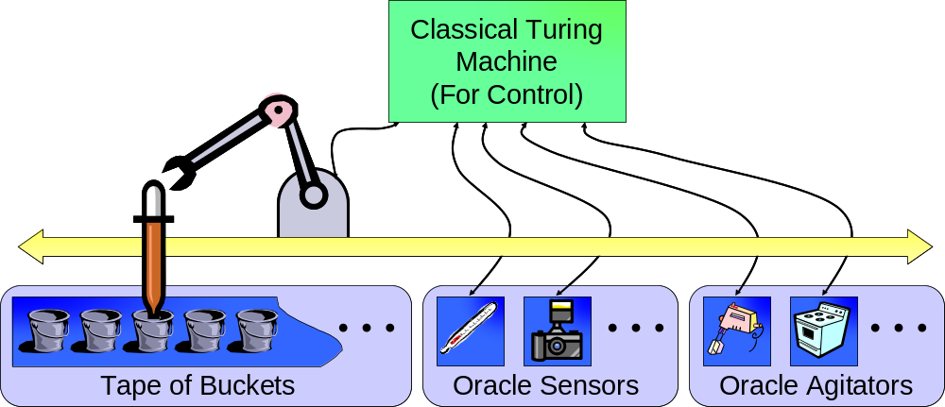
What Does General-Purpose Mean?
Computing: Turing Machine
  Implementation parameter: memory size
Microfluidics: “Universal Fluidic Machine”
  Implementation parameters:
    memory size • precision • sensors/agitators

Slide 27
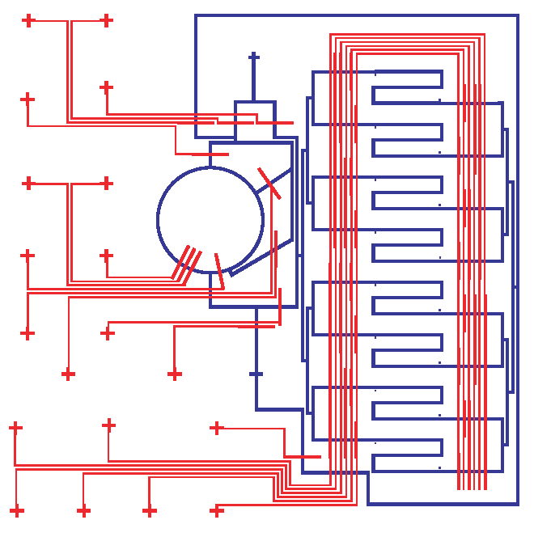
Our General-Purpose Chip (April 2004)
Control layer
Flow layer
5 mm

Slide 28
Our General-Purpose Chip (April 2004)
Purge Out
Multiplexor
Control layer
Flow layer
8 storage cells
  Individually
  addressable
  9 picoliters each
Control ports
Mixer
Storage
Cells
Rotary mixer
(Quake et al.)
Wash
In
Input / Output
  Can also add I/O
  ports to storage
  cells
5 mm
Notes:
Control ports are pressure activated (pneumatic pumps); flow lines are fluids

Slide 29
Chip-Level Operations
All operations are “pushed” by input,
flow to purge out
Extra inputs / outputs attached to storage cells
Basic operations:
  storage → output
  storage → mixer
  mixer → storage
Due to precision limits, output of mixer only fills
one storage cell
storage → storage is
“mix 2 of same fluid and store”
Purge Out
A
B
Wash
In
Notes:
NOTES
Wash input is something inert, driven by slight pressure
- this pressure can be augmented with pumps

Slide 30
Outline
Introduction
Mixing algorithms
General-purpose microfluidic chip
Portable programming system
Implementation
Related Work
Conclusions

Slide 31
A Portable Machine Language (PML)
C is PML for von-Neumann machines
  Hides idiosyncratic differences
  Exposes important properties
  Enables portability
Things to virtualize in microfluidic realm:
  # of chambers, pipes, mixing reservoirs, etc.
  Location of fluids on the chip
  Precision of mixing and routing hardware
  Timing of events
Our solution: Lava
  A Java library with first-class Fluid objects
  Virtualizes basic resources
  Provides native hooks for common agitators / sensors

Slide 32
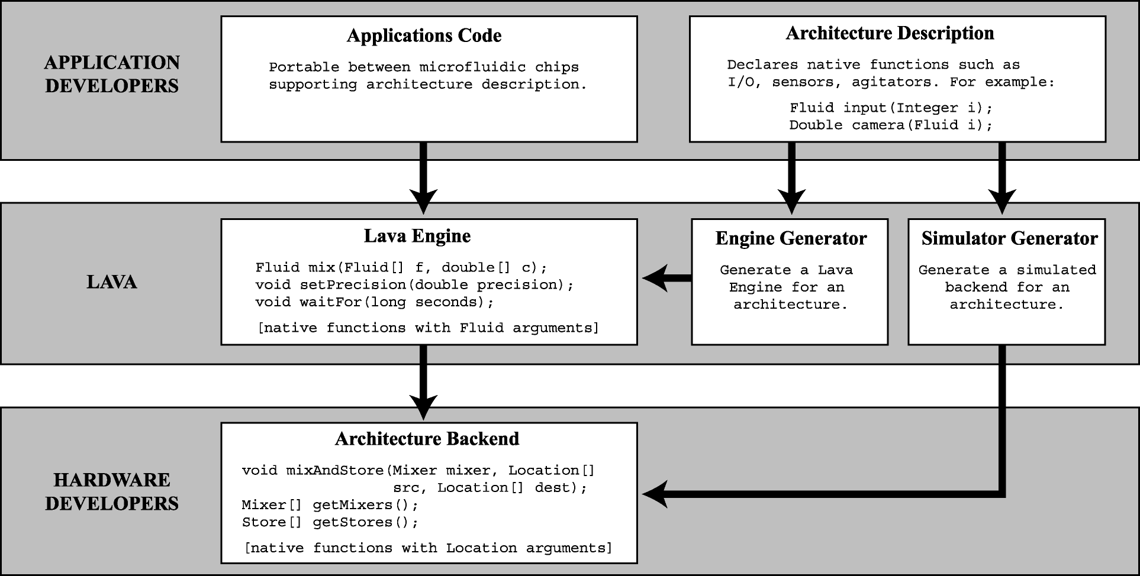
Lava System Architecture

Slide 33
Example: Recursive Descent Search
Goal: find ratio of two fluids with highest activity
  Common question in biology
    Modeling activators / inhibitors
    Understanding signaling pathways
    Drug discovery
Method: zoom in on area of interest
  set range = [0,1]
  for each round {
  for each point p in range {
  measure activity at p
  }
  adjust range around highest activity
  }
  report range and activity
Round:
1
2
3
Range:

Slide 34
Example: Recursive Descent Search
interface SimpleEngine extends FluidEngine {
Fluid input(Integer i); // require array of fluid inputs
Double luminescence(Fluid f); // require luminescence camera
}
class RecursiveDescent {
public static void main(String[] args) {
SimpleEngine engine = (SimpleEngine) // build engine for interface
EngineFactory.buildEngine("SimpleEngine", MY_BACKEND);
run(engine);
}
static void run(SimpleEngine engine) {
…
}
}
Notes:
TODO: syntax highlighting

Slide 35
Example: Recursive Descent Search
static void run(SimpleEngine engine) {
Fluid A = engine.input(new Integer(0)); // input Fluids
Fluid B = engine.input(new Integer(1));
double center = 0.5, radius = 0.5; // set range of interest
double act, bestActivity = -1;
for (int i=0; i<ROUNDS; i++) { // repeat a number of rounds
int bestJ = 0;
for (int j=0; j<10; j++) { // try 10 samples
double target = center+radius*(1-2*(double)j/10);
Fluid f = engine.mix(A, target, B, 1-target); // prepare mixture
engine.waitFor(30);
act = engine.luminescence(f).doubleValue(); // measure activity
if (act > bestActivity) {
bestActivity = act; bestJ = j; // remember highest activity
}}
center = center+radius*(1-2*(double)bestJ/10); // zoom in on highest activity
radius = radius / 2;
}
System.out.println("Highest activity at: " + center);
}
Notes:
TODO: syntax highlighting.

Slide 36
Providing Digital Abstraction
Challenge: Fluid variables used multiple times
  But once a fluid is used on-chip, it is gone!
  This is a lossy system
  Need to provide some notion of GAIN

Slide 37
Providing Digital Abstraction
Challenge: Fluid variables used multiple times
Solution: re-generate fluids on demand
  Lava traces history for computing each Fluid
  Current model: stateless mixing, native functions
  If unavailable fluid referenced, re-evaluate history
Optimizations
  Lazy evaluation
  Evaluate in order that minimizes temporaries
input (0)
input (0)
mix
heat(10)
mix
wait(30)
input (1)
Notes:
- Might need deallocate call to clear things.

Slide 38
Outline
Introduction
Mixing algorithms
General-purpose microfluidic chip
Portable programming system
Implementation
Related Work
Conclusions

Slide 39
Implementation Status (April 2004)
Prototype chip fabricated
Demonstrated I/O, moving fluids, mixing
Current focus:
  Robustness
    Air bubbles
    Diffusion
  Calibration
    Need to determine
    timing for automatic control

Slide 40
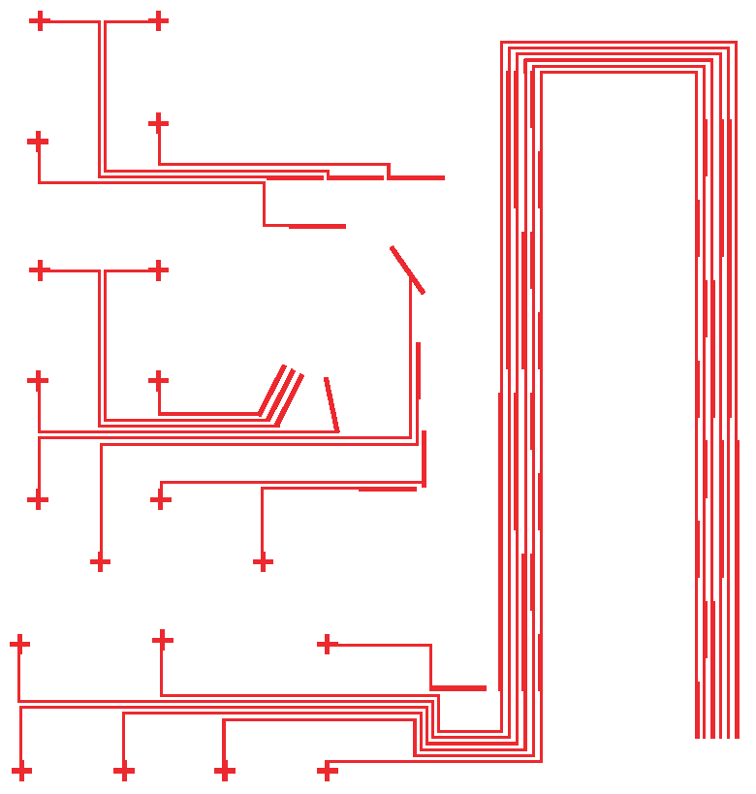
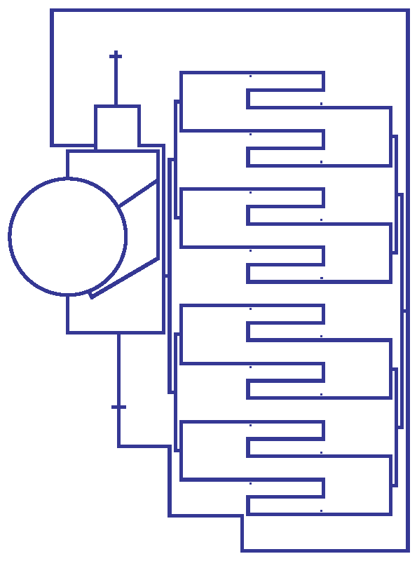
Fabrication Process (Quake et al.)
Control
Layer
0. Start with mask of channels
Flow
Layer

Slide 41
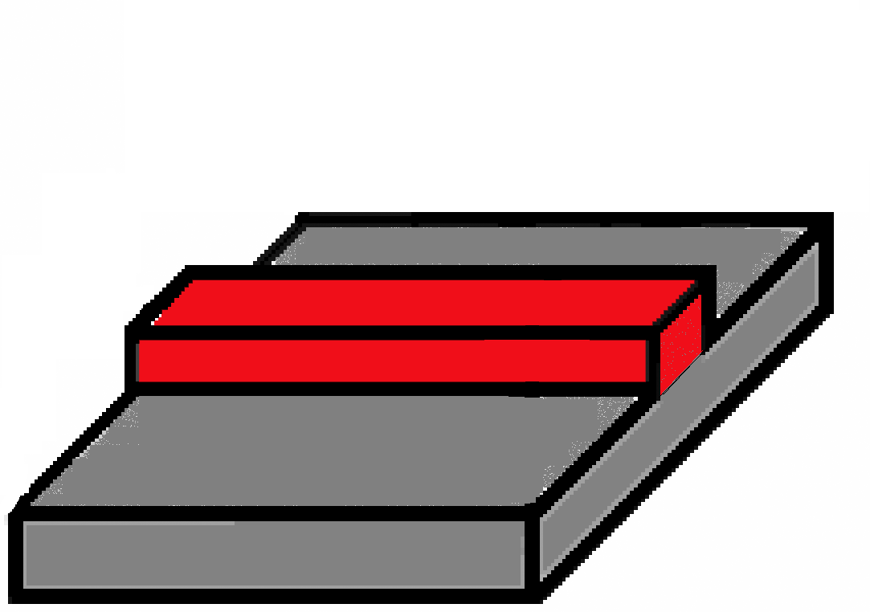
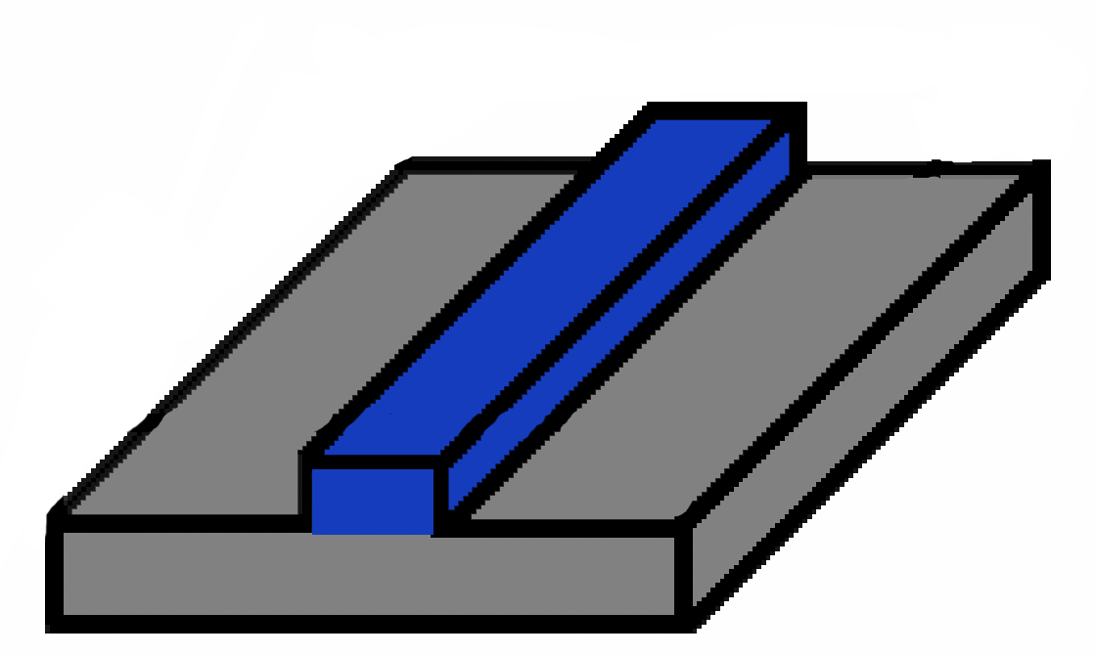
Fabrication Process (Quake et al.)
Control
Layer
1. Deposit pattern on silicon wafer
Flow
Layer

Slide 42
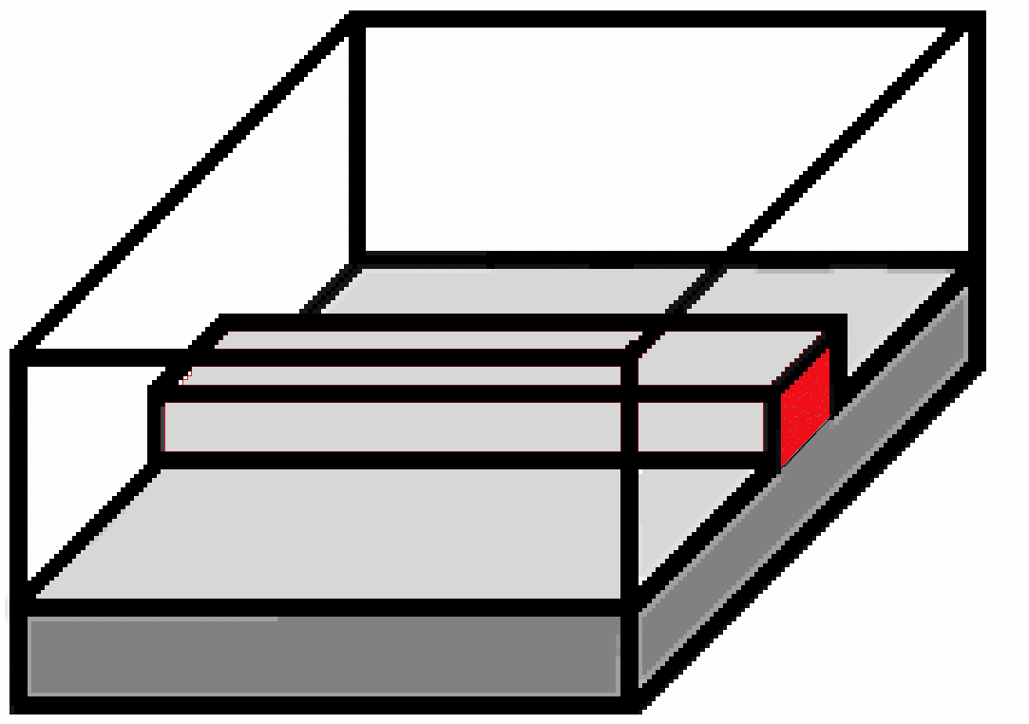
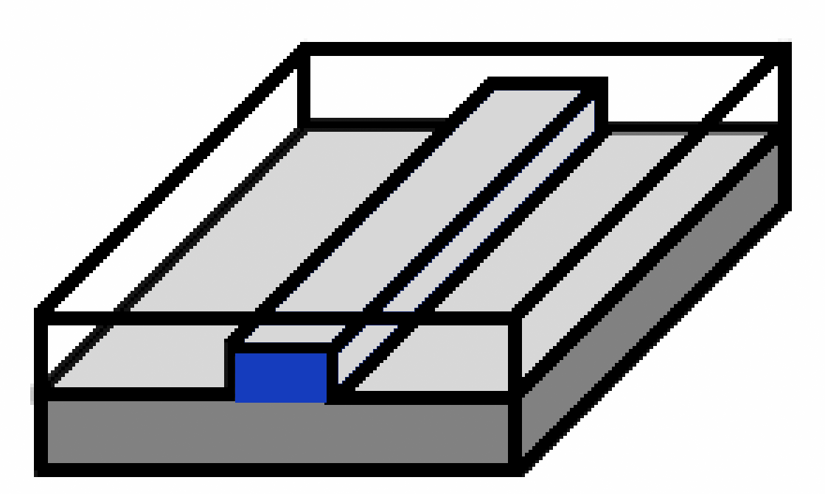
Fabrication Process (Quake et al.)
Control
Layer
2. Pour PDMS over mold
- polydimexylsiloxane: “soft lithography”
Thick layer (poured)
Thin layer (spin-coated)
Flow
Layer

Slide 43
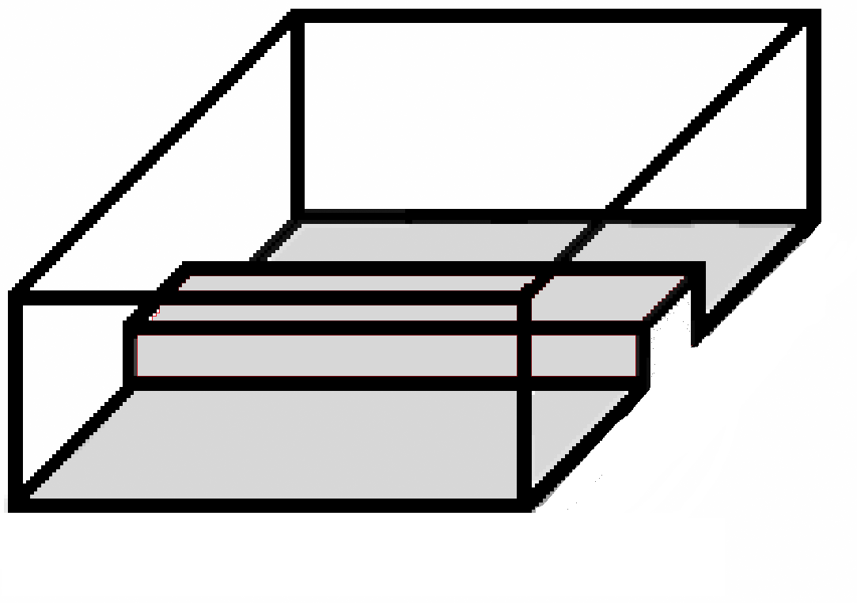
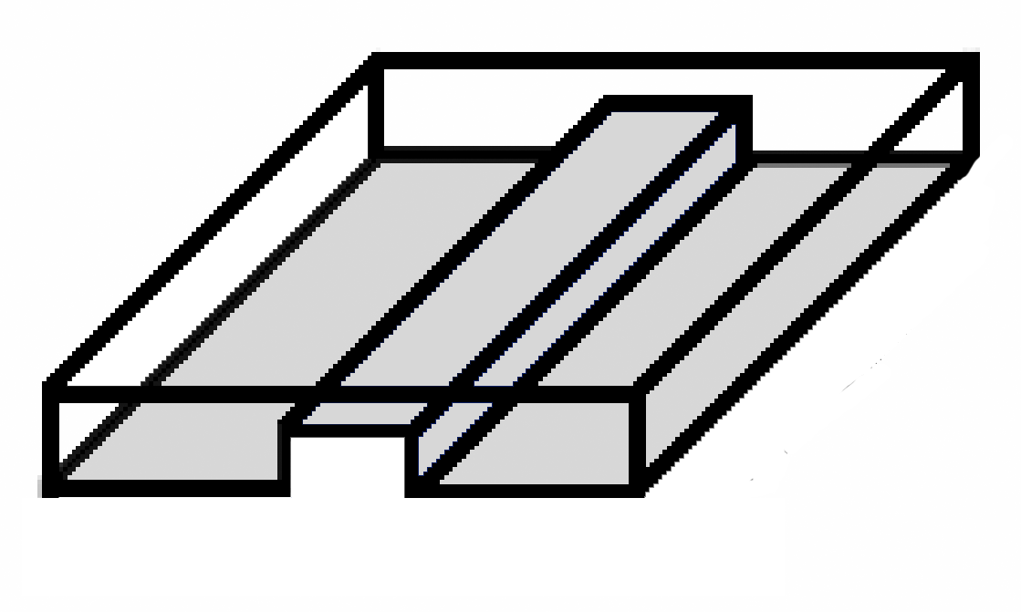
Fabrication Process (Quake et al.)
Control
Layer
3. Bake at 80° C (primary cure),
then release PDMS from mold
Flow
Layer

Slide 44
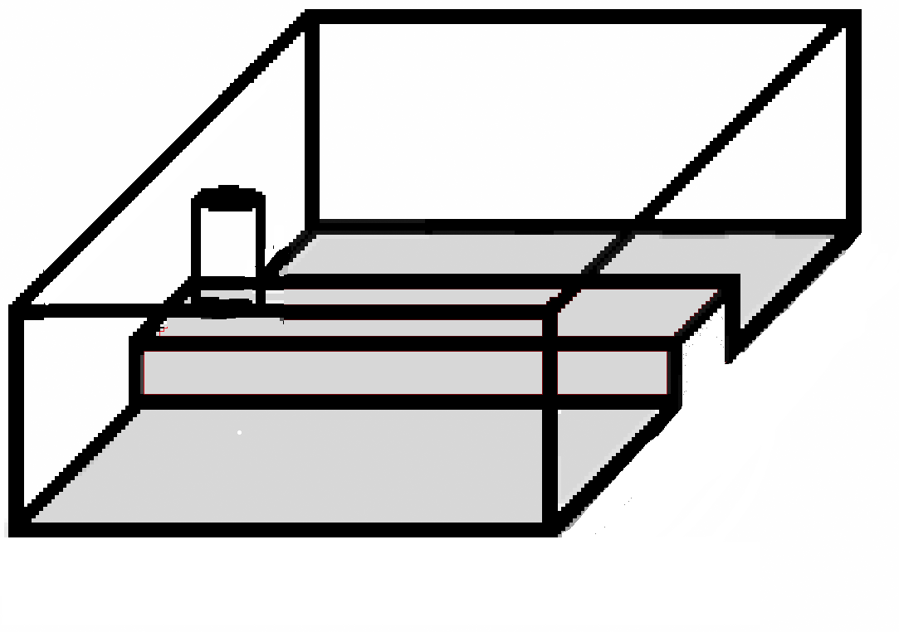
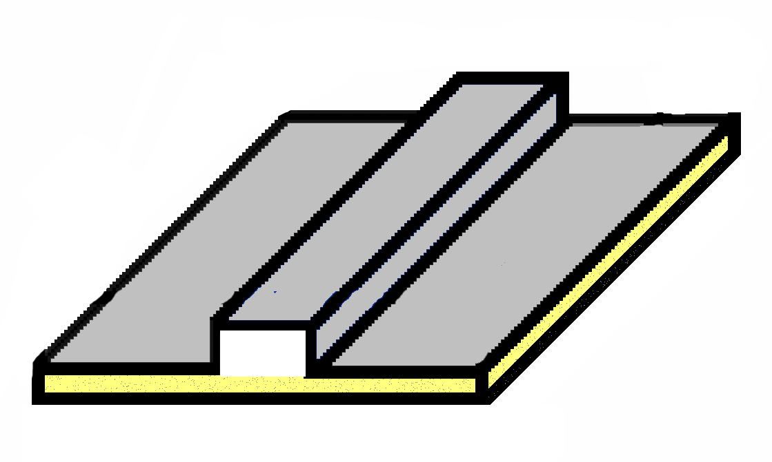
Fabrication Process (Quake et al.)
Control
Layer
4a. Punch hole in control channel
4b. Attach flow layer to glass slide
Flow
Layer

Slide 45
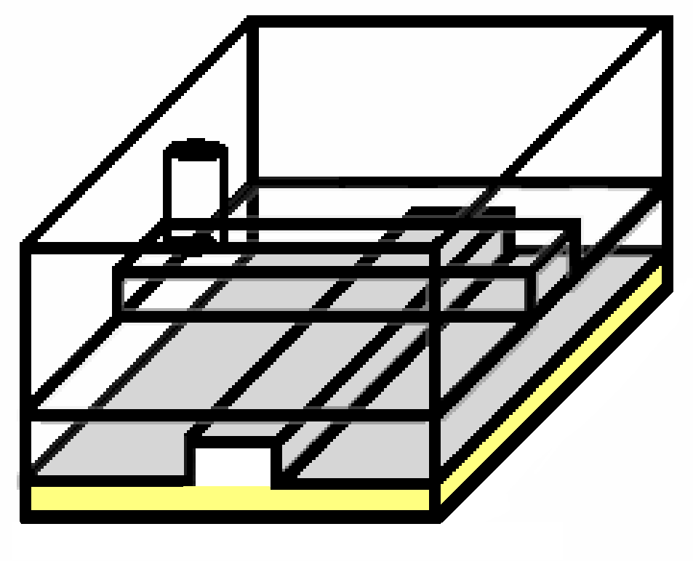
Fabrication Process (Quake et al.)
Control
Layer
5. Align flow layer over control layer
Flow
Layer

Slide 46
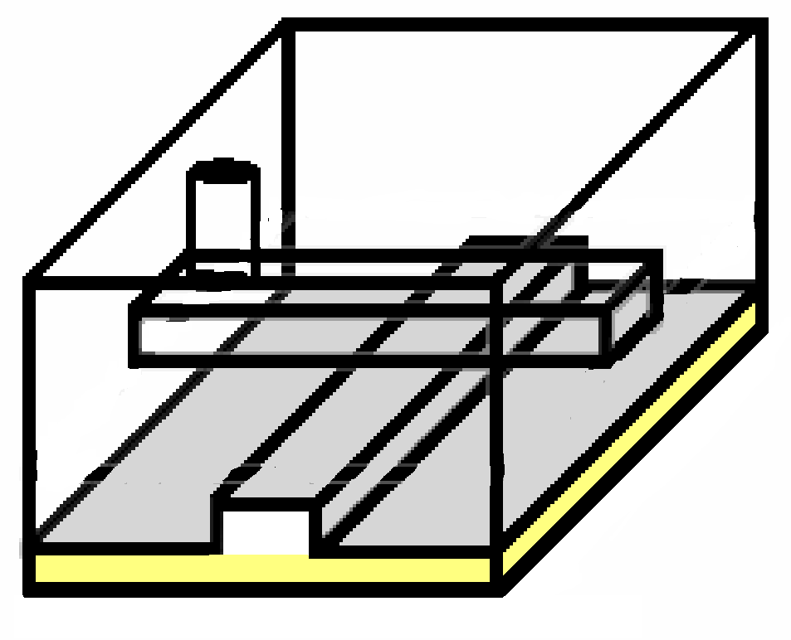
Fabrication Process (Quake et al.)
Control
Layer
6. Bake at 80° C (secondary cure)
Flow
Layer

Slide 47
Fabrication Process (Quake et al.)
7. When pressure is high, control
channel pinches flow channel to
form a valve
Control
Layer
pressure
actuator
Flow
Layer
Notes:
Note that this can be done in university facilities in about two days, with marginal cost of less than a dollar.

Slide 48
Making a Multiplexor (Thorsen et al.)
Bit 2
Bit 1
Bit 0
flow layer
control layer
0
1
0
1
0
1
Output 7
Control lines can cross
flow lines
- Only thick parts make valves
Output 6
Output 5
Input
Output 4
Logic is not
complimentary
To control n flow lines,
need 2 log₂ n control lines
Output 3
Output 2
Output 1
Output 0

Slide 49
Making a Multiplexor (Thorsen et al.)
Bit 2
Bit 1
Bit 0
flow layer
control layer
0
1
0
1
0
1
Output 7
Control lines can cross
flow lines
- Only thick parts make valves
Output 6
Output 5
Input
Output 4
Logic is not
complimentary
To control n flow lines,
need 2 log₂ n control lines
Output 3
Output 2
Output 1
Output 0
Example: select 3 = 011

Slide 50
Making a Multiplexor (Thorsen et al.)
Bit 2
Bit 1
Bit 0
flow layer
control layer
0
1
0
1
0
1
Output 7
Control lines can cross
flow lines
- Only thick parts make valves
Output 6
Output 5
Input
Output 4
Logic is not
complimentary
To control n flow lines,
need 2 log₂ n control lines
Output 3
Output 2
Output 1
Output 0
Example: select 3 = 011

Slide 51
Making a Multiplexor (Thorsen et al.)
Bit 2
Bit 1
Bit 0
flow layer
control layer
0
1
0
1
0
1
Output 7
Control lines can cross
flow lines
- Only thick parts make valves
Output 6
Output 5
Input
Output 4
Logic is not
complimentary
To control n flow lines,
need 2 log₂ n control lines
Output 3
Output 2
Output 1
Output 0
Example: select 3 = 011

Slide 52
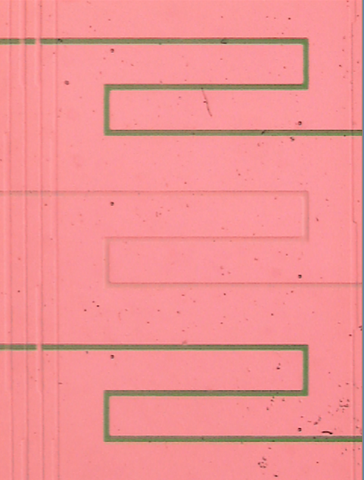
Our Multiplexor in Operation
Dye
Open Valve
Water
Closed Valve

Slide 53
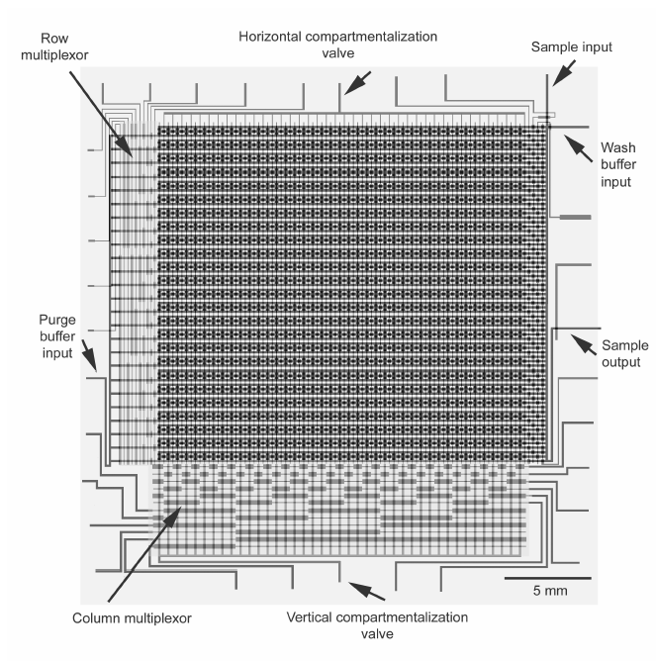
Scaling to Large Chips (Thorsen et al.)
1000 individually
addressable chambers
Uses row multiplexor,
column multiplexor
With industrial fabrication
processes, will be possible
to scale much further

Slide 54
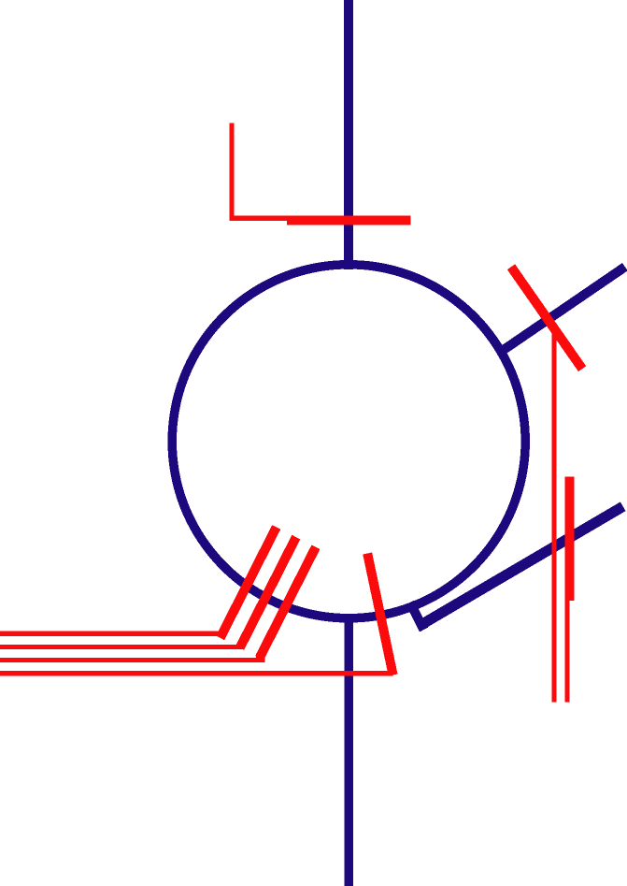
Rotary Mixer (Quake et al.)
Mode of operation:
1. Fill left with reagant A
2. Fill right with reagant B
3. Lock down I/O
4. Use mixer valves as
peristaltic pump
Channel mixes due to difference in inner / outer rotational velocities

Slide 55
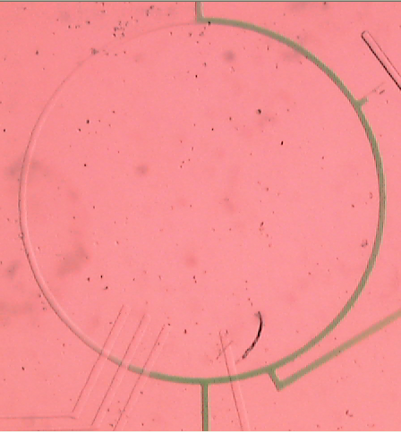
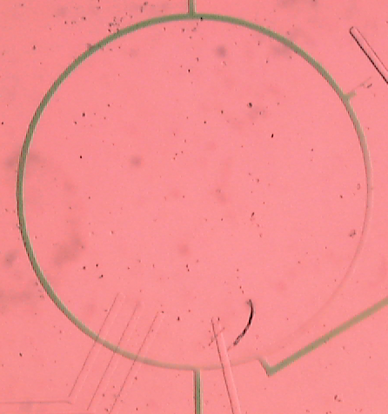
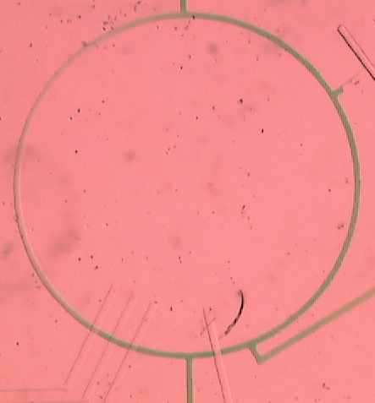
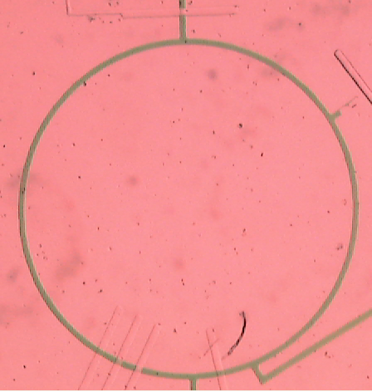
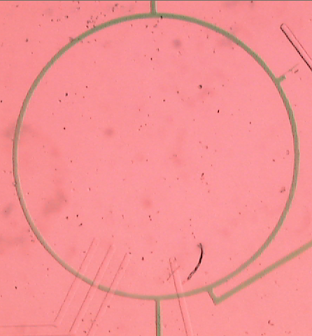
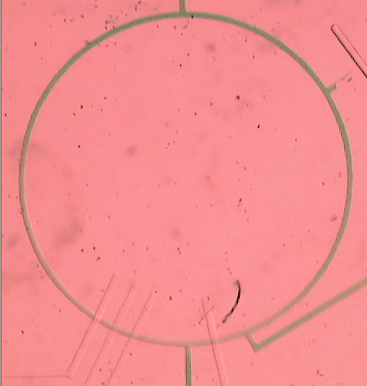
Our Mixer in Operation

Slide 56
Outline
Introduction
General-purpose microfluidic chip
Portable programming system
Mixing algorithms
Related work
Conclusions

Slide 57
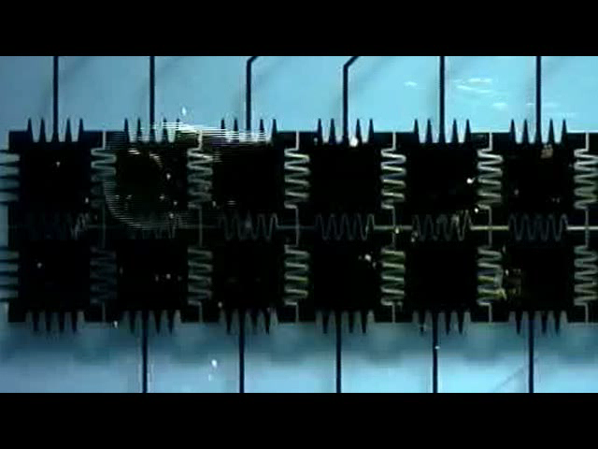
Related Work
Droplet-based microfluidics (Fair et al.)
  Manipulate discrete droplets using electrowetting
  Pro:
    Flexible grid of cells
    No diffusion
    Conventional fabrication
    process
  Con:
    Unclear if droplets can scale down (currently 100X larger than our storage chambers)
    Non-polar reagants cannot be manipulated
    Imprecise dispensing and splitting of droplets
  Droplets vs. continuous flow will be ongoing debate
Lava can target a droplet-based machine
  Easy to emulate mixer, storage on chip

Slide 58
Related Work
Mixing for droplets (Fair et al.)
  Seems to suggest binary-search procedure
    O(n) mixes to obtain concentration p/n
    Only deals with two fluids
    Slightly different model of computation
  Our algorithm is improvement: O(k lg n)
Quake et al. – continuous flow microfluidics
  Two-layer soft lithography, rotary mixer, PCR
  Our work relies on these foundations

Slide 59
Outline
Introduction
General-purpose microfluidic chip
Portable programming system
Mixing algorithms
Related work
Conclusions

Slide 60
Future Work
Mixing Algorithms
  Generalize 1-to-1 mixing model to N-to-M mixer
  Find mixing tree with minimal storage
  Exploit error tolerances to optimize mixing
Software
  Expand language to encompass broader idioms
    Can we simulate an entire cell on-chip?
  Scheduling optimizations: re-order computation
  Verification of safety properties
Hardware
  Integrate sensors / agitators on chip
  Develop CAD tools for micofluidic domain
  Explore parallel hardware constructs

Slide 61
Conclusions
Microfluidic is the next big thing in biology
Many opportunities for computer scientists
Our contributions:
  End-to-end programmable system
    Universal Fluidic Machine
    General-purpose microfluidic chip
    Lava: portable, high-level language
  Novel mixing algorithm
    Mix k fluids with precision ± 1/n: O(k lg n) mixes
    Guarantees optimal reagant usage, # of mixes
Vision: create de-facto language for experimental scientists
  Replicate a published experiment on your
  own microfluidic chip

