Slide 1
Multicores from the Compiler's Perspective
A Blessing or A Curse?
Saman Amarasinghe
Associate Professor, Massachusetts Institute of Technology Department of Electrical Engineering and Computer Science
Computer Science and Artificial Intelligence Laboratory
CTO, Determina Inc.

Slide 2
Multicores are coming!
MIT Raw
16 Cores
Since 2002
Intel Montecito
1.7 Billion transistors
Dual Core IA/64
Intel Tanglewood
Dual Core IA/64
Intel Pentium D
(Smithfield)
Intel Dempsey
Dual Core Xeon
Intel Pentium Extreme
3.2GHz Dual Core
Cancelled
Intel Tejas & Jayhawk
Unicore (4GHz P4)
Intel Yonah
Dual Core Mobile
AMD Opteron
Dual Core
Sun Olympus and Niagara
8 Processor Cores
IBM Cell
Scalable Multicore
IBM Power 4 and 5
Dual Cores Since 2001
IBM Power 6
Dual Core
…
2H 2004
1H 2005
2H 2005
1H 2006
2H 2006

Slide 3
What is Multicore?
Multiple, externally visible processors on a single die where the processors have independent control-flow, separate internal state and no critical resource sharing.
Multicores have many names…
  Chip Multiprocessor (CMP)
  Tiled Processor
  ….

Slide 4
Why move to Multicores?
Many issues with scaling a unicore
  Power
  Efficiency
  Complexity
  Wire Delay
  Diminishing returns from optimizing
  a single instruction stream

Slide 5
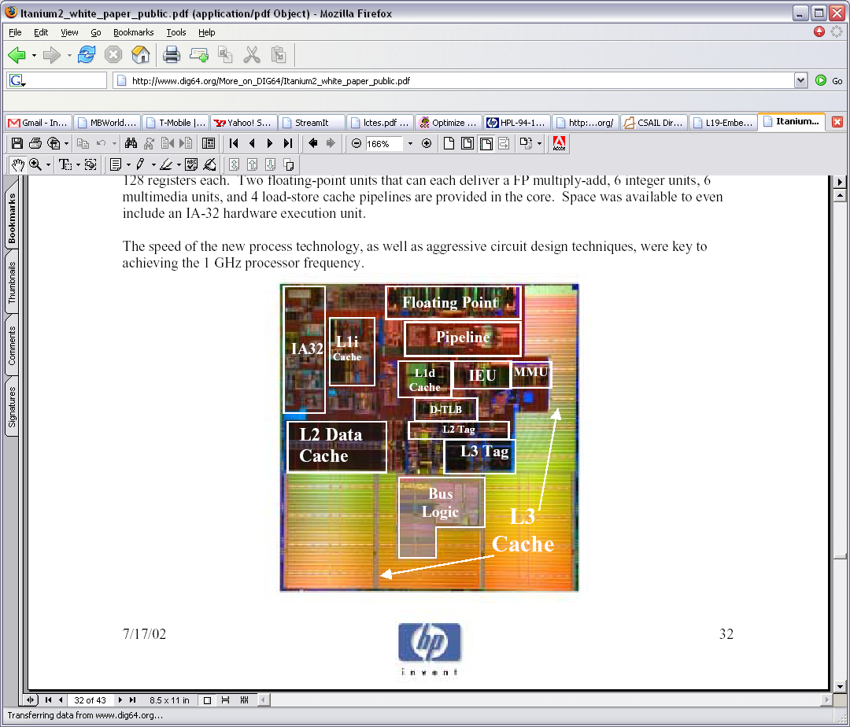
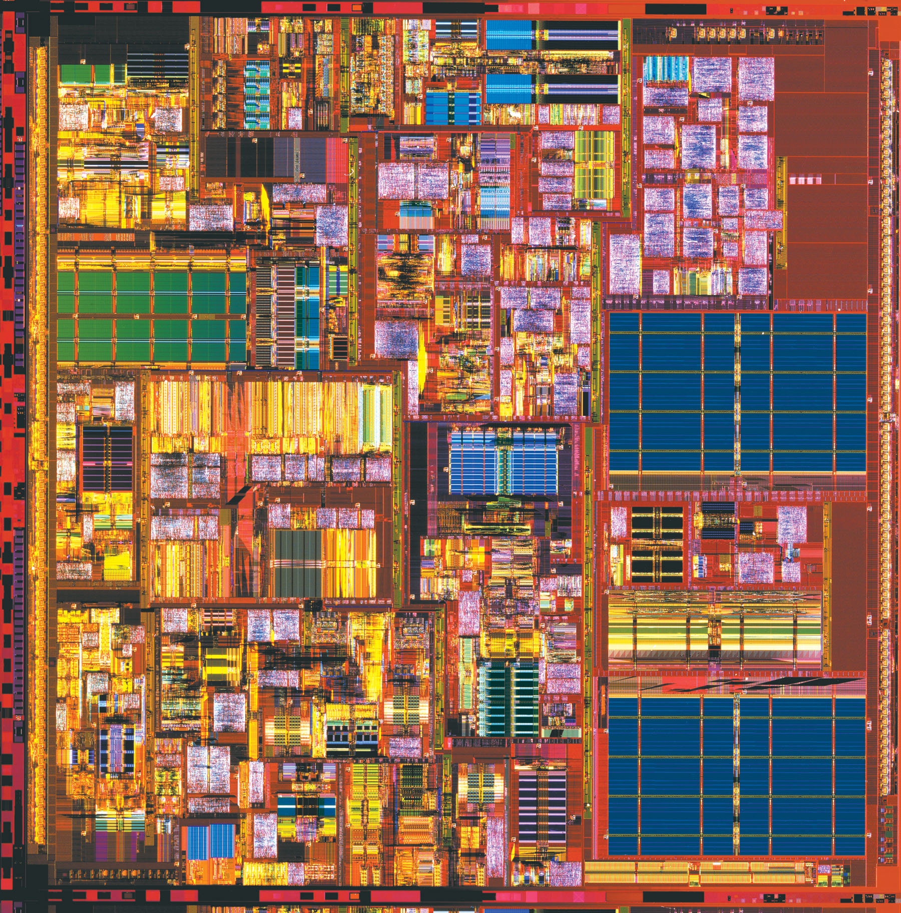
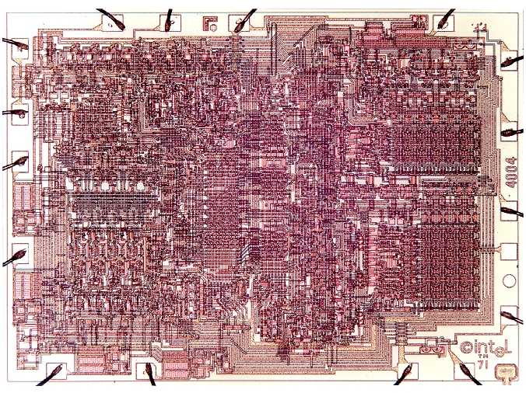
Moore’s Law:
Transistors Well Spent?
Itanium 2 (421mm² / .18μ)
Floating Point
Pentium 4 (217mm² / .18μ)
Integer Core
transistors
Decode
Fetch
Bus
Control
Itanium 2
1,000,000,000
Trace
Cache
Itanium
L2 Data
Cache
FPU
MMX/SSE
P4
100,000,000
Integer
Core
P3
Renaming
L2 Data
Cache
P2
10,000,000
μOp Scheduling
Pentium
486
1,000,000
4004 (12mm² / 8μ)
386
286
100,000
8086
8080
10,000
8008
Moore’s Law
4004
1,000
1970
1975
1980
1985
1990
1995
2000
2005

Slide 6
Outline
Introduction
Overview of Multicores
Success Criteria for a Compiler
Data Level Parallelism
Instruction Level Parallelism
Language Exposed Parallelism
Conclusion

Slide 7

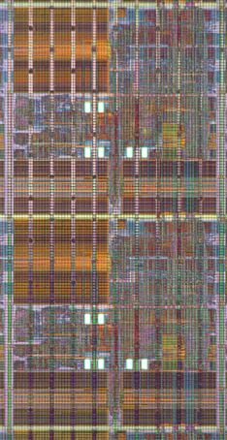
Impact of Multicores
How does going from Multiprocessors to Multicores impact programs?
What changed?
Where is the Impact?
  Communication Bandwidth
  Communication Latency

Slide 8
Communication Bandwidth
How much data can be communicated
between two cores?
What changed?
  Number of Wires
    IO is the true bottleneck
    On-chip wire density is very high
  Clock rate
    IO is slower than on-chip
  Multiplexing
    No sharing of pins
Impact on programming model?
  Massive data exchange is possible
  Data movement is not the bottleneck
  → locality is not that important
10,000X
32 Giga bits/sec
~300 Tera bits/sec

Slide 9
Communication Latency
How long does it take for a round trip communication?
What changed?
  Length of wire
    Very short wires are faster
  Pipeline stages
    No multiplexing
    On-chip is much closer
Impact on programming model?
  Ultra-fast synchronization
  Can run real-time apps
  on multiple cores
50X
~200 Cycles
~4 cycles

Slide 10
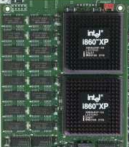
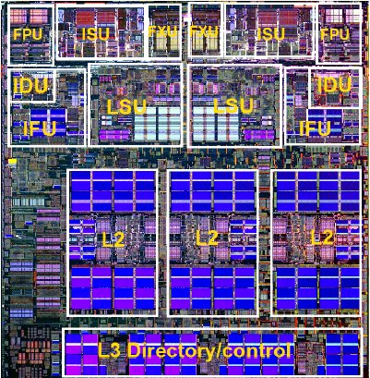
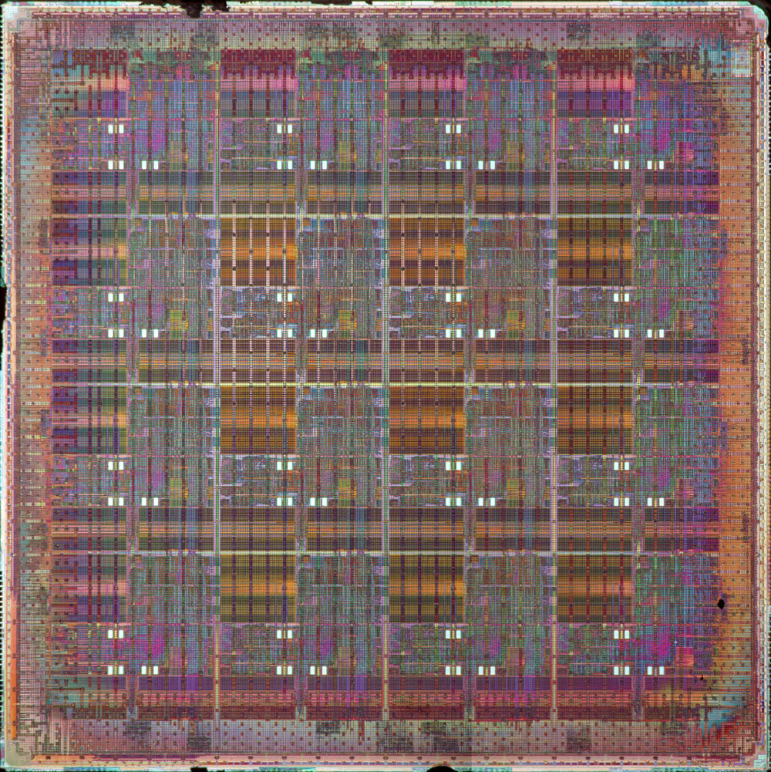
Past, Present and the Future?
Traditional
Multiprocessor
Basic Multicore
IBM Power5
Integrated Multicore
16 Tile MIT Raw
PE
PE
PE
PE
PE
PE
Memory
$$
X
$$
X
$$
$$
$$
$$
PE
PE
$$
X
$$
X
Memory
Memory
Memory
Memory
Memory

Slide 11
Outline
Introduction
Overview of Multicores
Success Criteria for a Compiler
Data Level Parallelism
Instruction Level Parallelism
Language Exposed Parallelism
Conclusion

Slide 12
When is a compiler successful as a general purpose tool?
General Purpose
  Programs compiled with the compiler are in daily use by non-expert users
  Used by many programmers
  Used in open source and commercial settings
Research / niche
  You know the names of all the users

Slide 13
Success Criteria
Effective
Stable
General
Scalable
Simple

Slide 14
1: Effective
Good performance improvements on most programs
The speedup graph goes here!

Slide 15
2: Stable
Simple change in the program should not drastically change the performance!
  Otherwise need to understand the compiler inside-out
  Programmers want to treat the compiler as a black box

Slide 16
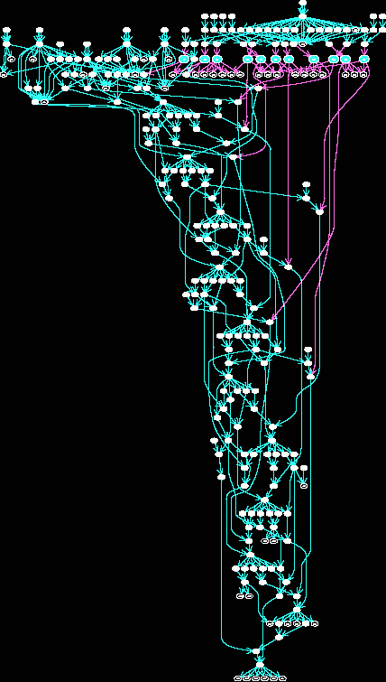
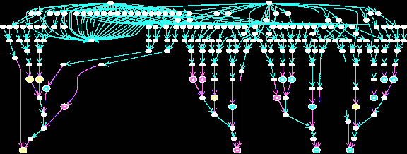
3: General
Support the diversity of programs
  Support Real Languages: C, C++, (Java)
    Handle rich control and data structures
    Tolerate aliasing of pointers
  Support Real Environments
    Separate compilation
    Statically and dynamically linked libraries
Work beyond an ideal laboratory setting

Slide 17
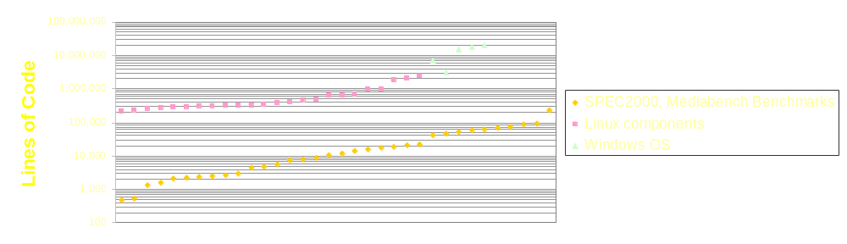
4: Scalable
Real applications are large!
  Algorithm should scale
    polynomial or exponential in the program size doesn’t work
Real Programs are Dynamic
  Dynamically loaded libraries
  Dynamically generated code
Whole program analysis tractable?

Slide 18
5: Simple
Aggressive analysis and complex transformation lead to:
  Buggy compilers!
    Programmers want to trust their compiler!
    How do you manage a software project when the compiler is broken?
  Long time to develop
Simple compiler ⇒ fast compile-times
Current compilers are too complex!
Compiler | Lines of Code
GNU GCC | ~ 1.2 million
SUIF | ~ 250,000
Open Research Compiler | ~3.5 million
Trimaran | ~ 800,000
StreamIt | ~ 300,000

Slide 19
Outline
Introduction
Overview of Multicores
Success Criteria for a Compiler
Data Level Parallelism
Instruction Level Parallelism
Language Exposed Parallelism
Conclusion

Slide 20
Data Level Parallelism
Identify loops where each iteration can run in parallel
  DOALL parallelism
What affects performance?
  Parallelism Coverage
  Granularity of Parallelism
  Data Locality
TDT = DT
MP1 = M+1
NP1 = N+1
EL = N*DX
PI = 4.D0*ATAN(1.D0)
TPI = PI+PI
DI = TPI/M
DJ = TPI/N
PCF = PI*PI*A*A/(EL*EL)
DO 50 J=1,NP1
DO 50 I=1,MP1
PSI(I,J) = A*SIN((
I-.5D0)*DI)*
SIN((J-.5D0)*DJ)
P(I,J) = PCF*(COS(2.D0)
CONTINUE
DO 60 J=1,N
DO 60 I=1,M
U(I+1,J) = -(PSI(I+1,J+1)
-PSI(I+1,J))/DY
V(I,J+1) = (PSI(I+1,J+1)-
PSI(I,J+1))/DX
CONTINUE
TIME
processors

Slide 21
Parallelism Coverage
Amdahl’s Law
Performance improvement to be gained from faster mode of execution is limited by the fraction of the time the faster mode can be used
Find more parallelism
  Interprocedural analysis
  Alias analysis
  Data-flow analysis
  ……
More
processors
processors

Slide 22
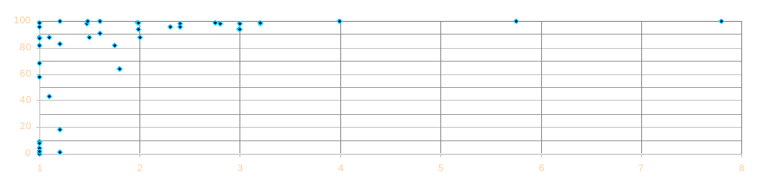
SUIF Parallelizer Results
Parallelism Coverage
S p e e d u p
SPEC95fp, SPEC92fp, Nas, Perfect Benchmark Suites
On a 8 processor Silicon Graphics Challenge (200MHz MIPS R4000)

Slide 23
Granularity of Parallelism
Synchronization is expensive
Need to find very large parallel regions →
coarse-grain loop nests
Heroic analysis required
TDT = DT
MP1 = M+1
NP1 = N+1
EL = N*DX
PI = 4.D0*ATAN(1.D0)
TPI = PI+PI
DI = TPI/M
DJ = TPI/N
PCF = PI*PI*A*A/(EL*EL)
DO 50 J=1,NP1
DO 50 I=1,MP1
PSI(I,J) = A*SIN((
I-.5D0)*DI)*
SIN((J-.5D0)*DJ)
P(I,J) = PCF*(COS(2.D0)
CONTINUE
DO 60 J=1,N
DO 60 I=1,M
U(I+1,J) = -(PSI(I+1,J+1)
-PSI(I+1,J))/DY
V(I,J+1) = (PSI(I+1,J+1)-
PSI(I,J+1))/DX
CONTINUE
TIME
processors

Slide 24
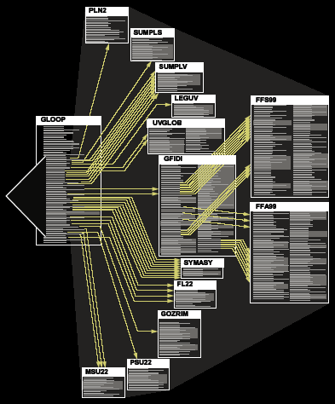
Granularity of Parallelism
Synchronization is expensive
Need to find very large
parallel regions →
coarse-grain loop nests
Heroic analysis required
Single unanalyzable line →
turb3d in SPEC95fp

Slide 25
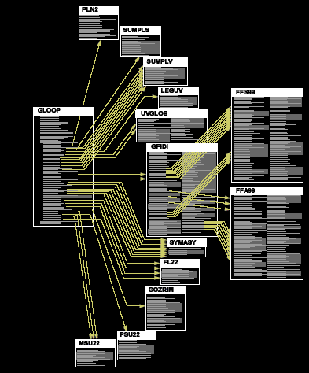
Granularity of Parallelism
Synchronization is expensive
Need to find very large
parallel regions →
coarse-grain loop nests
Heroic analysis required
Single unanalyzable line →
  Small Reduction in Coverage
  Drastic Reduction in Granularity
turb3d in SPEC95fp

Slide 26
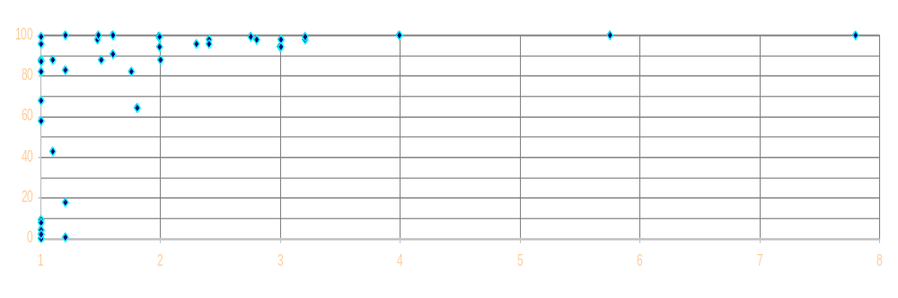
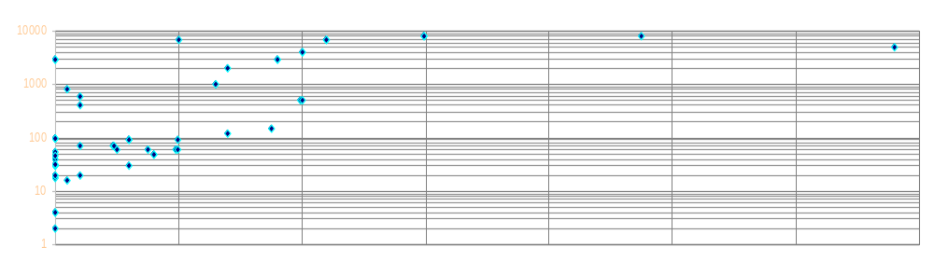
SUIF Parallelizer Results
Parallelism Coverage
S p e e d u p
Granularity of Parallelism

Slide 27
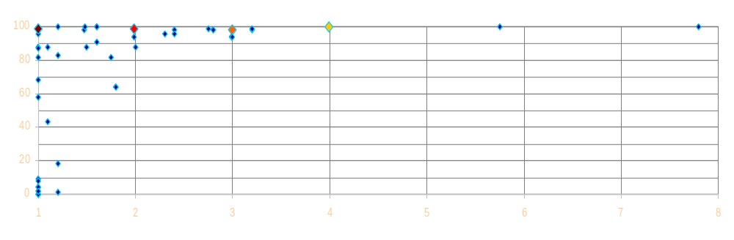
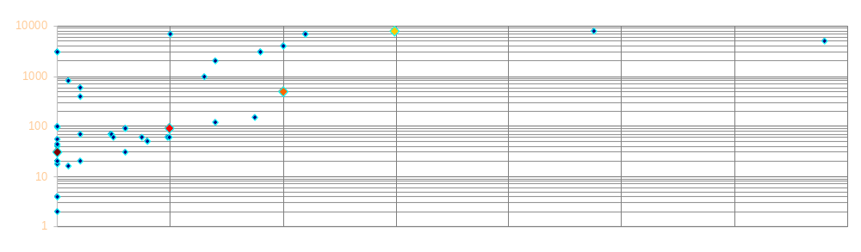
SUIF Parallelizer Results
Parallelism Coverage
S p e e d u p
Granularity of Parallelism

Slide 28
Data Locality
Non-local data →
  Stalls due to latency
  Serialize when lack of bandwidth
Data Transformations
  Global impact
  Whole program analysis
A[0]
A[1]
A[2]
A[3]
A[4]
A[5]
A[6]
A[7]
A[8]
A[9]
A[10]
A[11]
A[12]
A[13]
A[14]
A[15]

Slide 29
DLP on Multiprocessors:
Current State
Huge body of work over the years.
  Vectorization in the ’80s
  High Performance Computing in ’90s
Commercial DLP compilers exist
  But…only a very small user community
Can multicores make DLP mainstream?
?

Slide 30
Effectiveness
Main Issue
  Parallelism Coverage
Compiling to Multiprocessors
  Amdahl’s law
    Many programs have no loop-level parallelism
Compiling to Multicores
  Nothing much has changed

Slide 31
Stability
Main Issue
  Granularity of Parallelism
Compiling for Multiprocessors
  Unpredictable, drastic granularity changes reduce the stability
Compiling for Multicores
  Low latency → granularity is less important

Slide 32
Generality
Main Issue
  Changes in general purpose programming styles over time impacts compilation
Compiling for Multiprocessors (In the good old days)
  Mainly FORTRAN
    Loop nests and Arrays
Compiling for Multicores
  Modern languages/programs are hard to analyze
    Aliasing (C, C++ and Java)
    Complex structures (lists, sets, trees)
    Complex control (concurrency, recursion)
    Dynamic (DLLs, Dynamically generated code)

Slide 33
Scalability
Main Issue
  Whole program analysis and global transformations don’t scale
Compiling for Multiprocessors
  Interprocedural analysis needed to improve granularity
  Most data transformations have global impact
Compiling for Multicores
  High bandwidth and low latency → no data transformations
  Low latency → granularity improvements not important

Slide 34
Simplicity
Main Issue
  Parallelizing compilers are exceedingly complex
Compiling for Multiprocessors
  Heroic interprocedural analysis and global transformations are required because of high latency and low bandwidth
Compiling for Multicores
  Hardware is a lot more forgiving…
  But…modern languages and programs make life difficult

Slide 35
Outline
Introduction
Overview of Multicores
Success Criteria for a Compiler
Data Level Parallelism
Instruction Level Parallelism
Language Exposed Parallelism
Conclusion

Slide 36
Instruction Level parallelism on a Unicore
seed.0=seed
tmp0 = (seed*3+2)/2
tmp1 = seed*v1+2
tmp2 = seed*v2 + 2
tmp3 = (seed*6+2)/3
v2 = (tmp1 - tmp3)*5
v1 = (tmp1 + tmp2)*3
v0 = tmp0 - v1
v3 = tmp3 - v2
pval1=seed.0*3.0
v1.2=v1
v2.4=v2
pval2=seed.0*v1.2
pval5=seed.0*6.0
pval0=pval1+2.0
pval3=seed.o*v2.4
tmp1.3=pval2+2.0
pval4=pval5+2.0
tmp0.1=pval0/2.0
tmp2.5=pval3+2.0
tmp1=tmp1.3
tmp3.6=pval4/3.0
tmp0=tmp0.1
pval7=tmp1.3+tmp2.5
tmp2=tmp2.5
tmp3=tmp3.6
pval6=tmp1.3-tmp2.5
v1.8=pval7*3.0
v2.7=pval6*5.0
v0.9=tmp0.1-v1.8
v1=v1.8
v3.10=tmp3.6-v2.7
v0=v0.9
v2=v2.7
v3=v3.10
Programs have ILP
Modern processors extract the ILP
  Superscalars → Hardware
  VLIW → Compiler

Slide 37
Scalar Operand Network (SON)
Moves results of an operation to dependent instructions
Superscalars → in Hardware
What makes a good SON?
seed.0=seed
pval5=seed.0*6.0
ALU
ALU
ALU
ALU
ALU
ALU
ALU
ALU
Register File
ALU
ALU
ALU
ALU
Bypass
Network
ALU
ALU
ALU
ALU
Notes:
To gain some insight let’s look at a tiny program. I have here on the right an add instruction whose output is processed by a shift
Instruction. When this program is executed, first the instructions are mapped to the array of ALUs. Then, after the add
Instruction is executed, the operand is routed out of the array of ALUs, through this bypass network, which is very large,
and then back into array of alus. As you can see, communication between instructions is a relatively global event.

Slide 38
Scalar Operand Network (SON)
Moves results of an operation to dependent instructions
Superscalars → in Hardware
What makes a good SON?
  Low latency from producer to consumer
seed.0=seed
pval5=seed.0*6.0
seed.0=seed
pval5=seed.0*6.0
Notes:
To gain some insight let’s look at a tiny program. I have here on the right an add instruction whose output is processed by a shift
Instruction. When this program is executed, first the instructions are mapped to the array of ALUs. Then, after the add
Instruction is executed, the operand is routed out of the array of ALUs, through this bypass network, which is very large,
and then back into array of alus. As you can see, communication between instructions is a relatively global event.

Slide 39
Scalar Operand Network (SON)
Moves results of an operation to dependent instructions
Superscalars → in Hardware
What makes a good SON?
  Low latency from producer to consumer
  Low occupancy at the producer and consumer
seed.0=seed
pval5=seed.0*6.0
seed.0=seed
lock
Write mem
unlock
Test lock
Branch
Test lock
Branch
Test lock
Branch
Test lock
Branch
Read memory
pval5=seed.0*6.0
Notes:
To gain some insight let’s look at a tiny program. I have here on the right an add instruction whose output is processed by a shift
Instruction. When this program is executed, first the instructions are mapped to the array of ALUs. Then, after the add
Instruction is executed, the operand is routed out of the array of ALUs, through this bypass network, which is very large,
and then back into array of alus. As you can see, communication between instructions is a relatively global event.

Slide 40
Scalar Operand Network (SON)
Moves results of an operation to dependent instructions
Superscalars → in Hardware
What makes a good SON?
  Low latency from producer to consumer
  Low occupancy at the producer and consumer
  High bandwidth for multiple operations
seed.0=seed
v1.2=v1
v2.4=v2
pval2=seed.0*v1.2
pval3=seed.o*v2.4
pval5=seed.0*6.0
tmp1.3=pval2+2.0
tmp2.5=pval3+2.0
pval7=tmp1.3+tmp2.5
tmp1=tmp1.3
seed.0=seed
pval5=seed.0*6.0
Notes:
To gain some insight let’s look at a tiny program. I have here on the right an add instruction whose output is processed by a shift
Instruction. When this program is executed, first the instructions are mapped to the array of ALUs. Then, after the add
Instruction is executed, the operand is routed out of the array of ALUs, through this bypass network, which is very large,
and then back into array of alus. As you can see, communication between instructions is a relatively global event.

Slide 41
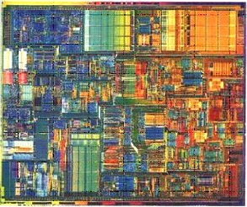
Is an Integrated Multcore Reedy to be a Scalar Operand Network?
Traditional
Multiprocessor
Basic
Multicore
Integrated
Multicore
VLIW
Unicore
Latency (cycles) | 60 | 4 | 3 | 0
Occupancy (instructions) | 50 | 10 | 0 | 0
Bandwidth (operands/cycle) | 1 | 2 | 16 | 6

Slide 42
Scalable Scalar Operand Network?
Integrated
Multicore
Unicore
Unicores
  N2 connectivity
  Need to cluster →
  introduces latency
Integrated Multicores
  No bottlenecks in scaling

Slide 43
Compiler Support for
Instruction Level Parallelism
Accepted general purpose technique
  Enhance the performance of superscalars
  Essential for VLIW
Instruction Scheduling
  List scheduling or Software pipelining
seed.0=seed
pval1=seed.0*3.0
v1.2=v1
v2.4=v2
pval0=pval1+2.0
pval2=seed.0*v1.2
pval5=seed.0*6.0
tmp1.3=pval2+2.0
pval3=seed.o*v2.4
pval4=pval5+2.0
tmp0.1=pval0/2.0
tmp2.5=pval3+2.0
tmp3.6=pval4/3.0
tmp0=tmp0.1
tmp1=tmp1.3
tmp2=tmp2.5
pval7=tmp1.3+tmp2.5
pval6=tmp1.3-tmp2.5
tmp3=tmp3.6
v1.8=pval7*3.0
v2.7=pval6*5.0
v0.9=tmp0.1-v1.8
v1=v1.8
v3.10=tmp3.6-v2.7
v0=v0.9
v2=v2.7
v3=v3.10
seed.0=recv()
seed.0=recv()
pval2=seed.0*v1.2
pval5=seed.0*6.0
tmp1.3=pval2+2.0
pval4=pval5+2.0
send(tmp1.3)
tmp3.6=pval4/3.0
tmp1=tmp1.3
tmp3=tmp3.6
tmp2.5=recv()
v2.7=recv()
pval7=tmp1.3+tmp2.5
v3.10=tmp3.6-v2.7
v1.8=pval7*3.0
v3=v3.10
v1=v1.8
v1=v1.8
tmp0.1=recv()
tmp0.1=recv()
v0.9=tmp0.1-v1.8
v0.9=tmp0.1-v1.8
v0=v0.9
v0=v0.9

Slide 44
ILP on Integrated Multicores:
Space-Time Instruction Scheduling
Partition, placement, route and schedule
Similar to Clustered VLIW
seed.0=seed
pval1=seed.0*3.0
v1.2=v1
v2.4=v2
pval0=pval1+2.0
pval2=seed.0*v1.2
pval5=seed.0*6.0
tmp1.3=pval2+2.0
pval3=seed.o*v2.4
pval4=pval5+2.0
tmp0.1=pval0/2.0
tmp2.5=pval3+2.0
tmp3.6=pval4/3.0
tmp0=tmp0.1
tmp1=tmp1.3
tmp2=tmp2.5
pval7=tmp1.3+tmp2.5
pval6=tmp1.3-tmp2.5
tmp3=tmp3.6
v1.8=pval7*3.0
v2.7=pval6*5.0
v0.9=tmp0.1-v1.8
v1=v1.8
v3.10=tmp3.6-v2.7
v0=v0.9
v2=v2.7
v3=v3.10
v2.4=v2
v1.2=v1
seed.0=seed
send(seed.0)
route(t,E)
route(t,E)
pval1=seed.0*3.0
seed.0=recv(0)
route(N,t)
route(W,S)
seed.0=recv()
route(W,t)
pval3=seed.o*v2.4
seed.0=recv()
route(N,t)
pval5=seed.0*6.0
pval0=pval1+2.0
seed.0=seed
pval2=seed.0*v1.2
tmp0.1=pval0/2.0
tmp2.5=pval3+2.0
pval4=pval5+2.0
tmp2=tmp2.5
tmp1.3=pval2+2.0
tmp3.6=pval4/3.0
pval1=seed.0*3.0
v1.2=v1
v2.4=v2
send(tmp2.5)
route(t,E)
send(tmp1.3)
pval0=pval1+2.0
pval2=seed.0*v1.2
pval5=seed.0*6.0
route(t,W)
tmp1=tmp1.3
tmp3=tmp3.6
send(tmp0.1)
pval3=seed.o*v2.4
pval4=pval5+2.0
tmp1.3=recv()
route(E,t)
route(t,E)
tmp0=tmp0.1
tmp1.3=pval2+2.0
pval6=tmp1.3-tmp2.5
route(W,t)
tmp2.5=recv()
route(W,S)
route(W,S)
tmp0.1=pval0/2.0
tmp2.5=pval3+2.0
tmp3.6=pval4/3.0
v2.7=pval6*5.0
pval7=tmp1.3+tmp2.5
route(N,t)
tmp0=tmp0.1
tmp1=tmp1.3
tmp2=tmp2.5
v1.8=pval7*3.0
pval7=tmp1.3+tmp2.5
tmp3=tmp3.6
Send(v2.7)
pval6=tmp1.3-tmp2.5
v2=v2.7
route(t,E)
v1=v1.8
v1.8=pval7*3.0
v2.7=pval6*5.0
route(W,N)
tmp0.1=recv()
v0.9=tmp0.1-v1.8
route(W,N)
v0.9=tmp0.1-v1.8
v0=v0.9
route(S,t)
v2.7=recv()
v1=v1.8
v3.10=tmp3.6-v2.7
v3.10=tmp3.6-v2.7
v0=v0.9
v2=v2.7
v3=v3.10
v3=v3.10

Slide 45
Handling Control Flow
• • •
• • •
br x
x = cmp a, b
• • •
• • •
br x
• • •
br x
• • •
• • •
br x
Asynchronous global branching
  Propagate the branch condition to all the tiles as part of the basic block schedule
  When finished with the basic block execution asynchronously switch to another basic block schedule depending on the branch condition

Slide 46
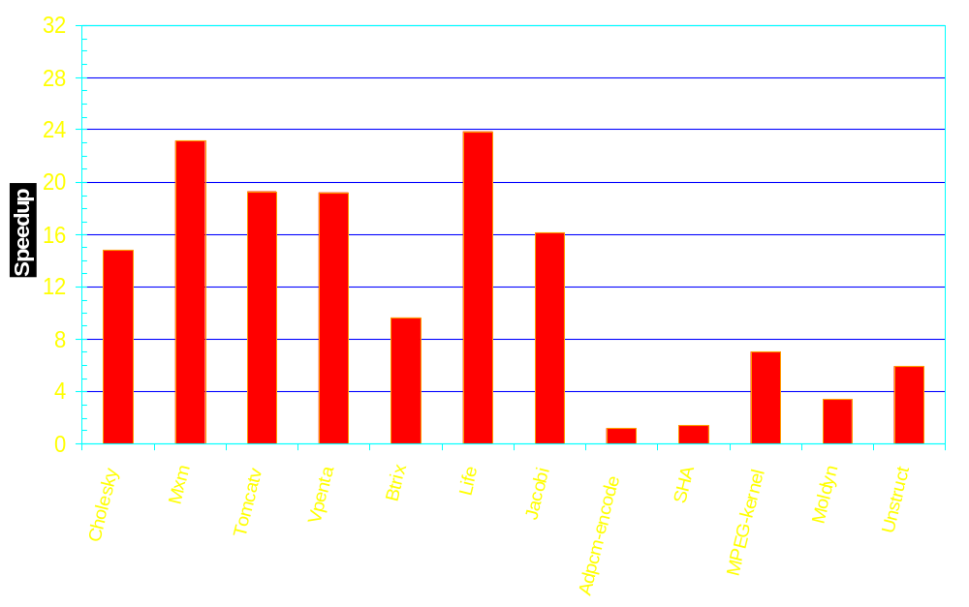
Raw Performance
Dense Matrix
Multimedia
Irregular
32 tile Raw

Slide 47
Success Criteria
integrated
multicore
unicore
Effective
  If ILP exists → same
Stable
  Localized optimization → similar
General
  Applies to same type of applications
Scalable
  Local analysis → similar
Simple
  Deeper analysis and more transformations

Slide 48
Outline
Introduction
Overview of Multicores
Success Criteria for a Compiler
Data Level Parallelism
Instruction Level Parallelism
Language Exposed Parallelism
Conclusion

Slide 49


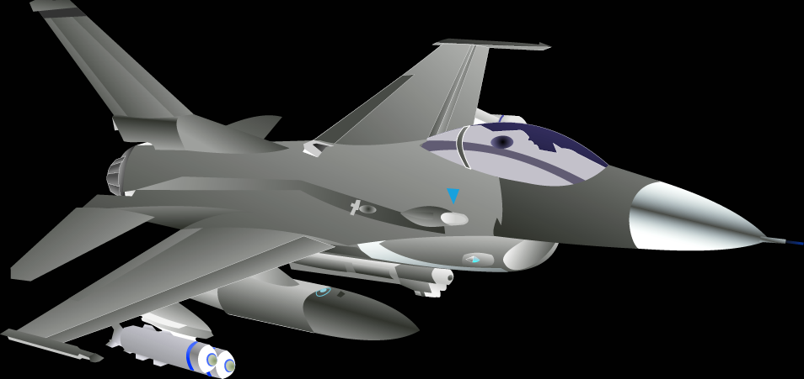

Languages are out-of-touch with Architecture
C
von-Neumann
machine
Modern
architecture
Two choices:
  Develop cool architecture with
  complicated, ad-hoc language
  Bend over backwards to support
  old languages like C/C++

Slide 50
Supporting von Neumann Languages
Why C (FORTRAN, C++ etc.) became very successful?
  Abstracted out the differences of von Neumann machines
    Register set structure
    Functional units and capabilities
    Pipeline depth/width
    Memory/cache organization
  Directly expose the common properties
    Single memory image
    Single control-flow
    A clear notion of time
  Can have a very efficient mapping to a von Neumann machine
  “C is the portable machine language for von Numann machines”
Today von Neumann languages are a curse
  We have squeezed out all the performance out of C
  We can build more powerful machines
  But, cannot map C into next generation machines
  Need better languages with more information for optimization

Slide 51
New Languages for Cool Architectures
Processor specific languages
  Not portable
Increase the burden on programmers
  Many more tasks for the programmer (parallelism
  annotations, memory alias annotations)
  But, no software engineering benefits
Assembly hacker mentality
  Worked so hard on putting architectural features
  Don’t want compilers to squander it away
  Proof-of-concept done in assembly
Architects don’t know how to design languages

Slide 52
What Motivates Language Designers
Primary Motivation → Programmer Productivity
  Raising the abstraction layer
  Increasing the expressiveness
  Facilitating design, development, debugging, maintenance of large complex applications
Design Considerations
  Abstraction → Reduce the work programmers have to do
  Malleablility → Reduce the interdependencies
  Safety → Use types to prevent runtime errors
  Portability → Architecture/system independent
No consideration given for the architecture
  For them, performance is a non-issue!

Slide 53
Is There a Win-Win Solution
Languages that increase programmer productivity while making it easier to compile

Slide 54
Example: StreamIt,
A spatially-aware Language
A language for streaming applications
  Provides high-level stream abstraction
    Exposes Pipeline Parallelism
  Improves programmer productivity
Breaks the von Neumann language barrier
  Each filter has its own control-flow
  Each filter has its own address space
  No global time
  Explicit data movement between filters
  Compiler is free to reorganize the computation

Slide 55
Example: Radar Array Front End
Splitter
FIRFilter
FIRFilter
FIRFilter
FIRFilter
FIRFilter
FIRFilter
FIRFilter
FIRFilter
FIRFilter
FIRFilter
FIRFilter
FIRFilter
FIRFilter
FIRFilter
FIRFilter
FIRFilter
FIRFilter
FIRFilter
FIRFilter
FIRFilter
FIRFilter
FIRFilter
FIRFilter
FIRFilter
Joiner
Splitter
Vector Mult
Vector Mult
Vector Mult
Vector Mult
FirFilter
FirFilter
FirFilter
FirFilter
Magnitude
Magnitude
Magnitude
Magnitude
Detector
Detector
Detector
Detector
Joiner

Slide 56
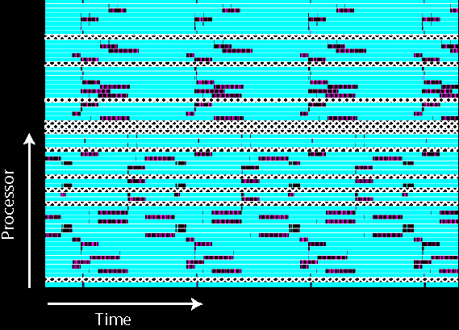
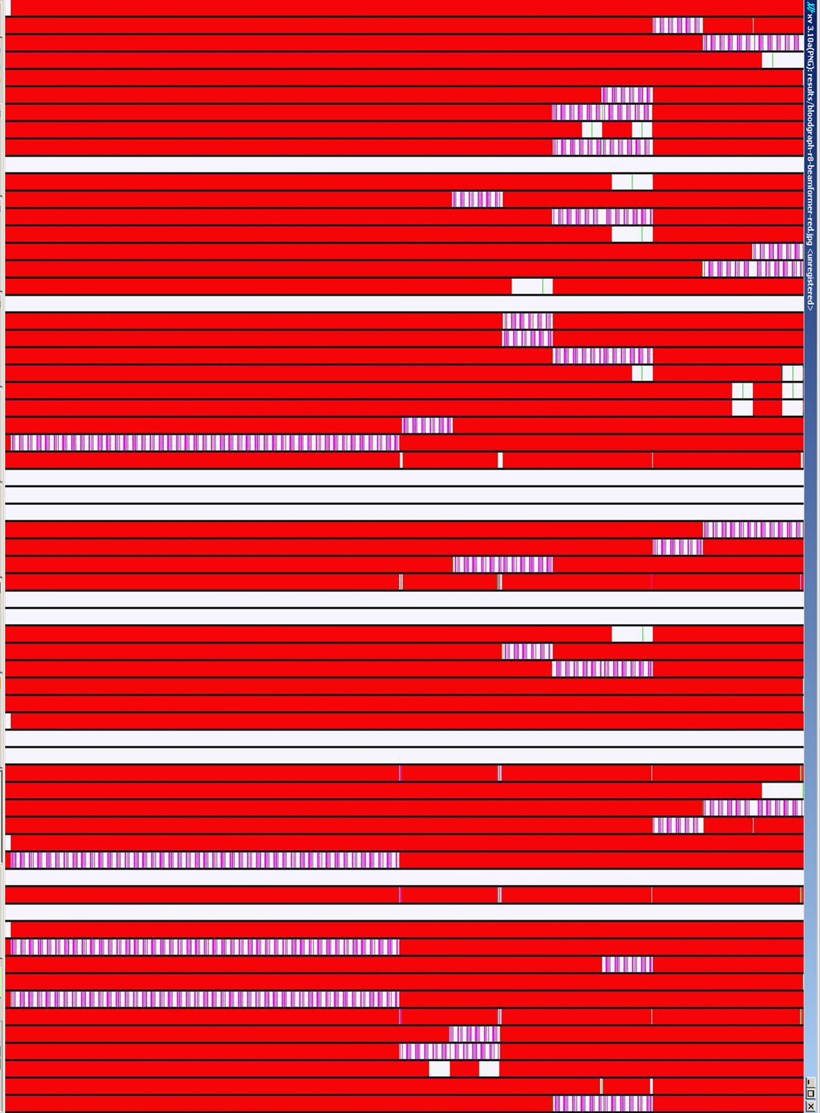
Radar Array Front End on Raw
Blocked on Network
Executing Instructions
Pipeline Stall

Slide 57
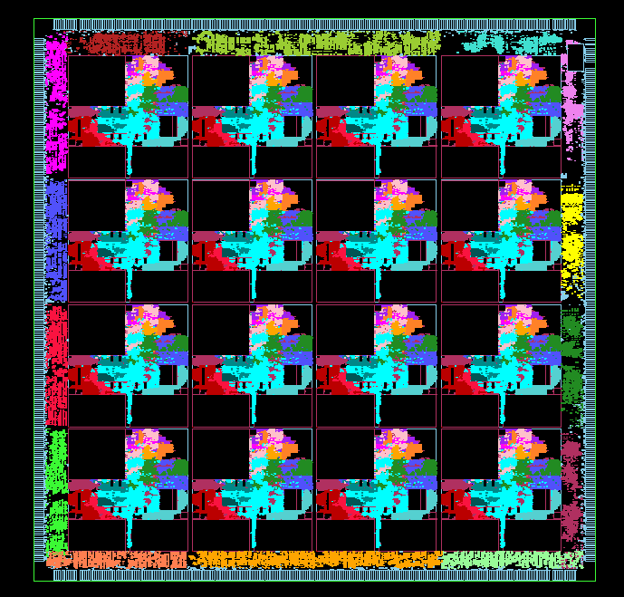
Bridging the Abstraction layers
StreamIt language exposes the data movement
  Graph structure is architecture independent
Each architecture is different in granularity and topology
  Communication is exposed to the compiler
The compiler needs to efficiently bridge the abstraction
  Map the computation and communication pattern of the program
  to the tiles, memory and the communication substrate

Slide 58
Bridging the Abstraction layers
StreamIt language exposes the data movement
  Graph structure is architecture independent
Each architecture is different in granularity and topology
  Communication is exposed to the compiler
The compiler needs to efficiently bridge the abstraction
  Map the computation and communication pattern of the program
  to the tiles, memory and the communication substrate
The StreamIt Compiler
  Partitioning
  Placement
  Scheduling
  Code generation

Slide 59
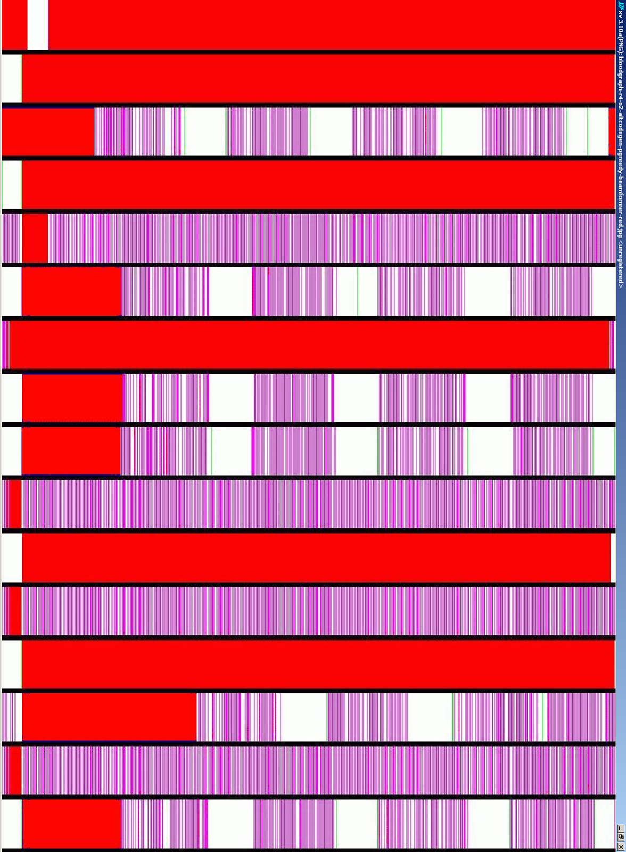
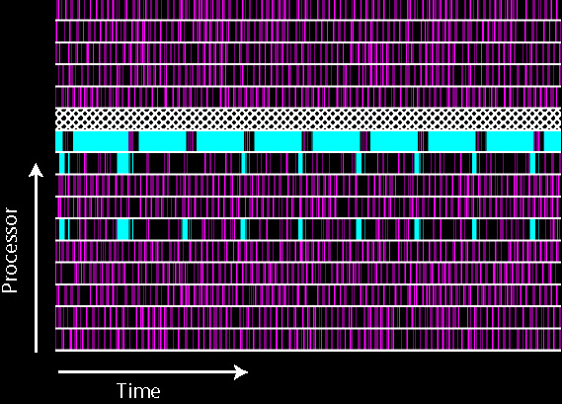
Optimized Performance for Radar Array Front End on Raw
Blocked on Network
Executing Instructions
Pipeline Stall

Slide 60
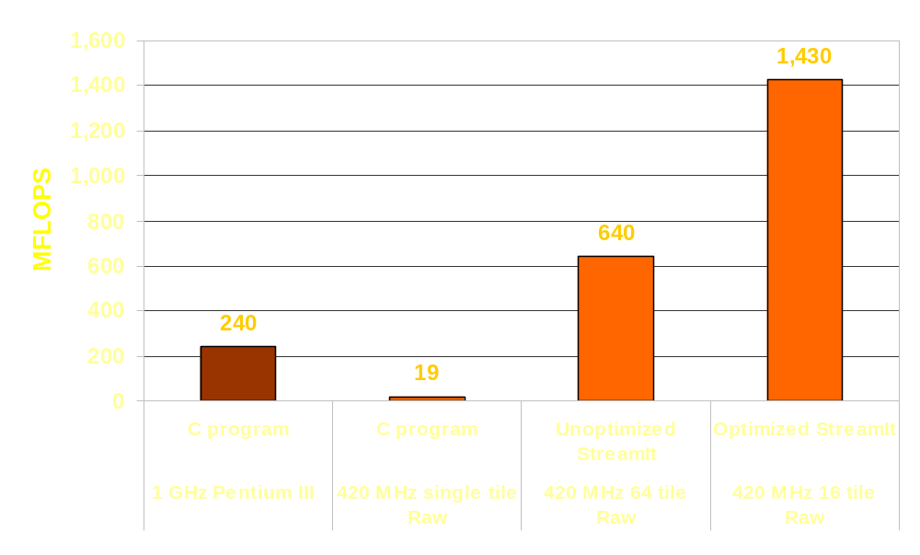
Performance

Slide 61
Success Criteria
Von
Neumann
Languages
Compiler for:
Stream
Language
Effective
  Information available for more optimizations
Stable
  Much more analyzable
General
  Domain-Specific
Scalable
  No global data structures
Simple
  Heroic analysis vs. more transformations

Slide 62
Outline
Introduction
Overview of Multicores
Success Criteria for a Compiler
Data Level Parallelism
Instruction Level Parallelism
Language Exposed Parallelism
Conclusion

Slide 63
Overview of Success Criteria
Data Level
Parallelism
Instruction Level
Parallelism
Language Exposed
Parallelism on Multicore
multi
processor
basic
multicore
integrated
multicore
Von
Neumann
Languages
unicore
Stream
Language
Effective
Stable
General
Scalable
Simple

Slide 64
Can Compilers take on
Multicores?
Success Criteria is Somewhat Mixed
But….
  Don’t need to compete with unicores
  Multicores will be available regardless
New Opportunities
  Architectural advances in integrated multicores
  Domain specific languages
  Possible compiler support for using multicores for other than parallelism
    Security Enforcement
    Program Introspection
    ISA extensions
http://cag.csail.mit.edu/commit
http://www.determina.com

