Slide 1

Cache Aware Optimization of Stream Programs
Janis Sermulins, William Thies, Rodric Rabbah and
Saman Amarasinghe
LCTES
Chicago, June 2005
Notes:
Move main text box up in master slide

Slide 2
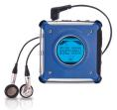









Streaming Computing Is Everywhere!
Prevalent computing domain with applications in embedded systems
  As well as desktops and high-end servers
Notes:
Emphasize embedded systems (Cell phones, handhelds, DSPs)
But also extends to desktop and HPS
Performance and power is a major concern in embedded systems
Important to make execution as efficient as possible: optimizations are key
In streaming codes:
Locality: computation and data locality
Easy to extract and exploit both parallelism and locality
Can have a major impact on memory system

Slide 3
Properties of Stream Programs
AtoD
FMDemod
Regular and repeating computation
Independent actors
with explicit communication
Data items have short lifetimes
Duplicate
LPF₁
LPF₂
LPF₃
HPF₁
HPF₂
HPF₃
RoundRobin
Adder
Speaker
Notes:
Emphasize embedded systems (Cell phones, handhelds, DSPs)
But also extends to desktop and HPS
Performance and power is a major concern in embedded systems
Important to make execution as efficient as possible: optimizations are key
In streaming codes:
Locality: computation and data locality
Easy to extract and exploit both parallelism and locality
Can have a major impact on memory system

Slide 4
Application Characteristics:
Implications on Caching
 | Scientific | Streaming
Control | Inner loops | Single outer loop
Data | Persistent array processing | Limited lifetime producer-consumer
Working set | Small | Whole-program
Implications | Natural fit for cache hierarchy | Demands novel mapping

Slide 5
Application Characteristics:
Implications on Compiler
 | Scientific | Streaming
Parallelism | Fine-grained | Coarse-grained
Data access | Global | Local
Communication | Implicit random access | Explicit producer-consumer
Implications | Limited program transformations | Potential for global reordering

Slide 6
Motivating Example
Baseline
Full Scaling
A
for i = 1 to N
A();
B();
C();
end
for i = 1 to N
A();
for i = 1 to N
B();
for i = 1 to N
C();
for i = 1 to N
A();
B();
end
for i = 1 to N
C();
B
C
cache
size
A
+
B
B
A
A
Working
Set Size
B
B
A
A
+
+
A
C
C
C
B
B
B
C
C
C
B
B
inst
data
inst
data
inst
data
Notes:
Walk through the example: stream program with three kernels A, B, and C, with the data flowing between them A->B, B->C
Straight forward execution: loop, calling A then B then C; emphasize working set requirements for instructions
Alternatively, can run all executions of A, all of B, then all of C: emphasize better icache locality, but data requirements grow because buffering more data
Should refer to baseline and scaling as a “schedule” of executions: is it possible to automatically find a schedule that gets the best of both worlds
A cache-aware schedule: boost instruction locality but don’t over burden the dcache (by keeping data working set small enough): goal of this paper, co-optimize
- recognize that we can combine A and B
Introduce Fusion

Slide 7
Motivating Example
Baseline
Full Scaling
A
for i = 1 to N
A();
for i = 1 to N
B();
for i = 1 to N
C();
for i = 1 to N
A();
B();
end
for i = 1 to N
C();
for i = 1 to N
A();
B();
C();
end
64
B
C
64
cache
size
A
+
B
B
A
A
B
A
B
Working
Set Size
B
A
+
+
A
C
C
C
B
B
B
C
C
C
C
B
B
inst
data
inst
data
inst
data
Notes:
Walk through the example: stream program with three kernels A, B, and C, with the data flowing between them A->B, B->C
Straight forward execution: loop, calling A then B then C; emphasize working set requirements for instructions
Alternatively, can run all executions of A, all of B, then all of C: emphasize better icache locality, but data requirements grow because buffering more data
Should refer to baseline and scaling as a “schedule” of executions: is it possible to automatically find a schedule that gets the best of both worlds
A cache-aware schedule: boost instruction locality but don’t over burden the dcache (by keeping data working set small enough): goal of this paper, co-optimize
- recognize that we can combine A and B
Introduce Fusion

Slide 8
Motivating Example
Baseline
Full Scaling
Cache Opt
A
for i = 1 to N
A();
for i = 1 to N
B();
for i = 1 to N
C();
for i = 1 to N
A();
B();
end
for i = 1 to N
C();
for i = 1 to N/64
end
for i = 1 to N
A();
B();
C();
end
64
B
C
64
cache
size
A
+
B
A
A
B
A
B
Working
Set Size
B
A
+
+
A
C
C
B
B
B
C
C
C
C
B
B
inst
data
inst
data
inst
data
Notes:
Walk through the example: stream program with three kernels A, B, and C, with the data flowing between them A->B, B->C
Straight forward execution: loop, calling A then B then C; emphasize working set requirements for instructions
Alternatively, can run all executions of A, all of B, then all of C: emphasize better icache locality, but data requirements grow because buffering more data
Should refer to baseline and scaling as a “schedule” of executions: is it possible to automatically find a schedule that gets the best of both worlds
A cache-aware schedule: boost instruction locality but don’t over burden the dcache (by keeping data working set small enough): goal of this paper, co-optimize
- recognize that we can combine A and B
Introduce Fusion

Slide 9
Outline
StreamIt
Cache Aware Fusion
Cache Aware Scaling
Buffer Management
Related Work and Conclusion
Notes:
ANIMATE THIS SLIDE showing CAS, CAF, and BUFFER, one at a time, followed by StreamIt, then last bullet???
I’m going to tell you about cache aware scheduling of streaming programs, focusing on three things:
Scaling: to improve instruction locality while cognizant of the data working set
Scaling is a global transformation (how we choose loop bound: don’t overflow dcache)
For a local transformation, I’m going to describe CA Fusion: how we can combine kernels to expose more optimization opportunities between kernels (how we choose contents of the loop: don’t overflow icache)
Object is to create coarser grained kernels that are scaled up, leading to better cache utilizations
But in addition, enabling buffer management optimizations for benchmarks that perform sliding window computations
All of this work is in the context of streamit: a new language, and so I’ll give an overview of that first
Finally, I’ll wrap up the talk with a comparison to related work and highlight some of the main conclusions to take away form this talk

Slide 10
Model of Computation
Synchronous Dataflow [Lee 92]
  Graph of autonomous filters
  Communicate via FIFO channels
  Static I/O rates
Compiler decides on an order
of execution (schedule)
  Many legal schedules
  Schedule affects locality
  Lots of previous work on
  minimizing buffer
  requirements between
  filters
A/D
Band Pass
Duplicate
Detect
Detect
Detect
Detect
LED
LED
LED
LED
Notes:
Highlight “filters”
Replace with filterbank
Every language has an underlying model of computation
Streamit adopts SDF
Programs as graph, nodes: filters i.e. kernels, which represent autonomous/standalone computation kernels; edges represent data flow between kernels
Compiler orchestrate execution of kernels: this is the schedule
As the example earlier showed, example can affect locality: how often does a kernel get loaded/reloaded into cache
A lot of previous emphasis on minimizing data requirements between filters but as we will show, this in the presence of caches, this isn’t a good strategy as we will show

Slide 11
Example StreamIt Filter
0
1
2
3
4
5
6
7
8
9
10
11
input
FIR
0
1
output
float→float filter FIR (int N) {
work push 1 pop 1 peek N {
float result = 0;
for (int i = 0; i < N; i++) {
result += weights[i] ∗ peek(i);
}
push(result);
pop();
}
}
Notes:
Talk through filter example: what computation looks like in StreamIt
Highlight peek/pop/push rates, and work function
Parameterizable: takes argument N
Emphasize the code!

Slide 12
StreamIt Language Overview
StreamIt is a novel language for streaming
  Exposes parallelism and
  communication
  Architecture independent
  Modular and composable
    Simple structures composed to creates complex graphs
  Malleable
    Change program behavior with small modifications
filter
pipeline
may be any StreamIt language construct
splitjoin
parallel computation
splitter
joiner
feedback loop
joiner
splitter
Notes:
The streamit language is designed with productivity in mind
- natural for the program to represent computation
- expose what is traditionally hard for the compiler to discover: namely, parallelism and communication
The language is also designed to be modular/composable: important to software engineering, and also for correctness checking
Show stream constructs:
- filter: basic unit of computation
- pipeline: sequential/serial execution of streams that communication data
> a stream can be a filter or any of the language stream constructs: modularity/reusability
- sj: explicit parallelism, scatter data with splitter, gather data with joiner
- also a feedback loop allows for cycles in the graph
The stream constructs are parameterizable: length of pipeline, width of sj
This gives rise to malleabililty: small change in code leads to big changes in program graph
Example on the next slide

Slide 13
Freq Band Detector in StreamIt
void->void pipeline FrequencyBand {
float sFreq = 4000;
float cFreq = 500/(sFreq*2*pi);
float wFreq = 100/(sFreq*2*pi);
add D2ASource(sFreq);
add BandPassFilter(100, cFreq-wFreq, cFreq+wFreq);
add splitjoin {
split duplicate;
for (int i=0; i<4; i++) {
add pipeline {
add Detect (i/4);
add LED (i);
}
}
join roundrobin(0);
}
}
A/D
Band pass
Duplicate
Detect
Detect
Detect
Detect
LED
LED
LED
LED
Notes:
Two things to take away from this: 1) natural correspondence between text and graph, unlike many graph descriptions (e.g., dot). 2) programmers can use this as scripting language to construct graph. This allows it to be malleable (change one parameter to increase width of splitjion). Also, compile can optimize because it is a two-stage compilation process. It can SPATIALLY UNROLL the graph construction to expose all the parallelism and communication at compile time.
Change this to filterbank. Fix spacing.

Slide 14
Outline
StreamIt
Cache Aware Fusion
Cache Aware Scaling
Buffer Management
Related Work and Conclusion

Slide 15
Fusion
Fusion combines adjacent filters into a single filter
work pop 1 push 2 {
int a = pop();
push( a );
push( a );
}
work pop 1 push 2 {
int t1, t2;
int a = pop();
t1 = a;
t2 = a;
int b = t1;
push(b * 2);
int c = t2;
push(c * 2);
}
× 1
work pop 1 push 1 {
int b = pop();
push(b * 2);
}
× 2
Reduces method call overhead
Improves producer-consumer locality
Allows optimizations across filter boundaries
  Register allocation of intermediate values
  More flexible instruction scheduling
Notes:
Add spacing

Slide 16
Evaluation Methodology
StreamIt compiler generates C code
  Baseline StreamIt optimizations
    Unrolling, constant propagation
  Compile C code with gcc-v3.4 with -O3 optimizations
StrongARM 1110 (XScale) embedded processor
  370MHz, 16Kb I-Cache, 8Kb D-Cache
  No L2 Cache (memory 100× slower than cache)
  Median user time
Suite of 11 StreamIt Benchmarks
Evaluate two fusion strategies:
  Full Fusion
  Cache Aware Fusion
Notes:
- Remind no L2 cache

Slide 17
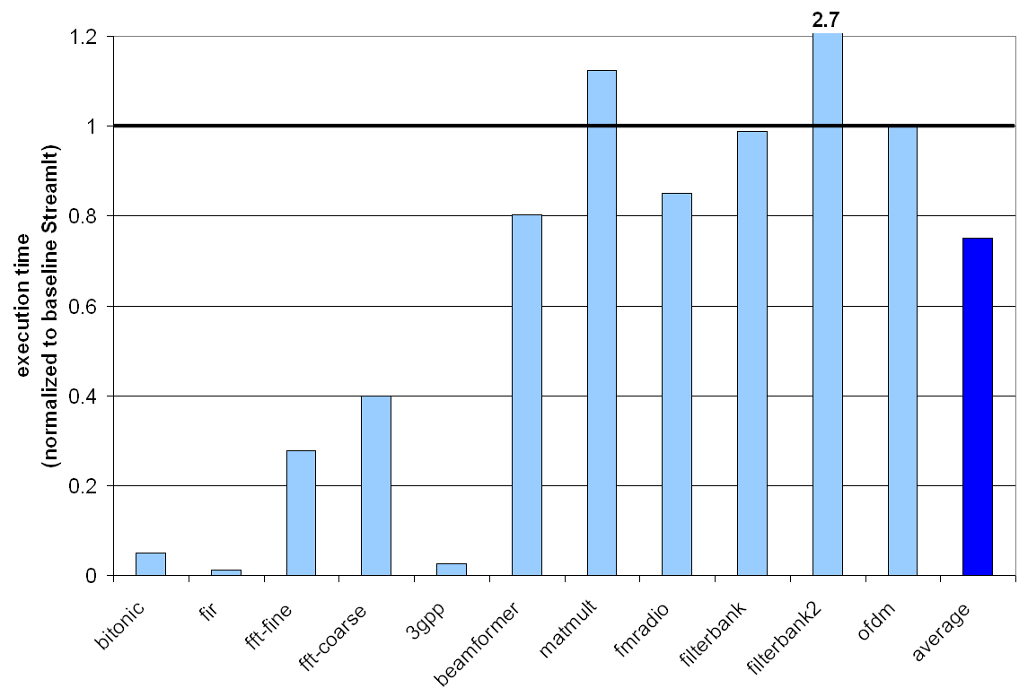
Results for Full Fusion
(StrongARM 1110)
Hazard: The instruction or data working set of the fused program may exceed cache size!
Notes:
Lower is better!
Explain baseline and axes

Slide 18
Cache Aware Fusion (CAF)
Fuse filters so long as:
  Fused instruction working set fits the I-cache
  Fused data working set fits the D-cache
Leave a fraction of D-cache for input and output to facilitate cache aware scaling
Use a hierarchical fusion heuristic

Slide 19
Hierarchical Fusion Heuristic
Does splitjoin fit in cache?
Yes!
splitter
Identify highest bandwidth connection, fuse greedily
Does pipeline segment fit in cache?
No!
joiner
Does splitjoin fit in cache?
No!
splitter
joiner
Notes:
When stop fusing?
Why highest bandwidth?

Slide 20
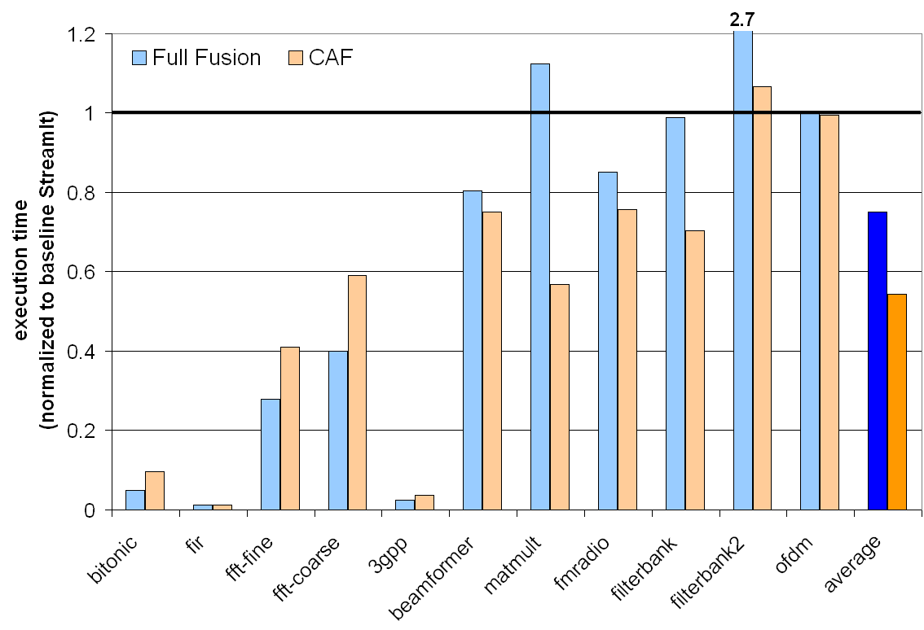
Full Fusion vs. CAF
Notes:
Point out that CAF avoids the fusion hazard
Point out that scaling is next: coarser actors -> better locality enhancing opportunity

Slide 21
Outline
StreamIt
Cache Aware Fusion
Cache Aware Scaling
Buffer Management
Related Work and Conclusion

Slide 22
Improving Instruction Locality
cache miss
cache hit
Baseline
Full Scaling
A
for i = 1 to N
A();
B();
C();
end
for i = 1 to N
A();
for i = 1 to N
B();
for i = 1 to N
C();
B
C
cache
size
A
miss rate = 1
miss rate = 1 / N
+
Working
Set Size
B
+
A
C
C
B
inst
inst
Notes:
The advantages of scaling as I showed you earlier: smaller inst working sets and better instruction locality: run all of A, then all of B, then all of C
But the disadvantage is that we have to buffer more data between producers and consumers: A->B and B->C

Slide 23
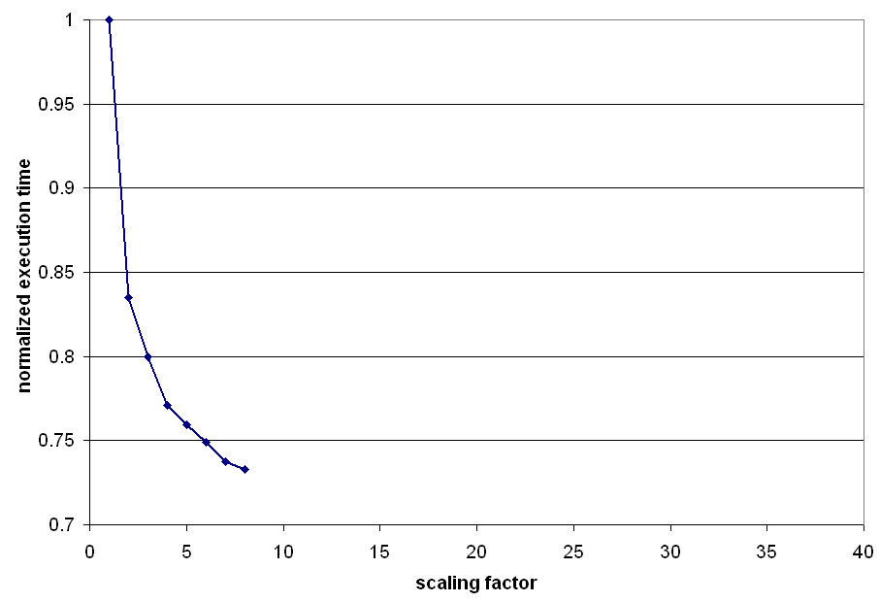
Impact of Scaling
Fast Fourier Transform
Notes:
And this is confirmed by our empirical results: in this case, showing how a FFT implemented in streamit performs on a P3 as we scale the execution of filters
(scaling factor on x axis, wall clock time on y axis)

Slide 24
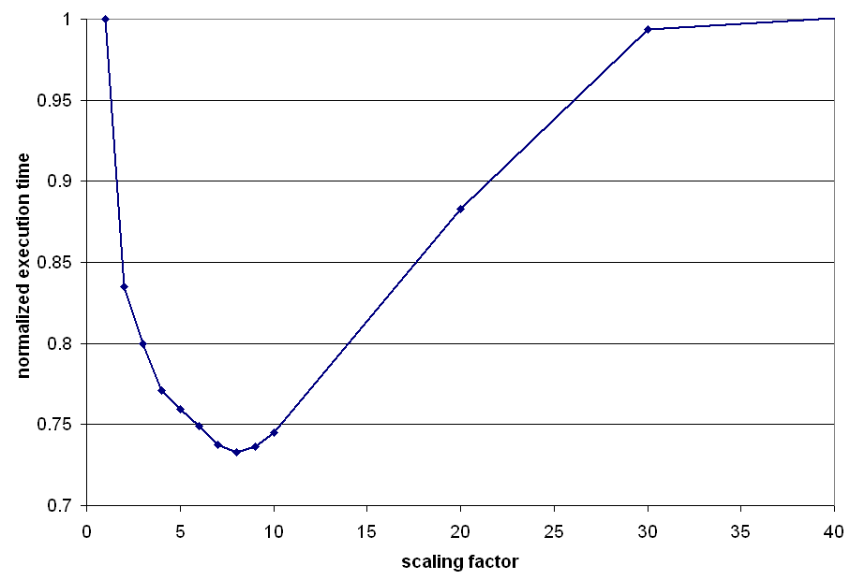
Impact of Scaling
Fast Fourier Transform
Notes:
Note that the performance is better but up to a point: this is where the data cache becomes the bottleneck, and at that point, performance gets worse
The flattening if someone asks is probably because of the L2; just a hunch
So the scaling factor as we see can have a major impact on performance, and so it’s natural that we want to find the sweet spot: how close can we get to the knee of this curve?

Slide 25
How Much To Scale?
cache
size
state
I/O
A
B
Data
Working
Set Size
C
A
B
C
A
B
C
A
B
A
C
B
C
no
scaling
scale
by 3
scale
by 4
scale
by 5
Scale as much as possible
Ensure at least 90% of filters have data working sets that fit into cache
Our Scaling
Heuristic:
Notes:
Change color of letters
Behind the scenes: data working set growing beyond the cache
Remind what is the state?
Walk through example
We developed a heuristic to find the best point along the curve

Slide 26
How Much To Scale?
cache
size
state
I/O
A
B
Data
Working
Set Size
Scale as much as possible
Ensure at least 90% of filters have data working sets that fit into cache
Our Scaling
Heuristic:

Slide 27
Impact of Scaling
Heuristic choice is
4% from optimal
Fast Fourier Transform
Notes:
Show what is the performance difference
Point out that the y-axis goes from 0.7-1
Err on the side of being conservative: scaling shouldn’t hurt performance
How far from optimal on average?

Slide 28
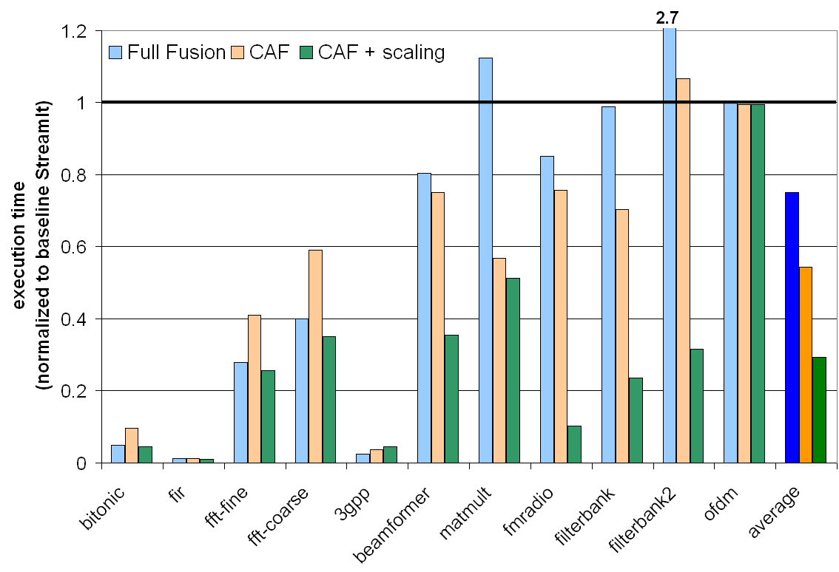
Scaling Results

Slide 29
Outline
StreamIt
Cache Aware Fusion
Cache Aware Scaling
Buffer Management
Related Work and Conclusion

Slide 30
Sliding Window Computation
0
1
2
3
4
5
6
7
8
9
10
11
input
FIR
0
1
2
3
output
float→float filter FIR (int N) {
work push 1 pop 1 peek N {
float result = 0;
for (int i = 0; i < N; i++) {
result += weights[i] ∗ peek(i);
}
push(result);
pop();
}
}

Slide 31
Buffer Management
Circular Buffer:
8
peek(i) → A[(head + i) mod 8]
0
9
1
2
3
4
5
6
7
N
N

Slide 32
Buffer Management
Circular Buffer:
0
9
peek(i) → A[(head + i) mod 8]
8
1
2
3
4
5
6
7
N
N
Copy-Shift:
0
1
2
3
4
5
8
9
6
7
N

Slide 33
Buffer Management
Circular Buffer:
0
9
peek(i) → A[(head + i) mod 8]
8
1
2
3
4
5
6
7
N
N
Copy-Shift:
2
3
4
5
6
7
8
9
6
7
N
Copy-Shift + Scaling:
0
1
2
3
4
5
6
7
8
9
10
11
12
13
14
15
16
N

Slide 34
Buffer Management
Circular Buffer:
0
9
peek(i) → A[(head + i) mod 8]
8
1
2
3
4
5
6
7
N
N
Copy-Shift:
2
3
4
5
6
7
8
9
6
7
N
Copy-Shift + Scaling:
17
18
19
20
21
11
22
12
23
13
24
14
25
15
26
16
0
1
2
3
4
5
6
7
8
9
10
27
N

Slide 35
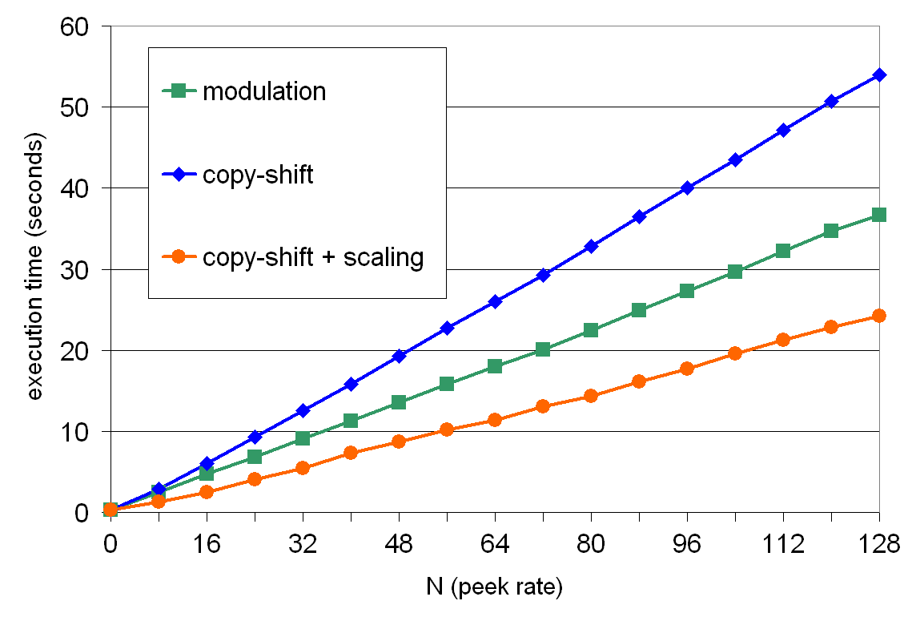
Performance vs. Peek Rate
(StrongARM 1110)
FIR
Notes:
Explain the axes (x axis)

Slide 36
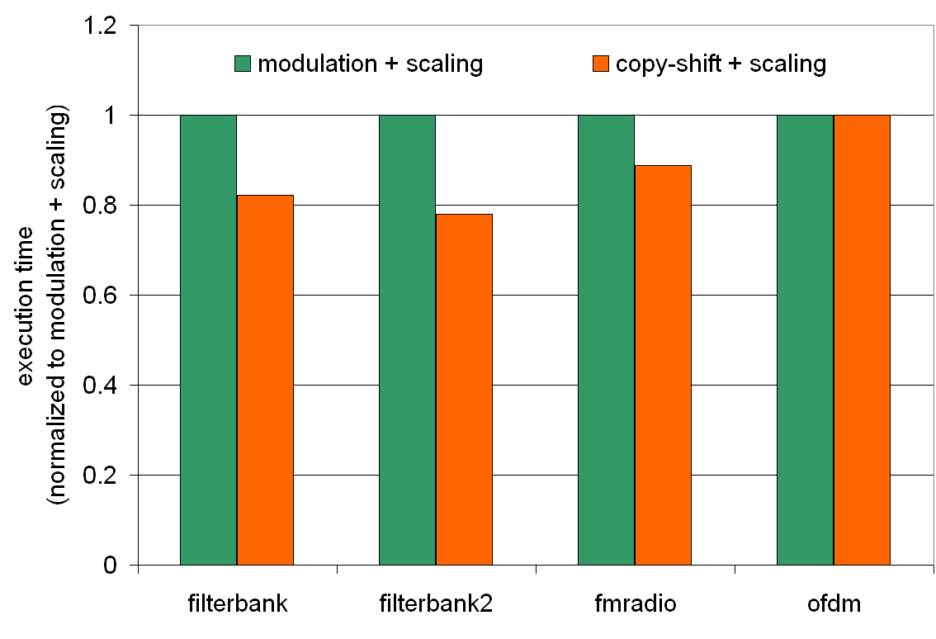
Evaluation for Benchmarks
(StrongARM 1110)
caf + scaling + modulation
caf + scaling + copy-shift
Notes:
Fix y axis

Slide 37
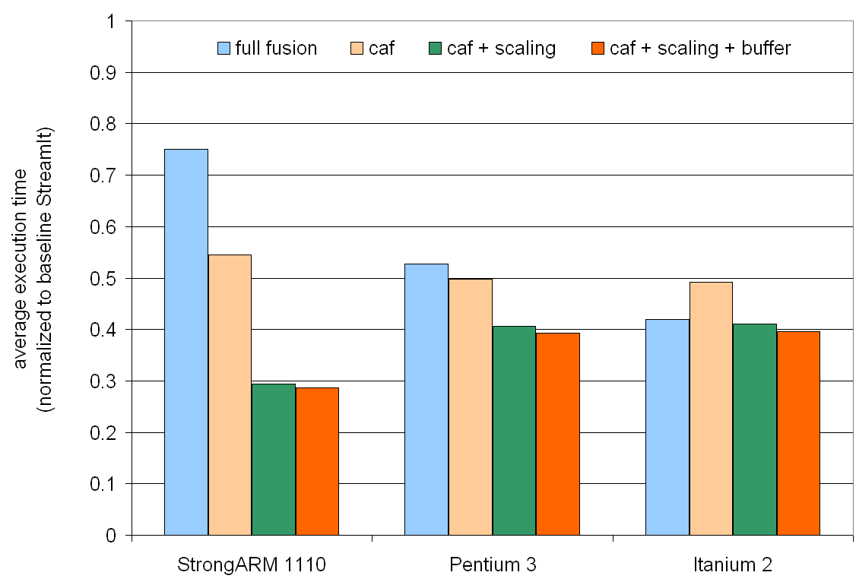
Results Summary
Large L2 Cache
Large L2 Cache
Large Reg. File
VLIW
Notes:
Itanium: Instruction scheduling

Slide 38
Outline
StreamIt
Cache Aware Fusion
Cache Aware Scaling
Buffer Management
Related Work and Conclusion

Slide 39
Related work
Minimizing buffer requirements
  S.S. Bhattacharyya, P. Murthy, and E. Lee
    Software Synthesis from Dataflow Graphs (1996)
    AGPAN and RPMC: Complimentary Heuristics for Translating DSP Block Diagrams into Efficient Software Implementations (1997)
    Synthesis of Embedded software from Synchronous Dataflow Specifications (1999)
  P.K.Murthy, S.S. Bhattacharyya
    A Buffer Merging Technique for Reducing Memory Requirements of Synchronous Dataflow Specifications (1999)
    Buffer Merging – A Powerful Technique for Reducing Memory Requirements of Synchronous Dataflow Specifications (2000)
  R. Govindarajan, G. Gao, and P. Desai
    Minimizing Memory Requirements in Rate-Optimal Schedules (1994)
Fusion
  T. A. Proebsting and S. A. Watterson, Filter Fusion (1996)
Cache optimizations
  S. Kohli, Cache Aware Scheduling of Synchronous Dataflow Programs (2004)
Notes:
Good outline, but need more detail: add sub-bullets showing authors, years, possibly conferences
Point out differences to our work

Slide 40
Conclusions
Streaming paradigm exposes parallelism and allows massive reordering to improve locality
Must consider both data and instruction locality
  Cache Aware Fusion enables local optimizations by judiciously increasing the instruction working set
  Cache Aware Scaling improves instruction locality by judiciously increasing the buffer requirements
Simple optimizations have high impact
  Cache optimizations yield significant speedup over both baseline and full fusion on an embedded platform
Notes:
Emphasize: cache aware increase in working set sizes

