Slide 1


A Reconfigurable Architecture for
Load-Balanced Rendering
Jiawen Chen
Michael I. Gordon
William Thies
Matthias Zwicker
Kari Pulli
Frédo Durand
Graphics Hardware July 31, 2005, Los Angeles, CA
Notes:
Good morning
My name is Jiawen Chen, and I’m here to talk about A Reconfigurable Architecture for Load-Balanced Rendering
This is joint work between the graphics and architecture groups at MIT.

Slide 2
The Load Balancing Problem
data parallel
GPUs: fixed resource allocation
  Fixed number of
  functional units per task
  Horizontal load balancing achieved via data parallelism
  Vertical load balancing
  impossible for many applications
Our goal: flexible allocation
  Both vertical and horizontal
  On a per-rendering pass basis
V
V
V
V
R
R
R
R
task
parallel
T
T
T
T
F
F
F
F
D
D
D
D
Parallelism in multiple graphics pipelines
Notes:
We’re motivated by the fact that modern GPUs have a fixed resource allocation.
By resource allocation, we mean how many functional units are devoted to performing certain functions
But because the allocation of resources are fixed at design time, there will always be scenarios where the load isn’t balanced across the functional units
To achieve better load balancing, we want to exploit data *as well as* task parallelism
To exploit data parallelism, the input should be distributed evenly among multiple pipelines
In what’s called *horizontal* load balancing
To achieve vertical load balancing, all units *within* a pipeline need to be utilized efficiently
Our goal is to balance the load in both directions
By using a flexible resource allocation
And we want to do this on a per rendering-pass basis

Slide 3
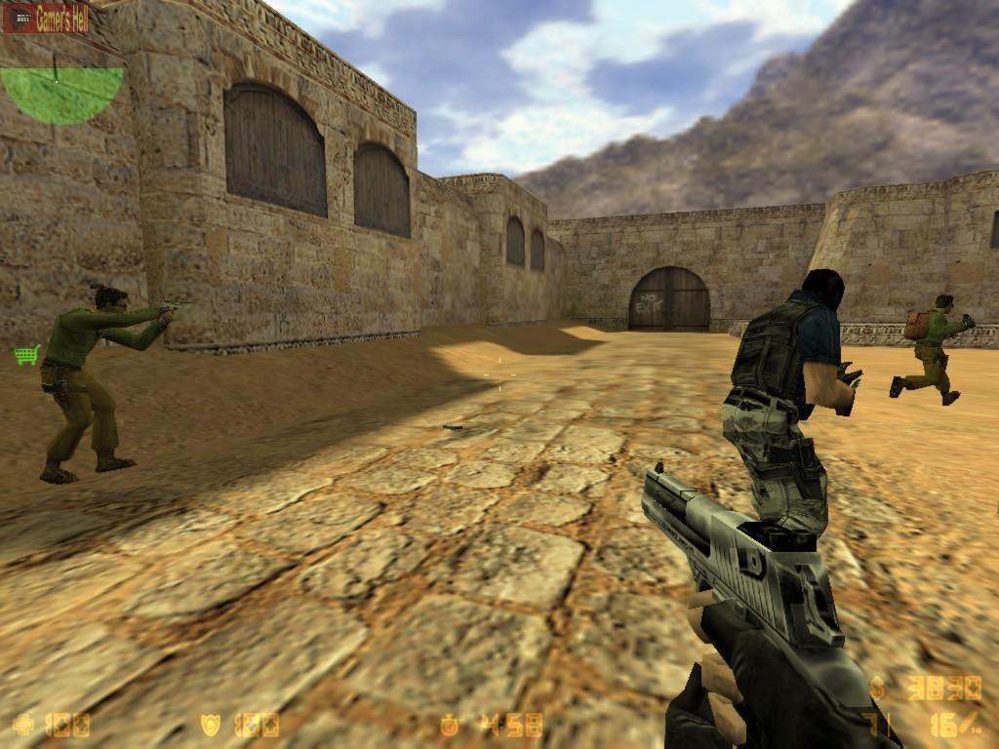
Application-specific load balancing
Input
V
Vertex
Vertex
Sync
Triangle Setup
P
Pixel
Pixel
Screenshot from Counterstrike
Simplified graphics pipeline
Notes:
In this scene, you see a few detailed characters on a relatively sparse background.
The characters are made up of many vertices and small triangles, and put the load on the vertex processor. They occupy relatively few pixels on screen.
Whereas the background and skybox use just a few triangles but occupy a large portion of the screen, and put load on the rasterizer and pixel processor
What if we had control over the graphics pipeline’s allocation of resources?
How would you load balance for this scene?
Render the scene in two passes
In the first passes, draw the characters, devote functional units to vertex processing
In the second passes, draw the background and skybox, devoting resources to pixel processing.

Slide 4
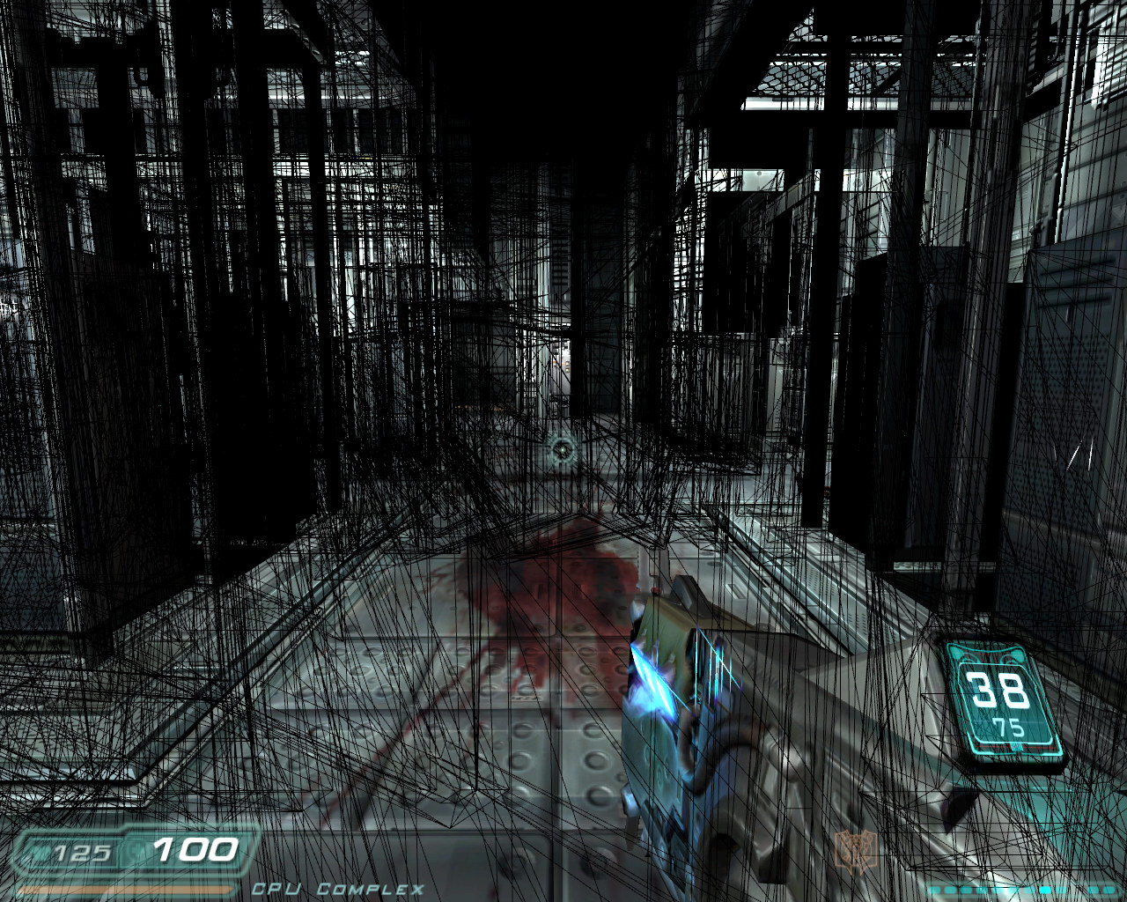
Application-specific load balancing
Input
V
Vertex
Vertex
Sync
Triangle Setup
Rasterizer
R
Rasterizer
Screenshot from Doom 3
Rest of
Pixel Pipeline
Rest of
Pixel Pipeline
Simplified graphics pipeline
Notes:
And here’s a typical scene from Doom 3. The shadow volume geometry is shown in wireframe.
The GPU spends a lot of time rasterizing the shadow volumes, during which the rest of the pipeline is idle.
If you could reconfigure the pipeline
When drawing the shadow volumes, use only say, one unit for vertex processing
Leave the rest for rasterization and stencil ops.
Remove the programmable pixel pipeline entirely
So how can this be done?

Slide 5
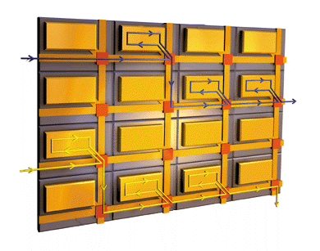
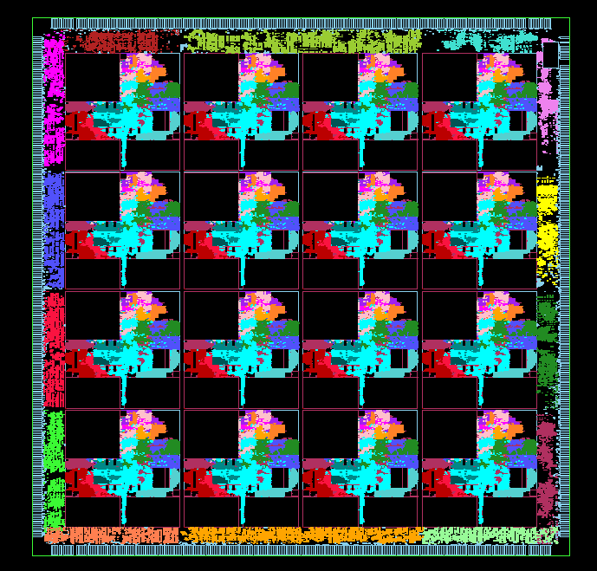
Our Approach: Hardware
Use a general-purpose multi-core processor
  With a programmable communications network
  Map pipeline stages to one or more cores
MIT Raw Processor
  16 general purpose cores
  Low-latency programmable network
Diagram of a 4x4 Raw processor
Die Photo of 16-tile Raw chip
Notes:
In our approach, we use a general-purpose multi-core processor
Since each core is general-purpose, you can assign it any task
And a key requirement is that the processor has to have a programmable communications network
This allows us to design configurations tailored for specific scenarios
And be able to switch between them at runtime
So for example, you would use one configuration for shadow volumes
And switch to another when doing complex lighting effects
We used the MIT Raw Processor
Which has 16 general purpose cores
And a low-latency programmable network

Slide 6
Our Approach: Software
Specify graphics pipeline in software as a stream program
  Easily reconfigurable
Static load balancing
  Stream graph specifies resource allocation
  Tailor stream graph to rendering pass
StreamIt programming language
Input
split
Vertex
V
Vertex
join
Triangle Setup
split
P
Pixel
Pixel
Sort-middle graphics pipeline stream graph
Notes:
We specify the entire graphics pipeline as a high level stream graph in software
The programmer has full control and can easily change the graph
The goal is to allow the programmer to do *static* load balancing
What I mean by static is that
It’s the programmer’s responsibility to
manually adjust the resource allocation
And tailor it for the particular rendering pass
We use the StreamIt programming language

Slide 7
Benefits of Programmable Approach
Compile stream program to multi-core processor
Flexible resource allocation
Fully programmable pipeline
  Pipeline specialization
Nontraditional configurations
  Image processing
  GPGPU
Stream graph for graphics pipeline
StreamIt
Layout on 8x8 Raw
Notes:
We use StreamIt to compile the stream program and map it onto the Raw processor
The advantages of using this approach is that
You have a very simple way of allocating resources
And have the ability to reprogram the entire pipeline
Specializing the pipeline for the rendering pass
For example, if texturing is not used, you can just not implement texture coordinate interpolation
And since Raw is general purpose
You don’t have to stick with a traditional graphics pipeline
For example, if you wanted to do a special effects image processing pass, you can easily parallelize the computation onto the Raw tiles
And of course, you can use Raw and StreamIt to do GPGPU type computations

Slide 8
Related Work
Scalable Architectures
  Pomegranate [Eldridge et al., 2000]
Streaming Architectures
  Imagine [Owens et al., 2000]
Unified Shader Architectures
  ATI Xenos
Notes:
There have been many architectures that have addressed load balancing
For example, the Pomegranate architecture by Eldridge et al. in 2000 was an extremely scalable architecture
That achieves excellent horizontal load balance
However, they don’t address the vertical load balancing issue
Our work is similar to other streaming architectures
For example, Owens et al. in 2000 have characterized graphics as a streaming computation
They implemented a graphics pipeline on the Imagine stream processor
We extend their work by looking at load balancing on stream processors
Our work is also similar to a unified shader architecture
Where shading units are time multiplexed between vertex and pixel processing
For example, the upcoming ATI Xenos GPU has 48 shader units, organized in 3 groups of 16
Each group can independently perform vertex or pixel computation
In contrast, our entire pipeline is “now unified”
And we do a space-time multiplexing of our processors

Slide 9
Outline
Background
  Raw Architecture
  StreamIt programming language
Programmer Workflow
  Examples and Results
Future Work
Notes:
So the outline for the rest of the talk is as follows
First I’ll give some background on the Raw Architecture and the StreamIt compiler
I’ll follow up with what the programmer workflow is for our approach
Giving some examples and results along the way
And I’ll conclude with a discussion of some future work

Slide 10
The Raw Processor
A scalable computation fabric
  Mesh of identical tiles
  No global signals
Programmable interconnect
  Integrated into bypass paths
  Register mapped
  Fast neighbor communications
  Essential for flexible resource allocation
Raw tiles
  Compute processor
  Programmable Switch Processor
A 4x4 Raw chip
Computation
Resources
Switch Processor Diagram
Notes:
The Raw processor was designed as a *scalable computation fabric*
It’s designed to fight the wire-delay problem as clock rates got higher and higher
So it features
A mesh of identical tiles
With no global signals
Instead, it has a programmable interconnect where the longest wire is the length of one tile
The interconnect network is register mapped
And directly connected to the bypass paths of the cores so communications with neighbors is only 3 cycles
Again, we use the programmable interconnect to map different tasks in different configurations and switch between them
Each Raw tile consists of a compute processor and a switch processor
The compute processor is a MIPS style RISC processor
The switch processor is also programmable to do the routing

Slide 11
The Raw Processor
Current hardware
  180nm process
  16 tiles at 425 MHz
  6.8 GFLOPS peak
  47.6 GB/s memory bandwidth
Simulation results based on 8x8 configuration
  64 tiles at 425 MHz
  27.2 GFLOPS peak
  108.8 GB/s memory bandwidth (32 ports)
Die photo of 16-tile Raw chip
180nm process, 331 mm²
Notes:
The current version of our hardware
was fabbed using a 180nm process
With 16 tiles running at 425 MHz
And is theoretically capable of 6.8 gigaflops
It has 14 memory ports at the edges of the chip with a peak memory bandwidth of 47.6 GB/s
Our work was done using a cycle-accurate simulator for a 64-tile configuration
So it has a scaled up arithmetic capabilities
And features 32 memory ports at the border with 108.8 GBps of memory bandwidth

Slide 12
StreamIt
High-level stream programming language
  Architecture independent
Structured Stream Model
  Computation organized as filters in a stream graph
  FIFO data channels
  No global notion of time
  No global state
Example stream graph
Notes:
Now I want to talk about the StreamIt programming language
StreamIt is designed as an architecture independent high-level stream programming language
It uses a structured stream programming model where
The computation is organized as a stream graph
The graph consists of units of computations called filters (the orange boxes)
That communicate over FIFO data channels
There’s no global notion of time or state
StreamIt lets you create complex stream graphs hierarchically with some simple primitives

Slide 13
StreamIt Graph Constructs
filter
pipeline
may be any StreamIt language construct
feedback loop
joiner
splitter
splitjoin
parallel computation
splitter
joiner
Graphics pipeline stream graph
Notes:
So this is how you build a stream graph
You take the filter, which is the basic unit of computation
And combine them hierarchically
Currently, we have three constructs
The pipeline is the familiar linear chain, where the output of one stage is the input of another
The feedback loop lets you use the output of a later filter to feed back as input to an earlier stage
And the splitjoin, which is the most important construct
A splitjoin explicity specifies parallelism
The input is scheduled to be delivered onto different branches by some policy such as round robin
And can be joined later
The sort-middle graphics pipeline on the right can be created by a combination of pipelines and splitjoins

Slide 14
Automatic Layout and Scheduling
StreamIt compiler performs layout, scheduling on Raw
  Simulated annealing layout algorithm
  Generates code for compute processors
  Generates routing schedule for switch processors
Input
Vertex Processor
Sync
StreamIt Compiler
Triangle Setup
Rasterizer
Pixel Processor
Frame Buffer
Stream graph
Layout on 8x8 Raw
Notes:
The StreamIt compiler maps the stream graph onto the Raw processor
It features an automatic layout algorithm
Which uses simulated annealing to optimize the layout
Taking into account memory latency and added synchronization
It generates the code for the compute processors
As well as the routing schedule for the switch processors

Slide 15
Outline
Background
  Raw Architecture
  StreamIt programming language
Programmer Workflow
  Examples and Results
Future Work
Notes:
Next I’m going to talk about what the programmer workflow is for our approach
Giving some examples and results along the way

Slide 16
Programmer Workflow
Input
For each rendering pass
  Estimate resource requirements
  Implement pipeline in StreamIt
  Adjust splitjoin widths
  Compile with StreamIt compiler
  Profile application
split
Vertex
V
Vertex
join
Triangle Setup
split
P
Pixel
Pixel
Sort-middle Stream Graph
Notes:
The typical workflow is as follows:
For each rendering pass
You first estimate the resource requirements.
For example, what the ratio of vertex to pixel computation is
And what parts of the pipeline aren’t needed
Say, you’re rendering shadow volumes
You really don’t need any pixel shaders or texture coordinate interpolation
You would implement this pipeline in Streamit
Which should be pretty easy.
You just make minor modifications to existing filters that represent pipeline stages
You can easily adjust the width of splitjoins to specify how many tiles to dedicate to each stage
For instance, if you’re going to be vertex-limited, dedicate more units to vertex processing
Of course, the tradeoff is less processing elsewhere in the pipeline
The compile the resulting stream graph with streamit
You can then run the application and see what the load is like

Slide 17
Switching Between Multiple Configurations
Multi-pass rendering algorithms
  Switch configurations between passes
  Pipeline flush required anyway (e.g. shadow volumes)
Configuration 1
Configuration 2
Notes:
I want to address the issue of switching between multiple pipeline configurations at runtime
The way switching works now is we flush the pipeline, and each Raw tile jumps to the new code
So for multipass algorithms, it doesn’t incur any cost
Since you need to flush the pipeline anyway to ensure the data’s been committed

Slide 18
Experimental Setup
Compare reconfigurable pipeline against fixed resource allocation
Use same inputs on Raw simulator
Compare throughput and utilization
Input
Vertex Processor
Sync
Triangle Setup
Rasterizer
Pixel Processor
Frame Buffer
Fixed Resource Allocation:
6 vertex units, 15 pixel pipelines
Manual layout on Raw
Notes:
In our experiments, we compared reconfigurable pipeline against a fixed allocation
We wanted to see how much of a performance improvement came from our approach
We used a fixed allocation *on Raw* to simulate the fixed allocation of a GPU
We manually laid out this configuration on Raw to ensure the best possible throughput
I want to mention that it’s not realistic to compare Raw against a real GPU
A real GPU has 2 orders of magnitude more computation power
As well as much higher communication bandwidth between pipeline stages

Slide 19
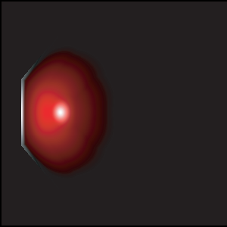
Example: Phong Shading
Per-pixel phong-shaded polyhedron
162 vertices, 1 light
Covers large area of screen
Allocate only 1 vertex unit
Exploit task parallelism
  Devote 2 tiles to pixel shader
  1 for computing the lighting direction and normal
  1 for shading
Pipeline specialization
  Eliminate texture coordinate interpolation, etc
Output, rendered using the Raw simulator
Notes:
So here’s a simple first example
I’m just rendering a simple polyhedron with per-pixel Phong shading
It only has 162 vertices, but covers a large area of the screen
So we really don’t need 6 vertex shaders
Instead we reuse those tiles for pixel processing
Instead of 1 tile for each pixel shader, exploit task parallelism and use 2 tiles for each
Here, I’m using 1 for computing the lighting direction and normal
And another for shading
We also increase throughput by eliminating functions that aren’t used
Since there’s no texturing, we can eliminate all the texture

Slide 20
Phong Shading Stream Graph
Phong Shading Stream Graph
Automatic Layout on Raw
Input
Rasterizer
Vertex Processor
Pixel Processor A
Triangle Setup
Pixel Processor B
Frame Buffer
Notes:
So this is the new pipeline
We’ve devoted most of the chip’s resources toward pixel processing now
Which is in two stages
And here’s the result of streamit’s automatic layout onto raw

Slide 21
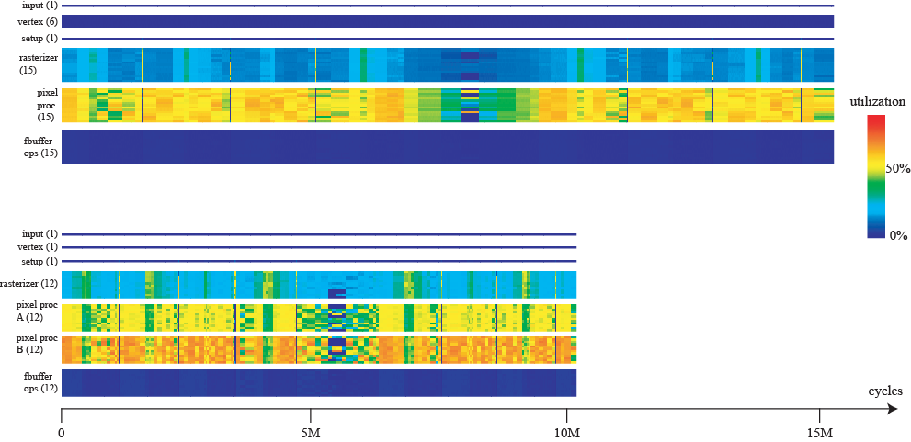
Utilization Plot: Phong Shading
Fixed pipeline
Reconfigurable pipeline
Notes:
This is a utilization plot
The top plot is the fixed pipeline and the bottom is the reconfigurable pipeline
Each line is a processor, grouped in pipeline order
Warmer colors denote better utilization
You can see the flexible finishes more quickly
In about 2/3 the time and 150% better utilization

Slide 22
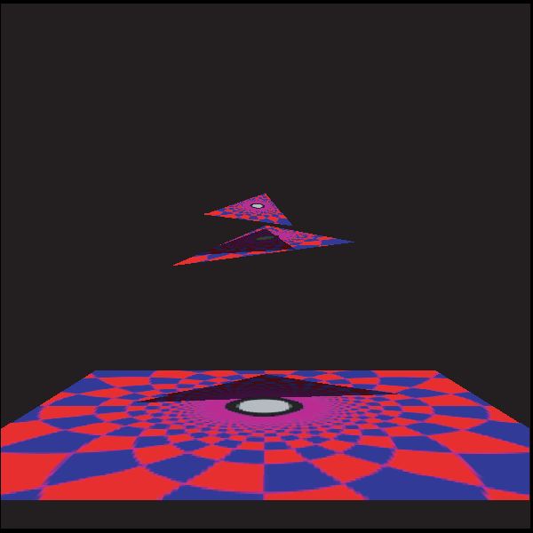
Example: Shadow Volumes
4 textured triangles, 1 point light
Very large shadow volumes cover most of the screen
Rendered in 3 passes
  Initialize depth buffer
  Draw extruded shadow volume geometry with Z-fail algorithm
  Draw textured triangles with stencil testing
Different configuration for each pass
  Adjust ratio of vertex to pixel units
  Eliminate unused operations
Output, rendered using the Raw simulator
Notes:
The second example I want to discuss is shadow volumes
In this scene, we have 4 textured triangles and a single point light
It generates very large shadow volumes which cover most of the screen
The scene is rendered in three passes
In the first pass, we render the scene with no texturing to initialize the depth buffer
In the second pass, we extrude the shadow volume geometry with the Z-fail algorithm
Finally, in the third pass, we draw the geometry again, with texturing and stencil testing to determine which pixels are in shadow
We use a different configuration for each rendering pass
Adjusting the ratio of vertex to pixel units
We also eliminate unused operations

Slide 23
Shadow Volumes Stream Graph: Passes 1 and 2
Input
Rasterizer
Vertex Processor
Frame Buffer
Triangle Setup
Notes:
We tried many different configurations
And ended up using nearly the same configuration for the first two passes
They’re essentially same, except for the frame buffer operations
The first writes to the depth buffer
The second does the z-fail stencil updates

Slide 24
Shadow Volumes Stream Graph: Pass 3
Shadow Volumes Pass 3 Stream Graph
Automatic Layout on Raw
Input
Rasterizer
Vertex Processor
Texture Lookup
Triangle Setup
Texture Filtering
Frame Buffer
Notes:
And for the third pass
Once again we go down to 1 vertex unit
And use 2 tiles for texture mapping
The first retrieves the texture samples
And the second performs the texture filtering

Slide 25
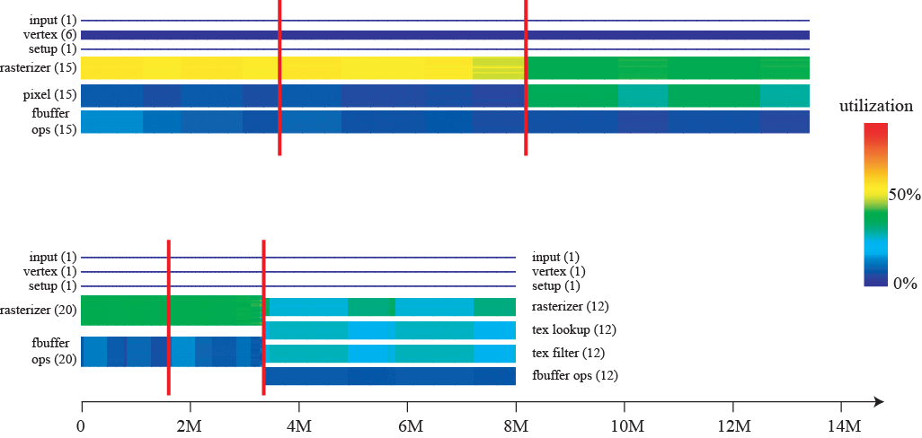
Utilization Plot: Shadow Volumes
Fixed pipeline
Pass 1
Pass 2
Pass 3
Reconfigurable pipeline
Pass 1
Pass 2
Pass 3
Notes:
And this is the utilization plot
Again, the fixed pipeline is on top and reconfigurable pipeline performs better
Throughput is more than twice the fixed in the first two passes
However, for the final pass, there’s only a 13% improvement in throughput
That’s because the scene is actually severely limited by memory access
There’s a 3 cycle latency in memory access, so you see about a 33% utilization in the first texture unit

Slide 26
Limitations
Software rasterization is extremely slow
  55 cycles per fragment
Memory system
  Technique does not optimize for texture access
Notes:
Our system is not without limitations
One weakness is in that we do all rasterization in software
Even though it’s a relatively simple operation, it’s extremely slow and costs 55 cycles per fragment
Our technique also does not address the memory system
Especially with respect to optimizing the texture cache
So in future work…

Slide 27
Future Work
Augment Raw with special purpose hardware
Explore memory hierarchy
  Texture prefetching
  Cache performance
Single-pass rendering algorithms
  Load imbalances may occur within a pass
  Decompose scene into multiple passses
  Tradeoff between throughput gained from better load balance and cost of flush
Dynamic Load Balancing
Notes:
We’d like to consider augmenting raw with special purpose hardware such as rasterizers and vector units
And vector ALUs, which we think will dramatically increase performance
We’d also like to explore the memory hierarchy
Taking into account texture prefetching
Cache performance
We’d also like to explore load balancing in single-pass rendering algorithms
Like the first scene I showed, with detailed characters on a sparse background
And you get a load imbalance within one pass
if you decompose it into multiple passes and reconfigure, you’ll have to flush the pipeline
We’d like to explore the tradeoff between the performance gained in better load balancing vs. the cost of the flush
Lastly, we’d like to look at dynamic load balancing
Where the pipeline can reconfigure *itself* during runtime based on the input
Not just at compile time

Slide 28
Summary
Reconfigurable Architecture
  Application-specific static load balancing
  Increased throughput and utilization
Ideas:
  General-purpose multi-core processor
  Programmable communications network
  Streaming characterization
Notes:
So in summary
We’ve demonstrated a reconfigurable architecture
That allows the programmer to perform application-specific static load balancing
And we’ve demonstrated that you can achieve increased throughput and utilization with this system
The key ideas of the approach are
To use a general purpose multi-core processor
With a programmable communications network
And to express the graphics pipeline as a stream computation
Which gets mapped to the processor

Slide 29
Acknowledgements
Mike Doggett, Eric Chan
David Wentzlaff, Patrick Griffin, Rodric Rabbah, and Jasper Lin
John Owens
Saman Amarasinghe
Raw group at MIT
DARPA, NSF, MIT Oxygen Alliance
Notes:
We’d like to thank the following individuals who’ve helped with the project
And that’s it.

