Slide 1

Teleport Messaging for Distributed Stream Programs
William Thies, Michal Karczmarek, Janis Sermulins,
Rodric Rabbah and Saman Amarasinghe
Massachusetts Institute of Technology
PPoPP 2005
http://cag.lcs.mit.edu/streamit

Slide 2
Streaming Application Domain
AtoD
Based on a stream of data
  Radar tracking, microphone arrays,
  HDTV editing, cell phone base stations
  Graphics, multimedia, software radio
Properties of stream programs
  Regular and repeating computation
  Parallel, independent actors
  with explicit communication
  Data items have short lifetimes
Decode
duplicate
LPF₁
LPF₂
LPF₃
HPF₁
HPF₂
HPF₃
roundrobin
Amenable to aggressive
compiler optimization
[ASPLOS ’02, PLDI ’03, LCTES’03, LCTES ’05]
Encode
Transmit

Slide 3
Control Messages
Occasionally, low-bandwidth control messages are sent between actors
Often demands precise timing
  Communications: adjust protocol,
  amplification, compression
  Network router: cancel invalid packet
  Adaptive beamformer: track a target
  Respond to user input, runtime errors
  Frequency hopping radio
AtoD
Decode
duplicate
LPF₁
LPF₂
LPF₃
HPF₁
HPF₂
HPF₃
roundrobin
What is the right
programming model?
Encode
How to implement efficiently?
Transmit
Notes:
Say: “out-of-band communication”

Slide 4
Supporting Control Messages
Option 1: Synchronous method call
  PRO: - delivery transparent to user
  CON: - timing is unclear
  - limits parallelism
Option 2: Embed message in stream
  PRO: - message arrives with data
  CON: - complicates filter code
  - complicates stream graph
  - runtime overhead
Notes:
1 - Massive reordering on uniprocessor
2 – don’t want to sacrifice high-bandiwdth data channels

Slide 5
Teleport Messaging
Looks like method call, but timed
relative to data in the stream
PRO:
  simple and precise for user
    adjustable latency
    can send upstream or downstream
  exposes dependences to compiler
TargetFilter x;
if newProtocol(p) {
x.setProtocol(p) @ 2;
}
void setProtocol(int p) {
reconfig(p);
}
Notes:
TODO: Adjust initial animation so it is interrupted only on frame boundaries

Slide 6
Outline
StreamIt
Teleport Messaging
Case Study
Related Work and Conclusion

Slide 7
Outline
StreamIt
Teleport Messaging
Case Study
Related Work and Conclusion

Slide 8
Model of Computation
Synchronous Dataflow [Lee 92]
  Graph of autonomous filters
  Communicate via FIFO channels
  Static I/O rates
Compiler decides on an order
of execution (schedule)
  Many legal schedules
A/D
Band Pass
Duplicate
Detect
Detect
Detect
Detect
LED
LED
LED
LED

Slide 9
Example StreamIt Filter
float->float filter LowPassFilter (int N, float[N] weights) {
work peek N push 1 pop 1 {
float result = 0;
for (int i=0; i<weights.length; i++) {
result += weights[i] * peek(i);
}
push(result);
pop();
}
}
N
filter

Slide 10
Example StreamIt Filter
float->float filter LowPassFilter (int N, float[N] weights) {
work peek N push 1 pop 1 {
float result = 0;
for (int i=0; i<weights.length; i++) {
result += weights[i] * peek(i);
}
push(result);
pop();
}
handler setWeights(float[N] _weights) {
weights = _weights;
}
}
N
filter

Slide 11
Example StreamIt Filter
float->float filter LowPassFilter (int N, float[N] weights, Frontend f ) {
work peek N push 1 pop 1 {
float result = 0;
for (int i=0; i<weights.length; i++) {
result += weights[i] * peek(i);
}
if (result == 0) {
f.increaseGain() @ [2:5];
}
push(result);
pop();
}
handler setWeights(float[N] _weights) {
weights = _weights;
}
}
N
filter

Slide 12
StreamIt Language Overview
StreamIt is a novel language for streaming
  Exposes parallelism and
  communication
  Architecture independent
  Modular and composable
    Simple structures composed to creates complex graphs
  Malleable
    Change program behavior with small modifications
filter
pipeline
may be any StreamIt language construct
splitjoin
parallel computation
splitter
joiner
feedback loop
joiner
splitter

Slide 13
Outline
StreamIt
Teleport Messaging
Case Study
Related Work and Conclusion

Slide 14
Providing a Common Timeframe
Control messages need precise
timing with respect to data stream
However, there is no global
clock in distributed systems
  Filters execute independently,
  whenever input is available
Idea: define message timing
with respect to data dependences
  Must be robust to multiple datarates
  Must be robust to splitting, joining

Slide 15
Stream Dependence Function (SDEP)
Describes data dependences between filters
A
B
Notes:
TODO: Animate items

Slide 16
Stream Dependence Function (SDEP)
Describes data dependences between filters
A
B
SDEP_{A←B}(n): minimum number of times that A must execute to make it possible for B to execute n times
Notes:
TODO: Animate items

Slide 17
Stream Dependence Function (SDEP)
Describes data dependences between filters
A
push 2
n | SDEP_{A←B}(n)
0
1
2
pop 3
B
SDEP_{A←B}(n): minimum number of times that A must execute to make it possible for B to execute n times
Notes:
TODO: Animate items

Slide 18
Stream Dependence Function (SDEP)
Describes data dependences between filters
A
push 2
n | SDEP_{A←B}(n)
0 | 0
1
2
pop 3
B
SDEP_{A←B}(n): minimum number of times that A must execute to make it possible for B to execute n times
Notes:
TODO: Animate items

Slide 19
Stream Dependence Function (SDEP)
Describes data dependences between filters
A
push 2
× 1
n | SDEP_{A←B}(n)
0 | 0
1
2
pop 3
B
SDEP_{A←B}(n): minimum number of times that A must execute to make it possible for B to execute n times
Notes:
TODO: Animate items

Slide 20
Stream Dependence Function (SDEP)
Describes data dependences between filters
A
push 2
× 2
n | SDEP_{A←B}(n)
0 | 0
1
2
pop 3
B
SDEP_{A←B}(n): minimum number of times that A must execute to make it possible for B to execute n times
Notes:
TODO: Animate items

Slide 21
Stream Dependence Function (SDEP)
Describes data dependences between filters
A
push 2
× 2
n | SDEP_{A←B}(n)
0 | 0
1
2
pop 3
B
× 1
SDEP_{A←B}(n): minimum number of times that A must execute to make it possible for B to execute n times
Notes:
TODO: Animate items

Slide 22
Stream Dependence Function (SDEP)
Describes data dependences between filters
A
push 2
× 2
n | SDEP_{A←B}(n)
0 | 0
1 | 2
2
pop 3
B
× 1
SDEP_{A←B}(n): minimum number of times that A must execute to make it possible for B to execute n times
Notes:
TODO: Animate items

Slide 23
Stream Dependence Function (SDEP)
Describes data dependences between filters
A
push 2
× 3
n | SDEP_{A←B}(n)
0 | 0
1 | 2
2
pop 3
B
× 1
SDEP_{A←B}(n): minimum number of times that A must execute to make it possible for B to execute n times
Notes:
TODO: Animate items

Slide 24
Stream Dependence Function (SDEP)
Describes data dependences between filters
A
push 2
× 3
n | SDEP_{A←B}(n)
0 | 0
1 | 2
2
pop 3
B
× 2
SDEP_{A←B}(n): minimum number of times that A must execute to make it possible for B to execute n times
Notes:
TODO: Animate items

Slide 25
Stream Dependence Function (SDEP)
Describes data dependences between filters
A
push 2
× 3
n | SDEP_{A←B}(n)
0 | 0
1 | 2
2 | 3
pop 3
B
× 2
SDEP_{A←B}(n): minimum number of times that A must execute to make it possible for B to execute n times
Notes:
TODO: Animate items

Slide 26
Stream Dependence Function (SDEP)
Describes data dependences between filters
A
push 2
× 3
n | SDEP_{A←B}(n)
0 | 0
1 | 2
2 | 3
=
n*3
2
pop 3
B
× 2
SDEP_{A←B}(n): minimum number of times that A must execute to make it possible for B to execute n times
Notes:
TODO: Animate items

Slide 27
Calculating SDEP: General Case
A
SDEP_{A←C}(n) =
max [SDEP_{A←Bi}(SDEP_{Bi←C}(n))]
B₁
B_{m}
i 2 [1,m]
SDEP is compositional
C
SDEP_{A←B}(n): minimum number of times that A must execute to make it possible for B to execute n times
Notes:
TODO: Animate items

Slide 28
Teleport Messaging using SDEP
SDEP provides precise
semantics for message timing
S
If S sends message to R:
  on the nth execution of S
  with latency range [k₁, k₂]
Then message is delivered to R:
  on any iteration m such that
  n+k₁ · SDEP_{S←R}(m) · n+k₂
X
R

Slide 29
Teleport Messaging using SDEP
SDEP provides precise
semantics for message timing
S
push 1
If S sends message to R:
  on the nth execution of S
  with latency range [k₁, k₂]
Then message is delivered to R:
  on any iteration m such that
  n+k₁ · SDEP_{S←R}(m) · n+k₂
pop 1
X
push 1
pop 1
R

Slide 30
Teleport Messaging using SDEP
SDEP provides precise
semantics for message timing
S
push 1
× 1
If S sends message to R:
  on the nth execution of S
  with latency range [k₁, k₂]
Then message is delivered to R:
  on any iteration m such that
  n+k₁ · SDEP_{S←R}(m) · n+k₂
pop 1
X
push 1
pop 1
R
Notes:
“All running in parllel, proceeding at their own rate”

Slide 31
Teleport Messaging using SDEP
SDEP provides precise
semantics for message timing
S
push 1
× 2
If S sends message to R:
  on the nth execution of S
  with latency range [k₁, k₂]
Then message is delivered to R:
  on any iteration m such that
  n+k₁ · SDEP_{S←R}(m) · n+k₂
pop 1
X
push 1
pop 1
R

Slide 32
Teleport Messaging using SDEP
SDEP provides precise
semantics for message timing
S
push 1
× 3
If S sends message to R:
  on the nth execution of S
  with latency range [k₁, k₂]
Then message is delivered to R:
  on any iteration m such that
  n+k₁ · SDEP_{S←R}(m) · n+k₂
pop 1
X
push 1
pop 1
R

Slide 33
Teleport Messaging using SDEP
SDEP provides precise
semantics for message timing
S
push 1
× 3
If S sends message to R:
  on the nth execution of S
  with latency range [k₁, k₂]
Then message is delivered to R:
  on any iteration m such that
  n+k₁ · SDEP_{S←R}(m) · n+k₂
pop 1
X
push 1
× 1
pop 1
R

Slide 34
Teleport Messaging using SDEP
SDEP provides precise
semantics for message timing
S
push 1
× 3
If S sends message to R:
  on the nth execution of S
  with latency range [k₁, k₂]
Then message is delivered to R:
  on any iteration m such that
  n+k₁ · SDEP_{S←R}(m) · n+k₂
pop 1
X
push 1
× 2
pop 1
R

Slide 35
Teleport Messaging using SDEP
SDEP provides precise
semantics for message timing
S
push 1
× 3
If S sends message to R:
  on the nth execution of S
  with latency range [k₁, k₂]
Then message is delivered to R:
  on any iteration m such that
  n+k₁ · SDEP_{S←R}(m) · n+k₂
pop 1
X
push 1
× 2
pop 1
R
× 1

Slide 36
Teleport Messaging using SDEP
SDEP provides precise
semantics for message timing
S
push 1
× 3
If S sends message to R:
  on the nth execution of S
  with latency range [k₁, k₂]
Then message is delivered to R:
  on any iteration m such that
  n+k₁ · SDEP_{S←R}(m) · n+k₂
pop 1
X
push 1
× 3
pop 1
R
× 1

Slide 37
Teleport Messaging using SDEP
Receiver r;
r.increaseGain() @ [0:0]
S
push 1
× 4
If S sends message to R:
  on the nth execution of S
  with latency range [k₁, k₂]
Then message is delivered to R:
  on any iteration m such that
  n+k₁ · SDEP_{S←R}(m) · n+k₂
pop 1
X
push 1
× 3
pop 1
R
× 1

Slide 38
Teleport Messaging using SDEP
Receiver r;
r.increaseGain() @ [0:0]
S
push 1
× 4
If S sends message to R:
  on the 4th execution of S
  with latency range [k₁, k₂]
Then message is delivered to R:
  on any iteration m such that
  n+k₁ · SDEP_{S←R}(m) · n+k₂
pop 1
X
push 1
× 3
pop 1
R
× 1

Slide 39
Teleport Messaging using SDEP
Receiver r;
r.increaseGain() @ [0:0]
S
push 1
× 4
If S sends message to R:
  on the 4th execution of S
  with latency range [0, 0]
Then message is delivered to R:
  on any iteration m such that
  n+k₁ · SDEP_{S←R}(m) · n+k₂
pop 1
X
push 1
× 3
pop 1
R
× 1

Slide 40
Teleport Messaging using SDEP
Receiver r;
r.increaseGain() @ [0:0]
S
push 1
× 4
If S sends message to R:
  on the 4th execution of S
  with latency range [0, 0]
Then message is delivered to R:
  on any iteration m such that
  4+0 · SDEP_{S←R}(m) · 4+0
pop 1
X
push 1
× 3
pop 1
R
× 1

Slide 41
Teleport Messaging using SDEP
Receiver r;
r.increaseGain() @ [0:0]
S
push 1
× 4
If S sends message to R:
  on the 4th execution of S
  with latency range [0, 0]
Then message is delivered to R:
  on any iteration m such that
  4+0 · SDEP_{S←R}(m) · 4+0
  SDEP_{S←R}(m) = 4
pop 1
X
push 1
× 3
pop 1
R
× 1

Slide 42
Teleport Messaging using SDEP
Receiver r;
r.increaseGain() @ [0:0]
S
push 1
× 4
If S sends message to R:
  on the 4th execution of S
  with latency range [0, 0]
Then message is delivered to R:
  on any iteration m such that
  4+0 · SDEP_{S←R}(m) · 4+0
  SDEP_{S←R}(m) = 4
m = 4
pop 1
X
push 1
× 3
pop 1
R
× 1

Slide 43
Teleport Messaging using SDEP
Receiver r;
r.increaseGain() @ [0:0]
S
push 1
× 4
If S sends message to R:
  on the 4th execution of S
  with latency range [0, 0]
Then message is delivered to R:
  on any iteration m such that
  4+0 · SDEP_{S←R}(m) · 4+0
  SDEP_{S←R}(m) = 4
m = 4
pop 1
X
push 1
× 3
pop 1
R
× 1

Slide 44
Teleport Messaging using SDEP
Receiver r;
r.increaseGain() @ [0:0]
S
push 1
× 4
If S sends message to R:
  on the 4th execution of S
  with latency range [0, 0]
Then message is delivered to R:
  on any iteration m such that
  4+0 · SDEP_{S←R}(m) · 4+0
  SDEP_{S←R}(m) = 4
m = 4
pop 1
X
push 1
× 3
pop 1
R
× 2

Slide 45
Teleport Messaging using SDEP
Receiver r;
r.increaseGain() @ [0:0]
S
push 1
× 4
If S sends message to R:
  on the 4th execution of S
  with latency range [0, 0]
Then message is delivered to R:
  on any iteration m such that
  4+0 · SDEP_{S←R}(m) · 4+0
  SDEP_{S←R}(m) = 4
m = 4
pop 1
X
push 1
× 3
pop 1
R
× 3

Slide 46
Teleport Messaging using SDEP
Receiver r;
r.increaseGain() @ [0:0]
S
push 1
× 4
If S sends message to R:
  on the 4th execution of S
  with latency range [0, 0]
Then message is delivered to R:
  on any iteration m such that
  4+0 · SDEP_{S←R}(m) · 4+0
  SDEP_{S←R}(m) = 4
m = 4
pop 1
X
push 1
× 4
pop 1
R
× 3

Slide 47
Teleport Messaging using SDEP
Receiver r;
r.increaseGain() @ [0:0]
S
push 1
× 4
If S sends message to R:
  on the 4th execution of S
  with latency range [0, 0]
Then message is delivered to R:
  on any iteration m such that
  4+0 · SDEP_{S←R}(m) · 4+0
  SDEP_{S←R}(m) = 4
m = 4
pop 1
X
push 1
× 4
pop 1
R
× 4

Slide 48
Teleport Messaging using SDEP
Receiver r;
r.increaseGain() @ [0:0]
S
push 1
× 4
If S sends message to R:
  on the 4th execution of S
  with latency range [0, 0]
Then message is delivered to R:
  on any iteration m such that
  4+0 · SDEP_{S←R}(m) · 4+0
  SDEP_{S←R}(m) = 4
m = 4
pop 1
X
push 1
× 4
pop 1
R
× 4

Slide 49
Sending Messages Upstream
If embedding messages in stream,
must send in direction of dataflow
Teleport messaging provides
provides a unified abstraction
Intuition:
  If S sends to R with latency k
  Then R receives message when producing
  item that S sees in k of its own time steps
R
push 1
× 4
pop 1
X
push 1
× 4
pop 1
S
× 4

Slide 50
Sending Messages Upstream
If embedding messages in stream,
must send in direction of dataflow
Teleport messaging provides
provides a unified abstraction
Intuition:
  If S sends to R with latency k
  Then R receives message when producing
  item that S sees in k of its own time steps
R
push 1
× 4
pop 1
X
push 1
× 4
pop 1
S
× 4
Receiver r;
r.decimate() @ [3:3]

Slide 51
Sending Messages Upstream
If embedding messages in stream,
must send in direction of dataflow
Teleport messaging provides
provides a unified abstraction
Intuition:
  If S sends to R with latency k
  Then R receives message when producing
  item that S sees in k of its own time steps
R
push 1
× ?
?
?
pop 1
X
push 1
× ?
?
pop 1
S
× 7
Receiver r;
r.decimate() @ [3:3]

Slide 52
Sending Messages Upstream
If embedding messages in stream,
must send in direction of dataflow
Teleport messaging provides
provides a unified abstraction
Intuition:
  If S sends to R with latency k
  Then R receives message when producing
  item that S sees in k of its own time steps
R
push 1
× ?
?
?
pop 1
X
push 1
× ?
?
pop 1
S
× 6
Receiver r;
r.decimate() @ [3:3]

Slide 53
Sending Messages Upstream
If embedding messages in stream,
must send in direction of dataflow
Teleport messaging provides
provides a unified abstraction
Intuition:
  If S sends to R with latency k
  Then R receives message when producing
  item that S sees in k of its own time steps
R
push 1
×10
pop 1
X
push 1
× 8
pop 1
S
× 6
Receiver r;
r.decimate() @ [3:3]

Slide 54
Sending Messages Upstream
If embedding messages in stream,
must send in direction of dataflow
Teleport messaging provides
provides a unified abstraction
Intuition:
  If S sends to R with latency k
  Then R receives message when producing
  item that S sees in k of its own time steps
R
push 1
×10
pop 1
X
push 1
× 7
pop 1
S
× 6
Receiver r;
r.decimate() @ [3:3]

Slide 55
Sending Messages Upstream
If embedding messages in stream,
must send in direction of dataflow
Teleport messaging provides
provides a unified abstraction
Intuition:
  If S sends to R with latency k
  Then R receives message when producing
  item that S sees in k of its own time steps
R
push 1
× 9
pop 1
X
push 1
× 7
pop 1
S
× 6
Receiver r;
r.decimate() @ [3:3]

Slide 56
Sending Messages Upstream
If embedding messages in stream,
must send in direction of dataflow
Teleport messaging provides
provides a unified abstraction
Intuition:
  If S sends to R with latency k
  Then R receives message when producing
  item that S sees in k of its own time steps
R
push 1
× 9
pop 1
X
push 1
× 6
pop 1
S
× 6
Receiver r;
r.decimate() @ [3:3]

Slide 57
Sending Messages Upstream
If embedding messages in stream,
must send in direction of dataflow
Teleport messaging provides
provides a unified abstraction
Intuition:
  If S sends to R with latency k
  Then R receives message when producing
  item that S sees in k of its own time steps
R
push 1
× 8
pop 1
X
push 1
× 6
pop 1
S
× 6
Receiver r;
r.decimate() @ [3:3]

Slide 58
Sending Messages Upstream
If embedding messages in stream,
must send in direction of dataflow
Teleport messaging provides
provides a unified abstraction
Intuition:
  If S sends to R with latency k
  Then R receives message when producing
  item that S sees in k of its own time steps
R
push 1
× 7
pop 1
X
push 1
× 6
pop 1
S
× 6
Receiver r;
r.decimate() @ [3:3]

Slide 59
Sending Messages Upstream
If embedding messages in stream,
must send in direction of dataflow
Teleport messaging provides
provides a unified abstraction
Intuition:
  If S sends to R with latency k
  Then R receives message when producing
  item that S sees in k of its own time steps
R
push 1
× 7
pop 1
X
push 1
× 6
pop 1
S
× 6
R receives message on iteration 7
Receiver r;
r.decimate() @ [3:3]

Slide 60
Constraints Imposed on Schedule
 | latency < 0 | latency = 0 | latency > 0
Message travels upstream
Message travels downstream
Notes:
Say: can view messaging as a way of specifying latency constraints on schedule

Slide 61
Constraints Imposed on Schedule
 | latency < 0 | latency = 0 | latency > 0
Message travels upstream |  |  | Must not buffer too much data
Message travels downstream
Notes:
Say: can view messaging as a way of specifying latency constraints on schedule

Slide 62
Constraints Imposed on Schedule
 | latency < 0 | latency = 0 | latency > 0
Message travels upstream | Illegal | Illegal | Must not buffer too much data
Message travels downstream
Notes:
Say: can view messaging as a way of specifying latency constraints on schedule

Slide 63
Constraints Imposed on Schedule
 | latency < 0 | latency = 0 | latency > 0
Message travels upstream | Illegal | Illegal | Must not buffer too much data
Message travels downstream | Must not buffer too little data
Notes:
Say: can view messaging as a way of specifying latency constraints on schedule

Slide 64
Constraints Imposed on Schedule
 | latency < 0 | latency = 0 | latency > 0
Message travels upstream | Illegal | Illegal | Must not buffer too much data
Message travels downstream | Must not buffer too little data | No constraint | No constraint
Notes:
Say: can view messaging as a way of specifying latency constraints on schedule

Slide 65
Finding a Schedule
Non-overlapping messages:
greedy scheduling algorithm
Overlapping messages:
future work
  Overlapping constraints
  can be feasible in isolation,
  but infeasible in combination
Notes:
Should clarify that overlapping is ok if going in same direction

Slide 66
Outline
StreamIt
Teleport Messaging
Case Study
Related Work and Conclusion

Slide 67
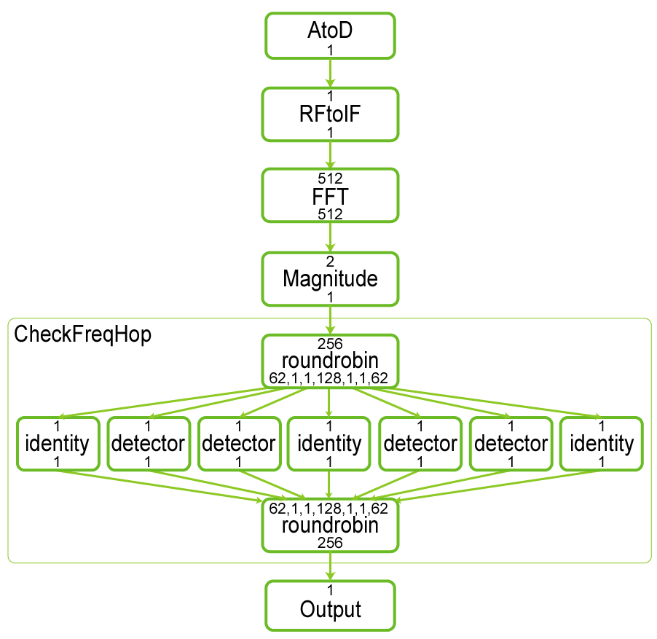
Frequency Hopping Radio
Transmitter and receiver
switch between set of
known frequencies
Transmitter indicates
timing and target of
hop using freq. pulse
Receiver detects
pulse downstream,
adjusts RFtoIF
with exact timing:
  Switch at same time as transmitter
  Switch at FFT frame boundary

Slide 68
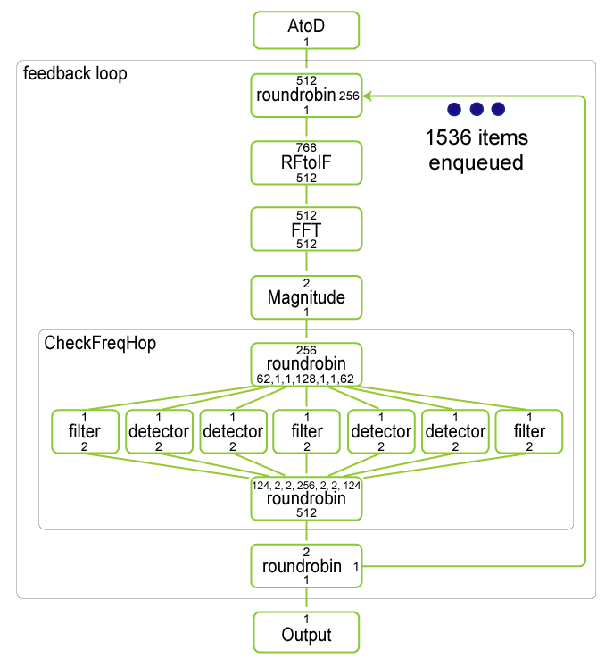
Frequency Hopping Radio:
Manual Feedback
Introduce feedback loop with dummy items to indicate presence or absence of message
To add latency, enqueue 1536 initial items on loop
Extra changes needed
along path of message
  Interleave messages, data
  Route messages to loop
  Adjust I/O rates
To respect FFT frames, change RFtoIF granularity

Slide 69
Frequency Hopping Radio:
Teleport Messaging
Use message latency of 6
Modify only RFtoIF, detector
FFT frame boundaries
automatically respected:
SDEP_{RFIF←det}(n) = 512*n
Teleport
messaging
improves
programmability
Notes:
Highlight mismatching rates

Slide 70
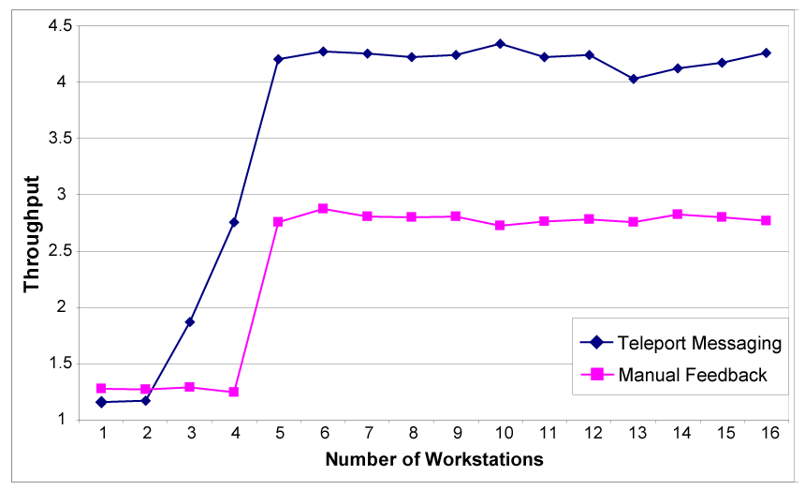
Preliminary Results

Slide 71
Outline
StreamIt
Teleport Messaging
Case Study
Related Work and Conclusion

Slide 72
Related Work
Heterogeneous systems modeling
  Ptolemy project (Lee et al.); scheduling (Bhattacharyya, …)
  Boolean dataflow: parameterized data rates
  Teleport messaging allows complete static scheduling
Program slicing
  Many researchers; see Tip’95 for survey
  Like SDEP, find set of dependent operations
  SDEP is more specialized; can calculate exactly
Streaming languages
  Brook, Cg, StreamC/KernelC, Spidle, Occam, Sisal, Parallel Haskell, Lustre, Esterel, Lucid Synchrone
  Our goal: adding restricted dynamism to static language

Slide 73
Conclusion
← Language Features →
Static
Powerful optimizations
Dynamic
Expressive behavior
Static-rate streaming
(Synchronous dataflow)
Control messages
Teleport messaging
StreamIt Language
Teleport messaging provides precise and flexible event handling while allowing static optimizations
  Data dependences (SDEP) is natural timing mechanism
  Messaging exposes true communication to compiler

Slide 74
Extra Slides

Slide 75
Calculating SDEP in Practice
Direct SDEP formulation:
SDEP_{A←C}(n) =
max [
n*oc – k
ub1
max(0, )*ob1 – k
ua
max(0, ),
n*oc – k
ub2
max(0, )*ob2 – k
ua
max(0, ),
n*oc – k
ub3
max(0, )*ob3 – k
ua
max(0, )]
Direct calculation could grow unwieldy

Slide 76
Calculating SDEP in Practice
init
steady₁
steady₂
steady₃
SDEP_{A←C}(n)
n
initialization: consumes all initial items
steady state: repetition of each actor that does not
change number of items on channels

Slide 77
Calculating SDEP in Practice
init
steady₀
steady₁
steady₂
SDEP_{A←C}(n)
S_{C}
S_{A}
n
0 n 2 init
lookup_table[n] n 2 steady₀
k*S_{A} + SDEP(n – k*S_{C}) n 2 steady_{k}
SDEP(n) =
Build small SDEP table statically, use for all n
Notes:
Say: see the paper for alternate formulation (deals with phases)

Slide 78
Sending Messages Upstream
If S sends upstream message to R:
  with latency range [k₁, k₂]
  on the nth execution of S
Then message is delivered to R:
  on any iteration m such that
SDEP_{R←S}(n+k₁) · m · SDEP_{R←S}(n+k₂)
R
push 1
pop 1
X
push 1
pop 1
S

Slide 79
Sending Messages Upstream
If S sends upstream message to R:
  with latency range [k₁, k₂]
  on the nth execution of S
Then message is delivered to R:
  on any iteration m such that
SDEP_{R←S}(n+k₁) · m · SDEP_{R←S}(n+k₂)
R
push 1
× 4
pop 1
X
push 1
× 4
pop 1
S
× 4
Receiver r;
r.decimate() @ [3:3]

Slide 80
Sending Messages Upstream
If S sends upstream message to R:
  with latency range [3, 3]
  on the nth execution of S
Then message is delivered to R:
  on any iteration m such that
SDEP_{R←S}(n+k₁) · m · SDEP_{R←S}(n+k₂)
R
push 1
× 4
pop 1
X
push 1
× 4
pop 1
S
× 4
Receiver r;
r.decimate() @ [3:3]

Slide 81
Sending Messages Upstream
If S sends upstream message to R:
  with latency range [3, 3]
  on the 4th execution of S
Then message is delivered to R:
  on any iteration m such that
SDEP_{R←S}(n+k₁) · m · SDEP_{R←S}(n+k₂)
R
push 1
× 4
pop 1
X
push 1
× 4
pop 1
S
× 4
Receiver r;
r.decimate() @ [3:3]

Slide 82
Sending Messages Upstream
If S sends upstream message to R:
  with latency range [3, 3]
  on the 4th execution of S
Then message is delivered to R:
  on any iteration m such that
SDEP_{R←S}(4+3) · m · SDEP_{R←S}(4+3)
R
push 1
× 4
pop 1
X
push 1
× 4
pop 1
S
× 4
Receiver r;
r.decimate() @ [3:3]

Slide 83
Sending Messages Upstream
If S sends upstream message to R:
  with latency range [3, 3]
  on the 4th execution of S
Then message is delivered to R:
  on any iteration m such that
SDEP_{R←S}(4+3) · m · SDEP_{R←S}(4+3)
m = SDEP_{R←S}(7)
R
push 1
× 4
pop 1
X
push 1
× 4
pop 1
S
× 4
Receiver r;
r.decimate() @ [3:3]

Slide 84
Sending Messages Upstream
If S sends upstream message to R:
  with latency range [3, 3]
  on the 4th execution of S
Then message is delivered to R:
  on any iteration m such that
SDEP_{R←S}(4+3) · m · SDEP_{R←S}(4+3)
m = SDEP_{R←S}(7)
m = 7
R
push 1
× 4
pop 1
X
push 1
× 4
pop 1
S
× 4
Receiver r;
r.decimate() @ [3:3]

Slide 85
Constraints Imposed on Schedule
If S sends on iteration n, then
R receives on iteration n+3
  Thus, if S is on iteration n, then
  R must not execute past n+3
  Otherwise, R could miss message
R
push 1
pop 1
X
push 1
Messages constrain the schedule
If latency is 0 instead of 3, then
no schedule satisfies constraint
pop 1
S
Some latencies are infeasible
Receiver r;
r.decimate() @ [3:3]

Slide 86
Implementation
Teleport messaging implemented in
cluster backend of StreamIt compiler
  SDEP calculated at compile-time, stored in table
Message delivery uses “credit system”
  Sender sends two types of packets to receiver:
  1. Credit: “execute n times before checking again.”
  2. Message: “deliver this message at iteration m.”
  Frequency of credits depends on SDEP, latency range
  Credits expose parallelism, reduce communication

Slide 87
Evaluation
Evaluation platform:
  Cluster of 16 Pentium III’s (750 Mhz)
  Fully-switched 100 Mb network
StreamIt cluster backend
  Compile to set of parallel threads, expressed in C
  Threads communicate via TCP/IP
  Partitioning algorithm creates load-balanced threads

