Slide 1
The Looming Software Crisis due to the Multicore Menace
Saman Amarasinghe
Computer Science and Artificial Intelligence Laboratory
Massachusetts Institute of Technology

Slide 2
The “Software Crisis”
“To put it quite bluntly: as long as there were no machines, programming was no problem at all; when we had a few weak computers, programming became a mild problem, and now we have gigantic computers, programming has become an equally gigantic problem."
-- E. Dijkstra, 1972 Turing Award Lecture
Notes:
Full quote starts with:
“The major cause [of the crisis] is that the machines have become several orders of magnitude more powerful!”

Slide 3
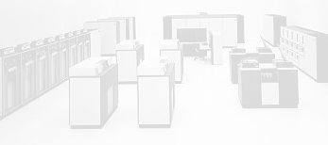
The First Software Crisis
Time Frame: ’60s and ’70s
Problem: Assembly Language Programming
  Computers could handle larger more complex programs
Needed to get Abstraction and Portability without losing Performance

Slide 4
How Did We Solve the
First Software Crisis?
High-level languages for von-Neumann machines
  FORTRAN and C
Provided “common machine language” for uniprocessors
  Only the common properties are exposed
  Hidden properties are backed-up by good compiler technology
Common Properties
Single flow of control
Single memory image
Differences:
Register File
ISA
Functional Units
Register Allocation
Instruction Selection
Instruction Scheduling

Slide 5
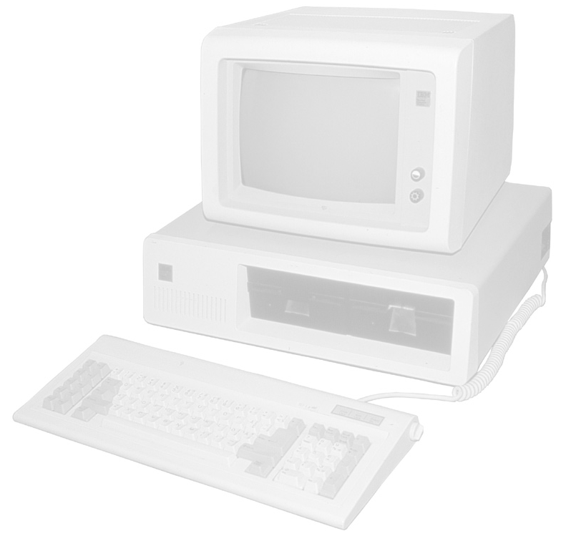
The Second Software Crisis
Time Frame: ’80s and ’90s
Problem: Inability to build and maintain complex and robust applications requiring multi-million lines of code developed by hundreds of programmers
  Computers could handle larger more complex programs
Needed to get Composability, Malleability
and Maintainability
  High-performance was not an issue → left to Moore’s Law

Slide 6
How Did We Solve the
Second Software Crisis?
Object Oriented Programming
  C++
  Now C# and Java
Better tools
  Component libraries, Purify
Better software engineering methodology
  Design patterns, specification,
  testing, code reviews

Slide 7
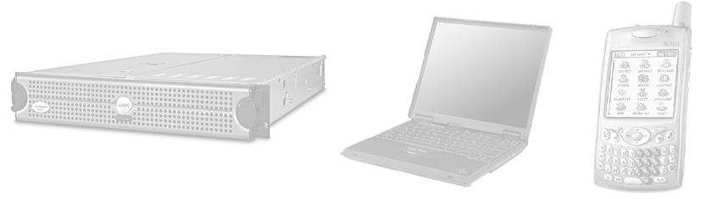
Today: Programmers are
Oblivious about the Processors
Solid boundary between Hardware and Software
Programmers don’t have to know anything about the processor
  High level languages abstract away the processors
    Ex: Java bytecode is machine independent
  Moore’s law does not require the programmers to know anything about the processors to get good speedups
Programs are oblivious to the processor → works on all processors
  A program written in ’70 using C still works and is much faster today
This abstraction provides a lot of freedom for the programmers

Slide 8
The Origins of a Third Crisis
Time Frame: 2010 to ??
Problem: Sequential performance is left behind by Moore’s law
  All software developers have abstracted away the processor assuming that Moore’s law will always provide performance gains!

Slide 9
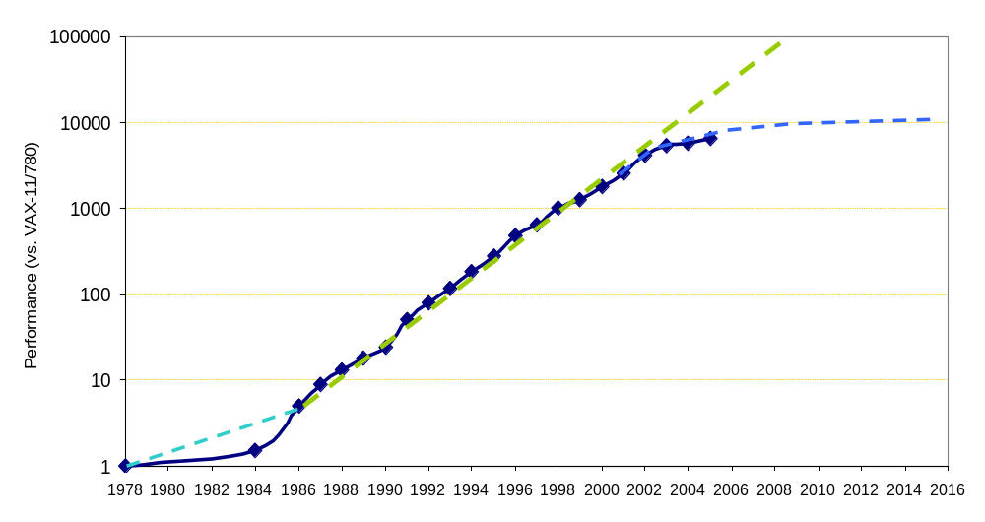
The March to Multicore:
Moore’s Law
From Hennessy and Patterson, Computer Architecture:
A Quantitative Approach, 4th edition, 2006
Itanium 2
1,000,000,000
Itanium
100,000,000
P4
P3
10,000,000
P2
Pentium
Number of Transistors
486
1,000,000
386
286
100,000
8086
10,000
From David Patterson

Slide 10
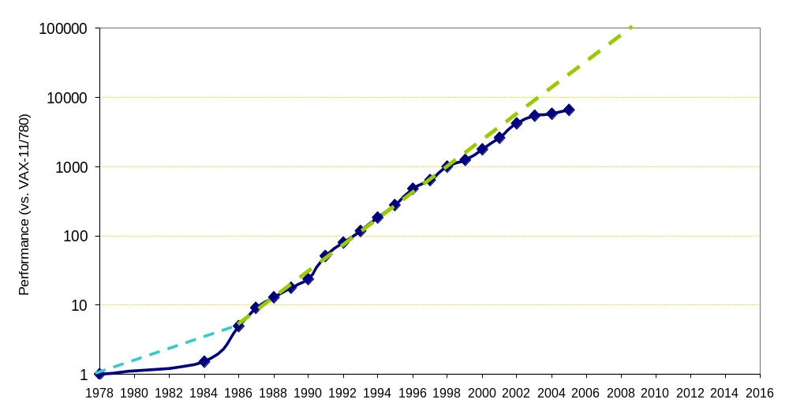
The March to Multicore:
Uniprocessor Performance (SPECint)
From Hennessy and Patterson, Computer Architecture:
A Quantitative Approach, 4th edition, 2006
Itanium 2
1,000,000,000
Itanium
100,000,000
P4
P3
10,000,000
P2
Pentium
Number of Transistors
486
1,000,000
386
286
100,000
8086
10,000
From David Patterson

Slide 11
The March to Multicore:
Uniprocessor Performance (SPECint)
From Hennessy and Patterson, Computer Architecture:
A Quantitative Approach, 4th edition, 2006
Itanium 2
1,000,000,000
Itanium
100,000,000
P4
P3
10,000,000
P2
Pentium
Number of Transistors
486
1,000,000
386
286
100,000
8086
10,000
General-purpose unicores have stopped historic performance scaling
  Power consumption
  Wire delays
  DRAM access latency
  Diminishing returns of more instruction-level parallelism
From David Patterson

Slide 12
The Origins of a Third Crisis
512
How to program
multicores?
Picochip
PC102
Ambric
AM2045
256
Cisco
CSR-1
128
Intel
Tflops
64
# of
cores
32
Raw
Raza
XLR
Cavium
Octeon
16
8
Niagara
Cell
4
A Program written in the 70’s not only works today…
but also runs faster (tracking Moore’s law)
Broadcom 1480
Opteron 4P
Xbox360
Xeon MP
2
Power4
PA-8800
Opteron
Tanglewood
PExtreme
Power6
1
4004
8080
8086
286
386
486
Pentium
P2
P3
Itanium
Yonah
8008
P4
Athlon
Itanium 2
1970
1975
1980
1985
1990
1995
2000
2005
20??
Notes:
Now that multicore designs are becoming dominant, we want to ask ourselves what is the common machine language for them.
We would like to write a program once and have it be portable and scale with future generations of multicore designs.
Also, we want parallel programming has to become as easy as sequential programming thus, the common machine language should be
composeable, malleable, and maintainable and the mapping burden should be squarely on the compiler.

Slide 13
The Origins of a Third Crisis
Time Frame: 2010 to ??
Problem: Sequential performance is left behind by Moore’s law
Needed continuous and reasonable performance improvements
  to support new features
  to support larger datasets
While sustaining portability, malleability and maintainability
without unduly increasing complexity faced by the programmer
→ critical to keep-up with the current rate of evolution in software

Slide 14
Why Parallelism is Hard
A huge increase in complexity and work for the programmer
  Programmer has to think about performance!
  Parallelism has to be designed in at every level
Humans are sequential beings
  Deconstructing problems into parallel tasks is hard for many of us
Parallelism is not easy to implement
  Parallelism cannot be abstracted or layered away
  Code and data has to be restructured in very different (non-intuitive) ways
Parallel programs are very hard to debug
  Combinatorial explosion of possible execution orderings
  Race condition and deadlock bugs are non-deterministic and illusive
  Non-deterministic bugs go away in lab environment and with instrumentation

Slide 15
Outline: Ideas on Solving the Third Software Crisis
Advances in Computer Architecture
Novel Programming Models and Languages
Aggressive Compilers
Tools to support parallelization, debugging and migration

Slide 16
Computer Architecture
Current generation of multicores
  How can we cobble together something with existing parts/investments?
  Impact of multicores haven’t hit us yet
The move to multicore will be a disruptive shift
  An inversion of the cost model
  A forced shift in the programming model
A chance to redesign the microprocessor from scratch.
What are the innovations that will reduce/eliminate the extra burden placed on the programmer?

Slide 17

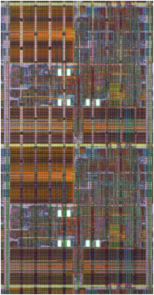
Novel Opportunities in Multicores
Don’t have to contend with uniprocessors
Not your same old multiprocessor problem
  How does going from Multiprocessors to Multicores impact programs?
  What changed?
  Where is the Impact?
    Communication Bandwidth
    Communication Latency

Slide 18
Communication Bandwidth
How much data can be communicated
between two cores?
What changed?
  Number of Wires
  Clock rate
  Multiplexing
Impact on programming model?
  Massive data exchange is possible
  Data movement is not the bottleneck
  → processor affinity not that important
10,000X
32 Giga bits/sec
~300 Tera bits/sec

Slide 19
Communication Latency
How long does it take for a round trip communication?
What changed?
  Length of wire
  Pipeline stages
Impact on programming model?
  Ultra-fast synchronization
  Can run real-time apps
  on multiple cores
50X
~200 Cycles
~4 cycles

Slide 20
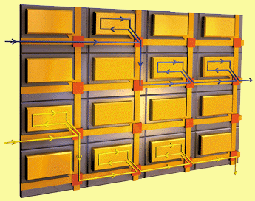
Architectural Innovations
The Raw Experience
Supported by a CISE
Experimental Partnership

Slide 21
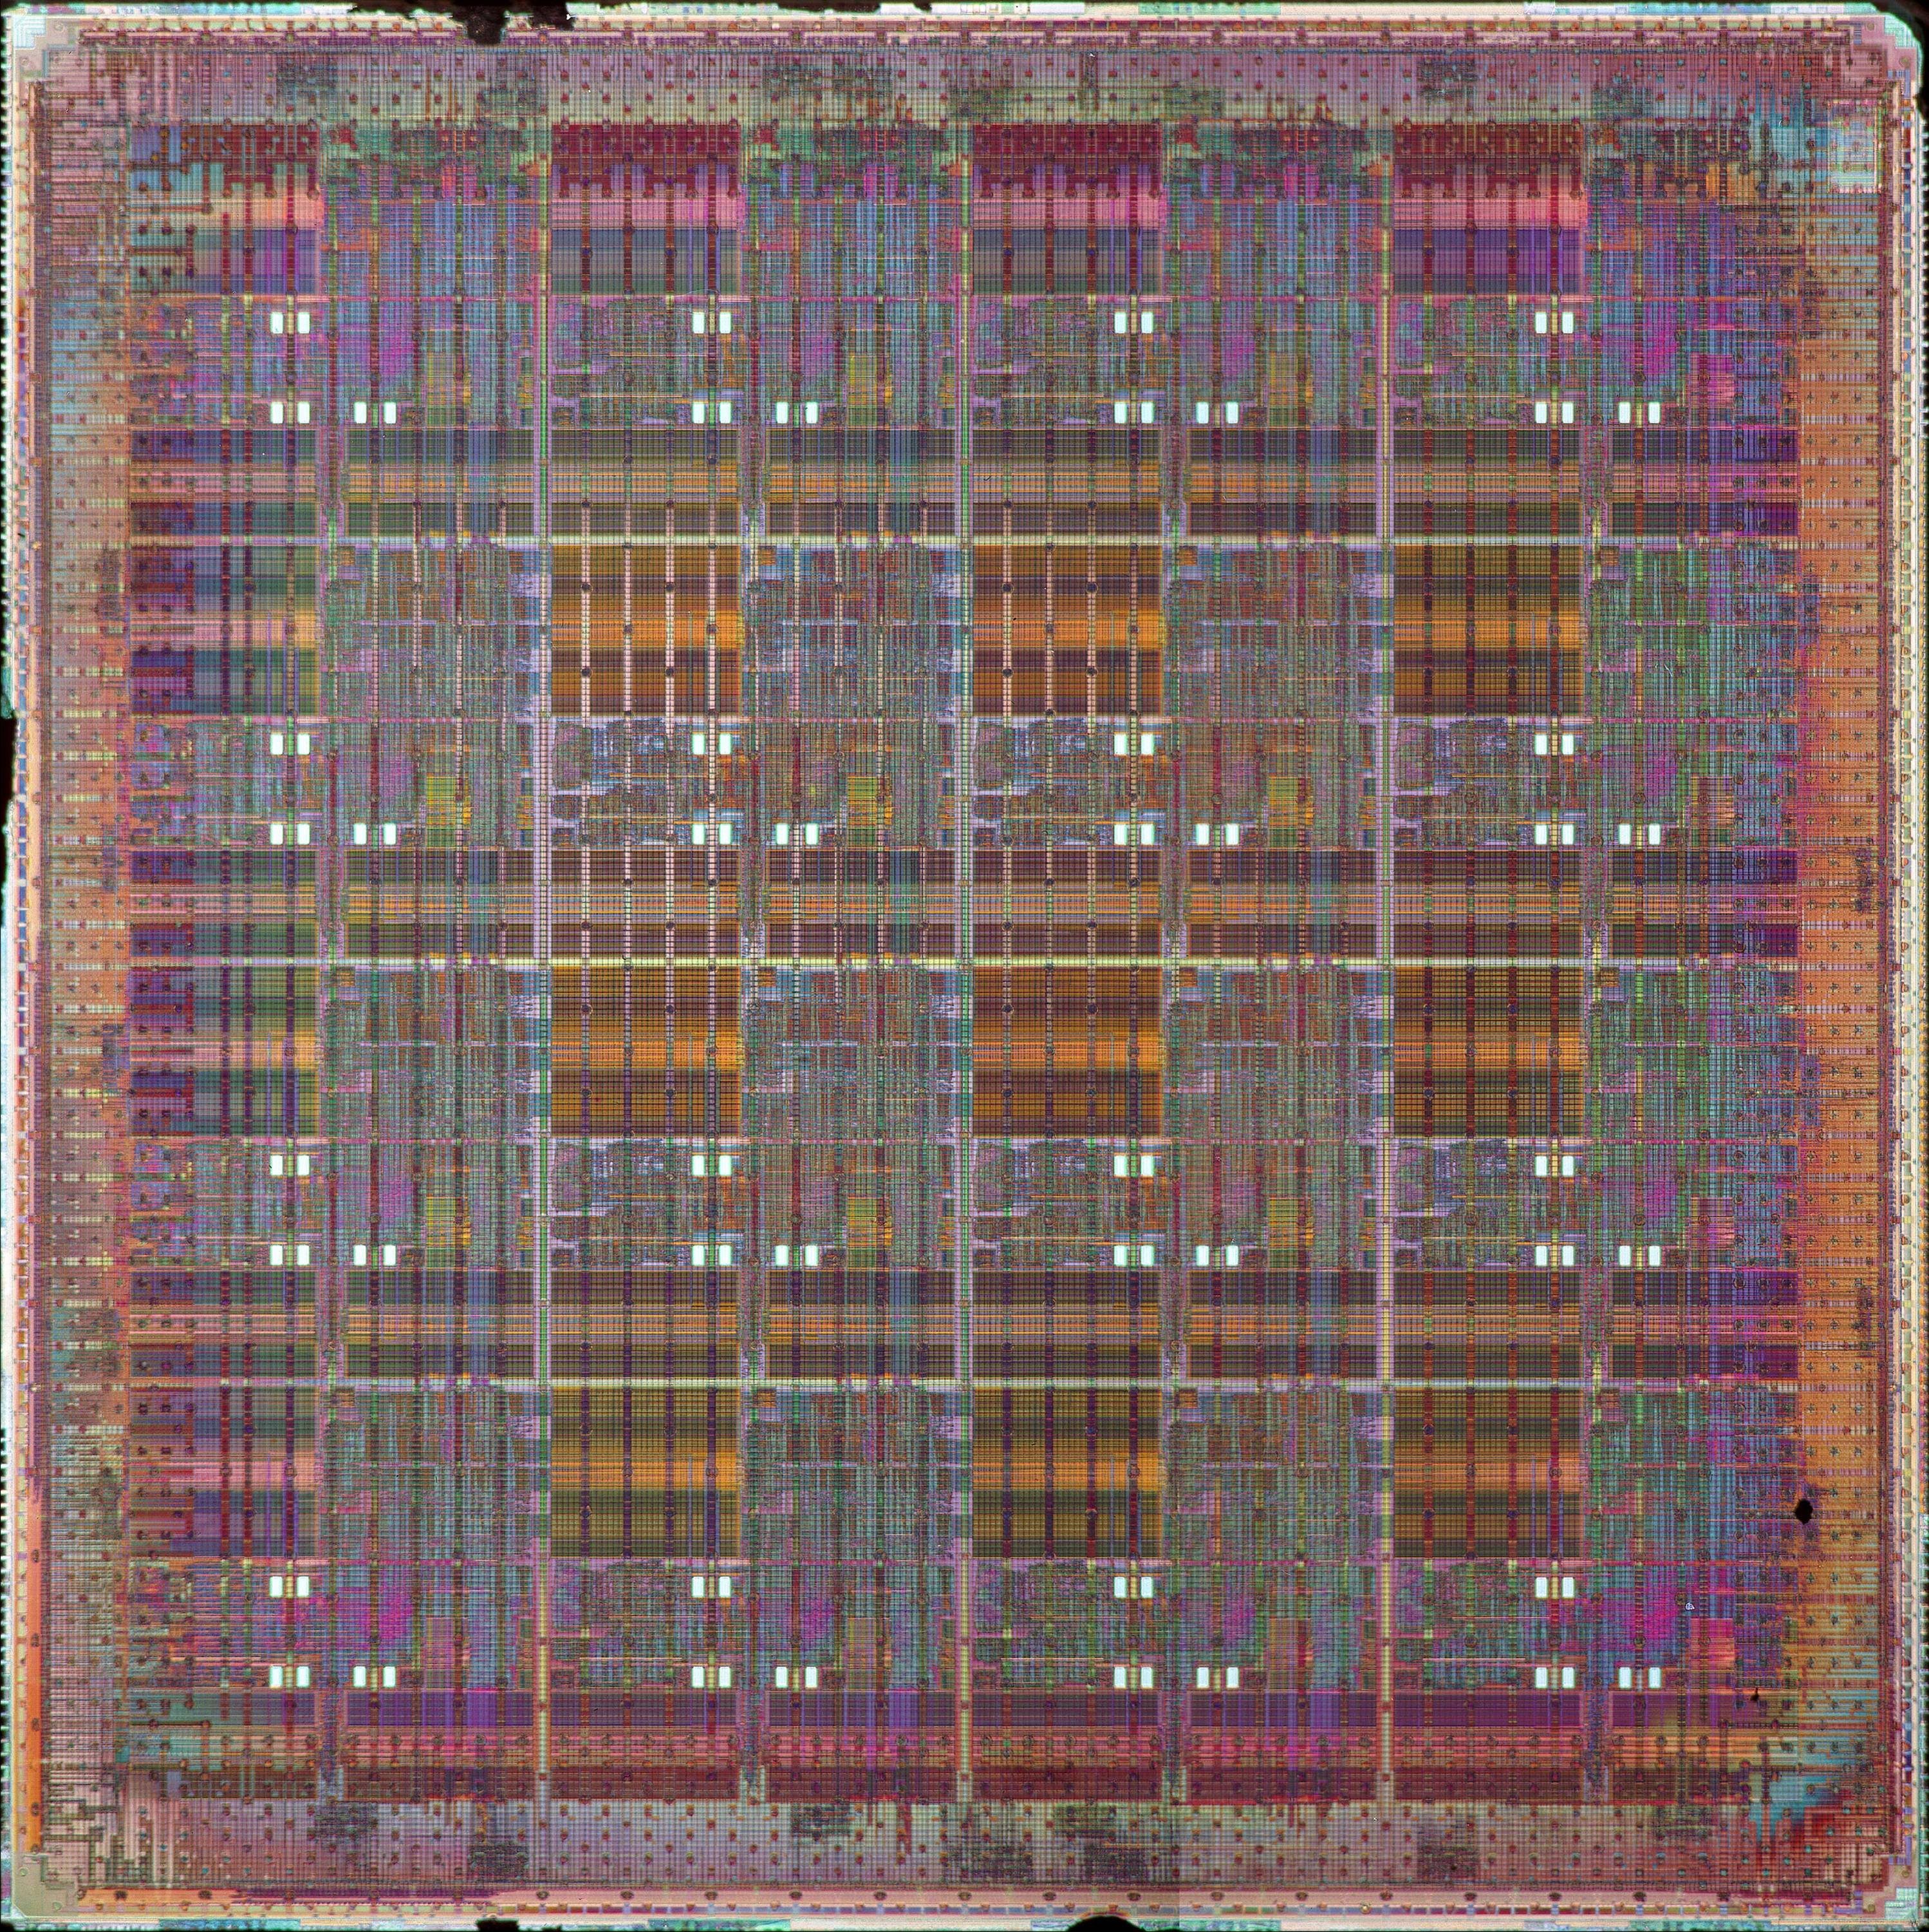
The MIT Raw Processor
Raw project started in 1997
Prototype operational in 2003
The Problem: How to keep the Moore’s Law going with
  Increasing processor complexity
  Longer wire delays
  Higher power consumption
Raw philosophy
  Build a tightly integrated multicore
  Off-load most functions to compilers and software
Raw design
  16 single issue cores
  4 register-mapped networks
  Huge IO bandwidth
Raw power
  16 Flops/ops per cycle
  16 Memory Accesses per cycle
  208 Operand Routes per cycle
  12 IO Operations per cycle
180 nm ASIC (IBM SA-27E)
18.2mm x 18.2mm
~100 million transistors
Designed for 225 MHz
Tested at 425 MHz

Slide 22

Raw’s networks are tightly coupled into the bypass paths
r24
r24
r25
Ex: lb r25, 0x341(r26)
r25
r26
r26
r27
r27
Network
Input
FIFOs
Network
Output
FIFOs
E
M1
M2
A
TL
TV
IF
D
RF
F
P
U
F4
WB
fmul r24, r3, r4
fadd r5, r3, r24
route P->E
route W->P
software
controlled
crossbar
software
controlled
crossbar
Notes:
Instead, we actually integrate the networks into the bypass paths of the processor.
In the picture above, there are two groups of fifos, one input and one output. These fifos
are flow controlled, so a read from an empty fifo will cause the processor to stall, and a write to
a fifo that’s full will also cause a stall.
These fifos are register mapped. This means that when a processor writes to register 24, for instance,
the data value ends up going into the fifo and out through the network. Similarly a read from register 24
will read a data value from the incoming fifo.
It’s interesting to see how the fifos are integrated into the pipeline. The input fifos are muxed into the bypass
muxes of the dispatch stage. The output fifos tap into each of the stages of the pipeline. This allows us to
take a value out of the pipeline as soon as it is ready. This is very important for ensuring low-latency communication.
The logic for this is just like bypass logic, except that the priorities are reversed. The networks favor the oldest values in
the pipeline, while normally bypassing favors the newest values.

Slide 23
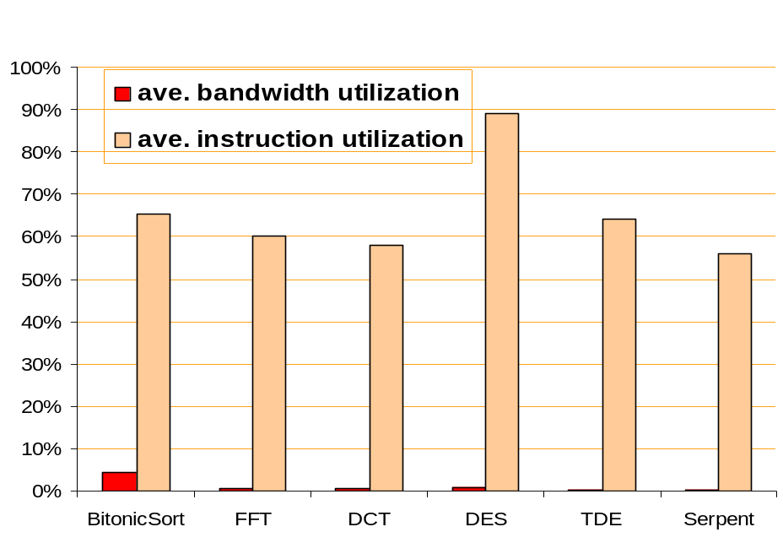
Raw Networks is Rarely the Bottleneck
Raw has 4 bidirectional,
point-to-point mesh networks
  Two of them statically routed
  Two of the dynamically routed
A single issue core may read from or write to one network in a given cycle
The cores cannot saturate the network!
(225 Gb/s @ 225 Mhz)
MIPS-Style
Pipeline
8 32-bit
buses

Slide 24
Outline: Ideas on Solving the Third Software Crisis
Advances in Computer Architecture
Novel Programming Models and Languages
Aggressive Compilers
Tools to support parallelization, debugging and migration

Slide 25
Programming Models and Languages
Critical to solving the third software crisis
Novel languages were the central solution in the
last two crises

Slide 26
Lessons from the Last Crisis:
The OO Revolution
Object Oriented revolution did not come out of a vacuum
Hundreds of small experimental languages
Rely on lessons learned from lesser-known languages
  C++ grew out of C, Simula, and other languages
  Java grew out of C++, Eiffel, SmallTalk, Objective C, and Cedar/Mesa¹
Depend on results from research community
1
J. Gosling, H. McGilton, The Java Language Enviornment

Slide 27
Object Oriented Languages
Ada 95
BETA
Boo
C++
C#
ColdFusion
Common Lisp
COOL (Object Oriented COBOL)
CorbaScript
Clarion
Corn
D
Dylan
Eiffel
F-Script
Fortran 2003
Gambas
Graphtalk
IDLscript
incr Tcl
J
JADE
Java
Lasso
Lava
Lexico
Lingo
Modula-2
Modula-3
Moto
Nemerle
Nuva
NetRexx
Nuva
Oberon (Oberon-1)
Object REXX
Objective-C
Objective Caml
Object Pascal (Delphi)
Oz
Perl 5
PHP
Pliant
PRM
PowerBuilder
ABCL
Python
REALbasic
Revolution
Ruby
Scala
Simula
Smalltalk
Self
Squeak
Squirrel
STOOP (Tcl extension)
Superx++
TADS
Ubercode
Visual Basic
Visual FoxPro
Visual Prolog
Tcl
ZZT-oop
Source: Wikipedia

Slide 28
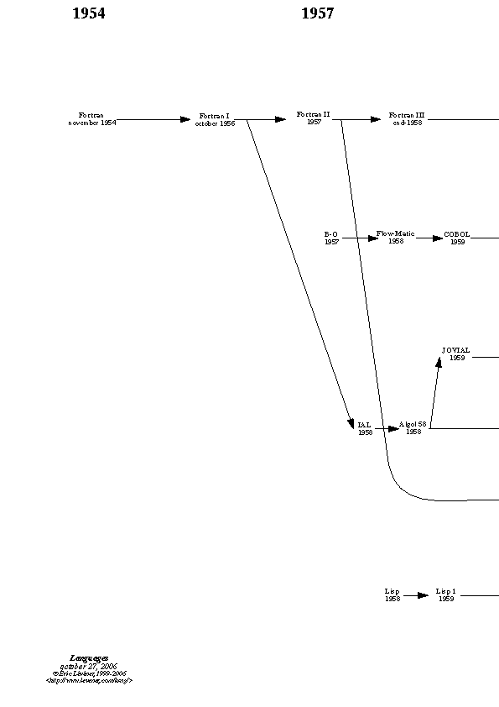
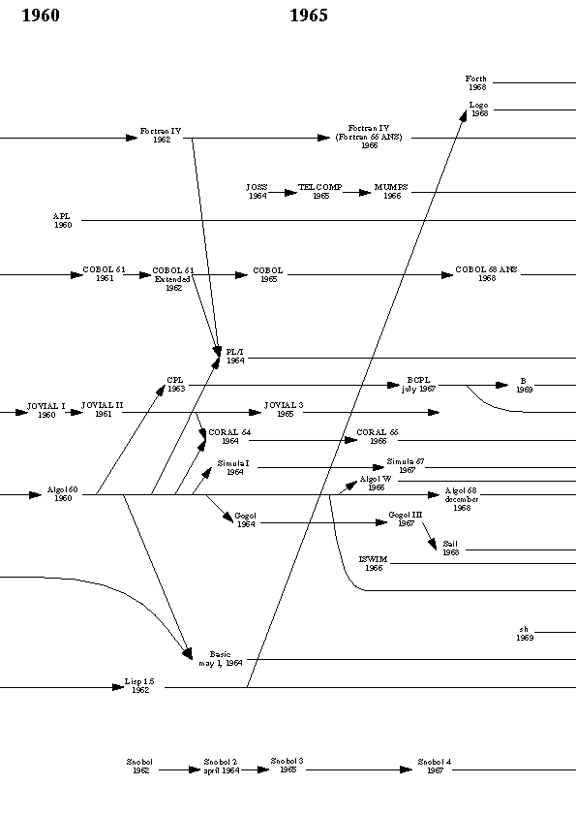
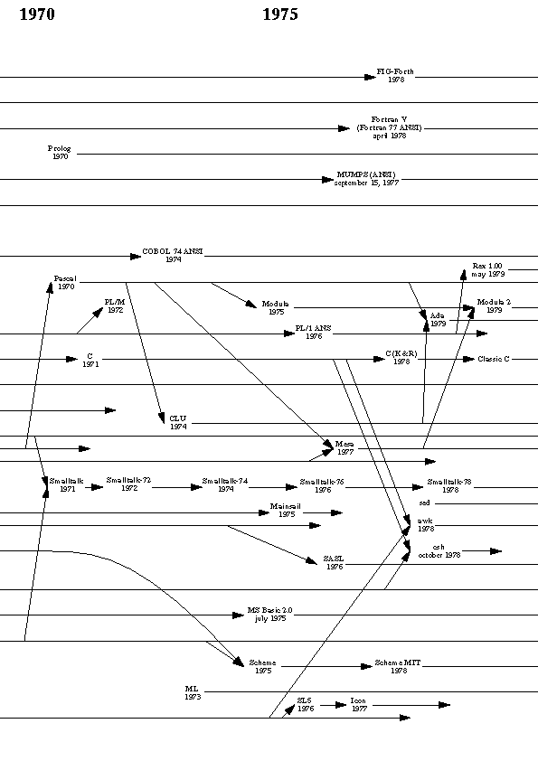
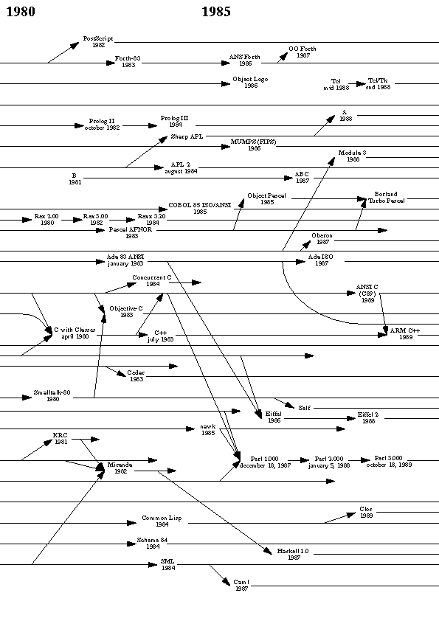
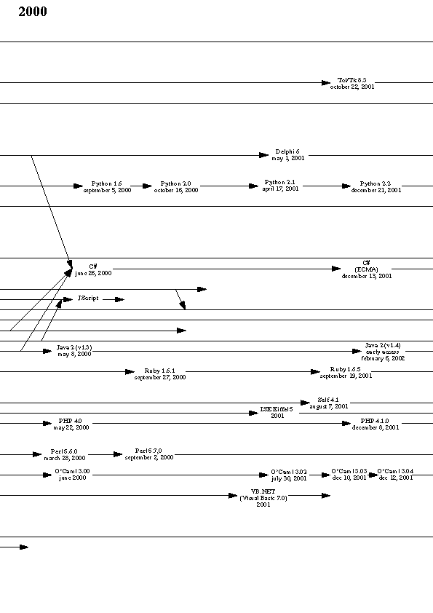
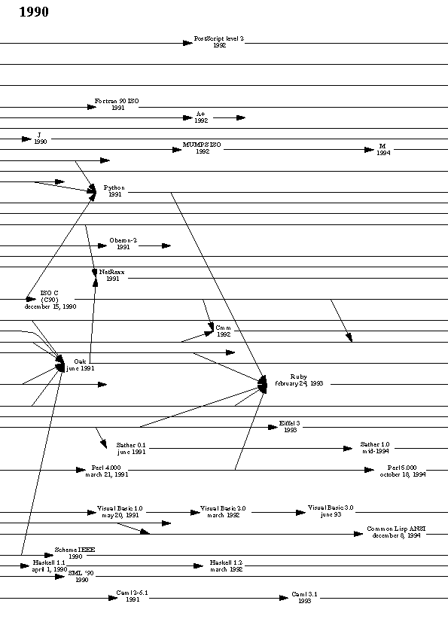
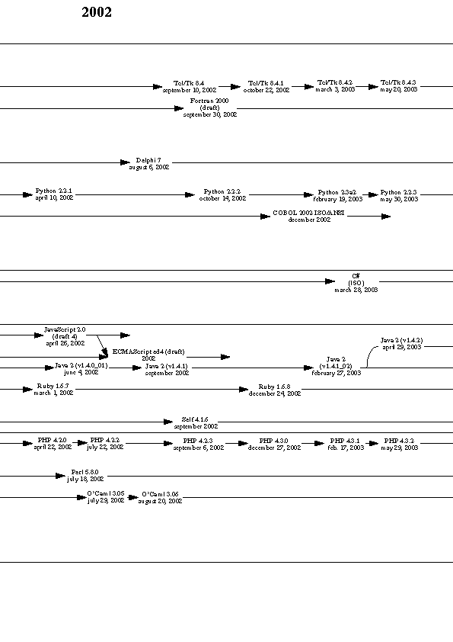
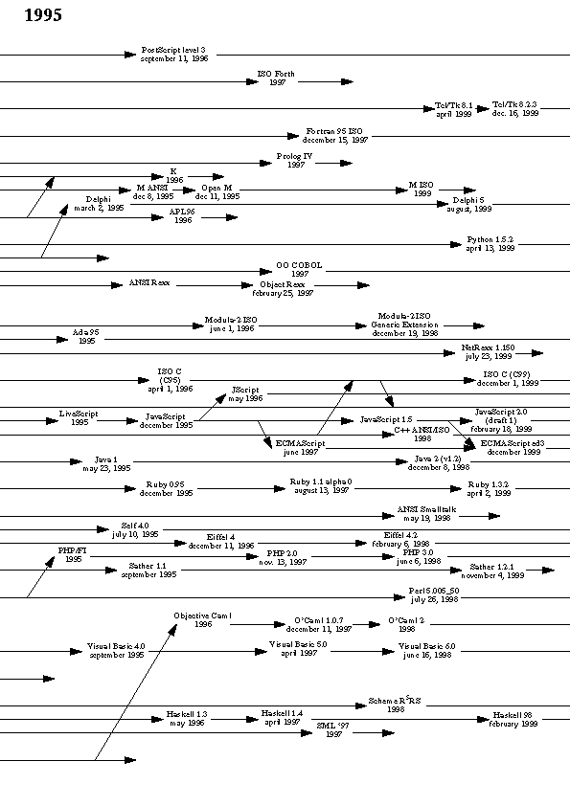
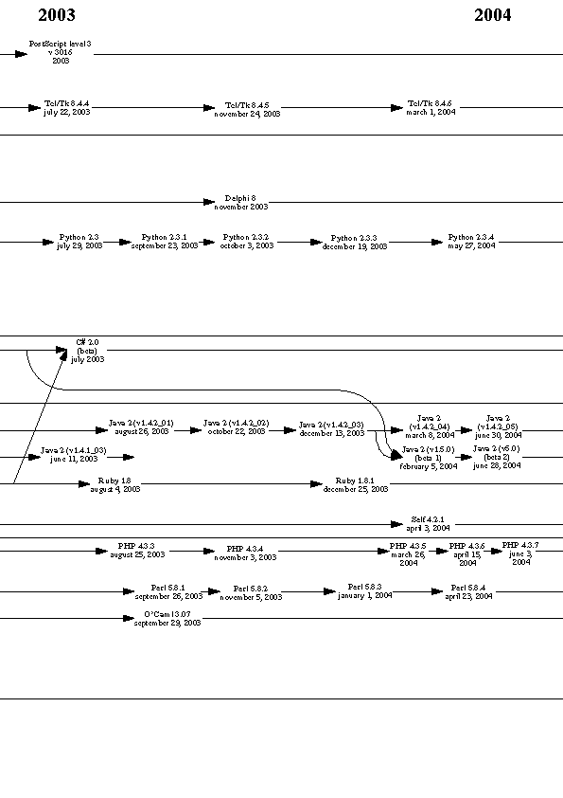
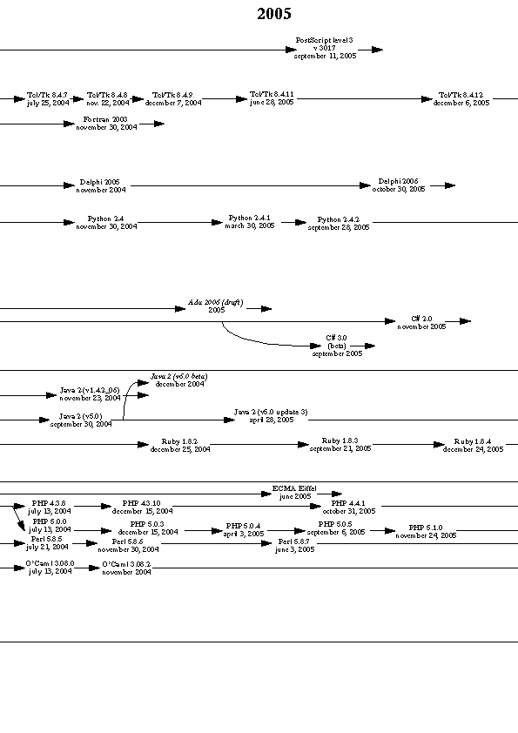
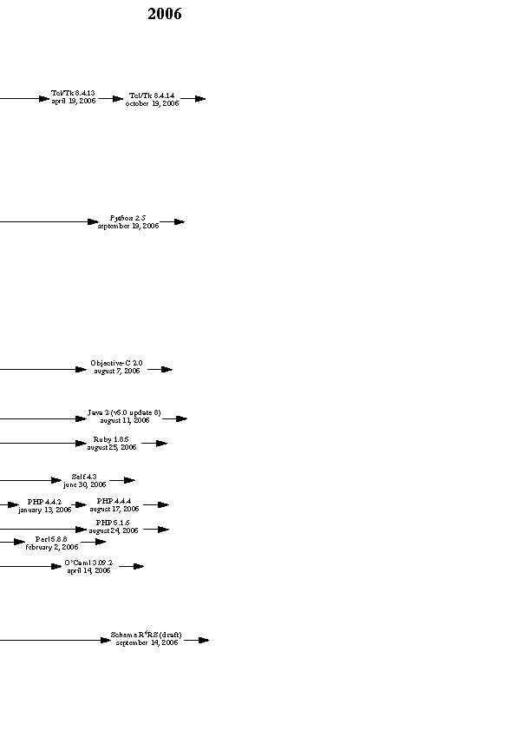
Language Evolution
From FORTRAN to a few present day languages
Source: Eric Levenez

Slide 29
Origins of C++
Structural influence
Feature influence
Fortran
1960
Algol 60
CPL
1970
BCPL
Simula 67
C
1980
Algol 68
ML
Clu
C with Classes
Ada
C++
1990
ANSI C
C++arm
C++std
Source: B. Stroustrup, The Design and Evolution of C++

Slide 30
Academic Influence on C++
  “Exceptions were considered in the original design of C++, but
  were postponed because there wasn't time to do a thorough job of exploring the design and implementation issues.
  In retrospect, the greatest influence on the C++ exception
  handling design was the work on fault-tolerant systems started at the University of Newcastle in England by Brian Randell and his colleagues and continued in many places since.”
  …
-- B. Stroustrup, A History of C++

Slide 31
Origins of Java
Java grew out of C++, Eiffel, SmallTalk, Objective C, and Cedar/Mesa
Example lessons learned:
  Stumbling blocks of C++ removed (multiple inheritance, preprocessing, operator overloading, automatic coercion, etc.)
  Pointers removed based on studies of bug injection
  GOTO removed based on studies of usage patterns
  Objects based on Eiffel, SmallTalk
  Java interfaces based on Objective C protocols
  Synchronization follows monitor and condition variable paradigm (introduced by Hoare, implemented in Cedar/Mesa)
  Bytecode approach validated as early as UCSD P-System (‘70s)
→ Lesser-known precursors essential to Java’s success
Source: J. Gosling, H. McGilton, The Java Language Enviornment

Slide 32
Why New Programming Models and Languages?
Paradigm shift in architecture
  From sequential to multicore
  Need a new “common machine language”
New application domains
  Streaming
  Scripting
  Event-driven (real-time)
New hardware features
  Transactions
  Introspection
  Scalar Operand Networks or Core-to-core DMA
New customers
  Mobile devices
  The average programmer!
Can we achieve parallelism without burdening the programmer?

Slide 33
Domain Specific Languages
There is no single programming domain!
  Many programs don’t fit the OO model (ex: scripting and streaming)
Need to identify new programming models/domains
  Develop domain specific end-to-end systems
  Develop languages, tools, applications ⇒ a body of knowledge
Stitching multiple domains together is a hard problem
  A central concept in one domain may not exist in another
    Shared memory is critical for transactions, but not available in streaming
  Need conceptually simple and formally rigorous interfaces
  Need integrated tools
  But critical for many DOD and other applications

Slide 34
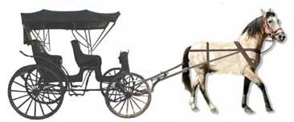
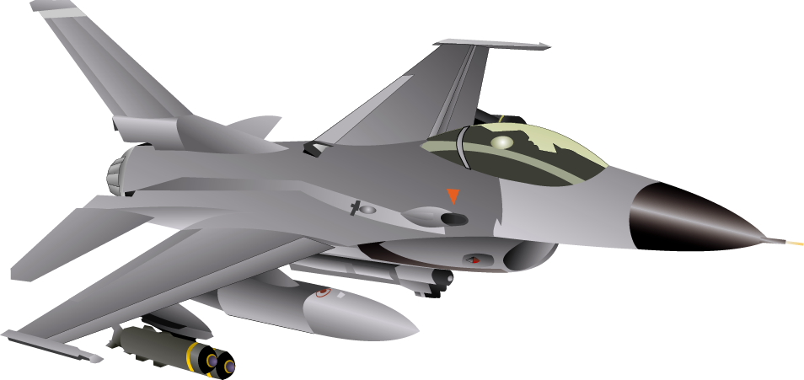

Programming Languages and Architectures
C
von-Neumann
machine
Modern
architecture
Two choices:
  Bend over backwards to support
  old languages like C/C++
  Develop parallel architectures
  that are hard to program

Slide 35
Compiler-Aware
Language Design
The StreamIt Experience
FMDemod
Scatter
LPF₁
LPF₂
LPF₃
Gather
Supported by ITR
and NGS Awards
Speaker

Slide 36
Is there a win-win situation?
boost productivity, enable faster development and rapid prototyping
programmability
domain specific
optimizations
enable parallel
execution
simple and effective optimizations for domain specific abstractions
target tiled architectures, clusters, DSPs, multicores, graphics processors, …
Some programming models are inherently concurrent
  Coding them using a sequential language is…
    Harder than using the right parallel abstraction
    All information on inherent parallelism is lost
There are win-win situations
  Increasing the programmer productivity while extracting parallel performance

Slide 37
The StreamIt Project
Applications
  DES and Serpent [PLDI 05]
  MPEG-2 [IPDPS 06]
  SAR, DSP benchmarks, JPEG, …
Programmability
  StreamIt Language (CC 02)
  Teleport Messaging (PPOPP 05)
  Programming Environment in Eclipse (P-PHEC 05)
Domain Specific Optimizations
  Linear Analysis and Optimization (PLDI 03)
  Optimizations for bit streaming (PLDI 05)
  Linear State Space Analysis (CASES 05)
Architecture Specific Optimizations
  Compiling for Communication-Exposed Architectures (ASPLOS 02)
  Phased Scheduling (LCTES 03)
  Cache Aware Optimization (LCTES 05)
  Load-Balanced Rendering
  (Graphics Hardware 05)
  Task, Data and Pipeline Parallelism (ASPLOS 06)
StreamIt Program
Front-end
Annotated Java
Simulator
(Java Library)
Stream-Aware
Optimizations
Uniprocessor
backend
Cluster
backend
Raw
backend
IBM X10
backend
C/C++
MPI-like
C/C++
C per tile +
msg code
Streaming
X10 runtime
Notes:
over the last 5 years we have been developing….

Slide 38
Streaming Application Abstraction
MPEG bit stream
picture type
Structured block level diagram describes computation and flow of data
Conceptually easy to understand
  Clean abstraction of functionality
Mapping to C (sequentialization) destroys this simple view
VLD
add VLD(QC, PT1, PT2);
add splitjoin {
split roundrobin(N∗B, V);
add pipeline {
add ZigZag(B);
add IQuantization(B) to QC;
add IDCT(B);
add Saturation(B);
}
add pipeline {
add MotionVectorDecode();
add Repeat(V, N);
}
join roundrobin(B, V);
}
add splitjoin {
split roundrobin(4∗(B+V), B+V, B+V);
add MotionCompensation(4∗(B+V)) to PT1;
for (int i = 0; i < 2; i++) {
add pipeline {
add MotionCompensation(B+V) to PT1;
add ChannelUpsample(B);
}
}
join roundrobin(1, 1, 1);
}
add PictureReorder(3∗W∗H) to PT2;
add ColorSpaceConversion(3∗W∗H);
quantization coefficients
macroblocks, motion vectors
<QC>
splitter
<PT1, PT2>
frequency encoded
macroblocks
differentially coded
motion vectors
ZigZag
IQuantization
Motion Vector Decode
<QC>
IDCT
Repeat
Saturation
spatially encoded macroblocks
joiner
motion vectors
splitter
Y
Cb
Cr
Motion Compensation
Motion Compensation
Motion Compensation
<PT1>
reference
picture
<PT1>
reference
picture
<PT1>
reference
picture
Channel Upsample
Channel Upsample
joiner
recovered picture
Picture Reorder
<PT2>
Color Space Conversion
MPEG-2 Decoder

Slide 39
StreamIt Improves Productivity
MPEG bit stream
picture type
VLD
add VLD(QC, PT1, PT2);
add splitjoin {
split roundrobin(N∗B, V);
add pipeline {
add ZigZag(B);
add IQuantization(B) to QC;
add IDCT(B);
add Saturation(B);
}
add pipeline {
add MotionVectorDecode();
add Repeat(V, N);
}
join roundrobin(B, V);
}
add splitjoin {
split roundrobin(4∗(B+V), B+V, B+V);
add MotionCompensation(4∗(B+V)) to PT1;
for (int i = 0; i < 2; i++) {
add pipeline {
add MotionCompensation(B+V) to PT1;
add ChannelUpsample(B);
}
}
join roundrobin(1, 1, 1);
}
add PictureReorder(3∗W∗H) to PT2;
add ColorSpaceConversion(3∗W∗H);
quantization coefficients
macroblocks, motion vectors
<QC>
splitter
<PT1, PT2>
frequency encoded
macroblocks
differentially coded
motion vectors
ZigZag
IQuantization
Motion Vector Decode
<QC>
IDCT
Repeat
Saturation
spatially encoded macroblocks
joiner
motion vectors
splitter
Y
Cb
Cr
Motion Compensation
Motion Compensation
Motion Compensation
<PT1>
reference
picture
<PT1>
reference
picture
<PT1>
reference
picture
Channel Upsample
Channel Upsample
joiner
recovered picture
Picture Reorder
<PT2>
Color Space Conversion
output to player

Slide 40
StreamIt Compiler
Extracts Parallelism
MPEG bit stream
picture type
Task Parallelism
  Thread (fork/join) parallelism
  Parallelism explicit in algorithm
  Between filters without producer/consumer relationship
Data Parallelism
  Data parallel loop (forall)
  Between iterations of a stateless filter
  Can’t parallelize filters with state
Pipeline Parallelism
  Usually exploited in hardware
  Between producers and consumers
  Stateful filters can be parallelized
VLD
add VLD(QC, PT1, PT2);
add splitjoin {
split roundrobin(N∗B, V);
add pipeline {
add ZigZag(B);
add IQuantization(B) to QC;
add IDCT(B);
add Saturation(B);
}
add pipeline {
add MotionVectorDecode();
add Repeat(V, N);
}
join roundrobin(B, V);
}
add splitjoin {
split roundrobin(4∗(B+V), B+V, B+V);
add MotionCompensation(4∗(B+V)) to PT1;
for (int i = 0; i < 2; i++) {
add pipeline {
add MotionCompensation(B+V) to PT1;
add ChannelUpsample(B);
}
}
join roundrobin(1, 1, 1);
}
add PictureReorder(3∗W∗H) to PT2;
add ColorSpaceConversion(3∗W∗H);
quantization coefficients
macroblocks, motion vectors
<QC>
splitter
<PT1, PT2>
frequency encoded
macroblocks
differentially coded
motion vectors
ZigZag
IQuantization
Motion Vector Decode
<QC>
IDCT
Repeat
Saturation
spatially encoded macroblocks
joiner
motion vectors
splitter
Y
Cb
Cr
Motion Compensation
Motion Compensation
Motion Compensation
<PT1>
reference
picture
<PT1>
reference
picture
<PT1>
reference
picture
Channel Upsample
Channel Upsample
joiner
recovered picture
Picture Reorder
<PT2>
Color Space Conversion
MPEG-2 Decoder

Slide 41
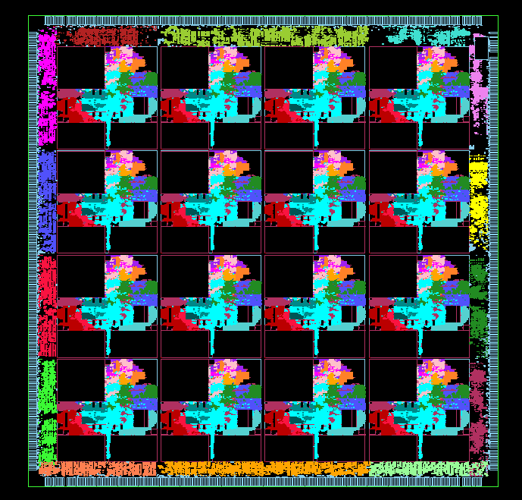
StreamIt Compiler
Parallelism → Processor Resources
StreamIt Compilers Finds the Inherent Parallelism
  Graph structure is architecture independent
  Abundance of parallelism in the StreamIt domain
Too much parallelism is as bad as too little parallelism
  (remember dataflow!)
Map the parallelism in to the available resources in a given multicore
  Use all available parallelism
  Maximize load-balance
  Minimize communication

Slide 42
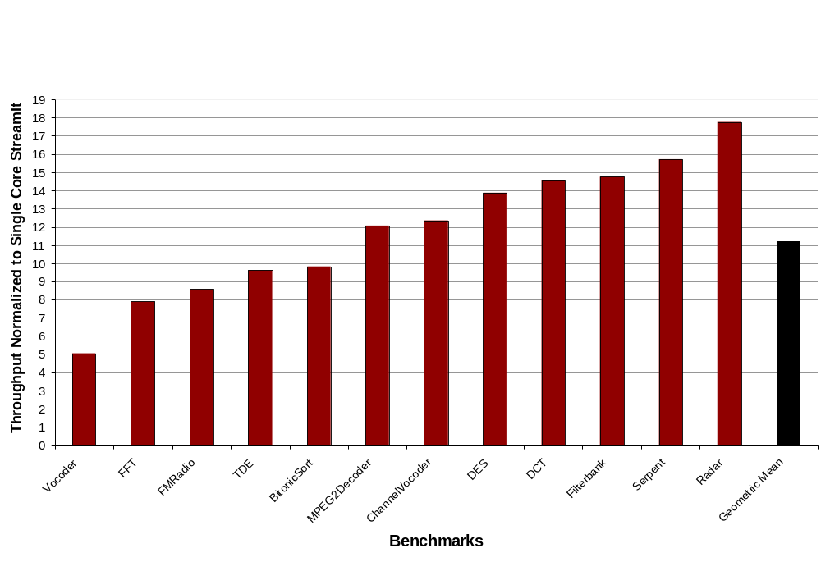
StreamIt Performance on Raw
Notes:
put in all the bars for this, grey out other bars, the outline and the fill
explain the vocoder and the radar app and why they do so well
redo colors!
explain the other minor speedups
explain mpeg2decoder
comment on state, is it going to become more important mpeg4, h264?

Slide 43
Outline: Ideas on Solving the Third Software Crisis
Advances in Computer Architecture
Novel Programming Models and Languages
Aggressive Compilers
Tools to support parallelization, debugging and migration

Slide 44
Compilers
Compilers are critical in reducing the burden on programmers
  Identification of data parallel loops can be easily automated, but many current systems (Brook, PeakStream) require the programmer to do it.
Need to revive the push for automatic parallelization
  Best case: totally automated parallelization hidden from the user
  Worst case: simplify the task of the programmer

Slide 45
Parallelizing Compilers
The SUIF Experience

Slide 46
The SUIF Parallelizing Compiler
The SUIF Project at Stanford in the ’90
  Mainly FORTRAN
  Aggressive transformations to undo “human optimizations”
  Interprocedural analysis framework
  Scalar and array data-flow, reduction recognition and a host of other analyses and transformations
SUIF compiler had the Best SPEC results by automatic parallelization

Slide 47
SPECFP92 performance
1200
8
s
r
1000
7
o
s
6
s
e
S
800
c
P
5
o
O
r
L
600
4
P
F
f
3
o
M
400
r
e
2
b
200
m
1
u
N
0
6
c
p
a
2
5
2
n
7
r
d
r
v
6
g
u
p
r
p
e
p
n
a
a
2
o
t
5
2
d
p
o
d
v
s
i
s
e
o
c
a
2
j
a
j
v
a
r
2
c
e
o
p
l
l
l
d
u
m
m
c
d
f
d
w
d
a
n
y
s
i
m
m
o
w
p
h
t
s
s
Vector processor Cray C90 540
Uniprocessor Digital 21164 508
SUIF on 8 processors Digital 8400 1,016

Slide 48
Automatic Parallelization
“Almost” Worked
Why did not this reach mainstream?
  The compilers were not robust
  Clients were impossible (performance at any cost)
  Multiprocessor communication was expensive
  Had to compete with improvements in sequential performance
  The Dogfooding problem
Today: Programs are even harder to analyze
  Complex data structures
  Complex control flow
  Complex build process
  Aliasing problem (type unsafe languages)

Slide 49
Outline: Ideas on Solving the Third Software Crisis
Advances in Computer Architecture
Novel Programming Models and Languages
Aggressive Compilers
Tools to support parallelization, debugging and migration

Slide 50
Tools
A lot of progress in tools to improve programmer productivity
Need tools to
  Identify parallelism
  Debug parallel code
  Update and maintain parallel code
  Stitch multiple domains together
Need an “Eclipse platform for multicores”

Slide 51
Migrating the Dusty Deck
Impossible to bring them to the new era automatically
  Badly mangled, hand-optimized, impossible to analyze code
  Automatic compilation, even with a heroic effort, cannot do anything
Help rewrite the huge stack of dusty deck
  Application in use
  Source code available
  Programmer long gone
Getting the new program to have the same behavior is hard
  “Word pagination problem”
Can take advantage of many recent advances
  Creating test cases
  Extracting invariants
  Failure oblivious computing

Slide 52
Facilitate Evaluation and Feedback for Rapid Evolution
Language/Compiler/Tools
Idea
Implementation
Evaluation
Evaluation
Evaluate
Performance
Debugging
Functional
Debugging
Develop a
Program

Slide 53
Rapid Evaluation
Extremely hard to get
  Real users have no interest in flaky tools
  Hard to quantify
  Superficial users vs. Deep users will give different feedback
    Fatal flaws as well as amazing uses may not come out immediately
Need a huge, sophisticated (and expensive) infrastructure
  How to get a lot of application experts to use the system?
  How do you get them to become an expert?
  How do you get them to use it for a long time?
  How do you scientifically evaluate?
  How go you get actionable feedback?
A “Center for Evaluating Multicore Programming Environments”??

Slide 54
Build and Mobilize the Community
Bring the High Performance Languages/Compilers/Tools folks out of the woodwork!
  Then: A few customers with the goal of performance at any cost.
  Then: Had to compete with Moore’s law
  Now: Reasonable performance improvements for the masses
Bring the folks who won the second crisis
  Then: the focus is improving programmer productivity
  Now: how to maintain performance in a multicore world
  Now: If not solved, all the productivity gains will be lost!
Get architects to listen to language/compiler people
  Then: We don’t need you, we can do everything in hardware
  Then: Or here is a cool hardware feature, you figure out how to use it.
  Now: Superscalars crashed and burned; cannot keep the status quo!
  Now: Need to create a useable programming model

Slide 55
Conclusions
Programming language research is a critical long-term investment
  In the 1950s, the early background for the Simula language was funded by the Norwegian Defense Research Establishment
  In 2002, the designers received the ACM Turing Award “for ideas fundamental to the emergence of object oriented programming.”
Compilers and Tools are also essential components
Computer Architecture is at a cross roads
  Once in a lifetime opportunity to redesign from scratch
  How to use the Moore’s law gains to improve the programmability?
Switching to multicores without losing the gains in programmer productivity may be the Grandest of the Grand Challenges
  Half a century of work ⇒ still no winning solution
  Will affect everyone!
Need a Grand Partnership between the Government, Industry and Academia to solve this crisis!

