Slide 1

StreamIt – A Programming Language for the Era of Multicores
Saman Amarasinghe
http://cag.csail.mit.edu/streamit

Slide 2
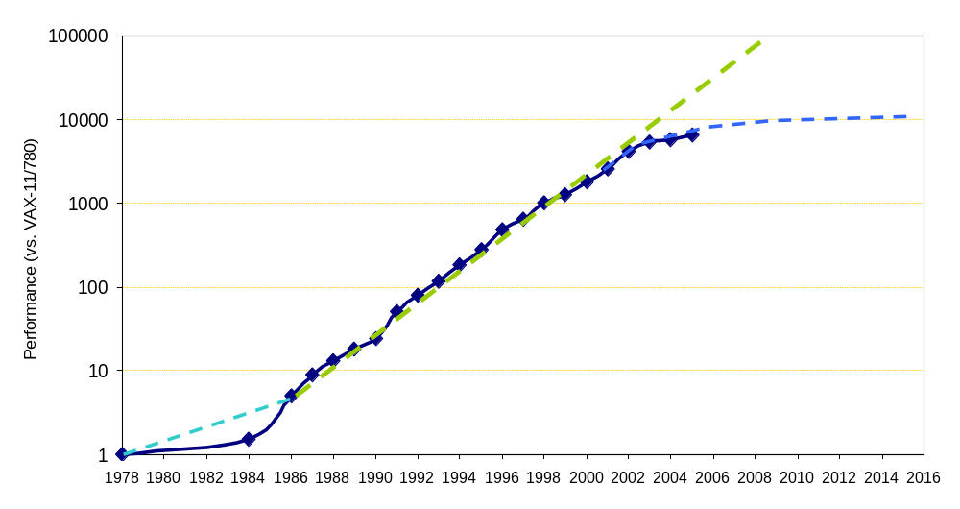
Moore’s Law
From Hennessy and Patterson, Computer Architecture:
A Quantitative Approach, 4th edition, 2006
Itanium 2
1,000,000,000
Itanium
100,000,000
P4
P3
10,000,000
P2
Pentium
Number of Transistors
486
1,000,000
386
286
100,000
8086
10,000
From David Patterson

Slide 3
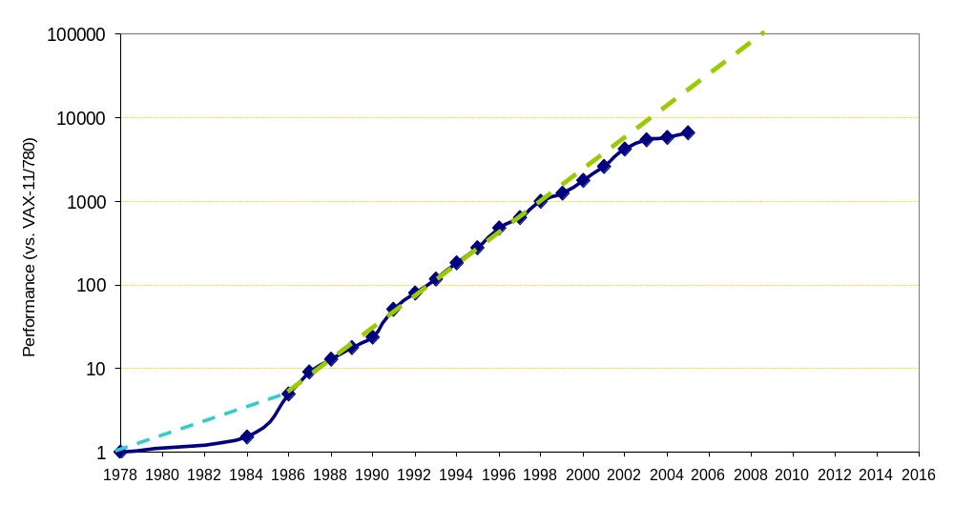
Uniprocessor Performance (SPECint)
From Hennessy and Patterson, Computer Architecture:
A Quantitative Approach, 4th edition, 2006
Itanium 2
1,000,000,000
Itanium
100,000,000
P4
P3
10,000,000
P2
Pentium
Number of Transistors
486
1,000,000
386
286
100,000
8086
10,000
From David Patterson

Slide 4
Uniprocessor Performance (SPECint)
From Hennessy and Patterson, Computer Architecture:
A Quantitative Approach, 4th edition, 2006
Itanium 2
1,000,000,000
Itanium
100,000,000
P4
P3
10,000,000
P2
Pentium
All major manufacturers moving to multicore architectures
Number of Transistors
486
1,000,000
386
286
100,000
8086
10,000
General-purpose unicores have stopped historic performance scaling
  Power consumption
  Wire delays
  DRAM access latency
  Diminishing returns of more instruction-level parallelism
From David Patterson

Slide 5
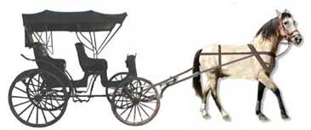
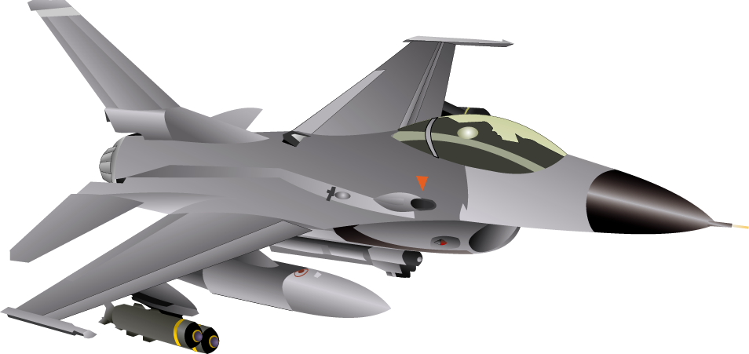

Programming Languages for Modern Architectures
C
von-Neumann
machine
Modern
architecture
Two choices:
  Bend over backwards to support
  old languages like C/C++
  Develop high-performance
  architectures that are hard to program

Slide 6
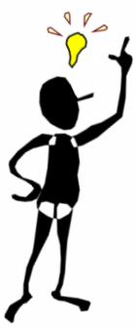
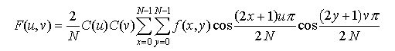
Parallel Programmer’s Dilemma
high
Rapid prototyping
- MATLAB
- Ptolemy
Natural parallelization
- StreamIt
Automatic parallelization
- FORTRAN compilers
- C/C++ compilers
Malleability
Manual parallelization
- C/C++ with MPI
Portability
Productivity
Optimal parallelization
- assembly code
low
Parallel Performance
high

Slide 7
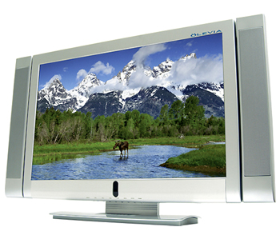
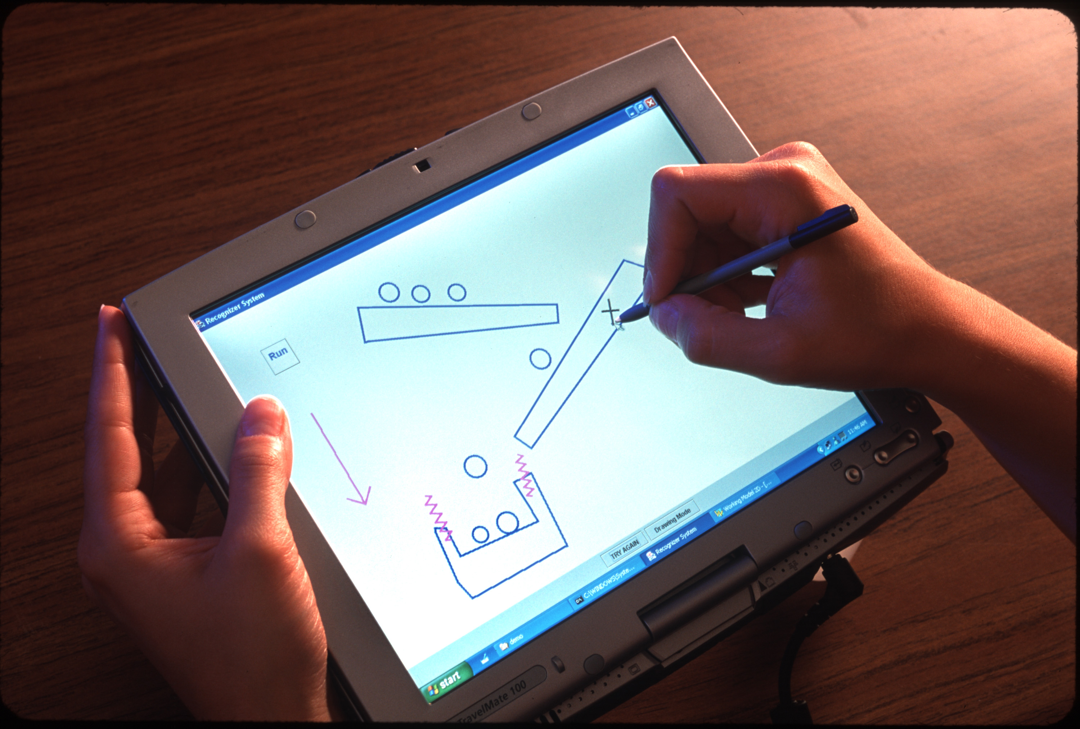

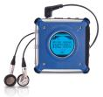

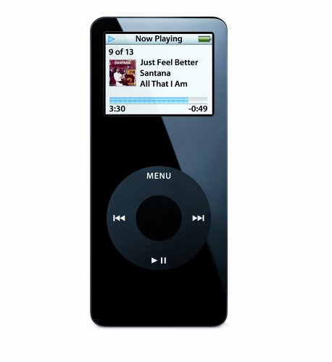




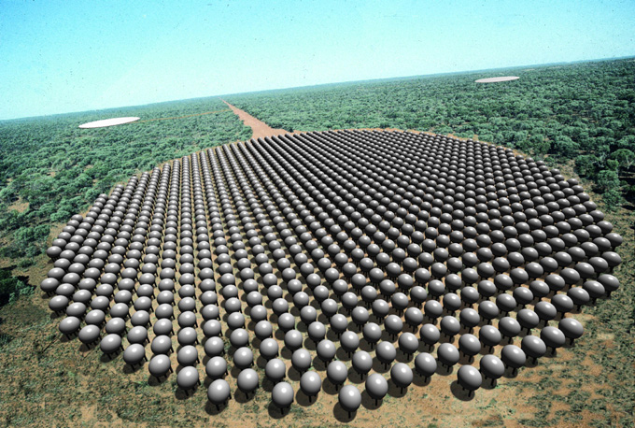

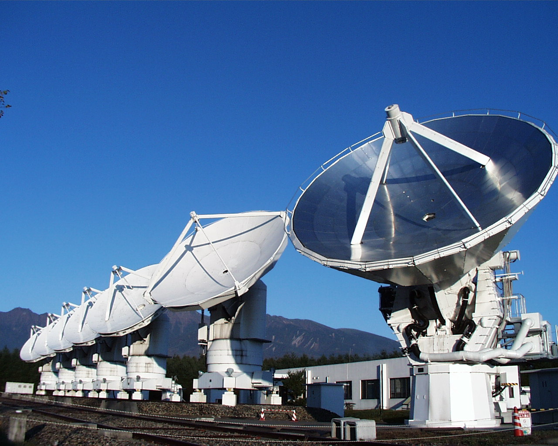
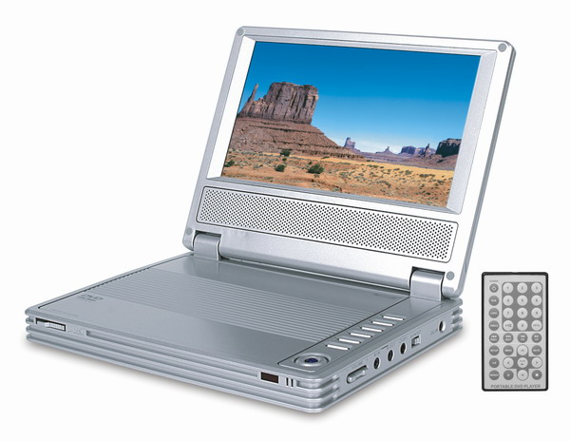

Stream Application Domain
Graphics
Cryptography
Databases
Object recognition
Network processing and security
Scientific codes
…

Slide 8
StreamIt Project
Language Semantics / Programmability
  StreamIt Language (CC 02)
  Programming Environment in Eclipse (P-PHEC 05)
Optimizations / Code Generation
  Phased Scheduling (LCTES 03)
  Cache Aware Optimization (LCTES 05)
Domain Specific Optimizations
  Linear Analysis and Optimization (PLDI 03)
  Optimizations for bit streaming (PLDI 05)
  Linear State Space Analysis (CASES 05)
Parallelism
  Teleport Messaging (PPOPP 05)
  Compiling for Communication-Exposed Architectures (ASPLOS 02)
  Load-Balanced Rendering
  (Graphics Hardware 05)
Applications
  SAR, DSP benchmarks, JPEG,
  MPEG [IPDPS 06], DES and
  Serpent [PLDI 05], …
StreamIt Program
Front-end
Annotated Java
Stream-Aware
Optimizations
Uniprocessor
backend
Cluster
backend
Raw
backend
IBM X10
backend
C
MPI-like
C
C per tile +
msg code
Streaming
X10 runtime

Slide 9
Compiler-Aware Language Design
boost productivity, enable faster development and
rapid prototyping
programmability
domain specific
optimizations
enable parallel
execution
simple and effective optimizations for domain specific abstractions
target multicores, clusters, tiled architectures, DSPs, graphics processors, …

Slide 10
Streaming Application Design
MPEG bit stream
picture type
Structured block level diagram describes computation and flow of data
Conceptually easy to understand
  Clean abstraction of functionality
VLD
add VLD(QC, PT1, PT2);
add splitjoin {
split roundrobin(N∗B, V);
add pipeline {
add ZigZag(B);
add IQuantization(B) to QC;
add IDCT(B);
add Saturation(B);
}
add pipeline {
add MotionVectorDecode();
add Repeat(V, N);
}
join roundrobin(B, V);
}
add splitjoin {
split roundrobin(4∗(B+V), B+V, B+V);
add MotionCompensation(4∗(B+V)) to PT1;
for (int i = 0; i < 2; i++) {
add pipeline {
add MotionCompensation(B+V) to PT1;
add ChannelUpsample(B);
}
}
join roundrobin(1, 1, 1);
}
add PictureReorder(3∗W∗H) to PT2;
add ColorSpaceConversion(3∗W∗H);
quantization coefficients
macroblocks, motion vectors
<QC>
splitter
<PT1, PT2>
frequency encoded
macroblocks
differentially coded
motion vectors
ZigZag
IQuantization
Motion Vector Decode
<QC>
IDCT
Repeat
Saturation
spatially encoded macroblocks
joiner
motion vectors
splitter
Y
Cb
Cr
Motion Compensation
Motion Compensation
Motion Compensation
<PT1>
reference
picture
<PT1>
reference
picture
<PT1>
reference
picture
Channel Upsample
Channel Upsample
joiner
recovered picture
Picture Reorder
<PT2>
Color Space Conversion
MPEG-2 Decoder

Slide 11
StreamIt Philosophy
MPEG bit stream
picture type
Preserve program structure
  Natural for application developers to express
Leverage program structure to discover parallelism and deliver high performance
Programs remain clean
  Portable and malleable
VLD
add VLD(QC, PT1, PT2);
add splitjoin {
split roundrobin(N∗B, V);
add pipeline {
add ZigZag(B);
add IQuantization(B) to QC;
add IDCT(B);
add Saturation(B);
}
add pipeline {
add MotionVectorDecode();
add Repeat(V, N);
}
join roundrobin(B, V);
}
add splitjoin {
split roundrobin(4∗(B+V), B+V, B+V);
add MotionCompensation(4∗(B+V)) to PT1;
for (int i = 0; i < 2; i++) {
add pipeline {
add MotionCompensation(B+V) to PT1;
add ChannelUpsample(B);
}
}
join roundrobin(1, 1, 1);
}
add PictureReorder(3∗W∗H) to PT2;
add ColorSpaceConversion(3∗W∗H);
quantization coefficients
macroblocks, motion vectors
<QC>
splitter
<PT1, PT2>
frequency encoded
macroblocks
differentially coded
motion vectors
ZigZag
IQuantization
Motion Vector Decode
<QC>
IDCT
Repeat
Saturation
spatially encoded macroblocks
joiner
motion vectors
splitter
Y
Cb
Cr
Motion Compensation
Motion Compensation
Motion Compensation
<PT1>
reference
picture
<PT1>
reference
picture
<PT1>
reference
picture
Channel Upsample
Channel Upsample
joiner
recovered picture
Picture Reorder
<PT2>
Color Space Conversion

Slide 12
StreamIt Philosophy
MPEG bit stream
picture type
VLD
add VLD(QC, PT1, PT2);
add splitjoin {
split roundrobin(N∗B, V);
add pipeline {
add ZigZag(B);
add IQuantization(B) to QC;
add IDCT(B);
add Saturation(B);
}
add pipeline {
add MotionVectorDecode();
add Repeat(V, N);
}
join roundrobin(B, V);
}
add splitjoin {
split roundrobin(4∗(B+V), B+V, B+V);
add MotionCompensation(4∗(B+V)) to PT1;
for (int i = 0; i < 2; i++) {
add pipeline {
add MotionCompensation(B+V) to PT1;
add ChannelUpsample(B);
}
}
join roundrobin(1, 1, 1);
}
add PictureReorder(3∗W∗H) to PT2;
add ColorSpaceConversion(3∗W∗H);
quantization coefficients
macroblocks, motion vectors
<QC>
splitter
<PT1, PT2>
frequency encoded
macroblocks
differentially coded
motion vectors
ZigZag
IQuantization
Motion Vector Decode
<QC>
IDCT
Repeat
Saturation
spatially encoded macroblocks
joiner
motion vectors
splitter
Y
Cb
Cr
Motion Compensation
Motion Compensation
Motion Compensation
<PT1>
reference
picture
<PT1>
reference
picture
<PT1>
reference
picture
Channel Upsample
Channel Upsample
joiner
recovered picture
Picture Reorder
<PT2>
Color Space Conversion
output to player

Slide 13
Stream Abstractions in StreamIt
MPEG bit stream
filters
VLD
add VLD(QC, PT1, PT2);
add splitjoin {
split roundrobin(N∗B, V);
add pipeline {
add ZigZag(B);
add IQuantization(B) to QC;
add IDCT(B);
add Saturation(B);
}
add pipeline {
add MotionVectorDecode();
add Repeat(V, N);
}
join roundrobin(B, V);
}
add splitjoin {
split roundrobin(4∗(B+V), B+V, B+V);
add MotionCompensation(4∗(B+V)) to PT1;
for (int i = 0; i < 2; i++) {
add pipeline {
add MotionCompensation(B+V) to PT1;
add ChannelUpsample(B);
}
}
join roundrobin(1, 1, 1);
}
add PictureReorder(3∗W∗H) to PT2;
add ColorSpaceConversion(3∗W∗H);
<QC>
splitter
<PT1, PT2>
pipelines
ZigZag
IQuantization
Motion Vector Decode
<QC>
IDCT
Repeat
Saturation
joiner
splitjoins
splitter
Motion Compensation
Motion Compensation
Motion Compensation
<PT1>
reference
picture
<PT1>
reference
picture
<PT1>
reference
picture
Channel Upsample
Channel Upsample
joiner
Picture Reorder
<PT2>
Color Space Conversion

Slide 14
StreamIt Language Highlights
Filters
Pipelines
Splitjoins
Teleport messaging

Slide 15
Example StreamIt Filter
0
1
2
3
4
5
6
7
8
9
10
11
input
FIR
0
1
output
float→float filter FIR (int N) {
work push 1 pop 1 peek N {
float result = 0;
for (int i = 0; i < N; i++) {
result += weights[i] ∗ peek(i);
}
push(result);
pop();
}
}

Slide 16
FIR Filter in C
FIR functionality obscured by buffer management details
Programmer must commit to a particular buffer implementation strategy
void FIR(
int* src,
int* dest,
int* srcIndex,
int* destIndex,
int srcBufferSize,
int destBufferSize,
int N) {
float result = 0.0;
for (int i = 0; i < N; i++) {
result += weights[i] * src[(*srcIndex + i) % srcBufferSize];
}
dest[*destIndex] = result;
*srcIndex = (*srcIndex + 1) % srcBufferSize;
*destIndex = (*destIndex + 1) % destBufferSize;
}

Slide 17
StreamIt Language Highlights
Filters
Pipelines
Splitjoins
Teleport messaging

Slide 18
Example StreamIt Pipeline
Pipeline
  Connect components in sequence
  Expose pipeline parallelism
Column_iDCTs
float→float pipeline 2D_iDCT (int N)
{
add Column_iDCTs(N);
add Row_iDCTs(N);
}
Row_iDCTs

Slide 19
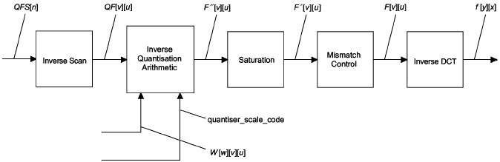
Preserving Program Structure
int->int pipeline BlockDecode(
portal<InverseQuantisation> quantiserData,
portal<MacroblockType> macroblockType) {
add ZigZagUnordering();
add InverseQuantization() to quantiserData, macroblockType;
add Saturation(-2048, 2047);
add MismatchControl();
add 2D_iDCT(8);
add Saturation(-256, 255);
}
quantiserData,
Can be reused for JPEG decoding
quantiserData,
64
64
1
1
64
From Figures 7-1 and 7-4 of the
MPEG-2 Specification
(ISO 13818-2, P. 61, 66)

Slide 20
In Contrast: C Code Excerpt
EXTERN unsigned char *backward_reference_frame[3];
EXTERN unsigned char *forward_reference_frame[3];
EXTERN unsigned char *current_frame[3];
...etc...
decode_macroblock() {
parser();
motion_vectors();
for (comp=0;comp<block_count;comp++) {
parser();
Decode_MPEG2_Block();
}
}
motion_vectors() {
parser();
decode_motion_vector
parser();
}
Decode_Picture {
for (;;) {
parser()
for (;;) {
decode_macroblock();
motion_compensation();
if (condition)
then break;
}
}
frame_reorder();
}
motion_compensation() {
for (channel=0;channel<3;channel++)
form_component_prediction();
for (comp=0;comp<block_count;comp++) {
Saturate();
IDCT();
Add_Block();
}
}
Decode_MPEG2_Block() {
for (int i = 0;; i++) {
parsing();
ZigZagUnordering();
inverseQuantization();
if (condition) then
break;
}
}
Explicit for-loops iterate through picture frames
Frames passed through global arrays, handled with pointers
Mixing of parser, motion compensation, and spatial decoding

Slide 21
StreamIt Language Highlights
Filters
Pipelines
Splitjoins
Teleport messaging

Slide 22
Example StreamIt Splitjoin
Splitjoin
  Connect components in parallel
  Expose task parallelism and data distribution
float→float splitjoin Row_iDCT (int N)
{
split roundrobin(N);
for (int i = 0; i < N; i++) {
add 1D_iDCT(N);
}
join roundrobin(N);
}
splitter
joiner

Slide 23
Example StreamIt Splitjoin
float→float pipeline 2D_iDCT (int N)
{
add Column_iDCTs(N);
add Row_iDCTs(N);
}
splitter
float→float splitjoin Column_iDCT (int N)
{
split roundrobin(1);
for (int i = 0; i < N; i++) {
add 1D_iDCT(N);
}
join roundrobin(1);
}
iDCT
iDCT
iDCT
iDCT
joiner
splitter
splitter
splitter
float→float splitjoin Row_iDCT (int N)
{
split roundrobin(N);
for (int i = 0; i < N; i++) {
add 1D_iDCT(N);
}
join roundrobin(N);
}
iDCT
iDCT
iDCT
iDCT
joiner
joiner
joiner

Slide 24



Naturally Expose Data Distribution
1
2
3
4
5
6
Y
Cb
Cr
scatter macroblocks according to chroma format
add splitjoin {
split roundrobin(4*(B+V), B+V, B+V);
add MotionCompensation();
for (int i = 0; i < 2; i++) {
add pipeline {
add MotionCompensation();
add ChannelUpsample(B);
}
}
join roundrobin(1, 1, 1);
}
splitter 4:1:1
Y
Cb
Cr
Motion
Compensation
Motion
Compensation
Motion
Compensation
Channel
Upsample
Channel
Upsample
joiner 1:1:1
gather one pixel at a time
recovered picture

Slide 25


Stream Graph Malleability
1
2
splitter 4,1,1
MC
MC
MC
3
4
5
6
Upsample
Upsample
Y
Cb
Cr
joiner
4:2:0 chroma format
splitter 4,(2+2)
1
2
5
6
splitter 1,1
MC
MC
MC
3
4
7
8
Upsample
Upsample
Y
Cb
Cr
joiner
4:2:2 chroma format
joiner

Slide 26
StreamIt Code Sample
red = code added or modified to support 4:2:2 format
splitter 4,1,1
MC
MC
MC
// C = blocks per chroma channel per macroblock
// C = 1 for 4:2:0, C = 2 for 4:2:2
add splitjoin {
split roundrobin(4*(B+V), 2*C*(B+V));
add MotionCompensation();
add splitjoin {
split roundrobin(B+V, B+V);
for (int i = 0; i < 2; i++) {
add pipeline {
add MotionCompensation()
add ChannelUpsample(C,B);
}
}
join roundrobin(1, 1);
}
join roundrobin(1, 1, 1);
}
Upsample
Upsample
joiner
splitter 4,(2+2)
splitter 1,1
MC
MC
MC
Upsample
Upsample
joiner
joiner

Slide 27
In Contrast: C Code Excerpt
red = pointers used for address calculations
/* Y */
form_component_prediction(src[0]+(sfield?lx2>>1:0),dst[0]+(dfield?lx2>>1:0),
lx,lx2,w,h,x,y,dx,dy,average_flag);
if (chroma_format!=CHROMA444) {
lx>>=1; lx2>>=1; w>>=1; x>>=1; dx/=2;
}
if (chroma_format==CHROMA420) {
h>>=1; y>>=1; dy/=2;
}
/* Cb */
form_component_prediction(src[1]+(sfield?lx2>>1:0),dst[1]+(dfield?lx2>>1:0),
lx,lx2,w,h,x,y,dx,dy,average_flag);
/* Cr */
form_component_prediction(src[2]+(sfield?lx2>>1:0),dst[2]+(dfield?lx2>>1:0),
lx,lx2,w,h,x,y,dx,dy,average_flag);
Adjust values used for address calculations depending on the chroma format used.

Slide 28
StreamIt Language Highlights
Filters
Pipelines
Splitjoins
Teleport messaging

Slide 29
Teleport Messaging
Avoids muddling data
streams with control
relevant information
Localized interactions
in large applications
  A scalable alternative to
  global variables or
  excessive parameter
  passing
VLD
IQ
MC
MC
MC
Order

Slide 30
Motion Prediction and Messaging
picture type
portal<MotionCompensation> PT;
add splitjoin {
split roundrobin(4*(B+V), B+V, B+V);
add MotionCompensation() to PT;
for (int i = 0; i < 2; i++) {
add pipeline {
add MotionCompensation() to PT;
add ChannelUpsample(B);
}
}
join roundrobin(1, 1, 1);
}
splitter
Y
Cb
Cr
Motion
Compensation
Motion
Compensation
Motion
Compensation
Channel
Upsample
Channel
Upsample
joiner
recovered picture

Slide 31
Teleport Messaging Overview
Looks like method call, but timed
relative to data in the stream
Simple and precise for user
  Exposes dependences to compiler
  Adjustable latency
  Can send upstream or downstream
TargetFilter x;
if newPictureType(p) {
x.setPictureType(p) @ 0;
}
void setPicturetype(int p) {
reconfigure(p);
}

Slide 32
Messaging Equivalent in C
The MPEG Bitstream
Decode
Picture
File
Parsing
Global
Variable
Space
Decode
Macroblock
Decode
Block
ZigZagUnordering
Inverse
Quantization
Motion
Compensation
Decode
Motion
Vectors
Saturate
IDCT
Motion Compensation
For Single Channel
Frame Reordering
Output Video

Slide 33
Compiler-Aware Language Design
boost productivity, enable faster development and
rapid prototyping
programmability
domain specific
optimizations
enable parallel
execution
simple and effective optimizations for domain specific abstractions
target multicores, clusters, tiled architectures, DSPs, graphics processors, …

Slide 34
Multicores Are Here!
512
Picochip
PC102
Ambric
AM2045
256
Cisco
CSR-1
128
Intel
Tflops
64
Tilera
# of
cores
32
Raw
Raza
XLR
Cavium
Octeon
16
8
Niagara
Cell
4
Broadcom 1480
Opteron 4P
Xbox360
Xeon MP
2
Power4
PA-8800
Opteron
Tanglewood
PExtreme
Power6
1
4004
8080
8086
286
386
486
Pentium
P2
P3
Itanium
Yonah
8008
P4
Athlon
Itanium 2
1970
1975
1980
1985
1990
1995
2000
2005
20??
Notes:
Lets look at a simplified graph of showing a log scale of the number of cores for some commodity microprocessors versus their date of introduction.
For 35 years, uniprocessor designs dominated the commodity microprocessor market.
But their end has come due to the limited scalability of their global, monolithic structures.
The major cpu vendors have stopped development of uniprocessor designs.
In the last 5 years, commodity processor designers have turned to multicore designs to continue performance scalability.
From 2 cores up to hundreds of cores.

Slide 35
Von Neumann Languages
Why C (FORTRAN, C++ etc.) became very successful?
  Abstracted out the differences of von Neumann machines
  Directly expose the common properties
  Can have a very efficient mapping to a von Neumann machine
  “C is the portable machine language for von Numann machines”
von Neumann languages are a curse for Multicores
  We have squeezed out all the performance out of C
  But, cannot easily map C into multicores

Slide 36
Common Machine Languages
Unicores:
Multicores:
Common Properties
Single flow of control
Single memory image
Common Properties
Multiple flows of control
Multiple local memories
Differences:
Register File
ISA
Functional Units
Differences:
Number and capabilities of cores
Communication Model
Synchronization Model
Register Allocation
Instruction Selection
Instruction Scheduling
von-Neumann languages represent the common properties and abstract away the differences
Notes:
also a common machine language must not be too complex so that it can attract typical programmers.
memories maybe shared, does not matter if it is exposed in the lang.
If we were to use a von Neumann language as a common machine language for a multicore, it would reaquire heroic efforts from the compiler
there are many research proposals for such a common machine language, one representation that will cover a large part of the application space is a streaming representation
our research proposes streaming languages as the common machine language across multicore architectures
Specifically, in this talk we develop algorithms to enable portability and high-performance across multicores beginning from a high-level stream language.
our work focuses on compiler algorithms to break the abstraction layer between the language and the number of cores/capability of cores
Enable portability and high-performance across multicores

Slide 37
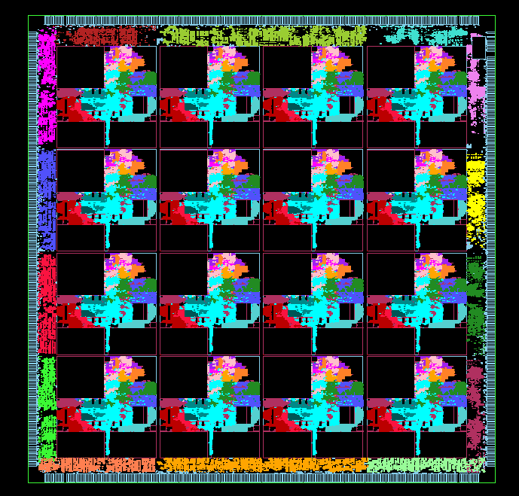
Bridging the Abstraction layers
StreamIt exposes the data movement
  Graph structure is architecture independent
StreamIt exposes the parallelism
  Explicit task parallelism
  Implicit but inherent data and pipeline parallelism
Each multicore is different in granularity and topology
  Communication is exposed to the compiler
The compiler needs to efficiently bridge the abstraction
  Map the computation and communication pattern of the program
  to the cores, memory and the communication substrate

Slide 38
Types of Parallelism
Task Parallelism
  Parallelism explicit in algorithm
  Between filters without producer/consumer relationship
Data Parallelism
  Peel iterations of filter, place within scatter/gather pair (fission)
  parallelize filters with state
Pipeline Parallelism
  Between producers and consumers
  Stateful filters can be parallelized
Scatter
Gather
Task
Notes:
Abundance of parallelism in streaming programs,
pipeline parallelism because these filters execute repeatedly, if they are mapped to different computing cores, we might be able to take advantage of pipeline parallelism, chains of producer and consumers
each of the resulting duplicate products executes less times than the original, they are placed in a round robin splitter…
a filter can be data-parallelized if it is stateless, meaning that the filter does not write to any variable that is read by a later iteration.
we have the nice properties that each type of parallelism can be naturally expressed in the stream graph

Slide 39
Types of Parallelism
Task Parallelism
  Parallelism explicit in algorithm
  Between filters without producer/consumer relationship
Data Parallelism
  Between iterations of a stateless filter
  Place within scatter/gather pair (fission)
  Can’t parallelize filters with state
Pipeline Parallelism
  Between producers and consumers
  Stateful filters can be parallelized
Scatter
Data Parallel
Gather
Scatter
Pipeline
Gather
Data
Task
Notes:
Abundance of parallelism in streaming programs,
Some streaming representations require that all filters are data parallel, we don’t have this requirement, the compiler discovers data parallel filters (see below)
pipeline parallelism because these filters execute repeatedly, if they are mapped to different computing cores, we might be able to take advantage of pipeline parallelism, chains of producer and consumers
each of the resulting duplicate products executes less times than the original, they are placed in a round robin splitter…
a filter can be data-parallelized if it is stateless, meaning that the filter does not write to any variable that is read by a later iteration.
we have the nice properties that each type of parallelism can be naturally expressed in the stream graph

Slide 40
Types of Parallelism
Traditionally:
Task Parallelism
  Thread (fork/join) parallelism
Data Parallelism
  Data parallel loop (forall)
Pipeline Parallelism
  Usually exploited in hardware
Scatter
Gather
Scatter
Pipeline
Gather
Data
Task

Slide 41
Problem Statement
Given:
  Stream graph with compute and communication estimate for each filter
  Computation and communication resources of the target machine
Find:
  Schedule of execution for the filters that best utilizes the available parallelism to fit the machine resources
Notes:
no filter dynamic filter migration
each filter is mapped to a single core
concerned with thruput!

Slide 42
Our 3-Phase Solution
Coarsen
Granularity
Data
Parallelize
Software
Pipeline
Coarsen: Fuse stateless sections of the graph
Data Parallelize: parallelize stateless filters
Software Pipeline: parallelize stateful filters
Compile to a 16 core architecture
  11.2x mean throughput speedup over single core
Notes:
coarsen gran to reduce communication overhead
Decreases global communication and synchronization
Enables internode optimizations on fused filter
data parallelize to parallel stateless components
to exploit pipeline parallelism we perform software pipeline to parallelize remaining components
after a prologue schedule is executed, we can statically schedule the filters in any order in the steady state…
data parallelize to parallel stateless components
to exploit pipeline parallelism we perform software pipeline to parallelize remaining components
after a prologue schedule is executed, we can statically schedule the filters in any order in the steady state
We employ a greedy heuristic to schedule the software pipelined steady-sate

Slide 43
Baseline 1: Task Parallelism
Splitter
Inherent task parallelism between two processing pipelines
Task Parallel Model:
  Only parallelize explicit task parallelism
  Fork/join parallelism
Execute this on a 2 core machine ~2x speedup over single core
What about 4, 16, 1024, … cores?
BandPass
BandPass
Compress
Compress
Process
Process
Expand
Expand
BandStop
BandStop
Joiner
Adder
Notes:
each pipeline filters a different frequency

Slide 44
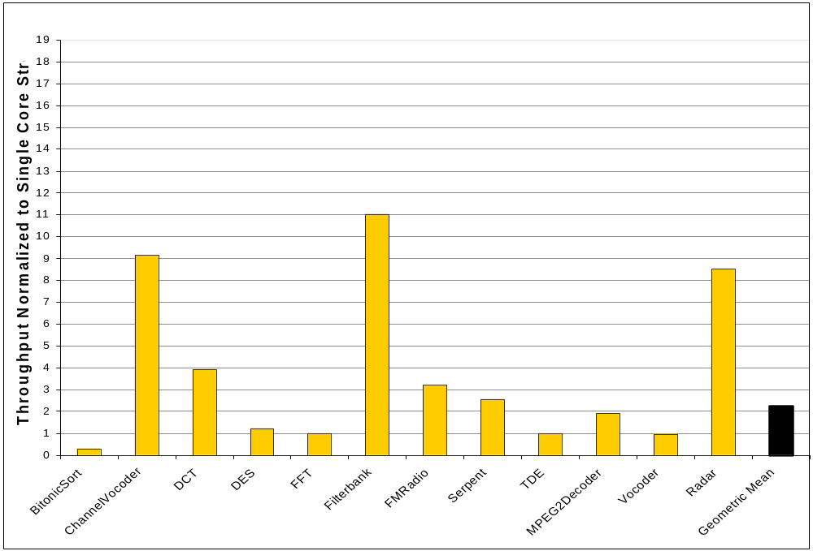

Evaluation: Task Parallelism
Raw Microprocessor
  16 inorder, single-issue cores with D$ and I$
  16 memory banks, each bank with DMA
  Cycle accurate simulator
Parallelism: Not matched to target!
Synchronization: Not matched to target!
Notes:
scale top to 16 , and use the same scale for each, height etc
mention problems with task parallelism
not adequate as only source of parallelism
highlight bitonic sort, mention the problems with communication granularity
how large is filterbank? does the number match?

Slide 45
Baseline 2: Fine-Grained
Data Parallelism
Splitter
Each of the filters in the example are stateless
Fine-grained Data Parallel Model:
  Fiss each stateless filter N ways (N is number of cores)
  Remove scatter/gather if possible
We can introduce data parallelism
  Example: 4 cores
Each fission group occupies entire machine
BandPass
Splitter
Splitter
BandPass
BandPass
BandPass
BandPass
BandPass
BandPass
BandPass
Joiner
Joiner
Splitter
Compress
Compress
Splitter
Compress
Compress
Compress
Compress
Compress
Compress
Joiner
Joiner
Process
Splitter
Splitter
Process
Process
Process
Process
Process
Process
Process
Joiner
Joiner
Splitter
Expand
Expand
Splitter
Expand
Expand
Expand
Expand
Expand
Expand
Joiner
Joiner
BandStop
Splitter
Splitter
BandStop
BandStop
BandStop
BandStop
BandStop
BandStop
BandStop
Joiner
Joiner
Joiner
Splitter
BandStop
BandStop
BandStop
Adder
Adder
Joiner
Notes:
where direct communication is possible, we remove the scatter/gather, but we need scatter/gather between data-parallel filters with non-matching i/o rates

Slide 46
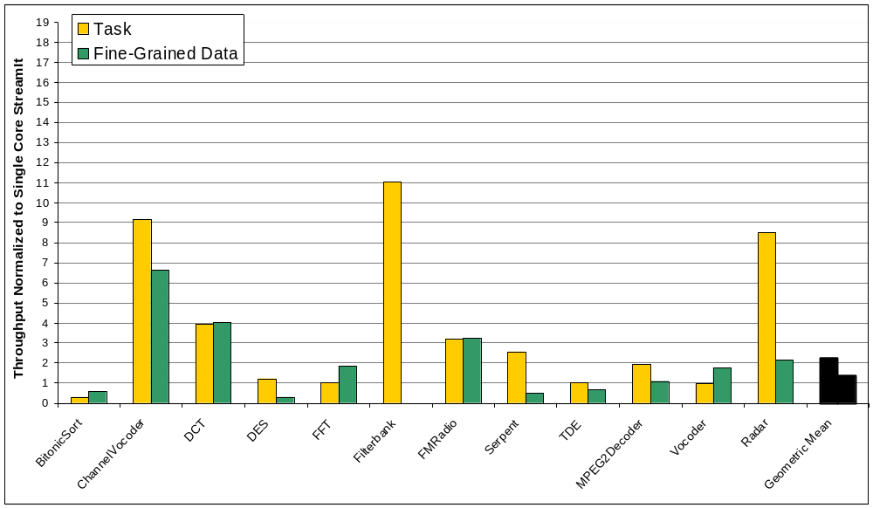
Evaluation:
Fine-Grained Data Parallelism
Good Parallelism!
Too Much Synchronization!
Notes:
Think about something to say about filterbank!
either make the legend bigger or say what the legend is!

Slide 47
Phase 1: Coarsen the Stream Graph
Splitter
Before data-parallelism is exploited
Fuse stateless pipelines as much as possible without introducing state
  Don’t fuse stateless with stateful
  Don’t fuse a peeking filter with anything upstream
BandPass
Peek
BandPass
Peek
Compress
Compress
Process
Process
Expand
Expand
BandStop
Peek
BandStop
Peek
Joiner
Adder
Notes:
A filter that peek performs computation on a sliding window computation and items need to be preserved across invocations of the filter

Slide 48
Phase 1: Coarsen the Stream Graph
Splitter
Before data-parallelism is exploited
Fuse stateless pipelines as much as possible without introducing state
  Don’t fuse stateless with stateful
  Don’t fuse a peeking filter with anything upstream
Benefits:
  Reduces global communication and synchronization
  Exposes inter-node optimization opportunities
BandPass
Compress
Process
Expand
BandPass
Compress
Process
Expand
BandStop
BandStop
Joiner
Adder
Notes:
Define fusion
Akin to inlining

Slide 49
Phase 2: Data Parallelize
Splitter
Data Parallelize for 4 cores
BandPass
Compress
Process
Expand
BandPass
Compress
Process
Expand
BandStop
BandStop
Joiner
Adder
Splitter
Adder
Adder
Fiss 4 ways, to occupy entire chip
Adder
Joiner
Notes:
each pipeline filters a different frequency
remember that a streamit is hierarchical so a pipeline element can be a nested splitjoin, pipeline, or a filter

Slide 50
Phase 2: Data Parallelize
Splitter
Data Parallelize for 4 cores
Splitter
Splitter
BandPass
Compress
Process
Expand
BandPass
Compress
Process
Expand
Task parallelism!
BandPass
Compress
Process
Expand
BandPass
Compress
Process
Expand
Each fused filter does equal work
Fiss each filter 2 times to occupy entire chip
Joiner
Joiner
BandStop
BandStop
Joiner
Adder
Splitter
Adder
Adder
Adder
Joiner

Slide 51
Phase 2: Data Parallelize
Splitter
Data Parallelize for 4 cores
Splitter
Splitter
Task-conscious data parallelization
  Preserve task parallelism
Benefits:
  Reduces global communication and synchronization
BandPass
Compress
Process
Expand
BandPass
Compress
Process
Expand
BandPass
Compress
Process
Expand
BandPass
Compress
Process
Expand
Joiner
Joiner
Splitter
Splitter
BandStop
BandStop
Task parallelism, each filter does equal work
BandStop
BandStop
Fiss each filter 2 times to occupy entire chip
Joiner
Joiner
Joiner
Adder
Splitter
Adder
Adder
Adder
Joiner
Notes:
More detail into benefits
Naturally take advantage of task parallelism and avoid added synchronization imposed by filter fission

Slide 52
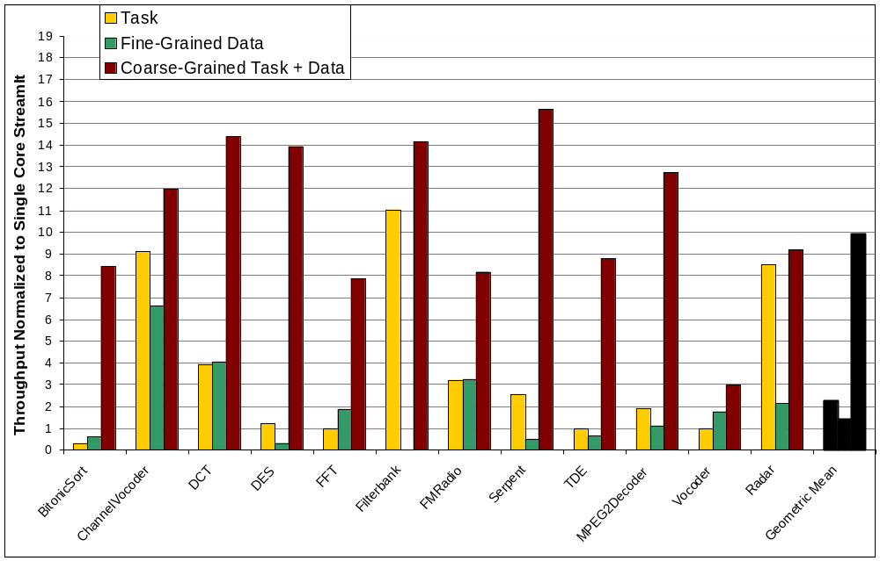

Evaluation:
Coarse-Grained Data Parallelism
Good Parallelism!
Low Synchronization!
Notes:
Significant amount of state…

Slide 53
Simplified Vocoder
Splitter
6
AdaptDFT
AdaptDFT
6
Joiner
RectPolar
20
Data Parallel
Splitter
Splitter
2
UnWrap
Unwrap
2
1
Diff
Diff
1
1
Amplify
Amplify
1
Data Parallel, but too little work!
1
Accum
Accum
1
Joiner
Joiner
PolarRect
20
Data Parallel
Target a 4 core machine
Notes:
annotated with relative load estimations for one execution of the stream graph
We don’t want to data parallelize the amplify filters because they perform such a small amount work per steady state, if we data-parallelize, the scatter and gather will cost more than the parallelized computation
we don’t coarsen the stateful components because we would like the scheduler to have as much freedom as possible in scheduling small tasks.

Slide 54
Data Parallelize
Splitter
6
AdaptDFT
AdaptDFT
6
Joiner
Splitter
RectPolar
5
RectPolar
RectPolar
20
RectPolar
Joiner
Splitter
Splitter
2
UnWrap
Unwrap
2
1
Diff
Diff
1
1
Amplify
Amplify
1
1
Accum
Accum
1
Joiner
Joiner
Splitter
RectPolar
5
RectPolar
RectPolar
20
PolarRect
Joiner
Target a 4 core machine

Slide 55
Data + Task Parallel Execution
Splitter
6
6
Cores
Joiner
Splitter
5
Joiner
Splitter
Splitter
2
2
Time
1
1
21
1
1
1
1
Joiner
Joiner
Splitter
RectPolar
5
Joiner
Target 4 core machine
Notes:
Color coding the graph for easier reference
We can map this graph to a multicore, following the structure of the graph and taking advantage of data and task parallelism
And each exeution of the graph would require 21 time units

Slide 56
We Can Do Better!
Splitter
6
6
Cores
Joiner
Splitter
5
Joiner
Splitter
Splitter
2
2
16
Time
1
1
1
1
1
1
Joiner
Joiner
Splitter
RectPolar
5
Joiner
Target 4 core machine
Notes:
But we can do better

Slide 57
Phase 3: Coarse-Grained
Software Pipelining
Prologue
New
Steady
State
RectPolar
RectPolar
New steady-state is free of dependencies
Schedule new steady-state using a greedy partitioning
RectPolar
RectPolar
RectPolar
RectPolar
Notes:
because we are executing the stream graph repeatedly, we can unroll successive iterations…

Slide 58
Greedy Partitioning
To Schedule:
Cores
16
Time
Target 4 core machine
Notes:
compare to 9.5

Slide 59
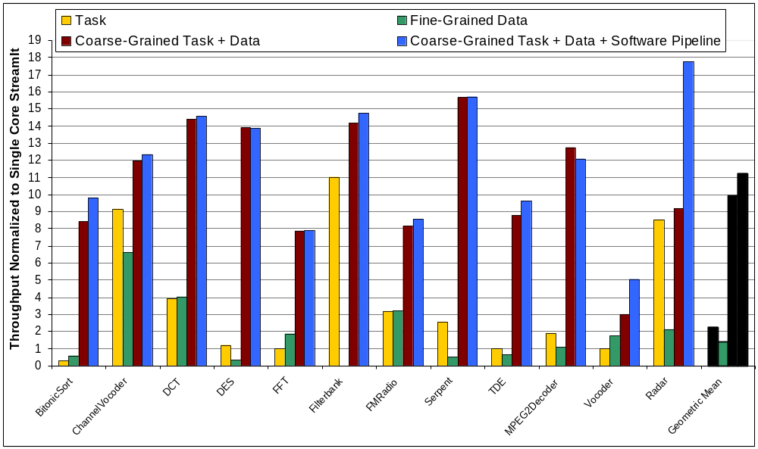
Evaluation: Coarse-Grained
Task + Data + Software Pipelining
Best Parallelism!
Lowest Synchronization!
Notes:
put in all the bars for this, grey out other bars, the outline and the fill
explain the vocoder and the radar app and why they do so well
redo colors!
explain the other minor speedups
explain mpeg2decoder
comment on state, is it going to become more important mpeg4, h264?

Slide 60
Compiler-Aware Language Design
boost productivity, enable faster development and
rapid prototyping
programmability
domain specific
optimizations
enable parallel
execution
simple and effective optimizations for domain specific abstractions
target multicores, clusters, tiled architectures, DSPs, graphics processors, …

Slide 61




Conventional DSP Design Flow
Spec. (data-flow diagram)
Design the Datapaths
(no control flow)
Signal Processing Expert
in Matlab
DSP Optimizations
Coefficient Tables
Rewrite the
program
Software Engineer
in C and Assembly
Architecture-specific
Optimizations
(performance,
power, code size)
C/Assembly Code

Slide 62


Design Flow with StreamIt
Application-Level Design
StreamIt Program
(dataflow + control)
Application Programmer
DSP Optimizations
StreamIt compiler
Architecture-Specific
Optimizations
C/Assembly Code

Slide 63
Design Flow with StreamIt
Application-Level Design
Benefits of programming in a single, high-level abstraction
  Modular
  Composable
  Portable
  Malleable
The Challenge:
Maintaining Performance
StreamIt Program
(dataflow + control)
DSP Optimizations
Architecture-Specific
Optimizations
C/Assembly Code

Slide 64
Focus: Linear State Space Filters
Properties:
1. Outputs are linear function of inputs and states
2. New states are linear function of inputs and states
Most common target of DSP optimizations
  FIR / IIR filters
  Linear difference equations
  Upsamplers / downsamplers
  DCTs

Slide 65

Representing State Space Filters
A state space filter is a tuple ⟨A, B, C, D⟩
inputs
u
states
⟨A, B, C, D⟩
x’ = Ax + Bu
y = Cx + Du
outputs

Slide 66

Representing State Space Filters
A state space filter is a tuple ⟨A, B, C, D⟩
inputs
float->float filter IIR {
float x1, x2;
work push 1 pop 1 {
float u = pop();
push(2*(x1+x2+u));
x1 = 0.9*x1 + 0.3*u;
x2 = 0.9*x2 + 0.2*u;
} }
u
states
⟨A, B, C, D⟩
x’ = Ax + Bu
y = Cx + Du
outputs

Slide 67

Representing State Space Filters
A state space filter is a tuple ↑A, B, C, D⟩
inputs
float->float filter IIR {
float x1, x2;
work push 1 pop 1 {
float u = pop();
push(2*(x1+x2+u));
x1 = 0.9*x1 + 0.3*u;
x2 = 0.9*x2 + 0.2*u;
} }
u
states
0.9 0
0 0.9
0.3
0.2
A =
B =
x’ = Ax + Bu
C =
2 2
D =
2
y = Cx + Du
outputs
Linear dataflow analysis

Slide 68
Linear Optimizations
Combining adjacent filters
Transformation to frequency domain
Change of basis transformations
Transformation Selection

Slide 69
1) Combining Adjacent Filters
u
Filter 1
y = D₁u
u
Combined
Filter
y
z = D₂D₁u
z = Eu
E
Filter 2
z = D₂y
z
z

Slide 70



Combination Example
IIR Filter
x’ = 0.9x + u
IIR / Decimator
y = x + 2u
x’ = 0.81x + [0.9 1]
u₁
u₂
Decimator
y = x + [2 0]
u₁
u₂
u₁
u₂
y = [1 0]
8 FLOPs
6 FLOPs
output
output

Slide 71

Combination Example
IIR Filter
x’ = 0.9x + u
IIR / Decimator
y = x + 2u
x’ = 0.81x + [0.9 1]
u₁
u₂
Decimator
y = x + [2 0]
u₁
u₂
u₁
u₂
y = [1 0]
As decimation factor goes to ∞,
eliminate up to 75% of FLOPs.
8 FLOPs
6 FLOPs
output
output
Notes:
At decimation factor of 16, 68% of FLOPs eliminated.
A decimation factor as high as 16 is common in something like RFtoIF conversion.

Slide 72
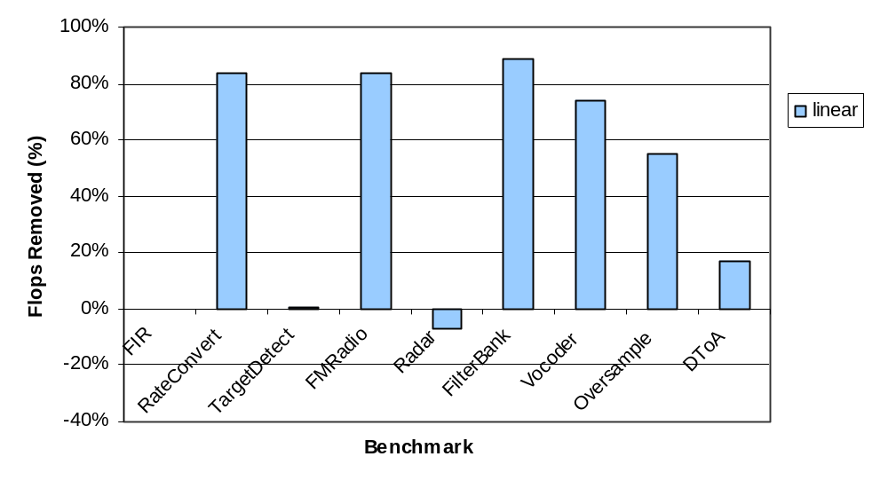
Floating-Point Operations Reduction
0.3%
Notes:
Note that modularity in original program leads to these kinds of speedups.

Slide 73
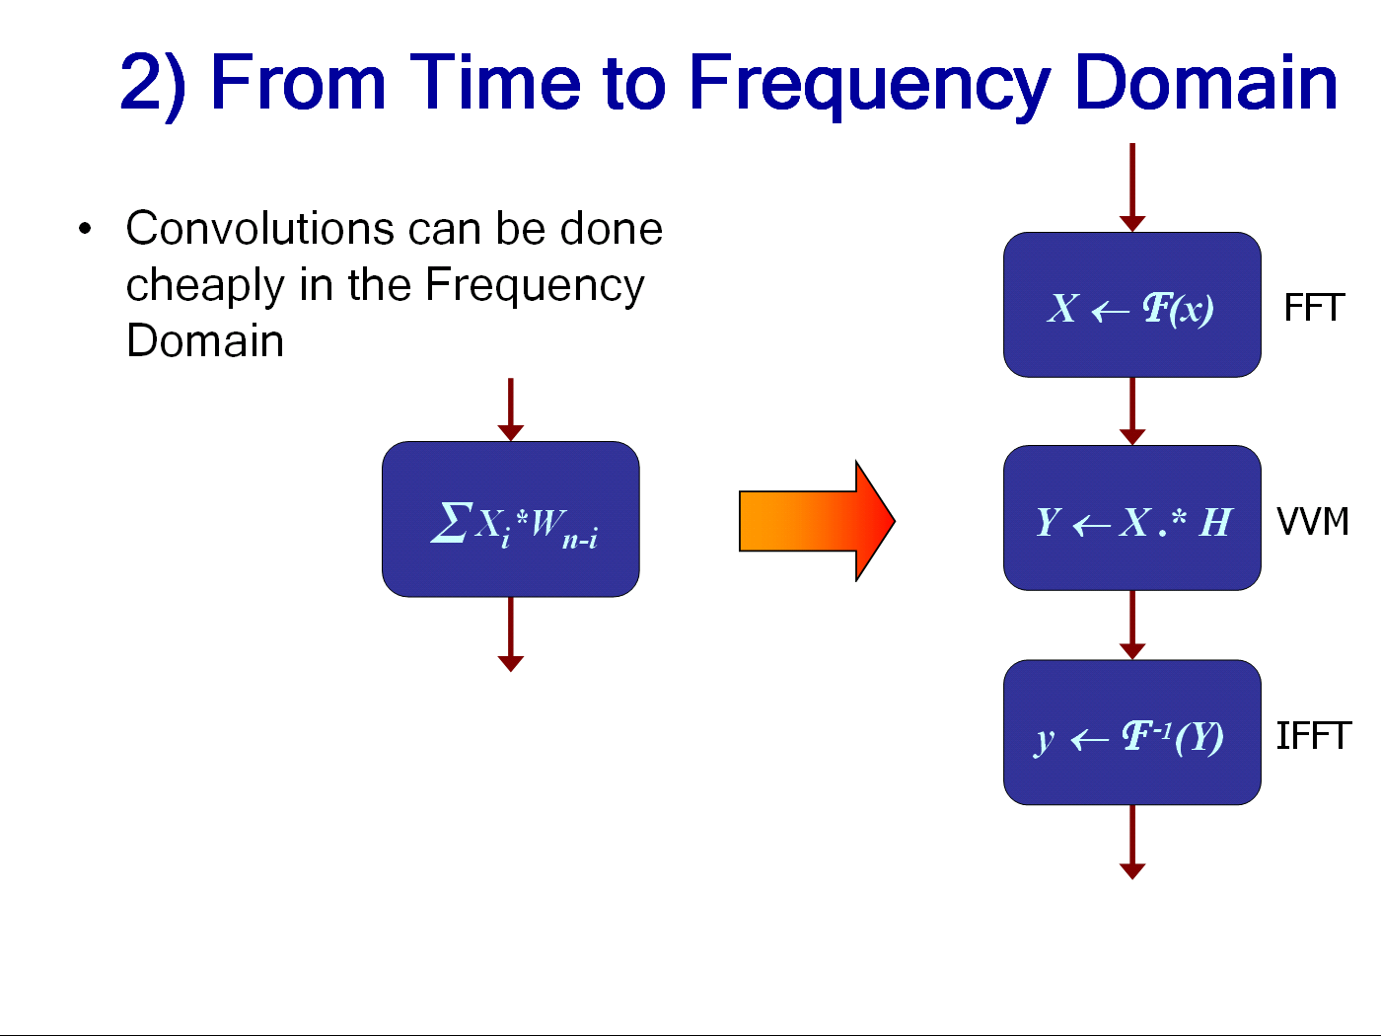
Painful to do by hand
  Blocking
  Coefficient calculations
  Startup etc.

Slide 74
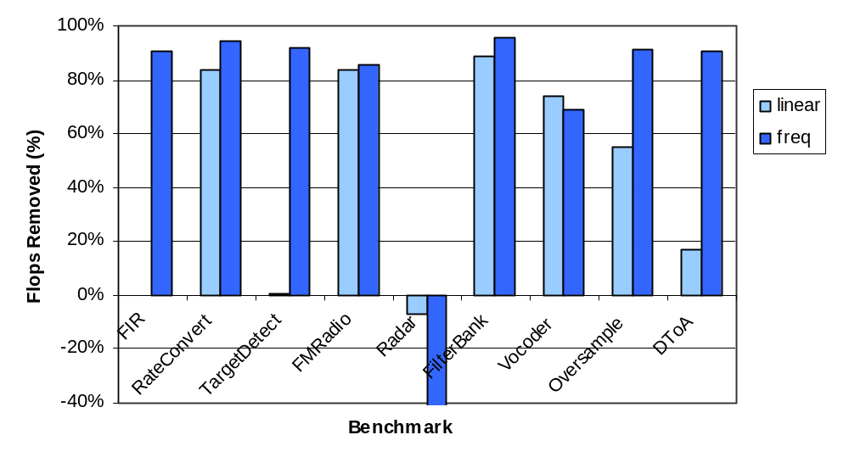
FLOPs Reduction
0.3%
-140%
Notes:
Obviously radar is very bad, so need to do something about it…

Slide 75


3) Change-of-Basis Transformation
x’ = Ax + Bu
y = Cx + Du
T = invertible matrix, z = Tx
z’ = A’z + B’u
y = C’z + D’u
A’ = TAT⁻¹ B’ =TB
C’ = CT⁻¹ D’ = D
Can map original states x to transformed
states z = Tx without changing I/O behavior

Slide 76
Change-of-Basis Optimizations
State removal
  Minimize number of states in system
Parameter reduction
  Increase number of 0’s and 1’s in multiplication
→ Formulated as general matrix operations

Slide 77
4) Transformation Selection
When to apply what transformations?
  Linear filter combination can increase the computation cost
  Shifting to the Frequency domain is expensive for filters with pop > 1
    Compute all outputs, then decimate by pop rate
  Some expensive transformations may later enable other transformations, reducing the overall cost

Slide 78
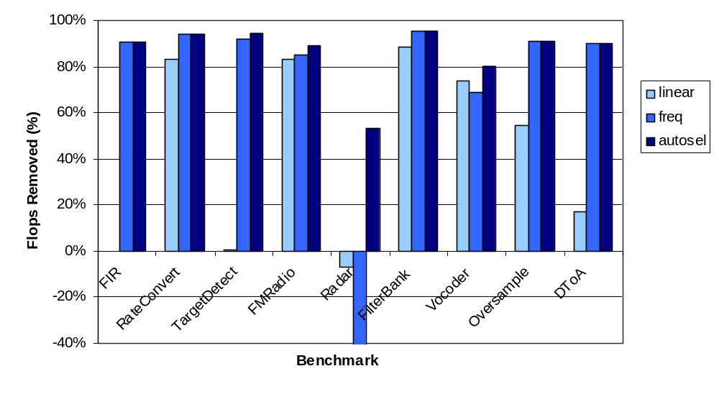
FLOPs Reduction with Optimization Selection
0.3%
-140%
Notes:
Again, not that optimizations are new, but that we’re automating them across module boundaries.

Slide 79
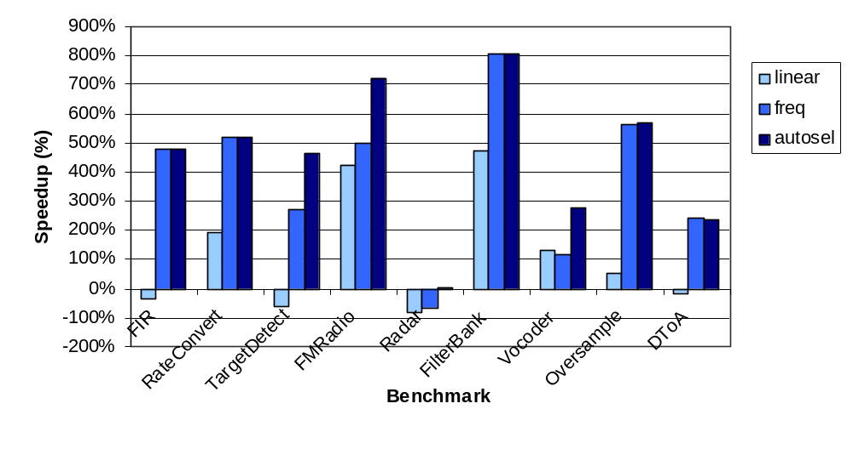
Execution Speedup
5%
On a Pentium IV

Slide 80
Conclusion
Streaming programming model
  Can break the von Neumann bottleneck
  A natural fit for a large class of applications
  An ideal machine language for multicores.
Natural programming language for many streaming applications
  Better modularity, composability, malleability and portability than C
Compiler can easily extract explicit and inherent parallelism
  Parallelism is abstracted away from architectural details of multicores
  Sustainable Speedups (5x to 19x on the 16 core Raw)
Can we replace the DSP engineer from the design flow?
  On the average 90% of the FLOPs eliminated, average speedup of 450% attained
Increased abstraction does not have to sacrifice performance
The compiler and benchmarks are available on the web
http://cag.csail.mit.edu/commit/

Slide 81
Thanks for Listening!
Any questions?
http://cag.csail.mit.edu/streamit

