Slide 1

Exploiting Coarse-Grained
Task, Data, and Pipeline Parallelism in
Stream Programs
Michael Gordon, William Thies, and
Saman Amarasinghe
Massachusetts Institute of Technology
ASPLOS
October 2006
San Jose, CA
http://cag.csail.mit.edu/streamit

Slide 2
Multicores Are Here!
512
Picochip
PC102
Ambric
AM2045
256
Cisco
CSR-1
128
Intel
Tflops
64
# of
cores
32
Raw
Raza
XLR
Cavium
Octeon
16
8
Niagara
Cell
4
Broadcom 1480
Opteron 4P
Xbox360
Xeon MP
2
Power4
PA-8800
Opteron
Tanglewood
PExtreme
Power6
1
4004
8080
8086
286
386
486
Pentium
P2
P3
Itanium
Yonah
8008
P4
Athlon
Itanium 2
1970
1975
1980
1985
1990
1995
2000
2005
20??
Notes:
Lets look at a simplified graph of showing a log scale of the number of cores for some commodity microprocessors versus their date of introduction.
For 35 years, uniprocessor designs dominated the commodity microprocessor market.
But their end has come due to the limited scalability of their global, monolithic structures.
The major cpu vendors have stopped development of uniprocessor designs.
In the last 5 years, commodity processor designers have turned to multicore designs to continue performance scalability.
From 2 cores up to hundreds of cores.

Slide 3
Multicores Are Here!
For uniprocessors,
C was:
Portable
High Performance
Composable
Malleable
Maintainable
512
Uniprocessors:
C is the common
machine language
Picochip
PC102
Ambric
AM2045
256
Cisco
CSR-1
128
Intel
Tflops
64
# of
cores
32
Raw
Raza
XLR
Cavium
Octeon
16
8
Niagara
Cell
4
Broadcom 1480
Opteron 4P
Xbox360
Xeon MP
2
Power4
PA-8800
Opteron
Tanglewood
PExtreme
Power6
1
4004
8080
8086
286
386
486
Pentium
P2
P3
Itanium
Yonah
8008
P4
Athlon
Itanium 2
1970
1975
1980
1985
1990
1995
2000
2005
20??
Notes:
During the age of the uniprocessor, programmers had it pretty easy. They could write a piece of code in c or another von Neumann language
and have it be portable and scalable across the generations of uniprocessor designs.
Furthermore, von Neumann languages had all these other great benefits…
debuggable
We could say that c and von Neumann languages were the common machine languages for uniprocessors.
They encapsulated the common properties but abstracted away the differences across uniprocessor architectures.

Slide 4
Multicores Are Here!
What is the common
machine language
for multicores?
512
Picochip
PC102
Ambric
AM2045
256
Cisco
CSR-1
128
Intel
Tflops
64
# of
cores
32
Raw
Raza
XLR
Cavium
Octeon
16
8
Niagara
Cell
4
Broadcom 1480
Opteron 4P
Xbox360
Xeon MP
2
Power4
PA-8800
Opteron
Tanglewood
PExtreme
Power6
1
4004
8080
8086
286
386
486
Pentium
P2
P3
Itanium
Yonah
8008
P4
Athlon
Itanium 2
1970
1975
1980
1985
1990
1995
2000
2005
20??
Notes:
Now that multicore designs are becoming dominant, we want to ask ourselves what is the common machine language for them.
We would like to write a program once and have it be portable and scale with future generations of multicore designs.
Also, we want parallel programming has to become as easy as sequential programming thus, the common machine language should be
composeable, malleable, and maintainable and the mapping burden should be squarely on the compiler.

Slide 5
Common Machine Languages
Uniprocessors:
Multicores:
Common Properties
Single flow of control
Single memory image
Common Properties
Multiple flows of control
Multiple local memories
Differences:
Register File
ISA
Functional Units
Differences:
Number and capabilities of cores
Communication Model
Synchronization Model
Register Allocation
Instruction Selection
Instruction Scheduling
von-Neumann languages represent the common properties and abstract away the differences
Need common machine language(s)
for multicores
Notes:
also a common machine language must not be too complex so that it can attract typical programmers.
memories maybe shared, does not matter if it is exposed in the lang.
If we were to use a von Neumann language as a common machine language for a multicore, it would reaquire heroic efforts from the compiler
there are many research proposals for such a common machine language, one representation that will cover a large part of the application space is a streaming representation
our research proposes streaming languages as the common machine language across multicore architectures
Specifically, in this talk we develop algorithms to enable portability and high-performance across multicores beginning from a high-level stream language.
our work focuses on compiler algorithms to break the abstraction layer between the language and the number of cores/capability of cores
Enable portability and high-performance across multicores

Slide 6
Streaming as a Common Machine Language
AtoD
Regular and repeating computation
Independent filters
with explicit communication
  Segregated address spaces and multiple program counters
Natural expression of Parallelism:
  Producer / Consumer dependencies
  Enables powerful, whole-program transformations
FMDemod
Scatter
LPF₁
LPF₂
LPF₃
HPF₁
HPF₂
HPF₃
Gather
Adder
Speaker
Notes:
streaming applications are becoming increasing prevalent in general purpose processing, already a large part of desktop and embedded workloads
outer
define stateless!
composable, malleable, debuggable (because it is deterministic)

Slide 7
Types of Parallelism
Task Parallelism
  Parallelism explicit in algorithm
  Between filters without producer/consumer relationship
Data Parallelism
  Peel iterations of filter, place within scatter/gather pair (fission)
  parallelize filters with state
Pipeline Parallelism
  Between producers and consumers
  Stateful filters can be parallelized
Scatter
Gather
Task
Notes:
Abundance of parallelism in streaming programs,
pipeline parallelism because these filters execute repeatedly, if they are mapped to different computing cores, we might be able to take advantage of pipeline parallelism, chains of producer and consumers
each of the resulting duplicate products executes less times than the original, they are placed in a round robin splitter…
a filter can be data-parallelized if it is stateless, meaning that the filter does not write to any variable that is read by a later iteration.
we have the nice properties that each type of parallelism can be naturally expressed in the stream graph

Slide 8
Types of Parallelism
Task Parallelism
  Parallelism explicit in algorithm
  Between filters without producer/consumer relationship
Data Parallelism
  Between iterations of a stateless filter
  Place within scatter/gather pair (fission)
  Can’t parallelize filters with state
Pipeline Parallelism
  Between producers and consumers
  Stateful filters can be parallelized
Scatter
Data Parallel
Gather
Scatter
Pipeline
Gather
Data
Task
Notes:
Abundance of parallelism in streaming programs,
Some streaming representations require that all filters are data parallel, we don’t have this requirement, the compiler discovers data parallel filters (see below)
pipeline parallelism because these filters execute repeatedly, if they are mapped to different computing cores, we might be able to take advantage of pipeline parallelism, chains of producer and consumers
each of the resulting duplicate products executes less times than the original, they are placed in a round robin splitter…
a filter can be data-parallelized if it is stateless, meaning that the filter does not write to any variable that is read by a later iteration.
we have the nice properties that each type of parallelism can be naturally expressed in the stream graph

Slide 9
Types of Parallelism
Traditionally:
Task Parallelism
  Thread (fork/join) parallelism
Data Parallelism
  Data parallel loop (forall)
Pipeline Parallelism
  Usually exploited in hardware
Scatter
Gather
Scatter
Pipeline
Gather
Data
Task

Slide 10
Problem Statement
Given:
  Stream graph with compute and communication estimate for each filter
  Computation and communication resources of the target machine
Find:
  Schedule of execution for the filters that best utilizes the available parallelism to fit the machine resources
Notes:
no filter dynamic filter migration
each filter is mapped to a single core
concerned with thruput!

Slide 11
Our 3-Phase Solution
Coarsen
Granularity
Data
Parallelize
Software
Pipeline
Coarsen: Fuse stateless sections of the graph
Data Parallelize: parallelize stateless filters
Software Pipeline: parallelize stateful filters
Compile to a 16 core architecture
  11.2x mean throughput speedup over single core
Notes:
coarsen gran to reduce communication overhead
Decreases global communication and synchronization
Enables internode optimizations on fused filter
data parallelize to parallel stateless components
to exploit pipeline parallelism we perform software pipeline to parallelize remaining components
after a prologue schedule is executed, we can statically schedule the filters in any order in the steady state…
data parallelize to parallel stateless components
to exploit pipeline parallelism we perform software pipeline to parallelize remaining components
after a prologue schedule is executed, we can statically schedule the filters in any order in the steady state
We employ a greedy heuristic to schedule the software pipelined steady-sate

Slide 12
Outline
StreamIt language overview
Mapping to multicores
  Baseline techniques
  Our 3-phase solution

Slide 13
The StreamIt Project
Applications
  DES and Serpent [PLDI 05]
  MPEG-2 [IPDPS 06]
  SAR, DSP benchmarks, JPEG, …
Programmability
  StreamIt Language (CC 02)
  Teleport Messaging (PPOPP 05)
  Programming Environment in Eclipse (P-PHEC 05)
Domain Specific Optimizations
  Linear Analysis and Optimization (PLDI 03)
  Optimizations for bit streaming (PLDI 05)
  Linear State Space Analysis (CASES 05)
Architecture Specific Optimizations
  Compiling for Communication-Exposed Architectures (ASPLOS 02)
  Phased Scheduling (LCTES 03)
  Cache Aware Optimization (LCTES 05)
  Load-Balanced Rendering
  (Graphics Hardware 05)
StreamIt Program
Front-end
Annotated Java
Simulator
(Java Library)
Stream-Aware
Optimizations
Uniprocessor
backend
Cluster
backend
Raw
backend
IBM X10
backend
C/C++
MPI-like
C/C++
C per tile +
msg code
Streaming
X10 runtime
Notes:
over the last 5 years we have been developing….

Slide 14
Model of Computation
Synchronous Dataflow [Lee ‘92]
  Graph of autonomous filters
  Communicate via FIFO channels
Static I/O rates
  Compiler decides on an order
  of execution (schedule)
  Static estimation of
  computation
A/D
Band Pass
Duplicate
Detect
Detect
Detect
Detect
LED
LED
LED
LED
Notes:
Many possible legal schedules
frequency band detection, used in garage door openers, metal detectors
Highlight “filters”
Replace with filterbank
Every language has an underlying model of computation
Streamit adopts SDF
Programs as graph, nodes: filters i.e. kernels, which represent autonomous/standalone computation kernels; edges represent data flow between kernels
Compiler orchestrate execution of kernels: this is the schedule
As the example earlier showed, example can affect locality: how often does a kernel get loaded/reloaded into cache
A lot of previous emphasis on minimizing data requirements between filters but as we will show, this in the presence of caches, this isn’t a good strategy as we will show

Slide 15
Example StreamIt Filter
0
1
2
3
4
5
6
7
8
9
10
11
input
FIR
0
1
output
float→float filter FIR (int N, float[N] weights) {
work push 1 pop 1 peek N {
float result = 0;
for (int i = 0; i < N; i++) {
result += weights[i] ∗ peek(i);
}
pop();
push(result);
}
}
Stateless
Notes:
start off with the work function, atomic unit of execution
This is the work function, it is repeated executed by the filter
emphasize peek!
stateful versus stateless filters
Stateless filters can be data-parallelized!
Talk through filter example: what computation looks like in StreamIt
Highlight peek/pop/push rates, and work function
Parameterizable: takes argument N
Emphasize the code!
we can detect stateless filters using a simple program analysis

Slide 16
Example StreamIt Filter
0
1
2
3
4
5
6
7
8
9
10
11
input
FIR
0
1
output
float→float filter FIR (int N, ) {
work push 1 pop 1 peek N {
float result = 0;
for (int i = 0; i < N; i++) {
result += weights[i] ∗ peek(i);
}
pop();
push(result);
}
}
float[N] weights
(int N) {
;
Stateful
weights = adaptChannel(weights);
Notes:
start off with the work function, atomic unit of execution
This is the work function, it is repeated executed by the filter
emphasize peek!
stateful versus stateless filters
Stateless filters can be data-parallelized!
Talk through filter example: what computation looks like in StreamIt
Highlight peek/pop/push rates, and work function
Parameterizable: takes argument N
Emphasize the code!
we can detect stateless filters using a simple program analysis

Slide 17
StreamIt Language Overview
StreamIt is a novel language for streaming
  Exposes parallelism and
  communication
  Architecture independent
  Modular and composable
    Simple structures composed to creates complex graphs
  Malleable
    Change program behavior with small modifications
filter
pipeline
may be any StreamIt language construct
splitjoin
parallel computation
splitter
joiner
feedback loop
joiner
splitter
Notes:
Mention that splitter can be duplicate or round-robin and joiner can be round robin
the streams of a pipeline/splitjoin do not have to be all the same
parameterized graphs
The streamit language is designed with productivity in mind
- natural for the program to represent computation
- expose what is traditionally hard for the compiler to discover: namely, parallelism and communication
The language is also designed to be modular/composable: important to software engineering, and also for correctness checking
Show stream constructs:
- filter: basic unit of computation
- pipeline: sequential/serial execution of streams that communication data
> a stream can be a filter or any of the language stream constructs: modularity/reusability
- sj: explicit parallelism, scatter data with splitter, gather data with joiner
- also a feedback loop allows for cycles in the graph
The stream constructs are parameterizable: length of pipeline, width of sj
This gives rise to malleabililty: small change in code leads to big changes in program graph
Example on the next slide

Slide 18
Outline
StreamIt language overview
Mapping to multicores
  Baseline techniques
  Our 3-phase solution

Slide 19
Baseline 1: Task Parallelism
Splitter
Inherent task parallelism between two processing pipelines
Task Parallel Model:
  Only parallelize explicit task parallelism
  Fork/join parallelism
Execute this on a 2 core machine ~2x speedup over single core
What about 4, 16, 1024, … cores?
BandPass
BandPass
Compress
Compress
Process
Process
Expand
Expand
BandStop
BandStop
Joiner
Adder
Notes:
each pipeline filters a different frequency

Slide 20
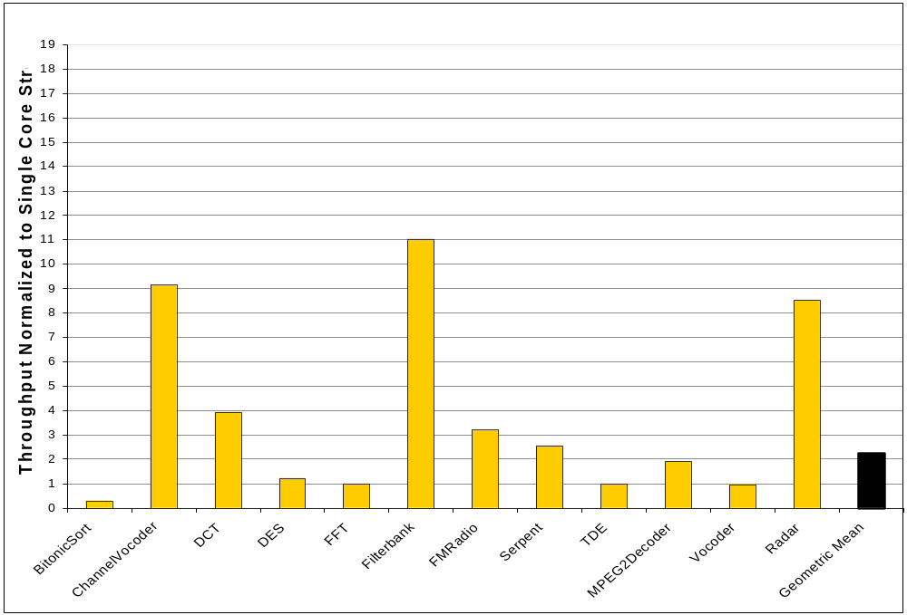

Evaluation: Task Parallelism
Raw Microprocessor
  16 inorder, single-issue cores with D$ and I$
  16 memory banks, each bank with DMA
  Cycle accurate simulator
Parallelism: Not matched to target!
Synchronization: Not matched to target!
Notes:
scale top to 16 , and use the same scale for each, height etc
mention problems with task parallelism
not adequate as only source of parallelism
highlight bitonic sort, mention the problems with communication granularity
how large is filterbank? does the number match?

Slide 21
Baseline 2: Fine-Grained
Data Parallelism
Splitter
Each of the filters in the example are stateless
Fine-grained Data Parallel Model:
  Fiss each stateless filter N ways (N is number of cores)
  Remove scatter/gather if possible
We can introduce data parallelism
  Example: 4 cores
Each fission group occupies entire machine
BandPass
Splitter
Splitter
BandPass
BandPass
BandPass
BandPass
BandPass
BandPass
BandPass
Joiner
Joiner
Splitter
Compress
Compress
Splitter
Compress
Compress
Compress
Compress
Compress
Compress
Joiner
Joiner
Process
Splitter
Splitter
Process
Process
Process
Process
Process
Process
Process
Joiner
Joiner
Splitter
Expand
Expand
Splitter
Expand
Expand
Expand
Expand
Expand
Expand
Joiner
Joiner
BandStop
Splitter
Splitter
BandStop
BandStop
BandStop
BandStop
BandStop
BandStop
BandStop
Joiner
Joiner
Joiner
Splitter
BandStop
BandStop
BandStop
Adder
Adder
Joiner
Notes:
where direct communication is possible, we remove the scatter/gather, but we need scatter/gather between data-parallel filters with non-matching i/o rates

Slide 22
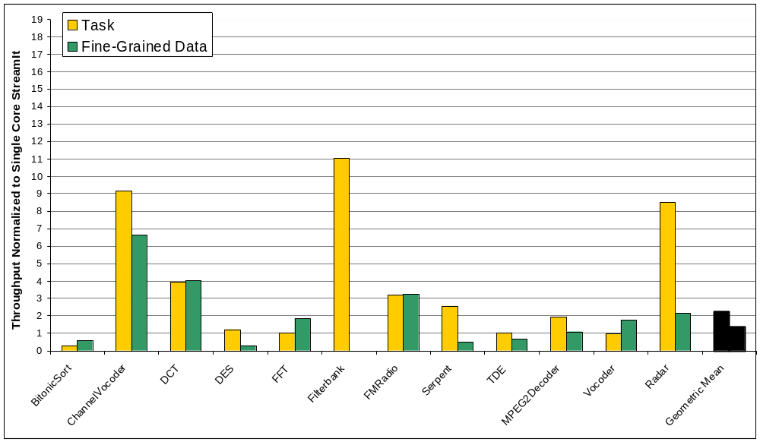
Evaluation:
Fine-Grained Data Parallelism
Good Parallelism!
Too Much Synchronization!
Notes:
Think about something to say about filterbank!
either make the legend bigger or say what the legend is!

Slide 23
Outline
StreamIt language overview
Mapping to multicores
  Baseline techniques
  Our 3-phase solution

Slide 24
Phase 1: Coarsen the Stream Graph
Splitter
Before data-parallelism is exploited
Fuse stateless pipelines as much as possible without introducing state
  Don’t fuse stateless with stateful
  Don’t fuse a peeking filter with anything upstream
BandPass
Peek
BandPass
Peek
Compress
Compress
Process
Process
Expand
Expand
BandStop
Peek
BandStop
Peek
Joiner
Adder
Notes:
A filter that peek performs computation on a sliding window computation and items need to be preserved across invocations of the filter

Slide 25
Phase 1: Coarsen the Stream Graph
Splitter
Before data-parallelism is exploited
Fuse stateless pipelines as much as possible without introducing state
  Don’t fuse stateless with stateful
  Don’t fuse a peeking filter with anything upstream
Benefits:
  Reduces global communication and synchronization
  Exposes inter-node optimization opportunities
BandPass
Compress
Process
Expand
BandPass
Compress
Process
Expand
BandStop
BandStop
Joiner
Adder
Notes:
Define fusion
Akin to inlining

Slide 26
Phase 2: Data Parallelize
Splitter
Data Parallelize for 4 cores
BandPass
Compress
Process
Expand
BandPass
Compress
Process
Expand
BandStop
BandStop
Joiner
Adder
Splitter
Adder
Adder
Fiss 4 ways, to occupy entire chip
Adder
Joiner
Notes:
each pipeline filters a different frequency
remember that a streamit is hierarchical so a pipeline element can be a nested splitjoin, pipeline, or a filter

Slide 27
Phase 2: Data Parallelize
Splitter
Data Parallelize for 4 cores
Splitter
Splitter
BandPass
Compress
Process
Expand
BandPass
Compress
Process
Expand
Task parallelism!
BandPass
Compress
Process
Expand
BandPass
Compress
Process
Expand
Each fused filter does equal work
Fiss each filter 2 times to occupy entire chip
Joiner
Joiner
BandStop
BandStop
Joiner
Adder
Splitter
Adder
Adder
Adder
Joiner

Slide 28
Phase 2: Data Parallelize
Splitter
Data Parallelize for 4 cores
Splitter
Splitter
Task-conscious data parallelization
  Preserve task parallelism
Benefits:
  Reduces global communication and synchronization
BandPass
Compress
Process
Expand
BandPass
Compress
Process
Expand
BandPass
Compress
Process
Expand
BandPass
Compress
Process
Expand
Joiner
Joiner
Splitter
Splitter
BandStop
BandStop
Task parallelism, each filter does equal work
BandStop
BandStop
Fiss each filter 2 times to occupy entire chip
Joiner
Joiner
Joiner
Adder
Splitter
Adder
Adder
Adder
Joiner
Notes:
More detail into benefits
Naturally take advantage of task parallelism and avoid added synchronization imposed by filter fission

Slide 29
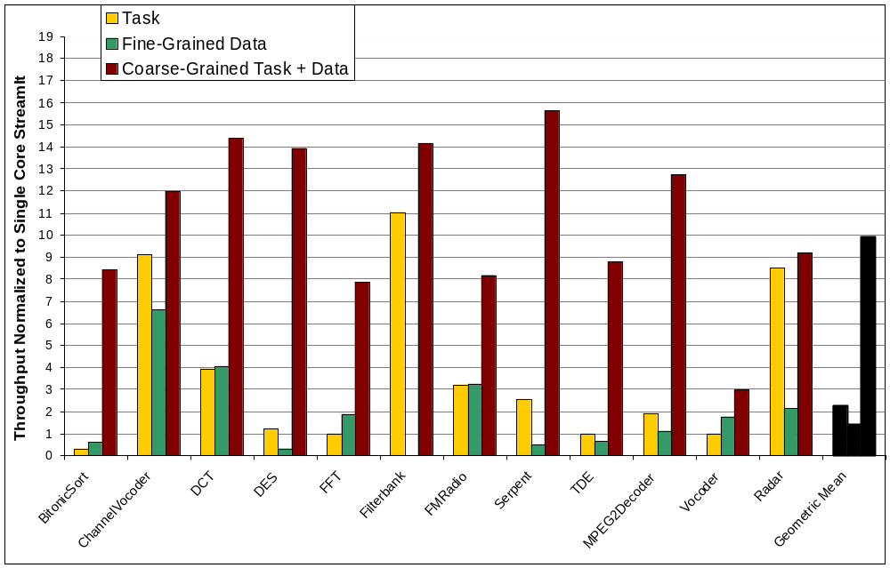

Evaluation:
Coarse-Grained Data Parallelism
Good Parallelism!
Low Synchronization!
Notes:
Significant amount of state…

Slide 30
Simplified Vocoder
Splitter
6
AdaptDFT
AdaptDFT
6
Joiner
RectPolar
20
Data Parallel
Splitter
Splitter
2
UnWrap
Unwrap
2
1
Diff
Diff
1
1
Amplify
Amplify
1
Data Parallel, but too little work!
1
Accum
Accum
1
Joiner
Joiner
PolarRect
20
Data Parallel
Target a 4 core machine
Notes:
annotated with relative load estimations for one execution of the stream graph
We don’t want to data parallelize the amplify filters because they perform such a small amount work per steady state, if we data-parallelize, the scatter and gather will cost more than the parallelized computation
we don’t coarsen the stateful components because we would like the scheduler to have as much freedom as possible in scheduling small tasks.

Slide 31
Data Parallelize
Splitter
6
AdaptDFT
AdaptDFT
6
Joiner
Splitter
RectPolar
5
RectPolar
RectPolar
20
RectPolar
Joiner
Splitter
Splitter
2
UnWrap
Unwrap
2
1
Diff
Diff
1
1
Amplify
Amplify
1
1
Accum
Accum
1
Joiner
Joiner
Splitter
RectPolar
5
RectPolar
RectPolar
20
PolarRect
Joiner
Target a 4 core machine

Slide 32
Data + Task Parallel Execution
Splitter
6
6
Cores
Joiner
Splitter
5
Joiner
Splitter
Splitter
2
2
Time
1
1
21
1
1
1
1
Joiner
Joiner
Splitter
RectPolar
5
Joiner
Target 4 core machine
Notes:
Color coding the graph for easier reference
We can map this graph to a multicore, following the structure of the graph and taking advantage of data and task parallelism
And each exeution of the graph would require 21 time units

Slide 33
We Can Do Better!
Splitter
6
6
Cores
Joiner
Splitter
5
Joiner
Splitter
Splitter
2
2
16
Time
1
1
1
1
1
1
Joiner
Joiner
Splitter
RectPolar
5
Joiner
Target 4 core machine
Notes:
But we can do better

Slide 34
Phase 3: Coarse-Grained
Software Pipelining
Prologue
New
Steady
State
RectPolar
RectPolar
New steady-state is free of dependencies
Schedule new steady-state using a greedy partitioning
RectPolar
RectPolar
RectPolar
RectPolar
Notes:
because we are executing the stream graph repeatedly, we can unroll successive iterations…

Slide 35
Greedy Partitioning
To Schedule:
Cores
16
Time
Target 4 core machine
Notes:
compare to 9.5

Slide 36
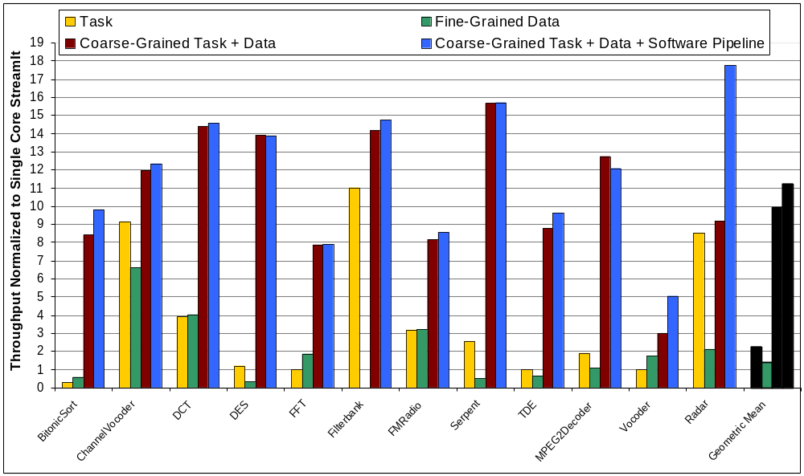
Evaluation: Coarse-Grained
Task + Data + Software Pipelining
Best Parallelism!
Lowest Synchronization!
Notes:
put in all the bars for this, grey out other bars, the outline and the fill
explain the vocoder and the radar app and why they do so well
redo colors!
explain the other minor speedups
explain mpeg2decoder
comment on state, is it going to become more important mpeg4, h264?

Slide 37
Generalizing to Other Multicores
Architectural requirements:
  Compiler controlled local memories with DMA
  Efficient implementation of scatter/gather
To port to other architectures, consider:
  Local memory capacities
  Communication to computation tradeoff
Did not use processor-to-processor communication on Raw
Notes:
Mention that our previous work utilized fine-grained processor-to-processor communication for hardware pipelining

Slide 38
Related Work
Streaming languages:
  Brook [Buck et al. ’04]
  StreamC/KernelC [Kapasi ’03, Das et al. ’06]
  Cg [Mark et al. ‘03]
  SPUR [Zhang et al. ‘05]
Streaming for Multicores:
  Brook [Liao et al., ’06]
Ptolemy [Lee ’95]
Explicit parallelism:
  OpenMP, MPI, & HPF
Notes:
brook, only data parallelism, actors are required to be stateless (support for reduction), focused on ilp and data-parallelism, proc/cons relationships are only exploited for memory hierarchy optimizations
Das’s recent PACT paper describes scheduling tecnhniques for brook targeting imagine, traditional loop scheduling techniques are leveraged but only parallelize memory access with a single compute kernel to hide memory latencies between the stream register file and system memory and to prevent spills from the stream register file. We apply trad loop scheduling techniques to parallelize stateful compute components (filters) and we target a multicore architecture. We exploit data-parallelism at a coarser-granularity, across cores, and we fuse compute components to match the granularity of the architecture
Cg, pipeline parallelism and data parallelism but only for 2 pipeline stages of a graphics processor
streamit has more emphasis on exploiting task and pipeline parallelis m
These languages make it difficult to coarsen the granularity and software pipeline
robust framework for dp that focuses on reductions (which we have not focused on), half of our benchmarks could be parallelized using mapreduce
Stress comparison to explicitly parallel langauges, we get great speedup without programmer intervention, the program is written in a portable manner that
Allows the compiler to produce efficient code.
Ptolemy is an environment for simulation, prototyping, and software synthesis for heterogeneous systems. It includes a SDF component, but the system focuses on simulation and modeling and on code generation for actual architectures.
intel and amd are pushing openmp and mpi to program their multicores. these systems graft parallel constructs onto c and fortan. They are not composable and are had to debug. They place the parallelization burden on the programmer. The programmer is forced to make granularity, load balancing, locality and synchronization decisions through profiling the code. We move these decisions into the compiler and lower the bar for parallel programming achieving portability and high-performance.

Slide 39
Conclusions
Streaming model naturally exposes task, data, and pipeline parallelism
This parallelism must be exploited at the correct granularity and combined correctly
 | Task | Fine-Grained Data | Coarse-Grained Task + Data | Coarse-Grained Task + Data + Software Pipeline
Parallelism | Not matched | Good | Good | Best
Synchronization | Not matched | High | Low | Lowest
Good speedups across varied benchmark suite
Algorithms should be applicable across multicores
Notes:
Task parallelism is inadequate because the parallelism and synchronization is not matched to the target, forcing the programmer to intervene and create un-portable code
Fine-grained data parallelism has good parallelism, but would overwhelm the communication mechanism of a multicore
Coarsening the granularity before data-parallelism is exploited and achieve great parallelization of stateless components
Finally, adding software pipelining allows us to parallelize stateful components and offers the best parallelism and the lowest synchronization because of the further opportunities for coarsening
conscious of the multicores communication substrate, we don’t want to overwhelm it
Our algorithms can remain largely unchanged across multicore architectures

