Slide 1
Abstraction Layers for Scalable Microfluidic Biocomputers
William Thies*, J.P. Urbanski†,
Todd Thorsen† and Saman Amarasinghe*
* Computer Science and Artificial Intelligence Laboratory
Hatsopoulos Microfluids Laboratory
Massachusetts Institute of Technology
International Meeting on DNA Computing – June 8, 2006
†
Notes:
The goal of our research is to enable biologists to perform a new class of experiments that would be too complex to do by hand.
As a collaboration between the Computer Science laboratory and the Microfluidics Laboratory at MIT, our approach is to build the next generation of microfluidic chips to automate experiments, and then to provide a programming language to enable biologists to control these chips just like they would control a normal computer.
I am excited to be presenting in this forum, because I think that any of you who have done work in this area can appreciate that the experimental protocols involved can be very complex.

Slide 2
Biocomputing Demands Complex Protocols
Complex biology experiments have many hazards
  Time-consuming laboratory protocols
  Risk of human error
  Expensive reagents and equipment
Biocomputing: complexity grows with problem size
  20-variable 3-SAT problem: >96 hours to complete
  Larger instances will be even more challenging
  Need a scalable approach
Our approach:
Write protocols as programs, run on microfluidic chips
  Write once, run anywhere
  This talk: how do you “program” a biological protocol?
  [Adleman02]

Slide 3
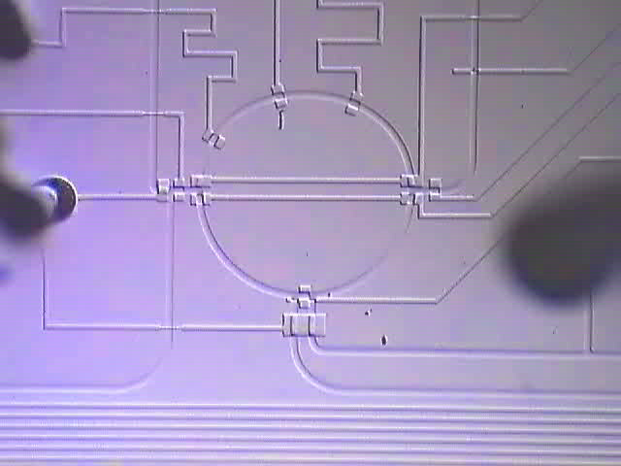
Microfluidic Chips
Idea: a whole biology lab on a single chip
  Input/output
  Sensors: luminescence,
  pH, glucose, etc.
  Actuators: mixing, PCR,
  electrophoresis, cell lysis, etc.
Benefits:
  Small sample volumes
  High throughput
  Geometrical manipulation
Applications:
  Biochemistry - Cell biology
  Biological computing
1 mm
10x real-time
  [Livstone/Landweber]
  [van Noort]
  [Grover/Mathies]
  [McCaskill]
  [Gehani/Reif]
  [Farfel/Stefanovic]
  [Somei/Kaneda/Fujii/Murata]

Slide 4
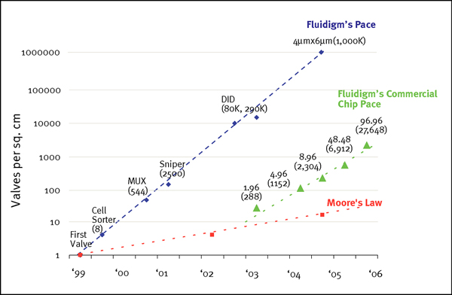
Moore’s Law of Microfluidics:
Valve Density Doubles Every 4 Months
Source: Fluidigm Corporation (http://www.fluidigm.com/images/mlaw_lg.jpg)

Slide 5
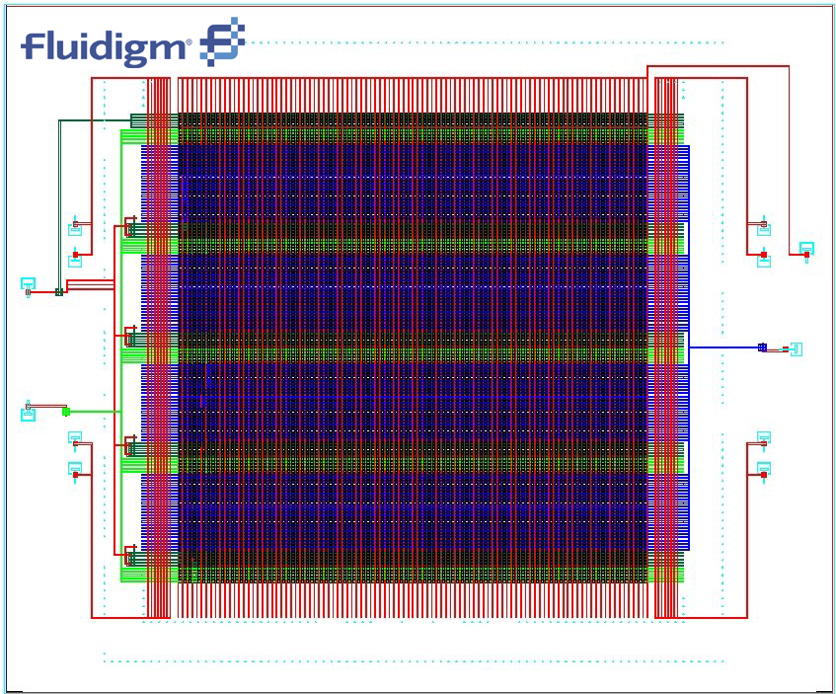
Moore’s Law of Microfluidics:
Valve Density Doubles Every 4 Months
Source: Fluidigm Corporation (http://www.fluidigm.com/didIFC.htm)
Notes:
(From Fluidigm website: ”After dividing the sample into 10,000 parts-an estimated 14.4 copies of the wild type per reaction chamber-the mutant alleles could be readily identified through amplification.“

Slide 6
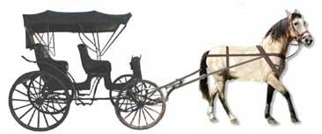
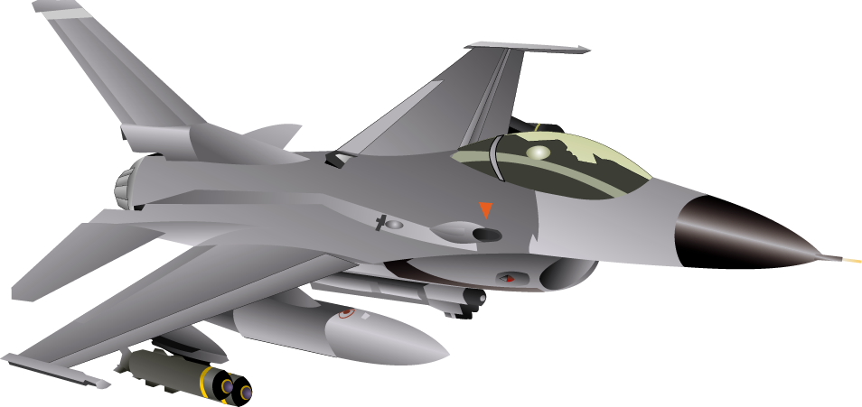

How to Conduct Experiments?
Human director
Lab bench
Lab-on-a-chip
Current choices:
  Design custom microfluidic chip to
  automatically perform your experiment
  Orchestrate every valve operation
  by hand (e.g., using Labview)
Two choices:
  Design custom microfluidic chip to
  automatically perform your experiment

Slide 7
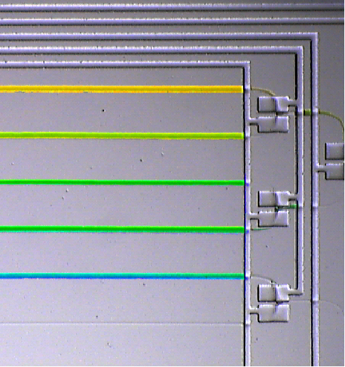
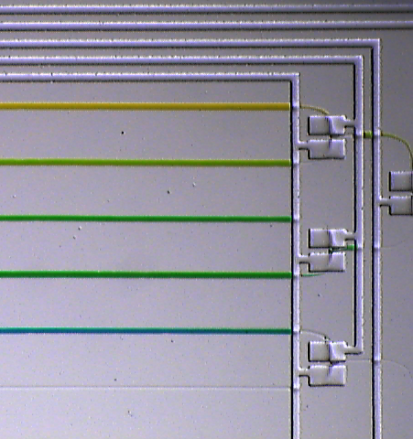
Programmable Solution
Example: Gradient generation
Hidden from programmer:
  Location of fluids
  Details of mixing, I/O
  Logic of valve control
  Timing of chip operations
Fluid yellow = input (0);
Fluid blue = input(1);
for (int i=0; i<=4; i++) {
mix(yellow, 1-i/4, blue, i/4);
}
450 Valve Operations

Slide 8
Programmable Solution
Example: Gradient generation
Hidden from programmer:
  Location of fluids
  Details of mixing, I/O
  Logic of valve control
  Timing of chip operations
Fluid yellow = input (0);
Fluid blue = input(1);
for (int i=0; i<=4; i++) {
mix(yellow, 1-i/4, blue, i/4);
}
setValve(0, HIGH); setValve(1, HIGH);
setValve(2, LOW); setValve(3, HIGH);
setValve(4, LOW); setValve(5, LOW);
setValve(6, HIGH); setValve(7, LOW);
setValve(8, LOW); setValve(9, HIGH);
setValve(10, LOW); setValve(11, HIGH);
setValve(12, LOW); setValve(13, HIGH);
setValve(14, LOW); setValve(15, HIGH);
setValve(16, LOW); setValve(17, LOW);
setValve(18, LOW); setValve(19, LOW);
wait(2000);
setValve(14, HIGH); setValve(2, LOW);
wait(1000);
setValve(4, HIGH); setValve(12, LOW);
setValve(16, HIGH); setValve(18, HIGH);
setValve(19, LOW);
wait(2000);
450 Valve Operations

Slide 9
Programmable Solution
Example: Gradient generation
Hidden from programmer:
  Location of fluids
  Details of mixing, I/O
  Logic of valve control
  Timing of chip operations
Fluid yellow = input (0);
Fluid blue = input(1);
for (int i=0; i<=4; i++) {
mix(yellow, 1-i/4, blue, i/4);
}
setValve(0, HIGH); setValve(1, HIGH);
setValve(2, LOW); setValve(3, HIGH);
setValve(4, LOW); setValve(5, LOW);
setValve(6, HIGH); setValve(7, LOW);
setValve(8, LOW); setValve(9, HIGH);
setValve(10, LOW); setValve(11, HIGH);
setValve(12, LOW); setValve(13, HIGH);
setValve(14, LOW); setValve(15, HIGH);
setValve(16, LOW); setValve(17, LOW);
setValve(18, LOW); setValve(19, LOW);
wait(2000);
setValve(14, HIGH); setValve(2, LOW);
wait(1000);
setValve(4, HIGH); setValve(12, LOW);
setValve(16, HIGH); setValve(18, HIGH);
setValve(19, LOW);
wait(2000);
wait(2000);
setValve(14, HIGH); setValve(2, LOW);
wait(1000);
setValve(4, HIGH); setValve(12, LOW);
setValve(16, HIGH); setValve(18, HIGH);
setValve(19, LOW);
wait(2000);
setValve(0, LOW); setValve(1, LOW);
setValve(2, LOW); setValve(3, HIGH);
setValve(4, LOW); setValve(5, HIGH);
setValve(6, HIGH); setValve(7, LOW);
setValve(8, LOW); setValve(9, HIGH);
setValve(10, HIGH); setValve(11, LOW);
setValve(12, LOW); setValve(13, LOW);
setValve(14, LOW); setValve(15, HIGH);
setValve(16, HIGH); setValve(17, LOW);
setValve(18, HIGH); setValve(19, LOW);
setValve(0, HIGH); setValve(1, HIGH);
setValve(2, LOW); setValve(3, HIGH);
setValve(4, LOW); setValve(5, LOW);
setValve(6, HIGH); setValve(7, LOW);
setValve(8, LOW); setValve(9, HIGH);
setValve(10, LOW); setValve(11, HIGH);
setValve(12, LOW); setValve(13, HIGH);
setValve(14, LOW); setValve(15, HIGH);
setValve(16, LOW); setValve(17, LOW);
setValve(18, LOW); setValve(19, LOW);
wait(2000);
setValve(14, HIGH); setValve(2, LOW);
wait(1000);
setValve(4, HIGH); setValve(12, LOW);
setValve(16, HIGH); setValve(18, HIGH);
setValve(19, LOW);
wait(2000);
wait(2000);
setValve(14, HIGH); setValve(2, LOW);
wait(1000);
setValve(4, HIGH); setValve(12, LOW);
setValve(16, HIGH); setValve(18, HIGH);
setValve(19, LOW);
wait(2000);
setValve(0, LOW); setValve(1, LOW);
setValve(2, LOW); setValve(3, HIGH);
setValve(4, LOW); setValve(5, HIGH);
setValve(6, HIGH); setValve(7, LOW);
setValve(8, LOW); setValve(9, HIGH);
setValve(10, HIGH); setValve(11, LOW);
setValve(12, LOW); setValve(13, LOW);
setValve(14, LOW); setValve(15, HIGH);
setValve(16, HIGH); setValve(17, LOW);
setValve(18, HIGH); setValve(19, LOW);
setValve(0, HIGH); setValve(1, HIGH);
setValve(2, LOW); setValve(3, HIGH);
setValve(4, LOW); setValve(5, LOW);
setValve(6, HIGH); setValve(7, LOW);
setValve(8, LOW); setValve(9, HIGH);
setValve(10, LOW); setValve(11, HIGH);
setValve(12, LOW); setValve(13, HIGH);
setValve(14, LOW); setValve(15, HIGH);
setValve(16, LOW); setValve(17, LOW);
setValve(18, LOW); setValve(19, LOW);
wait(2000);
setValve(14, HIGH); setValve(2, LOW);
wait(1000);
setValve(4, HIGH); setValve(12, LOW);
setValve(16, HIGH); setValve(18, HIGH);
setValve(19, LOW);
wait(2000);
wait(2000);
setValve(14, HIGH); setValve(2, LOW);
wait(1000);
setValve(4, HIGH); setValve(12, LOW);
setValve(16, HIGH); setValve(18, HIGH);
setValve(19, LOW);
wait(2000);
setValve(0, LOW); setValve(1, LOW);
setValve(2, LOW); setValve(3, HIGH);
setValve(4, LOW); setValve(5, HIGH);
setValve(6, HIGH); setValve(7, LOW);
setValve(8, LOW); setValve(9, HIGH);
setValve(10, HIGH); setValve(11, LOW);
setValve(12, LOW); setValve(13, LOW);
setValve(14, LOW); setValve(15, HIGH);
setValve(16, HIGH); setValve(17, LOW);
setValve(18, HIGH); setValve(19, LOW);
setValve(0, HIGH); setValve(1, HIGH);
setValve(2, LOW); setValve(3, HIGH);
setValve(4, LOW); setValve(5, LOW);
setValve(6, HIGH); setValve(7, LOW);
setValve(8, LOW); setValve(9, HIGH);
setValve(10, LOW); setValve(11, HIGH);
setValve(12, LOW); setValve(13, HIGH);
setValve(14, LOW); setValve(15, HIGH);
setValve(16, LOW); setValve(17, LOW);
setValve(18, LOW); setValve(19, LOW);
wait(2000);
setValve(14, HIGH); setValve(2, LOW);
wait(1000);
setValve(4, HIGH); setValve(12, LOW);
setValve(16, HIGH); setValve(18, HIGH);
setValve(19, LOW);
wait(2000);
wait(2000);
setValve(14, HIGH); setValve(2, LOW);
wait(1000);
setValve(4, HIGH); setValve(12, LOW);
setValve(16, HIGH); setValve(18, HIGH);
setValve(19, LOW);
wait(2000);
setValve(0, LOW); setValve(1, LOW);
setValve(2, LOW); setValve(3, HIGH);
setValve(4, LOW); setValve(5, HIGH);
setValve(6, HIGH); setValve(7, LOW);
setValve(8, LOW); setValve(9, HIGH);
setValve(10, HIGH); setValve(11, LOW);
setValve(12, LOW); setValve(13, LOW);
setValve(14, LOW); setValve(15, HIGH);
setValve(16, HIGH); setValve(17, LOW);
setValve(18, HIGH); setValve(19, LOW);
setValve(0, HIGH); setValve(1, HIGH);
setValve(2, LOW); setValve(3, HIGH);
setValve(4, LOW); setValve(5, LOW);
setValve(6, HIGH); setValve(7, LOW);
setValve(8, LOW); setValve(9, HIGH);
setValve(10, LOW); setValve(11, HIGH);
setValve(12, LOW); setValve(13, HIGH);
setValve(14, LOW); setValve(15, HIGH);
setValve(16, LOW); setValve(17, LOW);
setValve(18, LOW); setValve(19, LOW);
wait(2000);
setValve(14, HIGH); setValve(2, LOW);
wait(1000);
setValve(4, HIGH); setValve(12, LOW);
setValve(16, HIGH); setValve(18, HIGH);
setValve(19, LOW);
wait(2000);
wait(2000);
setValve(14, HIGH); setValve(2, LOW);
wait(1000);
setValve(4, HIGH); setValve(12, LOW);
setValve(16, HIGH); setValve(18, HIGH);
setValve(19, LOW);
wait(2000);
setValve(0, LOW); setValve(1, LOW);
setValve(2, LOW); setValve(3, HIGH);
setValve(4, LOW); setValve(5, HIGH);
setValve(6, HIGH); setValve(7, LOW);
setValve(8, LOW); setValve(9, HIGH);
setValve(10, HIGH); setValve(11, LOW);
setValve(12, LOW); setValve(13, LOW);
setValve(14, LOW); setValve(15, HIGH);
setValve(16, HIGH); setValve(17, LOW);
setValve(18, HIGH); setValve(19, LOW);
setValve(0, HIGH); setValve(1, HIGH);
setValve(2, LOW); setValve(3, HIGH);
setValve(4, LOW); setValve(5, LOW);
setValve(6, HIGH); setValve(7, LOW);
setValve(8, LOW); setValve(9, HIGH);
setValve(10, LOW); setValve(11, HIGH);
setValve(12, LOW); setValve(13, HIGH);
setValve(14, LOW); setValve(15, HIGH);
setValve(16, LOW); setValve(17, LOW);
setValve(18, LOW); setValve(19, LOW);
wait(2000);
setValve(14, HIGH); setValve(2, LOW);
wait(1000);
setValve(4, HIGH); setValve(12, LOW);
setValve(16, HIGH); setValve(18, HIGH);
setValve(19, LOW);
wait(2000);
wait(2000);
setValve(14, HIGH); setValve(2, LOW);
wait(1000);
setValve(4, HIGH); setValve(12, LOW);
setValve(16, HIGH); setValve(18, HIGH);
setValve(19, LOW);
wait(2000);
setValve(0, LOW); setValve(1, LOW);
setValve(2, LOW); setValve(3, HIGH);
setValve(4, LOW); setValve(5, HIGH);
setValve(6, HIGH); setValve(7, LOW);
setValve(8, LOW); setValve(9, HIGH);
setValve(10, HIGH); setValve(11, LOW);
setValve(12, LOW); setValve(13, LOW);
setValve(14, LOW); setValve(15, HIGH);
setValve(16, HIGH); setValve(17, LOW);
setValve(18, HIGH); setValve(19, LOW);
setValve(0, HIGH); setValve(1, HIGH);
setValve(2, LOW); setValve(3, HIGH);
setValve(4, LOW); setValve(5, LOW);
setValve(6, HIGH); setValve(7, LOW);
setValve(8, LOW); setValve(9, HIGH);
setValve(10, LOW); setValve(11, HIGH);
setValve(12, LOW); setValve(13, HIGH);
setValve(14, LOW); setValve(15, HIGH);
setValve(16, LOW); setValve(17, LOW);
setValve(18, LOW); setValve(19, LOW);
wait(2000);
setValve(14, HIGH); setValve(2, LOW);
wait(1000);
setValve(4, HIGH); setValve(12, LOW);
setValve(16, HIGH); setValve(18, HIGH);
setValve(19, LOW);
wait(2000);
wait(2000);
setValve(14, HIGH); setValve(2, LOW);
wait(1000);
setValve(4, HIGH); setValve(12, LOW);
setValve(16, HIGH); setValve(18, HIGH);
setValve(19, LOW);
wait(2000);
setValve(0, LOW); setValve(1, LOW);
setValve(2, LOW); setValve(3, HIGH);
setValve(4, LOW); setValve(5, HIGH);
setValve(6, HIGH); setValve(7, LOW);
setValve(8, LOW); setValve(9, HIGH);
setValve(10, HIGH); setValve(11, LOW);
setValve(12, LOW); setValve(13, LOW);
setValve(14, LOW); setValve(15, HIGH);
setValve(16, HIGH); setValve(17, LOW);
setValve(18, HIGH); setValve(19, LOW);
setValve(0, HIGH); setValve(1, HIGH);
setValve(2, LOW); setValve(3, HIGH);
setValve(4, LOW); setValve(5, LOW);
setValve(6, HIGH); setValve(7, LOW);
setValve(8, LOW); setValve(9, HIGH);
setValve(10, LOW); setValve(11, HIGH);
setValve(12, LOW); setValve(13, HIGH);
setValve(14, LOW); setValve(15, HIGH);
setValve(16, LOW); setValve(17, LOW);
setValve(18, LOW); setValve(19, LOW);
wait(2000);
setValve(14, HIGH); setValve(2, LOW);
wait(1000);
setValve(4, HIGH); setValve(12, LOW);
setValve(16, HIGH); setValve(18, HIGH);
setValve(19, LOW);
wait(2000);
wait(2000);
setValve(14, HIGH); setValve(2, LOW);
wait(1000);
setValve(4, HIGH); setValve(12, LOW);
setValve(16, HIGH); setValve(18, HIGH);
setValve(19, LOW);
wait(2000);
setValve(0, LOW); setValve(1, LOW);
setValve(2, LOW); setValve(3, HIGH);
setValve(4, LOW); setValve(5, HIGH);
setValve(6, HIGH); setValve(7, LOW);
setValve(8, LOW); setValve(9, HIGH);
setValve(10, HIGH); setValve(11, LOW);
setValve(12, LOW); setValve(13, LOW);
setValve(14, LOW); setValve(15, HIGH);
setValve(16, HIGH); setValve(17, LOW);
setValve(18, HIGH); setValve(19, LOW);
450 Valve Operations

Slide 10




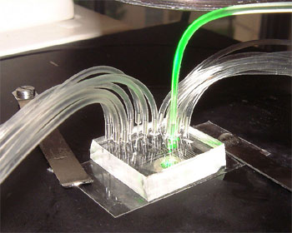
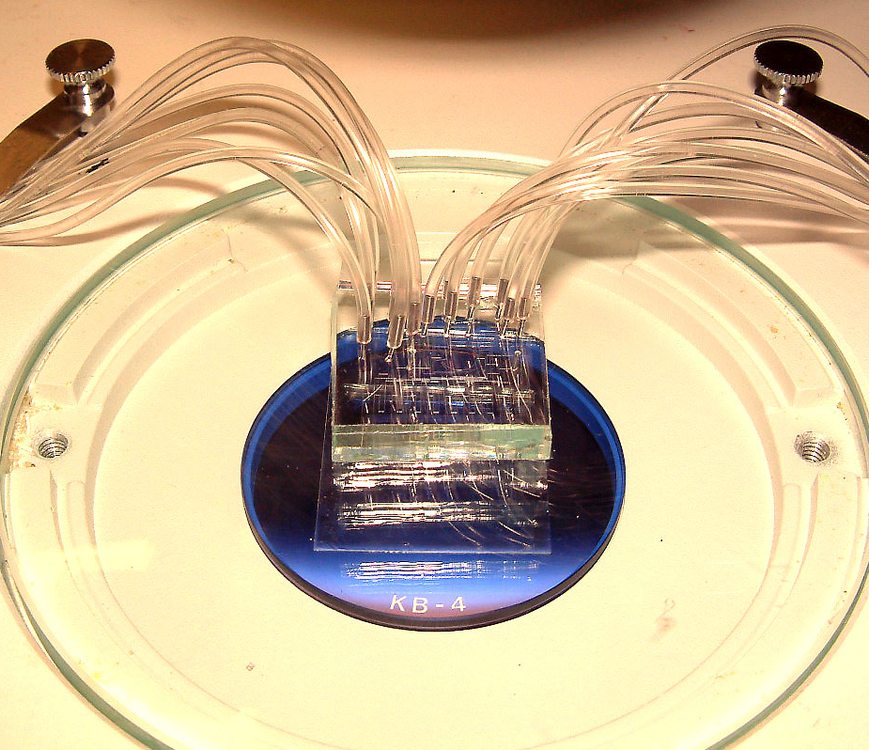
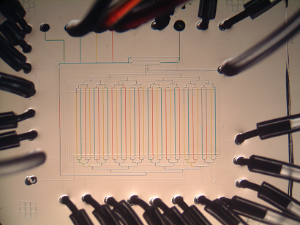
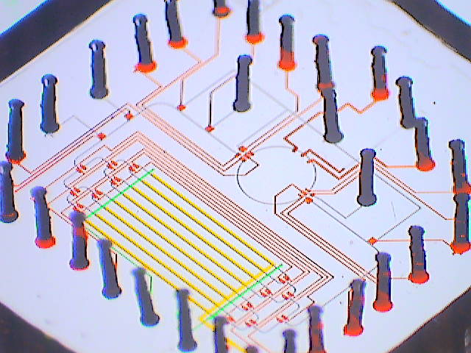
Fluidic Abstraction Layers
Silicon Analog
Abstract Computational Problem
- SAT formula, max-clique graph
Mathematica
Protocol Description Language
- readable code with high-level mixing ops
C
Fluidic Instruction Set Architecture (ISA)
- primitives for I/O, storage, transport, mixing
x86
Pentium III,
Pentium IV
chip 1
chip 2
chip 3

Slide 11
Fluidic Abstraction Layers
Abstract Computational Problem
- SAT formula, max-clique graph
Benefits:
  Portability
  Division of labor
  Scalability
  Expressivity
Protocol Description Language
- readable code with high-level mixing ops
Fluidic Instruction Set Architecture (ISA)
- primitives for I/O, storage, transport, mixing
chip 1
chip 2
chip 3

Slide 12

Fluidic Abstraction Layers
Abstract Computational Problem
- SAT formula, max-clique graph
Benefits:
  Portability
  Division of labor
  Scalability
  Expressivity
Protocol Description Language
- readable code with high-level mixing ops
Fluidic Instruction Set Architecture (ISA)
- primitives for I/O, storage, transport, mixing
chip 1
chip 2
chip 3

Slide 13
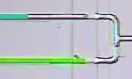
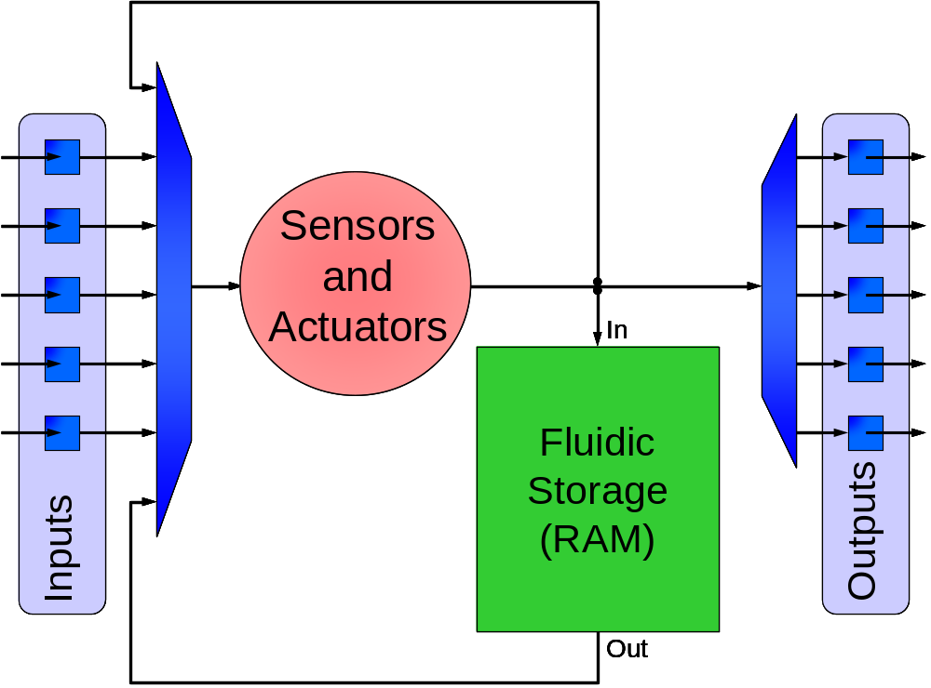
Abstraction 1: Digital Architecture
Recent chips can control independent fluid samples
  Droplet-based samples
  Continuous-flow samples
  Microfluidic latches
In abstract machine, all
samples have unit volume
  Input/output a sample
  Store a sample
  Operate on a sample
  [Fair et al.]
  [Urbanski et al.]
  [Urbanski et al.]

Slide 14
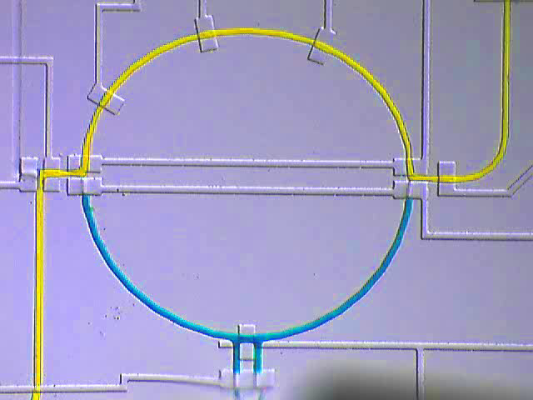
Abstraction 2: Mix Instruction
Microfluidic chips have various mixing technologies
  Electrokinetic mixing
  Droplet mixing
  Rotary mixing
Common attributes:
  Ability to mix two samples in equal proportions, store result
Fluidic ISA: mix (int src₁, int src₂, int dst)
  Ex: mix(1, 2, 3)
  To allow for lossy transport, only 1 unit of mixture retained
  [Levitan et al.]
  [Fair et al.]
  [Quake et al.]
Storage Cells
1
2
3
4
Mixer

Slide 15

Gradient Generation in Fluidic ISA
setValve(0, HIGH); setValve(1, HIGH);
setValve(2, LOW); setValve(3, HIGH);
setValve(4, LOW); setValve(5, LOW);
setValve(6, HIGH); setValve(7, LOW);
setValve(8, LOW); setValve(9, HIGH);
setValve(10, LOW); setValve(11, HIGH);
setValve(12, LOW); setValve(13, HIGH);
setValve(14, LOW); setValve(15, HIGH);
setValve(16, LOW); setValve(17, LOW);
setValve(18, LOW); setValve(19, LOW);
wait(2000);
setValve(14, HIGH); setValve(2, LOW);
wait(1000);
setValve(4, HIGH); setValve(12, LOW);
setValve(16, HIGH); setValve(18, HIGH);
setValve(19, LOW);
wait(2000);
wait(2000);
setValve(14, HIGH); setValve(2, LOW);
wait(1000);
setValve(4, HIGH); setValve(12, LOW);
setValve(16, HIGH); setValve(18, HIGH);
setValve(19, LOW);
wait(2000);
setValve(0, LOW); setValve(1, LOW);
setValve(2, LOW); setValve(3, HIGH);
setValve(4, LOW); setValve(5, HIGH);
setValve(6, HIGH); setValve(7, LOW);
setValve(8, LOW); setValve(9, HIGH);
setValve(10, HIGH); setValve(11, LOW);
setValve(12, LOW); setValve(13, LOW);
setValve(14, LOW); setValve(15, HIGH);
setValve(16, HIGH); setValve(17, LOW);
setValve(18, HIGH); setValve(19, LOW);
setValve(0, HIGH); setValve(1, HIGH);
setValve(2, LOW); setValve(3, HIGH);
setValve(4, LOW); setValve(5, LOW);
setValve(6, HIGH); setValve(7, LOW);
setValve(8, LOW); setValve(9, HIGH);
setValve(10, LOW); setValve(11, HIGH);
setValve(12, LOW); setValve(13, HIGH);
setValve(14, LOW); setValve(15, HIGH);
setValve(16, LOW); setValve(17, LOW);
setValve(18, LOW); setValve(19, LOW);
wait(2000);
setValve(14, HIGH); setValve(2, LOW);
wait(1000);
setValve(4, HIGH); setValve(12, LOW);
setValve(16, HIGH); setValve(18, HIGH);
setValve(19, LOW);
wait(2000);
wait(2000);
setValve(14, HIGH); setValve(2, LOW);
wait(1000);
setValve(4, HIGH); setValve(12, LOW);
setValve(16, HIGH); setValve(18, HIGH);
setValve(19, LOW);
wait(2000);
setValve(0, LOW); setValve(1, LOW);
setValve(2, LOW); setValve(3, HIGH);
setValve(4, LOW); setValve(5, HIGH);
setValve(6, HIGH); setValve(7, LOW);
setValve(8, LOW); setValve(9, HIGH);
setValve(10, HIGH); setValve(11, LOW);
setValve(12, LOW); setValve(13, LOW);
setValve(14, LOW); setValve(15, HIGH);
setValve(16, HIGH); setValve(17, LOW);
setValve(18, HIGH); setValve(19, LOW);
setValve(0, HIGH); setValve(1, HIGH);
setValve(2, LOW); setValve(3, HIGH);
setValve(4, LOW); setValve(5, LOW);
setValve(6, HIGH); setValve(7, LOW);
setValve(8, LOW); setValve(9, HIGH);
setValve(10, LOW); setValve(11, HIGH);
setValve(12, LOW); setValve(13, HIGH);
setValve(14, LOW); setValve(15, HIGH);
setValve(16, LOW); setValve(17, LOW);
setValve(18, LOW); setValve(19, LOW);
wait(2000);
setValve(14, HIGH); setValve(2, LOW);
wait(1000);
setValve(4, HIGH); setValve(12, LOW);
setValve(16, HIGH); setValve(18, HIGH);
setValve(19, LOW);
wait(2000);
wait(2000);
setValve(14, HIGH); setValve(2, LOW);
wait(1000);
setValve(4, HIGH); setValve(12, LOW);
setValve(16, HIGH); setValve(18, HIGH);
setValve(19, LOW);
wait(2000);
setValve(0, LOW); setValve(1, LOW);
setValve(2, LOW); setValve(3, HIGH);
setValve(4, LOW); setValve(5, HIGH);
setValve(6, HIGH); setValve(7, LOW);
setValve(8, LOW); setValve(9, HIGH);
setValve(10, HIGH); setValve(11, LOW);
setValve(12, LOW); setValve(13, LOW);
setValve(14, LOW); setValve(15, HIGH);
setValve(16, HIGH); setValve(17, LOW);
setValve(18, HIGH); setValve(19, LOW);
setValve(0, HIGH); setValve(1, HIGH);
setValve(2, LOW); setValve(3, HIGH);
setValve(4, LOW); setValve(5, LOW);
setValve(6, HIGH); setValve(7, LOW);
setValve(8, LOW); setValve(9, HIGH);
setValve(10, LOW); setValve(11, HIGH);
setValve(12, LOW); setValve(13, HIGH);
setValve(14, LOW); setValve(15, HIGH);
setValve(16, LOW); setValve(17, LOW);
setValve(18, LOW); setValve(19, LOW);
wait(2000);
setValve(14, HIGH); setValve(2, LOW);
wait(1000);
setValve(4, HIGH); setValve(12, LOW);
setValve(16, HIGH); setValve(18, HIGH);
setValve(19, LOW);
wait(2000);
wait(2000);
setValve(14, HIGH); setValve(2, LOW);
wait(1000);
setValve(4, HIGH); setValve(12, LOW);
setValve(16, HIGH); setValve(18, HIGH);
setValve(19, LOW);
wait(2000);
setValve(0, LOW); setValve(1, LOW);
setValve(2, LOW); setValve(3, HIGH);
setValve(4, LOW); setValve(5, HIGH);
setValve(6, HIGH); setValve(7, LOW);
setValve(8, LOW); setValve(9, HIGH);
setValve(10, HIGH); setValve(11, LOW);
setValve(12, LOW); setValve(13, LOW);
setValve(14, LOW); setValve(15, HIGH);
setValve(16, HIGH); setValve(17, LOW);
setValve(18, HIGH); setValve(19, LOW);
setValve(0, HIGH); setValve(1, HIGH);
setValve(2, LOW); setValve(3, HIGH);
setValve(4, LOW); setValve(5, LOW);
setValve(6, HIGH); setValve(7, LOW);
setValve(8, LOW); setValve(9, HIGH);
setValve(10, LOW); setValve(11, HIGH);
setValve(12, LOW); setValve(13, HIGH);
setValve(14, LOW); setValve(15, HIGH);
setValve(16, LOW); setValve(17, LOW);
setValve(18, LOW); setValve(19, LOW);
wait(2000);
setValve(14, HIGH); setValve(2, LOW);
wait(1000);
setValve(4, HIGH); setValve(12, LOW);
setValve(16, HIGH); setValve(18, HIGH);
setValve(19, LOW);
wait(2000);
wait(2000);
setValve(14, HIGH); setValve(2, LOW);
wait(1000);
setValve(4, HIGH); setValve(12, LOW);
setValve(16, HIGH); setValve(18, HIGH);
setValve(19, LOW);
wait(2000);
setValve(0, LOW); setValve(1, LOW);
setValve(2, LOW); setValve(3, HIGH);
setValve(4, LOW); setValve(5, HIGH);
setValve(6, HIGH); setValve(7, LOW);
setValve(8, LOW); setValve(9, HIGH);
setValve(10, HIGH); setValve(11, LOW);
setValve(12, LOW); setValve(13, LOW);
setValve(14, LOW); setValve(15, HIGH);
setValve(16, HIGH); setValve(17, LOW);
setValve(18, HIGH); setValve(19, LOW);
setValve(0, HIGH); setValve(1, HIGH);
setValve(2, LOW); setValve(3, HIGH);
setValve(4, LOW); setValve(5, LOW);
setValve(6, HIGH); setValve(7, LOW);
setValve(8, LOW); setValve(9, HIGH);
setValve(10, LOW); setValve(11, HIGH);
setValve(12, LOW); setValve(13, HIGH);
setValve(14, LOW); setValve(15, HIGH);
setValve(16, LOW); setValve(17, LOW);
setValve(18, LOW); setValve(19, LOW);
wait(2000);
setValve(14, HIGH); setValve(2, LOW);
wait(1000);
setValve(4, HIGH); setValve(12, LOW);
setValve(16, HIGH); setValve(18, HIGH);
setValve(19, LOW);
wait(2000);
wait(2000);
setValve(14, HIGH); setValve(2, LOW);
wait(1000);
setValve(4, HIGH); setValve(12, LOW);
setValve(16, HIGH); setValve(18, HIGH);
setValve(19, LOW);
wait(2000);
setValve(0, LOW); setValve(1, LOW);
setValve(2, LOW); setValve(3, HIGH);
setValve(4, LOW); setValve(5, HIGH);
setValve(6, HIGH); setValve(7, LOW);
setValve(8, LOW); setValve(9, HIGH);
setValve(10, HIGH); setValve(11, LOW);
setValve(12, LOW); setValve(13, LOW);
setValve(14, LOW); setValve(15, HIGH);
setValve(16, HIGH); setValve(17, LOW);
setValve(18, HIGH); setValve(19, LOW);
setValve(0, HIGH); setValve(1, HIGH);
setValve(2, LOW); setValve(3, HIGH);
setValve(4, LOW); setValve(5, LOW);
setValve(6, HIGH); setValve(7, LOW);
setValve(8, LOW); setValve(9, HIGH);
setValve(10, LOW); setValve(11, HIGH);
setValve(12, LOW); setValve(13, HIGH);
setValve(14, LOW); setValve(15, HIGH);
setValve(16, LOW); setValve(17, LOW);
setValve(18, LOW); setValve(19, LOW);
wait(2000);
setValve(14, HIGH); setValve(2, LOW);
wait(1000);
setValve(4, HIGH); setValve(12, LOW);
setValve(16, HIGH); setValve(18, HIGH);
setValve(19, LOW);
wait(2000);
wait(2000);
setValve(14, HIGH); setValve(2, LOW);
wait(1000);
setValve(4, HIGH); setValve(12, LOW);
setValve(16, HIGH); setValve(18, HIGH);
setValve(19, LOW);
wait(2000);
setValve(0, LOW); setValve(1, LOW);
setValve(2, LOW); setValve(3, HIGH);
setValve(4, LOW); setValve(5, HIGH);
setValve(6, HIGH); setValve(7, LOW);
setValve(8, LOW); setValve(9, HIGH);
setValve(10, HIGH); setValve(11, LOW);
setValve(12, LOW); setValve(13, LOW);
setValve(14, LOW); setValve(15, HIGH);
setValve(16, HIGH); setValve(17, LOW);
setValve(18, HIGH); setValve(19, LOW);
setValve(0, HIGH); setValve(1, HIGH);
setValve(2, LOW); setValve(3, HIGH);
setValve(4, LOW); setValve(5, LOW);
setValve(6, HIGH); setValve(7, LOW);
setValve(8, LOW); setValve(9, HIGH);
setValve(10, LOW); setValve(11, HIGH);
setValve(12, LOW); setValve(13, HIGH);
setValve(14, LOW); setValve(15, HIGH);
setValve(16, LOW); setValve(17, LOW);
setValve(18, LOW); setValve(19, LOW);
wait(2000);
setValve(14, HIGH); setValve(2, LOW);
wait(1000);
setValve(4, HIGH); setValve(12, LOW);
setValve(16, HIGH); setValve(18, HIGH);
setValve(19, LOW);
wait(2000);
wait(2000);
setValve(14, HIGH); setValve(2, LOW);
wait(1000);
setValve(4, HIGH); setValve(12, LOW);
setValve(16, HIGH); setValve(18, HIGH);
setValve(19, LOW);
wait(2000);
setValve(0, LOW); setValve(1, LOW);
setValve(2, LOW); setValve(3, HIGH);
setValve(4, LOW); setValve(5, HIGH);
setValve(6, HIGH); setValve(7, LOW);
setValve(8, LOW); setValve(9, HIGH);
setValve(10, HIGH); setValve(11, LOW);
setValve(12, LOW); setValve(13, LOW);
setValve(14, LOW); setValve(15, HIGH);
setValve(16, HIGH); setValve(17, LOW);
setValve(18, HIGH); setValve(19, LOW);
input(0, 0);
input(1, 1);
input(0, 2);
mix(1, 2, 3);
input(0, 2);
mix(2, 3, 1);
input(1, 3);
input(0, 4);
mix(3, 4, 2);
input(1, 3);
input(0, 4);
mix(3, 4, 5);
input(1, 4);
mix(4, 5, 3);
mix(0, 4);
abstraction
450 Valve Operations
Direct Control
- 450 valve actuations
- only works on 1 chip
Fluidic ISA
- 15 instructions
- portable across chips

Slide 16
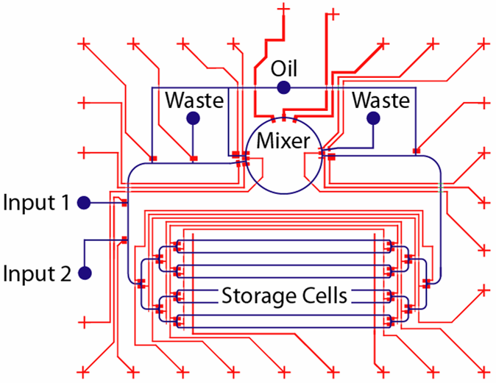
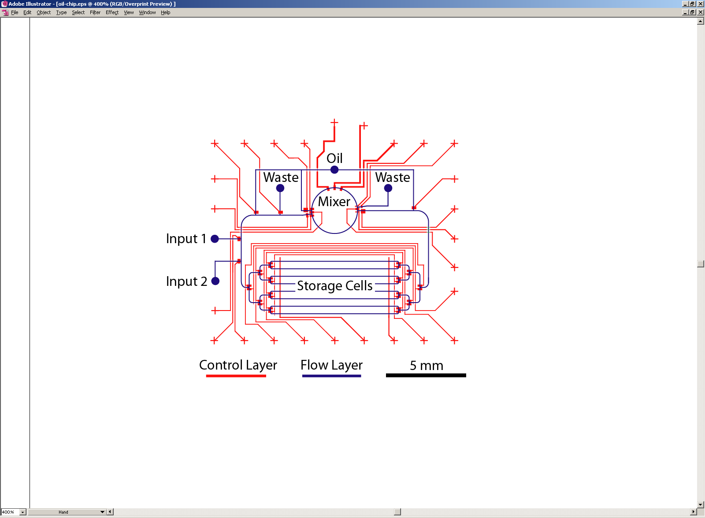
Implementation: Oil-Driven Chip
 | Inputs | Storage Cells | Background Phase | Wash Phase | Mixing
Chip 1 | 2 | 8 | Oil | — | Rotary

Slide 17
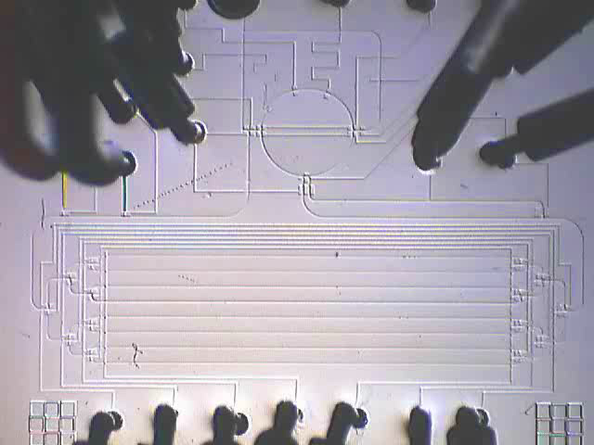
Implementation: Oil-Driven Chip
mix (S₁, S₂, D) {
1. Load S₁
2. Load S₂
3. Rotary mixing
4. Store into D
}
50x real-time
 | Inputs | Storage Cells | Background Phase | Wash Phase | Mixing
Chip 1 | 2 | 8 | Oil | — | Rotary

Slide 18
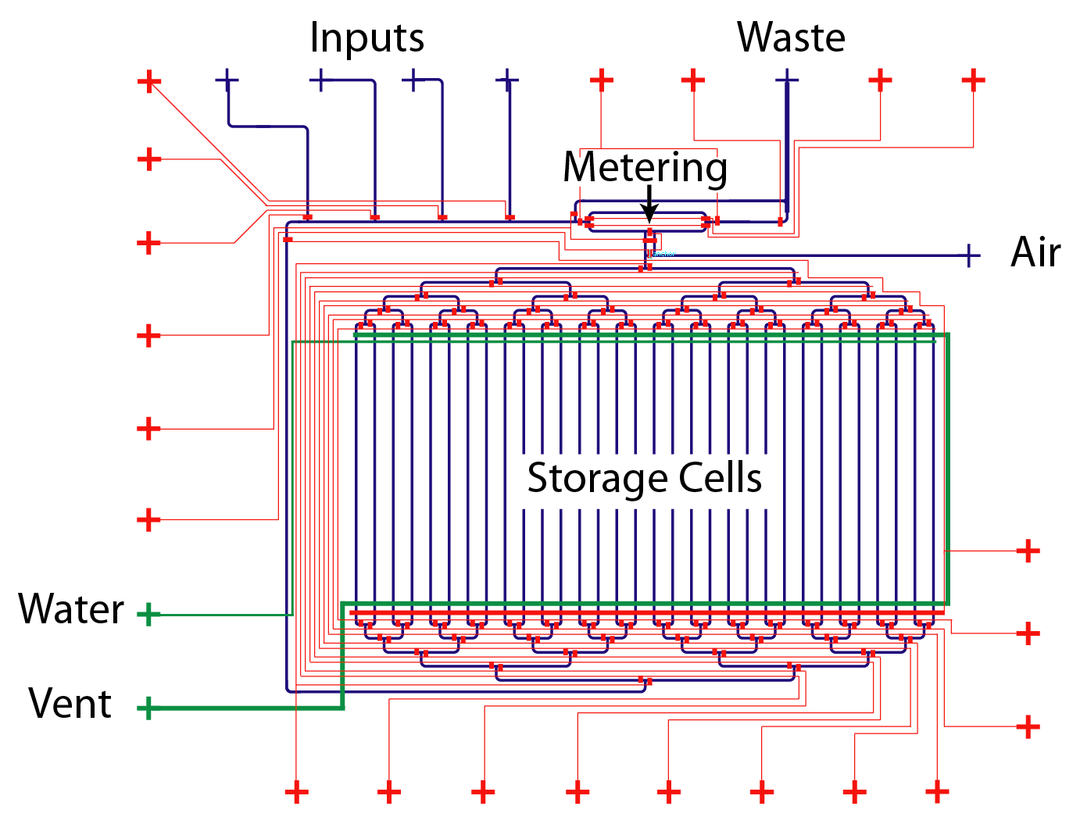
Implementation 2: Air-Driven Chip
 | Inputs | Storage Cells | Background Phase | Wash Phase | Mixing
Chip 1 | 2 | 8 | Oil | — | Rotary
Chip 2 | 4 | 32 | Air | Water | In channels

Slide 19
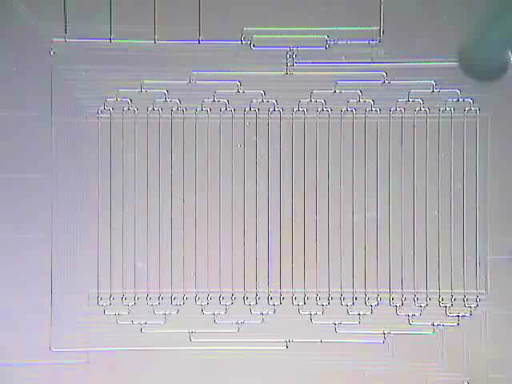
Implementation 2: Air-Driven Chip
mix (S₁, S₂, D) {
1. Load S₁
2. Load S₂
3. Mix / Store into D
4. Wash S₁
5. Wash S₂
}
50x real-time
 | Inputs | Storage Cells | Background Phase | Wash Phase | Mixing
Chip 1 | 2 | 8 | Oil | — | Rotary
Chip 2 | 4 | 32 | Air | Water | In channels

Slide 20
Abstraction Layers
Abstract Computational Problem
- SAT formula, max-clique graph
Protocol Description Language
- readable code with high-level mixing ops
Fluidic Instruction Set Architecture (ISA)
- primitives for I/O, storage, transport, mixing
chip 1
chip 2
chip 3

Slide 21

Abstraction 1: Managing Fluid Storage
Fluid[] out = new Fluid[8];
Fluid yellow, blue, green;
out[0] = input(0);
yellow = input(0);
blue = input(1);
green = mix(yellow, blue);
yellow = input(0);
out[1] = mix(yellow, green);
yellow = input(0);
blue = input(1);
out[2] = mix(yellow, blue);
yellow = input(0);
blue = input(1);
green = mix(yellow, blue);
blue = input(1);
out[3] = mix(blue, green);
out[4] = input(1);
input(0, 0);
input(1, 1);
input(0, 2);
mix(1, 2, 3);
input(0, 2);
mix(2, 3, 1);
input(1, 3);
input(0, 4);
mix(3, 4, 2);
input(1, 3);
input(0, 4);
mix(3, 4, 5);
input(1, 4);
mix(4, 5, 3);
mix(0, 4);
Fluidic
ISA
1. Storage
Management
Programmer uses location-independent Fluid variables
  Runtime system assigns & tracks location of each Fluid
  Comparable to automatic memory management (e.g., Java)

Slide 22
Fluid[] out = new Fluid[8];
Fluid yellow, blue, green;
out[0] = input(0);
yellow = input(0);
blue = input(1);
green = mix(yellow, blue);
yellow = input(0);
out[1] = mix(yellow, green);
yellow = input(0);
blue = input(1);
out[2] = mix(yellow, blue);
yellow = input(0);
blue = input(1);
green = mix(yellow, blue);
blue = input(1);
out[3] = mix(blue, green);
out[4] = input(1);

Slide 23
Abstraction 2: Fluid Re-Generation
Fluid[] out = new Fluid[8];
Fluid yellow, blue, green;
out[0] = input(0);
yellow = input(0);
blue = input(1);
green = mix(yellow, blue);
yellow = input(0);
out[1] = mix(yellow, green);
yellow = input(0);
blue = input(1);
out[2] = mix(yellow, blue);
yellow = input(0);
blue = input(1);
green = mix(yellow, blue);
blue = input(1);
out[3] = mix(blue, green);
out[4] = input(1);
Fluid[] out = new Fluid[8];
Fluid yellow = input(0);
Fluid blue = input(1);
Fluid green = mix(yellow, blue);
out[0] = yellow;
out[1] = mix(yellow, green);
out[2] = green;
out[3] = mix(blue, green);
out[4] = blue;
2. Fluid Re-Generation
Programmer may use a Fluid variable multiple times
  Each time, a physical Fluid is consumed on-chip
  Runtime system re-generates Fluids from computation history

Slide 24
Fluid[] out = new Fluid[8];
Fluid yellow = input(0);
Fluid blue = input(1);
Fluid green = mix(yellow, blue);
out[0] = yellow;
out[1] = mix(yellow, green);
out[2] = green;
out[3] = mix(blue, green);
out[4] = blue;
2. Fluid Re-Generation

Slide 25
Abstraction 3: Arbitrary Mixing
Fluid[] out = new Fluid[8];
Fluid yellow = input(0);
Fluid blue = input(1);
Fluid green = mix(yellow, blue);
out[0] = yellow;
out[1] = mix(yellow, green);
out[2] = green;
out[3] = mix(blue, green);
out[4] = blue;
Fluid[] out = new Fluid[8];
Fluid yellow = input (0);
Fluid blue = input (1);
out[0] = yellow;
out[1] = mix(yellow, 3/4, blue, 1/4);
out[2] = mix(yellow, 1/2, blue, 1/2);
out[3] = mix(yellow, 1/4, blue, 3/4);
out[4] = blue;
2. Fluid Re-Generation
3. Arbitrary Mixing
Allows mixing fluids in any proportion, not just 50/50
  Fluid mix (Fluid F₁, float p₁, Fluid f₂, float F₂)
    → Returns Fluid that is p₁ parts F₁ and p₂ parts F₂
  Runtime system translates to 50/50 mixes in Fluidic ISA
  Note: some mixtures only reachable within error tolerance ε

Slide 26
Abstraction 3: Arbitrary Mixing
Fluid[] out = new Fluid[8];
Fluid yellow = input(0);
Fluid blue = input(1);
Fluid green = mix(yellow, blue);
out[0] = yellow;
out[1] = mix(yellow, green);
out[2] = green;
out[3] = mix(blue, green);
out[4] = blue;
Fluid[] out = new Fluid[8];
Fluid yellow = input (0);
Fluid blue = input (1);
out[0] = yellow;
out[1] = mix(yellow, 3/4, blue, 1/4);
out[2] = mix(yellow, 1/2, blue, 1/2);
out[3] = mix(yellow, 1/4, blue, 3/4);
out[4] = blue;
2. Fluid Re-Generation
3. Arbitrary Mixing
Allows mixing fluids in any proportion, not just 50/50
  Fluid mix (Fluid F₁, float p₁, Fluid f₂, float F₂)
    → Returns Fluid that is p₁ parts F₁ and p₂ parts F₂
  Runtime system translates to 50/50 mixes in Fluidic ISA
  Note: some mixtures only reachable within error tolerance ε

Slide 27
Abstraction 3: Arbitrary Mixing
Fluid[] out = new Fluid[8];
Fluid yellow = input (0);
Fluid blue = input (1);
out[0] = yellow;
out[1] = mix(yellow, 3/4, blue, 1/4);
out[2] = mix(yellow, 1/2, blue, 1/2);
out[3] = mix(yellow, 1/4, blue, 3/4);
out[4] = blue;
Fluid[] out = new Fluid[8];
Fluid yellow = input (0);
Fluid blue = input (1);
for (int i=0; i<=4; i++) {
out[i] = mix(yellow, 1-i/4, blue, i/4);
}
3. Arbitrary Mixing
4. Parameterized Mixing
Allows mixing fluids in any proportion, not just 50/50
  Fluid mix (Fluid F₁, float p₁, Fluid f₂, float F₂)
    → Returns Fluid that is p₁ parts F₁ and p₂ parts F₂
  Runtime system translates to 50/50 mixes in Fluidic ISA
  Note: some mixtures only reachable within error tolerance ε

Slide 28




BioStream Protocol Language
Supports all the abstractions
  Automatic storage management
  Re-generation of fluids
  Arbitrary mixing
Implemented as a Java library
  Allows flexible integration with general-purpose Java code
Targets microfluidic chips or auto-generated simulator
Fluid yellow = input (0);
Fluid blue = input (1);
Fluid[] out = new Fluid[8];
for (int i=0; i<=4; i++) {
out[i] = mix(yellow, 1-i/4, blue, i/4);
}
User Code
Architecture Description
- Double camera(Fluid f);
BioStream Library
Simulator Generator
Fluidic ISA
Microfluidic chip
Microfluidic simulator

Slide 29
Example: Fixed-pH Reaction
Goal: maintain given pH throughout reaction
  For in-vitro modeling of natural environment
Method: periodically test, adjust pH if needed
Fluid sample = input (0);
Fluid acid = input(1);
Fluid base = input(2);
do {
Fluid pH_test = mix(sample, 0.9, indicator, 0.1); // test pH of sample
double pH = test_luminescence(pH_test);
if (pH > 7.5) { // if pH too high, add acid
sample = mix (sample, 0.9, acid, 0.1);
} else if (pH < 6.5) { // if pH too low, add base
sample = mix (sample, 0.9, base, 0.1);
}
wait(60);
} while (detect_activity(sample));

Slide 30

Example: Fixed-pH Reaction
Goal: maintain given pH throughout reaction
  For in-vitro modeling of natural environment
Method: periodically test, adjust pH if needed
Fluid sample = input (0);
Fluid acid = input(1);
Fluid base = input(2);
do {
Fluid pH_test = mix(sample, 0.9, indicator, 0.1); // test pH of sample
double pH = test_luminescence(pH_test);
if (pH > 7.5) { // if pH too high, add acid
sample = mix (sample, 0.9, acid, 0.1);
} else if (pH < 6.5) { // if pH too low, add base
sample = mix (sample, 0.9, base, 0.1);
}
wait(60);
} while (detect_activity(sample));
Feedback-Intensive Applications:
Recursive descent
search
Directed evolution
Cell isolation
and manipulation
Dose/response curves
Long, complex
protocols

Slide 31
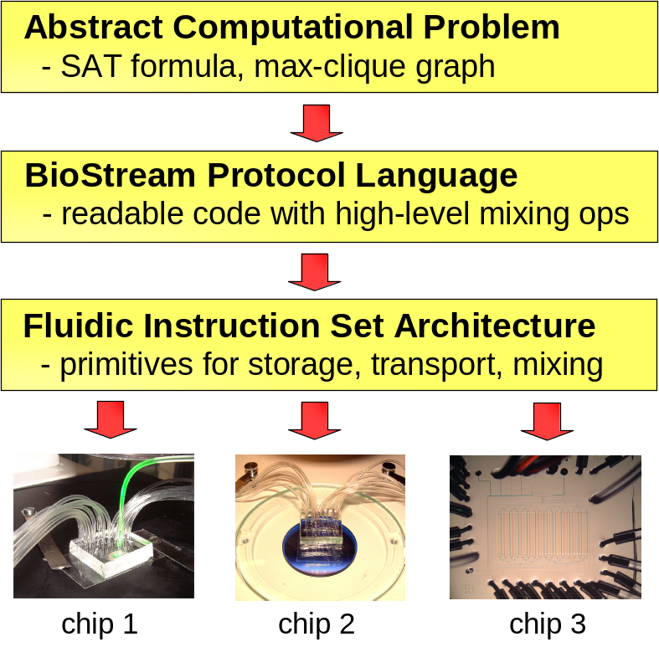
Big Picture
Abstraction layers enable
simple, scalable hardware
  Instead of custom chips,
  build general-purpose devices
Vision for microfluidics:
everyone uses a standard chip
  Thousands of storage cells
  Dozens of parallel mixers
  Integrated support for cell
  manipulation, PCR, readout, etc.
Vision for software:
a defacto language for experimental science
  You can download a colleague’s code, run it on your chip

Slide 32
Related Work
Automatic generation / scheduling of biology protocols
  EDNAC computer for automatically solving 3-SAT [Johnson]
  Compile SAT to microfluidic chips [Landweber et al.] [van Noort]
  Robot scientist: generates/tests genetic hypotheses [King et al.]
  Mapping sequence graphs to grid-based chips [Su/Chakrabarty]
Custom microfluidic chips for biological computation
  DNA computing [Grover & Mathies] [van Noort et al.] [McCaskill] [Livstone, Weiss, & Landweber] [Gehani & Reif] [Farfel & Stefanovic]
  Self-assembly [Somei, Kaneda, Fujii, & Murata] [Whitesides et al.]
General-purpose microfluidic chips
  Using electrowetting, with flexible mixing [Fair et al.]
  Using dialectrophoresis, with retargettable GUI [Gascoyne et al.]
  Using Braille displays as programmable actuators [Gu et al.]

Slide 33
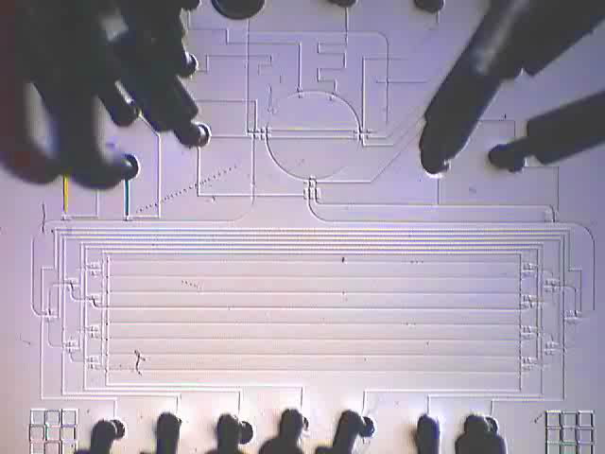
Conclusions
End-to-end system for programmable microfluidics
  Usable: high-level code is natural expression of protocol
  Portable: same code executes on diverse chips
  Scalable: protocols automatically utilize parallel resources
Relies on abstraction layers
  Fluidic ISA
  BioStream language
Future work
  Incorporate stateful molecules,
  cells into abstraction layers
  Looking for killer applications!
http://cag.csail.mit.edu/biostream

