Slide 1


MIT Digital Currency Initiative and the University of Brasilia presents
Cryptocurrency Design and Engineering
Assignment 3: Background
Presented by: Matthew Waleyko
10/22/2025
MAS.S62

Slide 2
Required Materials
Computer with Python3 installed
https://www.python.org/downloads/
Python’s ecdsa library
python –m pip install ecdsa
pip install ecdsa
Instructions and Starter Code
https://github.com/mit-dci-cde-2025/mit-dci-cde-2025-classroom-students-assignment-2-cde2025.2-digital-signatures-makerere
Cryptocurrency Design and Engineering Fall 2025

Slide 3
Goals
Have a basic working understanding of ECDSA’s usage in bitcoin
A completed assignment 3
Create a signature
Sign a message
Forge 2 messages
Alter a valid signature
Cryptocurrency Design and Engineering Fall 2025

Slide 4
Hashing
Takes an arbitrary length input
Outputs fixed length output
The output appears random but is deterministic
Allows for data integrity
Allows for the commitment of information
It will rain tomorrow
aa6937cfa2c147206b40c2fe45e8182174bad1d705eae2d91efb8e773e22d36f
It will not rain tomorrow
725763ae3279cc027377cf04cce9a5fa14f9850852be6435040b9c16083e7d13
Cryptocurrency Design and Engineering Fall 2025

Slide 5
Digital Signatures
Method by which a data can be verified
Consists of two key components
Private Key
Public Key
Used to verify information came from a specific source
Relies on complex mathematics
RSA
ECDSA
Cryptocurrency Design and Engineering Fall 2025

Slide 6
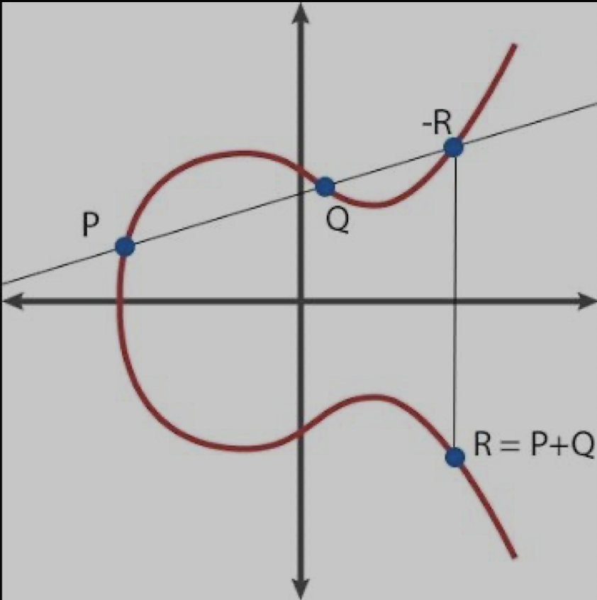
Elliptic Curve Digital Signature Algorithm
Smaller keys
Faster computation
Patent free
Capitol letters will represent a Point on the curve
Lower Case letters represent a scaler
P+Q+R = 0
P+Q = -R
Tadge Dryja. Cryptocurrency Engineering and Design. 2018. Massachusetts Institute of Technology: MIT OpenCouseWare, https://ocw.mit.edu/. License: Creative Commons BY-NC-SA.
Cryptocurrency Design and Engineering Fall 2025

Slide 7
Elliptic Curve Operations
A+B
A-B
A*b
A/b
Cryptocurrency Design and Engineering Fall 2025

Slide 8
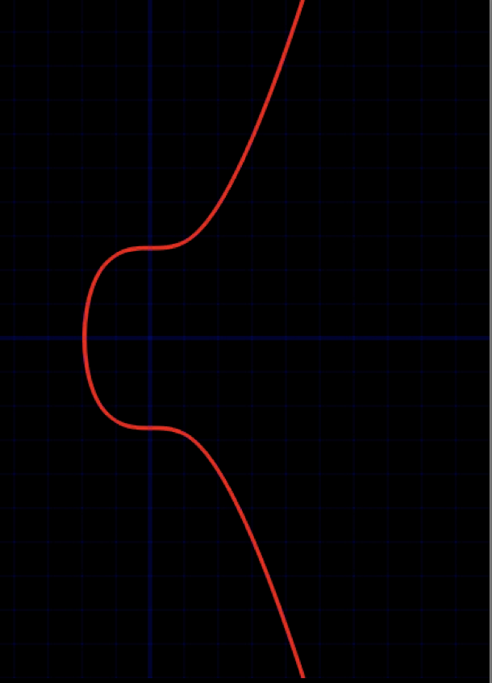
Elliptic Curve Digital Signature Algorithm
SECP256k1
y² = x³ + 7
G and n are constants
Private key is random integer a
Public key is derived from the private key
E = e*G
R = k*G
r = x mod n
s = k^(-1) * (hash(m) + r*e) mod n
Tadge Dryja. Cryptocurrency Engineering and Design. 2018. Massachusetts Institute of Technology: MIT OpenCouseWare, https://ocw.mit.edu/. License: Creative Commons BY-NC-SA.
Cryptocurrency Design and Engineering Fall 2025

Slide 9
Assignment 2
Directories
data
graders
implementation
Solutions
https://ecdsa.readthedocs.io/en/latest/modules.html
Cryptocurrency Design and Engineering Fall 2025

Slide 10
Exercise 1
Create a Public/Private key pair
Sign a message
hashlib.sha256(b"").digest().hex()
Output your public key and signed message
All hex characters
Compressed format public key
Cryptocurrency Design and Engineering Fall 2025

Slide 11
Exercise 2
Given a known k forge a message
s = k^(-1) * (hash(m) + r*e) mod n
-> e = (s * k - h) * r_inv % n
r_inv = pow(r, -1, n)
Cryptocurrency Design and Engineering Fall 2025

Slide 12
Exercise 3
Given k reuse forge a message
Sony PlayStation 5 Hack
k = (hash(m1) - hash(m2))/(s1 - s2) mod n
Cryptocurrency Design and Engineering Fall 2025

Slide 13
Exercise 4
Signature malleability
(r, s) ≡ (r, n-s)
Vulnerability was patched
Cryptocurrency Design and Engineering Fall 2025

Slide 14
Exercise 5
Modify a block
(r, s) ≡ (r, n-s)
r = tx_data[47:79]
s = tx_data[81:113]
Cryptocurrency Design and Engineering Fall 2025

