Slide 1
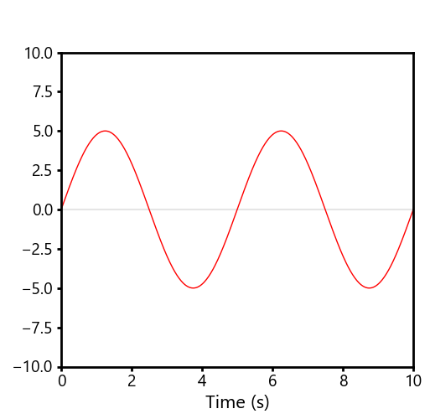
Period
Amplitude

