Slide 1
Building a RAG Pipeline on Engaging

Slide 2
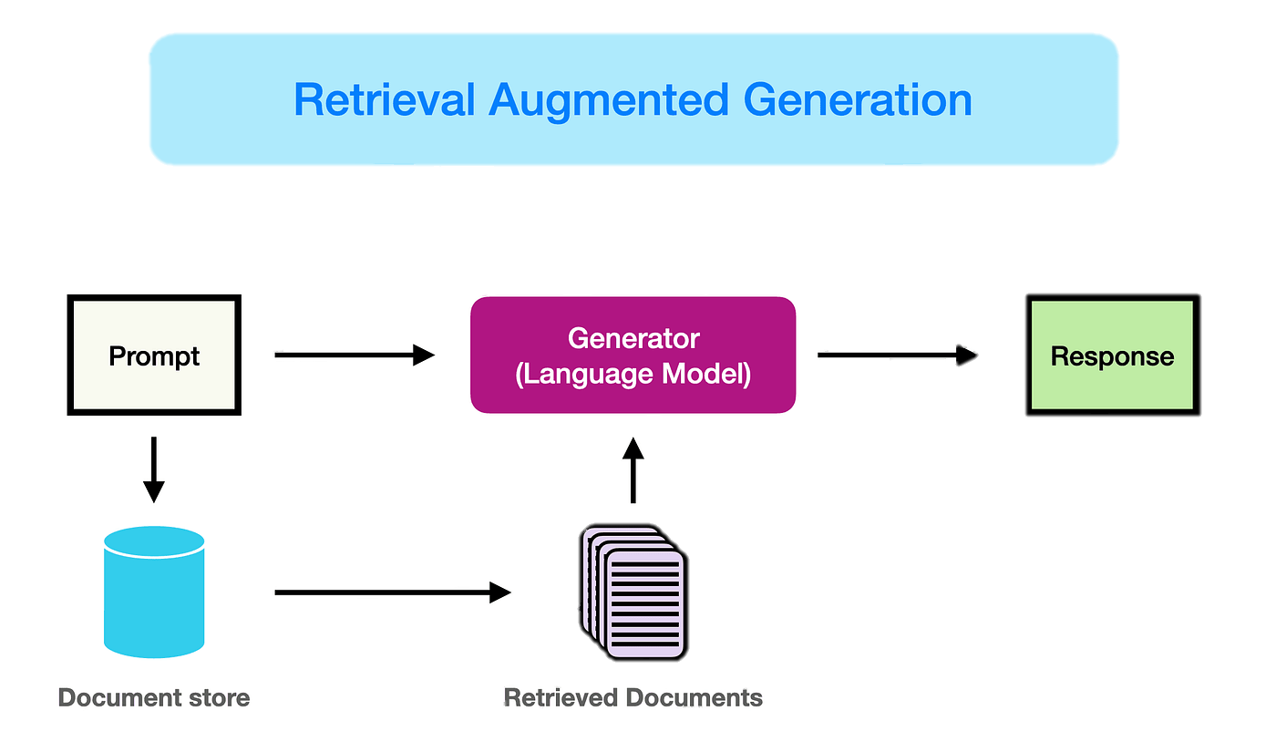
What is RAG?
Medium

Slide 3


RAG on Engaging
Other options:
  Notebook LM
  ChatGPT application
Advantages of developing your own:
  Greater customization
  Data privacy

Slide 4
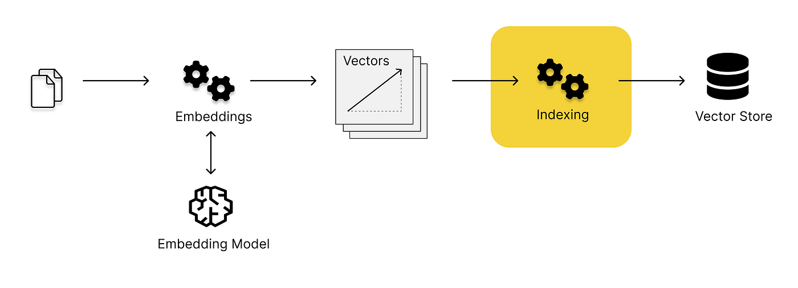
Vector Stores
Documents (PDFs, .md files, etc.)
Medium

Slide 5
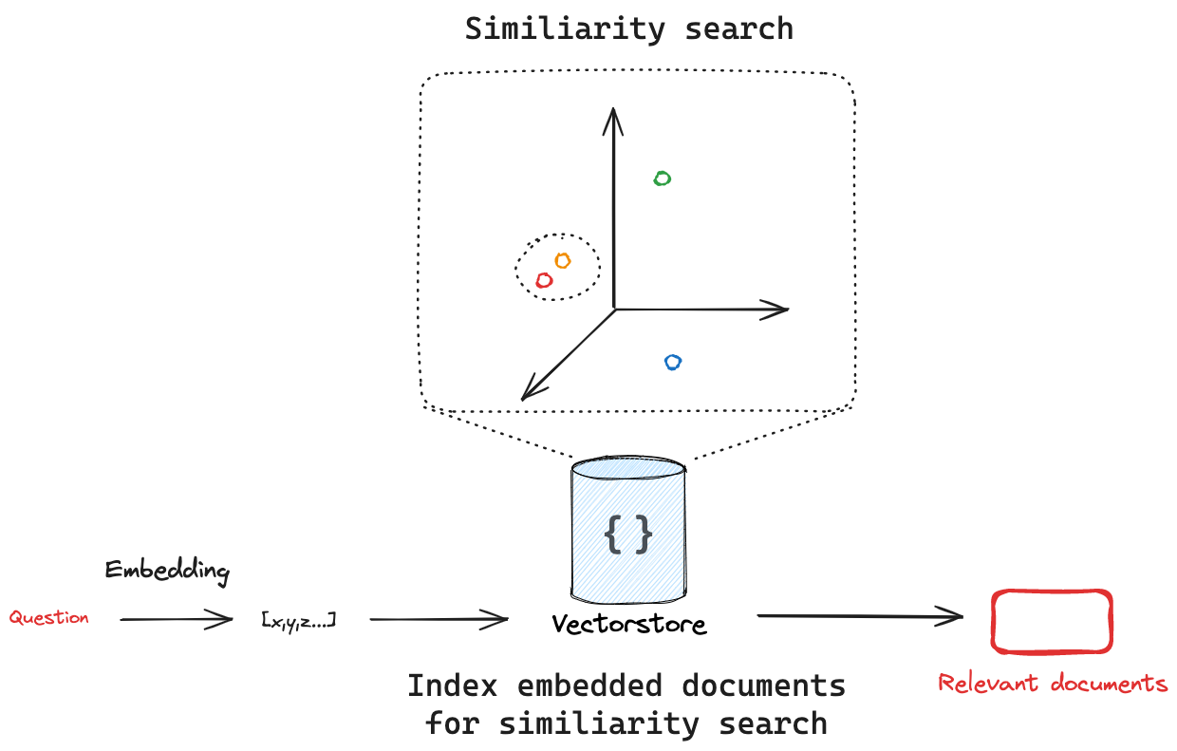
Vector Stores
LangChain

Slide 6
Setting up
Start a Jupyter session on orcd-ood.mit.edu
  4 CPU cores
  16GB memory
  Allocate GPU
Clone this GitHub repository: https://github.com/mitdbg/practical-programming-with-data

