Slide 1
x86 segmentation, page tables, and interrupts
3/17/08
Frans Kaashoek
MIT
kaashoek@mit.edu

Slide 2
Outline
Enforcing modularity with virtualization
  Virtualize processor and memory
x86 mechanism for virtualization
  Segmentation
  User and kernel mode
  Page tables
  System calls

Slide 3
Last lecture’s computer
Main memory
CPU
instruction
for (;;) {
next instruction
}
instruction
instruction
data
data
data
Memory holds instructions and data
CPU interprets instructions

Slide 4
Better view
Main memory
CPU
Program1
Program 1:
for (;;) {
next instruction
}
Program 2
Program 3
Data for P1
Data for P2
Data for P3
For modularity reasons: many programs
OS switches processor(s) between programs

Slide 5

Problem: no boundaries
Main memory
Program1
2³²-1
Program 2
Program 3
Data for P1
Data for P2
Data for P3
0
A program can modify other programs data
A program jumps into other program’s code
A program may get into an infinite loop

Slide 6
Goal: enforcing modularity
Give each program its private memory for code, stack, and data
Prevent one program from getting out of its memory
Allowing sharing between programs when needed
Force programs to share processor

Slide 7
Solution approach: virtualization
Physical
address
Virtual
address
2³²-1
Program1
2³²-1
Data for P1
Virtual address
0
2³²-1
Program 2
MMU
Data for P2
0
2³²-1
Program 3
Physical address
0
Data for P3
0
Virtualize memory: virtual addresses
Virtualize processor: preemptive scheduling

Slide 8
Page map guides translation
MMU
P1’s PT
Page-map
register
0
0xBF
Each program has its own page map
  Physical memory doesn’t have to be contiguous
When switching program, switch page map
Page maps stored in main memory

Slide 9
Protecting page maps: kernel and user mode
mov $val, %cr3
U/K
Page-map register
Kernel mode: can change page-map register, U/K
In user mode: cannot
Processor starts in kernel mode
On interrupts, processor switches to kernel mode

Slide 10
What is a kernel?
sh
ls
U
LibOS w. Unix API
LibOS w. Unix API
K
Kernel
The code running in kernel mode
  Trusted program: e.g., sets page-map, U/K register
  Enforces modularity

Slide 11
Entering the kernel: system calls
int #
sh
ls
LibOS w. Unix API
LibOS w. Unix API
Kernel
iret
Special instructions
  Switches U/K bit
Enter kernel at kernel-specified addresses

Slide 12
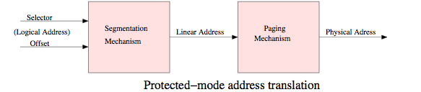
x86 virtual addresses
x86 starts in real mode (no protection)
  segment registers (cs, ss, ds, es)
  segment * 16 + offset ⇦physical address
OS can switch to protected mode
  Segmentation and paging

Slide 13
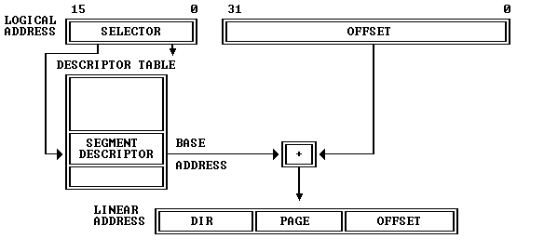
Translation with segments
LDGT loads CPU’s GDT
PE bit in CR0 register enables protected mode
Segments registers contain index

Slide 14
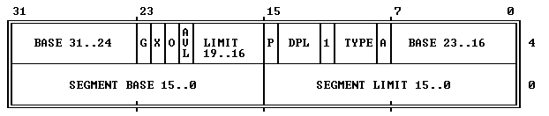
Segment descriptor
Linear address = logical address + base
  assert: logical address < limit
Segment restricts what memory an application can reference

Slide 15
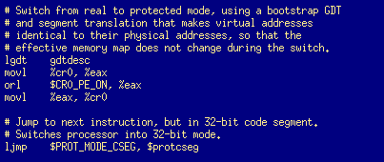
JOS code
Why does EIP contain the address of “ljmp” instruction after “movl %eax, %cr0”?

Slide 16

Enforcing modularity in x86
CPL: current privilege level
  0: privileged (kernel mode)
  3: user mode
User programs can set segment selector
Kernel can load value in CPL and GDT, but user programs cannot

Slide 17
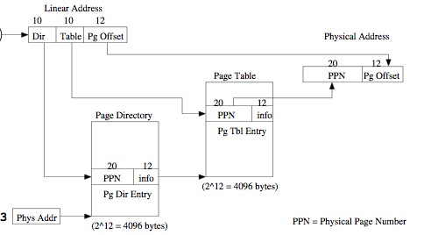
x86 two-level page table
Page size is 4,096 bytes
  1,048,576 pages in 2³²
  Two-level structure to translate

Slide 18

x86 page table entry
W: writable?
  Page fault when W = 0 and writing
U: user mode references allowed?
  Page fault when U = 0 and user references address
P: present?
  Page fault when P = 0

Slide 19
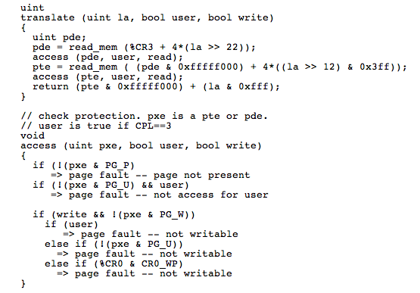
what does the x86 do exactly?

Slide 20
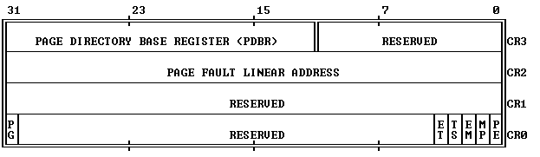
When does page table take effect?
PG enables page-based translation
CR3 contains address of page table
  Where does the next instruction come from?
When changing PDE or PTE, you must flush TLB
  Reload CR3

Slide 21
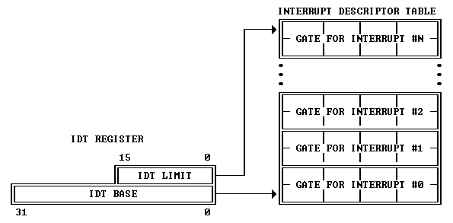
User mode to kernel mode
Instruction: INT n, or interrupt
n indexes into interrupt descriptor table (IDT)
IDTR contains physical address of IDT

Slide 22
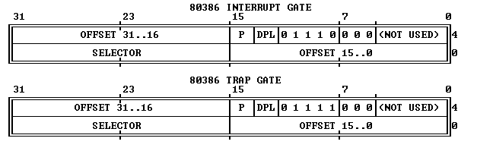
IDT descriptor
Three ways to get into kernel:
  User asks (trap)
  Page fault (trap)
  Interrupts

Slide 23
What happens on trap/interrupt?
CPU uses vector n to index into IDT
Checks that CPL ≤ DPL
Saves ESP and SS in internal register
Loads ESP and SS from TSS
Push user SS
Push user ESP
Push user EFLAGS
Push user CS
Push user EIP
Clear some EFLAGS bits
Set CS and EIP from IDT descriptor

Slide 24
From kernel to user
IRET instruction
  Reverse of INT

Slide 25
Labs
Lab 1: start kernel
  setup and use segmentation
Lab 2: kernel
  Set up kernel address space
Lab 3: user/kernel
  Set up user address space
  Set up IDT
  _x0018_System calls and page faults
Lab 4: many user programs
  _x0016_Preemptive scheduling

Slide 26
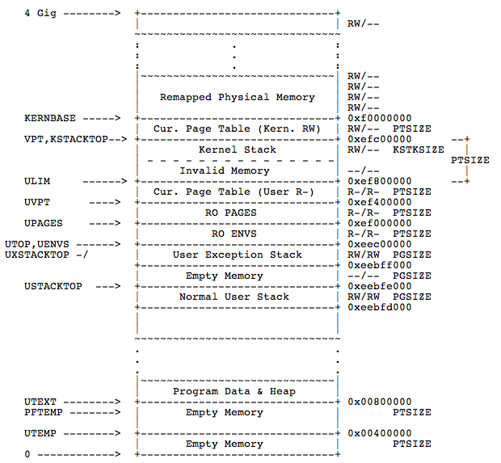
JOS

Slide 27
Recall x86 page table
To find P for V OS can walk PT manually

Slide 28
VPT: Mapping the page table
Z
Z|Z maps to the page directory
Z|V maps to V’s page table entry

Slide 29
Summary
Kernel enforcing modularity
  By switching processor between programs
  By giving each program its own virtual memory
x86 support for enforcing modularity
  Segments
  User and kernel mode
  Page tables
  Interrupts and traps
JOS

