Slide 1
PC hardware and x86
3/3/08
Frans Kaashoek
MIT
kaashoek@mit.edu

Slide 2
A PC
how to make it to do something useful?

Slide 3
Outline
PC architecture
x86 instruction set
gcc calling conventions
PC emulation
Illustrate a few
big CS ideas
Notes:
Big ideas: data can be instructions, stack, hardware == software

Slide 4
PC board
Notes:
CPU, address and data signals, memory, disk, keyboard, display, BIOS ROM, clock, …

Slide 5
The von Neumann model
Central
Processing
Unit
Main
Memory
Input/Output
I/O: communicating data to and from devices
CPU: digital logic for performing computation
Memory: N words of B bits

Slide 6
The stored program computer
Main memory
CPU
instruction
for (;;) {
next instruction
}
instruction
instruction
data
data
data
Memory holds instructions and data
CPU interpreter of instructions

Slide 7

x86 implementation
instruction
2³²-1
instruction
instruction
data
data
data
0
EIP is incremented after each instruction
Instructions are different length
EIP modified by CALL, RET, JMP, and conditional JMP

Slide 8
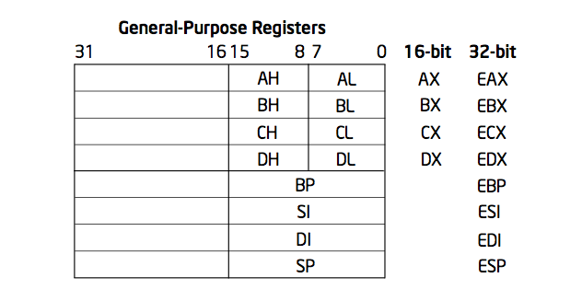
Registers for work space
8, 16, and 32 bit versions
By convention some registers for special purposes
Example: ADD EAX, 10
Other instructions: SUB, AND, etc.

Slide 9
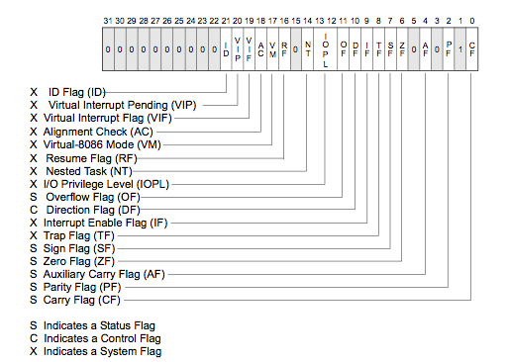
EFLAGS register
Test instructions: TEST EAX, 0
Conditional JMP instructions: JNZ address

Slide 10
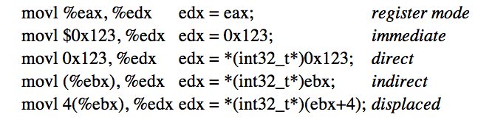
Memory: more work space
Memory instructions: MOV, PUSH, POP, etc
Most instructions can take a memory address

Slide 11
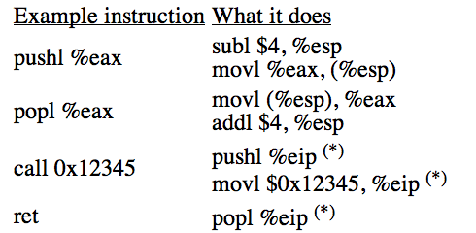
Stack memory + operations
Stack grows down
Use to implement procedure calls

Slide 12
More memory
8086 16 registers and 20-bit bus addresses
The extra 4 bits come segment registers
  CS: code segment, for EIP
  SS: stack segment, for SP and BP
  DS: data segment for load/store via other registers
  ES: another data segment, destination for string ops
  For example: CS=4096 to start executing at 65536
Makes life more complicated
  Cannot use 16 bit address of stack variable as pointer
  Pointer arithmetic and array indexing across segment boundaries
  For a far pointer programmer must include segment reg

Slide 13
And more memory
80386: 32 bit data and bus addresses
Now: the transition to 64 bit addresses
Backwards compatibility:
  Boots in 16-bit mode, and boot.S switches to 32-bit mode
  Prefix 0x66 gets you 32 bit mode:
    MOVW = 0x66 MOVW
  .code32 in boot.S tells assembler to insert 0x66
80386 also added virtual memory addresses
  Topic of lab lecture 3

Slide 14
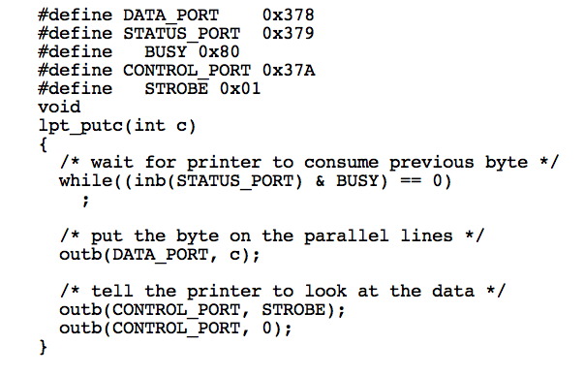
I/O space and instructions
8086: Only 1024 I/O addresses
Interrupts in lab 3 lecture

Slide 15
Memory-mapped I/O
Use normal addresses
  No need for special instructions
  No 1024 limit
  System controller routes to device
Works like “magic” memory
  Addressed and accessed like memory
  But does not behave like memory
  Reads and writes have “side effects”
  Read result can change due to external events

Slide 16
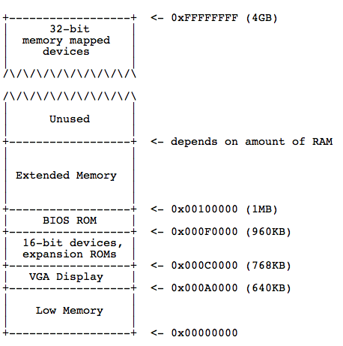
Memory layout

Slide 17
x86 instruction set
Instructions classes:
  Data movement: MOV, PUSH, POP, …
  Arithmetic: TEST, SHL, ADD, …
  I/O: IN, OUT, …
  Control: JMP, JZ, JNZ, CALL, RET
  String: REP, MOVSB, …
  System: IRET, INT, …
Intel architecture manual Volume 2
  Intel syntax: op dst, src
  AT&T (gcc/gas) syntax: op src, dst

Slide 18
gcc procedure calling conventions
After CALL instruction:
  %eip points to first instructions
  %esp + 4 points at first argument
  %esp points at return address
After RET instruction:
  %eip contains return address
  %esp points at arguments pushed by caller
  %eax contains return value, %ecx, %edx may be trashed
  %ebp, %ebx, %esi, %edi must be as before call
Caller saved
Callee saved

Slide 19
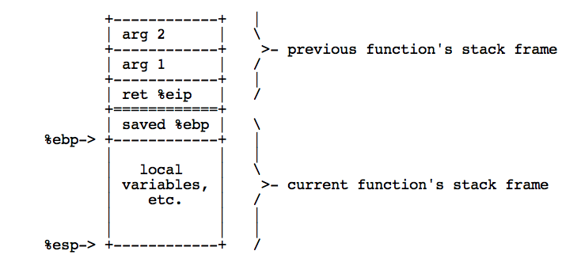
gcc does more: EBP
Prologue:
pushl %ebp
movl %esp, %ebp
Epilogue:
movl %ebp, %esp
popl %ebp
Saved %ebp’s form a chain, can walk stack
Arguments and locals at fixed offsets from EBP

Slide 20
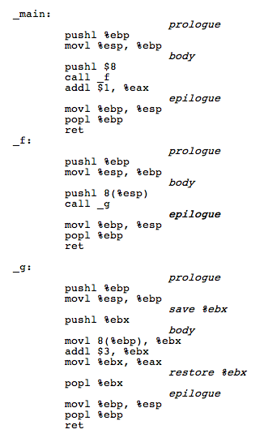

Example

Slide 21
From C to running program
.c
gcc
.asm
gas
.o
a.out
loader
memory
ld
.c
gcc
.asm
gas
.o
Compiler, assembler, linker, and loader

Slide 22
Development using PC emulator
Bochs PC emulator
  does what a real PC does
  Only implemented in software!
Runs like a normal program on “host” operating system
JOS
PC emulator
Linux
PC

Slide 23
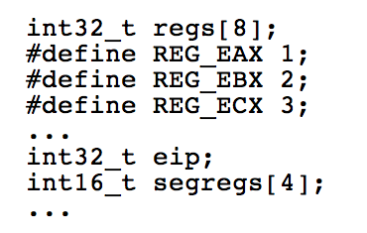

Emulation of memory

Slide 24
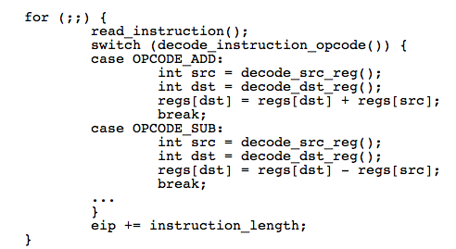
Emulation of CPU

Slide 25
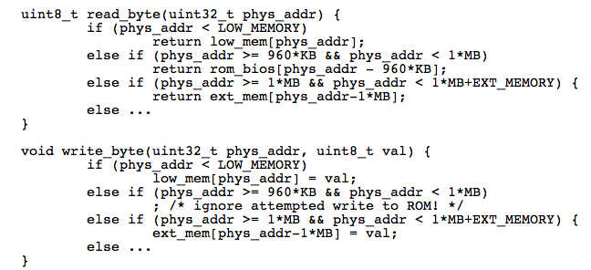
Emulation x86 memory

Slide 26
Emulating devices
Hard disk: using a file of the host
VGA display: draw in a host window
Keyboard: hosts’s keyboard API
Clock chip: host’s clock
Etc.

Slide 27
Summary
For lab: PC and x86
Illustrate several big ideas:
  Stored program computer
  Stack
  Memory-mapped I/O
  Software = hardware

