Slide 1
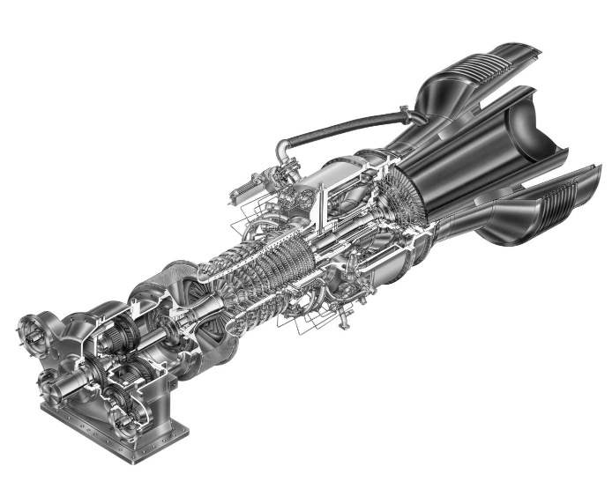
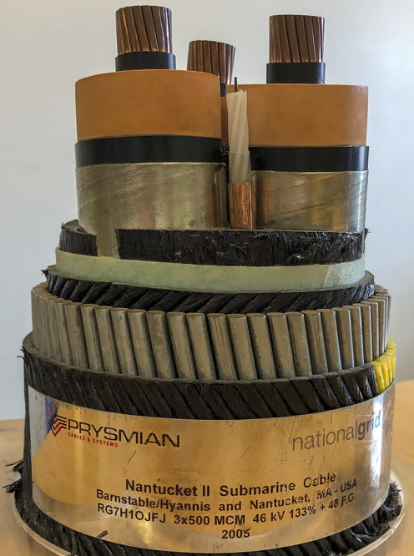
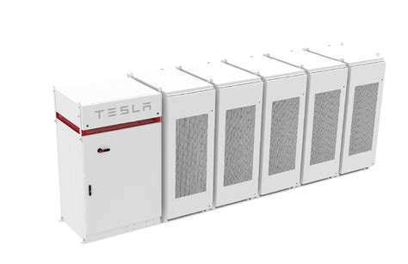
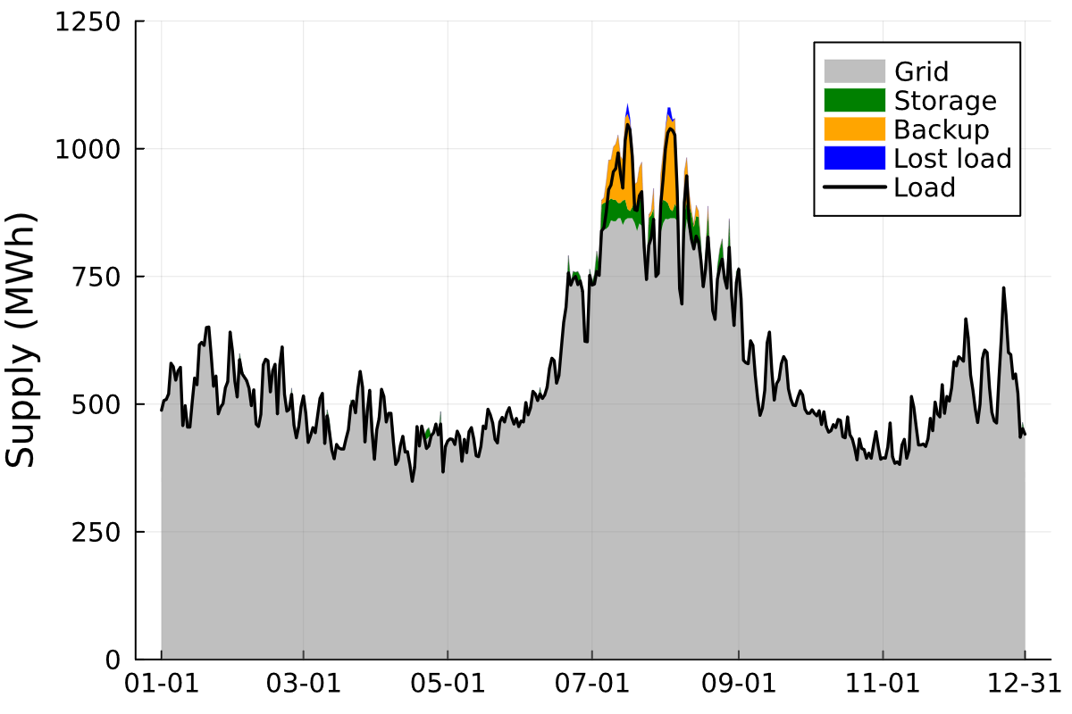


The Value of Storage in Electricity Distribution: The Role of Markets
Motivation: Storage is deployed to meet peak electricity demand in distribution grids but sits idle most of the time in deregulated markets because of concerns over market distortion.
Research Question: What is the value of distribution grid storage for deferring grid upgrades and what would be the value of market participation, if it were allowed?
Scope:
Markets: Day-ahead arbitrage and capacity markets because ancillary services are saturating in the US and Europe.
Grid Upgrades: Substation or cable investment.
Time: From the year 2025 through 2050.
Space: Jurisdictions, in which electricity distribution companies are not allowed to own generation (13 US states + the EU).
Goal: More efficient storage utilization, either by allowing distribution companies to own storage (as in New York and Maryland) or by partnering with third-parties that would own and operate storage to serve both local distribution and broader market needs.
Distribution Grid Assets:
backup
generation
substations
and cables
storage
No Market Participation (Status Quo)
Full
study
here

Slide 2
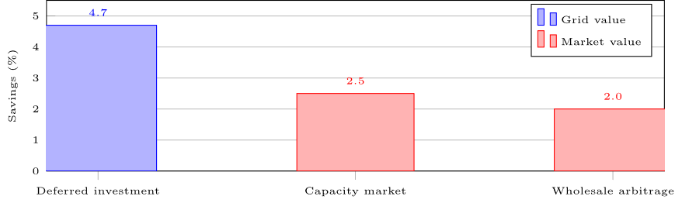
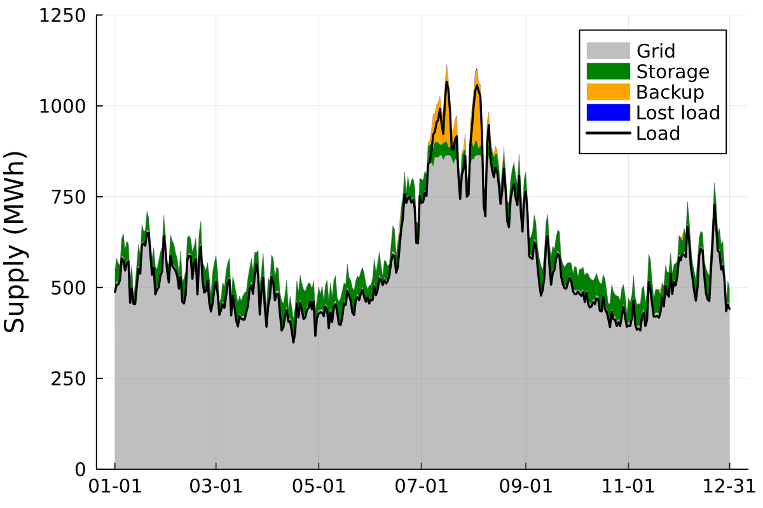
The Value of Storage in Electricity Distribution: The Role of Markets
Results:
If market participation was allowed, storage cycling would increase from once a month to every third day on average (the maximum covered by warranty).
Market participation would generate a similar value to investment deferral in our case study. Both decrease total electricity system costs by 5% each.
In our case study, there is no trade-off between market participation and investment deferral because the needs of the local distribution grid, in terms of storage charging and discharging, align with market needs.
Methods:
Mathematical programming for capacity expansion planning.
Novel formulation of market participation constraints. If the constraints apply, the generation from storage and backup generation is limited to the amount of electricity demand that cannot be covered by the grid.
Distribution Grid Assets:
backup
generation
substations
and cables
storage
With Market Participation (Hypothetical)
Full
study
here

