Slide 1

WHICH FRUIT CROP to grow ??? A Predictive Modeling Approach
Submitted To:
Mr. Kapil Oberai (Scientist)

Slide 2
INTRODUCTION
No. | NAME | ROLL NO. | ROLE
1 | MIT BORDA | TS90718 | Data analysis, Coding
2 | JATIN SATANI | TS90710 | Literature survey, Report preparation
3 | KAUSHAL KATHIRIYA | TS90708 | Data Preprocessing, Ppt formation
4 | DEEP RABADIYA | TS90713 | Data selection, and Preprocessing

Slide 3
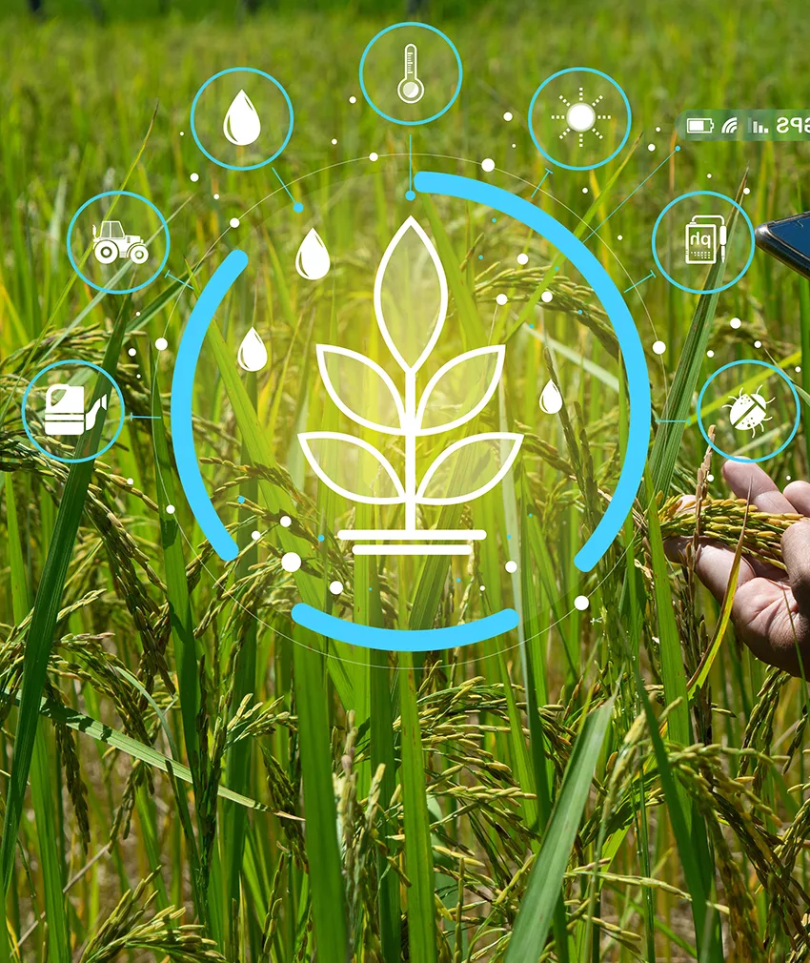
In the pursuit of identifying the most appropriate horticulture crop to cultivate, a multifaceted approach is employed, leveraging precision agriculture that relies on data-driven recommendations.
The objective is to develop a Predictive Modeling framework, incorporating key parameters associated with horticulture crop selection.
This approach, centered around predictive modeling and data integration, empowers farmers with a sophisticated toolset to make well-informed decisions regarding horticulture crop selection, fostering improved yields and enhanced profitability in precision agriculture.
This technique can reduce horticulture crop failures and will help the farmers to make informed decisions about their farming strategy.

Slide 4
Purpose:
To mitigate the agrarian crisis in the current status quo, there is a need for better recommendation systems to alleviate the crisis by helping the farmers make informed decisions before starting the cultivation of horticulture crops.
Planning and decision making
Resource utilization
Risk management
To recommend optimum horticulture crops to be cultivated by farmers based on several parameters and help them make an informed decision before cultivation.

Slide 5
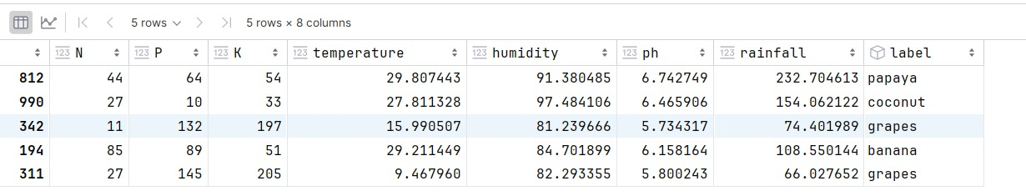
PARAMETERS USED IN Crop Recommendation:
Nitrogen
Phosphorus
Potash
PH Values
Humidity
Temperature
Rainfall
Data Source:
https://www.kaggle.com/datasets/atharvaingle/crop-recommendation-dataset

Slide 6
Process
DATA COLLECTION from Kaggle
DATA PRE-PROCESSING
DATA SPLITTING
MODEL TRAINING
MODEL EVALUATION

Slide 7
DIFFERENT ML ALGORITHMS USED:
Decision Tree
Naïve Bayes
SVM
Logistic Regression
KNN
Random Forest

Slide 8
Sr. No. | Algorithm | Accuracy
1 | Decision Tree | 98.8
2 | Naive Bayes | 98.3
3 | SVM | 95.0
4 | Logistic Regression | 98.9
5 | KNN | 100.0
6 | Random Forest | 97.4

Slide 9
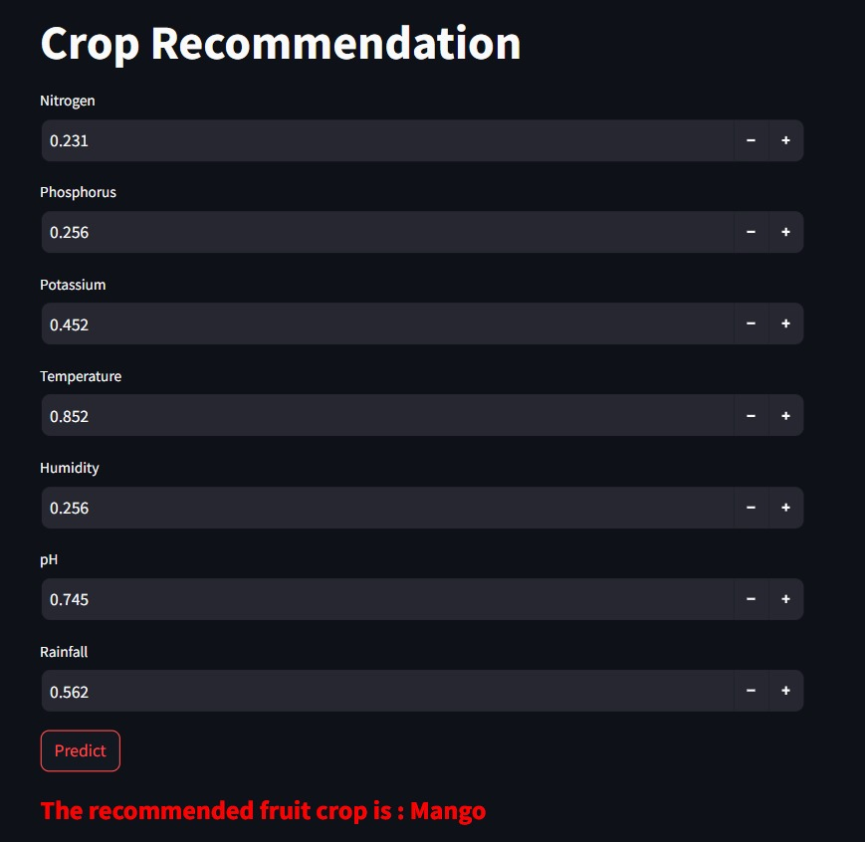
Prediction

Slide 10


