Slide 1

Indian Institute of Remote Sensing, ISRO
Module :2 Machine Learning (2.10.2)
PREDICTION OF SOIL MOISTURE USING MACHINE LEARNING
Under the Guidance of
Mr. Kamal Pandey
Scientist, IIRS (ISRO)
Group:2 Submitted by :-
1) KAUSHAL KATHIRIYA - TS90708 - PPT Preparation, Feature Selection
2) JATIN SATANI - TS90710 – Data Collection, Code Structuring, Feature selection
3) MIT BORDA - TS90718 - Data Pre-processing, Code Structuring, Feature selection
4) DEEP RABADIYA - TS90713 – Data Collection, Feature selection

Slide 2
Contents
INTRODUCTION
PROBLEM STATEMENT
CONVENTIONAL METHODS USED FOR SOIL MOISTURE PREDICTION
IMPORTANCE OF SOIL MOISTURE IN AGRICULTURE
MACHINE LEARNING MODELS FOR SOIL MOISTURE PREDICTION
ADVANTAGES OF MACHINE LEARNING MODELS
CONCLUSION

Slide 3
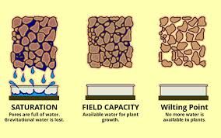
Introduction to Soil Moisture Prediction
Soil moisture prediction is a crucial aspect of agriculture, impacting crop yield and water management. Understanding and predicting soil moisture levels can help farmers make informed decisions regarding irrigation, planting, and harvesting. By leveraging machine learning techniques, it's possible to develop accurate predictive models that consider various environmental factors to forecast soil moisture levels. This enables farmers to optimize their water usage and maximize crop productivity, leading to sustainable and efficient agricultural practices.

Slide 4

Problem Statement
With the increasing demand for sustainable agriculture and water resource management, there is a critical need to develop accurate and efficient methods for predicting soil moisture content.
Soil moisture plays a pivotal role in determining crop health, irrigation scheduling, and overall agricultural productivity.
Traditional methods of soil moisture measurement are often time-consuming and labor-intensive, making real-time monitoring challenging.

Slide 5
CONVENTIONAL METHODS USED FOR WEATHER PREDICTION
Gravimetric Method
Tensiometers
Time Domain Reflectometry (TDR)
Empirical Models
Weather-based Models
Thornthwaite Method

Slide 6
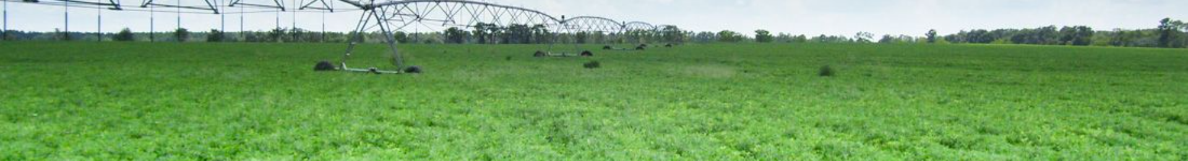
Importance of Soil Moisture in Agriculture
1
Optimizing Irrigation
Soil moisture data is fundamental for efficient irrigation systems, ensuring that plants receive the right amount of water at the right time, reducing water waste and improving crop health.
2
Crop Management
Soil moisture levels influence planting decisions, crop selection, and harvest timing, impacting the overall success of agricultural operations.
3
Environmental Impact
Proper soil moisture management contributes to conservation efforts, reducing water usage and environmental degradation associated with excessive irrigation.

Slide 7
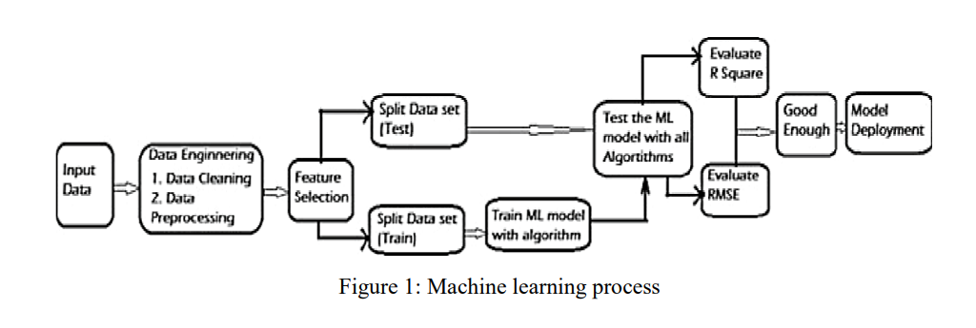
MACHINE LEARNING MODELS FOR SOIL MOISTURE PREDICTION

Slide 8

Data Collection and Preprocessing
Effective soil moisture prediction relies on the collection and preprocessing of vast amounts of relevant data. This involves gathering information from various sources such as ERA 5, Data.gov.in , Bhuvan and Kaggle.
In our project prediction of soil moisture depends upon the following factors….
1)Particle size
2)Humidity
3)Pressure
4)Temperature
Data preprocessing is essential to ensure the accuracy and reliability of the input data, involving cleaning, normalization, and handling missing values.

Slide 9
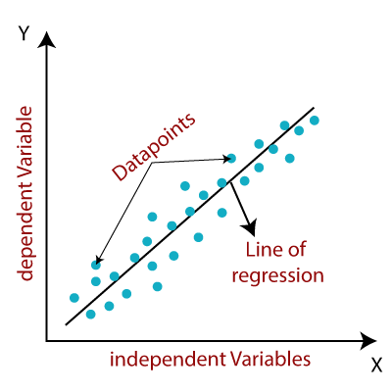
1. LINEAR REGRESSION
Linear regression is a statistical method used for modeling the relationship between a dependent variable and one or more independent variables by fitting a linear equation to observed data.
The goal of linear regression is to find the best-fitting line (or hyperplane in the case of multiple independent variables) that minimizes the sum of squared differences between the observed values (actual data) and the values predicted by the linear model.

Slide 10
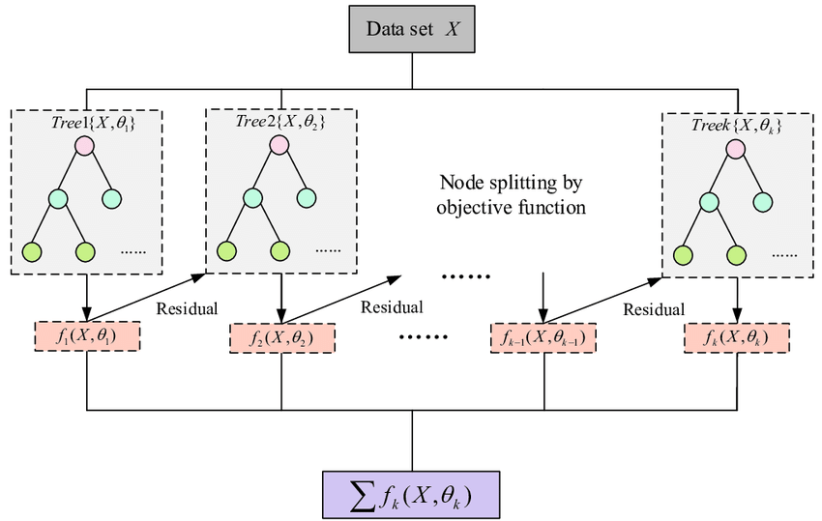
2. XG BOOST
XGBoost is a machine learning algorithm under ensemble learning. It is trendy for supervised learning tasks, such as regression and classification. XGBoost builds a predictive model by combining the predictions of multiple individual models, often decision trees, in an iterative manner.
The algorithm works by sequentially adding weak learners to the ensemble, with each new learner focusing on correcting the errors made by the existing ones. It uses a gradient descent optimization technique to minimize a predefined loss function during training.

Slide 11

3. DECISION TREE
A decision tree is one of the most powerful tools of supervised learning algorithms used for both classification and regression tasks. It builds a flowchart-like tree structure where each internal node denotes a test on an attribute, each branch represents an outcome of the test, and each leaf node (terminal node) holds a class label.
It is constructed by recursively splitting the training data into subsets based on the values of the attributes until a stopping criterion is met, such as the maximum depth of the tree or the minimum number of samples required to split a node.

Slide 12

4. SUPPORT VECTOR
A support vector machine (SVM) is a type of supervised learning algorithm used in machine learning to solve classification and regression tasks.
The aim of a support vector machine algorithm is to find the best possible line, or decision boundary, that separates the data points of different data classes. This boundary is called a hyperplane when working in high-dimensional feature spaces. The idea is to maximize the margin, which is the distance between the hyperplane and the closest data points of each category, thus making it easy to distinguish data classes.

Slide 13
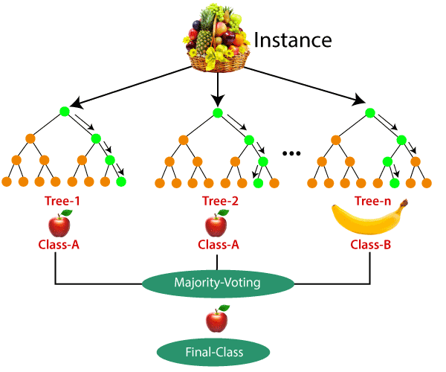
5. RANDOM FOREST
A Random Forest is like a group decision-making team in machine learning. It combines the opinions of many “trees” (individual models) to make better predictions, creating a more robust and accurate overall model.
Random Forest Algorithm is that it can handle the data set containing continuous variables, as in the case of regression, and categorical variables, as in the case of classification. It performs better for classification and regression tasks.

Slide 14
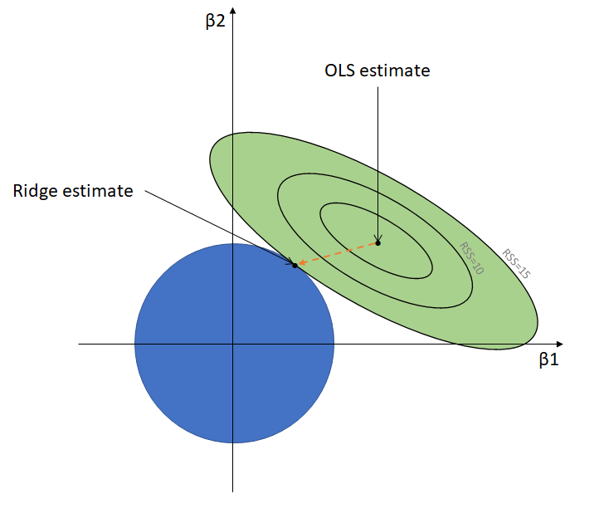
6. RIDGE REGULARIZATION
Ridge regression was also known as L2 regularization is one of several types of regularization for linear regression models.
Ridge regression specifically corrects for multicollinearity in regression analysis. This is useful when developing machine learning models that have a large number of parameters, particularly if those parameters also have high weights.

Slide 15
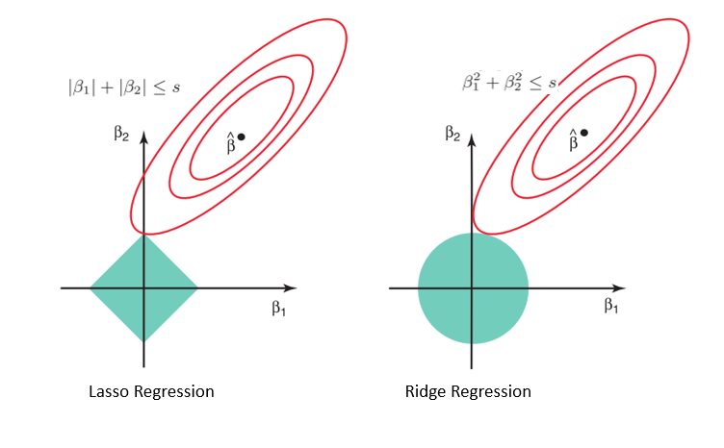
7. LASSO REGULARIZATION
LASSO regression, also known as L1 regularization, is a popular technique used in statistical modeling and machine learning to estimate the relationships between variables and make predictions
The primary goal of LASSO regression is to find a balance between model simplicity and accuracy. It achieves this by adding a penalty term to the traditional linear regression model, which encourages sparse solutions where some coefficients are forced to be exactly zero.

Slide 16
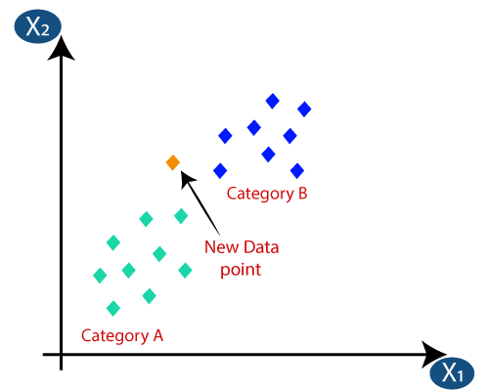
8. K – NEAREST NEIGHBOR (KNN)
K-nearest neighbor’s (KNN) is a supervised learning method that can be used for both regression and classification.
By calculating the distance between the testing data and all of the training points, KNN attempts to predict the correct class of testing data given a set of different classes.
Then it chooses the k points that are closest to the test.

Slide 17
ADVANTAGES OF MACHINE LEARNING
Machine learning models offer significant advantages by leveraging data-driven insights for automation and predictive analytics.
These models enhance decision-making processes, automate repetitive tasks, and enable personalized experiences through continuous learning and adaptation.
Efficient resource utilization, fraud detection, and improved scalability contribute to their widespread applicability across industries.
Machine learning integrates data from multiple sources to predict output, identifies patterns in a set of data and then finds a relationship between those patterns, and learns and adapts to test or validate data without human intervention using a training dataset.
Weather forecasting has also benefited from the machine learning approach.

Slide 18
CONCLUSION
The prediction of soil moisture using machine learning models has emerged as a promising and effective approach for optimizing agricultural practices and water resource management.
The ability of machine learning algorithms to analyze complex, nonlinear relationships within the data makes them valuable tools in predicting soil moisture content.
The implementation of machine learning models not only enhances the accuracy of soil moisture predictions but also contributes to resource conservation and improved crop yield.
By providing real-time or near-real-time information, these models enable farmers and land managers to make informed decisions regarding irrigation scheduling, leading to efficient water usage and cost savings.
The integration of machine learning models in soil moisture prediction represents a valuable step towards sustainable and precision agriculture, offering practical solutions for optimizing water management in the face of changing climate patterns and resource constraints.

Slide 19


