Slide 1
Soil Erosion Estimation

Slide 2
Group members
Group ID: 3
Sr.no | Name | Student ID
1 | Mit Borda | 202319008
2 | Kaushal Kathiriya | 202319013
3 | Nidhi Gusai | 202319015
4 | Drashti Nayakpara | 202319019
5 | Divya Prajapati | 202319024

Slide 3
Introduction
What is soil erosion ?
Soil erosion is the process of washing away of the surface layer, or topsoil, by the transportation of the surface particles under the mechanical actions of agents like wind, river, or even glaciers.
Factors affecting soil erosion (by RUSLE model )
R = rainfall-runoff erosivity factor.
K = soil erodibility factor.
L = slope length factor.
S = slope steepness factor.
C = crop cover-management factor.
P = support practice factor

Slide 4
Objective
Cause of soil erosion
Humans affect natural erosion processes and have induced a relevant and observable increase in soil erosion rates across landscapes.
Due to industrialization soil erosion increases day by day which greatly affects crop growth .
Objective:
Our main objective is to calculate amount of soil erosion due to various factors.
We will calculate it by using RUSLE model.
Inspire by:
https://www.sciencedirect.com/science/article/pii/S004896972101562X
https://www.researchgate.net/

Slide 5
Overview of RUSLE factors
R factor: The R Factor specifically quantifies the erosive force of rainfall on the soil.
K factor: K factor is soil erodibility factor which represents both susceptibility of soil to erosion and the rate of runoff , as measured under the standard unit plot condition. Soils high in clay have low K values, about 0.05 to 0.15, because they resistant to detachment.
LS factor: The slope length and steepness factor (LS-factor) describes the combined effects of slope length (i.e., flow length) and slope gradient (i.e., grade or relief)
C factor: The "C" factor represents the crop cover and management practices on the land, specifically the impact of vegetation or crop cover in reducing soil erosion.
P factor: represents the effectiveness of erosion control practices in place. It considers the impact of contouring, strip-cropping, and other support practices on reducing soil erosion.

Slide 6
Dataset
Datasets used:
Chirps rainfall data from: https://developers.google.com/earth-engine/datasets/catalog/UCSB-CHG_CHIRPS_PENTAD
Soil erodibility data from: https://developers.google.com/earth-engine/datasets/catalog/OpenLandMap_SOL_SOL_TEXTURE-CLASS_USDA-TT_M_v02
LS factor data: https://developers.google.com/earth-engine/datasets/catalog/USGS_SRTMGL1_003
Land use land cover data: https://developers.google.com/earth-engine/datasets/catalog/MODIS_061_MCD12Q1
NDVI data: https://developers.google.com/earth-engine/datasets/catalog/COPERNICUS_S2

Slide 7
Satellite imageries used in the study
No. | Sensor | Year of Acquisition | Spatial Resolution
1 | Sentinel -2 | 2020 | 10m
2 | Landsat - 8 | 2020 | 30m
3 | CHIRPS | 2020 | 5566m

Slide 8
Flow Chart
Download datasets from Google earth engine
Calculate RUSLE factors by using python
Creating map of RUSLE factors by ArcGIS
Creating graph of taluka wise mean by python
Calculate taluka wise mean by ArcGIS
Calculate final RUSLE by python

Slide 9
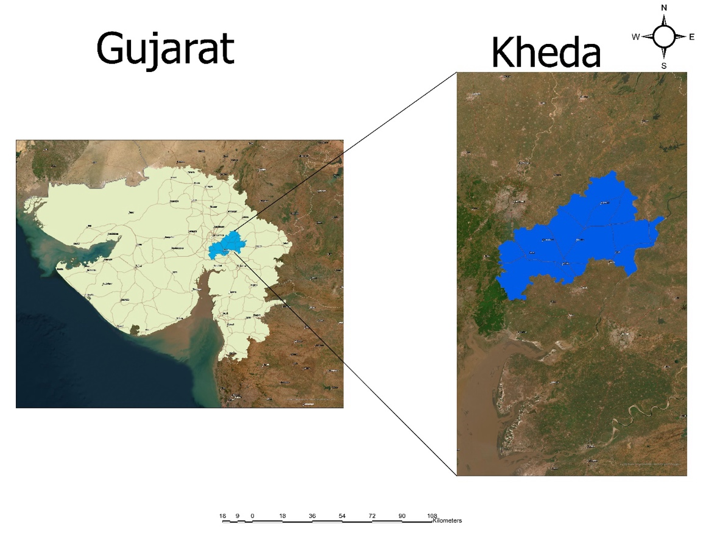
DESCRIPTION OF STUDY AREA
We take the study area of Kheda district, which spans an area of 719400 ha (3953 sq.km) and it is located at coordinates 72.68’ E longitude and 22.75’ N latitude. The study area is at altitude of 20 to 25m from mean sea level.

Slide 10
1.Calculation of R Factor
Steps To Calculate R Factor In Python
Function to read a raster and convert it to an array.
Function to write an array to a raster, using a reference raster for georeferencing
Load CHIRPS rainfall raster image.
Define the function to calculate the R factor from rainfall in python by use of given formula; (rainfall_array * 0.380)+81.5
Save the R factor as a new raster image.
Then by use of R_factor1.tif we create map of R factor in ArcGIS.
Link of code file: https://colab.research.google.com/drive/14fajQI8r5RwsXDnZiPVqIbAGtk9sHkIm?usp=sharing

Slide 11
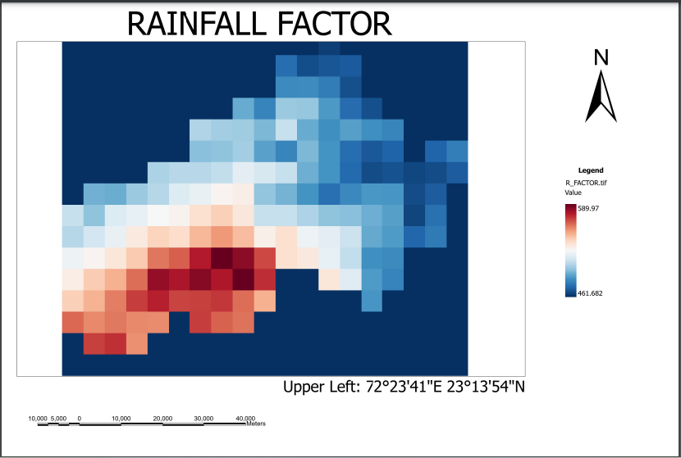
Map of R factor

Slide 12
2.Calculation of K Factor
Steps To Calculate K Factor In Python
Function to read a raster and convert it to an array.
Function to write an array to a raster, using a reference raster for georeferencing.
Create function to Calculate K factor based on the soil data and the provided conditions.
Nested conditions are used to assign K factor values based on soil classes.
Load soil raster image and apply function for calculation .
Save the K factor as a new raster image.
Then by use of K_factor1.tif we create map of K factor in ArcGIS.

Slide 13
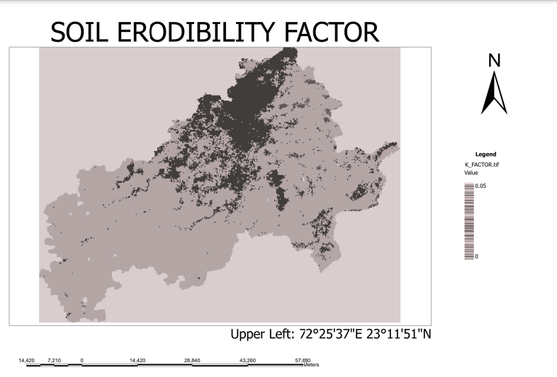
Map of K factor

Slide 14
3.Calculation of LS Factor
Steps To Calculate LS Factor In Python
Function to read a raster and convert it to an array.
Function to write an array to a raster, using a reference raster for georeferencing.
Create function to Calculate the slope in percentage from the elevation data by applying formula.
Formula : x, y = np.gradient(elevation_array, cell_size)
slope_radians = np.arctan(np.sqrt(x**2 + y**2))
slope_percentage = np.tan(slope_radians) * 100
Calculate the LS factor from the slope percentage by using formula: slope_percentage * 0.53+ slope_percentage * (slope_percentage * 0.076)+0.76+ np.sqrt(500 / 100)
4. Load SRTM elevation raster image and calculate LS factor by functions .
5. Save the LS factor as a new raster image.
6. Then by use of LS_factor1.tif we create map of LS factor in ArcGIS.

Slide 15
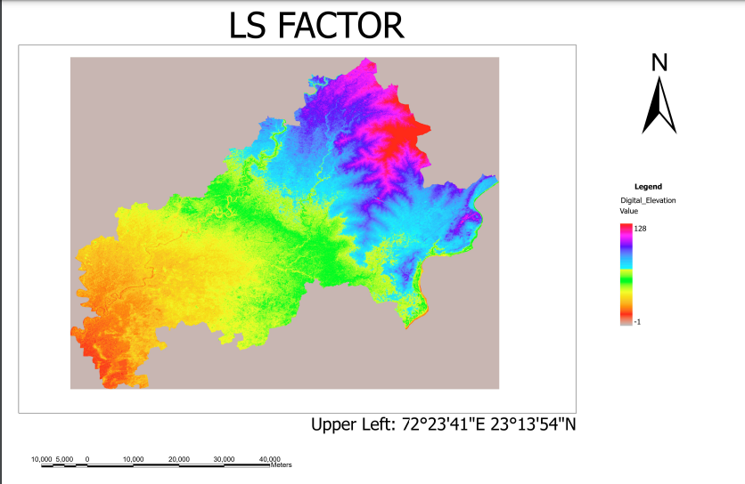
Map of LS factor

Slide 16
4.Calculation of C Factor
Steps To Calculate C Factor In Python
Function to read a raster and convert it to an array.
Function to write an array to a raster, using a reference raster for georeferencing.
Create function to Calculate the C factor from the NDVI data by applying formula
C=exp[−𝜶(𝑵𝑫𝑽𝑰/𝜷 − 𝑵𝑫𝑽𝑰)]
4. Perform min-max normalization only on valid values.
Load NDVI raster image and calculate C factor by functions.
Then by use of C_factor1.tif we create map of C factor in ArcGIS.

Slide 17
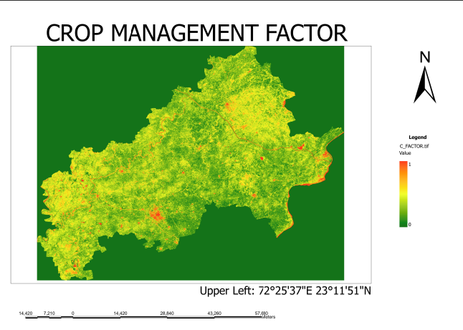
Map of C factor

Slide 18
5.Calculation of P Factor
Steps To Calculate P Factor In Python
Function to read a raster and convert it to an array.
Load LULC raster image.
Load slope raster image.
Create P Factor map using an expression.
Save the P factor as a new raster image.
Use one of the rasters as a reference for georeferencing (in this case, using LULC raster).
Load reference raster for georeferencing.
Write P factor array to the raster.
Then by use of P_factor1.tif we create map of P factor in ArcGIS.

Slide 19
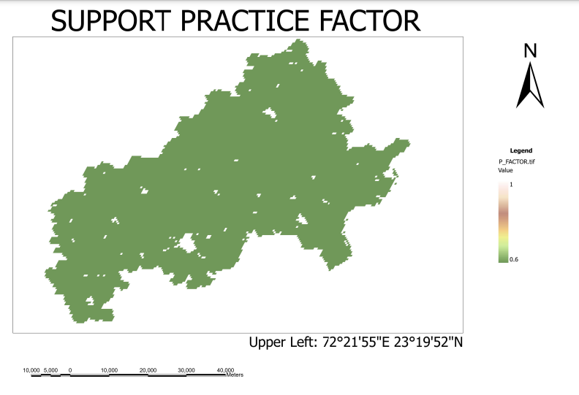
Map of P factor

Slide 20
Final Soil Erosion Calculation &Conclusion
Step 6: All the raster images have different minimum and maximum value therefore we have to normalize it before FINAL RUSLE multiplication.
Step 7: Then calculate RUSLE by multiply R_FACTOR_RES.tif, K_FACTOR_RES.tif, LS_FACTOR_RES.tif, C_FACTOR_RES.tif, P_FACTOR_RES.tif in python.
Step 8:Generate final calculated RUSLE tiff file.
Step 9: final image is plotted by using matplotlib and rasterio library for better visualization.
Step 10: Taluka wise mean calculation of soil erosion by ArcGIS.
Step 11: Creating Graph of Mean Values of Sub districts by python.
Conclusion: Highest soil erosion is noticed in kheda and vaso while Galteshwar have lowest value of soil erosion.

Slide 21
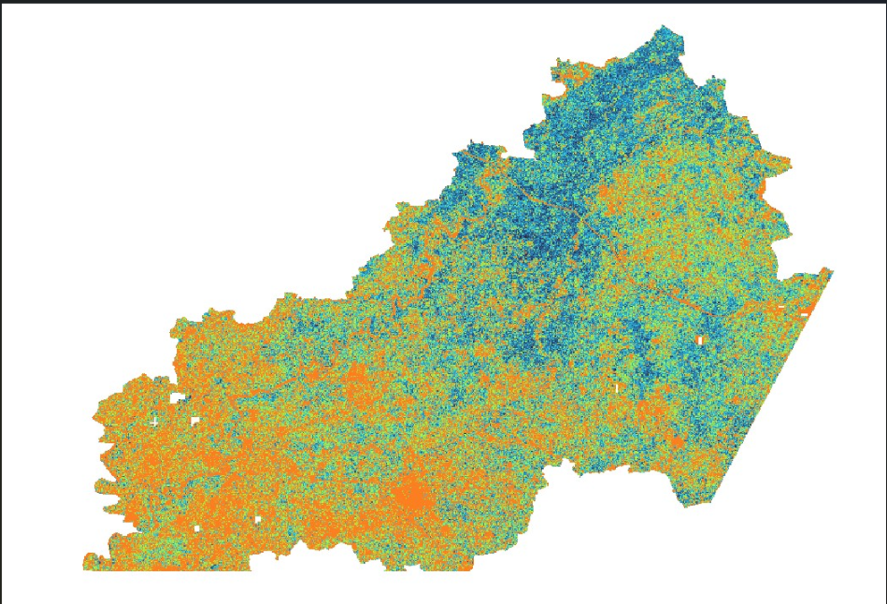
Final RUSLE

Slide 22
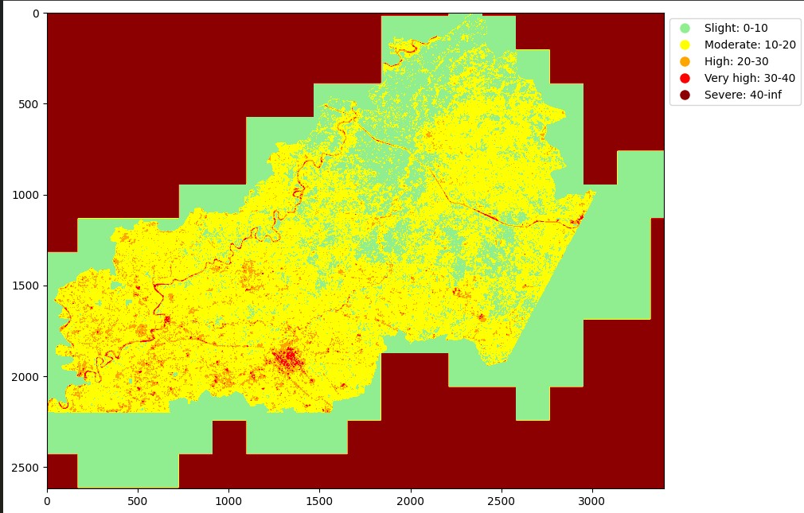
Visualize Final Image Using Python

Slide 23
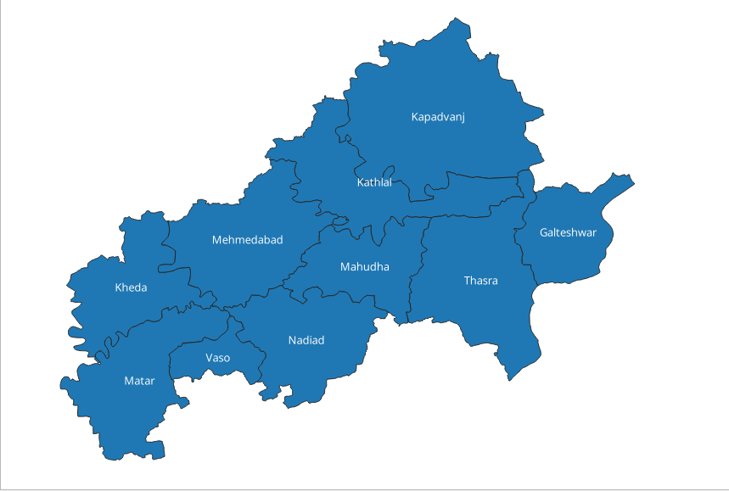
Talukawise image of Kheda district

Slide 24
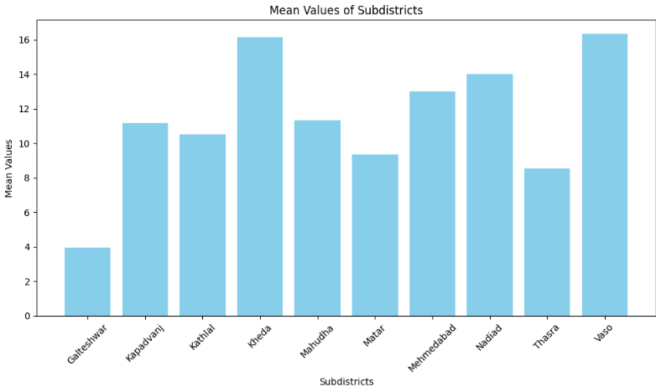
Taluka wise mean calculation of soil erosion
Results from Python
Results from ArcGIS
Subdistric | _Mean
Galteshwar | 3.965207394
Kapadvanj | 11.16750369
Kathlal | 10.53399319
Kheda | 16.14962733
Mahudha | 11.31283056
Matar | 9.362292869
Mehmedabad | 13.02221896
Nadiad | 14.02985216
Thasra | 8.532709776
Vaso | 16.33221787

Slide 25
References
Data downloads: https://youtu.be/vhwhPrlxDeg?feature=shared
Python code: https://rasterio.readthedocs.io/en/stable/api/rasterio.html
https://youtu.be/LVt8CezezZQ?feature=shared & https://gdal.org/
https://youtu.be/p_BsFdV_LUk?feature=shared
https://youtu.be/euCbgfj5DvM?feature=shared
Research paper reference: https://www.researchgate.net/publication/351371829_AN_ArcGIS_TOOLBOX_FOR_ESTIMATION_AND_MAPPING_SOIL_EROSION
LS: https://www.sciencedirect.com/science/article/pii/S0016706116310059

Slide 26
Thank you….

