Slide 1
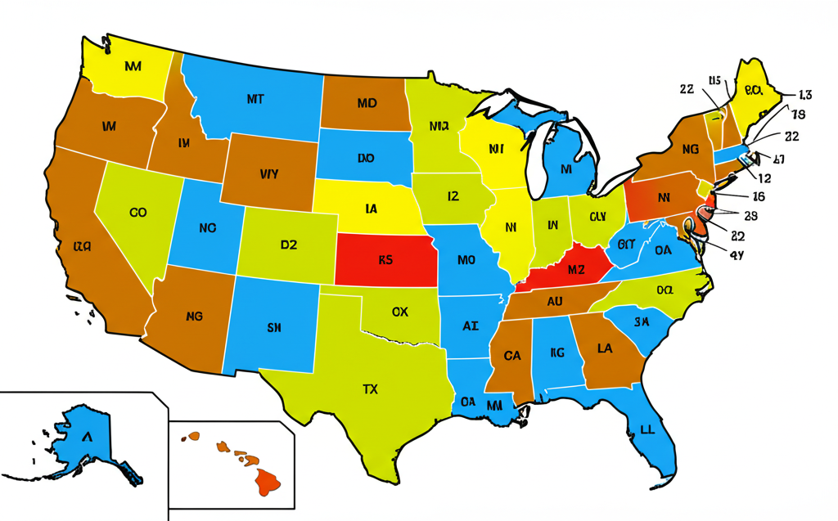
The Electoral College is the process by which the United States elects its President and Vice President. Instead of a direct popular vote, citizens vote for a slate of electors who are pledged to a particular candidate. The number of electors each state receives is based on its total number of representatives in Congress (House + Senate). A candidate needs 270 out of 538 electoral votes to win the presidency. This system was established by the Founding Fathers to balance the power of populous states with less populated ones and to prevent a "tyranny of the majority." [Source: National Archives and Records Administration]

Slide 2
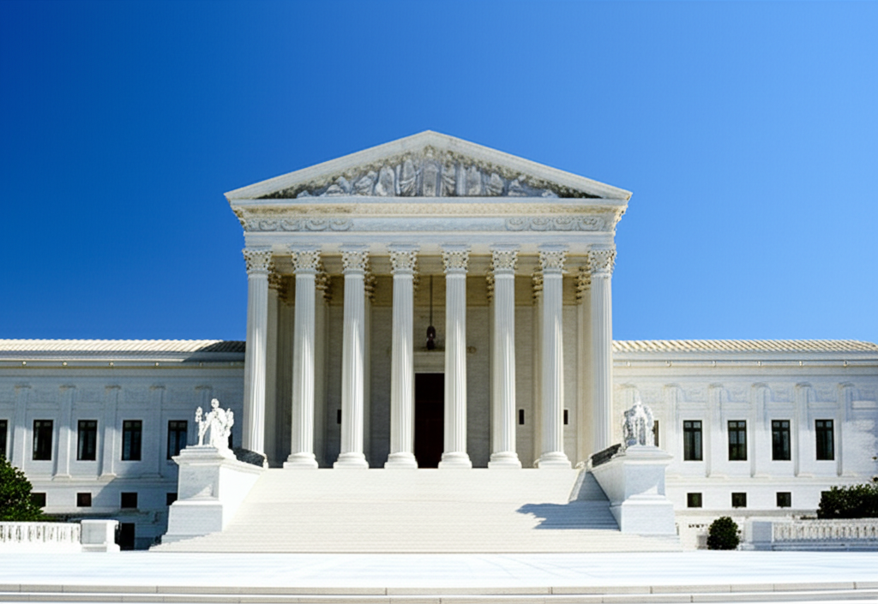
The Supreme Court is the highest judicial body in the United States, composed of nine justices. Its primary role is to interpret the U.S. Constitution and federal laws, ensuring their proper application. Through its power of judicial review, established in Marbury v. Madison (1803), the Court can declare laws and executive actions unconstitutional. Its decisions are final and serve as precedents for lower courts. The Court hears cases of national importance, often related to civil rights, government powers, and inter-state disputes. [Source: SupremeCourt.gov]

