Slide 1

The Moon: Earth's Celestial Companion
Explore the mysteries and marvels of Earth's only natural satellite, the Moon.

Slide 2
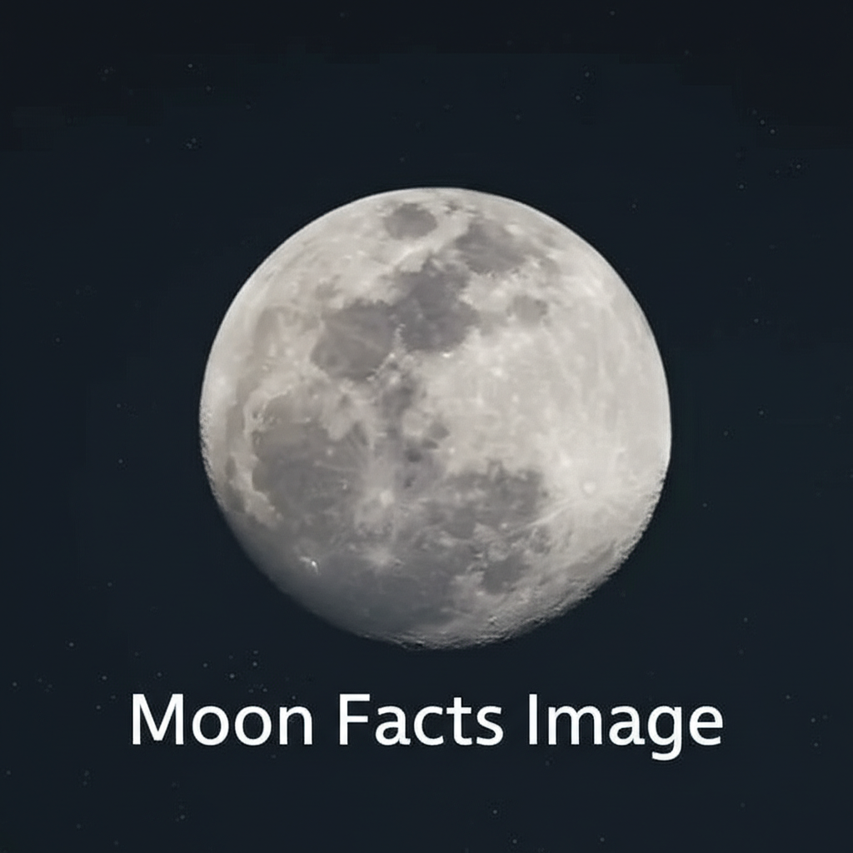
Key Facts About the Moon
The Moon is a barren, airless world, yet it profoundly influences our planet. Source: NASA, Lunar Reconnaissance Orbiter.
Diameter: Approximately 3,474 km (2,159 miles), about one-quarter the size of Earth.
Orbit: Orbits Earth every 27.3 days, resulting in its phases.
Surface: Covered in craters, maria (dark plains), and highlands.
Tidally Locked: Always shows the same face to Earth due to tidal forces.

Slide 3
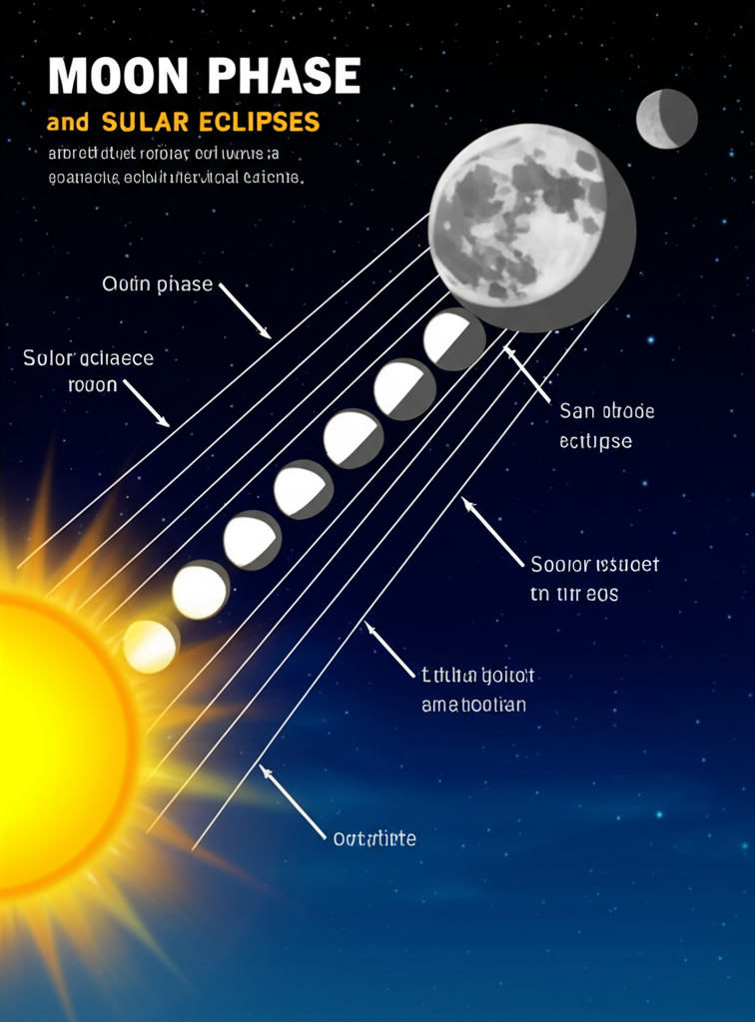
Lunar Phases and Eclipses
Lunar Phases: Result from the changing angles at which we see the Sunlit portion of the Moon as it orbits Earth. | Lunar Eclipses: Occur when the Earth passes between the Sun and Moon, casting a shadow on the Moon.
Phases include New Moon, Crescent, Quarter, Gibbous, and Full Moon. | Solar Eclipses: Occur when the Moon passes between the Sun and Earth, blocking the Sun's light.
Cycles approximately every 29.5 days (synodic month). | Both types require precise alignment of Sun, Earth, and Moon.

Slide 4
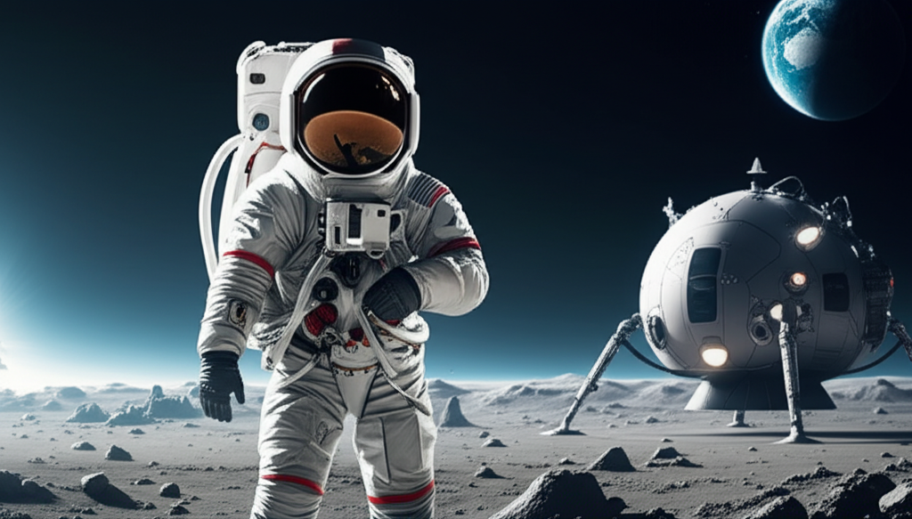
The Apollo program marked humanity's first steps on another celestial body. Between 1969 and 1972, six Apollo missions landed on the Moon, bringing back invaluable samples and data. Future missions, like Artemis, aim to establish a sustained human presence and prepare for journeys to Mars. Source: European Space Agency (ESA).

