Slide 1
MIT 6.875
Foundations of Cryptography
Lecture 17

Slide 2
We saw: a NIZK for all of NP in the CRS model

Slide 3
This was only the beginning…
Proofs vs. Arguments: Soundness against a computationally bounded prover.
Why?
1. It allows us to get perfect zero knowledge for all of NP. Recall perfect ZK proofs do not exist for NP-complete languages, unless the polynomial hierarchy collapses.
2. It allows us to get very short proofs = succinct arguments or SNARGs.

Slide 4

The Evolution of Proofs
CLASSICAL Proofs
Prover writes down a string (proof); Verifier checks.
Complexity class NP
INTERACTIVE Proofs
Prover and Verifier talk back and forth.
Graph non-iso
Complexity class IP = PSPACE >> NP
PROBABILISTICALLY CHECKABLE Proofs
Non-interactive, but Verifier only looks at 3 bits of proof
Complexity class NEXP >> PSPACE
MULTIPROVER interactive proofs
Proofs in the Wild:
….

Slide 5
An Application of NIZK: Non-malleable and Chosen Ciphertext Secure Encryption Schemes

Slide 6


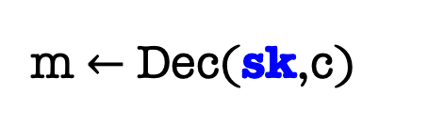
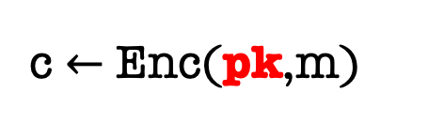
Non-Malleability
m $←$ Dec(sk,c)
c $←$ Enc(pk,m)
sk
Public-key directory
Bob
pk

Slide 7

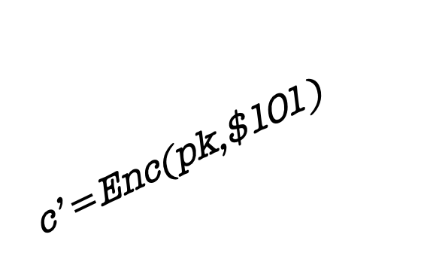
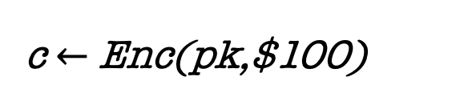
Active Attacks 1: Malleability
c $←$ Enc(pk,$100)
sk
c’ $=$Enc(pk,$101)
ATTACK: Adversary could modify (“maul”) an encryption of m into an encryption of a related message m’.

Slide 8
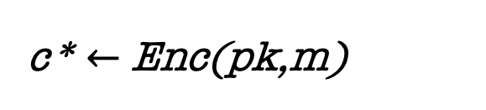
Active Attacks 2: Chosen-Ciphertext Attack
c* $←$ Enc(pk,m)
sk
ATTACK: Adversary may have access to a decryption “oracle” and can use it to break security of a ”target” ciphertext c* or even extract the secret key!
In fact, Bleichenbacher showed how to extract the entire secret key given only a “ciphertext verification” oracle.

Slide 9
















IND-CCA Security
Challenger
Eve
$$pk$$
$$\left(pk,sk\right)←Gen\left(1^{n}\right)$$
$$c_{i}$$
$$Dec(sk,c_{i})$$
$$m_{0}^{∗},m_{1}^{∗}$$
$$s.t. \left|m_{0}^{∗}\right|=|m_{1}^{∗}|$$
$b←\left\{0,1\right\}$;
$$c^{∗}←Enc(pk,m_{b}^{∗})$$
$$c^{∗}$$
$$c_{i}≠c^{∗}$$
$$c_{i}$$
Eve wins if $b^{′}=b$. IND-CCA secure if no PPT Eve can win with prob. > $\frac{1}{2}+negl(n)$.
$$Dec(sk,c_{i})$$
$$Dec(sk,c_{i})$$
$$b′$$
Notes:
This captures the concern of malleability and more.

Slide 10
Constructing CCA-Secure Encryption
(Intuition)
NIZK Proofs of Knowledge should help!
Idea: The encrypting party attaches an NIZK proof of knowledge of the underlying message to the ciphertext.
$$C: (c=CPAEnc\left(m;r\right),proof π that “I know m and r”)$$
This idea will turn out to be useful, but NIZK proofs themselves can be malleable!

Slide 11
Constructing CCA-Secure Encryption
(Intuition)
Digital Signatures should help!
OUR GOAL: Hard to modify an encryption of m into an encryption of a related message, say m+1.
OUR GOAL: Hard to modify an encryption of m into an encryption of a related message, say m+1.

Slide 12
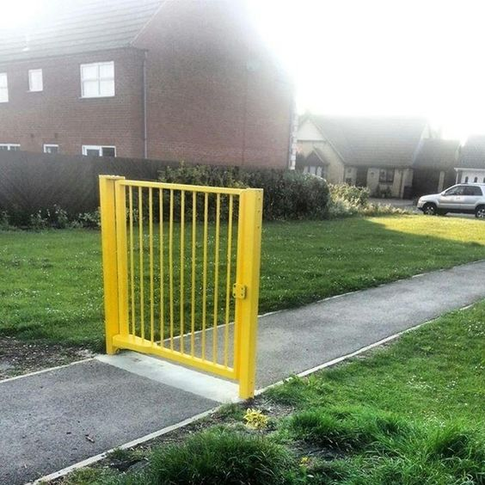
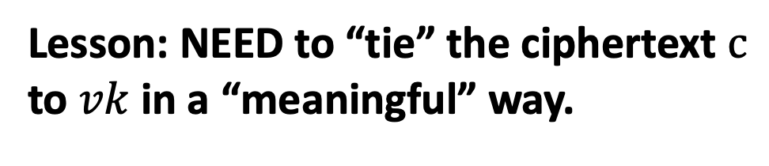
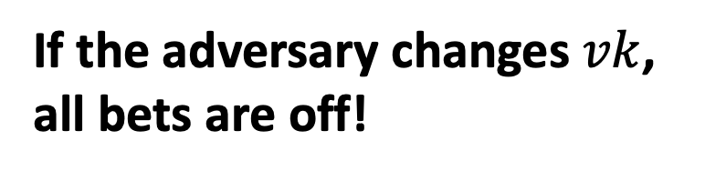
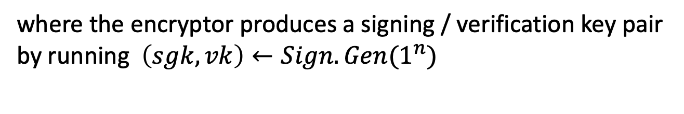
Constructing CCA-Secure Encryption
Let’s start with Digital Signatures.
$$C: (c=CPAEnc\left(pk,m;r\right),{Sign}_{sgk}\left(c\right),vk)$$
$$C: (c=CPAEnc\left(pk,m;r\right),Sign\left(c\right))$$
where the encryptor produces a signing / verification key pair by running $\left(sgk,vk\right)←Sign.Gen(1^{n})$
Is this CCA-secure/non-malleable?
If the adversary changes $vk$, all bets are off!
Lesson: NEED to “tie” the ciphertext $c$ to $vk$ in a “meaningful” way.

Slide 13

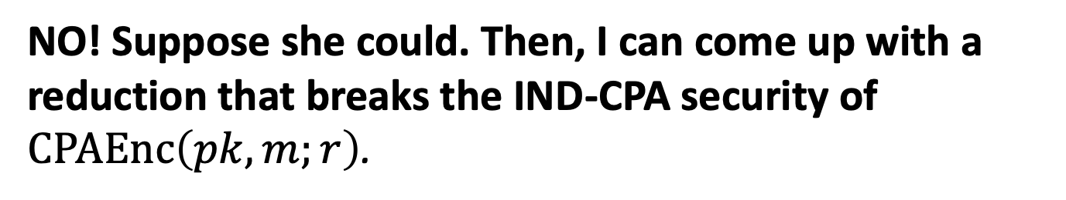
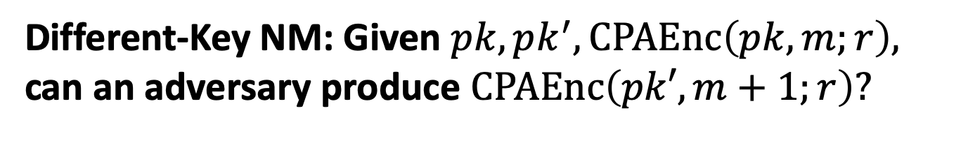
Observation: IND-CPA $⟹$ “Different-Key Non-malleability”
Different-Key NM: Given $pk,pk^{′},CPAEnc\left(pk,m;r\right),$ can an adversary produce $CPAEnc\left(pk′,m+1;r\right)?$
NO! Suppose she could. Then, I can come up with a reduction that breaks the IND-CPA security of $CPAEnc\left(pk,m;r\right)$.

Slide 14






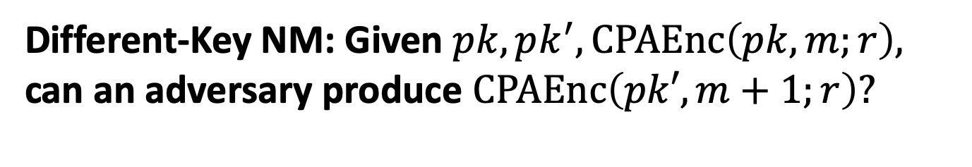

Observation: IND-CPA $⟹$ “Different-Key Non-malleability”
Different-Key NM: Given $pk,pk^{′},CPAEnc\left(pk,m;r\right),$ can an adversary produce $CPAEnc\left(pk′,m+1;r\right)?$
Reduction = CPA adversary
$$pk$$
Pick $(pk^{′},sk^{′})$
$$pk,pk′$$
$$CPAEnc(pk,m)$$
$$CPAEnc(pk,m)$$
$$m$$
$$CPAEnc(pk^{′},m+1)$$
Decrypt and
subtract 1.
Diff-Key NM
adversary

Slide 15
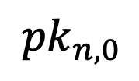


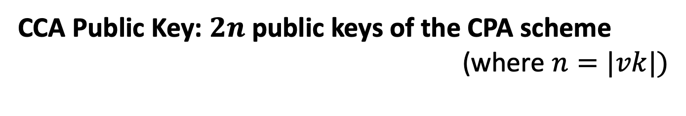
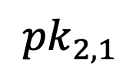



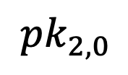

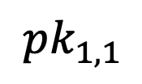


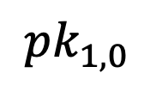
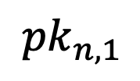

Putting it together
CCA Public Key: $2n$ public keys of the CPA scheme (where $n=|vk|)$
$${pk}_{1,0}$$
$${pk}_{2,0}$$
$${pk}_{n,0}$$
$$…$$
$${pk}_{1,1}$$
$${pk}_{2,1}$$
$${pk}_{n,1}$$
CCA Encryption:
First, pick a sign/ver key pair $(sgk,vk)$
$$CT=$$
$${ct}_{1,{vk}_{1}}$$
$${ct}_{2,{vk}_{2}}$$
$$…$$
$${ct}_{n,{vk}_{n}}$$
where ${ct}_{i,j }←CPAEnc({pk}_{i,j},m)$
Output $(CT, vk,σ=Sign(sgk,CT))$.

Slide 16
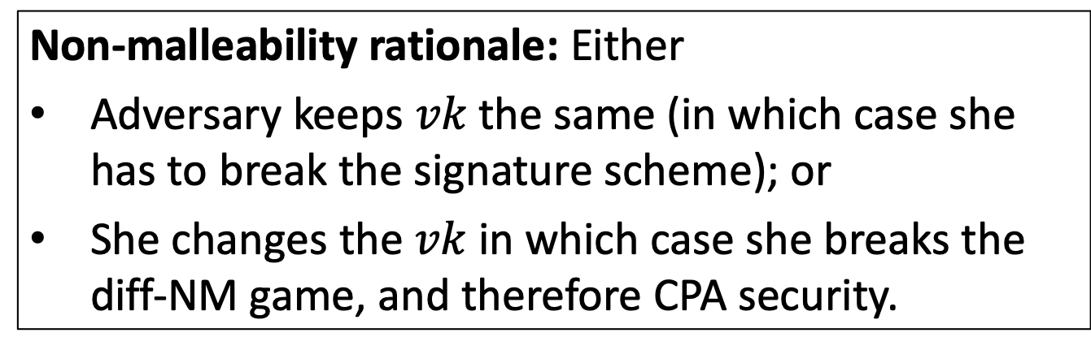
Putting it together
Non-malleability rationale: Either
Adversary keeps $vk$the same (in which case she has to break the signature scheme); or
She changes the $vk$ in which case she breaks the diff-NM game, and therefore CPA security.
CCA Encryption:
First, pick a sign/ver key pair $(sgk,vk)$
$$CT=$$
$${ct}_{1,{vk}_{1}}$$
$${ct}_{2,{vk}_{2}}$$
$$…$$
$${ct}_{n,{vk}_{n}}$$
where ${ct}_{i,j }←CPAEnc({pk}_{i,j},m)$
Output $(CT, vk,σ=Sign(sgk,CT))$.

Slide 17
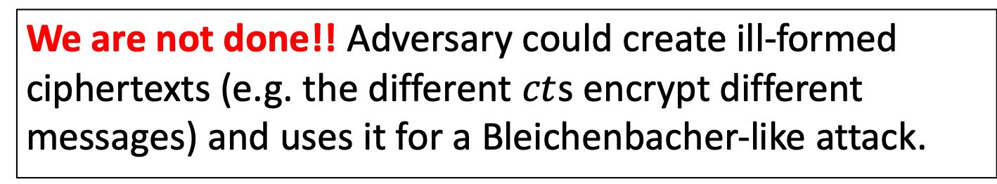
Call it a day?
We are not done!! Adversary could create ill-formed ciphertexts (e.g. the different $ct$s encrypt different messages) and uses it for a Bleichenbacher-like attack.
CCA Encryption:
First, pick a sign/ver key pair $(sgk,vk)$
$$CT=$$
$${ct}_{1,{vk}_{1}}$$
$${ct}_{2,{vk}_{2}}$$
$$…$$
$${ct}_{n,{vk}_{n}}$$
where ${ct}_{i,j }←CPAEnc({pk}_{i,j},m)$
Output $(CT, vk,σ=Sign(sgk,CT))$.

Slide 18
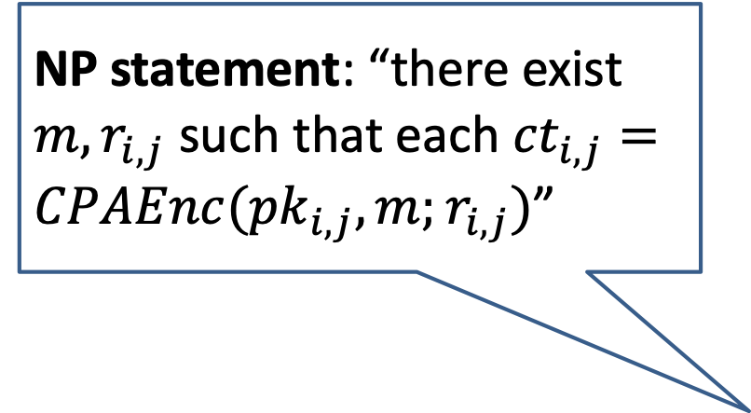

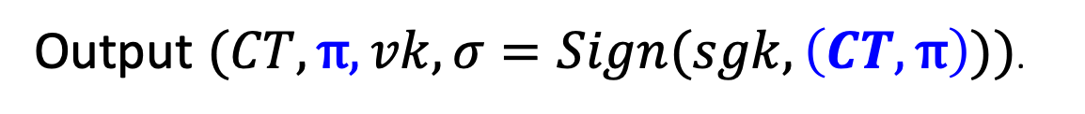
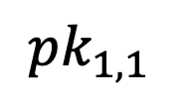

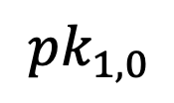

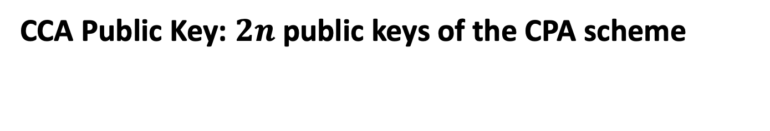
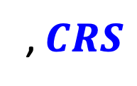


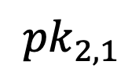
NIZK Proofs to the Rescue…
CCA Public Key: $2n$ public keys of the CPA scheme
$${pk}_{1,0}$$
$${pk}_{2,0}$$
$${pk}_{n,0}$$
$$…$$
, $CRS$
$${pk}_{1,1}$$
$${pk}_{2,1}$$
$${pk}_{n,1}$$
NP statement: “there exist $m,r_{i,j}$ such that each ${ct}_{i,j}=CPAEnc({pk}_{i,j},m;r_{i,j})$”
CCA Encryption:
First, pick a sign/ver key pair $(sgk,vk)$
$$CT=$$
$${ct}_{1,{vk}_{1}}$$
$${ct}_{2,{vk}_{2}}$$
$$…$$
$${ct}_{n,{vk}_{n}}$$
where ${ct}_{i,j }←CPAEnc({pk}_{i,j},m;r_{i,j})$
π = NIZK proof that “CT is well-formed”
Output $(CT, vk,σ=Sign(sgk,CT))$.
Output $(CT,\text{π}, vk,σ=Sign(sgk,\left(CT,\text{π}\right)))$.

Slide 19
Are there other attacks?
Did we miss anything else?
Turns out NO. We can prove that this is CCA-secure.

Slide 20

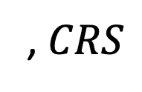



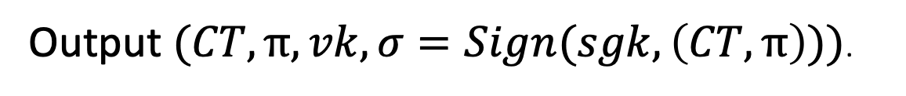

The Encryption Scheme
CCA Keys:
$${pk}_{1,0}$$
$${pk}_{2,0}$$
$${pk}_{n,0}$$
$${sk}_{1,0}$$
PK=
$$…$$
, $CRS$
SK=
$${pk}_{1,1}$$
$${pk}_{2,1}$$
$${pk}_{n,1}$$
$${sk}_{1,1}$$
CCA Encryption:
First, pick a sign/ver key pair $(sgk,vk)$
$$CT=$$
$${ct}_{1,{vk}_{1}}$$
$${ct}_{2,{vk}_{2}}$$
$$…$$
$${ct}_{n,{vk}_{n}}$$
where ${ct}_{i,j }←CPAEnc({pk}_{i,j},m;r_{i,j})$
π = NIZK proof that “CT is well-formed”
Output $(CT,\text{π}, vk,σ=Sign(sgk,\left(CT,\text{π}\right)))$.

Slide 21


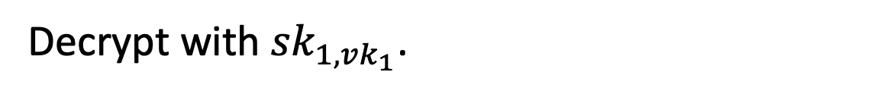
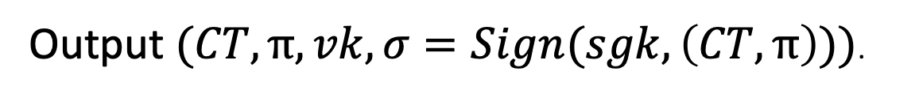

The Encryption Scheme
CCA Encryption:
First, pick a sign/ver key pair $(sgk,vk)$
$$CT=$$
$${ct}_{1,{vk}_{1}}$$
$${ct}_{2,{vk}_{2}}$$
$$…$$
$${ct}_{n,{vk}_{n}}$$
where ${ct}_{i,j }←CPAEnc({pk}_{i,j},m;r_{i,j})$
π = NIZK proof that “CT is well-formed”
Output $(CT,\text{π}, vk,σ=Sign(sgk,\left(CT,\text{π}\right)))$.
CCA Decryption:
Check the signature.
Check the NIZK proof.
Decrypt with ${sk}_{1,{vk}_{1}}$.

Slide 22
Proof Sketch
Let’s play the CCA game with the adversary.
We will use her to break either the NIZK soundness/ZK, the signature scheme or the CPA-secure scheme.

Slide 23
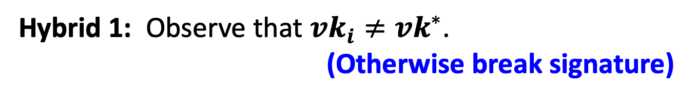
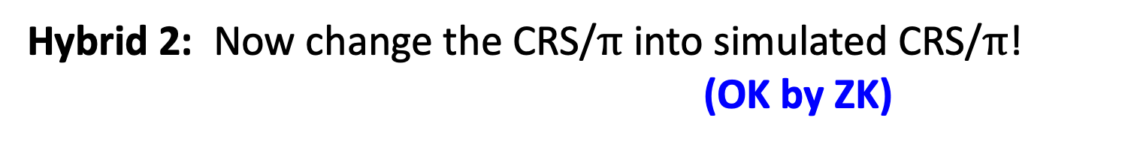
Proof Sketch
Let’s play the CCA game with the adversary.
Hybrid 0: Play the CCA game as prescribed.
Hybrid 1: Observe that ${vk}_{i}≠{vk}^{∗}$. (Otherwise break signature)
Observe that this means each query ciphertext-tuple involves a different public-key from the challenge ciphertext. Use the “different private-key” to decrypt. (If the adv sees a difference, she broke NIZK soundness)
Hybrid 2: Now change the CRS/$\text{π}$ into simulated CRS/$\text{π}$! (OK by ZK)
If the Adv wins in this hybrid, she breaks IND-CPA!
Notes:
Hybrid 1 explanation: the real decryption algorithm uses one of the private keys, say either sk_{1,0} or sk_{1,1} to decrypt, depending on whether the first ciphertext was encrypted using pk_{1,0} or pk_{1,1} --- which in turns depends on whether the first bit of the verification key was 0 or 1. in hybrid 1, we are potentially using a different private key to decrypt a different component ciphertext. That’s OK because we know by NIZK soundness that all ciphertexts encrypt the same message!
Hybrid 2 explanation: In the beginning of hybrid 2, the challenge ciphertext contains a NIZK proof of ciphertext well-formedness which uses the randomness underlying those ciphertexts. By changing the NIZK proof into a simulated proof, we remove the dependence on randomness, effectively saying that the proof reveals nothing about the randomness underlying the ciphertexts, in turn paving the way to invoke CPA-security.

Slide 24
Another Application of NIZK: Digital Signatures

Slide 25
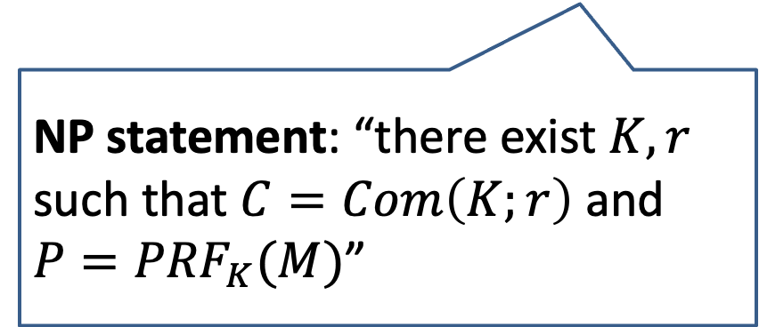
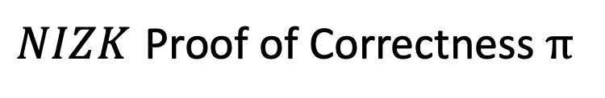
Bellare-Goldwasser Signatures
Keys:
SK= PRF seed K
VK= C: Commitment to K; NIZK CRS.
Signature of M:
$${P=PRF}_{K}(M)$$
$NIZK$ Proof of Correctness π
Verification: Check the NIZK Proof
NP statement: “there exist $K,r$ such that $C=Com\left(K;r\right)$ and ${P=PRF}_{K}(M)$”

Slide 26
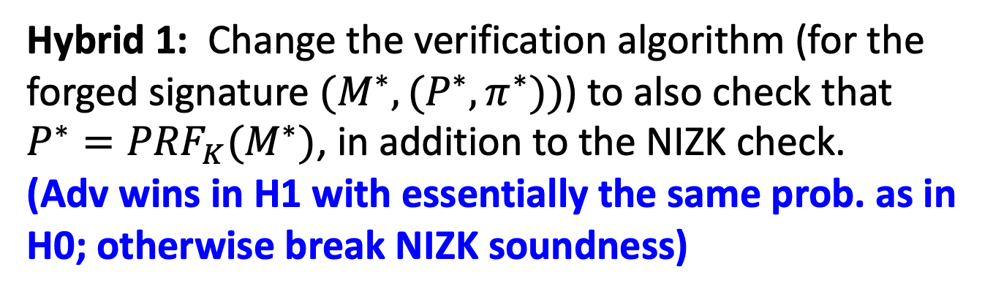
Proof Sketch
Let’s play the EUF-CMA game with the adversary.
Hybrid 0: Play the EUF-CMA game as prescribed.
Hybrid 1: Change the verification algorithm (for the forged signature $(M^{∗},(P^{∗},π^{∗}))$) to also check that ${P^{∗}=PRF}_{K}(M^{∗})$, in addition to the NIZK check. (Adv wins in H1 with essentially the same prob. as in H0; otherwise break NIZK soundness)

Slide 27
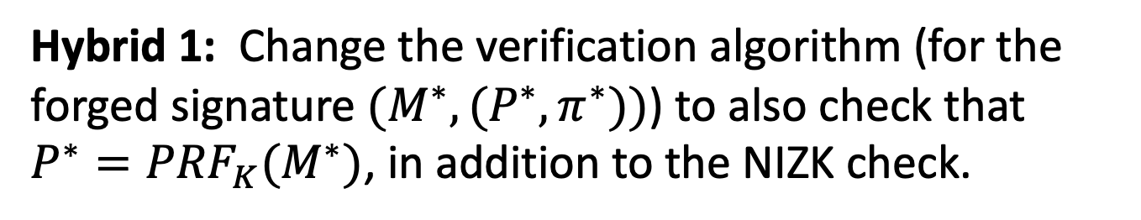
Proof Sketch
Let’s play the EUF-CMA game with the adversary.
Hybrid 0: Play the EUF-CMA game as prescribed.
Hybrid 1: Change the verification algorithm (for the forged signature $(M^{∗},(P^{∗},π^{∗}))$) to also check that ${P^{∗}=PRF}_{K}(M^{∗})$, in addition to the NIZK check.
Hybrid 2: Change CRS to simulated CRS. To answer signature queries, use simulated NIZK proofs.
(OK by Zero knowledge)

Slide 28
Proof Sketch
Let’s play the EUF-CMA game with the adversary.
Hybrid 0: Play the EUF-CMA game as prescribed.
Hybrid 1: Change the verification algorithm (for the forged signature $(M^{∗},(P^{∗},π^{∗}))$) to also check that ${P^{∗}=PRF}_{K}(M^{∗})$, in addition to the NIZK check.
Hybrid 2: Change CRS to simulated CRS. To answer signature queries, use simulated NIZK proofs.
Hybrid 3: Let C be a commitment to the $0$ string.
(OK by commitment hiding)

Slide 29
Proof Sketch
Let’s play the EUF-CMA game with the adversary.
Hybrid 0: Play the EUF-CMA game as prescribed.
Hybrid 1: Change the verification algorithm (for the forged signature $(M^{∗},(P^{∗},π^{∗}))$) to also check that ${P^{∗}=PRF}_{K}(M^{∗})$, in addition to the NIZK check.
Hybrid 2: Change CRS to simulated CRS. To answer signature queries, use simulated NIZK proofs.
Hybrid 3: Let C be a commitment to the $0$ string.
In hybrid 3, Adv is winning in the PRF game.
(Contradiction by PRF security)

